Slide 1
Flowchart
The flow of Statements

Slide 2
Flowchart
An organized combination of shapes, lines and text which graphically illustrate a process/program.
A type of diagram that represents an algorithm, workflow or process, showing the steps as boxes of various kinds, and their order by connecting them with arrows. This diagrammatic representation illustrates a solution to a given problem.
Flowcharts are used in analyzing, designing, documenting or managing a process or program. Like other types of diagrams, they help visualize what is going on and thereby help the people to understand a process, and perhaps also find flaws, bottlenecks, and other less-obvious features within it.
Very helpful in explaining program to others.

Slide 3
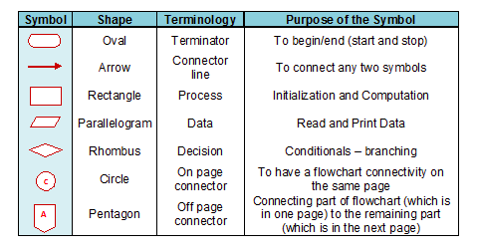
Symbols Used In Flowchart
Different symbols are used for different states in flowchart, For example: Input/Output and decision making has different symbols. The table below describes most of the symbols that are used in making flowchart

Slide 4
Example of flowchart
Draw a flowchart to add two numbers entered by user.
Start
Declare a, b , sum
Read a, b
sum ← a + b
Print sum
End

Slide 5
Example 2
Draw a flowchart to print the average of three numbers entered by user.
Start
Declare n1, n2 ,n3, sum, avg
Read n1, n2,n3
sum ← n1 + n2 + n3
avg ← sum / 3
Print avg
End

Slide 6
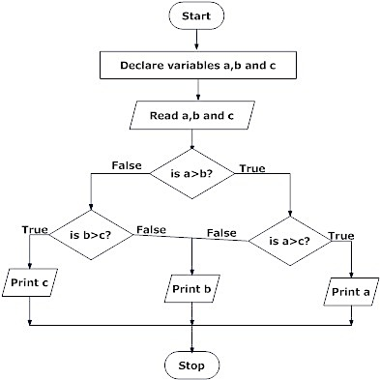
Example 3
Draw a flowchart to find the largest among three different numbers entered by user.

Slide 7
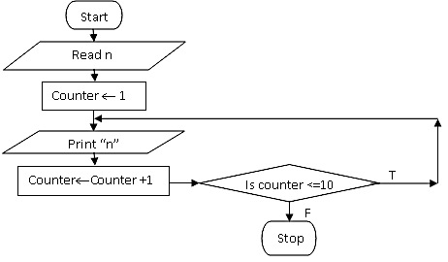
Example 4
Draw a flowchart to print a letter ‘n’ m times.
m
m

