Slide 1
Data Types in C

Slide 2
Data Transformation
Programs transform data from one form to another
  Input data → Output data
  Stimulus → Response
Programming languages store and process data in various ways depending on the type of the data; consequently, all data read, processed, or written by a program must have a type
Two distinguishing characteristics of a programming language are the data types it supports and the operations on those data types

Slide 3
A Data Type
A data type is
  A set of values AND
  A set of operations on those values
A data type is used to
  Identify the type of a variable when the variable is declared
  Identify the type of the return value of a function
  Identify the type of a parameter expected by a function

Slide 4
A Data Type (continued)
When the compiler encounters a declaration for a variable, it sets up a memory location for it
An operator used on a variable or variables is legal only if
  The operator is defined in that programming language for a variable of that type
  The variable or variables involved with the operator are of the same or compatible types

Slide 5
Rules for Constructing Identifiers in C
Capital letters A-Z, lowercase letters a-z, digits 0-9, and the underscore character
First character must be a letter or underscore
Usually only the first 32 characters are significant
There can be no embedded blanks
Keywords cannot be used as identifiers
Identifiers are case sensitive
Identifiers refer to the names of data types, constants,
variables, and functions

Slide 6
Two Classifications of Data Types
Built-in data types
  Fundamental data types (int, char, double, float, void, pointer)
  Derived data types (array, string, structure)
Programmer-defined data types
  Structure
  Union
  Enumeration

Slide 7
Fundamental Data Types
void – used to denote the type with no values
int – used to denote an integer type
char – used to denote a character type
float, double – used to denote a floating point type
int *, float *, char * – used to denote a pointer type, which is a memory address type

Slide 8
Uses of Fundamental Data Types
int elevationIndicator;
char inputSymbol;
float totalCost;
int main (void)
{
double grossProduct;
int *temperatureValuePtr;
grossProduct = 4567.89;
inputSymbol = 'a';
return (0);
} // End main

Slide 9
Derived Data Types
Array – a finite sequence (or table) of variables of the same data type
String – an array of character variables
Structure – a collection of related variables of the same and/or different data types. The structure is called a record and the variables in the record are called members or fields

Slide 10
Uses of Derived Data Types
int elevationTable[20];
char inputSymbols[] = "Hello World";
struct operationsStruct
{
double heatReading;
int temperatureValue;
float speedMeter;
char actionCode;
}; // End struct
struct operationsStruct currentOperations;

Slide 11
Records (Structures)
A record permits a programmer to handle a group of variables as one variable
The fields (members) of a record can be any built-in or programmer-defined data type
A record can have values assigned to and read from it just like the built-in variable types
A record can also be passed as an argument to a function and serve as the return value for a function

Slide 12
The typedef Keyword and Records
The typedef keyword can be used to create a synonym for a
data type. It is most often used to simplify the naming and
use of record types (i.e., structure types).
typedef struct
{
double heatReading;
int temperatureValue;
float speedMeter;
char actionCode;
} operationsRecordType;
operationsRecordType currentOperations;
operationsRecordType futureOperations;

Slide 13

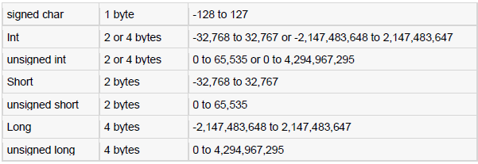
Integer Data Type

Slide 14
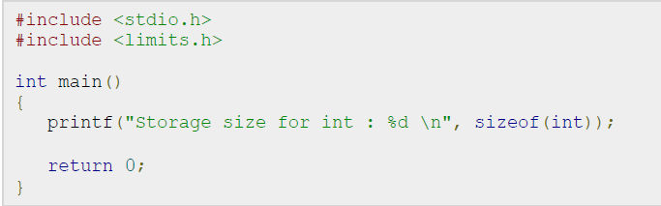
Memory Check

Slide 15
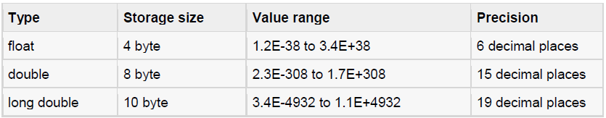
Floating Data Type

Slide 16
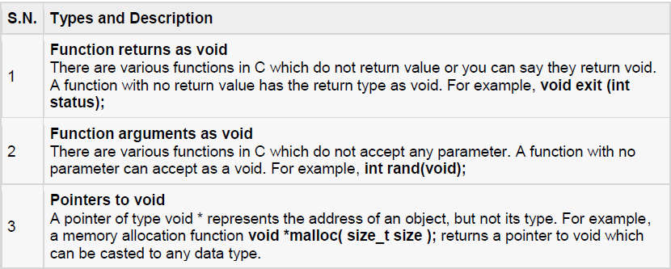
The void Type

Slide 17
Thank You

