Slide 1
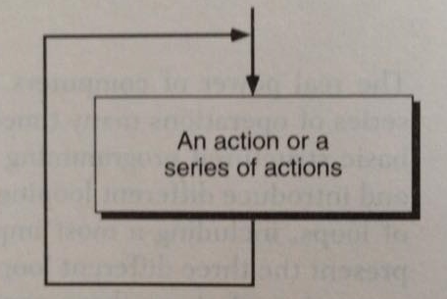
Repetition
Concept of a loop

Slide 2
Loop type in general
We have established that we need to test for the end of a loop, but where should we check it – before or after each iteration?
Programming language allow us to check the loop control expression either before or after each iteration of the loop.
We can have either a pre- or post-test terminating condition.
So, we have pretest loop and post-test loop.

Slide 3
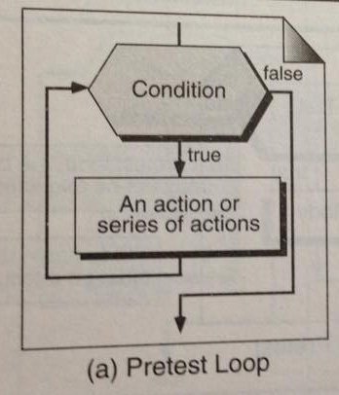
Pretest Loop
In each iteration, the control statement is tested first. If it is true, the loop continues; otherwise the loop is terminated.

Slide 4
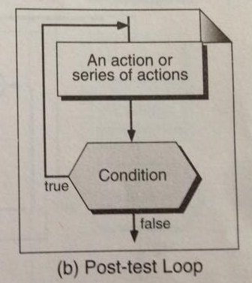
Post-test Loop
In each iteration, the loop action(s) are executed. Then the control expression is tested. If it is true, a new iteration is started; otherwise, the loop terminates.

Slide 5
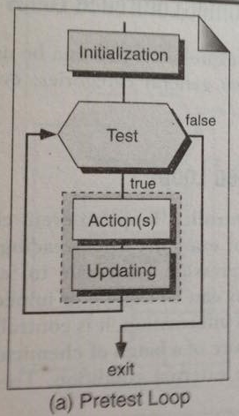
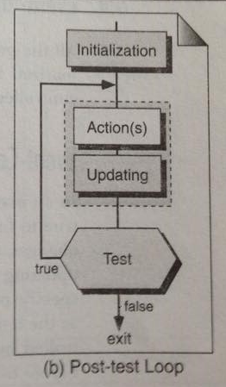
Another Example

Slide 6
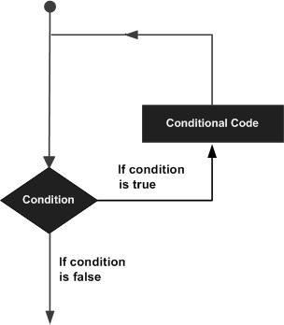
C – Loop
There may be a situation, when you need to execute a block of code several number of times. In general, statements are executed sequentially: The first statement in a function is executed first, followed by the second, and so on.
A loop statement allows us to execute a statement or group of statements multiple times and following is the general form of a loop statement in most of the programming languages:

Slide 7
Types of Loop
C programming language provides the following types of loop to handle looping requirements.
Statement | Description
1. for loop | Execute a sequence of statements multiple times and abbreviates the code that manages the loop variable.
2. while loop | Repeats a statement or group of statements while a given condition is true. It tests the condition before executing the loop body.
3. do...while loop | Like a while statement, except that it tests the condition at the end of the loop body
4. nested loop | You can use one or more loop inside any another while, for or do..while loop.

Slide 8

For Loop
A for loop is a repetition control structure that allows you to efficiently write a loop that needs to execute a specific number of times.
Syntax:

Slide 9
Flow of control in a for loop
The init step is executed first, and only once. This step allows you to declare and initialize any loop control variables. You are not required to put a statement here, as long as a semicolon appears.
Next, the condition is evaluated. If it is true, the body of the loop is executed. If it is false, the body of the loop does not execute and flow of control jumps to the next statement just after the for loop.
After the body of the for loop executes, the flow of control jumps back up to the increment statement. This statement allows you to update any loop control variables. This statement can be left blank, as long as a semicolon appears after the condition.
The condition is now evaluated again. If it is true, the loop executes and the process repeats itself (body of loop, then increment step, and then again condition). After the condition becomes false, the for loop terminates.

Slide 10
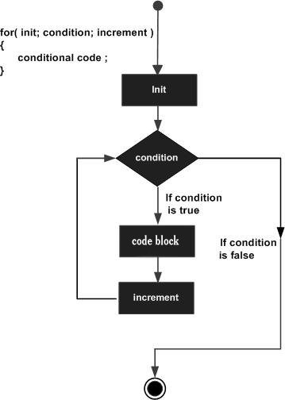
Flow Diagram : For Loop

Slide 11
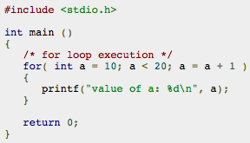
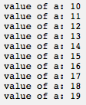
Code Example
Output:

Slide 12

2. While Loop
A while loop statement repeatedly executes a target statement as long as a given condition is true.
Syntax:
Here, statement(s) may be a single statement or a block of statements.
The condition may be any expression, and true is any nonzero value. The loop iterates while the condition is true.
When the condition becomes false, program control passes to the line immediately following the loop.

Slide 13
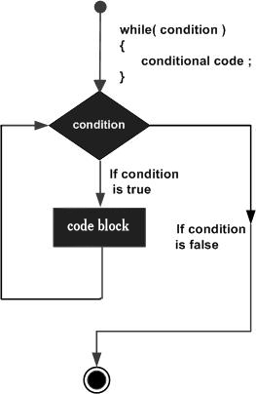
Flow Diagram: While Loop
Here, key point of the while loop is that the loop might not ever run.
When the condition is tested and the result is false, the loop body will be skipped and the first statement after the while loop will be executed.

Slide 14
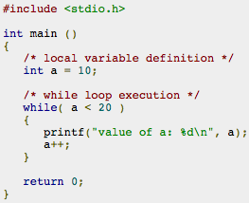
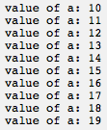
Code Example : If else
Output:

Slide 15

3. Do..While Loop
Unlike for and while loops, which test the loop condition at the top of the loop, the do...while loop in checks its condition at the bottom of the loop.
A do...while loop is similar to a while loop, except that a do...while loop is guaranteed to execute at least one time.
Syntax:
Notice that the conditional expression appears at the end of the loop, so the statement(s) in the loop execute once before the condition is tested.
If the condition is true, the flow of control jumps back up to do, and the statement(s) in the loop execute again. This process repeats until the given condition becomes false.

Slide 16
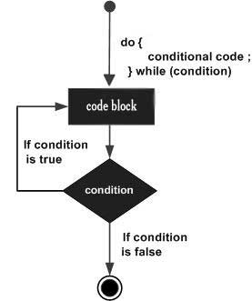
Flow Diagram: Do..While Loop

Slide 17
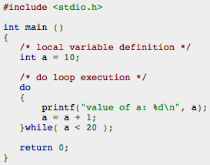
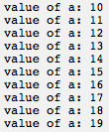
Code example: Do...While
Output:

Slide 18
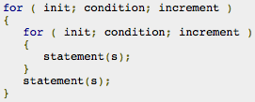
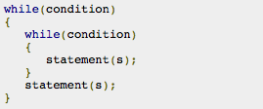
Nested loops in C
It is allow to use one loop inside another loop.
The syntax for a nested for loop statement
The syntax for a nested while loop statement

Slide 19
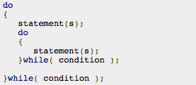
Nested loops in C
The syntax for a nested do...while loop
A final note on loop nesting is that you can put any type of loop inside of any other type of loop. For example, a for loop can be inside a while loop or vice versa.

Slide 20
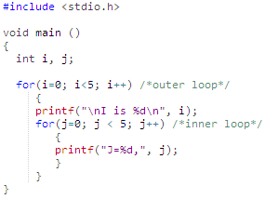
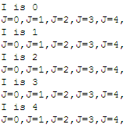
Code Example Nested For Loop

Slide 21
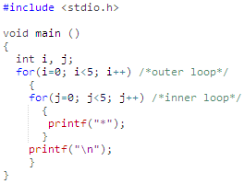

Code Example Nested For Loop

Slide 22
Loop Control Statements:
Loop control statements change execution from its normal sequence. C supports the following control statements.
Control Statement | Description
break statement | Terminates the loop or switch statement and transfers execution to the statement immediately following the loop or switch.
continue statement | Causes the loop to skip the remainder of its body and immediately retest its condition prior to reiterating.

Slide 23
break statement
The break statement in C programming language has the following two usages:
When the break statement is encountered inside a loop, the loop is immediately terminated and program control resumes at the next statement following the loop.
It can be used to terminate a case in the switch statement (we already saw).
If you are using nested loops (i.e., one loop inside another loop), the break statement will stop the execution of the innermost loop and start executing the next line of code after the block.
Syntax: break;

Slide 24
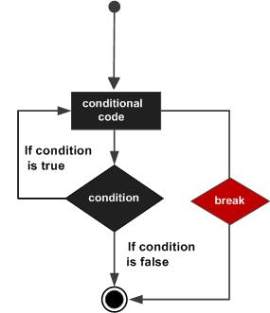
Flow Diagram: Break Statement

Slide 25
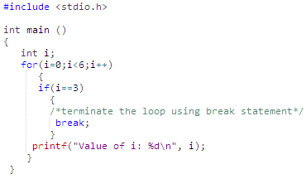

Code example: Break

Slide 26
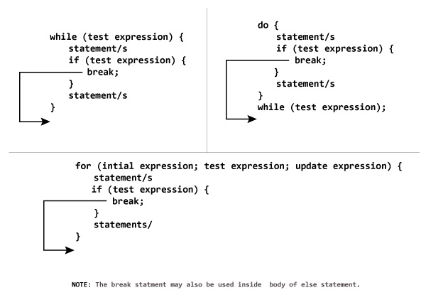
break

Slide 27
“continue” statement
The continue statement works somewhat like the break statement. Instead of forcing termination, however, continue forces the next iteration of the loop to take place, skipping any code in between.
For the for loop, continue statement causes the conditional test and increment portions of the loop to execute. For the while and do...while loops, continue statement causes the program control passes to the conditional tests.
Syntax: continue;

Slide 28
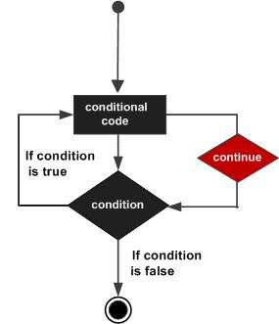
Flow Diagram: continue

Slide 29
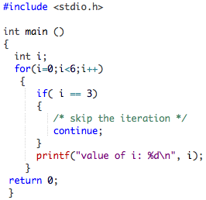
Code Example: Continue
value of i: 0
value of i: 1
value of i: 2
value of i: 4
value of i: 5
Notice that 3 is not there!

Slide 30
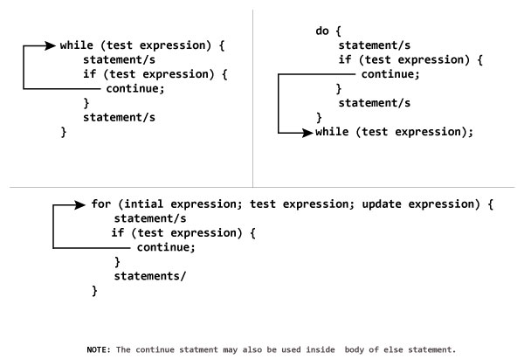
Continue

Slide 31
Thank You

