Slide 1
Starting the study of data structure
C – Array

Slide 2
C – Array
C programming language provides a data structure called the array, which can store a fixed-size sequential collection of elements of the same type.
An array is used to store a collection of data, but it is often more useful to think of an array as a collection of variables of the same type.
Instead of declaring individual variables, such as number0, number1, ..., and number99, you declare one array variable such as numbers and use numbers[0], numbers[1], and ..., numbers[99] to represent individual variables.
A specific element in an array is accessed by an index.

Slide 3
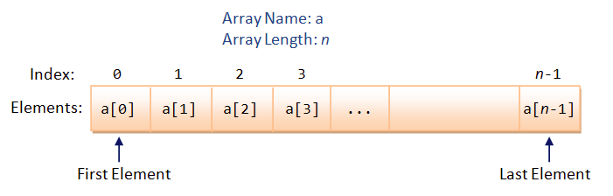
Array
All arrays consist of contiguous memory locations.
The lowest address corresponds to the first element and the highest address to the last element.

Slide 4
Declaring Arrays
To declare an array in C, a programmer specifies the type of the elements and the number of elements required by an array as follows :
This is called a single-dimensional array. The arraySize must be an integer constant greater than zero and type can be any valid C data type.
For example, to declare a 10-element array called balance of type double, use this statement:
Now balance is a variable array which is sufficient to hold up to 10 double numbers.

Slide 5
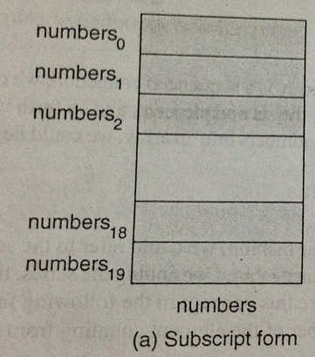
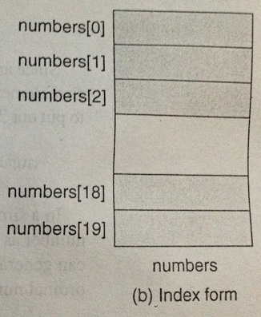
An array of Numbers

Slide 6
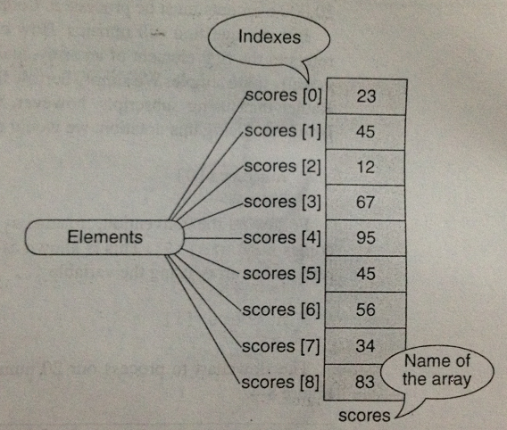
Array with values

Slide 7
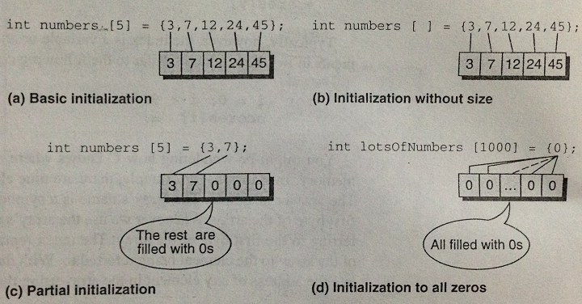
Initializing Arrays

Slide 8
Initializing Arrays (Cont..)
You can initialize array in C either one by one or using a single statement as follows:
The number of values between braces { } can not be larger than the number of elements that we declare for the array between square brackets [ ].
If you omit the size of the array, an array just big enough to hold the initialization is created. Therefore, if you write:
You will create exactly the same array as you did in the previous example.

Slide 9

Initializing Arrays cont.
Following is an example to assign a single element of the array:
The above statement assigns element number 5th in the array with a value of 50.0.
All arrays have 0 as the index of their first element which is also called base index and last index of an array will be total size of the array minus 1.
Following is the pictorial representation of the same array we discussed above:

Slide 10
Accessing Array Elements
An element is accessed by indexing the array name. This is done by placing the index of the element within square brackets after the name of the array.
For example:
The above statement will take 10th element from the array and assign the value to salary variable.

Slide 11
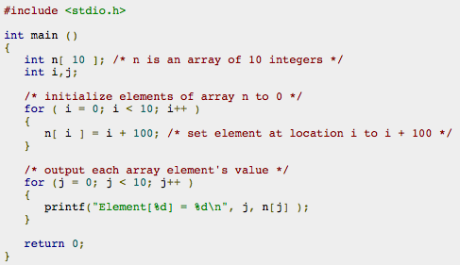
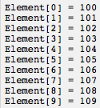
Code Example: Array
Following is an example which will use all the above mentioned three concepts declaration, assignment and accessing arrays:

Slide 12
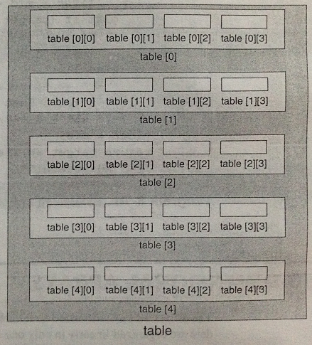
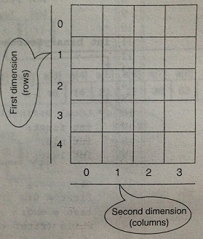
Two Dimensional Array : Array of arrays

Slide 13
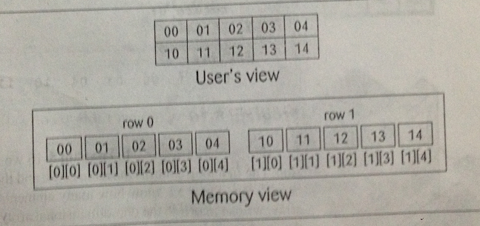
Memory Layout

Slide 14
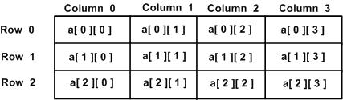
Two-Dimensional Arrays
A two-dimensional array is, in essence, a list of one-dimensional arrays. To declare a two-dimensional integer array of size x,y you would write as follows:
A two-dimensional array can be think as a table which will have x number of rows and y number of columns.
A 2-dimensional array a, which contains three rows and four columns can be shown as below:
Thus, every element in array a is identified by an element name of the form a[ i ][ j ], where a is the name of the array, and i and j are the subscripts that uniquely identify each element in a.

Slide 15

Initializing Two-Dimensional Arrays:
Multidimensional arrays may be initialized by specifying bracketed values for each row.
Following is an array with 3 rows and each row has 4 columns.
The nested braces, which indicate the intended row, are optional. The following initialization is equivalent to previous example:

Slide 16
Accessing Two-Dimensional Array Elements
An element in 2-dimensional array is accessed by using the subscripts, i.e., row index and column index of the array. For example:
The above statement will take 4th element from the 3rd row of the array. You can verify it in the above diagram.

Slide 17
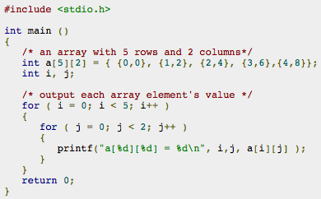

Accessing Two-Dimensional Array Elements
Let us check below program where we have used nested loop to handle a two dimensional array:

Slide 18
Multi-dimensional Arrays in C
C programming language allows multidimensional arrays. Here is the general form of a multidimensional array declaration:
For example, the following declaration creates a three dimensional 5 . 10 . 4 integer array:
As explained above, you can have arrays with any number of dimensions, although it is likely that most of the arrays you create will be of one or two dimensions.

Slide 19
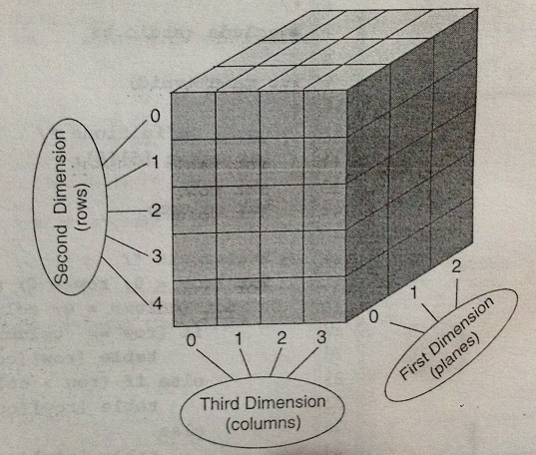
Three-Dimensional Array

Slide 20
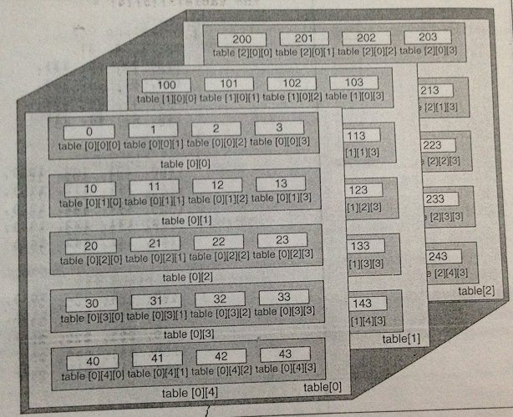
C view of three-dimensional array

Slide 21
Thank you

