Slide 1
C - String

Slide 2
C - String
strings are arrays of chars. String literals are words surrounded by double quotation marks.
The string in C programming language is actually a one-dimensional array of characters which is terminated by a null character '\0'. Thus a null-terminated string contains the characters that comprise the string followed by a null.
A string can be declared as a character array or with a string pointer.
The following declaration and initialization create a string consisting of the word "Hello". To hold the null character at the end of the array, the size of the character array containing the string is one more than the number of characters in the word "Hello."
"This is a static string"
Or
Or
char *greeting = “Hello” ;

Slide 3
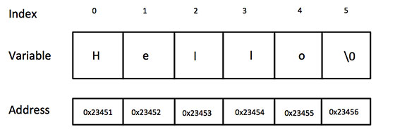
C - String
Following is the memory presentation of above defined string in C/C++:
It's important to remember that there will be an extra character on the end on a string, literally a '\0' character, just like there is always a period at the end of a sentence. Since this string terminator is unprintable, it is not counted as a letter, but it still takes up a space. Technically, in a fifty char array you could only hold 49 letters and one null character at the end to terminate the string.
Actually, you do not place the null character at the end of a string constant. The C compiler automatically places the '\0' at the end of the string when it initializes the array.

Slide 4
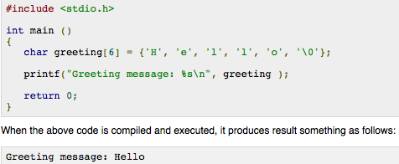
C - String
Let us try to print above mentioned string:
Note: %s is used to print a string.

Slide 5
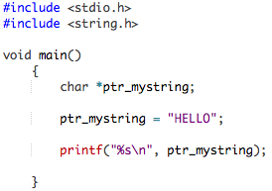
String pointer
String pointers are declared as a pointer to a char.
When there is a value assigned to the string pointer the NULL is put at the end automatically.
Take a look at this example:

Slide 6
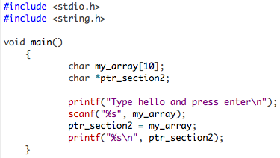
String pointer
It is not possible to read, with scanf(), a string with a string pointer. You have to use a character array and a pointer. See this example:

Slide 7
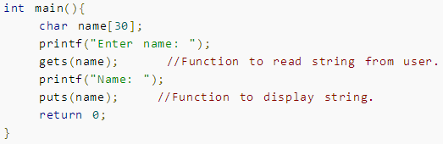
Reading a line of text
gets() and puts() are two string functions to take string input from user and display string respectively

Slide 8
String related operations
Find the Frequency of Characters in a String
Find the Number of Vowels, Consonants, Digits and White space in a String
Reverse a String by Passing it to Function
Find the Length of a String
Concatenate Two Strings
Copy a String
Remove all Characters in a String except alphabet
Sort a string in alphabetic order
Sort Elements in Lexicographical Order (Dictionary Order)
Change Decimal to Hexadecimal Number
Convert Binary Number to Decimal

Slide 9
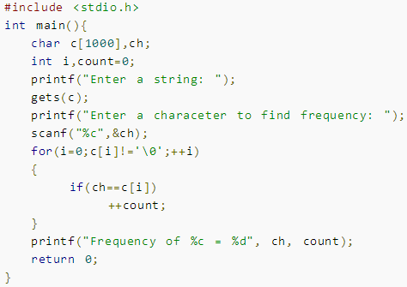

Find the Frequency of Characters

Slide 10
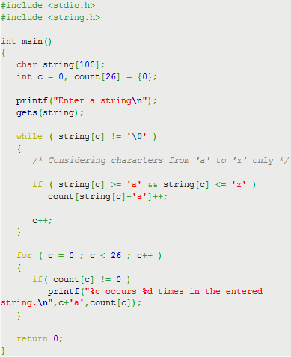
C program to find frequency of characters in a string
This program computes frequency of characters in a string i.e. which character is present how many times in a string.
For example in the string "code" each of the character 'c', 'o', 'd', and 'e' has occurred one time.
Only lower case alphabets are considered, other characters (uppercase and special characters) are ignored. You can easily modify this program to handle uppercase and special symbols.

Slide 11
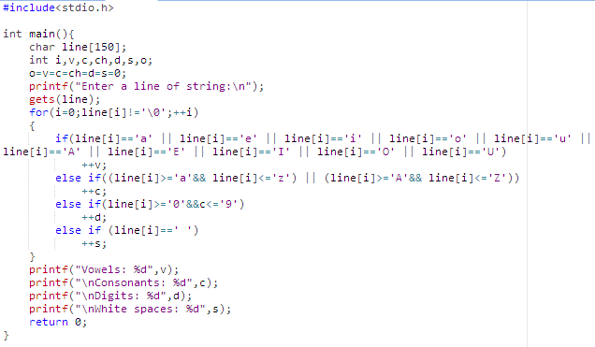
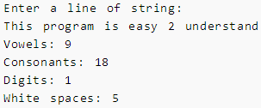
Find Number of Vowels, Consonants, Digits and White Space Character
Output

Slide 12
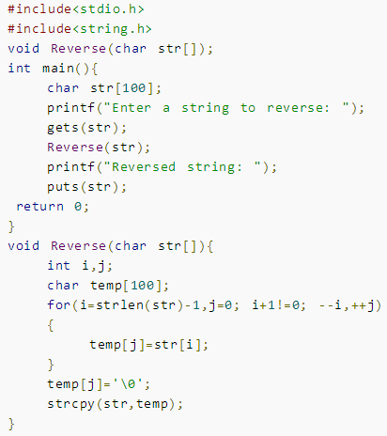

Reverse String
To solve this problem, two standard library functions strlen() and
strcpy() are used to calculate length and to copy string respectively.

Slide 13
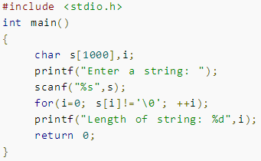

Calculated length of a String without using strlen() Function
You can use standard library function strlen( ) to find the length of a string but, this program computes the length of a string manually without using strlen( ) funtion.

Slide 14
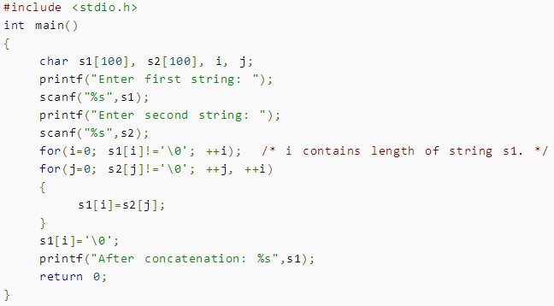

Concatenate Two Strings Manually
You can concatenate two strings using standard library function strcat( ) , this program concatenates two strings manually without using strcat( ) function.

Slide 15
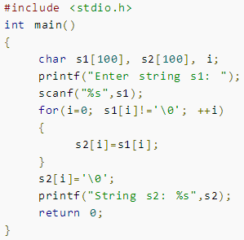

Copy String Manually
You can use the strcpy( ) function to copy the content of one string to another but, this program copies the content of one string to another manually without using strcpy( ) function.

Slide 16
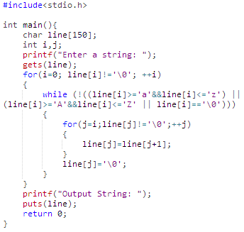

Remove Characters in String Except Alphabets
This program takes a string from user and for loop executed until all characters of string is checked. If any character inside a string is not a alphabet, all characters after it including null character is shifted by 1 position backwards.

Slide 17
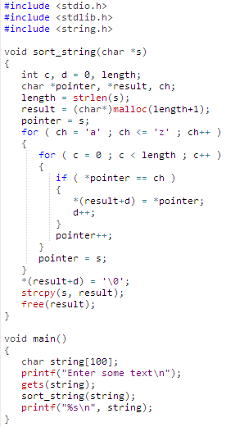

sort a string in alphabetic order
C program to sort a string in alphabetic order: For example if user will enter a string "programming" then output will be "aggimmnoprr" or output string will contain characters in alphabetical order.

Slide 18
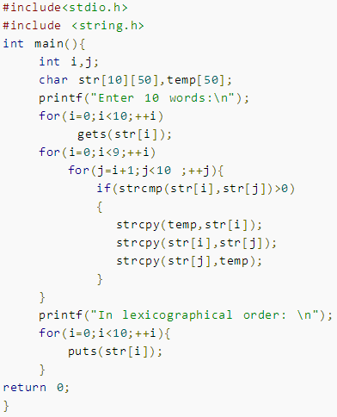
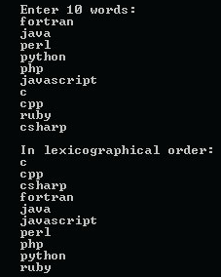
Sort Elements in Lexicographical Order (Dictionary Order)
This program takes 10 words from user and sorts elements in lexicographical order. To perform this task, two dimensional string is used.

Slide 19
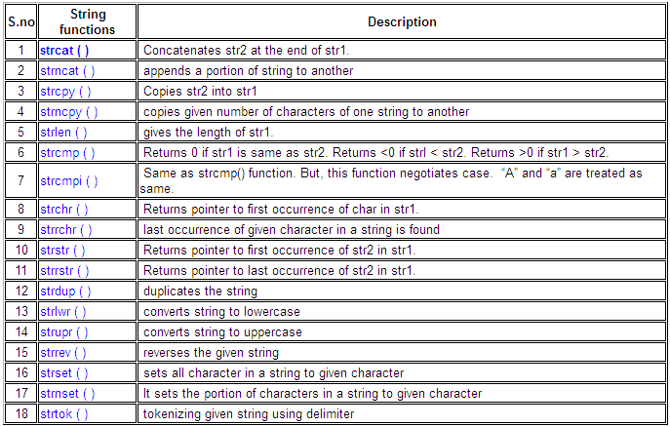
C library functions
C supports a wide range of functions that manipulate null-terminated strings:

Slide 20
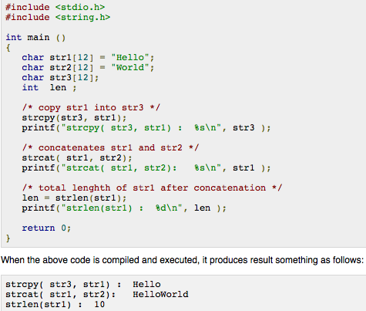
Following example makes use of few of the above-mentioned functions:

Slide 21
strcat( ) function
strcat( ) function concatenates two given strings. It concatenates source string at the end of destination string.
Syntax for strcat( ) function is given below.
char * strcat ( char * destination, const char * source );
Example :
strcat ( str2, str1 ); - str1 is concatenated at the end of str2. strcat ( str1, str2 ); - str2 is concatenated at the end of str1.
As you know, each string in C is ended up with null character (‘\0′).
In strcat( ) operation, null character of destination string is overwritten by source string’s first character and null character is added at the end of new destination string which is created after strcat( ) operation.

Slide 22
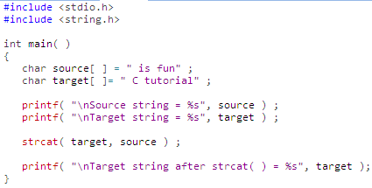
Example program for strcat( )
In this program, two strings “is fun” and “C tutorial” are concatenated using strcat( ) function and result is displayed as “C tutorial is fun”.
Output:
Source string = is fun Target string = C tutorial Target string after strcat( ) = C tutorial is fun

Slide 23
Thank You

