Slide 1
C – Pointer
Md. Mezbahul Islam
Lecturer
Department of Computer Science

Slide 2
C – Pointer
If you want to be proficient in the writing of code in the C programming language, you must have a thorough working knowledge of how to use pointers.
Some C programming tasks are performed more easily with pointers, and other tasks, such as dynamic memory allocation, cannot be performed without using pointers. So it becomes necessary to learn pointers to become a perfect C programmer.
As you know, every variable is a memory location and every memory location has its address defined which can be accessed using ampersand (&) operator, which denotes an address in memory. Consider the following example, which will print the address of the variables defined:

Slide 3
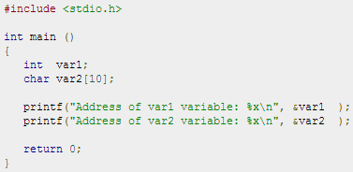

C – Pointer
So you understood what is memory address and how to access it, so base of the concept is over. Now let us see what is a pointer.

Slide 4
What is Pointer?
A pointer is a variable whose value is the address of another variable, i.e., direct address of the memory location. Like any variable or constant, you must declare a pointer before you can use it to store any variable address.
The general form of a pointer variable declaration is:
dataType *var_name;
Here,
dataType is the pointer's base type; it must be a valid C data type(i.e., int, float, char etc).
var_name is the name of the pointer variable.
The asterisk * you used to declare a pointer is the same asterisk that you use for multiplication. However, in this statement the asterisk is being used to designate a variable as a pointer.

Slide 5

Pointer
Following are the valid pointer declaration:
The actual data type of the value of all pointers, whether integer, float, character, or otherwise, is the same, a long hexadecimal number that represents a memory address.
The only difference between pointers of different data types is the data type of the variable or constant that the pointer points to.

Slide 6
How to use Pointers?
There are few important operations, which we will do with the help of pointers very frequently.
we define a pointer variable
assign the address of a variable to a pointer and
finally access the value at the address available in the pointer variable by dereferencing.
Dereferencing is done by using unary operator * that returns the value of the variable located at the address specified by its operand.
Dereferencing a pointer means getting the value stored in the memory at the address which the pointer “points” to.
The * is the value-at-address operator, also called the indirection operator. It is used both when declaring a pointer and when dereferencing a pointer.

Slide 7
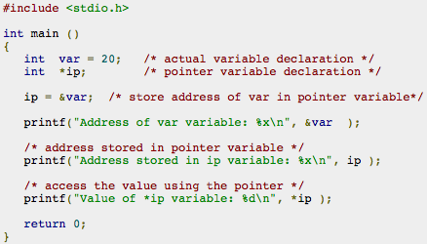

How to use Pointers?
Following example makes use of these operations:
When the above code is compiled and executed, it produces result something as follows:

Slide 8
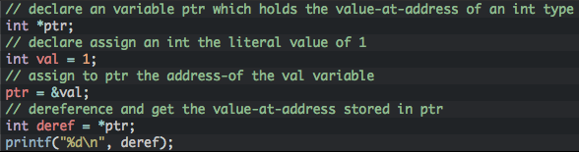
How to use Pointers?
the & is the address-of operator and is used to reference the memory address of a variable.
By using the & operator in front of a variable name we can retrieve the memory address-of that variable. It is best to read this operator as address-of operator.
Following code shows some common notations for the value-at-address (*) and adress-of (&) operators.

Slide 9
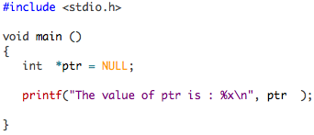
NULL Pointers in C
It is always a good practice to assign a NULL value to a pointer variable in case you do not have exact address to be assigned. This is done at the time of variable declaration. A pointer that is assigned NULL is called a null pointer.
The NULL pointer is a constant with a value of zero defined in several standard libraries. Consider the following program:
When the above code is compiled and executed, it produces the following result:

Slide 11
NULL Pointers in C
On most of the operating systems, programs are not permitted to access memory at address 0 because that memory is reserved by the operating system. However, the memory address 0 has special significance; it signals that the pointer is not intended to point to an accessible memory location. But by convention, if a pointer contains the null (zero) value, it is assumed to point to nothing.
To check for a null pointer you can use an if statement as follows:

Slide 12
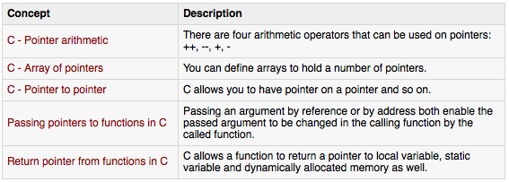
C Pointers in Detail
Pointers have many but easy concepts and they are very important to C programming. There are following few important pointer concepts which should be clear to a C programmer:

Slide 13
C - Pointer arithmetic
C pointer is an address, which is a numeric value. Therefore, you can perform arithmetic operations on a pointer just as you can a numeric value.
There are four arithmetic operators that can be used on pointers: ++, --, +, and -
To understand pointer arithmetic, let us consider that ptr is an integer pointer which points to the address 1000. Assuming 32-bit integers, let us perform the following arithmetic operation on the pointer:
++ptr
Now, after the above operation, the ptr will point to the location 1004 because each time ptr is incremented, it will point to the next integer location which is 4 bytes next to the current location.
If ptr points to a character whose address is 1000, then above operation will point to the location 1001 because next character will be available at 1001.

Slide 14
Incrementing a Pointer
We prefer using a pointer in our program instead of an array because the variable pointer can be incremented, unlike the array name which cannot be incremented because it is a constant pointer.
The following program increments the variable pointer to access each succeeding element of the array (see next slide).

Slide 15
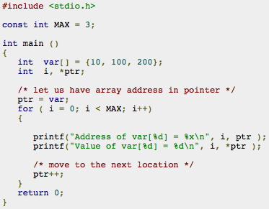

Incrementing a Pointer

Slide 16
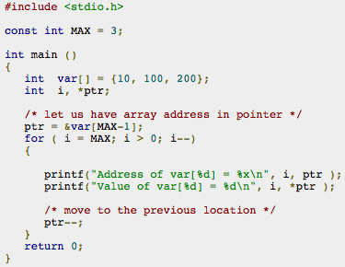

Decrementing a Pointer
The same considerations apply to decrementing a pointer, which decreases its value by the number of bytes of its data type as shown below:

Slide 17
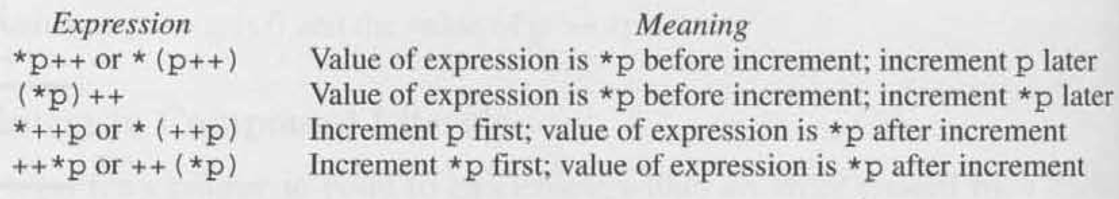
Pointer * and ++

Slide 18
Pointer Comparisons
Pointers may be compared by using relational operators, such as ==, <, and >.
If p1 and p2 point to variables that are related to each other, such as elements of the same array, then p1 and p2 can be meaningfully compared.
The following program modifies the previous example one by incrementing the variable pointer as long as the address to which it points is either less than or equal to the address of the last element of the array, which is &var[MAX - 1] (see next slide).

Slide 19
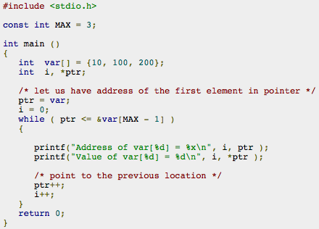

Pointer Comparisons

Slide 20
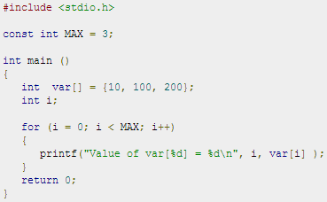

Array of pointers
Before we understand the concept of arrays of pointers, let us consider the following example, which makes use of an array of 3 integers:

Slide 21
Array of pointers
There may be a situation when we want to maintain an array, which can store pointers to an int or char or any other data type available. Following is the declaration of an array of pointers to an integer:
int *ptr[ ];
This declares ptr as an array of integer pointers. Thus, each element in ptr, now holds a pointer to an int value. Following example makes use of three integers, which will be stored in an array of pointers as follows:

Slide 22
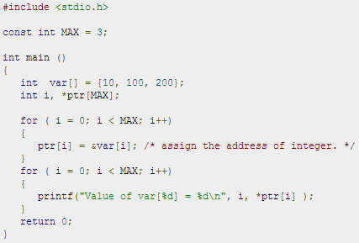

Array of pointers
Following example makes use of three integers, which will be stored in an array of pointers as follows:

Slide 23
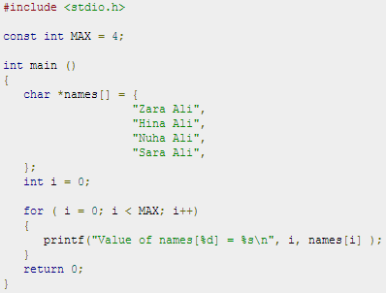

Array of pointers
You can also use an array of pointers to character to store a list of strings as follows:

Slide 24

Pointer to Pointer
A pointer to a pointer is a form of multiple indirection, or a chain of pointers. Normally, a pointer contains the address of a variable. When we define a pointer to a pointer, the first pointer contains the address of the second pointer, which points to the location that contains the actual value as shown below.
A variable that is a pointer to a pointer must be declared as such. This is done by placing an additional asterisk in front of its name. For example, following is the declaration to declare a pointer to a pointer of type int:

Slide 25
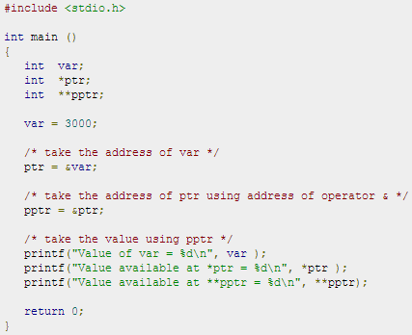

Pointer to Pointer
When a target value is indirectly pointed to by a pointer to a pointer, accessing that value requires that the asterisk operator be applied twice, as is shown below in the example:

Slide 26
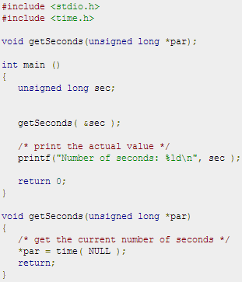
Passing pointers to functions
C programming language allows you to pass a pointer to a function. To do so, simply declare the function parameter as a pointer type.
Following is a simple example where we pass an unsigned long pointer to a function and change the value inside the function which reflects back in the calling function:

Slide 27
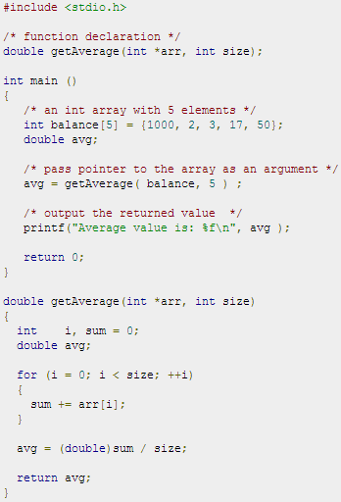
Passing pointers to functions
The function, which can accept a pointer, can also accept an array as shown in the following example:

Slide 28

Return pointer from functions
C allows us to return a pointer from a function. To do so, you would have to declare a function returning a pointer as in the following example:
Second point to remember is that, it is not good idea to return the address of a local variable to outside of the function so you would have to define the local variable as static variable.

Slide 29
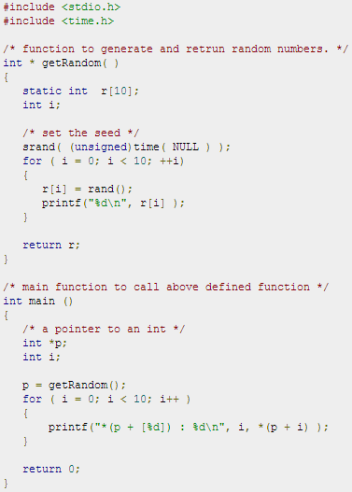
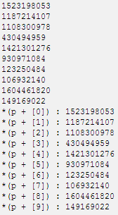
Return pointer from functions
Consider the following function which will generate 10 random numbers and return them using an array name which represents a pointer i.e., address of first array element.

