Slide 1
Repetition Statements (loops)

Slide 2
Loops – While, Do, For
Repetition Statements
  While
  Do
  For

Slide 3
Repetition Statements
Repetition statements allow us to execute a statement or a block of statements multiple times
Often they are referred to as loops
Like conditional statements, they are controlled by boolean expressions
Java has three kinds of repetition statements:
  while
  do
  for
The programmer should choose the right kind of loop statement for the situation

Slide 4
The while Statement
A while statement has the following syntax:
If the condition is true, the statement is executed
Then the condition is evaluated again, and if it is still true, the statement is executed again
The statement is executed repeatedly until the condition becomes false
while ( condition )
statement;

Slide 5
Logic of a while Loop
condition
evaluated
true
false
statement
5

Slide 6
The while Statement
An example of a while statement:
If the condition of a while loop is false initially, the statement is never executed
Therefore, the body of a while loop will execute zero or more times
int count = 0;
while (count < 2)
{
System.out.println("Welcome to Java!");
count++;
}

Slide 7
Trace while Loop
animation
Initialize count
int count = 0;
while (count < 2)
{
System.out.println("Welcome to Java!");
count++;
}
7

Slide 8
Trace while Loop, cont.
animation
(count < 2) is true
int count = 0;
while (count < 2)
{
System.out.println("Welcome to Java!");
count++;
}
8

Slide 9
Trace while Loop, cont.
animation
Print Welcome to Java
int count = 0;
while (count < 2)
{
System.out.println("Welcome to Java!");
count++;
}
9

Slide 10
Trace while Loop, cont.
animation
Increase count by 1
count is 1 now
int count = 0;
while (count < 2)
{
System.out.println("Welcome to Java!");
count++;
}
10

Slide 11
Trace while Loop, cont.
animation
(count < 2) is still true since count is 1
int count = 0;
while (count < 2)
{
System.out.println("Welcome to Java!");
count++;
}
11

Slide 12
Trace while Loop, cont.
animation
Print Welcome to Java
int count = 0;
while (count < 2)
{
System.out.println("Welcome to Java!");
count++;
}
12

Slide 13
Trace while Loop, cont.
animation
Increase count by 1
count is 2 now
int count = 0;
while (count < 2)
{
System.out.println("Welcome to Java!");
count++;
}
13

Slide 14
Trace while Loop, cont.
animation
(count < 2) is false since count is 2 now
int count = 0;
while (count < 2)
{
System.out.println("Welcome to Java!");
count++;
}
14

Slide 15
Trace while Loop
animation
The loop exits. Execute the next statement after the loop.
int count = 0;
while (count < 2)
{
System.out.println("Welcome to Java!");
count++;
}
15

Slide 16
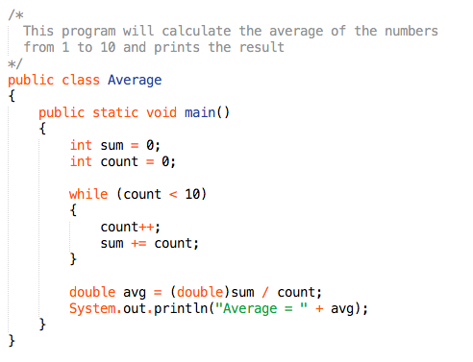
Example (Average.java)

Slide 17
Infinite Loops
Executing the statements in the body of a while loop must eventually make the condition false
If not, it is called an infinite loop, which will execute until the user interrupts the program
This is a common logical error
You should always double check the logic of a program to ensure that your loops will terminate

Slide 18
Infinite Loops
An example of an infinite loop:
This loop will continue executing until the user externally interrupts the program.
int count = 1;
while (count <= 25)
{
System.out.println(count);
count = count - 1;
}

Slide 19
Nested Loops
Similar to nested if statements, loops can be nested as well
That is, the body of a loop can contain another loop
For each iteration of the outer loop, the inner loop iterates completely

Slide 20
Nested Loops
How many times will the string "Here" be printed?
count1 = 1;
while (count1 <= 10)
{
count2 = 1;
while (count2 <= 20)
{
System.out.println ("Here");
count2++;
}
count1++;
}
10 * 20 = 200

