Slide 1
Chapter 2: The Microprocessor and its Architecture

Slide 2
Introduction
This chapter presents the microprocessor as a programmable device by first looking at its internal programming model and then how its memory space is addressed.
The architecture of Intel microprocessors is presented, as are the ways that the family members address the memory system.
Addressing modes for this powerful family of microprocessors are described for the real, protected, and flat modes of operation.

Slide 3
Chapter Objectives
Upon completion of this chapter, you will be able to:
Describe function and purpose of each program-visible register in the 8086-Core2 microprocessors, including 64-bit extensions.
Detail the flag register and the purpose of each flag bit.
Describe how memory is accessed using real mode memory-addressing techniques.

Slide 4
Chapter Objectives
(cont.)
Upon completion of this chapter, you will be able to:
Describe how memory is accessed using protected mode memory-addressing techniques.
Describe how memory is accessed using the 64-bit flat memory model.
Describe program-invisible registers found in the 80286 through Core2 microprocessors.
Detail the operation of the memory-paging mechanism.

Slide 5
2–1 INTERNAL MICROPROCESSOR ARCHITECTURE
Before a program is written or instruction investigated, internal configuration of the microprocessor must be known.
In a multiple core microprocessor each core contains the same programming model.
Each core runs a separate task or thread simultaneously.

Slide 6
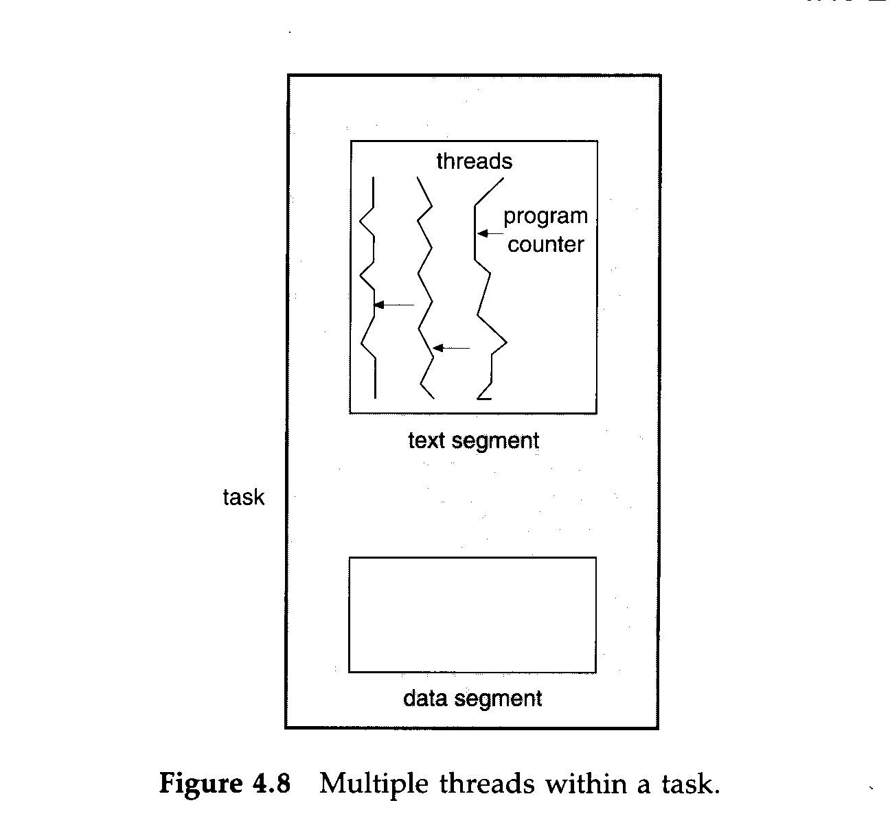
A thread consists of a program counter, a register set, and a stack space.
A task shares with peer threads its code section, data section, and operating system resources

Slide 7
The Programming Model
8086 through Core2 considered program visible.
  registers are used during programming and are specified by the instructions
Other registers considered to be program invisible.
  not addressable directly during applications programming

Slide 8
80286 and above contain program-invisible registers to control and operate protected memory.
  and other features of the microprocessor
80386 through Core2 microprocessors contain full 32-bit internal architectures.
8086 through the 80286 are fully upward-compatible to the 80386 through Core2.
Figure 2–1 illustrates the programming model 8086 through Core2 microprocessor.
  including the 64-bit extensions

Slide 9
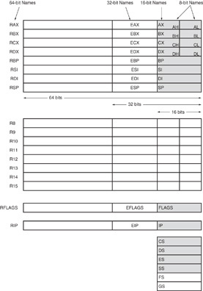
Figure 2–1 The programming model of the 8086 through the Core2 microprocessor including the 64-bit extensions.

Slide 10
Multipurpose Registers
RAX - a 64-bit register (RAX), a 32-bit register (accumulator) (EAX), a 16-bit register (AX), or as either of two 8-bit registers (AH and AL).
The accumulator is used for instructions such as multiplication, division, and some of the adjustment instructions.
Intel plans to expand the address bus to 52 bits to address 4P (2⁵²~10¹⁵ =peta) bytes of memory.

Slide 11
Address Space (Main Memory: RAM)
Address bus:16 bit →Address Space:64 KBytes
Address bus:20 bit →Address Space:1 MBytes Address bus:32 bit →Address Space:4 GBytes Address bus:34 bit →Address Space:16GBytes
Address bus:36 bit →Address Space:64GBytes
Address bus:38 bit →Address Space:256GBytes
Address bus:52 bit →Address Space:10¹⁵ Bytes

Slide 12
RBX, addressable as RBX, EBX, BX, BH, BL.
  BX register (base index) sometimes holds offset address of a location in the memory system in all versions of the microprocessor
RCX, as RCX, ECX, CX, CH, or CL.
  a (count) general-purpose register that also holds the count for various instructions
RDX, as RDX, EDX, DX, DH, or DL.
  a (data) general-purpose register
  holds a part of the result from a multiplication
  or part of dividend before a division

Slide 13
RBP, as RBP, EBP, or BP.
  points to a memory (base pointer) location
  for memory data transfers
RDI addressable as RDI, EDI, or DI.
  often addresses (destination index) string destination data for the string instructions
RSI used as RSI, ESI, or SI.
  the (source index) register addresses source string data for the string instructions
  like RDI, RSI also functions as a general-
  purpose register

Slide 14
R8 - R15 found in the Pentium 4 and Core2 if 64-bit extensions are enabled.
  data are addressed as 64-, 32-, 16-, or 8-bit
  sizes and are of general purpose
Most applications will not use these registers until 64-bit processors are common.
  the 8-bit portion is the rightmost 8-bit only
  bits 8 to 15 are not directly addressable as
  a byte

Slide 15
Special-Purpose Registers
Include RIP, RSP, and RFLAGS
  segment registers include CS, DS, ES, SS, FS, and GS
RIP addresses the next instruction in a section of memory.
  defined as (instruction pointer) a code segment
RSP addresses an area of memory called
the stack.
  the (stack pointer) stores data through this pointer

Slide 16
RFLAGS indicate the condition of the microprocessor and control its operation.
Figure 2–2 shows the flag registers of all versions of the microprocessor.
Flags are upward-compatible from the 8086/8088 through Core2 .
The rightmost five and the overflow flag are changed by most arithmetic and logic operations.
  although data transfers do not affect them

Slide 17
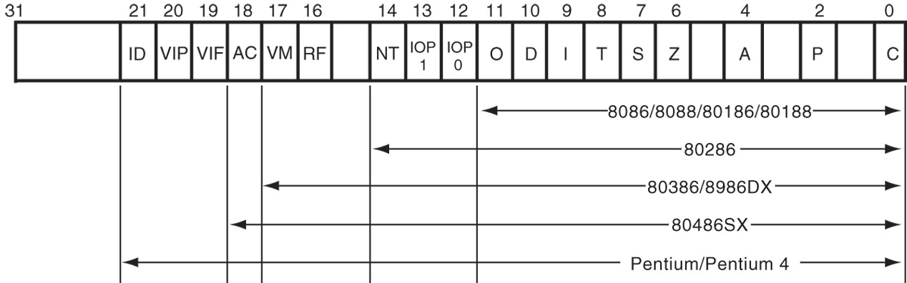
Figure 2–2 The EFLAG and FLAG register counts for the entire 8086 and Pentium microprocessor family.
Flags never change for any data transfer or program control operation.
Some of the flags are also used to control features found in the microprocessor.

Slide 18
Flag bits, with a brief description of function.
C (carry) holds the carry after addition or borrow after subtraction.
  also indicates error conditions
P (parity) is the count of ones in a number expressed as even or odd. Logic 0 for odd parity; logic 1 for even parity.
  if a number contains three binary one bits, it has odd parity
  if a number contains no one bits, it has even parity

Slide 19
List of Each Flag bit, with a brief description of function.
C (carry) holds the carry after addition or borrow after subtraction.
  also indicates error conditions
P (parity) is the count of ones in a number expressed as even or odd. Logic 0 for odd parity; logic 1 for even parity.
  if a number contains three binary one bits, it has odd parity; If a number contains no one bits, it
  has even parity

Slide 20
A (auxiliary carry) holds the carry (half-carry) after addition or the borrow after subtraction between bit positions 3 and 4 of the result.
Z (zero) shows that the result of an arithmetic or logic operation is zero.
S (sign) flag holds the arithmetic sign of the result after an arithmetic or logic instruction executes.
T (trap) The trap flag enables trapping through an on-chip debugging feature.

Slide 21
I (interrupt) controls operation of the INTR (interrupt request) input pin.
D (direction) selects increment or decrement mode for the DI and/or SI registers.
O (overflow) occurs when signed numbers are added or subtracted.
  an overflow indicates the result has exceeded
  the capacity of the machine

Slide 22
IOPL used in protected mode operation
to select the privilege level for I/O devices.
NT (nested task) flag indicates the current task is nested within another task in protected mode operation.
RF (resume) used with debugging to control resumption of execution after the next instruction.
VM (virtual mode) flag bit selects virtual mode operation in a protected mode system.

Slide 23
AC, (alignment check) flag bit activates if a word or doubleword is addressed on a non-word or non-doubleword boundary.
VIF is a copy of the interrupt flag bit available to the Pentium 4–(virtual interrupt)
VIP (virtual) provides information about a virtual mode interrupt for (interrupt pending) Pentium.
  used in multitasking environments to provide virtual interrupt flags

Slide 24
ID (identification) flag indicates that the Pentium microprocessors support the CPUID instruction.
  CPUID instruction provides the system with information about the Pentium microprocessor

Slide 25
Segment Registers
Generate memory addresses when combined with other registers in the microprocessor.
Four or six segment registers in various versions of the microprocessor.
A segment register functions differently in real mode than in protected mode.
Following is a list of each segment register, along with its function in the system.

Slide 26
CS (code) segment holds code (programs and procedures) used by the microprocessor.
DS (data) contains most data used by a program.
  Data are accessed by an offset address or contents of other registers that hold the offset address
ES (extra) an additional data segment used by some instructions to hold destination data.

Slide 27
SS (stack) defines the area of memory used for the stack.
  stack entry point is determined by the stack segment and stack pointer registers
  the BP register also addresses data within
  the stack segment

Slide 28
FS and GS segments are supplemental segment registers available in 80386–Core2 microprocessors.
  allow two additional memory segments for
  access by programs
Windows uses these segments for internal operations, but no definition of their usage
is available.

Slide 29
2–2 REAL MODE MEMORY ADDRESSING
80286 and above operate in either the real or protected mode.
Real mode operation allows addressing of only the first 1M byte of memory space—even in Pentium 4 or Core2 microprocessor.
  the first 1M byte of memory is called the real memory, conventional memory, or DOS memory system

Slide 30
Segments and Offsets
All real mode memory addresses must consist of a segment address plus an offset address.
  segment address defines the beginning address of any 64K-byte memory segment
  offset address selects any location within the
  64K byte memory segment
Figure 2–3 shows how the segment plus offset addressing scheme selects a memory location.

Slide 31
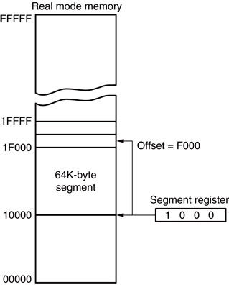
Figure 2–3 The real mode memory-addressing scheme, using a segment address plus an offset.
  this shows a memory segment beginning at 10000H, ending at location IFFFFH
    64K bytes in length
  also shows how an offset address, called a displacement, of F000H selects location
  1F000H in the memory

Slide 32
Once the beginning address is known, the ending address is found by adding FFFFH.
  because a real mode segment of memory is64K in length
The offset address is always added to the segment starting address to locate the data.
Segment and offset address is sometimes written as 1000:2000.
  a segment address of 1000H; an offset of 2000H

Slide 33
Default Segment and Offset Registers
The microprocessor has rules that apply to segments whenever memory is addressed.
  these define the segment and offset register combination
The code segment register defines the start of the code segment.
The instruction pointer locates the next instruction within the code segment.

Slide 34
Another of the default combinations is the stack.
  stack data are referenced through the stack segment at the memory location addressed by either the stack pointer (SP/ESP) or the pointer (BP/EBP)
Figure 2–4 shows a system that contains four memory segments.
  a memory segment can touch or overlap if 64K bytes of memory are not required for a segment

Slide 35
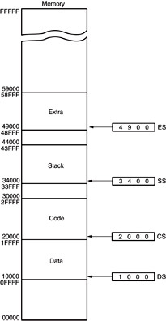
Figure 2–4 A memory system showing the placement of four memory segments.
  think of segments as Windows that can be moved over any area
  of memory to access data or code
  a program can have more than four or six segments,
    but only access four or six segments at a time

Slide 36
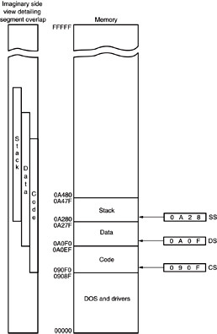
Figure 2–5 An application program containing a code, data, and stack segment loaded into a DOS system memory.
  a program placed in memory by DOS is loaded in the TPA at the first available area of memory above drivers and other TPA programs
  area is indicated by a free-pointer maintained by DOS
  program loading is handled automatically by the program loader within DOS

Slide 37
TPA
The transient program area (TPA) holds the DOS (disk operating system) operating system; other programs that control the computer system.

Slide 38
Segment and Offset Addressing Scheme Allows Relocation
Segment plus offset addressing allows DOS programs to be relocated in memory.
A relocatable program is one that can be placed into any area of memory and executed without change.
Relocatable data are data that can be placed in any area of memory and used without any change to the program.

Slide 39
Because memory is addressed within a segment by an offset address, the memory segment can be moved to any place in the memory system without changing any of the offset addresses.
Only the contents of the segment register must be changed to address the program
in the new area of memory.
Windows programs are written assuming that the first 2G of memory are available for code and data.

Slide 40
2–3 INTRO TO PROTECTED MODE
MEMORY ADDRESSING
Allows access to data and programs located within & above the first 1M byte of memory.
Protected mode is where Windows operates.
In place of a segment address, the segment register contains a selector that selects a descriptor from a descriptor table.
The descriptor describes the memory segment’s location, length, and access rights.

Slide 41
Selectors and Descriptors
The descriptor is located in the segment register & describes the location, length, and access rights of the segment of memory.
  it selects one of 8192 descriptors from one
  of two tables of descriptors
In protected mode, this segment number can address any memory location in the system
for the code segment.
Indirectly, the register still selects a memory segment, but not directly as in real mode.

Slide 42
Global descriptors contain segment definitions that apply to all programs.
Local descriptors are usually unique to an application.
  a global descriptor might be called a system descriptor, and local descriptor an application descriptor
Figure 2–6 shows the format of a descriptor for the 80286 through the Core2.
  each descriptor is 8 bytes in length
  global and local descriptor tables are a
  maximum of 64K bytes in length

Slide 43
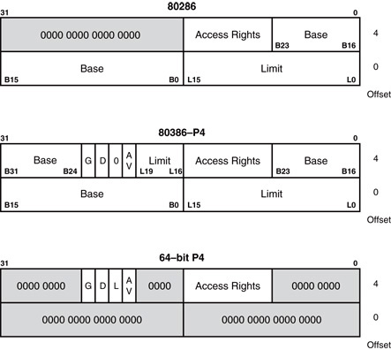
Figure 2–6 The 80286 through Core2 64-bit descriptors.

Slide 44
The base address of the descriptor indicates the starting location of the memory segment.
  the paragraph boundary limitation is removed in protected mode
  segments may begin at any address
The G, or granularity bit allows a segment length of 4K to 4G bytes in steps of 4K bytes.
  32-bit offset address allows segment lengths of 4G bytes
  16-bit offset address allows segment lengths of 64K bytes.

Slide 45
Operating systems operate in a 16- or 32-bit environment.
DOS uses a 16-bit environment.
Most Windows applications use a 32-bit environment called WIN32.
MSDOS/PCDOS & Windows 3.1 operating systems require 16-bit instruction mode.
Instruction mode is accessible only in a protected mode system such as Windows XP→ Windows Vista →Windows 7 → Windows 8 →???.

Slide 46
The access rights byte controls access to the protected mode segment.
  describes segment function in the system and allows complete control over the segment
  if the segment is a data segment, the direction of growth is specified
If the segment grows beyond its limit, the operating system is interrupted, indicating
a general protection fault.
You can specify whether a data segment
can be written or is write-protected.

Slide 47
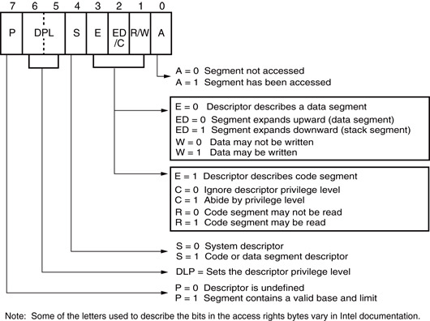
Figure 2–7 The access rights byte for the 80286 through Core2 descriptor.

Slide 48
Descriptors are chosen from the descriptor table by the segment register.
  register contains a 13-bit selector field, a table selector bit, and requested privilege level field
The TI bit selects either the global or the local descriptor table.
Requested Privilege Level (RPL) requests the access privilege level of a memory segment.
  If privilege levels are violated, system normally indicates an application or privilege level violation

Slide 49
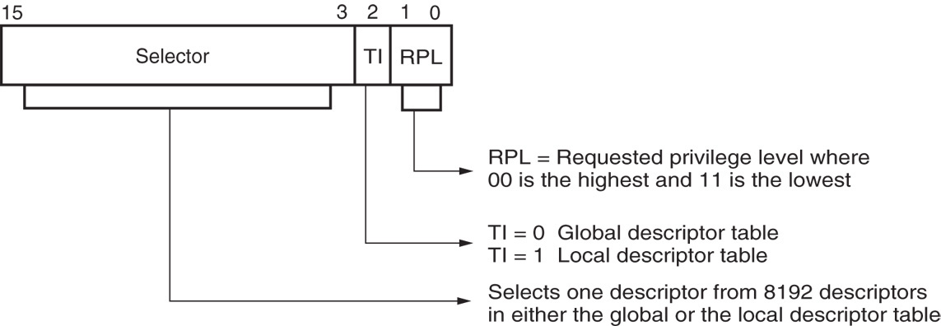
Figure 2–8 The contents of a segment register during protected mode operation of the 80286 through Core2 microprocessors.

Slide 50
Figure 2–9 shows how the segment register, containing a selector, chooses a descriptor from the global descriptor table.
The entry in the global descriptor table selects a segment in the memory system.
Descriptor zero is called the null descriptor, must contain all zeros, and may not be used for accessing memory.

Slide 51
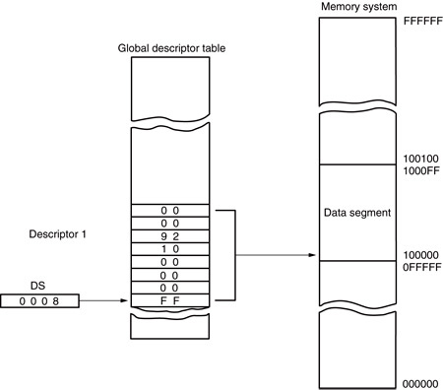
Figure 2–9 Using the DS register to select a description from the global descriptor table. In this example, the DS register accesses memory locations 00100000H–001000FFH as a data segment.

Slide 52
Program-Invisible Registers
Global and local descriptor tables are found
in the memory system.
To access & specify the table addresses, 80286–Core2 contain program-invisible registers.
  not directly addressed by software
Each segment register contains a program-invisible portion used in the protected mode.
  often called cache memory because cache is
  any memory that stores information

Slide 53
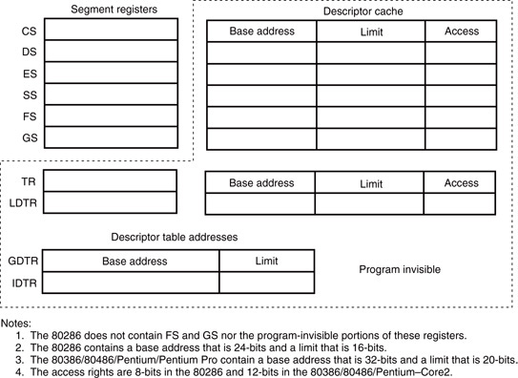
Figure 2–10 The program-invisible register within the 80286–Core2 microprocessors.

Slide 54
When a new segment number is placed in a segment register, the microprocessor accesses a descriptor table and loads the descriptor into the program-invisible portion of the segment register.
  held there and used to access the memory segment until the segment number is changed
This allows the microprocessor to repeatedly access a memory segment without referring to the descriptor table.
  hence the term cache

Slide 55
The GDTR (global descriptor table register) and IDTR (interrupt descriptor table register) contain the base address of the descriptor table and its limit.
  when protected mode operation desired, address of the global descriptor table and its limit are loaded into the GDTR
The location of the local descriptor table is selected from the global descriptor table.
  one of the global descriptors is set up to
  address the local descriptor table

Slide 56
To access the local descriptor table, the LDTR (local descriptor table register) is loaded with a selector.
  selector accesses global descriptor table, & loads local descriptor table address, limit, & access rights into the cache portion of the LDTR
The TR (task register) holds a selector, which accesses a descriptor that defines a task.
  a task is most often a procedure or application
Allows multitasking systems to switch tasks
to another in a simple and orderly fashion.

Slide 57
2–4 MEMORY PAGING
The memory paging mechanism allows any physical memory location to be assigned to any linear address.
Iinear address is defined as the address generated by a program.
Physical address is the actual memory location accessed by a program.
With memory paging, the linear address is invisibly translated to any physical address.

Slide 58
Paging Registers
The paging unit is controlled by the contents
of the microprocessor’s control registers.
Beginning with Pentium, an additional control register labeled CR4 controls extensions to the basic architecture.
See Figure 2–11 for the contents of control registers CR0 through CR4.

Slide 59
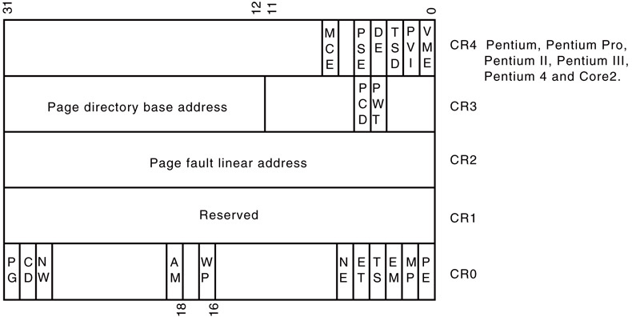
Figure 2–11 The control register structure of the microprocessor.

Slide 60
The linear address, as generated by software, is broken into three sections that are used to access the page directory entry, page table entry, and memory page offset address.
Figure 2–12 shows the linear address and its makeup for paging.
When the program accesses a location between 00000000H and 00000FFFH, the microprocessor physically addresses location 00100000H–00100FFFH.

Slide 61
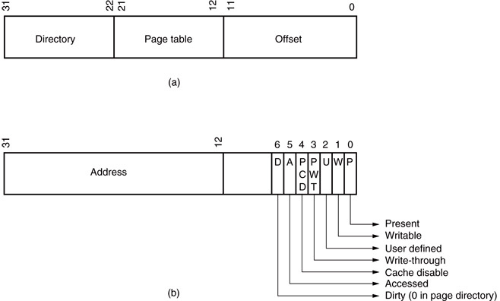
Figure 2–12 The format for the linear address (a) and a page directory or page table entry (b).

Slide 62
Intel has incorporated a special type of cache called TLB (translation look-aside buffer).
  because repaging a 4K-byte section of memory requires access to the page directory and a page table, both located in memory
The 80486 cache holds the 32 most recent page translation addresses.
  if the same area of memory is accessed, the address is already present in the TLB
  This speeds program execution
Pentium contains separate TLBs for each
of their instruction and data caches.

Slide 63
The Page Directory and Page Table
Only one page directory in the system.
The page directory contains 1024 doubleword addresses that locate up to 1024 page tables.
Page directory and each page table are 4K bytes in length.
Figure 2–13 shows the page directory, a few page tables, and some memory pages.

Slide 64
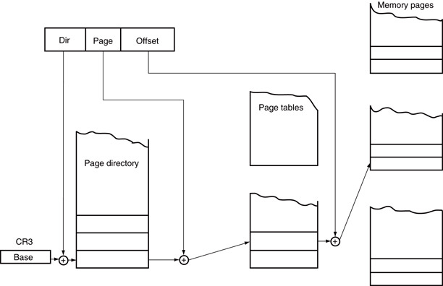
Figure 2–13 The paging mechanism in the 80386 through Core2 microprocessors.

Slide 65
DOS and EMM386.EXE use page tables to redefine memory between locations C8000H–EFFFFH as upper memory blocks.
  done by repaging extended memory to backfill conventional memory system to allow DOS access to additional memory
Each entry in the page directory corresponds to 4M bytes of physical memory.
Each entry in the page table repages 4K bytes of physical memory.
Windows also repages the memory system.

Slide 66
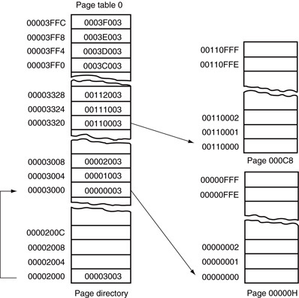
Figure 2–14 The page directory, page table 0, and two memory pages. Note how the address of page 000C8000–000C9000 has been moved to 00110000–00110FFF.

Slide 67
2–5 Flat Mode Memory
A flat mode memory system is one in which there is no segmentation.
  does not use a segment register to address a location in the memory
First byte address is at 00 0000 0000H; the last location is at FF FFFF FFFFH.
  address is 40-bits
The segment register still selects the privilege level of the software.

Slide 68
Real mode system is not available if the processor operates in the 64-bit mode.
Protection and paging are allowed in the 64-bit mode.
The CS register is still used in the protected mode operation in the 64-bit mode.
Most programs today are operated in the IA32 compatible mode.
  current software operates properly, but this will change in a few years as memory becomes
  larger and most people have 64-bit computers

Slide 69
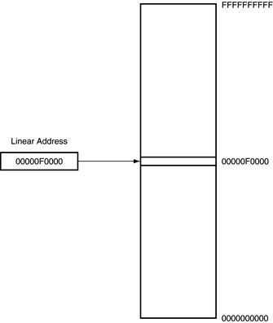
Figure 2–15 The 64-bit flat mode memory model.

Slide 70
SUMMARY
The programming model of the 8086 through 80286 contains 8- and 16-bit registers.
The programming model of the 80386 and above contains 8-, 16-, and 32-bit extended registers as well as two additional 16-bit segment registers: FS and GS.

Slide 71
SUMMARY
(cont.)
8-bit registers are AH, AL, BH, BL, CH, CL, DH, and DL.
16-bit registers are AX, BX, CX, DX, SP, BP, DI, and SI.
The segment registers are CS, DS, ES, SS, FS, and GS.
32-bit extended registers are EAX, EBX, ECX, EDX, ESP, EBP, EDI, and ESI.

Slide 72
SUMMARY
(cont.)
The 64-bit registers in a Pentium 4 with 64-bit extensions are RAX, RBX, RCX, RDX, RSP, RBP, RDI, RSI, and R8 through R15.
In addition, the microprocessor contains an instruction pointer (IP/EIP/RIP) and flag register (FLAGS, EFLAGS, or RFLAGS).
All real mode memory addresses are a combination of a segment address plus an offset address.

Slide 73
SUMMARY
(cont.)
The starting location of a segment is defined by the 16-bit number in the segment register that is appended with a hexadecimal zero at its rightmost end.
The offset address is a 16-bit number added to the 20-bit segment address to form the real mode memory address.
All instructions (code) are accessed by the combination of CS (segment address) plus IP or EIP (offset address).

Slide 74
SUMMARY
(cont.)
Data are normally referenced through a combination of the DS (data segment) and either an offset address or the contents of a register that contains the offset address.
The 8086-Core2 use BX, DI, and SI as default offset registers for data if 16-bit registers are selected.
The 80386 and above can use the 32-bit registers EAX, EBX, ECX, EDX, EDI, and ESI as default offset registers for data.

Slide 75
SUMMARY
(cont.)
Protected mode operation allows memory above the first 1M byte to be accessed by the 80286 through the Core2 microprocessors.
This extended memory system (XMS) is accessed via a segment address plus an offset address, just as in the real mode.
In the protected mode, the segment starting address is stored in a descriptor that is selected by the segment register.

Slide 76
SUMMARY
(cont.)
A protected mode descriptor contains a base address, limit, and access rights byte.
The base address locates the starting address of the memory segment; the limit defines the last location of the segment.
The access rights byte defines how the memory segment is accessed via a program.

Slide 77
SUMMARY
(cont.)
The 80286 microprocessor allows a memory segment to start at any of its 16M bytes of memory using a 24-bit base address.
The 80386 and above allow a memory segment to begin at any of its 4G bytes of memory using a 32-bit base address.
This allows an 80286 memory segment limit of 64K bytes, and an 80386 and above memory segment limit of either 1M bytes.

Slide 78
SUMMARY
(cont.)
The segment register contains three fields of information in the protected mode.
The leftmost 13 bits of the segment register address one of 8192 descriptors from a descriptor table.
The program-invisible registers are used by the 80286 and above to access the descriptor tables.

Slide 79
SUMMARY
(cont.)
Each segment register contains a cache portion that is used in protected mode to hold the base address, limit, and access rights acquired from a descriptor.
The cache allows the microprocessor to access the memory segment without again referring to the descriptor table until the segment register's contents are changed.

Slide 80
SUMMARY
(cont.)
A memory page is 4K bytes in length. The linear address, as generated by a program, can be mapped to any physical address through the paging mechanism found within the 80386 through the Pentium 4.
Memory paging is accomplished through control registers CR0 and CR3.
The PG bit of CR0 enables paging, and the contents of CR3 addresses the page directory.

Slide 81
SUMMARY
(cont.)
The page directory contains up to 1024 page table addresses that are used to access paging tables.
The page table contains 1024 entries that locate the physical address of a 4K-byte memory page.
The TLB (translation look-aside buffer) caches the 32 most recent page table translations.

Slide 82
SUMMARY
The flat mode memory contains 1T byte of memory using a 40-bit address.
In the future, Intel plans to increase the address width to 52 bits to access 4P bytes of memory.
The flat mode is only available in the Pentium 4 and Core2 that have their 64-bit extensions enabled.

