Slide 1
Understanding and Modeling Organizational Systems
2
Kendall & Kendall
Systems Analysis and Design, 9e

Slide 2
Learning Objectives
Understand that organizations and their members are systems and that analysts need to take a systems perspective.
Depict systems graphically using context-level data flow diagrams, and entity-relationship models, use cases, and use case scenarios.
Recognize that different levels of management require different systems.
Comprehend that organizational culture impacts the design of information systems.
2-<number>

Slide 3
Three Main Forces Interacting to Shape Organizations
Levels of management
Design of organizations
Organizational cultures
2-<number>

Slide 4
Organizations Are Composed of Interrelated Subsystems
Influenced by levels of management decision makers that cut horizontally across the organizational system
  Operations
  Middle management
  Strategic management
Influenced by organizational cultures and subcultures
2-<number>

Slide 5
Major Topics
Organizations as systems
Depicting systems graphically
  Data flow diagram
  Entity-relationship model
  Use case modeling
Levels of management
Organizational culture
2-<number>

Slide 6
Organizations as Systems
Conceptualized as systems designed to accomplish predetermined goals and objectives
Composed of smaller, interrelated systems serving specialized functions
Specialized functions are reintegrated to form an effective organizational whole
2-<number>
Notes:
To ascertain information requirements properly and to design appropriate information systems, it is of primary importance to understand the organization as a whole.
All systems are composed of subsystems.

Slide 7
Interrelatedness and Independence of Systems
All systems and subsystems are interrelated and interdependent
All systems process inputs from their environments
All systems are contained by boundaries separating them from their environments
System feedback for planning and control
An ideal system self-corrects or self-regulates itself.
2-<number>
Notes:
When an element of a system is changed or eliminated, the rest of the system’s elements and subsystems are also significantly affected.
Processes change or transform inputs into outputs.
Typical processes include:
verifying
updating
printing
Organizational boundaries exist on a continuum ranging from extremely permeable (open) to almost impermeable (closed).
All organizations (systems) need planning and control to manage their resources effectively. Feedback is useful for planning and control.
The ideal system is one that self-corrects or self-regulates in such a way that decisions on typical occurrences are not required.

Slide 8
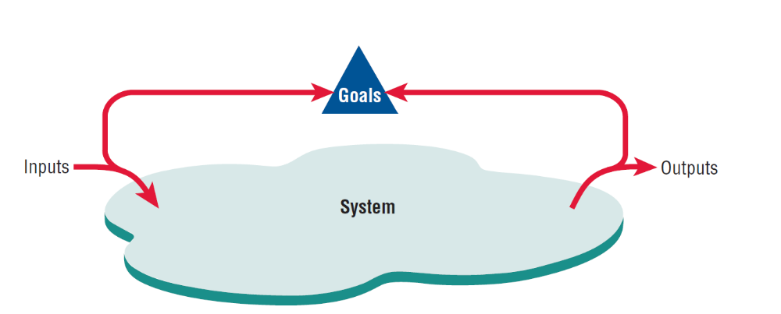
System Outputs Serve as Feedback that Compares Performance with Goals (Figure 2.1)
2-<number>
Notes:
Feedback is received both internal and external to the organization. Anything external to an organization’s boundaries is considered to be an environment.

Slide 9
Organizational Environments
Community
  Physical location
  Demographic profile (education, income)
Economic
  Market factors
  Competition
Political
  State and local government
Legal
  Federal, state, regional, local laws, and guidelines
2-<number>
Notes:
Numerous environments, with varying degrees of stability, constitute the milieu in which organizations exist.
Although changes in environment can be planned for, they cannot be directly controlled by the organization.

Slide 10
Openness and Closedness
Open
  Free flow of information
  Output from one system becomes input to another
Closed
  Restricted access to information
  Limited by numerous rules
  Information only on a “need to know” basis
2-<number>
Notes:
Openness and closedness exist on a continuum, there is no such thing as an absolutely open or completely closed organization.

Slide 11
Virtual Organizations and Virtual Teams
A virtual organization has parts of the organization in different physical locations
Computer networks and communications technology are used to bring virtual teams together to work on projects
2-<number>
Notes:
In some instances, organizations of remote workers have been able to succeed without the traditional investment in infrastructure.

Slide 12
Benefits of Virtual Organizations and Teams
Possibility of reducing costs of physical facilities
More rapid response to customer needs
Helping virtual employees to fulfill their familial obligations to children or aging parents
2-<number>
Notes:
Just how important it will be to meet the social needs of virtual workers is still open to research and debate.

Slide 13
Taking a Systems Perspective
Allows system analyst to understand businesses before they begin their tasks
It is important that members of subsystems realize that they are interrelated with other subsystems
Problems occur when each manager thinks that his/her department is the most important
Bigger problems may occur when that manager rises through the ranks
2-<number>
Notes:
Taking a systems perspective allows systems analysts to start broadly clarifying and understanding the various businesses with which they will come into contact.
Without recognizing the interrelatedness of the subsystems; subsystems cannot properly accomplish their goals.
Managers of different subsystems need to have the same picture of the functioning and interrelatedness of the organization.
In his/her new position, the former manager may still think of his/her old department as the most important. The potential for this problem to occur exists in almost any business. If the analyst interviews this manager early on, he/she may get a distorted view of the company structure.

Slide 14
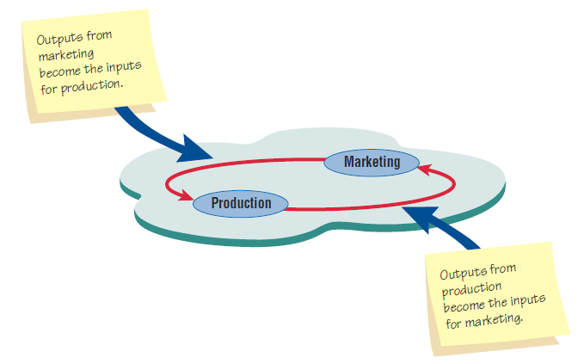
Taking a Systems Perspective (Figure 2.2)
Outputs from one department serve as inputs for another such
that subsystems are interrelated.
2-<number>

Slide 15
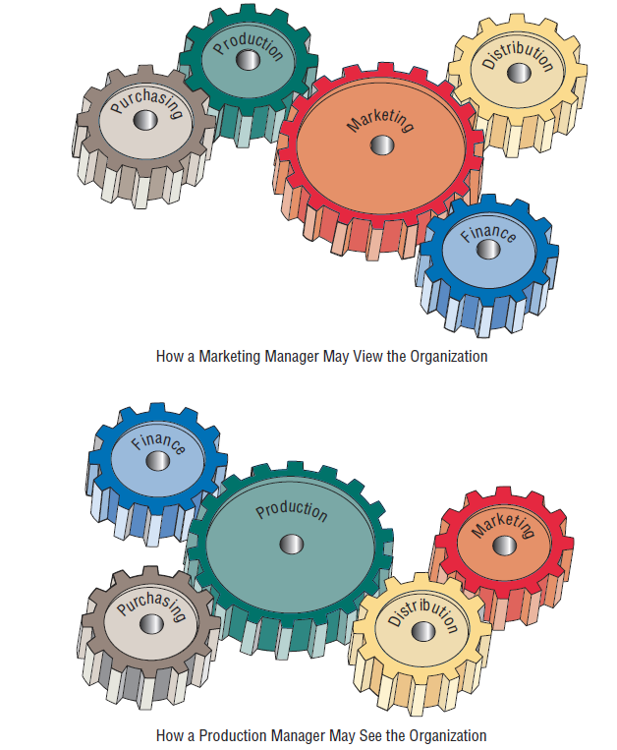
Perspective of Functional
Managers (Figure 2.3)
2-<number>

Slide 16
Enterprise Resource Planning
Enterprise Systems or Enterprise Resource Planning (ERP) describes an integrated organizational information system
Software that helps the flow of information between the functional areas within the organization
2-<number>
Notes:
ERP systems include:
manufacturing components
sales and operations planning
distribution
managing the supply train
Problems with implementation:
difficult to analyze a system currently in use and then fit the ERP model to that system
companies tend to design their business processes before ERP is implemented
ERP, although growing in use is also being viewed with some skepticism.

Slide 17
ERP and the Organization
ERP can affect every aspect of the organization, including:
  Design of employees’ work
  Skills required for job competency
  Strategic positioning of the company
2-<number>

Slide 18
Issues to be Overcome for ERP Success
Many issues must be overcome for the ERP installation is to be declared a success:
  User acceptance
  Integration with legacy systems and the supply chain
  Upgrading functionality (and complexity) of ERP modules
  Reorganizing work life of users and decision makers
  Expanded reach across several organizations
  Strategic repositioning of the company
2-<number>

Slide 19
Depicting Systems Graphically
Context-level data flow diagrams
Entity-relationship model
Use case modeling
2-<number>
Notes:
The various graphical models show the boundaries of the system and the information used in the system.

Slide 20
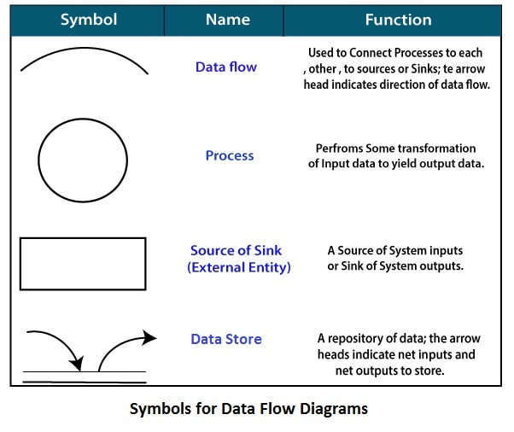
Standard symbols for DFDs are derived from the electric circuit diagram analysis and are shown in fig:
2-<number>

Slide 21
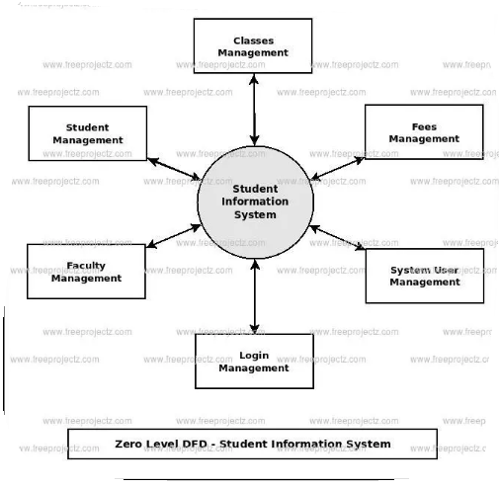
Context–Level of Student Information System
2-<number>

Slide 22
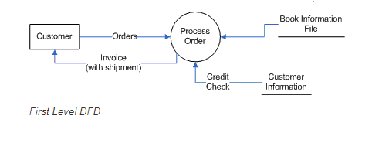
Book Order System Context level DFD
2-<number>

Slide 23
Context-Level Data Flow Diagrams
Focus is on the data flowing into and out of the system and the processing of the data
Shows the scope of the system:
  What is to be included in the system
  The external entities are outside the scope of the system
2-<number>
Notes:
Sometimes called an environmental model.

Slide 24
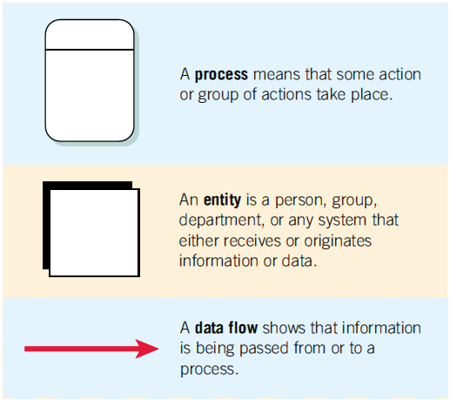
The Basic Symbols of a Data Flow Diagram (Figure 2.4)
2-<number>
Notes:
Process—transforms incoming data into outgoing information, the content level has only one process representing the entire system.
Entity—entity, a person, group, department, or system that supplies or receives information.
Data flows—the lines that connect external entities to the process.

Slide 25
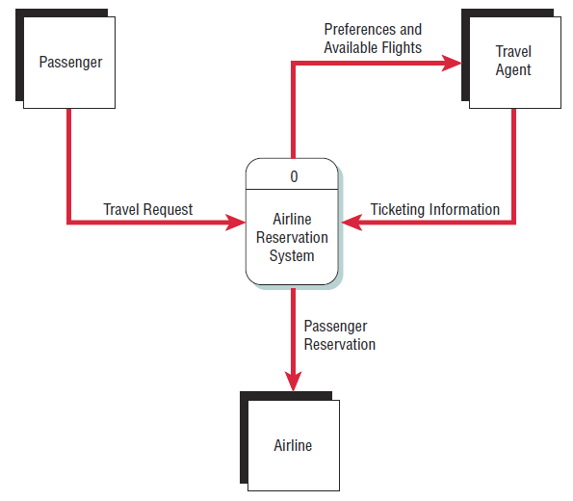
Airline Reservation System (Figure 2.5)
A context-level data flow diagram
for an airline reservation system
2-<number>
Notes:
The passenger (an entity) initiates a travel request (data flow). The passenger’s preferences and the available flights are sent to the travel agent, who sends ticketing information back to the process. The passenger information is also sent to the airline.

Slide 26
Entity-Relationship Model
Focus is on the entities and their relationships within the organizational system
Another way to show the scope of a system
2-<number>
Notes:
An entity may be a person, a place, thing, or an event.
A relationship is the association that describes the interaction among the entities.

Slide 27
Relationships
Relationships show how the entities are connected
Three types of relationships:
  One-to-one
  One-to-many
  Many-to-many
2-<number>
Notes:
One-to-one—one employee is assigned to one phone extension.
One-to-many—many employees are assigned to a department.
Many-to-many—many passengers fly to many destinations.

Slide 28
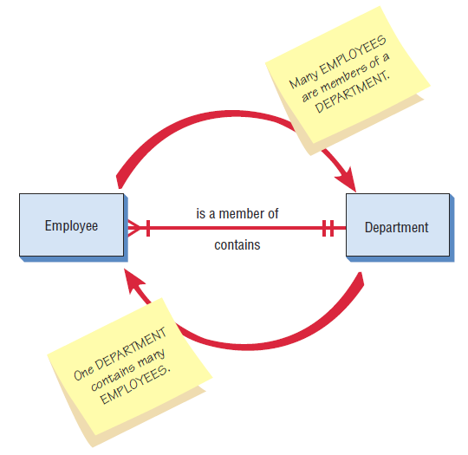
Entity-Relationship Example (Figure 2.7)
An entity-relationship diagram
showing a many-to-one
relationship
2-<number>

Slide 29
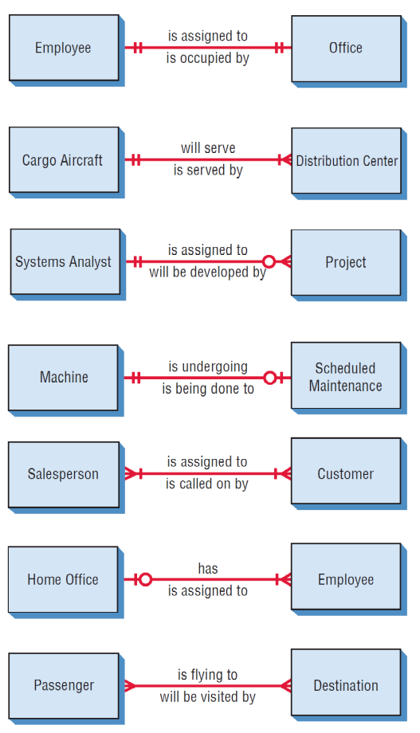
Examples of Different Types of Relationships in E-R Diagrams (Figure 2.8)
2-<number>

Slide 30
Entities
Fundamental entity
Associative entity
Attributive entity
2-<number>

Slide 31
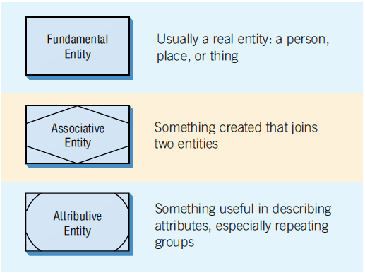
Three Different Types of Entities Used in E-R Diagrams (Figure 2.9)
2-<number>
Notes:
Different symbols are used to represent different types of entities.
An associative entity can only exist if it is connected to at least two other entities.
An attributive entity is used when we want to show data that are completely dependent on the existence of an fundamental entity.

Slide 32
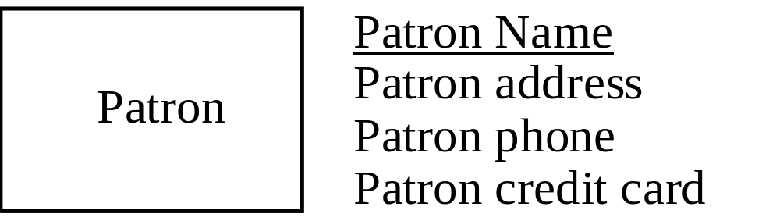
Attributes
Data attributes may be added to the diagram.
2-<number>
Notes:
Data attributes are what make up or define the entity.

Slide 33
Creating Entity-Relationship Diagrams
List the entities in the organization
Choose key entities to narrow the scope of the problem
Identify what the primary entity should be
Confirm the results of the above through data gathering
2-<number>
Notes:
ER diagrams are generally used to model the database.
ER diagrams help the analyst understand what business the organization is actually in, determine the size of the problem, and discern whether the right problem is being addressed. The E-R diagram needs to be confirmed or revised as the data-gathering process takes place.

Slide 34
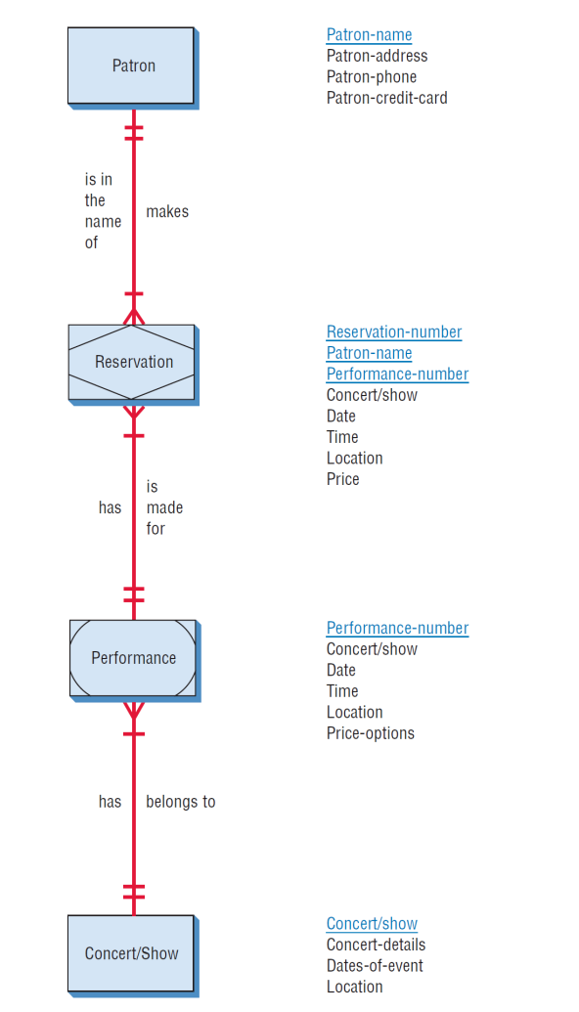
A More Complete E-R Diagram Showing Data Attributes of the Entities (Figure 2.12 )
2-<number>

Slide 35
Use Case Modeling
Describes what a system does without describing how the system does
  A logical model of the system
Use case is a view of the system requirements
Analyst works with business experts to develop requirements
2-<number>
Notes:
Originally, introduced as a diagram for use in the object-oriented UML, use cases are now being used regardless of the approach to systems development. It can be used as part of the SDLC or in agile modeling.

Slide 36
Use Case Diagram
Actor
  Refers to a particular role of a user of the system
  Similar to external entities; they exist outside of the system
Use case symbols
  An oval indicating the task of the use case
Connecting lines
  Arrows and lines used to diagram behavioral relationships
2-<number>
Notes:
A use case always describes three things:
an actor that initiates an event
the event that triggers a use case
the use case that performs the actions triggered by the event

Slide 37
Actor
Divided into two groups
  Primary actors:
    Supply data or receive information from the system
    Provide details on what the use case should do
  Supporting actors:
    Help to keep the system running or provide help
    The people who run the help desk, the analysts, programmers, and so on
2-<number>
Notes:
Sometimes a table is created with actor profiles that lists the actors, their background, and their skills.
These profiles can be useful to understand how the actor interacts with the system.

Slide 38
A Use Case Always Provides Three Things
An actor that initiates an event
The event that triggers a use case
The use case that performs the actions triggered by the event
2-<number>
Notes:
A use case documents a single transaction or event.
An event is an input to the system that happens at a specific time and place and causes the system to do something.

Slide 39
Use Case Relations
Behavioral relationships
  Communicates
    Used to connect an actor to a use case
  Includes
    Describes the situation in which a use case contains behavior that is common to more than one use case
2-<number>

Slide 40
Use Case Relations
Behavioral relationships (continued)
  Extends
    Describes the situation in which one use case possesses the behavior that allows the new case to handle a variation or exception from the basic use case
  Generalizes
    Implies that one thing is more typical than the other thing
2-<number>

Slide 41
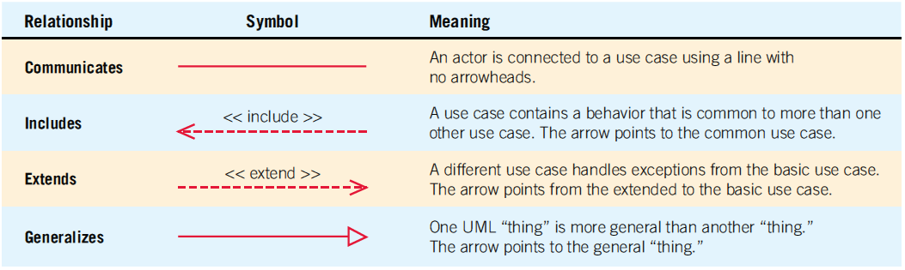
Four Types Of Behavioral Relationships And The Lines Used To Diagram Each
(Figure 2.13)
2-<number>

Slide 42
Some components of use case diagrams showing actors, use cases, and relationships for a student enrollment example (Figure 2.14)
2-<number>
Notes:
Communicates—used to connect an actor to a use case. The task of the use case is to give some sort of result that is beneficial to the actor in the system.
Includes—describes the situation in which a use case contains behavior that is common to more than one use case.
Extends—describes the situation in which one use case possesses the behavior that allows the new use case to handle a variation or exception from the basic use case.
Generalizes—implies that one thing is more typical than the other thing.

Slide 43
Scope
System scope defines its boundaries:
  What is in or outside the system
  Project has a budget that helps to define scope
  Project has a start and an end time
Actors are always outside of scope
Communication lines are the boundaries and define the scope
2-<number>

Slide 44
Developing Use Case Diagrams
Review the business specifications and identify the actors involved
May use agile stories
Identify the high-level events and develop the primary use cases that describe those events and how the actors initiate them
Review each primary use case to determine the possible variations of flow through the use case
The context-level data flow diagram could act as a starting point for creating a use case
2-<number>
Notes:
When diagramming a use case, start by asking the users to list everything the system should do for them.

Slide 45
A Use Case Diagram Representing a System Used to Plan a Conference (Figure 2.15 )
2-<number>
Notes:
Example of a use case diagram representing a system used to plan a conference.

Slide 46
Developing the Use Case Scenarios
The description of the use case
Three main areas:
  Use case identifiers and initiators
  Steps performed
  Conditions, assumptions, and questions
2-<number>
Notes:
Each use case has a description referred to as the use case scenario.

Slide 47
A Use Case Scenario Is Divided into Three Sections (Figure 2.16)
Use case name: Register for Conference |  | UniqueID: Conf RG 003
Area: Conference Planning
Actor(s): Participant
Stakeholder Conference Sponsor, Conference Speakers
Level Blue
Description: Allow conference participant to register online for the conference using a secure Web site.
Triggering Event: Participant uses Conference Registration Web site, enters userID and password, and clicks the logon button.
Trigger type:  External  Temporal
Steps Performed (Main Path) | Information for Steps
1. Participant logs in using the secure Web server | userID, Password
More steps included here…
12. Successful Registration Confirmation Web page is sent to the participant | Registration Record Confirmation Number
Preconditions: Participant has already registered and has created a user account.
Postconditions: Participant has successfully registered for the conference.
Assumptions: Participant has a browser and a valid userID and password.
Success Guarantee: Participant has registered for the conference and is enrolled in all selected sessions.
Minimum Guarantee: Participant was able to logon.
Requirements Met: Allow conference participants to be able to register for the conference using a secure Web site.
Outstanding Issues: How should a rejected credit card be handled?
Priority: High
Risk: Medium
2-<number>
Notes:
(First area)
Use case identifiers and initiators—orients the reader and contains:
1. The use case name and a unique ID
2. The application area or system that this use case belongs to
3. The actors involved in the use case
4. A brief description of what the use case accomplishes
5. The triggering event
6. Type of trigger:
external or temporal
external—those started by an actor
temporal—triggered or started by time
7. May list stakeholders
(Second area)
Includes the steps performed, and the information required for each of the steps.
(Third area)
Preconditions
Post conditions
Assumptions
Outstanding issues
optional statement of priority
optional statement of risk

Slide 48
Use Case Header Area
Has a name and a unique ID
Include application area
List actors
Include stakeholders
Include the level
Has a brief description of the use case
2-<number>

Slide 49
Use Case Levels
Use case levels describe how global or detailed the use case description is:
  White (like clouds): enterprise level
  Kite: business unit or department level
  Blue (sea level): user goals
  Indigo (or fish): functional or subfunctional
  Black (or clam): most detailed
2-<number>

Slide 50
Alternative Scenarios
Extensions or exceptions to the main use case
Number with an integer, decimal point, integer
Steps that may or may not always be used
2-<number>

Slide 51
Use Case Footer Area
Preconditions—need to be met before use case can be performed
Postconditions or the state of the system after the use case has finished
Assumptions
Minimal guarantee
Success guarantee
Outstanding issues
Optional priority and risk
2-<number>

Slide 52
Four Steps Used to Create Use Cases
Use agile stories, problem definition objectives, user requirements, or a features list
Ask about the tasks that must be done
Determine if there are any iterative or looping actions
The use case ends when the customer goal is complete
2-<number>

Slide 53
Why Use Case Diagrams Are Helpful
Identify all the actors in the problem domain
Actions that need to be completed are also clearly shown on the use case diagram
The use case scenario is also worthwhile
Simplicity and lack of technical detail
2-<number>
Notes:
Identify all the actors in the problem domain—the systems analyst can concentrate on what humans want and need to use the system, extend their capabilities, and enjoy their interaction with technology.
Actions that need to be completed are also clearly shown on the use case diagram—this makes it easy for the analyst to identify processes and aids in communication with other analysts on the team and business executives
The use case scenario is also worthwhile—because a lot of the information the users impart to the analysts are in story form, it is easy to capture on the use case scenario form.
Simplicity and lack of technical detail—used to show the scope of a system, along with the major features of the system and the actors that work with those major features.

Slide 54
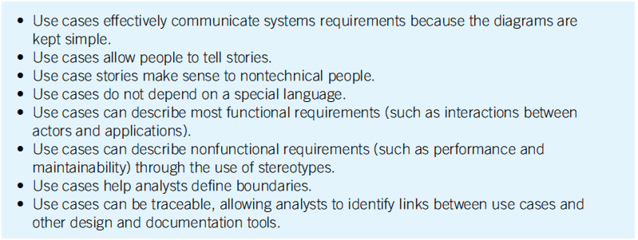
The Main Reasons for Writing Use Cases Are Their Effectiveness in Communicating with Users and Their Capturing of User Stories (Figure 2.18)
2-<number>

Slide 55
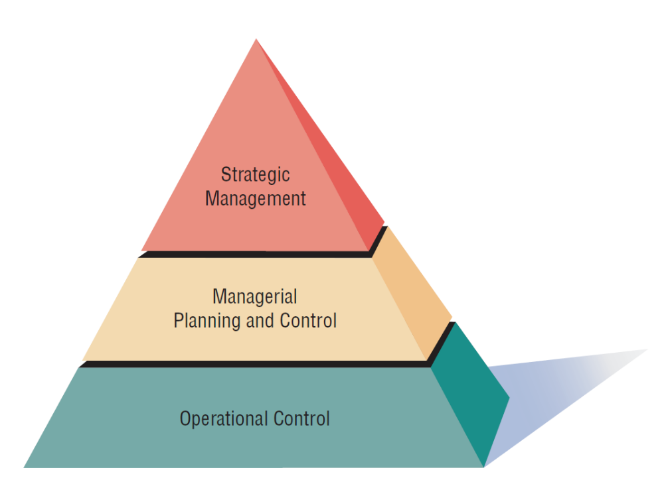
Management in Organizations Exists on Three Horizontal Levels: Operational Control, Managerial Planning and Control, and Strategic Management (Figure 2.19)
2-<number>
Notes:
Management in organizations exists on three broad, horizontal levels. Each level carries its own responsibilities, and all work toward achieving organizational goals and objectives in their own ways.

Slide 56
Operations Control
Make decisions using predetermined rules that have predictable outcomes
Oversee the operating details of the organization
2-<number>
Notes:
Forms the bottom tier of the three-tiered model.

Slide 57
Managerial Planning and Control
Make short-term planning and control decisions about resources and organizational objectives
Decisions may be partly operational and partly strategic
2-<number>
Notes:
Forms the second or intermediate tier of the three-tiered model.

Slide 58
Strategic Management
Look outward from the organization to the future
Make decisions that will guide middle and operations managers
Work in highly uncertain decision-making environment
Define the organization as a whole
2-<number>
Notes:
Third level of the three-tiered model.

Slide 59
Managerial Levels
Different organization structure
Leadership style
Technological considerations
Organization culture
Human interaction
All carry implications for the analysis and design of information systems
2-<number>
Notes:
Operations managers:
need internal information that is of a repetitive, low-level nature
highly dependent on information that captures current performance
large users of online, real-time information resources
need for past performance information and periodic information is moderate
have little use for external information that allows future projections
Middle management:
in need of both short and longer-term information
need for information in real time
need current information on performance as measured against set standards
highly dependent on internal information
need for historical information, along with information that allows prediction of future events
Strategic management:
highly dependent on information from external sources that supply news of market trends and the strategies of competing corporations
high need for information of a predictive nature
need for periodically reported information

Slide 60
Organizational Culture
Organizations have cultures and subcultures
Learn from verbal and nonverbal symbolism
2-<number>
Notes:
We need to think of organizations as hosts to multiple, often competing subcultures.
Competing subcultures may be in conflict, attempting to gain adherents to their vision of what the organization should be.
Verbal symbolism—includes shared language used to construct, convey, and preserve subculture myths, metaphors, visions, and humor.
Nonverbal symbolism—includes shared artifacts, rites, and ceremonies.
Understanding and recognizing predominant organizational subcultures may help the systems analyst overcome the resistance to change that arises when a new information system is installed.

Slide 61
Verbal Symbolism
Myths
Metaphors
Visions
Humor
2-<number>

Slide 62
Nonverbal Symbolism
Shared artifacts
  Trophies, etc.
Rites and rituals
  Promotions
  Birthdays, etc.
Clothing worn
Office placement and decorations
2-<number>

Slide 63
Summary
Organizational fundamentals
  Organizations as systems
  Levels of management
  Organizational culture
Graphical representation of systems
  DFD
  ERD
  Use case diagrams and scenarios
2-<number>

Slide 64
Summary (continued)
Levels of managerial control
  Operational
  Middle management
  Strategic
Organizational culture
2-<number>

Slide 65

Copyright © 2014 Pearson Education, Inc.
Publishing as Prentice Hall
2-<number>

