Slide 1


HeritageLens
AI-Powered Indian Art and Cultural Heritage Recognition System
CNN (MobileNetV2 Transfer Learning) | Flask REST API | HTML / CSS / JavaScript
Suditi S Pai | USN: 4AL23CS163
Varshitha V Shetty | USN: 4AL23CS180

Slide 2

Problem and Objectives
Problem
Many people know little about India's traditional art forms, and there is no simple tool to identify an artwork from a photo and learn about it.
Motivation
Make learning about Indian art quick, visual, and interactive using AI.
Objectives
1. Recognize 10 Indian art forms
2. Show prediction with confidence %
3. Provide cultural information
4. Explore, search, and filter heritage
5. Keep local recognition history

Slide 3
System Architecture and Technology Stack
Frontend
Upload image
Flask API
/api/predict
Preprocess
Pillow + NumPy
CNN Model
MobileNetV2
Knowledge Base
JSON
Result
Art + confidence
Frontend
HTML, CSS, JavaScript, and localStorage for history.
Backend
Python, Flask, Pillow, and NumPy.
AI / ML
TensorFlow / Keras, MobileNetV2, and Adam optimizer.
API and Data
REST API (/api/predict) and a JSON knowledge base.
Each component is separate, so any part can be upgraded easily.

Slide 4
Algorithm: CNN with Transfer Learning
How a CNN works
Filters detect edges and textures, deeper layers find shapes and patterns, and softmax gives a probability for each art form.
Why transfer learning
MobileNetV2 is already pretrained, so only a small classifier is trained. This needs less data and time.
Our model (MobileNetV2)
1. RandomFlip, RandomRotation
2. Rescaling
3. MobileNetV2 pretrained base
4. GlobalAveragePooling2D
5. Dropout
6. Dense + softmax (10 classes)
Trained with Adam optimizer.

Slide 5
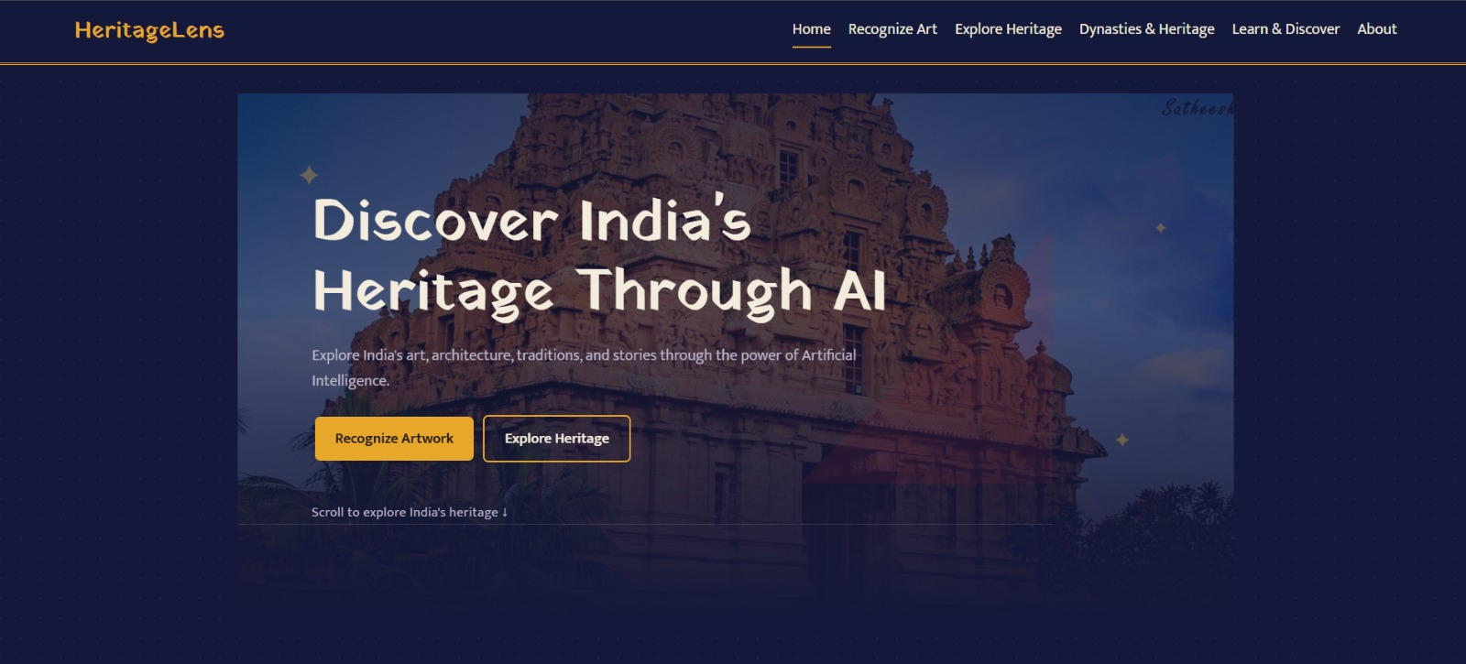
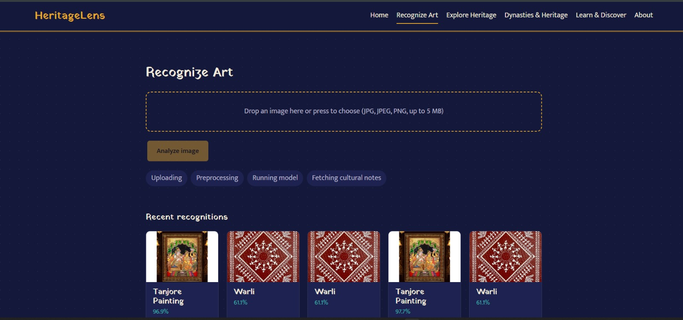
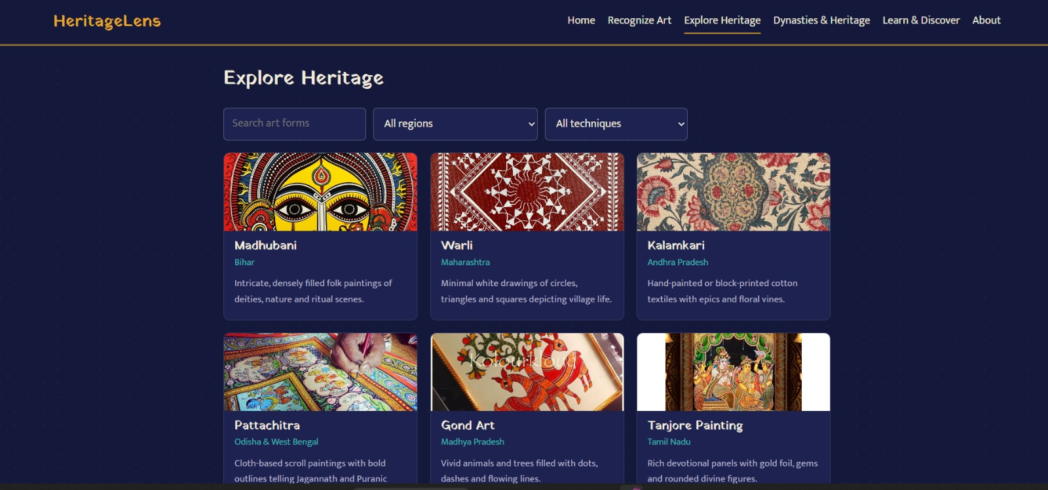
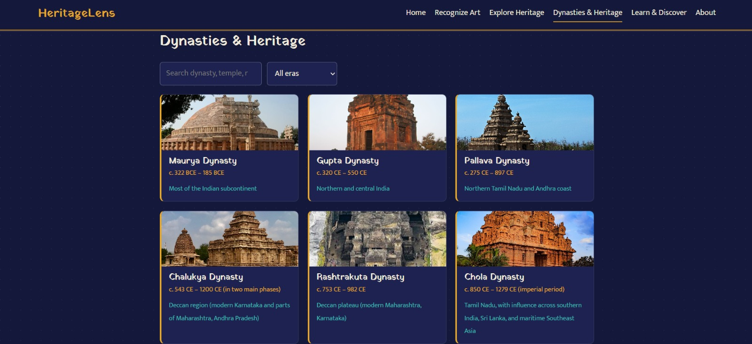
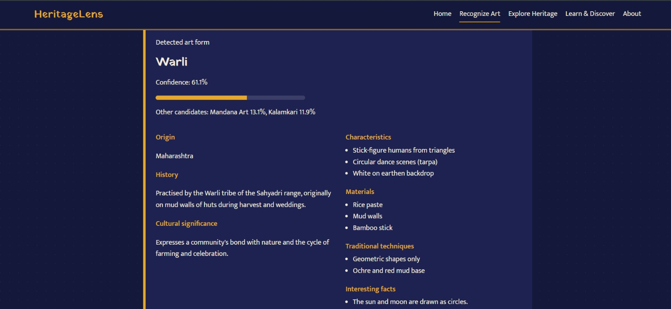
Application Output
Home page
Recognize Art with recent recognitions
Explore Heritage: search and filters
Result
Detected art form, confidence, other candidates, and cultural details. Recent results (e.g. Tanjore Painting 96.9%) are kept in history.
Dynasties & Heritage
Result: Warli, 61.1% confidence
Dynasties & Heritage: browse the Maurya, Gupta, Pallava, Chalukya, Rashtrakuta, and Chola dynasties with era, region, and search and era filters.

Slide 6
Limitations, Future Scope, Conclusion
Limitations
- Accuracy depends on dataset quality
- Similar styles can be confused
- Only 10 art forms supported
- Out-of-set images get a closest match
Future scope
- More art forms
- "Unknown" threshold
- Grad-CAM explanations
- Multiple languages and mobile app
Conclusion
HeritageLens uses AI to help people understand, explore, and preserve India's art heritage. Predictions are educational guidance.

Slide 7
Thank You

