Slide 1
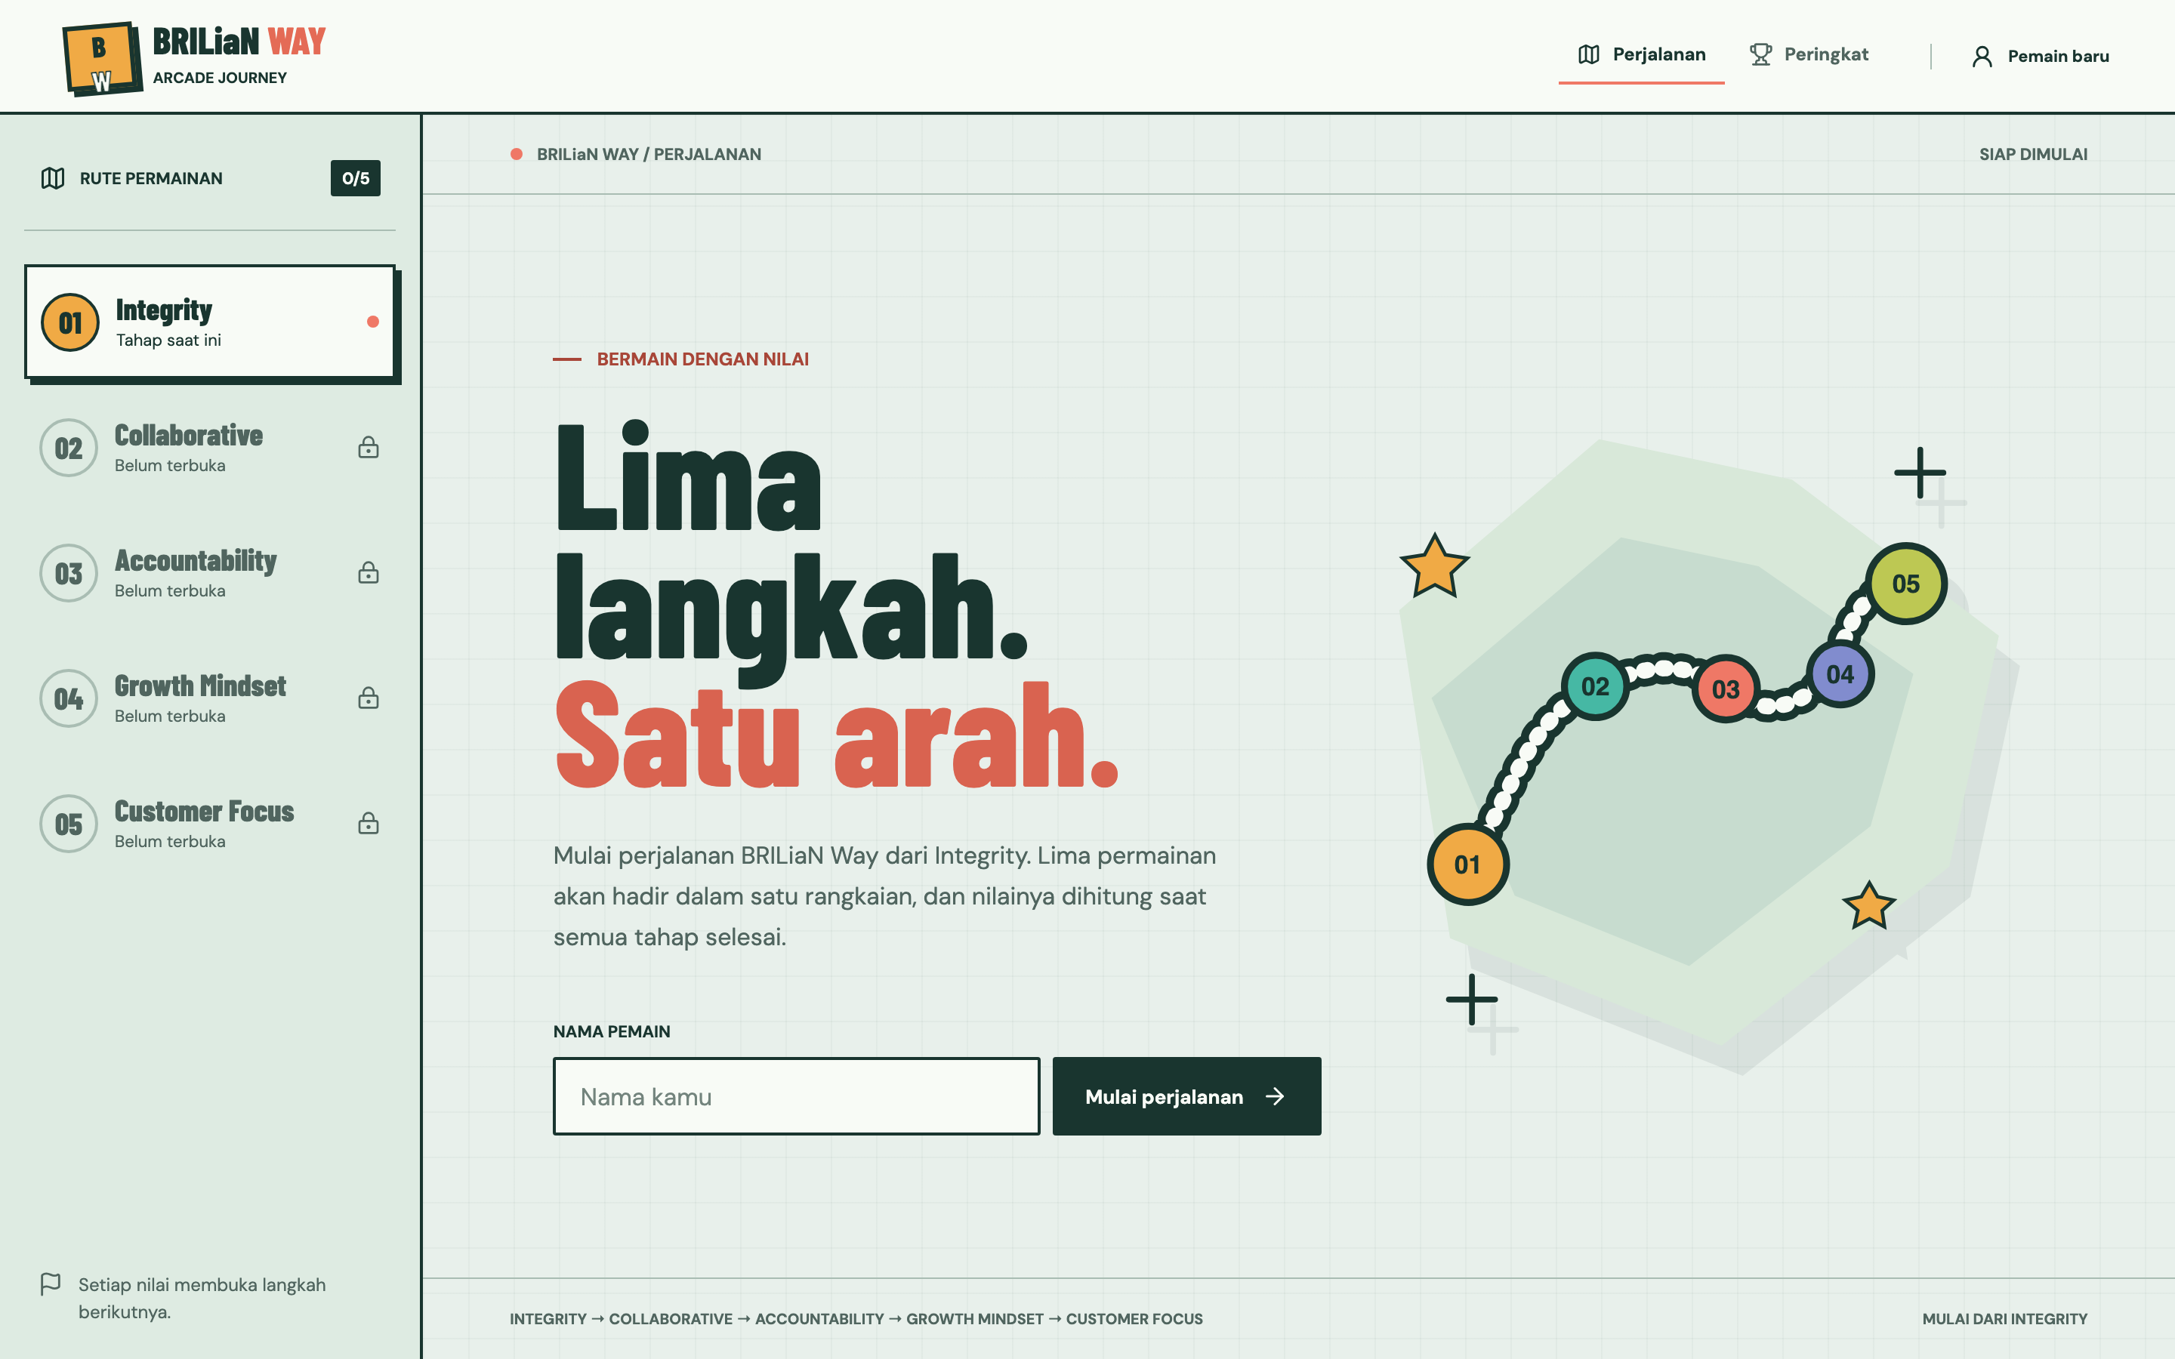
— SPEC-DRIVEN DEVELOPMENT · GITHUB COPILOT
Building the BRILiaN
Way as playable
minigames.
How our team turned five culture values into an arcade journey — specified first, generated with Copilot, shipped game by game.
5 minigames
one fixed journey, one score
Integrity → Collaborative →
Accountability → Growth
Mindset → Customer Focus
A spec-first story →
See the demo
BRILiaN WAY / Pitch deck
01

Slide 2
— IDEATION
One idea, two bets.
We wanted to try spec-driven development with GitHub Copilot — and we needed a project worth specifying. The BRILiaN Way, reimagined as minigames, became both.
THE METHOD BET
THE PRODUCT BET
WHY IT FITS
Spec-driven development
BRILiaN Way as an arcade
Many games, one contract
Write the spec before the code. Let Copilot generate against a precise, reviewed contract instead of vague prompts.
Turn five culture values into a desktop arcade journey players move through in a fixed order, earning one score.
Each value is a self-contained game. A shared contract lets five people build in parallel without stepping on each other.
BRILiaN WAY / Ideation
02

Slide 3
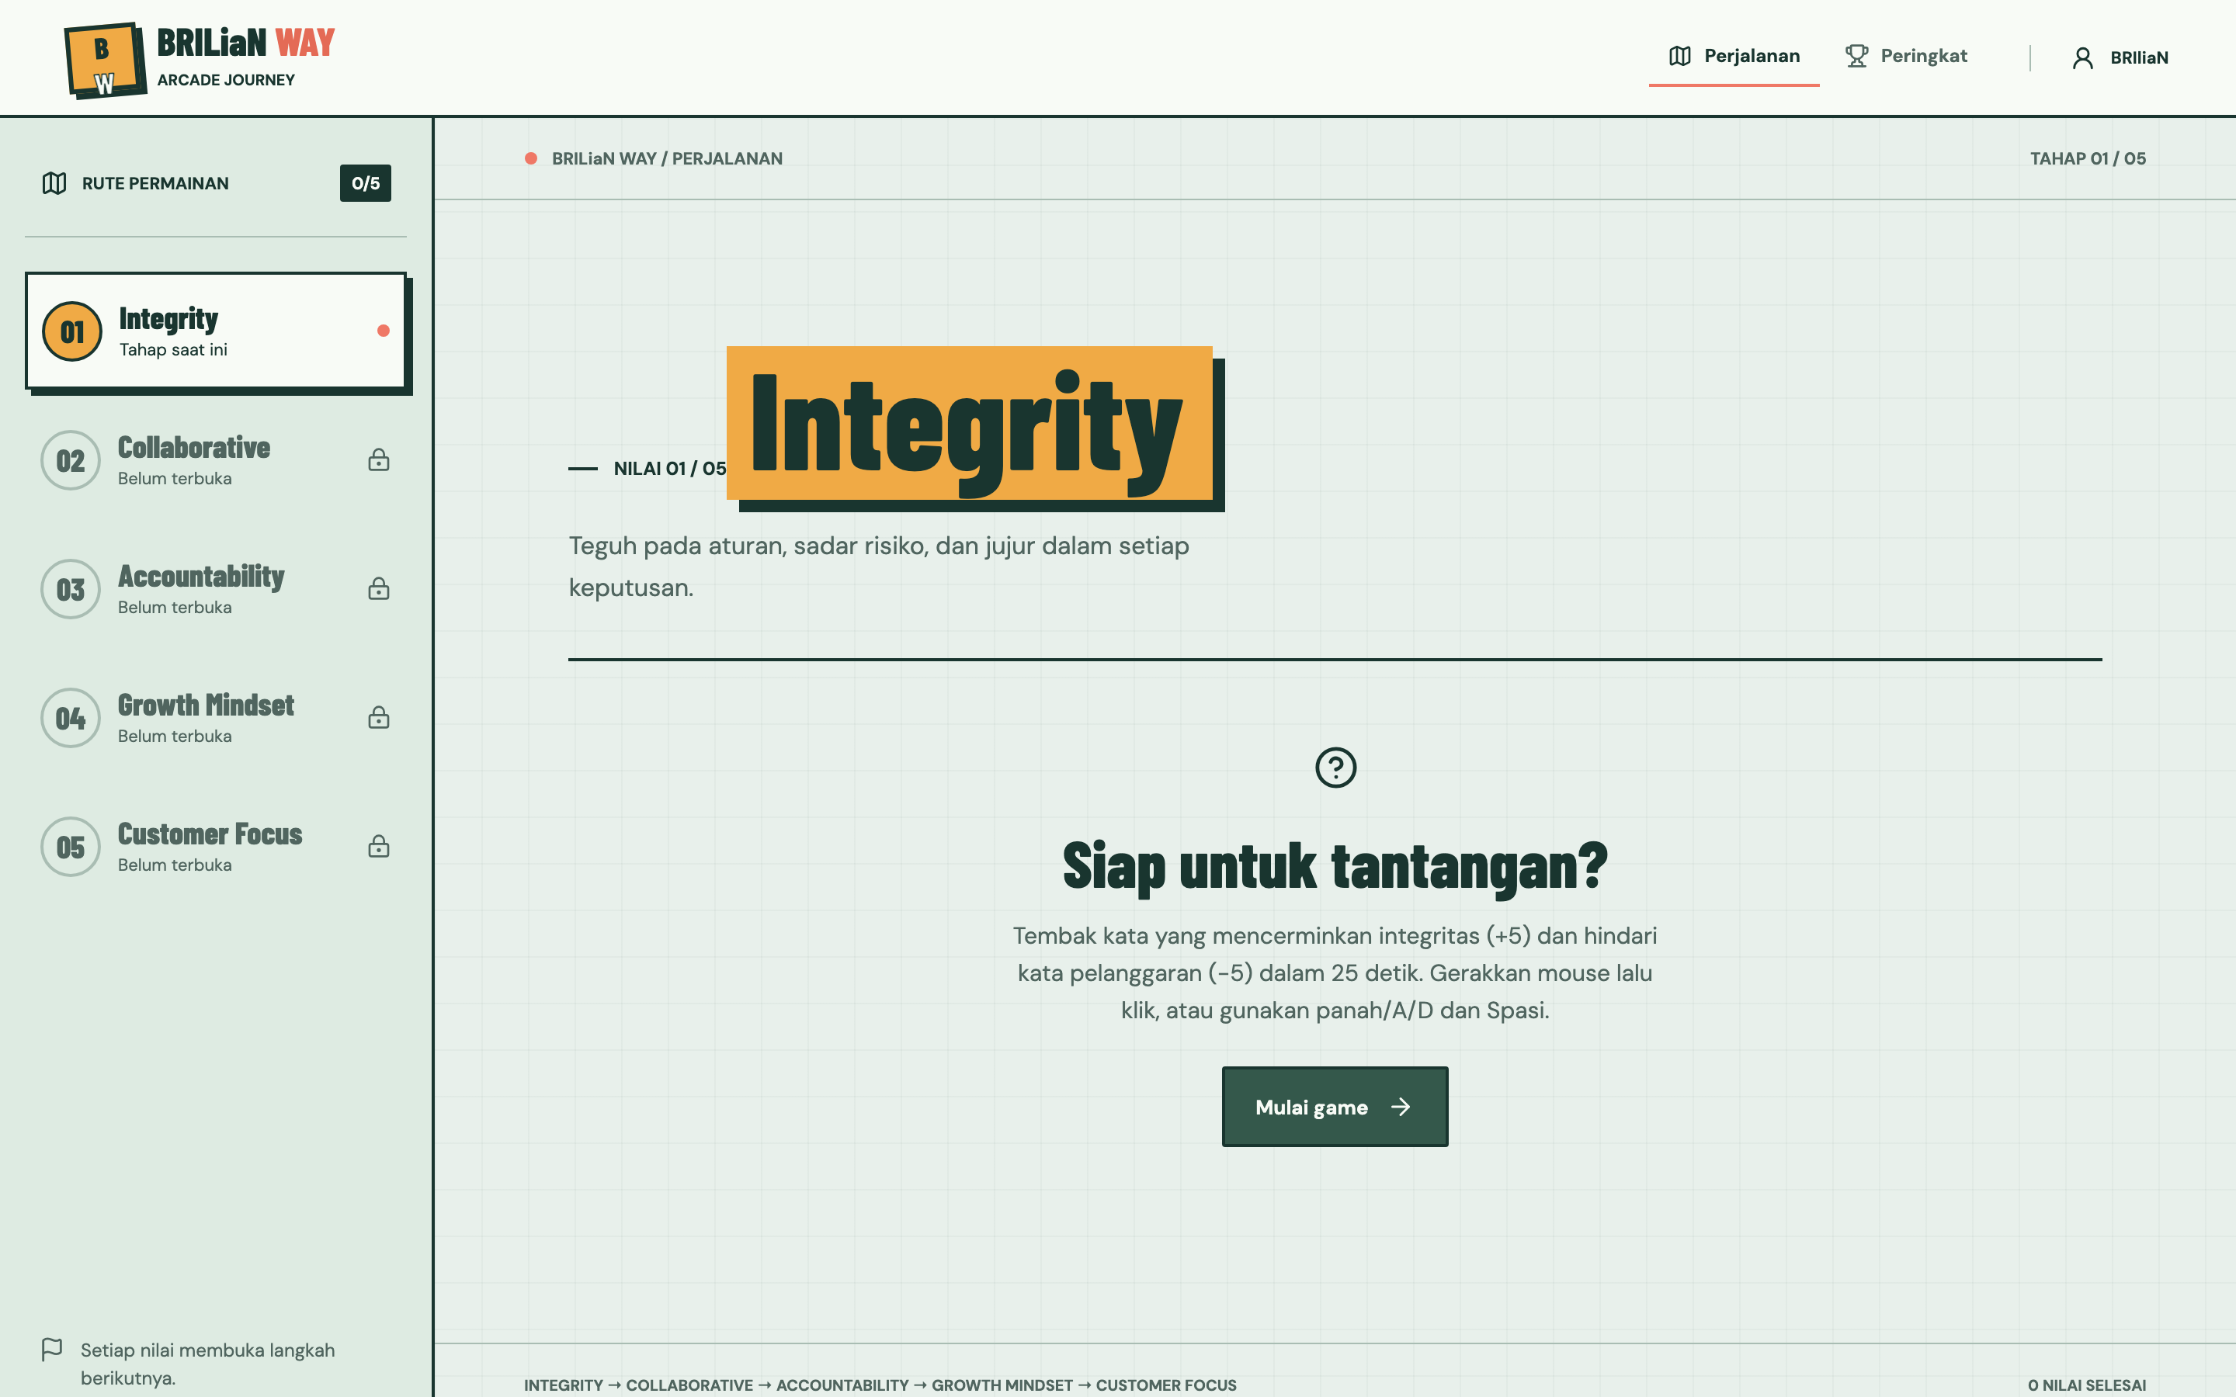
— IDEATION · THE JOURNEY
Five values
become five stages.
01
Integrity
Teguh pada aturan, sadar risiko, jujur.
02
Collaborative
Bekerja bersama, saling menguatkan.
03
Accountability
Memiliki tanggung jawab, menuntaskan.
04
Growth Mindset
Terus belajar, beradaptasi, bertumbuh.
05
Customer Focus
Melayani cepat, tepat, bernilai tambah.
BRILiaN WAY / Ideation
03

Slide 4
— PROCESS
How we build each game.
Every game is one OpenSpec change. The spec is written and reviewed first; Copilot and subagents implement against it; tests and the shared contract guard the merge.
01
02
03
04
PROPOSE
SPECIFY
IMPLEMENT
APPLY & ARCHIVE
proposal.md
design.md · specs/
Copilot + subagents
tasks.md · tests
Each game starts as an OpenSpec change: why, what changes, capabilities, impact — one change per value.
Mechanic, controls, timing, a verifiable 0–100 scoring rubric, and asset provenance written before any code.
Opsx skills (propose / apply / archive) and the OpenSpec agent generate against the spec and tasks.md checklist.
typecheck + vitest + build must pass; the PlayableGame contract is wired; the change is archived when done.
BRILiaN WAY / Process
04

Slide 5
— PROCESS · THE CONTRACT
Five developers, one seam.
Each owner touches only their directory under src/games/ and exports a PlayableGame component. The shell mounts it on the current stage and listens on three callbacks — nobody writes another game's result or the leaderboard directly.
WHY A CONTRACT FIRST
“The spec and the PlayableGame contract were the real product. Once the seam was fixed, five of us could generate games with Copilot in parallel — and still drop them into one journey that just worked.”
onComplete({ valueId, score })
once, integer 0–100, on a real finish
onCancel()
player left early — no points
onError(error)
failure — no points
— BRILiaN Way build team
BRILiaN WAY / Process
05

Slide 6
— STRUGGLE
When spec-driven helped — and hurt.
The method paid off most where the problem was clear, and slowed us down where the game was still being discovered.
WHERE IT WAS GOOD
WHERE IT HURT
• Clear scoring rubrics (0–100) became tests Copilot could target.
• Fun is hard to specify — arcade feel needed play, not prose.
• Parallel work: five games, one contract, few merge conflicts.
• Early specs churned: Customer Focus was re-specced into an arcade.
• Reviews happened on the spec, not after 500 lines of generated code.
• Over-specifying tiny games cost more than just building them.
• Archived changes gave each game an auditable paper trail.
• Shared-file edits (the registry) still needed human coordination.
BRILiaN WAY / Struggle
06

Slide 7
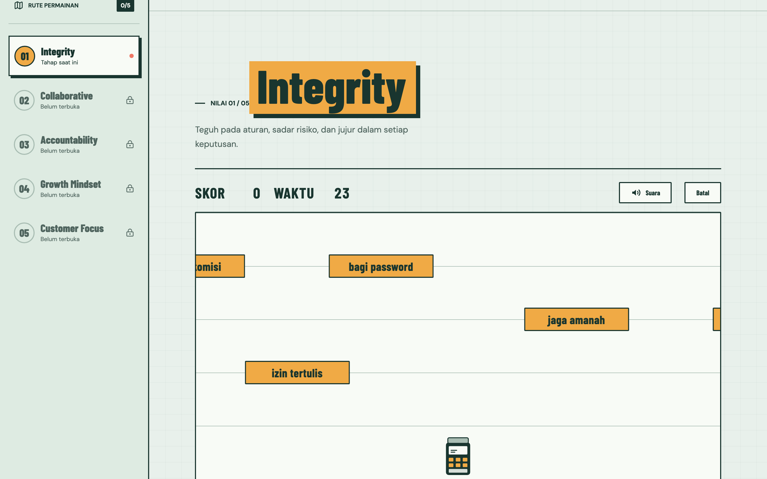
— DEMO
See it running.
A desktop shell routes players through the five stages. Here is the live Integrity round — a 25-second shooting gallery built entirely from a spec.
localhost:5174 →
BRILiaN WAY / Demo
07

Slide 8
— DEMO · THE FIVE GAMES
Five mechanics, one contract.
INTEGRITY
COLLABORATIVE
ACCOUNTABILITY
GROWTH MINDSET
CUSTOMER FOCUS
Shooting gallery
Blind Builder
Kasir Sat Set
Pola Tumbuh
Match the Solution
25s. Shoot integrity-aligned words (+5), avoid violations (−5). EDC-style launcher.
180s. Guide a blind teammate across a 5×5 board with clear text instructions.
20s cashier. Three payment methods, a FIFO queue of buyers, fast correct service.
20s arrow-memory, 5 levels. A mistake is a lesson — pattern replays. Pass mark 65.
45s arcade. Three situations, six cycling cards (3 right, 3 distractor) to catch.
BRILiaN WAY / Demo
08

Slide 9


— DEMO · ORIGINAL ARCADE ART
Specs covered
art provenance
too.
Each game's spec required an asset manifest — source, license, attribution, usage. The Customer Focus round ships original branded-neutral 3D art: a bank lobby, a service counter, and reactive customer characters.
SOURCE: ORIGINAL · DOCUMENTED IN README MANIFEST
No BRI logos or wordmarks until brand approval is documented — the spec says so.
BRILiaN WAY / Demo
09

Slide 10
— LESSONS LEARNED
What we'd keep and change.
01 Spec the seam, not the soul
02 Rubrics are the best prompts
03 Right-size the spec
Lock the contract and scoring early; leave room for feel to emerge through play.
A verifiable 0–100 rubric gave Copilot a target and gave reviewers a test.
Heavy OpenSpec changes fit real games; trivial ones can be lighter and faster.
04 Review specs, not diffs
05 Protect shared files
06 Keep the paper trail
Catching intent problems in proposal.md was far cheaper than in generated code.
The registry and journey are seams — coordinate humans, don't just generate.
Archived changes made every game auditable, from why to done.
BRILiaN WAY / Lessons learned
10

Slide 11
— THANK YOU
Specify first.
Then let the team play.
The BRILiaN Way arcade — five values, five games, one spec-driven workflow.
Questions →
npm run dev
BRILiaN WAY / Closing
11

