Slide 1


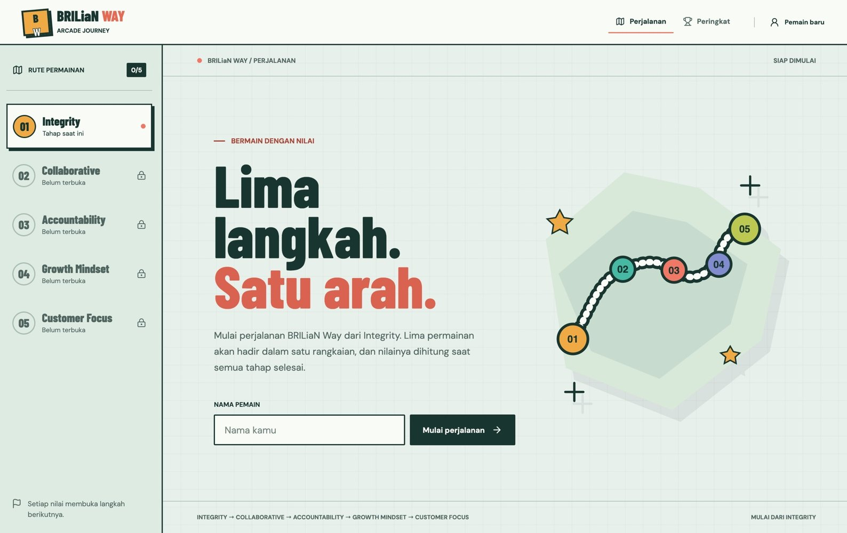
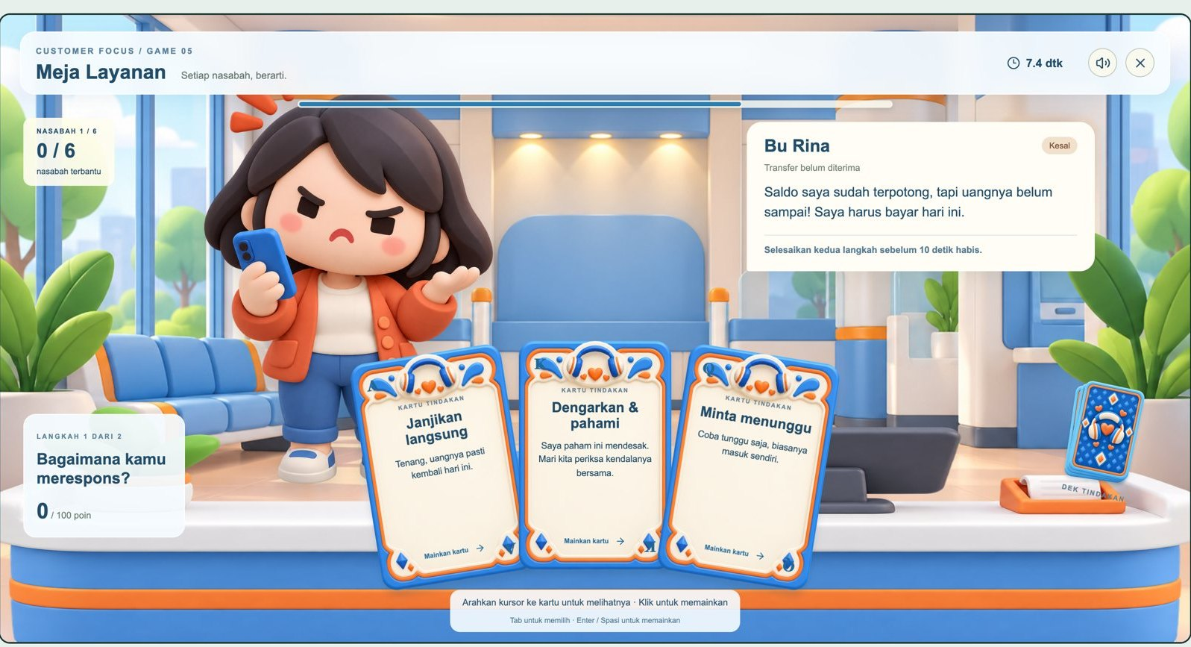
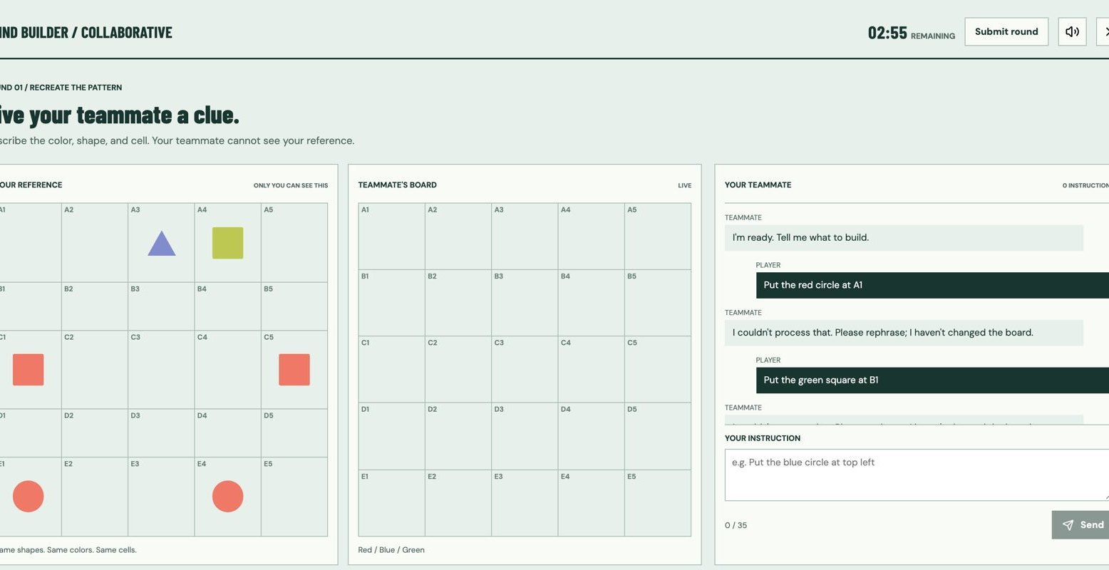
● BRILiaN Way Arcade
Sharing session
Spec-driven development · GitHub Copilot · OpenSpec
Five values, one spec at a time.
Play the journey
Read the specs
01 / 16

Slide 2
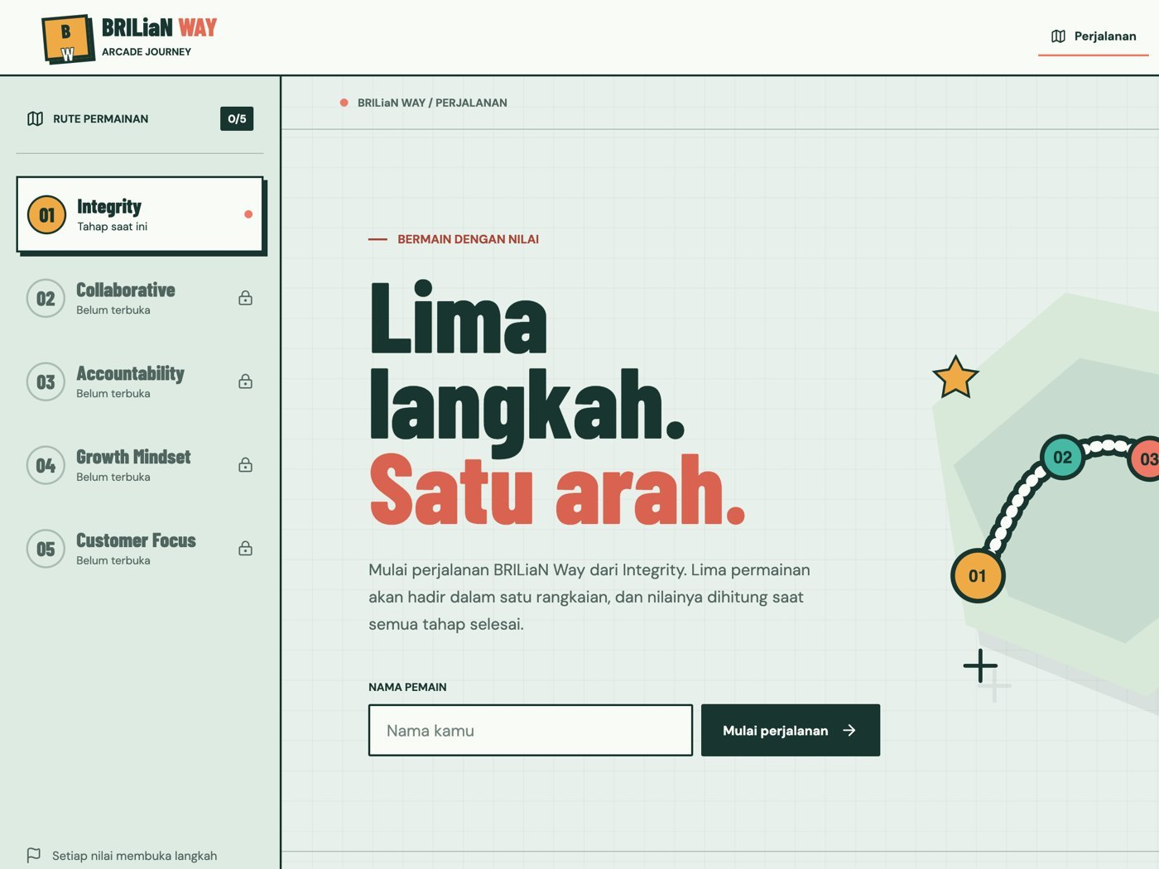
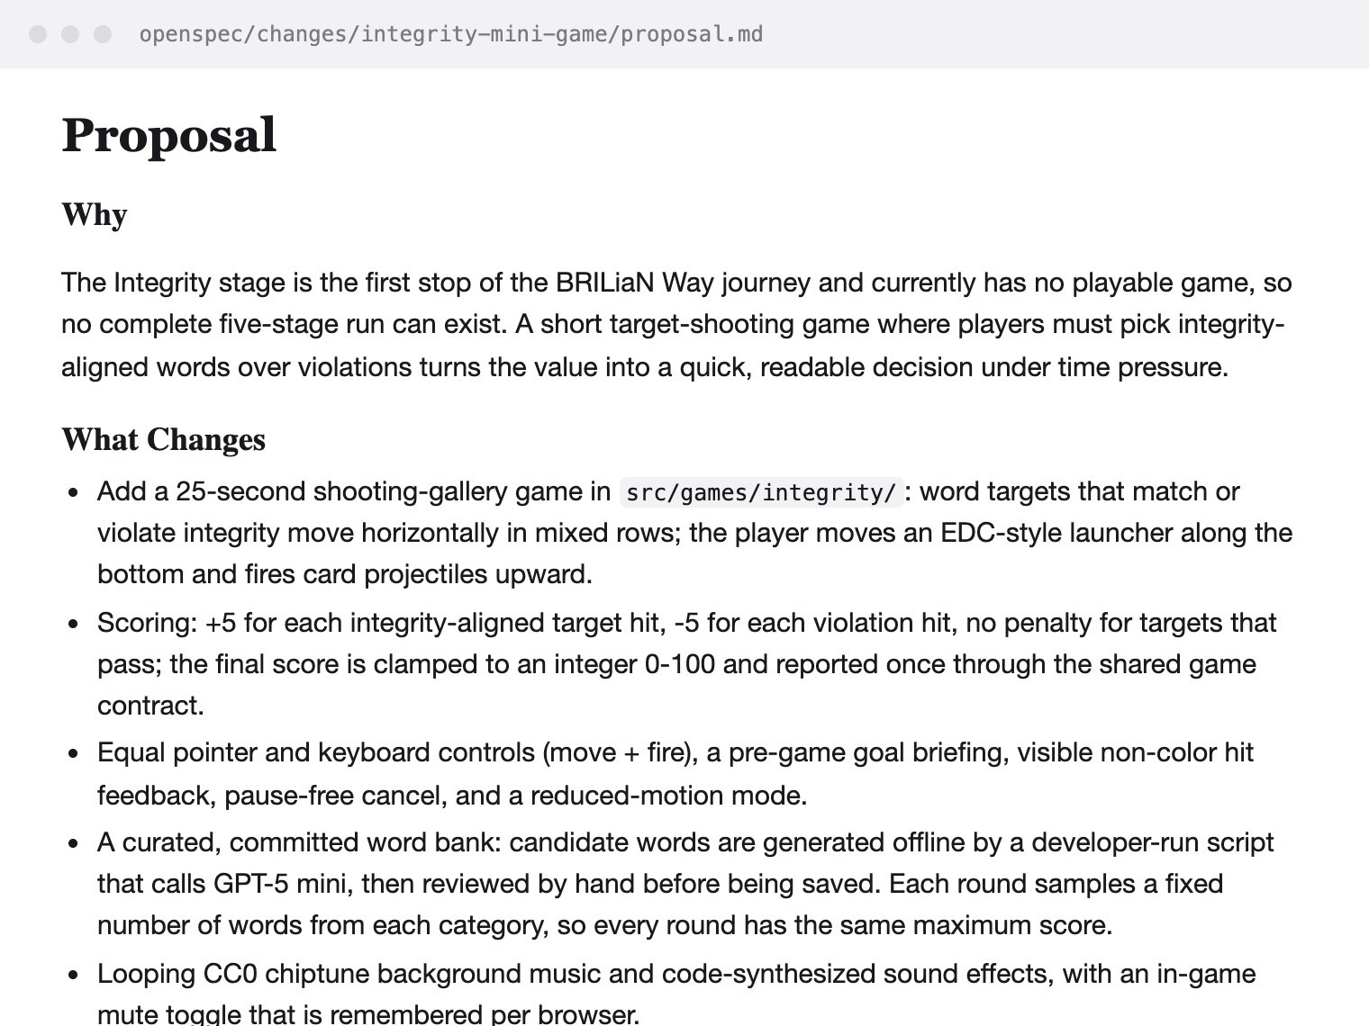
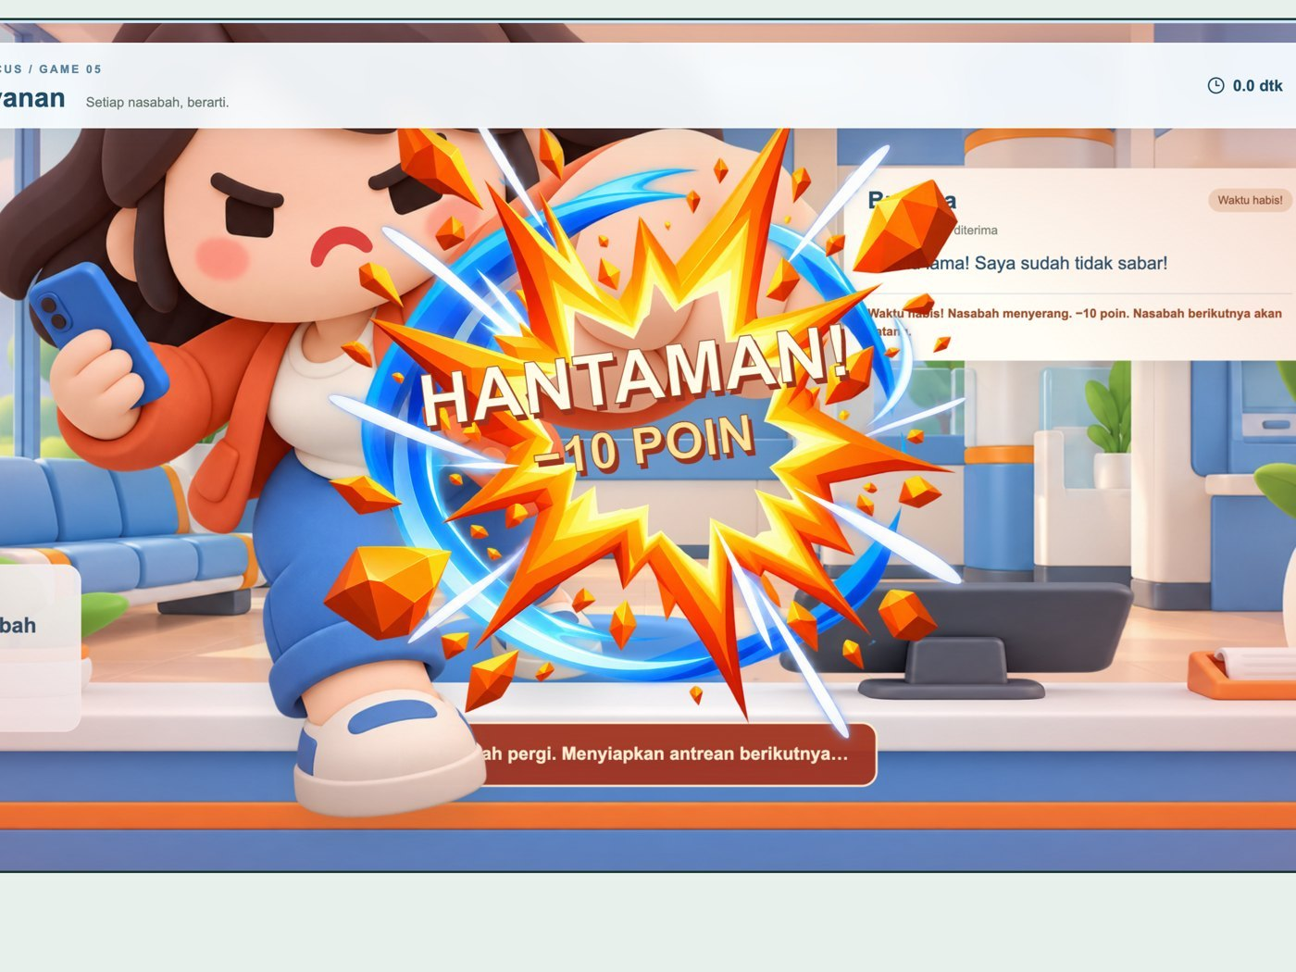
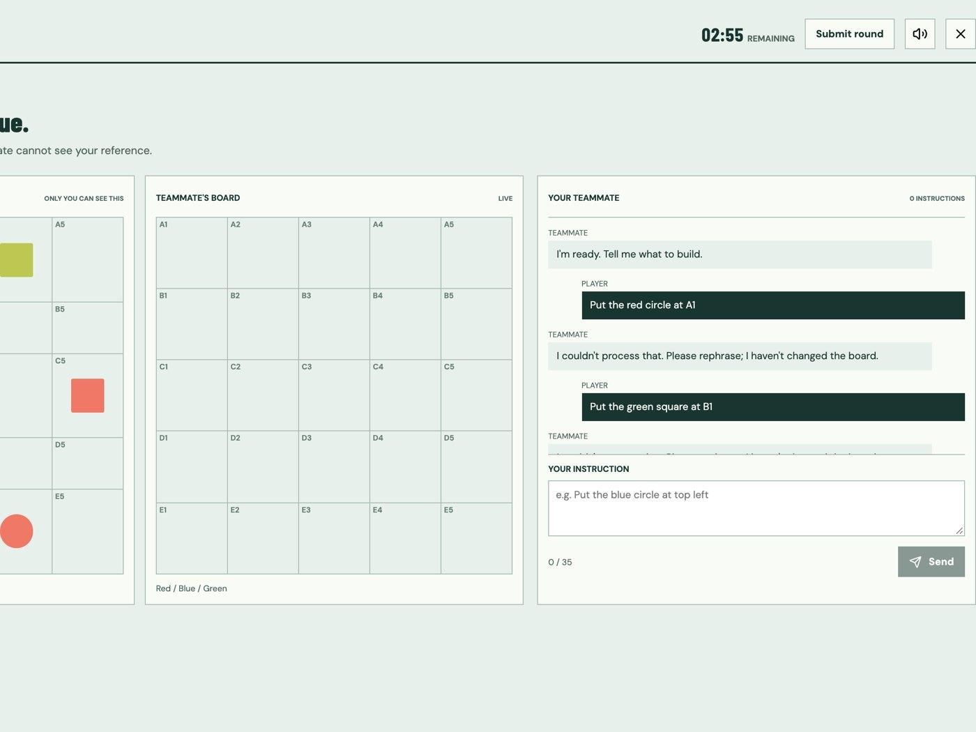
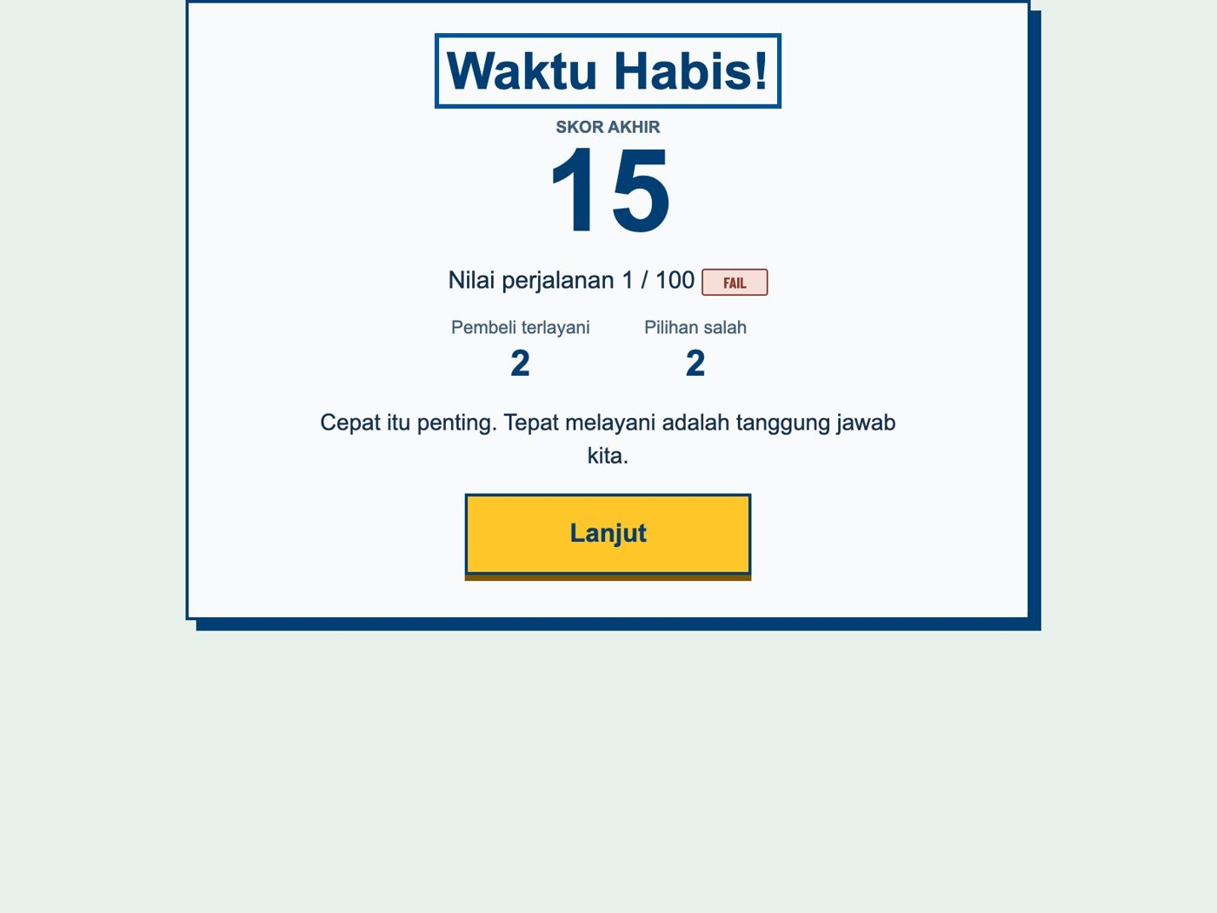
● BRILiaN Way Arcade
Agenda
What we will walk through
01
02
03
04
05
Ideation
Process
Struggle
Demo
Lessons
02 / 16

Slide 3
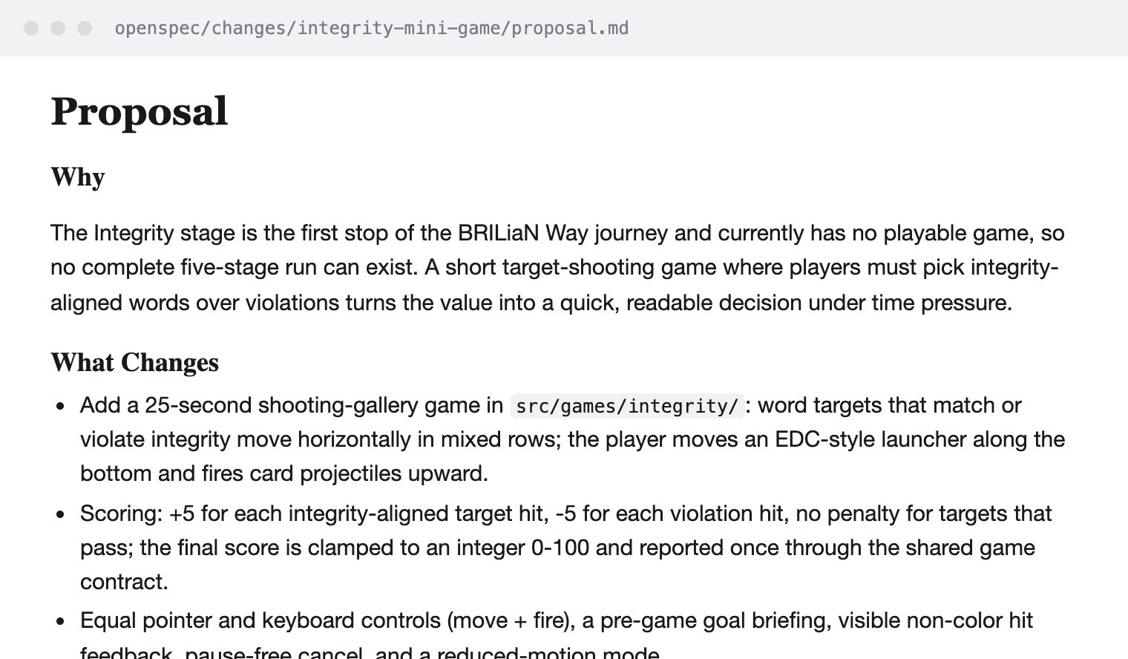
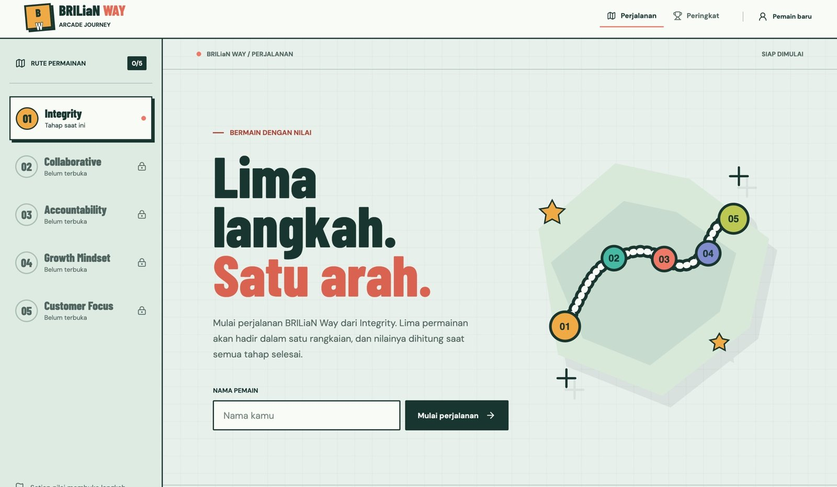
● BRILiaN Way Arcade
01 Ideation
Two ideas walked into one repo.
Idea 01 · How we build
Idea 02 · What we build
Spec-driven, with GitHub Copilot
The BRILiaN Way, as mini-games
03 / 16

Slide 4
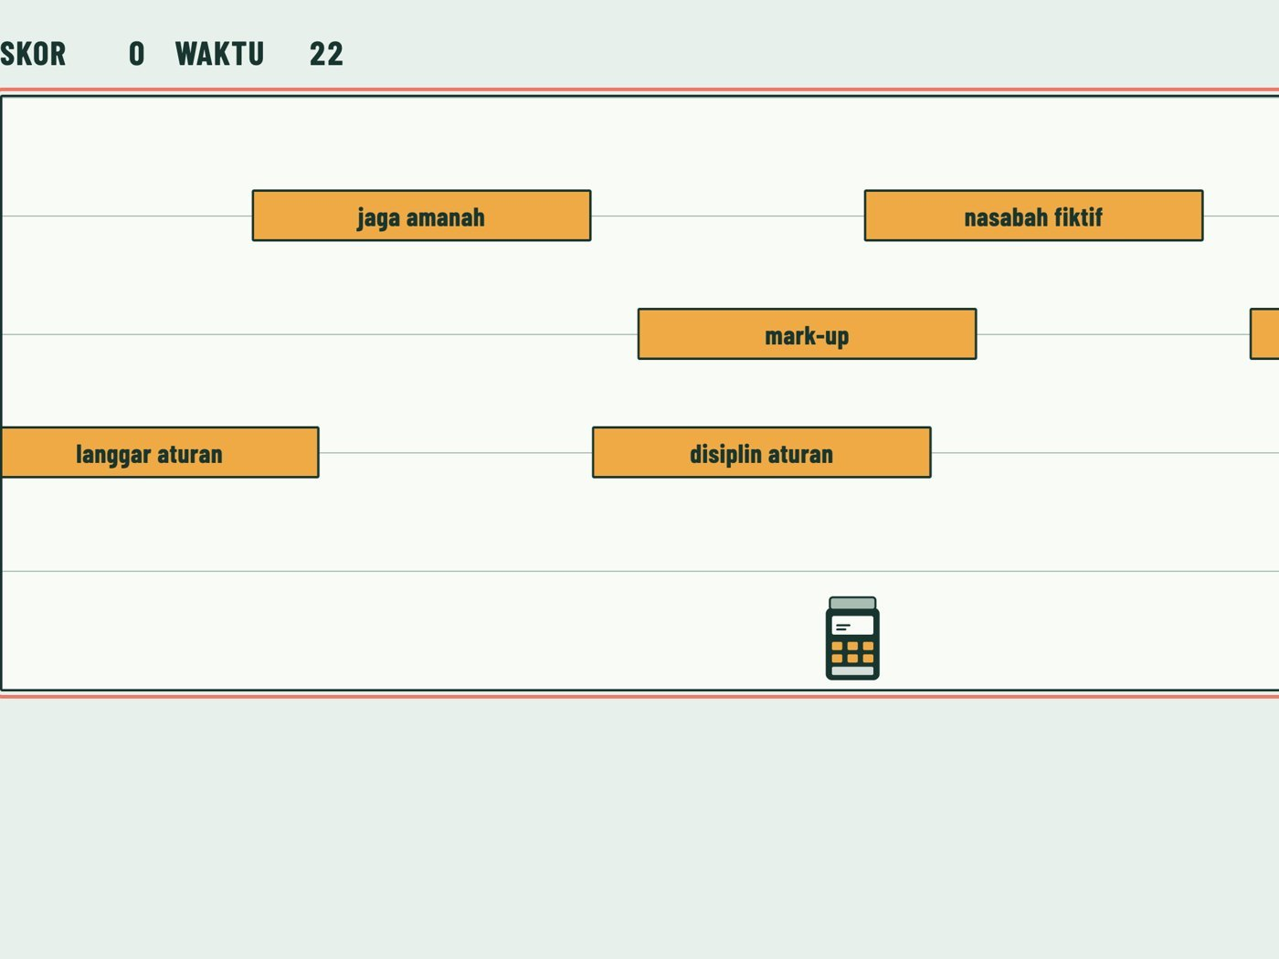
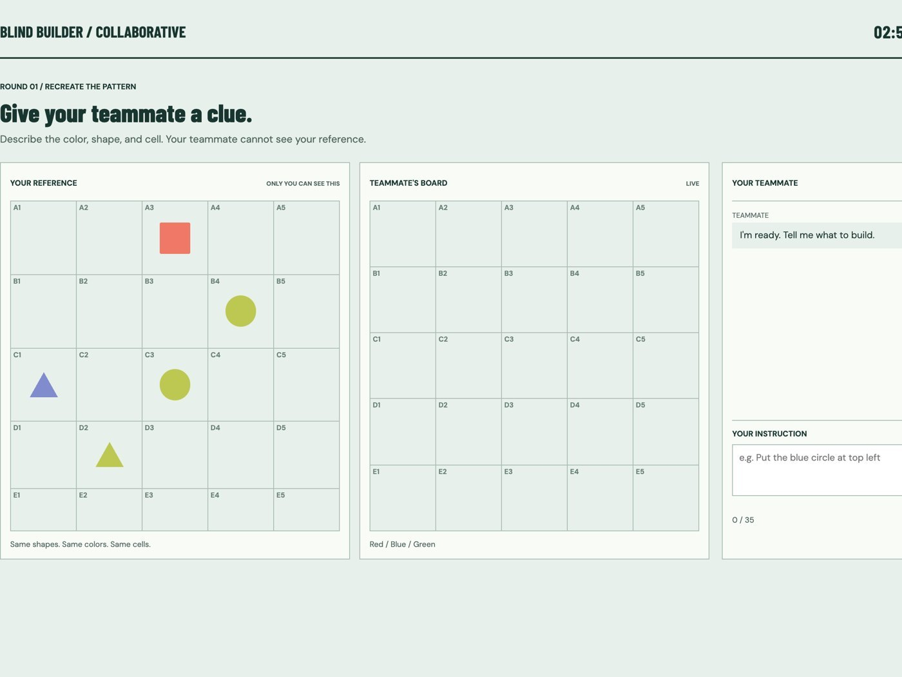
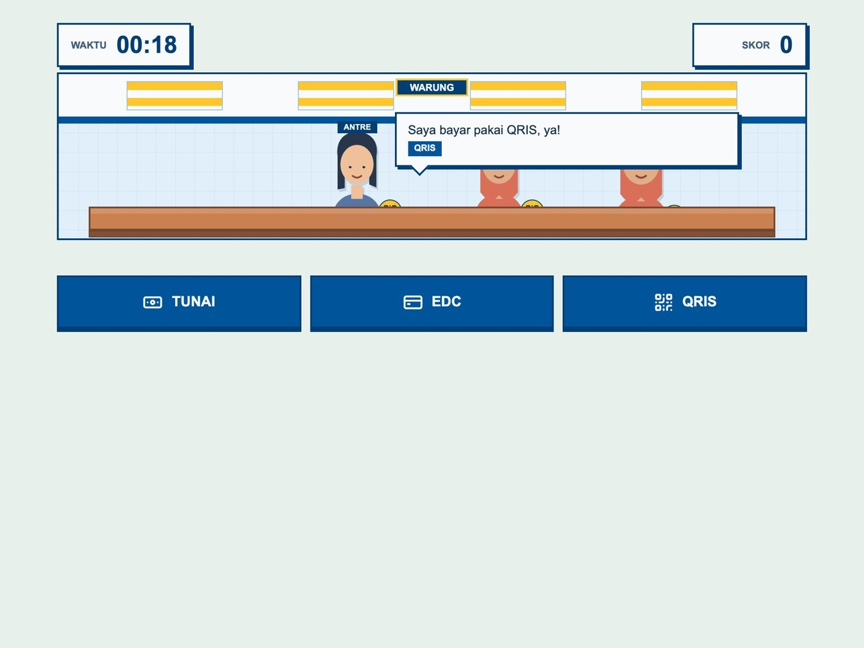
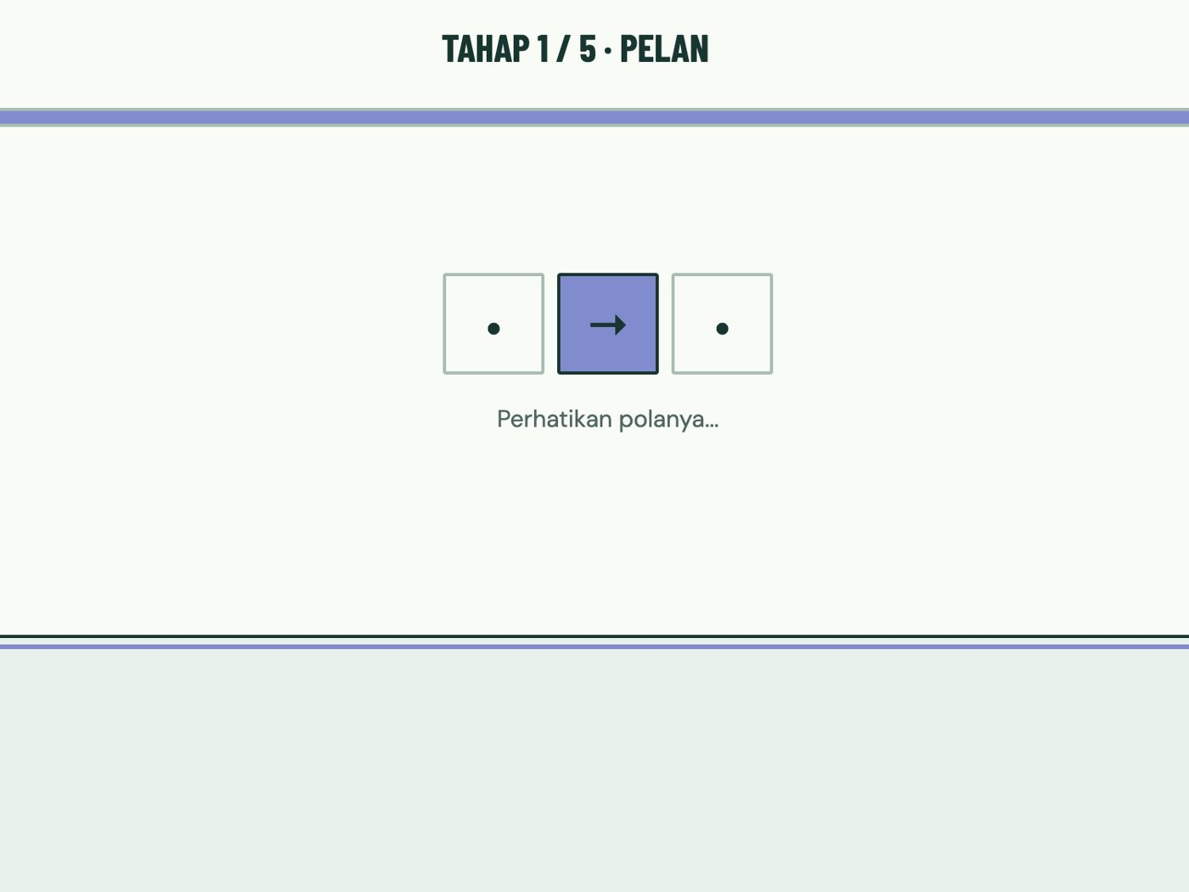
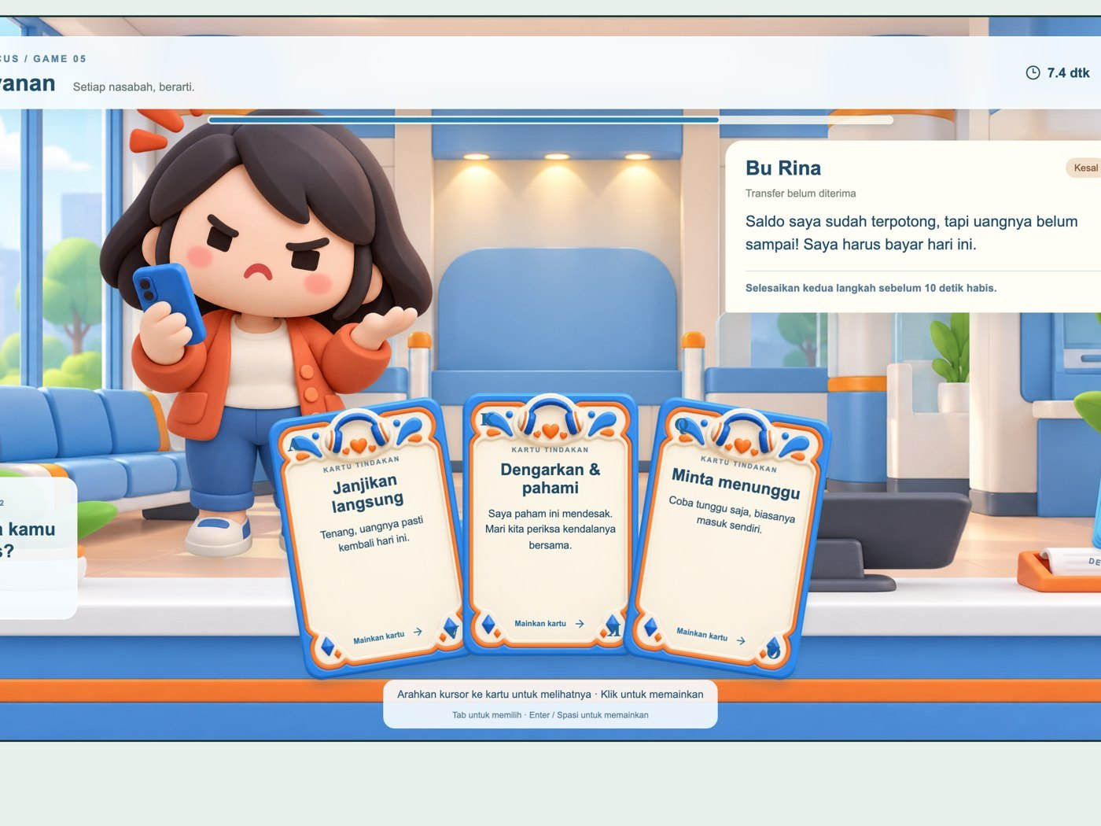
● BRILiaN Way Arcade
01 Ideation
One journey, five owners.
01 · Integrity
02 · Collaborative
03 · Accountability
04 · Growth Mindset
05 · Customer Focus
Word Shooter
Blind Builder
Kasir Sat Set
Pola Tumbuh
Meja Layanan
25 s round
180 s round
20 s round
20 s round
45 s round
One contract · one score 0–100 per game
04 / 16

Slide 5
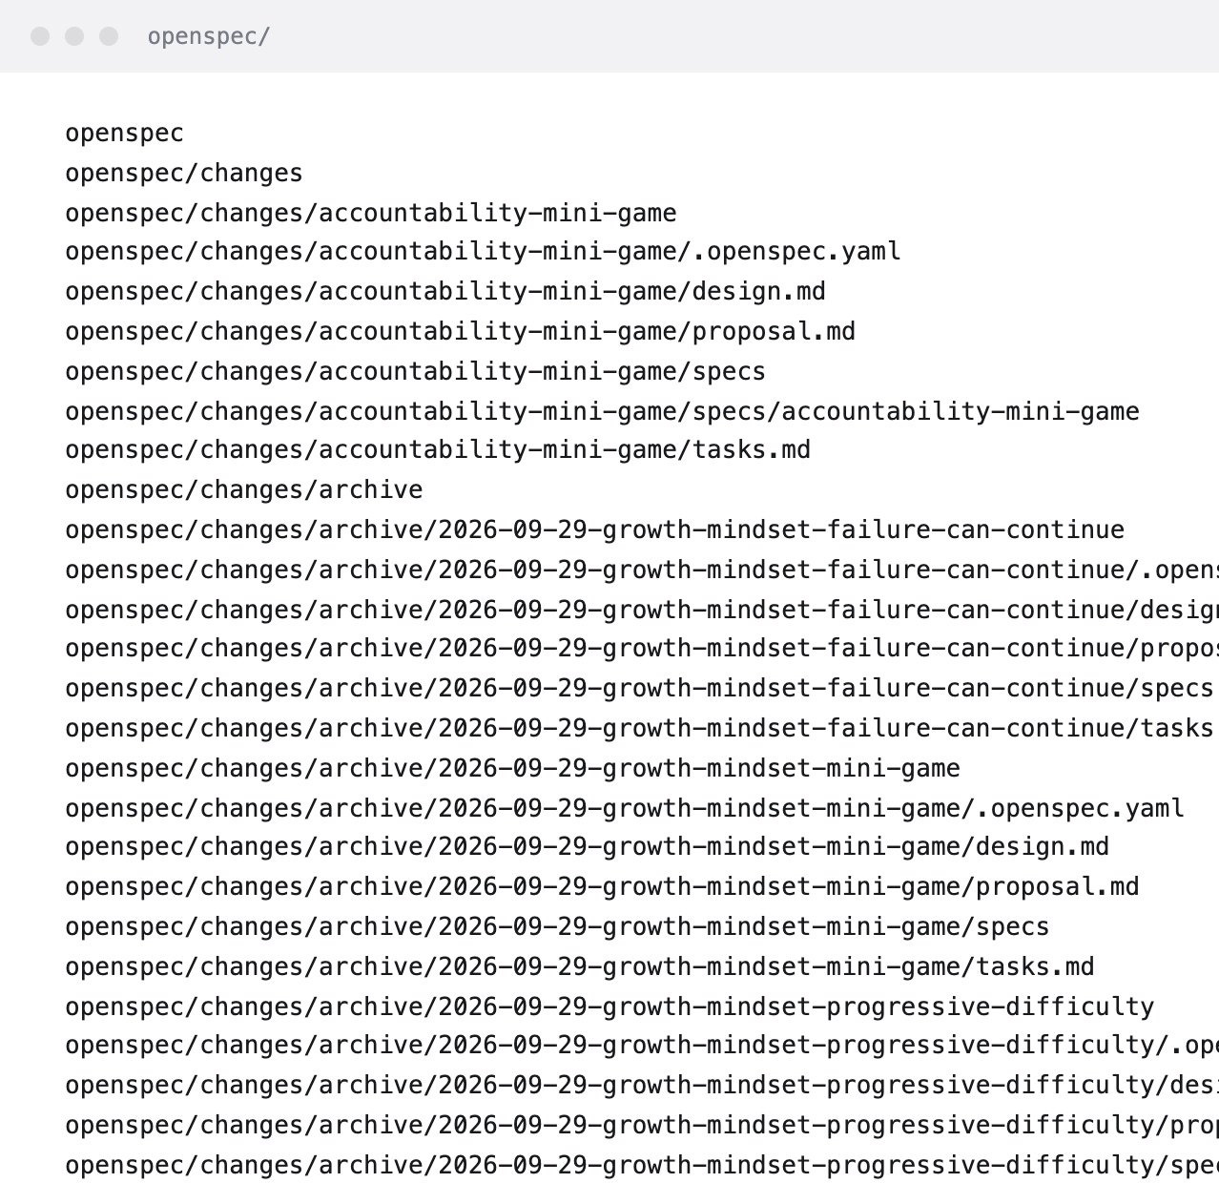
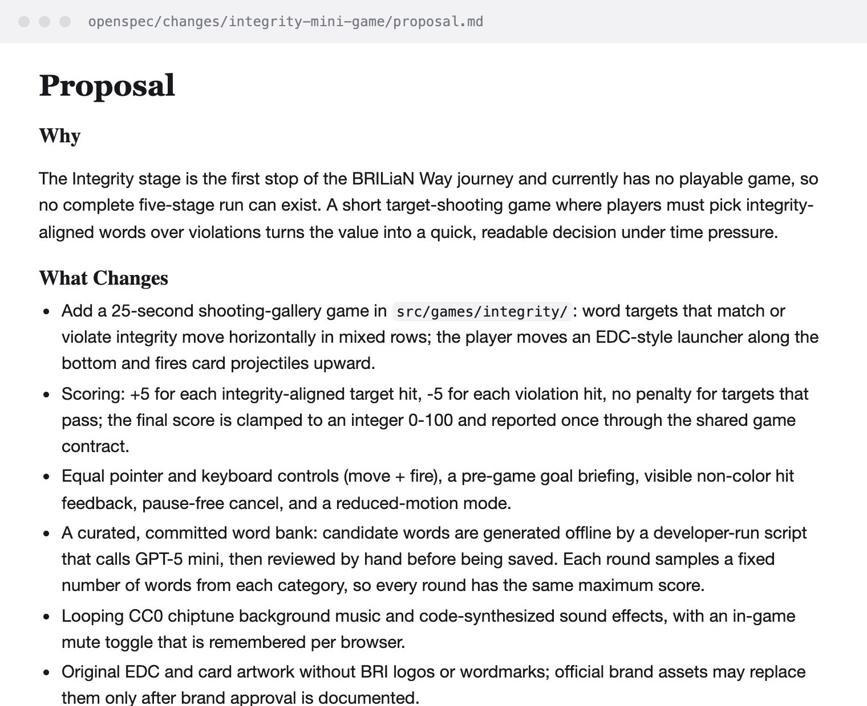
● BRILiaN Way Arcade
02 Process
02
Spec first.
Code second.
05 / 16

Slide 6
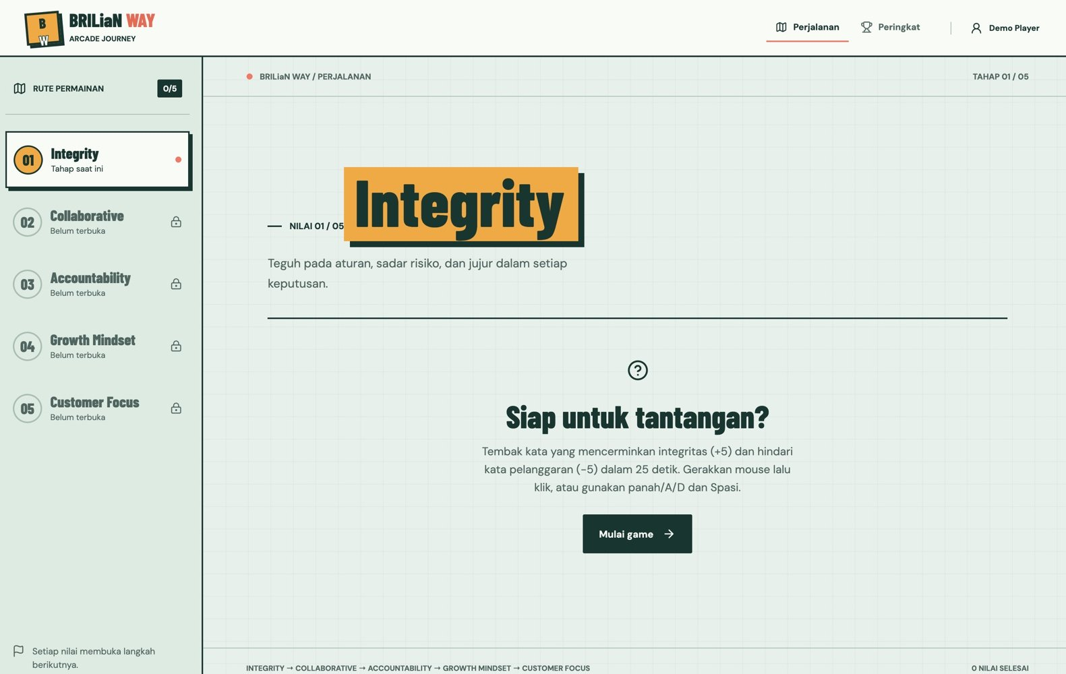
● BRILiaN Way Arcade
02 Process
Step 0 · the hub change
Boundaries first.
—
Fixed order of five values
—
One folder per game
—
One contract, one score
src/games/contract.ts
onComplete({ valueId, score }) // 0–100, once
onCancel() // no points
onError(error) // no points
The shell owns the route; each game only plugs in.
06 / 16

Slide 7
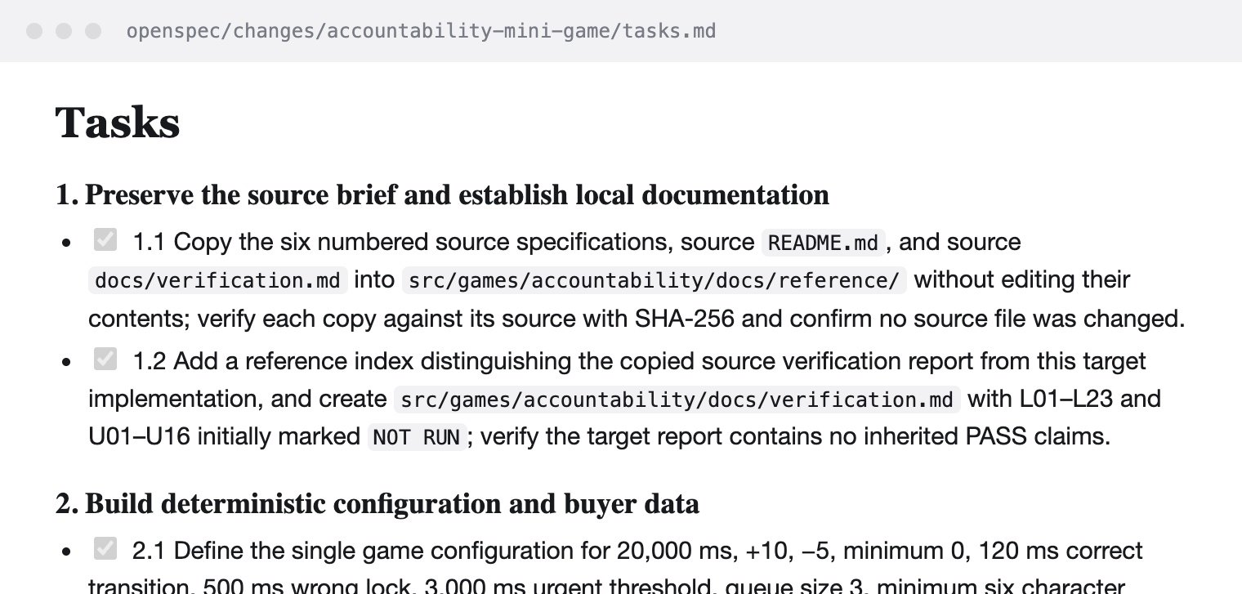
● BRILiaN Way Arcade
02 Process
The loop every game went through
01
02
03
04
Explore
→
Propose
→
Apply
→
Archive
/opsx-explore
/opsx-propose
/opsx-apply
/opsx-archive
tasks.md · done / planned
hub
11/11
integrity
14/16
collaborative
10/11
accountability
25/26
growth ×3
32/32
customer focus
17/17
07 / 16

Slide 8
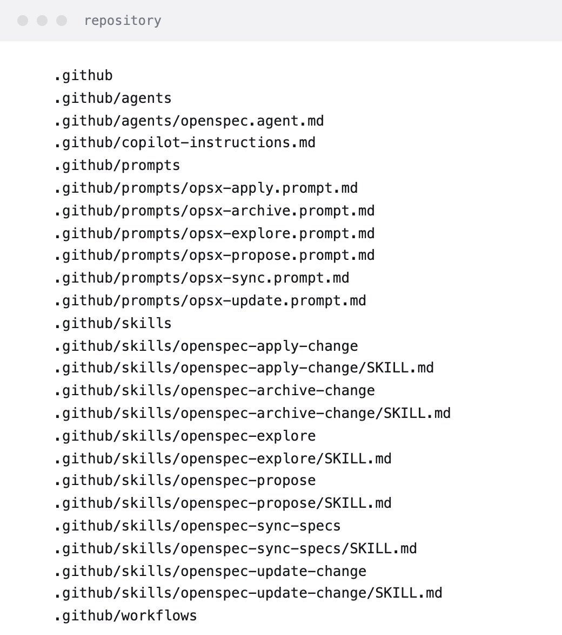
● BRILiaN Way Arcade
02 Process
Agents with guardrails
OpenSpec agent
.github/agents
Six reusable skills
.github/skills · prompts
Subagents per stage
research → build → review
House rules
copilot-instructions.md
CI on every PR
typecheck · test · build
08 / 16

Slide 9
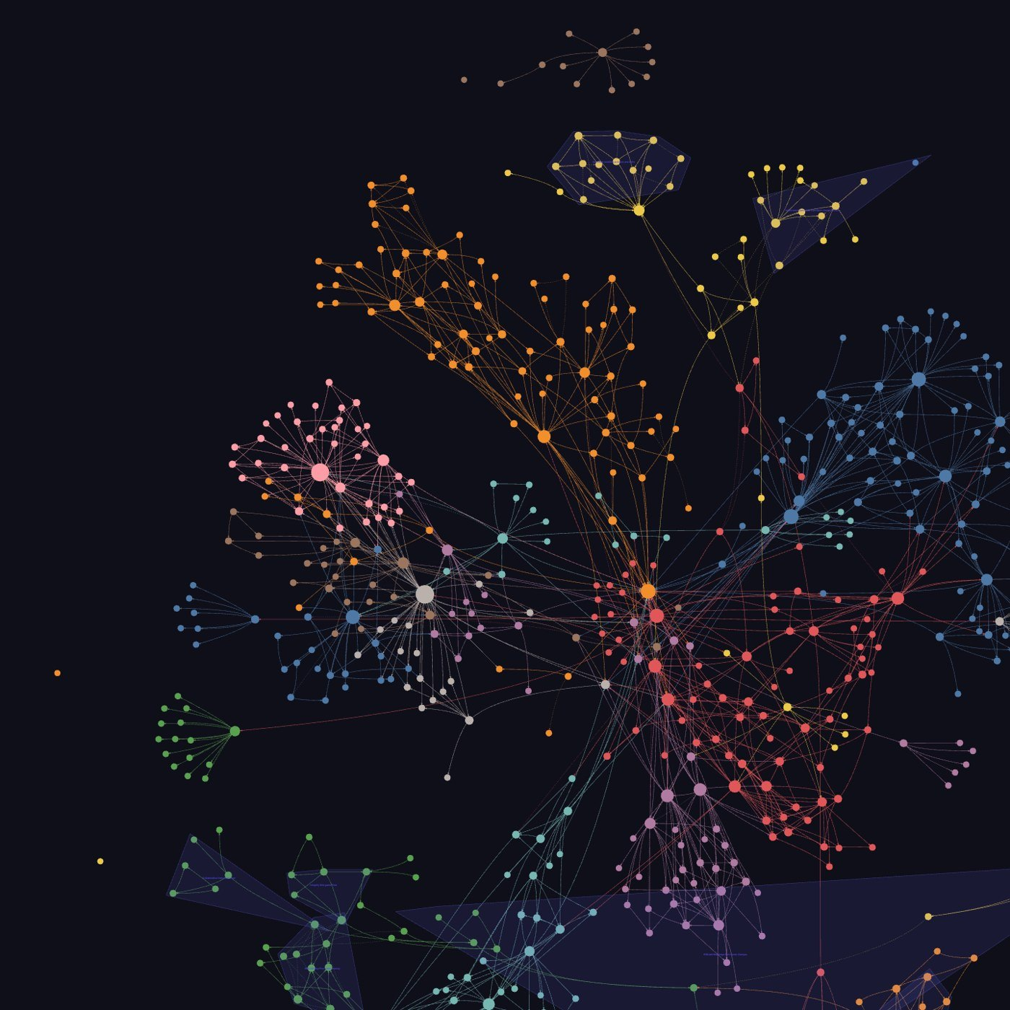
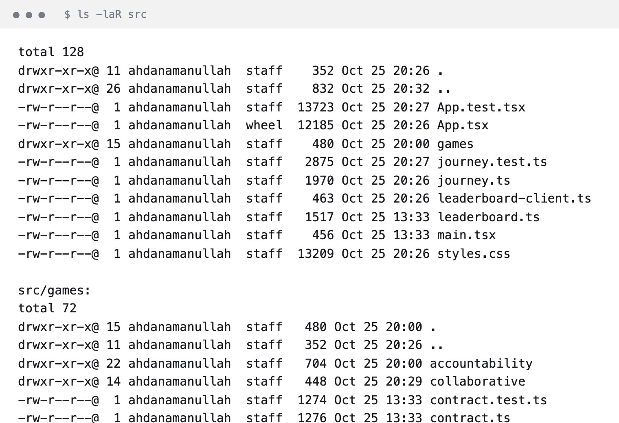
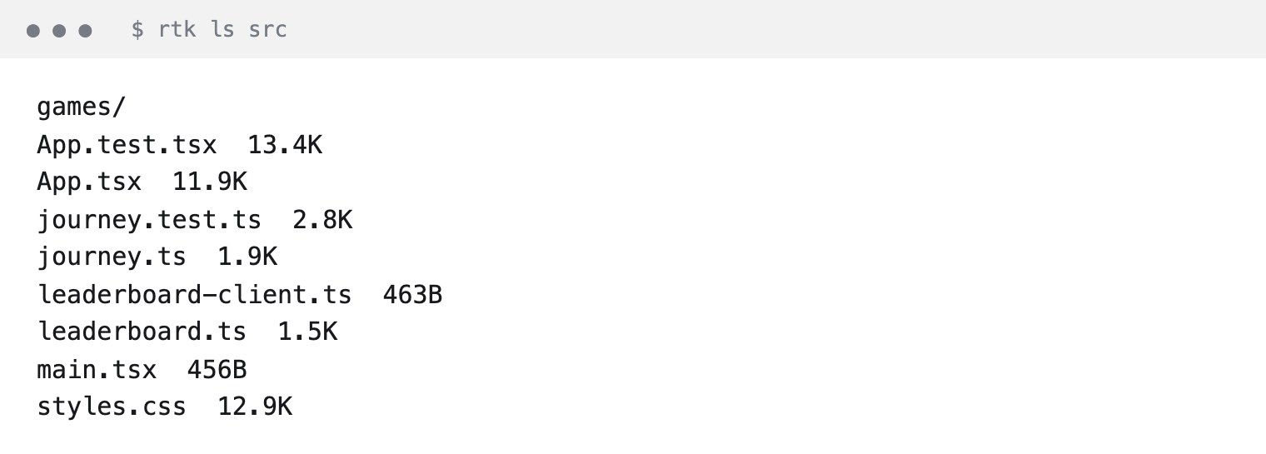
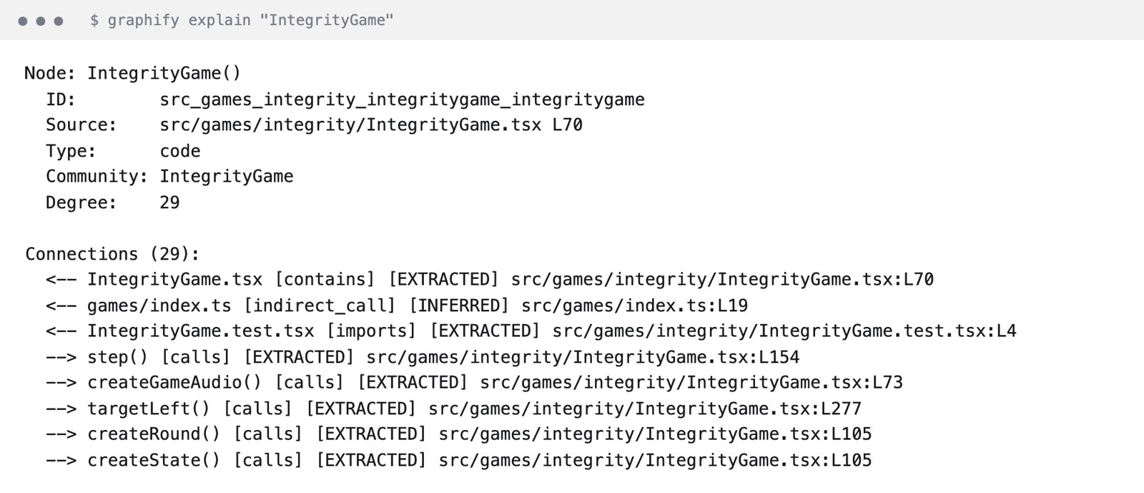
● BRILiaN Way Arcade
02 Process
Fewer tokens, same answers.
RTK · compact command output
−98%
→
rtk ls src · 2,460 → 40 tok
git log −52%
npm test −15%
Graphify · ask the graph, read less
−96%
explain 1 node · 501 tok
read integrity/ · 14,367 tok
graphify-out · 670 nodes · 1,413 edges · 34 clusters
Measured on this repo, tokens ≈ bytes ÷ 4 · graph rebuilt free with graphify update . · query graph.json, never read it whole (≈202K tok)
09 / 16

Slide 10
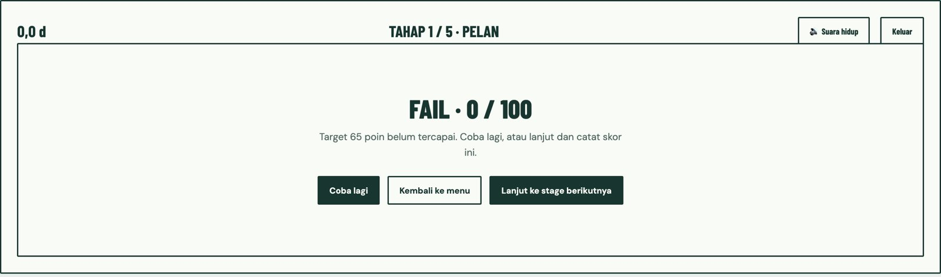
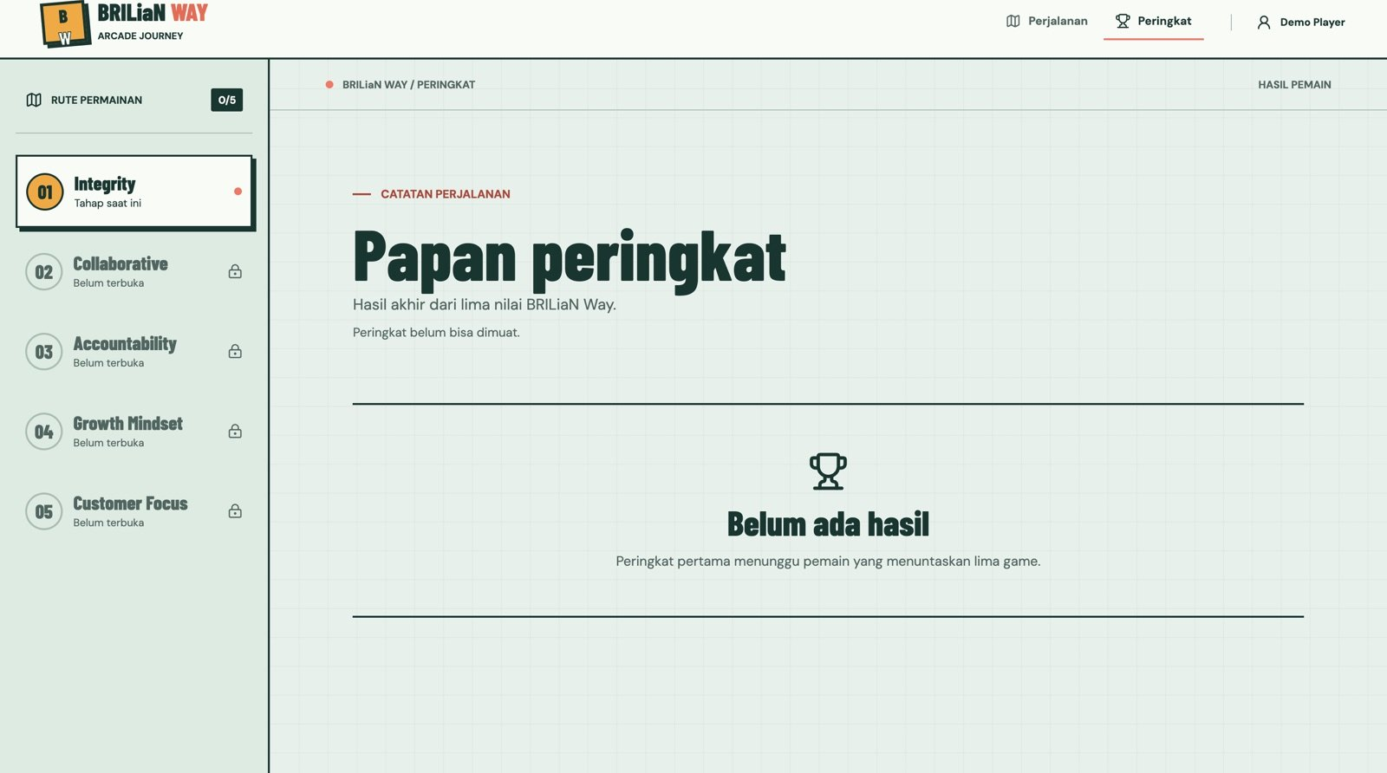
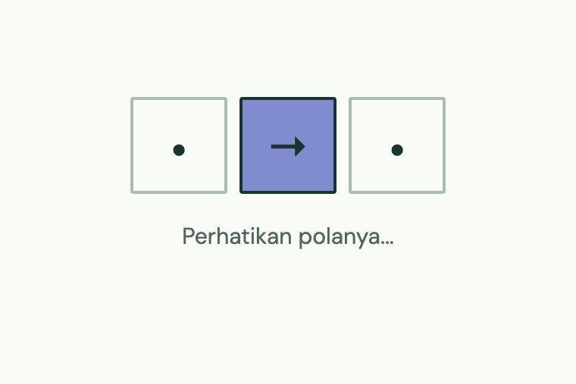
● BRILiaN Way Arcade
02 Process
Case study · Growth Mindset
One game, three specs.
growth-mindset-mini-game
the base game
Change 3, live: FAIL, but you can continue.
progressive-difficulty
faster every level
failure-can-continue
a FAIL no longer blocks
ms per arrow
550 → 260
10 / 16

Slide 11

● BRILiaN Way Arcade
03 Struggle
When specs help — and when they hurt
Where it paid off
Where it slowed us
+
Many owners, one contract
−
Game feel is not a spec
+
Rules become unit tests
−
Spec drift after decisions
+
Review intent, not diffs
−
Overhead on tiny tweaks
+
Agents stay in their folder
−
Specs not archived yet
11 / 16

Slide 12

● BRILiaN Way Arcade
03 Struggle
The moment it clicked
“The spec said retry only. Players wanted to keep going. One small proposal fixed it.”
→
growth-mindset-failure-can-continue
Spec the behaviour. Tune the feel by playing.
12 / 16

Slide 13

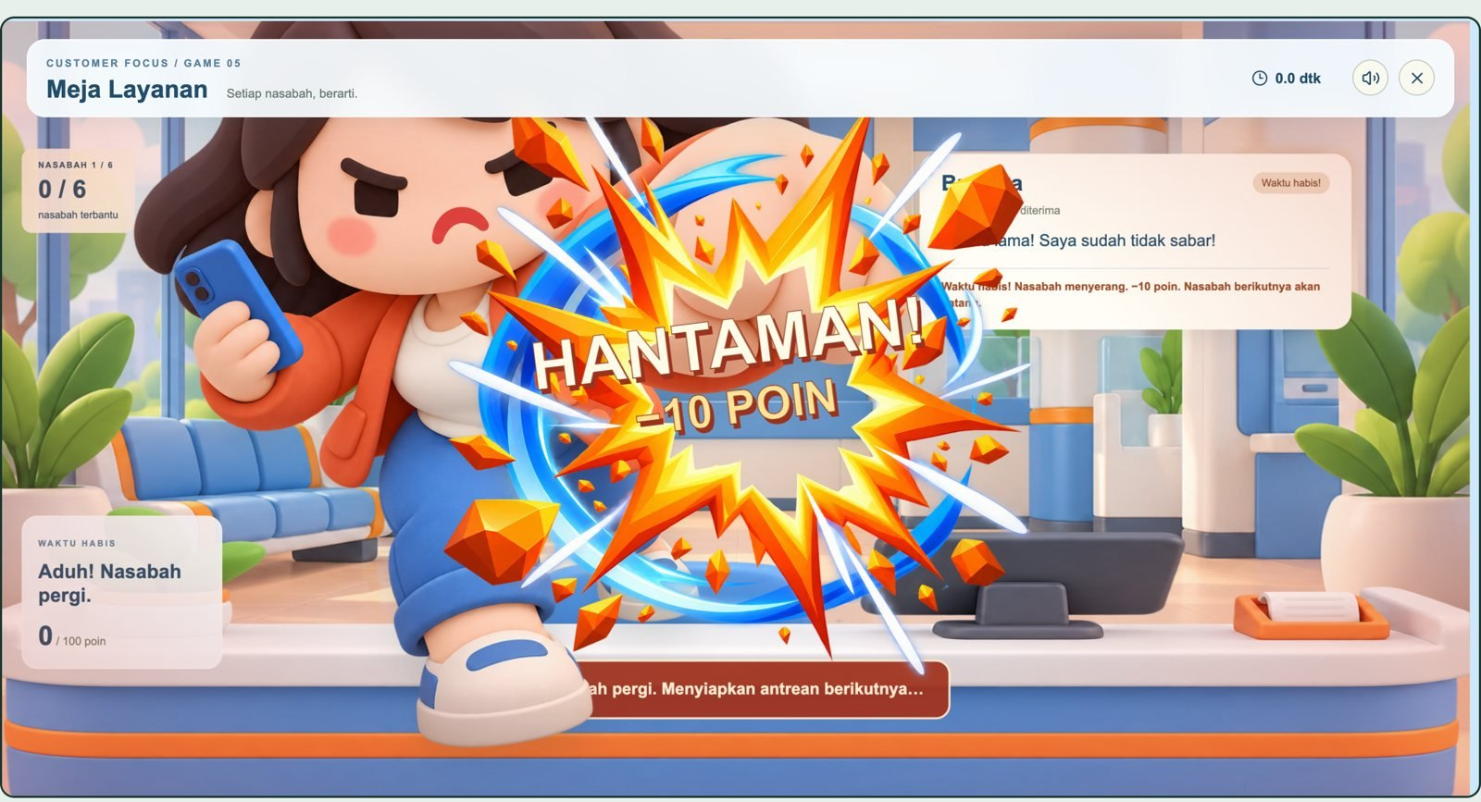
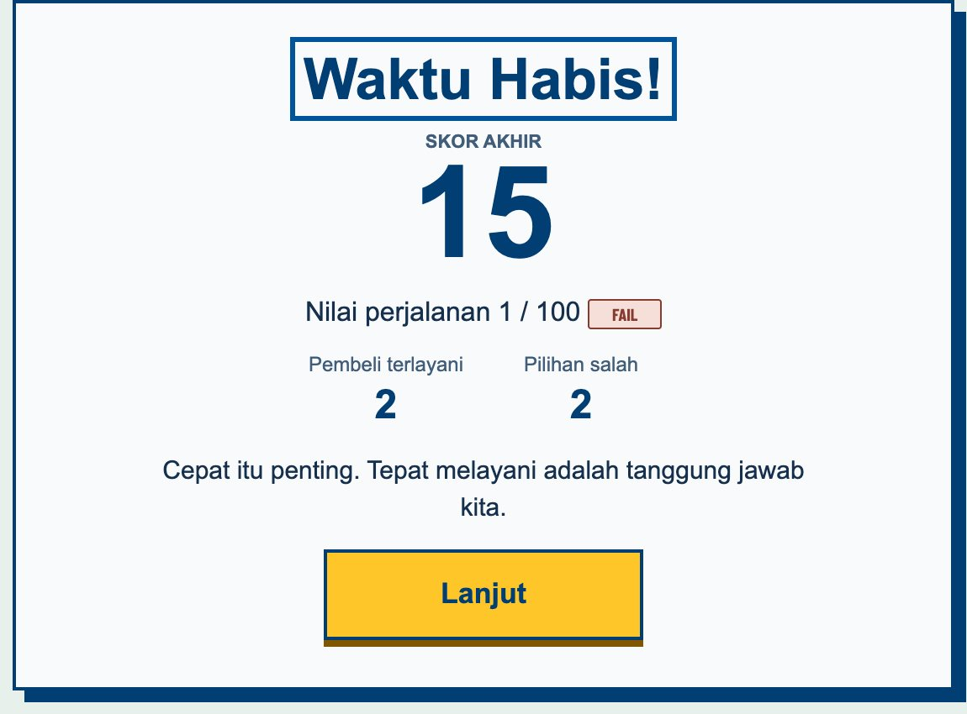
● BRILiaN Way Arcade
04 Demo
Real games, real art.
The customer cast
Generated art · prompts kept in repo
Customer Focus · time ran out
Accountability · results
13 / 16

Slide 14

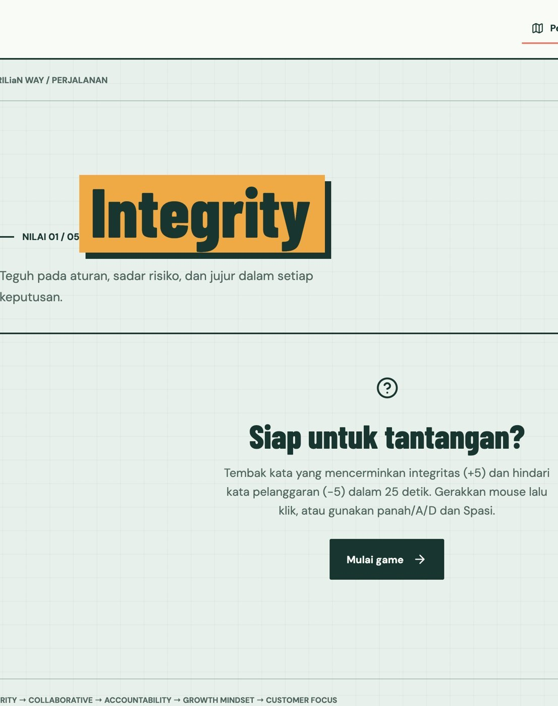
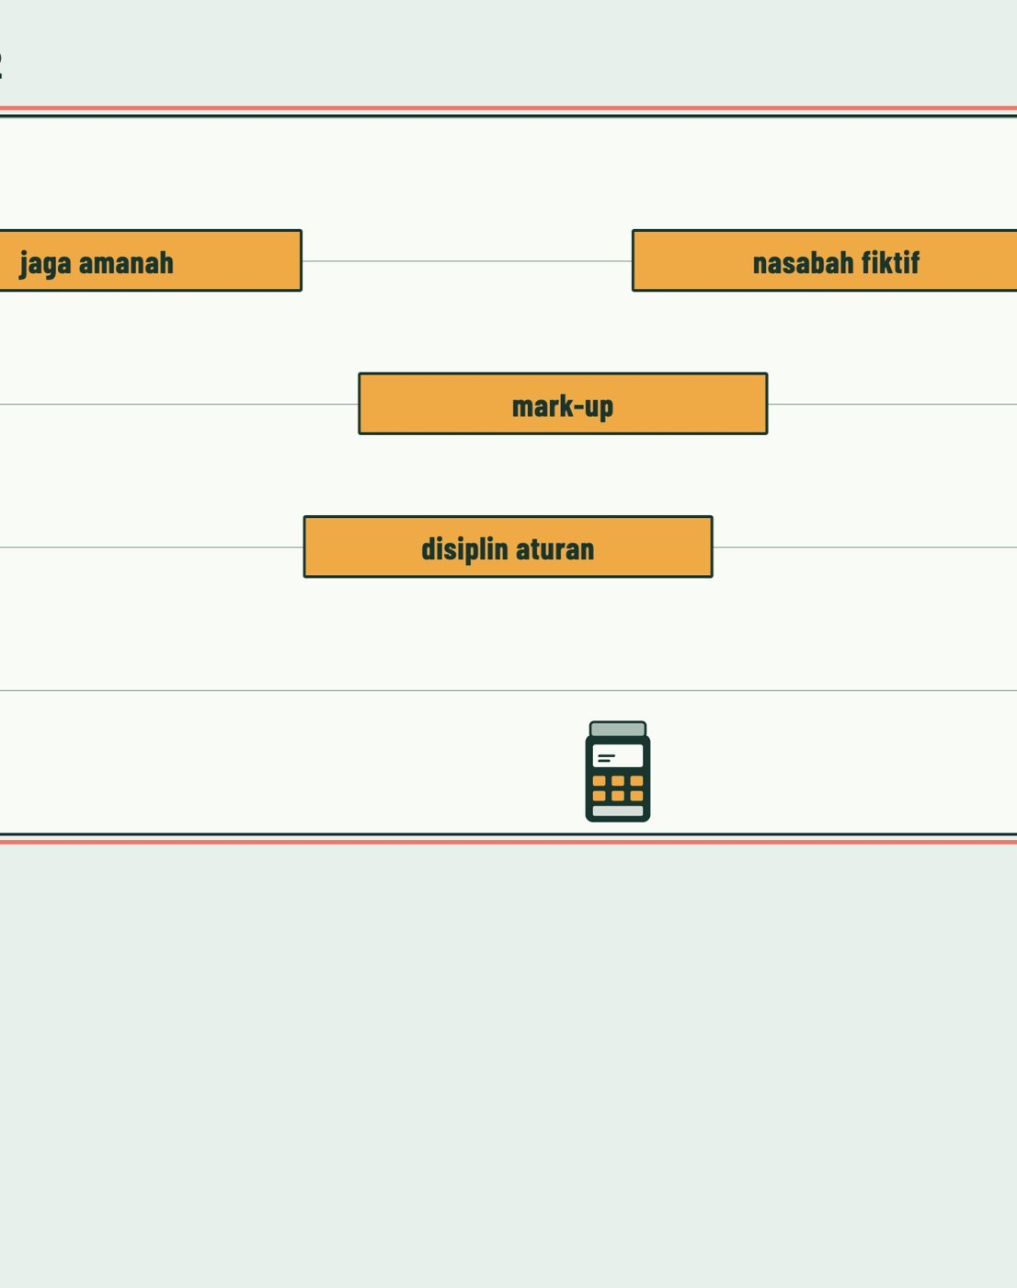
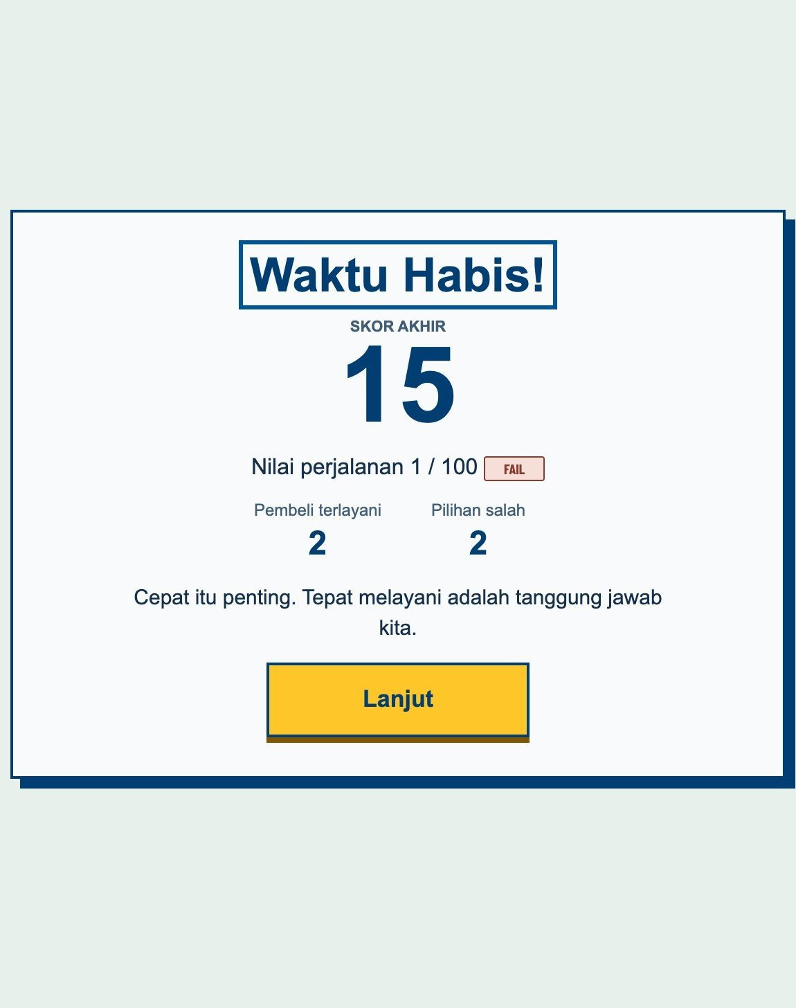
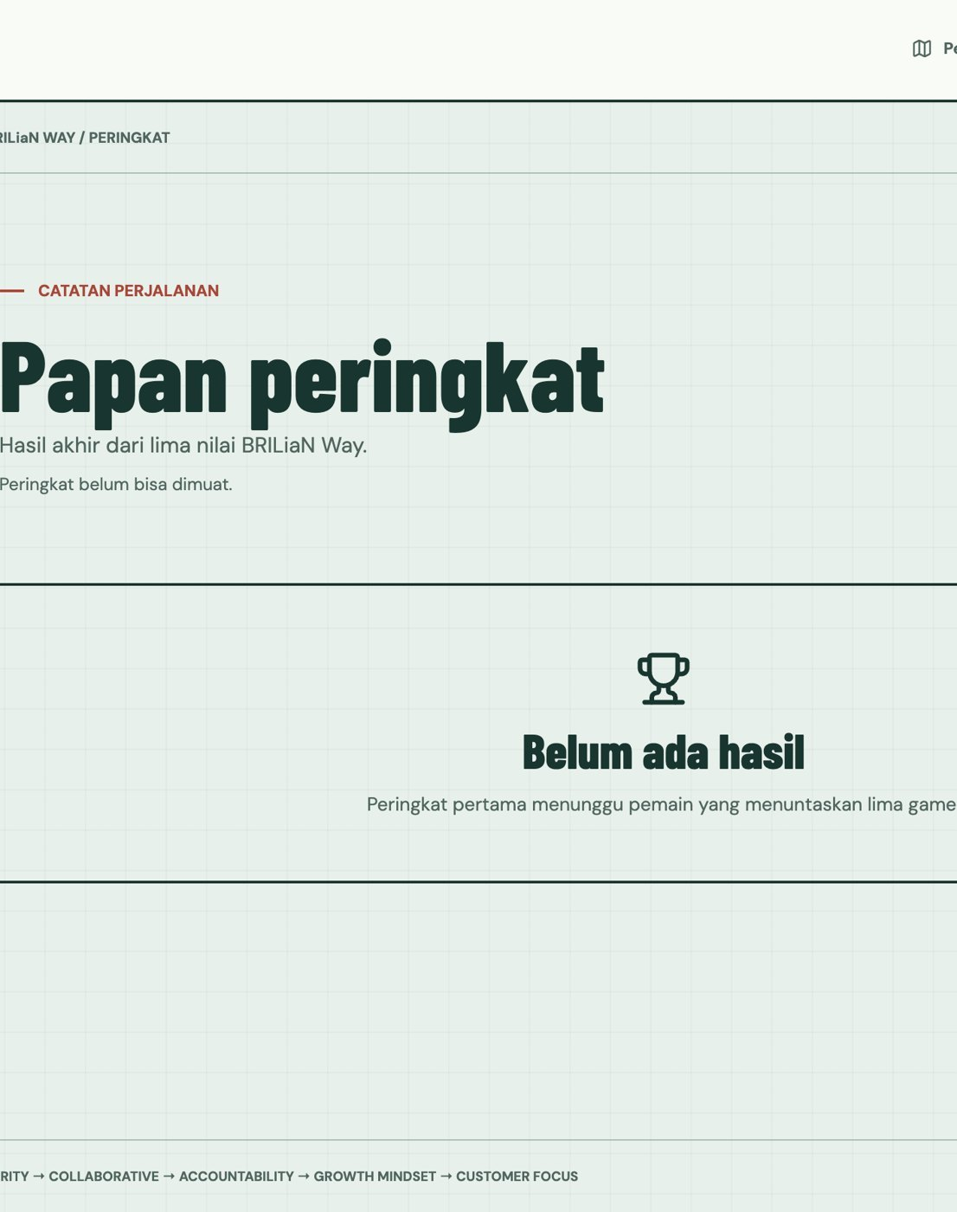
● BRILiaN Way Arcade
04 Demo
Let’s play it.
Start demo
Show the code
→
→
→
→
01
Enter name
02
Briefing
03
Play
04
Result
05
Leaderboard
npm ci && npm run dev · 127.0.0.1:5173
14 / 16

Slide 15
● BRILiaN Way Arcade
05 Lessons learned
What we would keep — and change
Keep
Keep
Keep
Spec the seams first
Small changes, often
Scope lines for agents
Change
Change
Change
Right-size the ceremony
Archive as you go
Write decisions back
15 / 16

Slide 16
● BRILiaN Way Arcade
Thank you
Questions, ideas, high scores
Write it down. Then build it.
Ask a question
Try the game
16 / 16

