Slide 1

AI
Artificial Intelligence and Tensorflow
Making machines think, and a method of making them think.

Slide 2
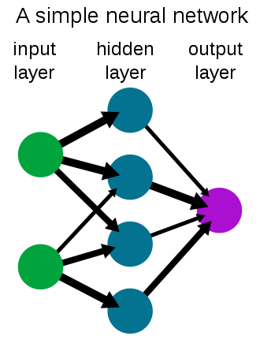
Artificial Intelligence.
The term ‘Artificial Intelligence’ means, as John McCarthy put it, ‘.. is the science and engineering of making intelligent machines, especially intelligent computer programs.’ It’s a very powerful asset in our technological age, and its use is becoming more widespread the more progress we make, due its unparalleled capacity of connecting seemingly unrelated data together. The most widespread implementation of it is of neural networks, a system of layered neurons, weights and biases.

Slide 3
A way to make AI models: Tensorflow
Tensorflow is an open-source library made by the Google Brain team for simplifying and providing more leverage in the creation, training and deployment of AI models. It has many powerful tools due to the combined efforts of Google and the open-source community. It can be used and implemented in a plethora of languages, including Java, JavaScript, C++, and most notably, Python.

