Slide 1
Automated [Customer Reviews]
By Ambrose

Slide 2
[The project]
This [project] has for objective the development of an NLP Model automating the customer feedback process for a retail company through the conception of 3 different models :
Sentiment analysis
Product category clustering
Top product reviews summarization per category

Slide 3
[The Dataset]
The given dataset consists of reviews data for Amazon tech products and accessories. For this project the relevant data is composed of the products names and categories followed by the customer review and star rating.
General preprocessing :
NaNs and duplicates were removed as well as non-alphanumeric characters for both the reviews and product names columns.

Slide 4
[Sentiment analysis Approach]
The reviews were categorised into positive, neutral and negative.
My first approach consisted of using clustering with unsupervised learning to determine the sentiment with k-means. Using the reviews, preprocessing techniques tried included the removal or non removal of stop words, lemmatization with Pos tag, stemming, bag of words and TF-IDF with bigrams and trigrams.
Those different tries were inconclusive since the clusters never seemed to make sense at each iteration.

Slide 5
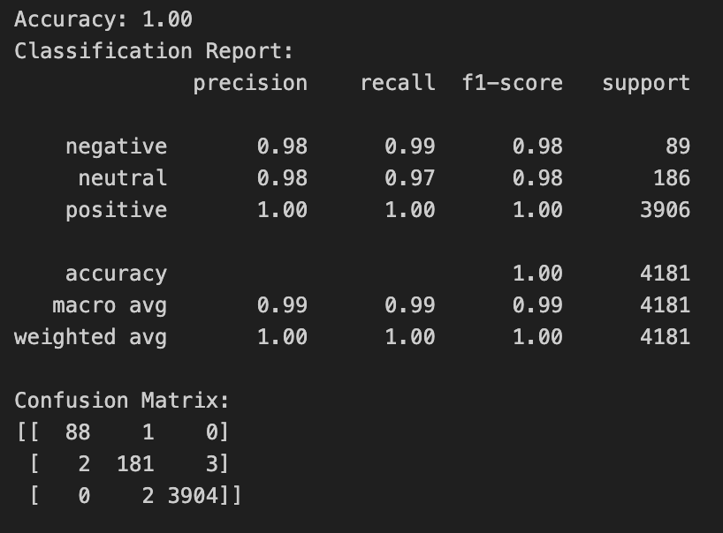
[Sentiment analysis Model]
From [unsupervised] to [supervised] :
The dataset was imbalance with an overrepresentation of positive reviews. SMOTE was applied on the training set to solve this issue. Once the model was trained and tested, it showed signs of overfitting on the dataset. It was not an issue for since the model would be used to predict on that same dataset.
For my final model, I decided to randomly reserve 50% of the dataset for training with Logistic Regression, creating labels from the star rating column. Preprocessing included stop words removal, POS tag lemmatization and TF-IDF bigrams and trigrams.
The star rating was normalized and added as a feature for more precision.

Slide 6
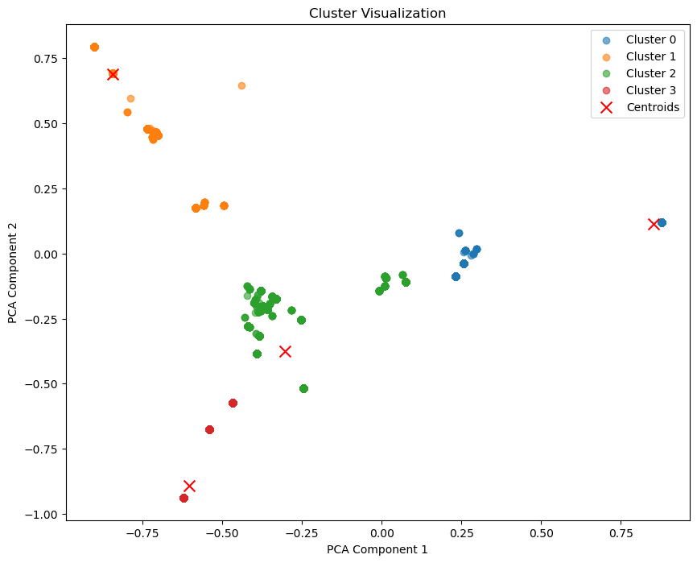
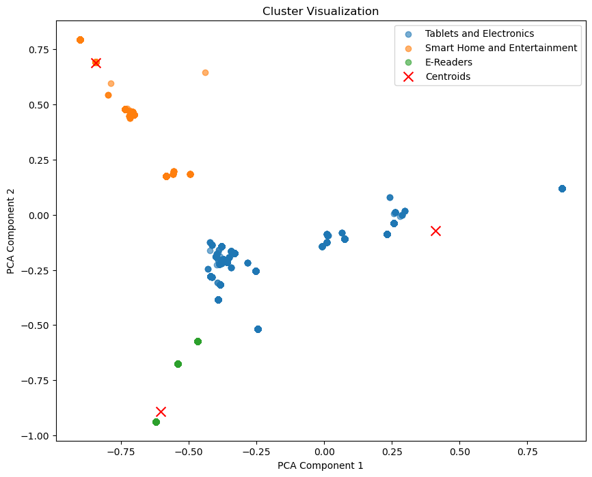
[Product category clustering Model]
The products were categorized into 3 general categories :
Tablets and Electronics
Smart Home and entertainment
E-Readers
Using the product names and their categories, preprocessing was simpler. The stopwords were left, and stemming with TF-IDF was used
Kmeans were initialized with 4 clusters and gave a silhouette score of 0.65, meaning the clusters were clearly defined.
Upon inspection of the clusters and the top 10 words per cluster, I decided to merge cluster 0 and 2 into ‘Tablets and Electronics’ due to their high similarity.

Slide 7
[LLM Product review Approach]
This part of the project was executed isolated from the Dataset and the 2 previous model results
To achieve summarization in a blog style article, I used prompt engineering with few shots inferring following this template :
Reviews :
Blog style summary :
Pros :
Cons :
Conclusion :
The first pre-trained model I used was Llama 3.2 from Meta with 1B parameters.
But when running inference with the prompt few shots and a new review, no new tokens were generated and I had no results. My conclusion was that the model was likely too small and a bigger one was needed

Slide 8
[LLM Product review]
Model output :
# Blog style summary:
"A Powerful, Yet Noisy, Kitchen Companion
This blender is a powerhouse, blending everything from ice to vegetables with ease.
The different speed settings offer flexibility for various recipes.
However, it's quite loud, especially on the higher settings, and the jar is heavy, making it a bit cumbersome to handle.
Cleaning is easy, but the blade is sharp, so caution is needed.
Overall, it's a solid choice for anyone seeking power and versatility in their kitchen."
# Pros:
- Blends everything smoothly.
- Versatile with different speed settings.
# Cons:
- Quite loud.
- Heavy jar.
- Sharp blade.
# Conclusion:
"This blender is a great choice for anyone who wants power and versatility in their kitchen,
but be aware of the noise and the weight of the jar."
The chosen pre-trained model was the Mistral v0.3 with 7B parameters.
Using the same few shots inferring template, I had results.
Given review :
This blender is absolutely fantastic! It blends everything smoothly, whether it's ice, vegetables, or fruits. I love the different speed settings, which give a lot of flexibility for various recipes. However, it’s quite loud, especially on the higher settings, so it can be a bit disruptive in the kitchen. The jar is also a bit heavy, which makes it a little difficult to handle, especially when it's full. Cleaning is easy, but the blade is really sharp, so I need to be careful. Overall, it's a solid blender for anyone who wants power and versatility in their kitchen.

Slide 9
[Takeaway]
From the original dataset, review sentiment and product category were successfully predicted and concatenated. A “Final.csv” was created with the results of Model 1 and Model 2.
Working fully alone turned out to be hard as expected, but [should not] mean to face everything alone. I need to find the strength to [ask for help] and fully use the [available resources]. A significant amount of time was lost due to it.
Evaluation steps needs to be more elaborated and taken into serious consideration. Preprocessing also needs [more care] and i should allow space for more [experimentation].

Slide 10
[Thank you]

