Slide 1
YoutuBot
Q/A agent By Ambrose

Slide 2
The project :
YoutuBot is an agentic system that can retrieve data from a youtube video and answer related queries and questions.
It processes one video at a time, clearing it’s database at each new given URL.
The LLM behind the hook is powered by OpenAI’s GPT 4o, providing high quality query understanding and retrieval interpretation.

Slide 3
Architecture :
The architecture of the agent is very simple, yet effective.
It is powered by the Langchain library and composed of :
A chat completion LLm
A Pinecone VectorStore
A simple retriever (VectorStore Cosine similarity search)
2 simple tools
All wrapped inside an OpenAI Functions type Agent and a fully custom system prompt.

Slide 4
Data fetching:
The Pinecone vectorstore is exclusively populated by one youtube video transcript at a time using the Youtube_Transcript_API library. It is associated with its video ID and timestamps.
Each video transcript is split into several 400 tokens long chunks for more precise retrieval, with an overlap of 20 tokens to avoid incomplete information indexing.
Each chunk’s text field is embedded using OpenAI’s embedding model “text embedding Ada 002”. It is then indexed in Pinecone alongside its metadata, ready for the performance of cosine similarity search.

Slide 5
The Agent:
The agent type used (OpenAI Functions) does not have a base prompt and fully rely on the custom system prompt provided.
The prompt is simple, yet strict, organized and clear. It is elaborated around 4 axes :
Agent’s role and abilities
Rules and workflow
Answering questions
Resetting for a new video
Onboarding strict instructions and a final reminder of critical guidelines
For obvious conversational purposes, the agent is initialized with a Conversational Buffer Memory, able to recall the last 7 interactions.
This allows context and the handling of follow up queries.
The agent now knows when and how to take actions. It can by itself fetch and index a video, and query the vectorstore correctly to get relevant data to fulfill the user’s request.

Slide 6
Tools:
As stated before, the agent has 2 tools in its hands.
When given a youtube link, the first tool will :
Clear the vectorstore
Fetch the video transcript and its metadata
Split it into chunks and index it in the vectorstore
When given a request, the agent will first create a proper query, then pass it to the second tool that will :
Perform Cosine similarity search on the vectorstore
Return the 3 closest match

Slide 7
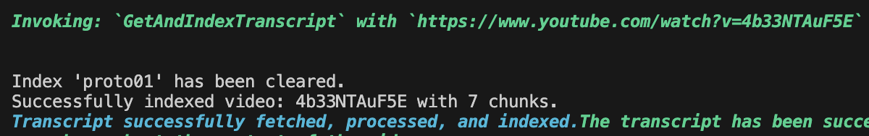
Here is an example of how the agent interprets the requests, and what is passed to the tools.
In this example, the link is provided alone, but the agent can extract the link in a message that contains “noise” text. It can even extract the link alongside a request and process both in order.

Slide 8
Improvements and evaluation:
Initially the agent type had a base system prompt provided by the Langchain agent library, but passing a full custom prompt with no previous instructions was proven to be more effective, allowing full control over the agent’s behavior from A to Z. All the base prompts available are very well crafted but can conflict with custom guidelines when seeking a more specific behavior.
Most of the changes were done through that prompt, refining and reviewing it, leading to the exclusive use of that prompt.
When lost about understanding its behavior, i found that you can simply ask the agent
why it is acting this way. It answers with its reasoning and own words that you can later use in the prompt, giving you a better view of the big picture and the gap between what is expected and what is known.
The retriever was initially a QA chain, only providing the agent with an LLM answer to the documents retrieved.
I chose to directly return those documents to the agent, providing better quality answers. Where the QA LLM performed similarity search with a question, the agent can perform it using keywords or adapted statements to retrieve more relevant documents.
The whole evaluation process was done through Langsmith, and testing through the chat. The agent always uses the retriever to answer queries as it understood perfectly it’s role : not informing the user about various topic but describe a video approach and ideas about those topics.
I didn’t use ROUGE or BLEU metrics as many phrasing can be achieved and being all equally valid, i found that highly irrelevant.
But I am aware that for a real scope project, those metrics are necessary for legitimacy and conformity purposes.

Slide 9
Deployment :
A simple gradio chatbot interface was created. It is hosted locally as a Hugging Face hosting resulted in errors, mainly with the Youtube API library. (Public link available for 72h)
The next slides will showcase a chat example with a video from Kurzgesagt - In a Nutshell “Can you upload your mind & live forever ?”

Slide 10
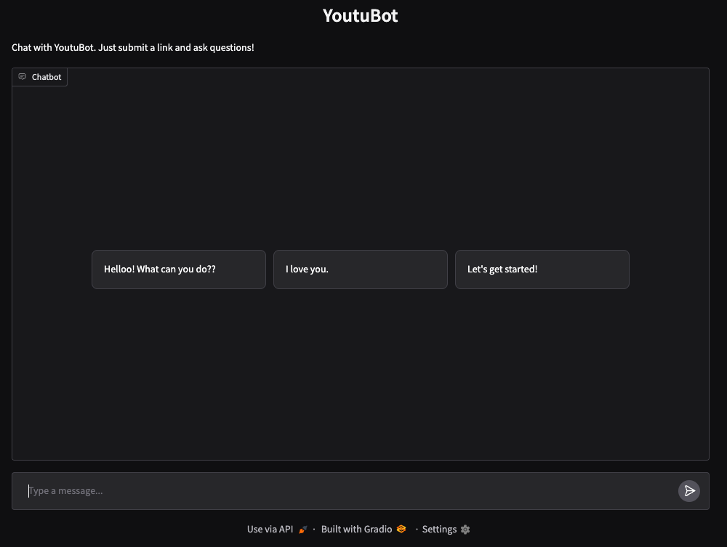

Slide 11
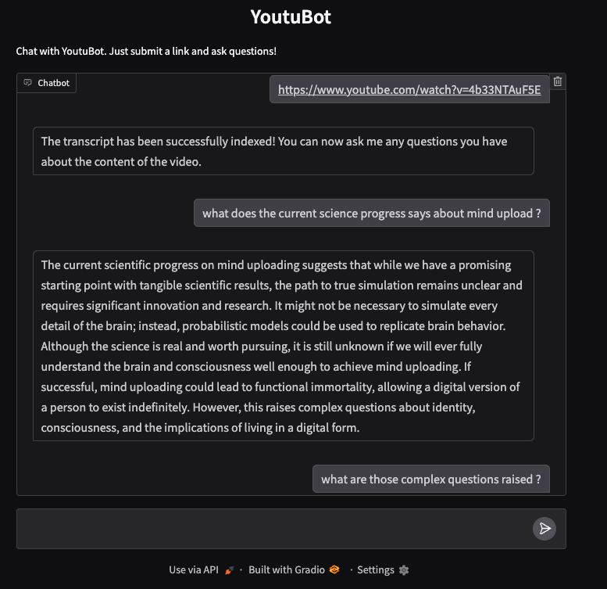
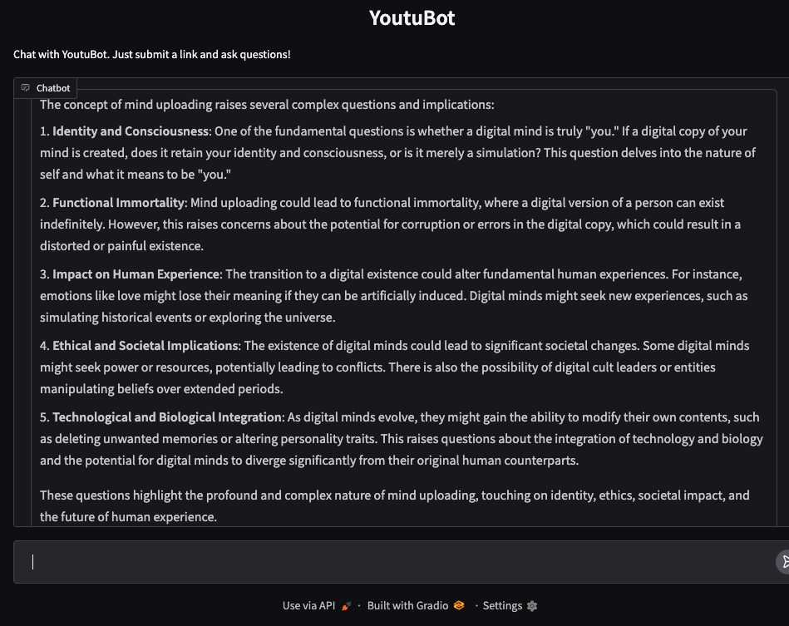

Slide 12
Thank you

