Slide 1
Notes:
Very nice

Slide 2
Installing NovaOS…

Slide 3


WELCOME
Welcome To the NovaOS Setup!
Exit
Next

Slide 4

USER & PERSONALISATION
Username *
PIN
Profile Picture
Desktop Background
Browse…
Browse…
Back
Next

Slide 5
FINISH
The Setup is completed
Start
Back

Slide 7


12:31:11
Notifications
NovaOS
Welcome To NovaOS! Make Sure to contact iDev#0001if You find Bugs.
BOT NovaSTDXX
Settings
Greetings! Make sure to log in or create a Nova Account For All services
Login

Slide 8






2 Notif…
100%
12:31:11
Chat
Notification Menu
2 Unread!
You
NovaOS
Welcome To NovaOS! Make Sure to contact iDev#0001if You find Bugs.
Settings
Greetings! Make sure to log in or create a Nova Account For All services
You
You
44725,93
1
False
No
Activites
191

Slide 9

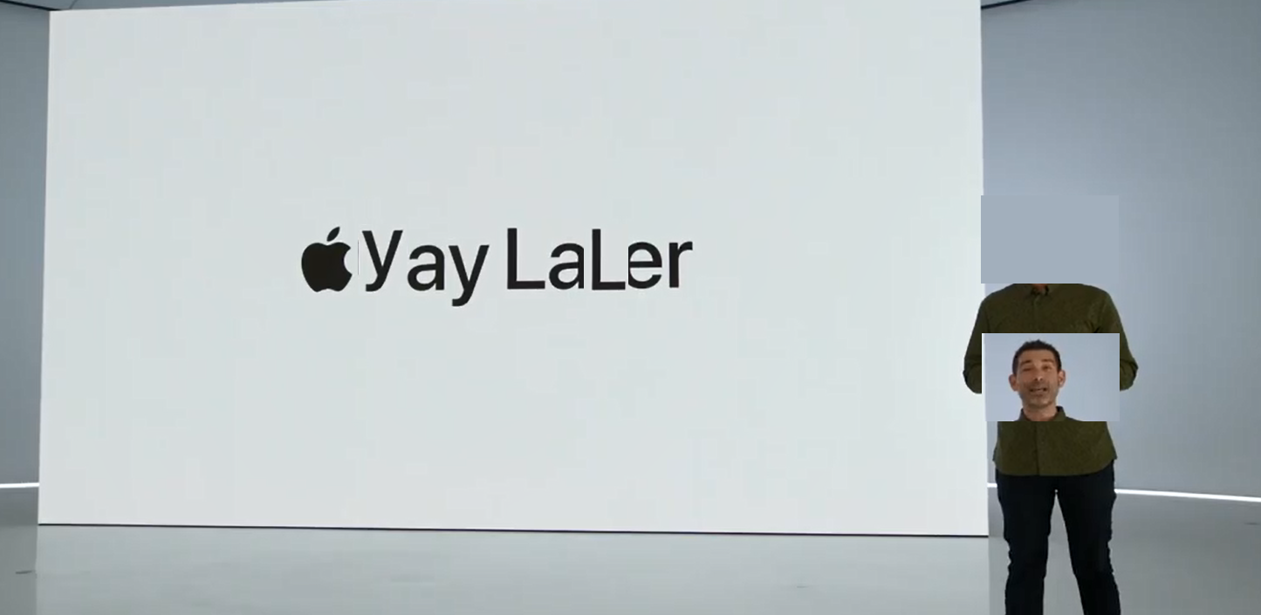

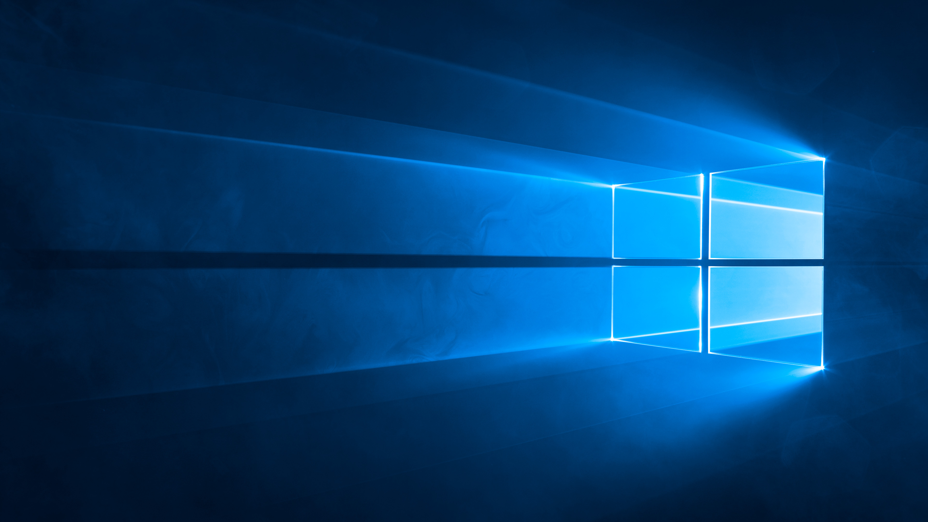




2 Notif…
100%
12:31:11
Close
Notification Menu
2 Unread!
Weather
20°
Sunny
Photos
Its kinda lonely here…
NovaOS
Welcome To NovaOS! Make Sure to contact iDev#0001if You find Bugs.
?
19°
15°
10°
19°
15°
10°
Settings
Greetings! Make sure to log in or create a Nova Account For All services
Next Up: Shape..
OPEN.FY
Notes
HEAT WAVES
GLASS ANIMALS
No
Activites

Slide 10






i
X
!
NovaOS Explicit beta 0.9
©2022 Nova Studios
NovaOS was built by:
const names =
[ “iDev#0001“,
“MNPTheDev#7335“,
“minecraftjava89#0336“,
“mrcoffee231#9396“ ]
//Have fun:)
X
For You
Nova365 NovaCode
Notepad
?
About
▢
X
Settings
▢
X
▢
X
Libraries
System
▢
X
NovaStore
▢
X
Files
B
I
U
+
-
L
C
R
AC
Font…
Reset
%
Appdata
Libraries
Desktop
Text
Nova
Nova Developer Studio
</>
WIP

Slide 11
Oh no…
An error has occured. Make sure to stay calm. NovaOS will do everything for you.
If you know someone who can Troubleshoot NovaOS Show them this code: novaos.sys.polyui.main: undefined UI key or bad API ( 0x09ad8fe7 ).

Slide 12
Shuting Down…

