Slide 1
Unit – 1
Basics of Internet

Slide 2
Internet & Its History
Internet is a world-wide global system of interconnected computer networks.
Internet uses the standard Internet Protocol (TCP/IP).
Every computer in internet is identified by a unique IP address.
A special computer DNS (Domain Name Server) is used to give name to the IP Address so that user can locate a computer by a name.
The Internet carries a vast range of information resources and services, such as the inter-linked hypertext documents and applications of the World Wide Web (WWW).
The origin of Internet devised from the concept of Advanced Research Project Agency Network (ARPANET) in 1969.
ARPANET was developed by United States Department of Defence.
Basic purpose of ARPANET was to provide communication among the various bodies of government.
Initially, there were only four nodes, formally called Hosts.
In 1972, the ARPANET spread over the globe with 23 nodes located at different countries and thus became known as Internet.

Slide 3
Application of Internet
Search engine: It can be used to search anything and everything. Most popular search engines are Google and Yahoo searches.
Shopping: Shopping has become easier with the advent of internet. We can buy or sell online.
Communication: This is a major role of the internet. It helps people to communicate either with the use of social networking websites or through e mails. Even chatting is a major use of the internet.
Job search: Nowadays, many people search for their jobs online as it is quicker and there is a larger variety of job vacancies present.
Hobbies: Those who are having certain hobbies can try to improve on it by reading up on many aspects of their hobby.
Research: Research papers are present online which helps in the researcher doing a literature review.
Studying: Now right from kinder garden children are exposed to internet and computers. They find many useful things to learn on the internet (though with supervision). Up to doctorate level education, people rely on internet for their education. Online educational books have even reduced the need for a library.

Slide 4
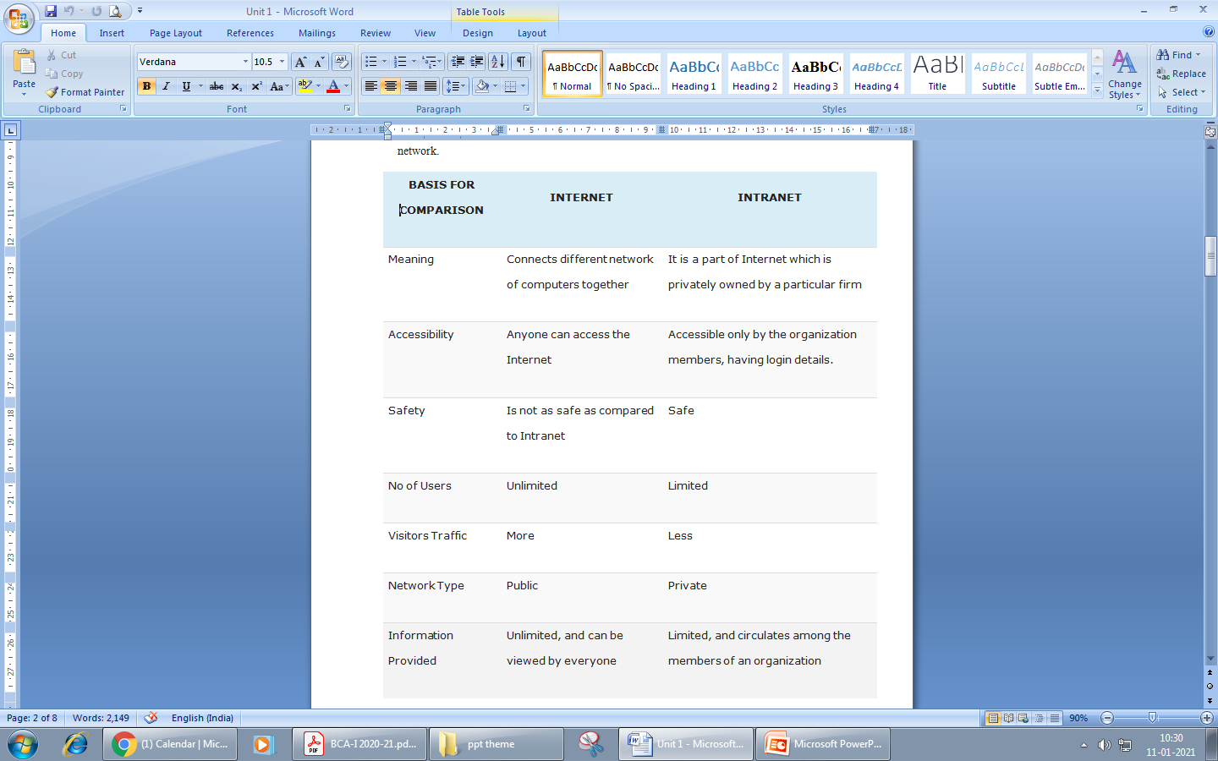
Intranet
An intranet is a part of Internet that is privately owned by an organization.
It connects all the computers together and provides access to files and folders within the network.

Slide 5
ARPANET
The Advanced Research Projects Agency Network (ARPANET) was an early packet-switching network and the first network to implement the protocol suite TCP/IP
The ARPANET began at the end of 1969 as a four node experiment to achieve resource sharing.
ARPANET was the network that became the basis for the Internet.
The ARPANET was initially funded by the Advanced Research Projects Agency (ARPA) of the Defence.
The initial purpose was to communicate with and share computer resources among mainly scientific users at the connected institutions.
Because ARPA's name was changed to Defense Advanced Research Projects Agency (DARPA) in 1971, ARPANET is sometimes referred to as DARPANET.

Slide 6
WWW
The World Wide Web, also known as the WWW and the Web, is an information space where documents and other web resources are identified by Uniform Resource Locators (URLs), interlinked by hypertext links, and accessible via the Internet
It is a way of accessing information over the medium of the internet.
Tim Berners-Lee invented the World Wide Web in 1989 at CERN in Geneva.
The WWW consists of billions of pages linked to each other that contain text, hyperlinks, graphics, multimedia files , and other interactive software that are accessed using a browser.
The first Internet browser was named WorldWideWeb (later changed to Nexus) and was invented by Tim Berners-Lee in 1990.

Slide 7
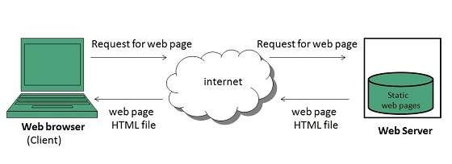
Web Page
webpage is a document commonly written in HTML (Hypertext Mark-up Language) that is accessible through the Internet using a browser.
Web Pages are stored on web server and can be viewed using a web browser.
Web pages can contain huge information including text, graphics, audio, video and hyper links. These hyper links are the link to other web pages.
Static Web page: Static web pages are also known as flat or stationary web page. They are loaded on the client’s browser as exactly they are stored on the web server. Such web pages contain only static information. User can only read the information but can’t do any modification or interact with the information.
Static web pages are created using only HTML. Static web pages are only used when the information is no more required to be modified.

Slide 8
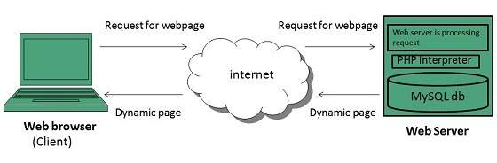
Web Page cont.
Dynamic Web page: Dynamic web page shows different information at different point of time. It is possible to change a portion of a web page without loading the entire web page. It has been made possible using Ajax technology.

Slide 9
Website
A website is a collection of publicly accessible, interlinked Web pages that share a single domain name. Websites can be created and maintained by an individual, group, business or organization to serve a variety of purposes.
A website may be accessible via a public Internet Protocol (IP) network, such as the Internet, or a private local area network (LAN), by referencing a uniform resource locator (URL) that identifies the site.
Websites are typically dedicated to a particular topic or purpose, ranging from entertainment and social networking to providing news and education.
A static website is one that has web pages stored on the server in the format that is sent to a client web browser. It is primarily coded in Hypertext Markup Language (HTML).
A dynamic website is one that changes or customizes itself frequently and automatically. Various web application frameworks and web template systems are available for general-use programming languages like Perl, PHP, Python and Ruby to make it faster and easier to create complex dynamic websites.

Slide 10
Web Browser
web Browser is an application software that allows us to view and explore information on the web. User can request for any web page by just entering a URL into address bar.
Web browser can show text, audio, video, animation and more. It is the responsibility of a web browser to interpret text and commands contained in the web page.
The first web browser, called Worldwide Web, was invented in 1990 by Sir Tim Berners-Lee.
A variety of web browsers are available with different features, and are designed to run on different operating systems. Common browsers include Internet Explorer from Microsoft, Firefox from Mozilla, Google Chrome, Safari from Apple, and Opera.

Slide 11
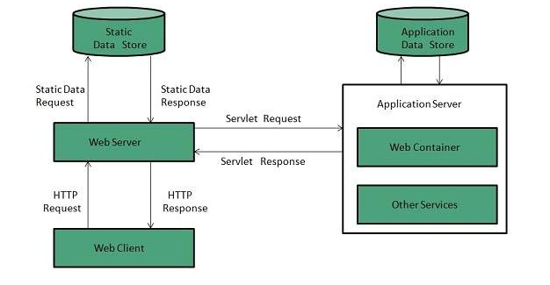
Web Server
Web server is a computer where the web content is stored. Basically web server is used to host the web sites but there exists other web servers also such as gaming, storage, FTP, email etc.
Web server respond to the client request in either of the following two ways:
Sending the file to the client associated with the requested URL.
Generating response by invoking a script and communicating with database

Slide 12
Search Engine
Search Engine refers to a huge database of internet resources such as web pages, newsgroups, programs, images etc. It helps to locate information on World Wide Web.
User can search for any information by passing query in form of keywords or phrase. It then searches for relevant information in its database and return to the user.
Search Engine Components
Generally there are three basic components of a search engine as listed below:
Web Crawler
Database
Search Interfaces
Web crawler: It is also known as spider or bots. It is a software component that traverses the web to gather information.
Database: All the information on the web is stored in database. It consists of huge web resources.
Search Interfaces: This component is an interface between user and the database. It helps the user to search through the database.

Slide 13
Search Engine Working
The source of all search engine data is collected using a spider or crawler that visits each page on the Internet and collects its information.
Once a page is crawled, the data contained in the page is processed and indexed.
The process of validating and storing the content from the WebPages in the search engine’s database called “index”. It is basically a big library of all the websites.
The data collected is used to rank each page. These rankings then determine which pages to show in the search results and in what order.

Slide 14

URL
URL is an acronym for Uniform Resource Locator and is a reference (an address) to
a resource on the Internet.
A URL is composed of different parts, some mandatory and others optional.
http:// or https://
The "http" stands for Hypertext Transfer Protocol. It let's the browser to know which
protocol it is going to use to access the information specified in the domain. An "https" protocol is short for "Hypertext Transfer Protocol Secure" and indicates that information transmitted over HTTP is encrypted and secure. After the http or https is the colon ( : ) and two forward slashes ( // ) that separate the protocol from the remainder of the URL.
www.
Next, "www" stands for World Wide Web and is used to distinguish the content. This portion of the URL is not required and many times can be left out. For example, typing "http://computerhope.com" would still get you to the Computer Hope website. This portion of the address can also be substituted for an important sub page known as a subdomain.

Slide 15
URL Cont..
computerhope.com
Next, "computerhope.com" is the domain name for the website. The last portion of the domain is known as the domain suffix. It is used to identify the type or location of the website. For example, ".com" is short for commercial, ".org" is short for an organization, and ".co.uk" is the United Kingdom. There are several domain suffixes available. To get a domain, you would register the name through a domain registrar.
/jargon/u/
Next, "jargon" and "u" are the directories where the web page is on the server. In this example, the web page is two directories deep.
url.htm
Finally, url.htm is the actual web page on the domain you're viewing. The trailing .htm is the file extension of the web page that indicates the file is an HTML file. Other common file extensions on the Internet include .html, .php, .asp.

Slide 16
DNS
Domain Name Server (DNS) is a standard protocol that helps Internet users discover websites using human readable addresses. Like a phonebook which lets you look up the name of a person and discover their number, DNS lets you type the address of a website and automatically discover the Internet Protocol (IP) address for that website.
How Does DNS Work?
The internet is a giant network of computers. Each device connected to the internet is assigned a unique IP address which helps other computers identify it.
This IP address is a string of numbers with periods that looks like this:
192.124.249.166
They are hard to remember. Domain names were invented to solve this problem by using alphabets and allowing users to select easy to remember names for their websites.
DNS or Domain Name System basically translates those domain names into IP addresses and points your device in the right direction.
A domain name and its matching IP address is called a “DNS record”.

Slide 17
DNS Cont..
Here is a simple way to understand how DNS works in four steps.
Suppose you want to visit our site at www.dcindia.in.
1. You open your browser and type www.dcindia.in in the address bar and hit Enter on the keyboard. Immediately there is a quick check to see if you have visited our website previously.
If the DNS records are found in your computer’s DNS cache, then the rest of the DNS lookup is skipped and you will be taken directly to www.dcindia.in.
2. If no DNS records are found, then a query is sent to your local DNS server. Typically this is your Internet provider’s server and is often called a “resolving name server”.
3. If the records are not cached on the resolving name server, then the request is forwarded to what’s called a “root name server” to locate the DNS records. Root name servers are designated servers around the world that are responsible for storing DNS data and keeping the system working smoothly. Once the DNS record is found on the root name server, it’s cached by your computer.
4. Now that the DNS records are located, a connection to the server where the website is stored will be opened and www.dcindia.in will be displayed on your screen.

Slide 18
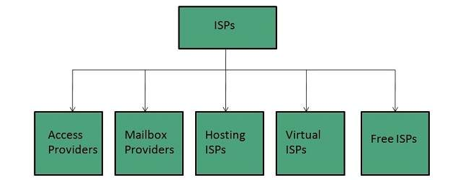
ISP
Internet Service Provider (ISP) is a company offering access to internet. They offer various services:
Internet Access
Domain name registration
Dial-up access
Leased line access
ISP Types
ISPs can broadly be classified into six categories as shown in the following diagram

Slide 19
ISP Cont..
Access providers
They provide access to internet through telephone lines, cable wi-fi or fiber optics.
Mailbox Provider
Such providers offer mailbox hosting services.
Hosting ISPs
Hosting ISPs offers e-mail, and other web hosting services such as virtual machines, clouds etc.
Virtual ISPs
Such ISPs offer internet access via other ISP services.
Free ISPs
Free ISPs do not charge for internet services.

Slide 20
Web Design Strategy
Web Design Strategy is a long-term strategic business planning of how to create and develop the online presence of the company adhering to all business strategies. A successful website is not built in a day or a week, with proper efforts and a little bit of time can make website and business successful.
Vision of Website
Before defining web strategy or goals, one must first have a clear vision of the site’s purpose which is often in line with the overall company vision and branding elements.
2. Goals of Website
What is the purpose of the website? What are the goals of the site? Website should serve a definite purpose
3. Target Market
A Target Market is sometimes called the target audience. It is critical to understand one’s market or audience How old are they? What is their gender? What is their education? What do they like? How do they communicate?

Slide 21
Web Design Strategy Cont..
4. Branding
Brand, in a simple format, ties in all the elements of communication into one clear message. Your brand, as simple as it may appear, should have a purpose for every aspect. Font types, keywords, colours, design, and placement. Your brand is what differentiates your company from your competitors.
5. Messaging
Message is the brand and the voice to the audience. A clear message will tell the audience what one want them to hear. Without clarity in the message, website can quickly lose its voice!
6. Design to Goals
Designing to goals is a fusion of several skills and art forms. It combines web design, graphic design, SEO (search engine optimization), competitive analysis, future web development trends, message, branding, and purposeful direction to achieve website goals.
7. Evaluate & Execute
The last step in web design strategy process is to evaluate the strategy from beginning to end.

Slide 22
Protocol
Protocols are set of rules that help in governing the way a particular technology will function for communication. In other words, it can be said that the protocols are digital languages implemented in the form of networking algorithms. There are different networks and network protocols, user's use while surfing.
Types of Protocols:-
There are various types of protocols that support a major and compassionate role in communicating with different devices across the network. These are:
Transmission Control Protocol (TCP)
Internet Protocol (IP)
User Datagram Protocol (UDP)
Post office Protocol (POP)
Simple mail transport Protocol (SMTP)
File Transfer Protocol (FTP)
Hyper Text Transfer Protocol (HTTP)
Hyper Text Transfer Protocol Secure (HTTPS)
Telnet
Gopher

Slide 23
HTTP
HTTP stands for HyperText Transfer Protocol.
It is a protocol used to access the data on the World Wide Web (www).
The HTTP protocol can be used to transfer the data in the form of plain text, hypertext, audio, video, and so on.
This protocol is known as HyperText Transfer Protocol because of its efficiency that allows us to use in a hypertext environment where there are rapid jumps from one document to another document.
HTTP is similar to the FTP as it also transfers the files from one host to another host. But, HTTP is simpler than FTP as HTTP uses only one connection, i.e., no control connection to transfer the files.
HTTP is used to carry the data in the form of MIME-like format (Multipurpose Internet Mail Extensions ).
HTTP is similar to SMTP as the data is transferred between client and server. The HTTP differs from the SMTP in the way the messages are sent from the client to the server and from server to the client. SMTP messages are stored and forwarded while HTTP messages are delivered immediately.

Slide 24
Features of HTTP
Connectionless protocol: HTTP is a connectionless protocol. HTTP client initiates a request and waits for a response from the server. When the server receives the request, the server processes the request and sends back the response to the HTTP client after which the client disconnects the connection. The connection between client and server exist only during the current request and response time only.
Media independent: HTTP protocol is a media independent as data can be sent as long as both the client and server know how to handle the data content. It is required for both the client and server to specify the content type in MIME-type header.
Stateless: HTTP is a stateless protocol as both the client and server know each other only during the current request. Due to this nature of the protocol, both the client and server do not retain the information between various requests of the web pages.

Slide 25
TCP
TCP stands for Transmission Control Protocol. It facilitates the transmission of packets from source to destination. It is a connection-oriented protocol that means it establishes the connection prior to the communication that occurs between the computing devices in a network. This protocol is used with an IP protocol, so together, they are referred to as a TCP/IP.
it divides the data into a several packets, provides numbering to these packets, and finally transmits these packets to the destination. The TCP, on the other side, will reassemble the packets. As we know that TCP is a connection-oriented protocol, so the connection will remain established until the communication is not completed between the sender and the receiver.

Slide 26
IP
IP stands for internet protocol. It is a protocol defined in the TCP/IP model used for sending the packets from source to destination. The main task of IP is to deliver the packets from source to the destination based on the IP addresses available in the packet headers.
An IP protocol provides the connectionless service, which is accompanied by two transport protocols, i.e., TCP/IP and UDP/IP, so internet protocol is also known as TCP/IP or UDP/IP.
The first version of IP (Internet Protocol) was IPv4. After IPv4, IPv6 came into the market, which has been increasingly used on the public internet since 2006.

Slide 27
UDP
In computer networking, the UDP stands for User Datagram Protocol. The David P. Reed developed the UDP protocol in 1980. The UDP protocol allows the computer applications to send the messages in the form of datagrams from one machine to another machine over the Internet Protocol (IP) network. The UDP is an alternative communication protocol to the TCP protocol (transmission control protocol). Like TCP, UDP provides a set of rules that governs how the data should be exchanged over the internet.
UDP enables the process to process communication, whereas the TCP provides host to host communication. Since UDP sends the messages in the form of datagrams, it is considered the best-effort mode of communication. TCP sends the individual packets, so it is a reliable transport medium. Another difference is that the TCP is a connection-oriented protocol whereas, the UDP is a connectionless protocol as it does not require any virtual circuit to transfer the data.

Slide 28
SMTP
SMTP stands for Simple Mail Transfer Protocol.
SMTP is a set of communication guidelines that allow software to transmit an electronic mail over the internet is called Simple Mail Transfer Protocol.
It is a program used for sending messages to other computer users based on e-mail addresses.
It provides a mail exchange between users on the same or different computers, and it also supports:
It can send a single message to one or more recipients.
Sending message can include text, voice, video or graphics.
It can also send the messages on networks outside the internet.
The main purpose of SMTP is used to set up communication rules between servers. The servers have a way of identifying themselves and announcing what kind of communication they are trying to perform. They also have a way of handling the errors such as incorrect email address. For example, if the recipient address is wrong, then receiving server reply with an error message of some kind.

Slide 29
FTP
FTP stands for File transfer protocol.
FTP is a standard internet protocol provided by TCP/IP used for transmitting the files from one host to another.
It is mainly used for transferring the web page files from their creator to the computer that acts as a server for other computers on the internet.
It is also used for downloading the files to computer from other servers.
There are two types of connections in FTP:
Control Connection: Through control connection, we can transfer a line of command or line of response at a time. The control connection is made between the control processes. The control connection remains connected during the entire interactive FTP session.
Data Connection:The data connection is made between data transfer processes. The data connection opens when a command comes for transferring the files and closes when the file is transferred.
FTP Connection
Control Connection
Data Connection

Slide 30
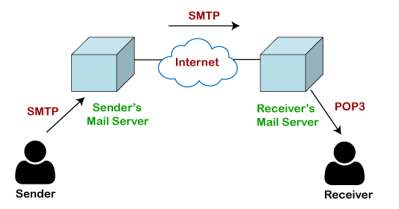
POP
The POP protocol stands for Post Office Protocol. As we know that SMTP is used as a message transfer agent. When the message is sent, then SMPT is used to deliver the message from the client to the server and then to the recipient server. But the message is sent from the recipient server to the actual server with the help of the Message Access Agent. The Message Access Agent contains two types of protocols, i.e., POP3 and IMAP.

Slide 31
Telnet
The main task of the internet is to provide services to users. For example, users want to run different application programs at the remote site and transfers a result to the local site. This requires a client-server program such as FTP, SMTP. But this would not allow us to create a specific program for each demand.
The better solution is to provide a general client-server program that lets the user access any application program on a remote computer. Therefore, a program that allows a user to log on to a remote computer. A popular client-server program Telnet is used to meet such demands. Telnet is an abbreviation for Terminal Network.
Telnet provides a connection to the remote computer in such a way that a local terminal appears to be at the remote site.
There are two types of Login:
When a user logs into a local computer, then it is known as local login.
When the user wants to access an application program on a remote computer, then the user must perform remote login

Slide 32
Gopher
Gopher is an application-layer protocol that provides the ability to extract and view Web documents stored on remote Web servers.
Gopher was designed to access a Web server or database via the Internet. It requires that files be stored in a menu-style hierarchy on a Gopher server that is accessible through a Gopher-enabled client browser and/or directly. It initially supported only text-based file/document access but later came to support some image formats such as GIF and JPEG.

Slide 33
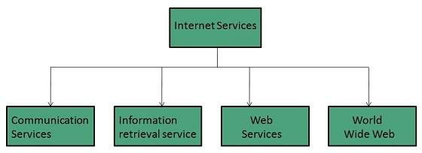
Internet Services
Internet Services allows us to access huge amount of information such as text, graphics, sound and software over the internet. Following diagram shows the four different categories of Internet Services.

Slide 34
Communication Services
There are various Communication Services available that offer exchange of information with individuals or groups.
Electronic Mail : Used to send electronic message over the internet.
Telnet : Used to log on to a remote computer that is attached to internet.
Newsgroup : Offers a forum for people to discuss topics of common interests.
Internet Relay Chat (IRC) : Allows the people from all over the world to communicate in real time.
Mailing Lists : Used to organize group of internet users to share common information through e-mail.
Internet Telephony (VoIP) : Allows the internet users to talk across internet to any PC equipped to receive the call.
Instant Messaging : Offers real time chat between individuals and group of people. Eg. Yahoo messenger, MSN messenger.

Slide 35
Information Retrieval Services
There exist several Information retrieval services offering easy access to information present on the internet. The following table gives a brief introduction to these services:
File Transfer Protocol (FTP) : Enable the users to transfer files.
Archie: It’s updated database of public FTP sites and their content. It helps to search a file by its name.
Gopher: Used to search, retrieve, and display documents on remote sites.
Very Easy Rodent Oriented Netwide Index to Computer Achieved (VERONICA): VERONICA is gopher based resource. It allows access to the information resource stored on gopher’s servers.

Slide 36
Web Services and WWW
Web services allow exchange of information between applications on the web. Using web services, applications can easily interact with each other.
WWW is also known as W3. It offers a way to access documents spread over the several servers over the internet. These documents may contain texts, graphics, audio, video, hyperlinks. The hyperlinks allow the users to navigate between the documents.

Slide 37
Audio Conferencing
Audio Conferencing is a telephone meeting conducted between multiple separate callers (three callers define a "conference"). It uses VoIP (Voice over Internet Protocol) Technology.
The three main conferencing models are ad hoc, reservationless, and scheduled conferencing modes.
Ad hoc conferencing is the most basic model and has the fewest features. It is also the easiest for the end user to create, because ad hoc conferences are simply created with the Conference button on the user’s phone.
Reservationless conferencing is the next most basic model and usually is created using the telephone keypad, after the user has called into the conference bridge. Both ad hoc and reservationless are immediate meetings, created quickly for this instant in time.
Scheduled conferences are more complex and have the largest set of conferencing features. They are placed on the system calendar for some point of time in the future and require more input from the meeting organizer than reservationless meetings.

Slide 38
Video Conferencing
Video conferencing is live, visual connection between two or more remote parties over the internet that simulates a face-to-face meeting. Video conferencing is important because it joins people who would not normally be able to form a face-to-face connection.
The video conferencing process can be split into two steps: compression and transfer.
During compression, the webcam and microphone capture analog audiovisual (AV) input. The data collected is in the form of continuous waves of frequencies and amplitudes. These represent the captured sounds, colors, brightness, depth and shades. In order for this data to be transferred over a normal network .codecs must be used to compress the data into digital packets. This enables the captured AV input to travel faster over broadband or Wi-Fi internet.
During the transfer phase, the digitally compressed data is sent over the digital network to the receiving computer. Once it reaches the endpoint, the codecs decompress the data. The codecs convert it back into analog audio and video. This enables the receiving screen and speakers to correctly view and hear the AV data.

Slide 39
Web Based Chat
It refers to any kind of communication over the internet that offers real time transmission of text messages from sender to receiver. Web based chatting is embedded in web browser. Web-based IM requires no application download, updates, installation or configuration.
A web chat is a system that allows users to communicate in real-time using easily accessible web interfaces. It is a type of Internet online chat distinguished by its simplicity and accessibility to users who do not wish to take the time to install and learn to use specialized chat software. This trait allows users instantaneous access and only a web browser is required to chat. Users will always get the latest version of a chat service because no software installation or update are required.
Ex: Google Chat, Live Chat

Slide 40
Instant Messaging
View all
Instant messaging (IM) technology is a type of online chat that offers real-time text transmission over the Internet.
Instant messaging (IM) technology is a type of online chat that offers real-time text transmission over the Internet.
Instant messaging allows two or more users to communicate with each other via real-time “chat.” Chat may be one-to-one or many-to-many, as in chat groups. In addition to chatting, most modern instant messaging software allows file sharing and sometimes audio and video conferencing.
Ex.: Whatsapp, Messanger, Snapchat

Slide 41
Internet Relay Chat
Internet Relay Chat (IRC) is an application layer protocol that facilitates communication in the form of text. The chat process works on a client/server networking model. IRC clients are computer programs that users can install on their system or web based applications running either locally in the browser or on a third party server. These clients communicate with chat servers to transfer messages to other clients. IRC is mainly designed for group communication in discussion forums, called channels, but also allows one-on-one communication via private messages as well as chat and data transfer, including file sharing.
Internet Relay Chat (IRC) is Internet application that was developed by Jakko Oikarinen in Finland.
IRC client connects/communicates with IRC server on Internet. First, you have to log on to server using client and then pick channel on which you want to chat. They are sent to your server when you type words on your keyboard. Now your server is part of global IRC server network. Your server sends your messages to other servers, which in turn, sends your messages to people who are part of your channel.
They can then read and respond to your messages. Many websites use proprietary chat software that does not use IRC protocol but enables you to chat when you are on site. There is another kind of chat, called Instant Messaging. In this kind of chatting, you communicate privately, one-to-one, with another person. You can create special lists so that you are informed when your “buddies” come online, ready to chat, and they are informed when you come online.

Slide 42
Newsgroup
A newsgroup is an online discussion forum accessible through Usenet. Each newsgroup contains discussions about a specific topic, indicated in the newsgroup name. You can browse newsgroups and post or reply to topics using a newsreader program. Access to newsgroups also requires a Usenet subscription. Most Usenet providers offer monthly access for around $10 USD per month.
Newsgroups may be either moderated or unmoderated. In a moderated newsgroup, a moderator must approve posts in order for them to become part of the discussion. In an unmoderated group, everything posted is included in the discussion. Some newsgroups may also use bots to moderate the content, automatically eliminating posts that are deemed offensive or off topic.
Below are some examples of active newsgroups.
alt.politics
talk.religion
sci.physics
comp.software.testing
alt.binaries.documentaries
alt.binaries.multimedia.comedy

