Slide 1
FMU: what I have done, how it compares to AlphaEarth,
and the open gaps
An honest status report
Study area: Sanjay Van, Delhi (13.0 km2) | window 2017–2022 | unsupervised, no ground-truth stand map
Prepared with Claude Code. Field/gap analysis from a separate Claude Science session.

Slide 2
PART 1 — WHAT I HAVE DONE
What FMU is
FMU delineates forest "stands" (management units) from satellite time series.
It is unsupervised: there is no field-drawn / operational stand map to train against.
It runs entirely on Google Earth Engine, driven by a YAML config, cached as EE assets.
It is multi-sensor: optical phenology + radar + canopy structure + terrain.
What I have so far is a replication of the paper’s method, extended with one experiment (below).
Honest framing used throughout: with no ground truth, nothing here claims one map is "more correct".

Slide 3
PART 1 — WHAT I HAVE DONE
The pipeline, step by step
1. mask
2. load
3. features
4. SNIC
5. k-means
6. profile
7. export
8. metrics
mask – restrict to the habitat of interest.
load – Sentinel-2, Sentinel-1, and auxiliary layers.
features – build the multi-sensor feature stack (step-by-step next).
SNIC – group pixels into superpixels (held fixed across all experiments = the control).
k-means – cluster superpixels into k = 6 stand types.
profile / export / metrics – per-stand statistics, output rasters + polygons, comparison scores.

Slide 4
PART 1 — WHAT I HAVE DONE
Step: the hand-crafted feature stack (22 bands)
Optical / phenology (Sentinel-2): NDVI mean, amplitude, phase, trend, residual variance.
Radar (Sentinel-1): VV and VH backscatter percentiles (p10 / p50 / p90) and spread.
Canopy structure: canopy height (mean, max, std).
Static terrain & climate: elevation, slope, aspect, annual rainfall, distance to water.
22 feature bands total | all reduced over one 2017–2022 window | robust-scaled before clustering
This hand-crafted stack is the thing an embedding model (AlphaEarth) proposes to replace — see Part 2.

Slide 5
PART 1 — WHAT I HAVE DONE
Step: segment, cluster, profile, score
SNIC segmentation builds spatially coherent superpixels. Its inputs are composite + structure + radar only — so the boundaries are identical no matter which feature stack is clustered. This is the experimental control.
k-means (k = 6, fixed seed) clusters the superpixel-mean features into stand types. The clustering is band-name-agnostic, so it runs unchanged on 22 hand-crafted bands or on 64 embedding dimensions.
Profiling summarises each cluster in original units (canopy height, NDVI, backscatter).
Metrics: silhouette per run, plus ARI / NMI / Hungarian overlap / agreement vs a reference run.
k = 6 is currently a fixed choice, not a swept / justified value — flagged later as gap G3.

Slide 6
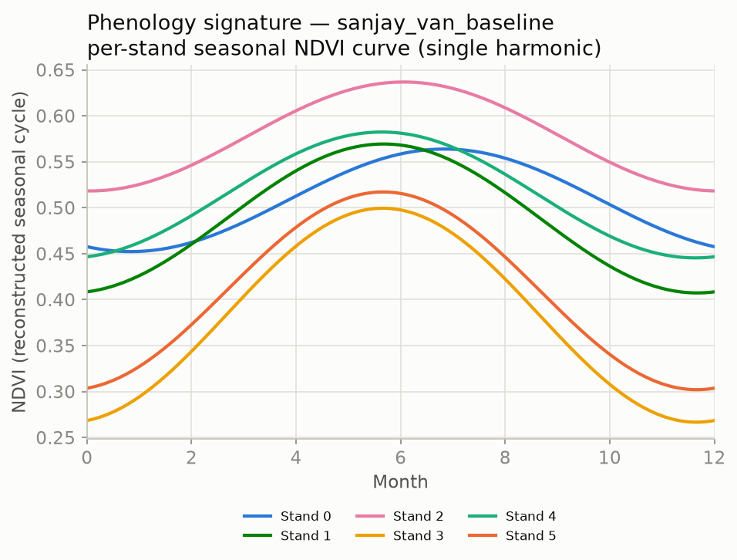
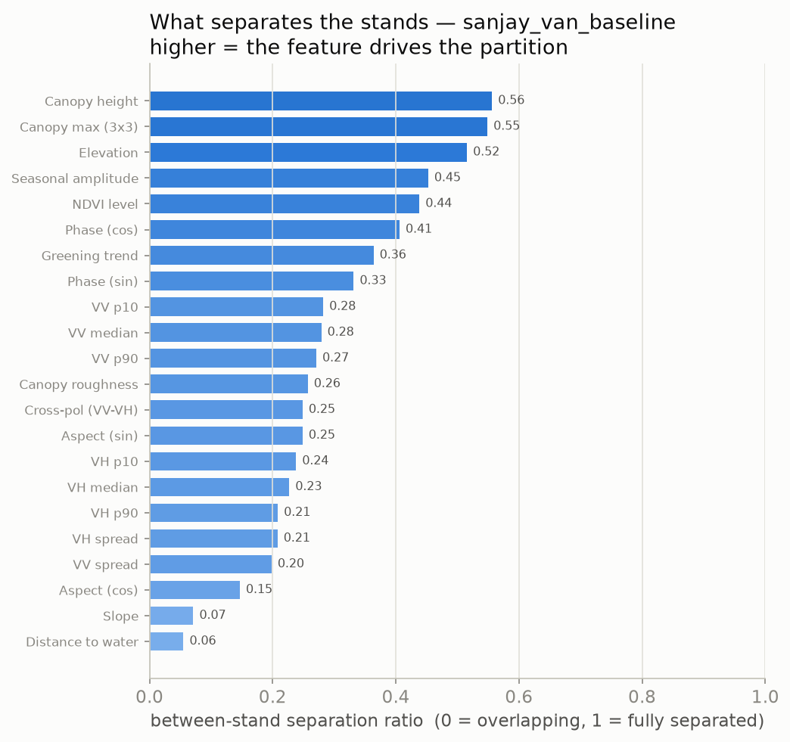
PART 1 — WHAT I HAVE DONE
What the hand-crafted stack lets me say
Baseline profiling output. Left: per-stand seasonal NDVI curve. Right: which features drive the partition (canopy height, elevation, seasonal amplitude lead).
Every stand is describable in real ecological units. The AlphaEarth embedding has no equivalent — its 64 dimensions are unnamed (see Part 3).

Slide 7
PART 1 — WHAT I HAVE DONE
What I have actually run
Replicated the full pipeline end-to-end (mask → metrics).
C-0: baseline vs variant (NDVI vs NIRv + dual-harmonic), SNIC held fixed — one completed feature-swap comparison.
Built and ran the AlphaEarth embedding arm end-to-end on Sanjay Van (Part 2).
Honest status of the AlphaEarth comparison:
Scored with internal metrics only (no external / ecological reference yet).
Run on Sanjay Van — the secondary AOI; Mudumalai (the site with field ground truth) is not yet done.
Two arms only — the Tessera arm is blocked (data coverage + ingestion bug).
Not pre-registered — no hypothesis was fixed before running.

Slide 8
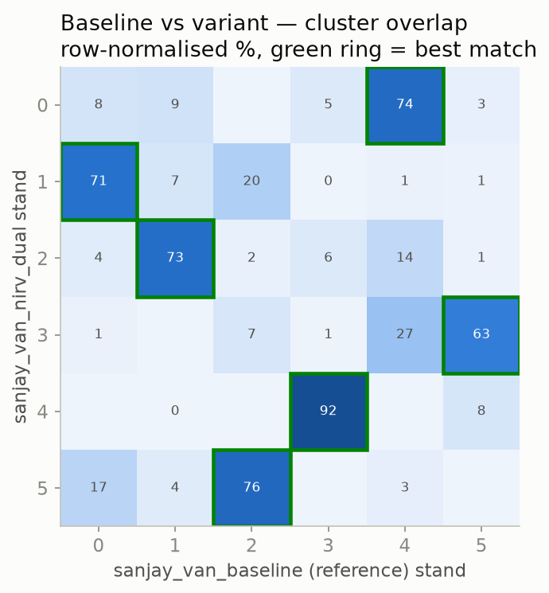
PART 1 — WHAT I HAVE DONE
The comparison I had already run (C-0)
baseline vs NIRv + dual-harmonic (optical features changed; SNIC / k / seed fixed)
Same design as the AlphaEarth swap, but only the optical features change.
Best-match overlap stays high — 73% to 92% (green rings). A small feature tweak barely moves the map.
This is the template (C-0). Part 2 runs the same experiment but swaps the whole representation — and the map moves far more (agreement drops to 41%).

Slide 9
Part 2 — how my code compares with AlphaEarth
The "swap only the feature arm" experiment, and its real outputs.

Slide 10
PART 2 — COMPARISON WITH ALPHAEARTH
The experiment: swap only the feature arm
Hand-crafted 22-band stack
k-means (k=6)
stands (Arm A)
compare:
ARI, NMI, silhouette, agreement
AlphaEarth 64-D embedding
k-means (k=6)
stands (Arm B)
Held identical for both arms: SNIC boundaries, k = 6, random seed, ROI, time window.
Only the feature vector changes — so any difference is attributable to the representation, not the pipeline.
This is exactly the "hand-crafted vs pretrained embedding" question the current literature is asking.

Slide 11
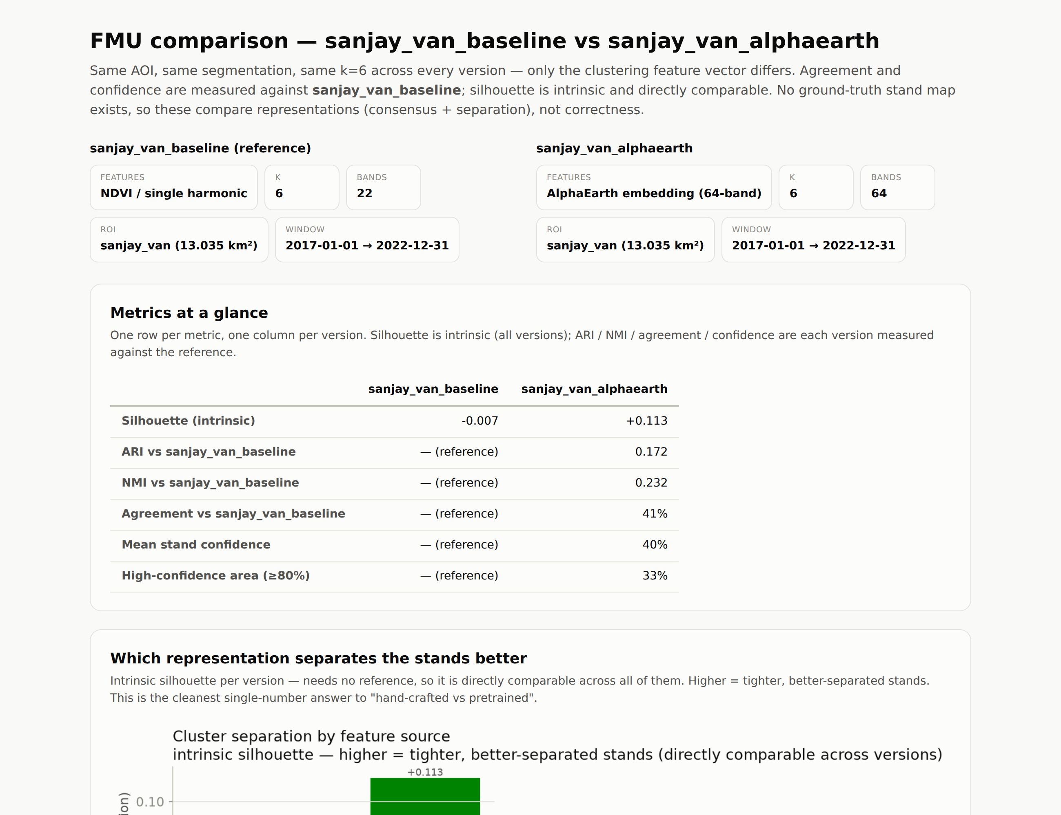
PART 2 — COMPARISON WITH ALPHAEARTH
The report my code produces
Screenshot of the HTML report generated by scripts/report.py (config summary + metrics table). Numbers below are read from this report.

Slide 12
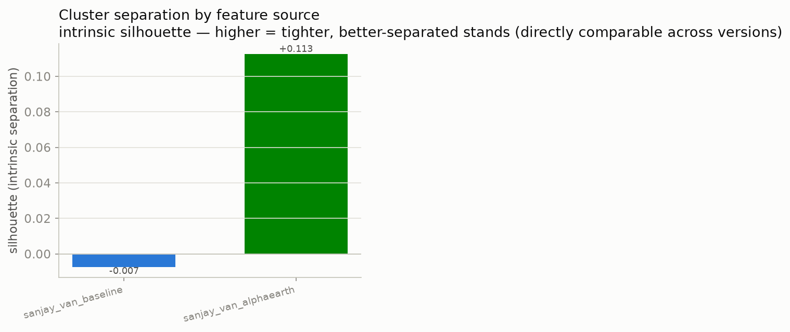
PART 2 — COMPARISON WITH ALPHAEARTH
Result 1: cluster separation (silhouette)
+0.113
AlphaEarth
−0.007
baseline (hand-crafted)
Silhouette is intrinsic (needs no reference) so it is directly comparable across arms.
AlphaEarth clusters are clearly more separable; the baseline sits essentially at zero.
Honest limit: this is an internal geometry measure, not evidence of ecological correctness.

Slide 13
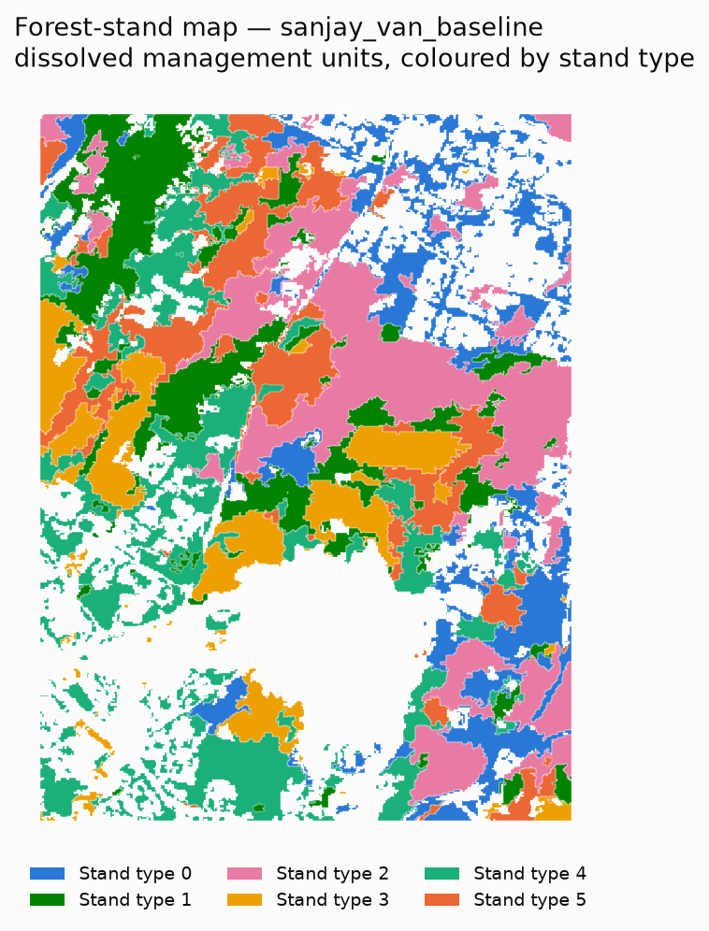
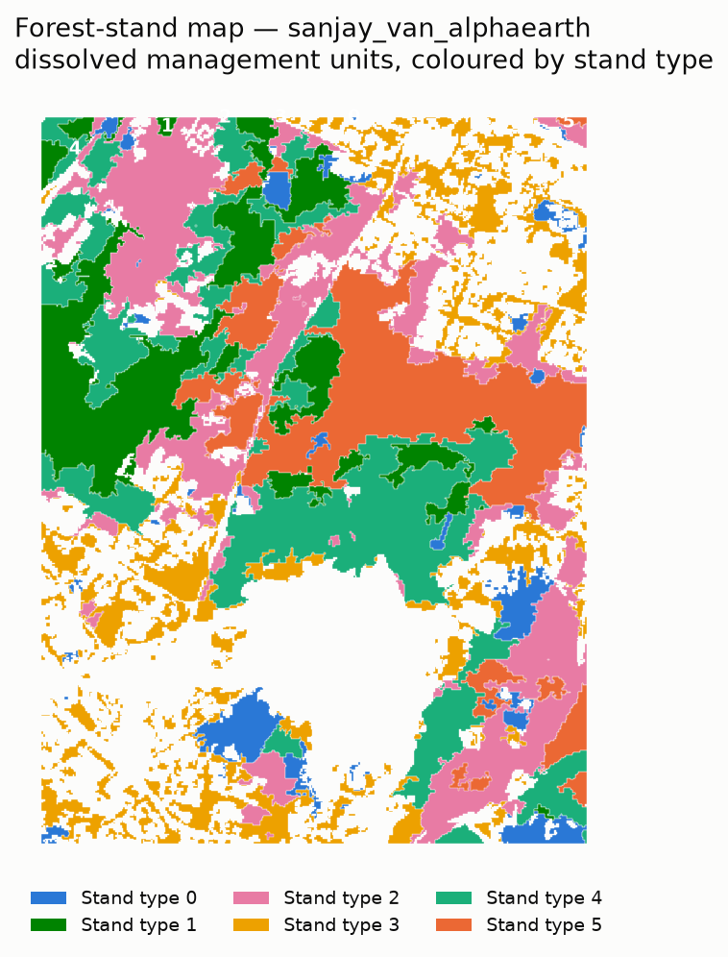
PART 2 — COMPARISON WITH ALPHAEARTH
Result 2: the stand maps
Baseline (hand-crafted)
AlphaEarth (embedding)
Same SNIC boundaries in both; only the cluster assignment differs.
Colours are per-arm — the same colour is a different stand in each map.
AlphaEarth gives larger, more contiguous stands; the baseline is more fragmented.

Slide 14
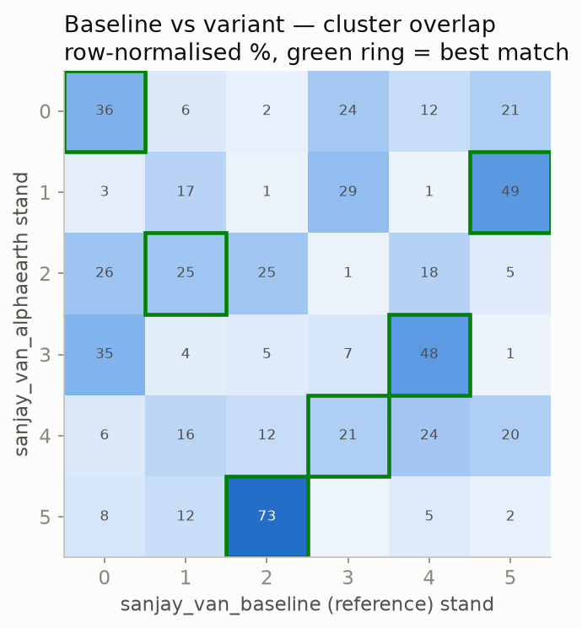
PART 2 — COMPARISON WITH ALPHAEARTH
Result 3: agreement between the two arms
ARI 0.17 NMI 0.23 Agreement 41%
Low-to-moderate agreement: after Hungarian alignment only ~41% of pixels fall in corresponding stands.
The two representations delineate the forest quite differently.
Green rings mark each AlphaEarth stand’s best-matching baseline stand — some map cleanly, others split.
Neither arm is a reference; this only quantifies how much the representation reshapes the map.

Slide 15
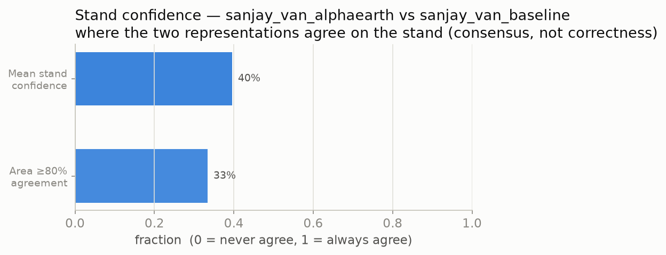
PART 2 — COMPARISON WITH ALPHAEARTH
Result 4: per-stand consensus (confidence)
mean 40% | 33% of area ≥ 80% agreement
Confidence = how often the two representations place a stand in corresponding classes (rolled up per stand).
It is a consensus / stability layer, explicitly not a correctness score — that would need ground truth.

Slide 16
PART 2 — COMPARISON WITH ALPHAEARTH
What this comparison does and does not show
It DOES show:
It does NOT show:
The two feature representations cluster the forest differently (ARI 0.17).
AlphaEarth clusters are internally more separable (silhouette +0.113 vs −0.007).
Where they agree can be mapped as a consensus layer.
That either representation is ecologically more correct — no ground truth exists.
External validity — all scores are internal (agreement between arms is not truth).
Generality — one AOI (Sanjay Van), one k, two arms, not pre-registered.
AlphaEarth: Brown et al. 2025 (arXiv:2507.22291), 64-D per-pixel annual embedding in Earth Engine. TESSERA: Feng et al. 2025 (arXiv:2506.20380), 128-D S1/S2 time-series, preserves phenology, CC0.

Slide 17
Part 3 — the gaps we identified
Gaps I found with a separate Claude Science literature review (~246 verified DOIs).

Slide 18
PART 3 — GAPS
The one gap underneath all the others
There is no independent, stand-level ground reference.
So "ecologically meaningful" is currently neither provable nor falsifiable at scale.
Unsupervised delineation has no agreed validation grammar — only internal, circular metrics.
Embedding clusters get checked against land-cover labels, not against ecology.
This is a field-wide condition, not a personal one — it is where the contribution is.
This reframes the advisor’s "going in circles" feedback: the loop is the field’s, and it points at the opening.

Slide 19
PART 3 — GAPS
Gaps on my committed path
G1 — no validation grammar for unsupervised delineation (internal metrics are circular).
G2 — a "stand" is aggregated from superpixels, never drawn or tested against a reference unit.
G3 — k and segmentation parameters chosen unprincipled; k = 6 is asserted, not swept.
G4 — embeddings vs hand-crafted features have never been raced head-to-head for stand clustering.
G10–G13 — the "spectral community" bridge (SVH) is untested in Indian dry forest, and I have no falsifiable claim yet.
My AlphaEarth run is a first attack on G4 — but internal-only, so it does not yet close it (needs G1/G2 external validation).

Slide 20
PART 3 — GAPS
The SVH test (what would close G10–G13)
Spectral Variation Hypothesis (SVH): spectral heterogeneity is a proxy for biological diversity.
Alpha-SVH: within a patch, does more spectral variation mean more species?
Beta-SVH: do two spectrally different patches also differ in species? — this is what validates a stand boundary.
Test: correlate spectral distance vs field species turnover across units, with a permutation / Mantel null.
Site: the Mudumalai ForestGEO stem-mapped plot gives the real species ground truth.
Papers I am confident about:
Schmidtlein & Fassnacht 2017 (RSE, doi:10.1016/j.rse.2017.01.036) — SVH does not hold generally (falsification). Nagendra 2010 (doi:10.3390/rs2020478) — Indian dry forest, mixed/scale-dependent. Torresani et al. 2024 (doi:10.1016/j.ecoinf.2024.102702) — 20-year review.

Slide 21
PART 3 — GAPS
What would turn my current work into a real result
Add external validation (the missing piece): score each arm against an independent reference, not just against each other.
References available now: national forest-type maps (Roy 2015 / Reddy 2015 — to confirm) and FSI products (coarse, wall-to-wall); the Mudumalai ForestGEO plot (fine, real, but one plot).
Run on Mudumalai as the primary AOI — it carries the ground truth; Sanjay Van becomes the transfer test.
Add the Tessera arm (fix the ingestion) for a three-way comparison.
Pre-register the hypothesis before running, so the pipeline can fail (closes the "no committed hypothesis" gap).

Slide 22
PART 3 — GAPS
Papers
Confident (used above):
AlphaEarth Foundations — Brown et al. 2025, arXiv:2507.22291.
TESSERA — Feng et al. 2025, arXiv:2506.20380.
Schmidtlein & Fassnacht 2017 — Remote Sensing of Environment, doi:10.1016/j.rse.2017.01.036.
Nagendra 2010 — doi:10.3390/rs2020478. Torresani et al. 2024 — doi:10.1016/j.ecoinf.2024.102702.
To confirm with Claude Science (I did not want to assert these):
SVH origin: Palmer 2002 and Rocchini 2004 — exact refs/claims.
"Spectral species": Féret & Asner 2014 — exact ref.
SVH design checklist: "Wallis 2025" — which paper exactly?
Confounds: Wang 2017 (grain/scale) and Thornley 2022 (phenology) — exact refs.
Indian forest-type reference maps: Roy 2015, Reddy 2015 — exact refs. Delineation: Xiong 2024, Sandum/Ørka 2026.

Slide 23
BOTTOM LINE
Where this honestly stands
Done: a working, reproducible, unsupervised multi-sensor pipeline, plus one completed feature-swap (C-0) and the AlphaEarth swap run end-to-end.
The AlphaEarth comparison shows the embedding separates stands better internally (+0.113 vs −0.007) and delineates differently (ARI 0.17) — but on internal metrics only, one AOI, two arms.
It is not yet a validated result: no external reference, not on the ground-truth site (Mudumalai), no pre-registered hypothesis.
The real work ahead is validation: external references now, Mudumalai run, the falsifiable SVH test — that is what turns clusters into an ecological claim.

