Slide 1
METHODOLOGY · EXPERIMENTS · RESULTS · GAPS
Forest Monitoring Units (FMU)
An unsupervised, multi-sensor framework for delineating forest stands from satellite time series — built end to end on Google Earth Engine.
Consolidated master deck — methodology (v3.1) + feature selection + two swap experiments (optical variant & AlphaEarth) + gaps, SVH test and roadmap. Every claim reconciled against the code.
Jaskaran Singh · Study areas: Sanjay Van, Delhi (13.0 km²) · Mudumalai (intended primary) · window 2017–2022

Slide 2
MOTIVATION
Drawing forest stands at scale, without labels
A stand is a patch of forest internally similar in species mix, structure and condition — and different from its neighbours. Foresters work in stands; the problem is drawing them repeatably, at scale, without hand-digitising.
Unsupervised
Multi-sensor
Where it points
No wall-to-wall label layer exists for Indian forest stand types. Supervised classification needs labels we don’t have — so let the data define the strata.
No single sensor captures a stand: optical carries phenology; radar carries structure/moisture and sees through cloud; canopy height carries vertical structure; terrain is the physical template.
Stand units are candidates for spectral/structural communities — the unit behind the Spectral Variation Hypothesis. A destination for biodiversity monitoring, not a finished result.
The pipeline does not measure biodiversity — it produces ecologically structured units that are the right input to an SVH/HVH analysis.
FMU · Forest Monitoring Units Motivation
2

Slide 3
READ THIS FIRST
The honest constraint: there is no ground truth
No field-drawn or operational reference stand map exists for these forests.
So nothing in this deck is validated as ecologically "correct" — that claim needs a reference we do not have.
Every result is bounded to what we CAN measure: internal separation (silhouette), cross-representation agreement (ARI/NMI/overlap), consensus/confidence, and interpretability.
This is a field-wide condition, not a personal one — it is exactly where the contribution lies (see Gaps & Roadmap).
The whole deck is framed this way: a methods comparison under label scarcity, not a validated map.
FMU · Forest Monitoring Units Framing
3

Slide 4
OVERVIEW
The pipeline at a glance — 11 stages
1 mask
2 load
3 optical
4 radar
5 structure
6 static
7 SNIC
8 k-means
9 profile
10 export
11 metrics
Stages 1–6 build the multi-sensor feature stack · 7 turns pixels into objects (superpixels) · 8 assigns clusters · 9–11 describe, export and evaluate.
Config-driven: every stage is a Pydantic-validated YAML config, cached as an Earth Engine asset — the whole run is reproducible and cheap to re-run.
FMU · Forest Monitoring Units Overview
4

Slide 5
DATA
Everything is free, global, and on one platform
Layer | Source | Used for
Optical surface reflectance | Sentinel-2 (harmonized SR) | Phenology (NDVI / NIRv)
C-band SAR backscatter | Sentinel-1 GRD (dB) | Structure / moisture
Canopy height | ETH Global Canopy Height, 10 m | Vertical structure
Terrain | NASADEM (SRTM lineage) | Elevation, slope, aspect
Surface water | JRC Global Surface Water | Distance to water
Rainfall | CHIRPS | Climate context
Habitat mask — primary | IndiaSAT LULC · CoRE Stack LULC_v4 | Restrict to forest / shrub
Habitat mask — fallback | ESA WorldCover 10 m v200 | Restrict to forest / shrub
Compute platform | Google Earth Engine | The whole pipeline
FMU · Forest Monitoring Units Data
5

Slide 6
STAGE 1 · MASKING
Make the clustering question well-posed
Cluster only what is actually forest or shrub. Leave cropland, built-up, water and bare ground in, and the clusterer spends its budget separating tree from parking lot — instead of one forest type from another.
Without masking
Habitat only
Clusters split by land use — forest vs road vs field.
Clusters split by forest type — the question we actually want answered.
One binary mask, applied once, up front. Everything downstream runs inside it.
FMU · Forest Monitoring Units Stage 1 · Masking
6

Slide 7
STAGE 1 · MASKING
Habitat = IndiaSAT trees + shrubs
Value | IndiaSAT class
6 | Trees · HABITAT
12 | Shrubs / Scrubs · HABITAT
1 | Built-up
2–4 | Water (seasonal)
5, 8–11 | Crops (by intensity)
7 | Barren
0 | Background
Primary: CoRE Stack LULC_v4 (annual 30 m maps, band predicted_label) — the openly-readable form of IndiaSAT. Classes 6 + 12 kept; all else excluded.
Fallback: ESA WorldCover v200 classes 10/20/30 (tree/shrub/grassland), only where IndiaSAT is unavailable.
Single phase: no separate water mask — water is dropped because its classes aren’t in the habitat set. JRC water is used later for distance, not masking.
Across annual maps (2017–2021) each pixel’s habitat is a majority vote over usable years; ties go to the most recent usable year.
Change from older code: the old WorldCover + JRC water + Open Buildings + VIIRS three-phase mask is superseded by IndiaSAT-first, single phase (fixes mode collapse).
FMU · Forest Monitoring Units Stage 1 · Masking
7

Slide 8
STAGE 2 · DATA LOADING
Pull, composite, and align every sensor
Sentinel-2 — harmonized SR, cloud-masked, composited; feeds NDVI (baseline) or NIRv (variant).
Sentinel-1 — GRD, already in decibels; ASCENDING orbits only.
ETH canopy height, NASADEM — single static rasters. JRC water & CHIRPS — for the static-feature stage.
2017–2022 — a 6-year window; every time-series feature shares the same temporal support.
Why harmonized S2
After Jan 2022 ESA shifted the reflectance offset; an unharmonized series would show a fake step the harmonic fit misreads as phenology.
ASCENDING-only · judgment call
Mixing ascending/descending passes mixes viewing geometries and shifts backscatter. One orbit removes that, at the cost of ~half the observations. Unvalidated.
FMU · Forest Monitoring Units Stage 2 · Data
8

Slide 9
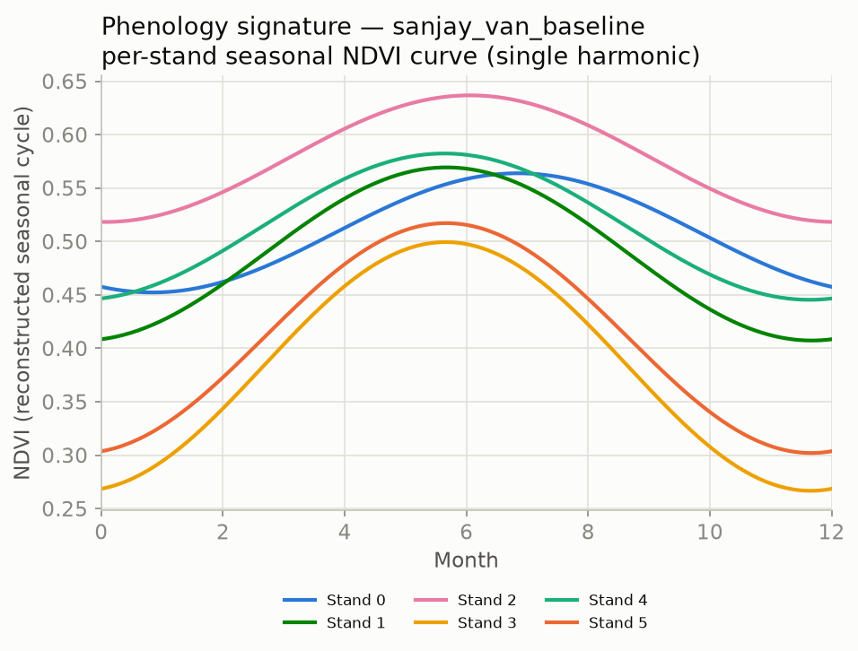
STAGE 3 · OPTICAL
Phenology is a fingerprint
A forest patch has a yearly rhythm: when it greens up, how strongly it swings between seasons, whether it is greening or browning year on year. Two patches identical in a single snapshot can have completely different calendars.
So summarise the whole 6-year curve with a few interpretable numbers — not one date.
Per-stand seasonal NDVI (real baseline run) — amplitude separates evergreen from deciduous behaviour.
FMU · Forest Monitoring Units Stage 3 · Optical
9

Slide 10
STAGE 3 · OPTICAL
The harmonic model
NDVI(t) = a + b·cos(2πt) + c·sin(2πt) [ + semi-annual term ] + f·t ( t = years since 2017-01-01, fit per pixel )
Feature | Formula | What it means ecologically
mean | a | Overall greenness / productivity level
amplitude_annual | √(b² + c²) | Size of the yearly swing (evergreen vs deciduous)
phase_annual | atan2(c, b) | Timing of peak greenness within the year
trend | f | Inter-annual greening (+) or browning (−)
residual_variance | var(residuals) | Fit quality — DIAGNOSTIC only, NOT a clustering feature
Baseline fits NDVI; variant fits NIRv (less confounded by soil/saturation) and adds a semi-annual term. residual_variance is exported as a diagnostic — the code now excludes it from clustering.
FMU · Forest Monitoring Units Stage 3 · Optical
10

Slide 11
STAGE 4 · RADAR
Structure and moisture, through cloud
Through cloud
Structure & moisture
Cross-pol VH
C-band backscatter is unaffected by cloud, smoke or illumination — observations when optical fails.
Backscatter rises with vegetation volume and water content, independent of canopy colour.
The cross-polarised return is sensitive to volume scattering of a structured canopy; the VH–VV relationship tracks density and phenology.
Radar does two things optical cannot: it sees through cloud, and it responds to structure and moisture rather than colour — not a luxury for a cloudy-season country.
FMU · Forest Monitoring Units Stage 4 · Radar
11

Slide 12
STAGE 4 · RADAR
What we compute from Sentinel-1 — 9 features
Group | Features | Meaning
Percentiles | VV p10/p50/p90 · VH p10/p50/p90 | low / median / high backscatter over 6 years
Temporal spread | vv_iqr, vh_iqr (p90 − p10) | how much backscatter varies through time
Cross-pol contrast | vv_minus_vh_median | the cross-polarisation contrast, in dB
Contrast in dB: a difference in dB is the log of a ratio, so VV − VH is the cross-pol ratio expressed additively — the scale-stable encoding.
No spatial speckle filter: speckle averages down over independent looks; temporal percentiles and a 6-year median suppress it without blurring boundaries.
Code fix reflected: the temporal spread is p90 − p10 (was IQR).
FMU · Forest Monitoring Units Stage 4 · Radar
12

Slide 13
STAGE 5 · STRUCTURE
Canopy height and its local texture
Feature | What it is
canopy_height | ETH 10 m height — the most direct structural variable available wall to wall
canopy_height_std | std in a 3×3 window — local roughness of the canopy top
canopy_height_max | max in a 3×3 window — the tallest neighbour (smooth plantation vs ragged natural canopy)
Why ETH, and where it leads
ETH fuses GEDI lidar with Sentinel-2 into a continuous 10 m raster — chosen over GEDI’s sparse footprints, which a wall-to-wall segmentation can’t use. Canopy-height heterogeneity is itself a proposed diversity proxy under the Height Variation Hypothesis (HVH).
FMU · Forest Monitoring Units Stage 5 · Structure
13

Slide 14
STAGE 6 · STATIC
Terrain, water, and rainfall
Terrain — elevation, slope, aspect from NASADEM: the physical template that sets moisture, insolation and drainage.
Distance to water — to nearest JRC permanent-water pixel, capped at 1000 px (a reasonable but arbitrary cutoff — judgment call).
Rainfall — annual_rainfall, the CHIRPS climatological mean: context, useful for larger AOIs.
annual_rainfall is dropped at clustering · reasoning
CHIRPS pixels are ~5.5 km, so a site like Sanjay Van sits inside roughly one cell — the variable is near-constant across the AOI and adds no within-AOI separation, so it is computed but kept out of the clustering vector. Aspect is circular and is decomposed (sin/cos) before clustering.
FMU · Forest Monitoring Units Stage 6 · Static
14

Slide 15
FEATURE SPACE
The feature space — 22 baseline, 25 variant
Optical phenology: mean, amplitude, phase (sin/cos), trend — NDVI (baseline) or NIRv + semi-annual (variant).
Radar (9): VV/VH p10/p50/p90, vv_iqr, vh_iqr, vv_minus_vh_median.
Structure (3): canopy_height, _std, _max.
Static: elevation, slope, aspect (sin/cos).
Computed but NOT clustered — each for a stated reason
residual_variance — a fit-quality diagnostic (cloud, sparse obs), not ecology.
annual_rainfall — near-constant over a small AOI.
obs_count — a data-density diagnostic.
With phase/aspect each expanded into sin/cos and the three diagnostics excluded, the clustering vector is exactly 22 (baseline) / 25 (variant).
Retires the old deck’s 20–21 / 23–26 counts; code and deck now agree on 22 / 25 and on the exclude-list.
FMU · Forest Monitoring Units Features
15

Slide 16
STAGE 7 · SEGMENTATION
Cluster places, not pixels
Clustering raw pixels gives salt-and-pepper: neighbours in the same stand scatter into different clusters because of per-pixel noise.
per-pixel features
group adjacent, similar pixels
(SNIC superpixels)
cluster the segments
Group adjacent, similar pixels into segments first, then cluster the segments — within-stand variability drops out. In computer-vision terms these segments are superpixels.
Segment-then-classify over per-pixel clustering is well established (OBIA).
FMU · Forest Monitoring Units Stage 7 · Segmentation
16

Slide 17
STAGE 7 · SEGMENTATION
SNIC superpixels
An improvement on SLIC: non-iterative, enforces connectivity from the start, low memory, fast — well suited to Earth Engine.
Runs on 5 normalised bands: B4_median · B8_median · composite_nirv · canopy_height · vv_minus_vh_median.
Parameters: size 10 · compactness 0.5 · connectivity 8 · neighbourhood 128 — chosen empirically, not swept (judgment call).
Z-scored first, so canopy height in metres can’t dominate reflectances in [0,1].
Boundaries FIXED across configs
SNIC is computed once and held byte-identical for baseline, variant AND the embedding arm — the lever that isolates the feature effect. It is the experimental control for every comparison in this deck.
FMU · Forest Monitoring Units Stage 7 · Segmentation
17

Slide 18
FEATURE SELECTION · SEGMENTATION
Segmentation features ≠ clustering features
SNIC only draws boundaries (where the landscape changes); k-means decides what each region is (the full 22/25 stack). Boundary-finding uses a deliberately reduced set — for four reasons.
Redundancy
Noise
Most of the 22 share a source and are correlated; feed them all and whichever sensor has the most columns dominates the distance. One representative per signal.
Noisier derived bands (phase, trend, residual variance, the IQRs) inject spurious per-pixel texture — SNIC would carve superpixels around fitting artifacts.
Dimensionality
Experimental control
SNIC trades feature distance against spatial compactness; add bands and the feature distances concentrate, the spatial term is swamped, superpixels stop being clean.
Boundaries must be identical across configs to isolate the feature effect — that requires a fixed band set; the variant’s extra harmonics must not move segments.
FMU · Forest Monitoring Units Feature selection
18

Slide 19
FEATURE SELECTION · SEGMENTATION
Why these five SNIC bands
Band | Axis | Why it earns a slot
B4 — red (median) | Optical colour | Strongest single optical separator (red/NIR edge); median = temporally stable
B8 — NIR (median) | Optical colour | Pairs with red for the vegetation edge
composite NIRv | Optical productivity | One integrative, soil/saturation-robust greenness summary shared by both configs
canopy_height | Vertical structure | The dominant empirical separator (~11.5 m cluster spread at Sanjay Van)
vv_minus_vh_median | Radar structure | Marks boundaries under cloud/canopy that reflectance misses
The span is optical colour + productivity + vertical structure + radar structure (minimal redundancy). The exact five were not ablated vs another four/six — same status as the SNIC parameters, under the "no sensitivity analysis" gap.
FMU · Forest Monitoring Units Feature selection
19

Slide 20
STAGE 8 · CLUSTERING
From superpixels to clusters
superpixel →
one feature vector
cyclic sin/cos
(phase, aspect)
log skewed
bands
robust median/IQR
scale
k-means++
(k = 6)
Exclude-list — code and deck agree
residual_variance is a fit-quality diagnostic, not a feature: the clustering exclude-list drops it alongside obs_count and annual_rainfall, so k-means never sees it.
Cyclic sin/cos so December (≈2π) and January (≈0) aren’t "far apart"; log compresses right tails; robust median/IQR is outlier-resistant; standardise so no band dominates Euclidean distance.
FMU · Forest Monitoring Units Stage 8 · Clustering
20

Slide 21
STAGE 8 · CLUSTERING
What’s principled — and what’s still a guess
Principled (reasoning)
Judgment calls (need validation)
Cyclic sin/cos for phase & aspect
Log-transform for skewed bands
Robust median/IQR scaling
Standardise before Euclidean distance
k-means++ seeding for stability
k = 6 — needs a silhouette/elbow sweep or ecological prior
seed = 42
skewness threshold = 1.0
10,000-superpixel training sample
FMU · Forest Monitoring Units Stage 8 · Clustering
21

Slide 22
FEATURE SELECTION · CLUSTERING
Keep weak features — decide by ablation, not assertion
Keep — "weak" ≠ "useless"
Genuine drop candidates
Site-specific: amplitude/phase are flat in urban scrub but dominant across Mudumalai’s deciduous gradients — pruning to one weak AOI breaks transfer.
Marginal ≠ joint: k-means uses joint distance; a feature with small 1-D spread can still split otherwise-overlapping clusters.
Descriptive value + ~zero cost (already computed).
SAR IQRs (vv_iqr, vh_iqr): near-zero spread AND a mechanism — ASCENDING-only, limited looks may be capturing speckle/sampling variance, not real dynamics. Strongest ablation target.
vv_minus_vh_median: weak in profiles but doing double duty as a SNIC band — test before assuming idle.
The test (Phase 0): full stack vs reduced stack — compare partitions with the ARI/NMI already in the pipeline, run at BOTH Sanjay Van and Mudumalai.
ARI ≈ 1 at Sanjay Van but the reduced set collapses clusters at Mudumalai → the weak features do transferable work, keep them. Dropping the SAR IQRs changes nothing anywhere → drop them, and say why. Trap: don’t over-prune toward "only what separates Sanjay Van".
FMU · Forest Monitoring Units Feature selection
22

Slide 23
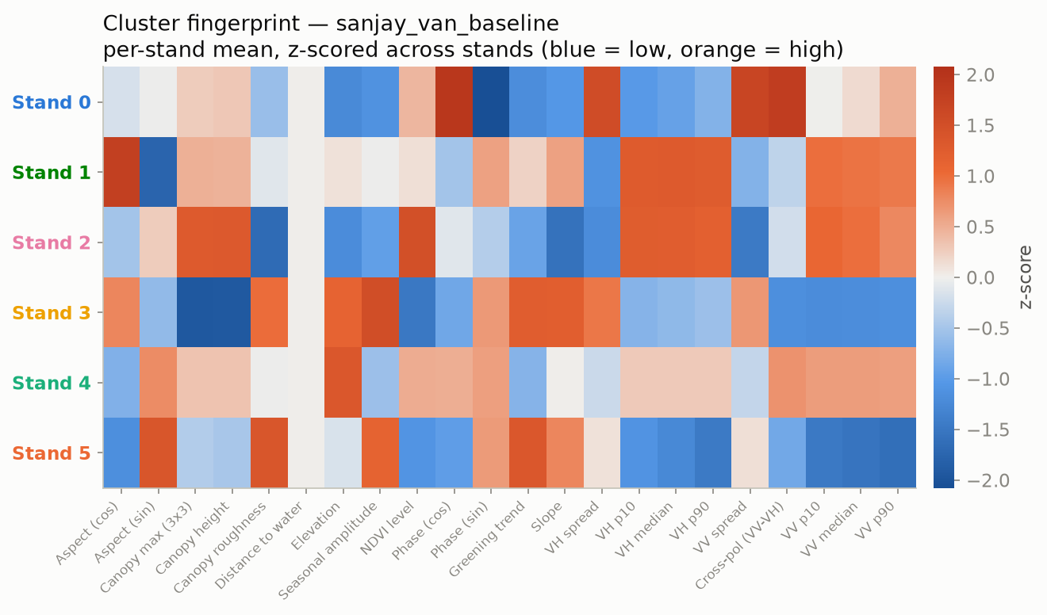
STAGE 9 · PROFILING
Give every cluster a readable fingerprint
Summarise each cluster’s features in original units — height in metres, backscatter in dB, NDVI unitless — not scaled space.
Clusters are only interpretable if you can read them as "tall, low-seasonality, far from water".
Output: cluster_profiles.csv — one row per cluster, the fingerprint of each stand type, the input to every results figure.
Per-stand z-scored feature signature (real baseline run): orange above / blue below the cross-stand average.
FMU · Forest Monitoring Units Stage 9 · Profiling
23

Slide 24
STAGE 10 · EXPORT
Rasters, vectors, and a manifest
Raster
Three GeoTIFFs — the single-band cluster-label map, plus two multi-band rasters carrying every feature (one in original units, one in the scaled space k-means saw) with the cluster label.
Vectors
stands_snic (the superpixels) and stands_dissolved (superpixels merged by cluster into stand polygons) — each as SHP and GeoJSON.
Manifest
A record of configuration and outputs — what makes a run repeatable.
stands_dissolved is the usable stand map — the layer a forester or ecologist actually opens (the old export slide omitted it; B4 GeoTIFF fix applied).
FMU · Forest Monitoring Units Stage 10 · Export
24

Slide 25
STAGE 11 · METRICS
Scoring a configuration
Metric | What it measures
Silhouette | Internal cohesion vs separation of one clustering — no labels needed (intrinsic)
Adjusted Rand Index (ARI) | Agreement of two partitions, corrected for chance
Normalized Mutual Information (NMI) | Shared information between two partitions
Hungarian correspondence | Optimal one-to-one matching of cluster IDs between two runs
Silhouette is internal — it judges one clustering’s geometry. ARI and NMI are comparative — how much two clusterings agree. The Hungarian step lines up cluster IDs first, since cluster 3 in one run may be cluster 5 in another. Higher silhouette = tighter, better-separated stands; it needs no ground truth, so it is the one number directly comparable across every arm.
FMU · Forest Monitoring Units Stage 11 · Metrics
25

Slide 26
EXPERIMENT 1 · OPTICAL
Baseline vs variant — one variable changed
NDVI single-harmonic vs NIRv + dual-harmonic. SNIC held fixed, so any difference is the optical features alone.

Slide 27
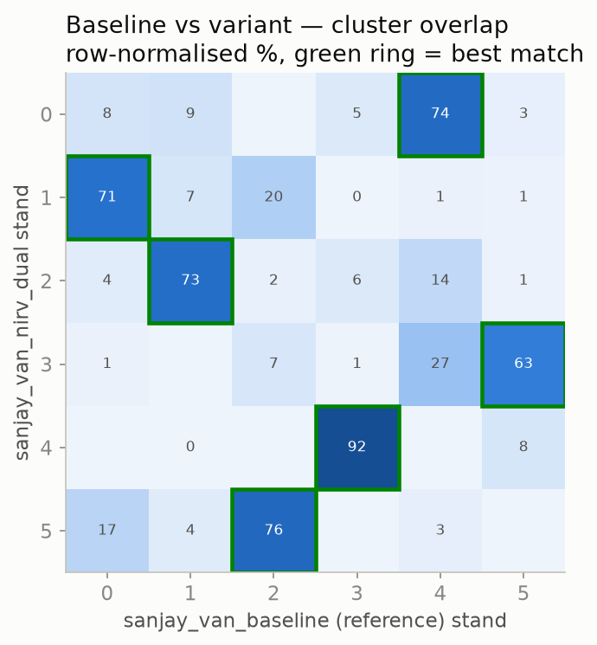
EXPERIMENT C-0 · RESULT
Does NIRv + dual-harmonic change the map?
ARI 0.49 · NMI 0.55 — the two partitions agree moderately, not fully.
73% of superpixels keep the same stand once cluster IDs are aligned.
Silhouette −0.007 (baseline) → +0.010 (variant): both near zero — stands overlap heavily in feature space either way.
The variant reshuffles some boundaries but does not, here, produce a sharply better-separated map.
Row-normalised overlap after Hungarian matching (green ring = best match). SNIC fixed, so the difference is the optical features alone. Distinct from Experiment C-1 (AlphaEarth).
FMU · Forest Monitoring Units Experiment C-0
27

Slide 28
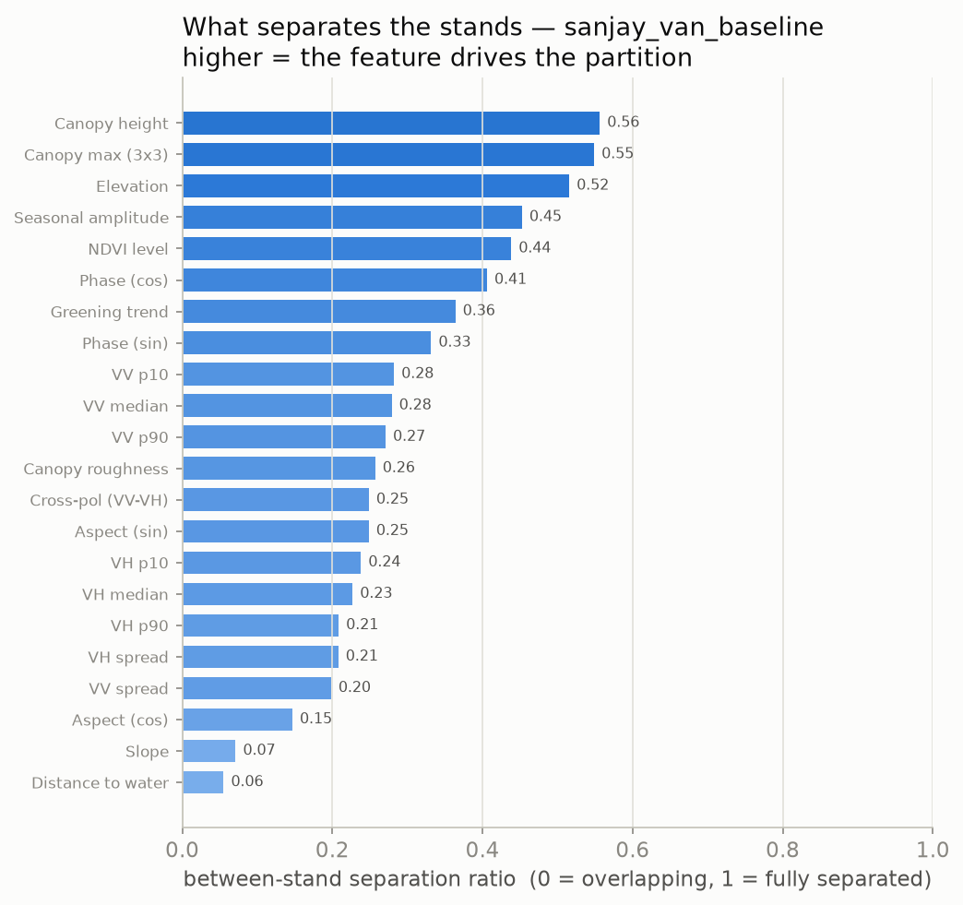
BASELINE RUN · RESULTS
What separates the stands at Sanjay Van
Canopy structure leads — the stands are mostly a structural partition.
Radar backscatter is the secondary axis; NDVI level and cross-pol separate weakly.
distance_to_water is flat — near-constant across stands here.
An urban-forest finding: stands differ more in build than in greenness rhythm — one reason the NIRv/dual-harmonic variant exists.
Between-stand separation per feature (real baseline run). Higher = the feature drives the partition.
FMU · Forest Monitoring Units Results
28

Slide 29
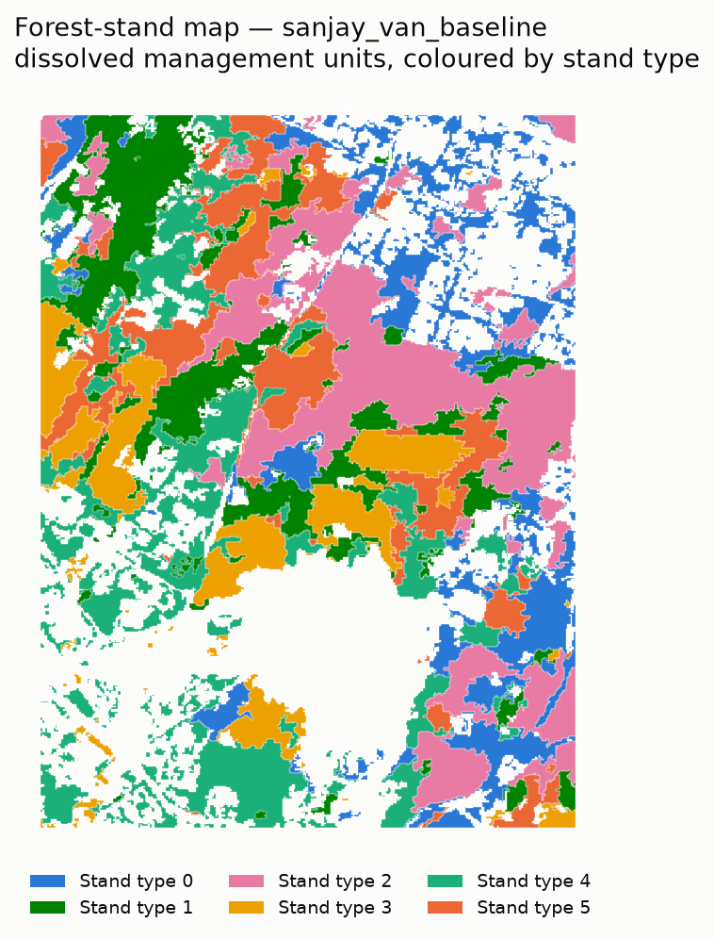
BASELINE RUN · RESULTS
The stand map and what defines each stand
Stand map (stands_dissolved)
Per-stand signature (z-scored)
Six stand types over ~968 ha of habitat inside the 13.0 km² AOI. Each colour = one k-means cluster. Canopy-height and radar columns carry the strongest contrast; distance_to_water is flat.
FMU · Forest Monitoring Units Results
29

Slide 30
BASELINE RUN · RESULTS
The seasonal rhythm of each stand
Every stand greens up mid-year with the monsoon — the timing (phase) is shared.
They separate mainly in overall NDVI level and in amplitude (the size of the seasonal swing).
Amplitude is what tells evergreen-like from deciduous-like behaviour.
Per-stand seasonal NDVI rebuilt from the fitted harmonic (real baseline run).
FMU · Forest Monitoring Units Results
30

Slide 31
EXPERIMENT 2 · EMBEDDING
Baseline vs AlphaEarth — swap the whole feature arm
The field has moved from hand-engineering features to clustering pretrained per-pixel embeddings. Same SNIC, same k — only the feature vector changes.

Slide 32
EXPERIMENT C-1 · CONTEXT
From hand-crafted features to pretrained embeddings
AlphaEarth Foundations (Brown et al. 2025): a 64-D embedding per 10 m pixel per year, global, shipped inside Earth Engine — designed as a drop-in feature vector.
TESSERA (Feng et al. 2025): 128-D, self-supervised on Sentinel-1/2 time series, preserves phenology, CC0 — the open counterpart (intended 3rd arm).
Clustering a pretrained embedding is now a mainstream workflow — the field independently converged on FMU’s "embedding → k-means → strata" design.
The honest question is not "why not embeddings?" but "do they produce more-separable stands than the hand-crafted stack, here?" — a falsifiable test.
FMU · Forest Monitoring Units Experiment C-1
32

Slide 33
EXPERIMENT C-1 · DESIGN
Swap only the feature arm
Hand-crafted 22-band stack
k-means (k=6)
stands (Arm A)
compare:
ARI · NMI · silhouette · agreement
AlphaEarth 64-D embedding
k-means (k=6)
stands (Arm B)
Held identical for both arms: SNIC boundaries · k = 6 · random seed · ROI · time window. Only the feature vector changes — so any difference is the representation, not the pipeline.
FMU · Forest Monitoring Units Experiment C-1
33

Slide 34
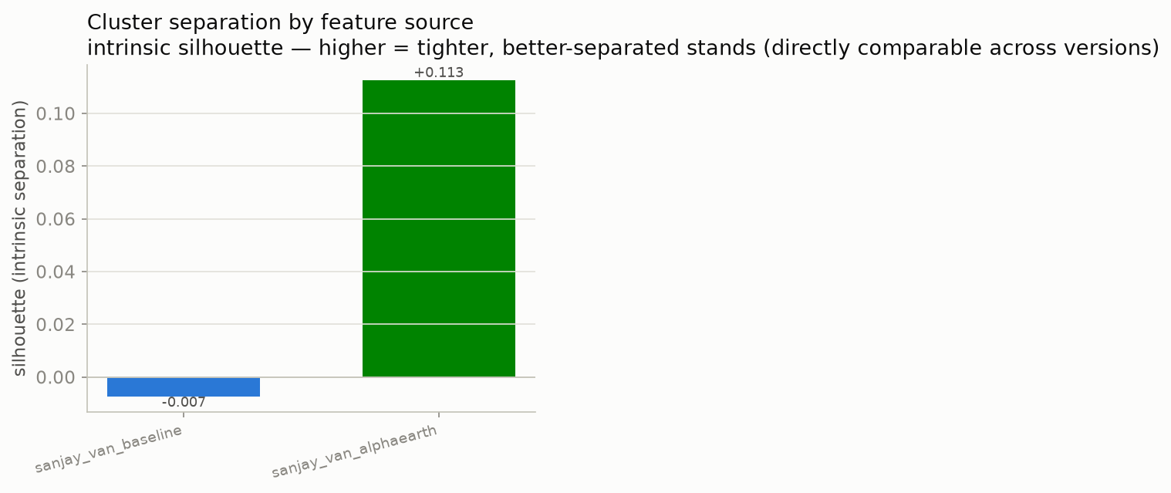
EXPERIMENT C-1 · RESULT 1
AlphaEarth separates the stands far better
+0.113
AlphaEarth silhouette
−0.007
baseline silhouette
Silhouette is intrinsic — comparable across arms without any reference.
AlphaEarth is clearly more separable; the baseline sits essentially at zero.
Honest limit: +0.113 is still "weak structure" in absolute terms, and this is internal geometry — not ecological correctness.
FMU · Forest Monitoring Units Experiment C-1
34

Slide 35

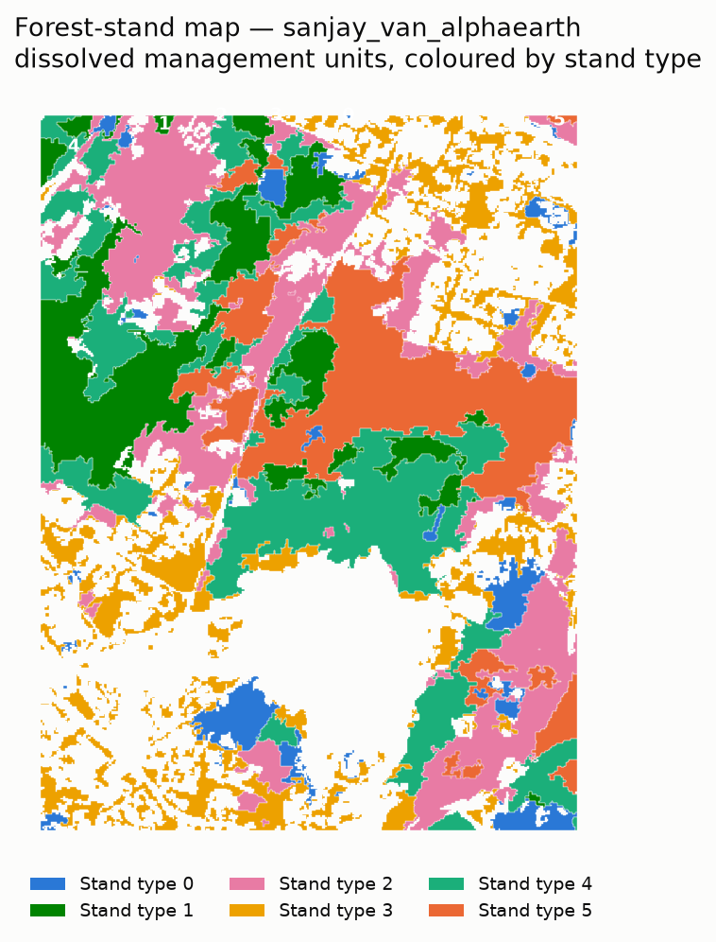
EXPERIMENT C-1 · RESULT 2
Same boundaries, different stands
Baseline (hand-crafted)
AlphaEarth (embedding)
Same SNIC boundaries in both; only the cluster assignment differs.
Colours are per-arm — the same colour is a different stand in each map.
AlphaEarth gives larger, more contiguous stands; the baseline is more fragmented — the visual counterpart of the silhouette gap.
FMU · Forest Monitoring Units Experiment C-1
35

Slide 36
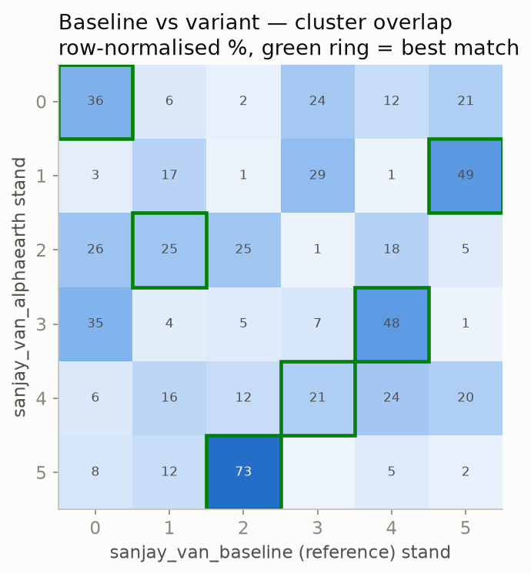
EXPERIMENT C-1 · RESULT 3
The two representations delineate quite differently
ARI 0.17 NMI 0.23 Agreement 41%
Low-to-moderate agreement: after Hungarian alignment only ~41% of pixels fall in corresponding stands.
Green rings mark each AlphaEarth stand’s best-matching baseline stand — one maps cleanly (73%), a few moderately (49%, 48%), two are smeared.
Neither arm is a reference; this only quantifies how much the representation reshapes the map.
FMU · Forest Monitoring Units Experiment C-1
36

Slide 37
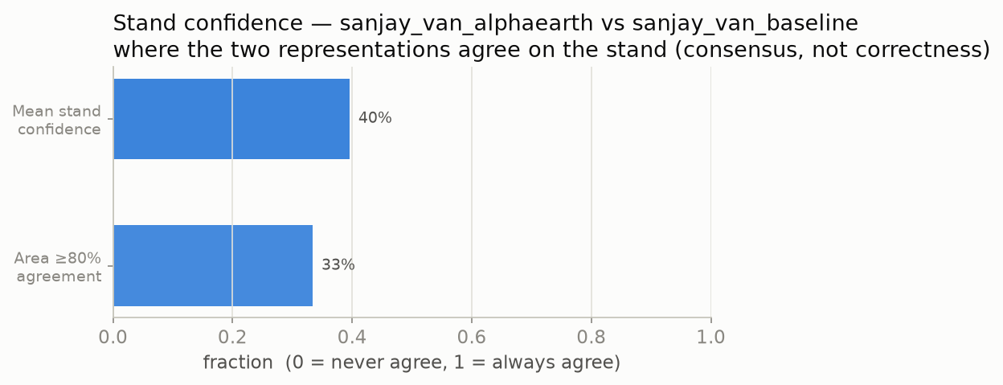
EXPERIMENT C-1 · RESULT 4
A per-stand consensus (confidence) layer
mean 40% 33% of area ≥ 80% agreement
Confidence = how often the two representations place a stand in corresponding classes (the agreement map rolled up per stand).
A stability / uncertainty layer a forester can act on — explicitly NOT a correctness score, which would need ground truth.
FMU · Forest Monitoring Units Experiment C-1
37

Slide 38
EXPERIMENT C-1 · TRADE-OFF
Separability comes at the cost of interpretability
Baseline — readable
AlphaEarth — abstract
Clusters profile in real ecological units:
canopy height & vertical structure
NDVI mean, amplitude & phenological phase
VV/VH radar backscatter · elevation, slope
→ "Stand 3 is short, sparse canopy on a dry slope."
Clusters profile in 64 learned dimensions:
A00, A01, A02 … A63 — no physical units
more separable, but not directly nameable
ecological meaning must be recovered post-hoc
→ "Stand 3 is high on A17, low on A40." — separable, not self-explaining.
FMU · Forest Monitoring Units Experiment C-1
38

Slide 39
EXPERIMENT C-1 · HONEST READING
What this comparison does and does not show
It DOES show
It does NOT show
The two representations cluster the forest differently (ARI 0.17).
AlphaEarth clusters are internally more separable (+0.113 vs −0.007).
Where they agree can be mapped as a consensus layer.
That either representation is ecologically more correct — no ground truth.
External validity — all scores are internal (agreement between arms is not truth).
Generality — one AOI (Sanjay Van, the secondary site), one k, two arms, not pre-registered.
A real Phase-1 result needs external validation + the Mudumalai run + a pre-registered hypothesis (see Roadmap).
FMU · Forest Monitoring Units Experiment C-1
39

Slide 40
INTENDED THIRD ARM
Tessera — attempted, not completed
What it is & why
Why it is blocked
A second pretrained per-pixel embedding (128-D, S1/S2 time-series, preserves phenology, CC0) — off-GEE, ingested as an EE asset.
Goal: a three-way comparison (hand-crafted vs AlphaEarth vs Tessera).
The pipeline is already source-agnostic: the features_embedding stage loads either embedding unchanged.
Coverage: for the Delhi ROI, Tessera publishes tiles only for 2024–2025 — a temporal mismatch with AlphaEarth’s 2017–2022 window.
Ingestion: geotessera 0.9.0 reports a covering tile but writes no GeoTIFF, so the mosaic step fails.
Status: scaffolding in place; a clean run needs a fixed fetch + a stated window caveat.
Reported transparently: the third arm is future work, not a result. No Tessera numbers appear anywhere in this deck.
FMU · Forest Monitoring Units Tessera
40

Slide 41
GAPS & ROADMAP
Where this goes next
From a separate literature review (~246 verified DOIs): the field is six currents around one binding constraint — and India owns that constraint.

Slide 42
GAPS
The one gap underneath all the others
There is no independent, stand-level ground reference.
So "ecologically meaningful" is neither provable nor falsifiable at scale.
Unsupervised delineation has no agreed validation grammar — only internal, circular metrics.
Embedding clusters get checked against land-cover labels, not against ecology.
This is a field-wide condition — and India (FSI working-plan compartments + Mudumalai ForestGEO) is where the reference can be built. That is a comparative advantage in ground truth, the field’s binding constraint.
FMU · Forest Monitoring Units Gaps
42

Slide 43
GAPS
Gaps on the committed path
ID | Gap
G1 | No validation grammar for unsupervised delineation (internal metrics are circular)
G2 | A "stand" is aggregated from superpixels, never drawn or tested against a reference unit
G3 | k and segmentation parameters chosen unprincipled; k = 6 asserted, not swept
G4 | Embeddings vs hand-crafted features never raced head-to-head for stand clustering
G10–G13 | The "spectral community" bridge (SVH) is untested in Indian dry forest; no falsifiable claim yet
The AlphaEarth run (C-1) is a first attack on G4 — but internal-only, so it does not yet close it; it needs G1/G2 external validation.
FMU · Forest Monitoring Units Gaps
43

Slide 44
GAPS · THE SCIENTIFIC CORE
The SVH test (what would close G10–G13)
Spectral Variation Hypothesis (SVH): spectral heterogeneity as a proxy for biological diversity.
Alpha-SVH: within a patch, does more spectral variation mean more species?
Beta-SVH: do two spectrally different patches also differ in species? — THIS validates a stand boundary.
Test: correlate spectral distance vs field species turnover across units, with a permutation / Mantel null (spatial autocorrelation fakes a positive otherwise).
Site: the Mudumalai ForestGEO stem-mapped plot gives the real species ground truth.
It is falsifiable — the sharpest paper in the field is a falsification (Schmidtlein & Fassnacht 2017); in Indian dry forest it was tested once, with mixed results (Nagendra 2010).
FMU · Forest Monitoring Units SVH
44

Slide 45
GAPS
What would turn C-1 into a real result
Add external validation (the missing piece): score each arm against an independent reference, not just against each other — national forest-type maps (Roy 2015 / Reddy 2015) and FSI products (coarse, wall-to-wall), plus the Mudumalai ForestGEO plot (fine, real, one plot).
Run on Mudumalai as the primary AOI — it carries the ground truth; Sanjay Van becomes the transfer test.
Add the Tessera arm (fix ingestion) for a three-way comparison.
Pre-register the hypothesis before running, so the pipeline can fail (closes the "no committed hypothesis" gap).
Internal + exploratory → tested + externally validated. That is the jump from "we produced a map" to "we tested a hypothesis about the map."
FMU · Forest Monitoring Units Gaps
45

Slide 46
ROADMAP
The phased plan
Phase 0 (2–4 wk)
Make the replication defensible k-selection sweep · parameter & feature-ablation sensitivity (both AOIs) · complete the Mudumalai run.
Phase 1 (2–3 mo)
Embeddings swap, externally validated → first paper Add AlphaEarth (+ Tessera) arms; score internal AND external; pre-register the falsifiable H0.
Phase 2 (4–6 mo)
The falsifiable SVH/HVH test → scientific core Reuse Phase-1 references; test spectral-community boundaries vs field turnover at Mudumalai.
Phase 3 (start now)
The Indian stand-reference layer → unique asset FSI working-plan compartments; digitise a division. Access is the bottleneck — begin in month 1.
FMU · Forest Monitoring Units Roadmap
46

Slide 47
HONEST LIMITATIONS
Open decisions and known gaps
Inherited / unvalidated settings
Structural gaps — next phase
k = 6 — not justified by a sweep or ecological prior
seed = 42 · skewness threshold = 1.0
SNIC size / compactness / connectivity / neighbourhood
the 5 SNIC bands (not ablated)
10,000-superpixel training sample
distance-to-water cap (1000 px)
ASCENDING-only Sentinel-1
No validation framework beyond visual inspection and internal metrics — clusters not checked against an independent ground reference.
No parameter/feature sensitivity analysis yet — we don’t know how far the map moves when the constants move.
No committed falsifiable hypothesis — the framework produces stands but hasn’t stated a claim it could fail.
FMU · Forest Monitoring Units Limitations
47

Slide 48
CONCLUSIONS
What we can honestly say
1. A working, reproducible pipeline
FMU delineates forest stands from a multi-sensor time series, fully unsupervised, config-driven and cached in Earth Engine — baseline, optical variant and embedding arms all run end-to-end.
2. Two controlled experiments
C-0 (optical variant) reshuffles moderately (ARI 0.49); C-1 (AlphaEarth) is more separable (silhouette −0.007 → +0.113) but delineates differently (ARI 0.17) and trades away interpretability.
3. A methods comparison under label scarcity
The contribution is controlled representation comparisons + a per-stand consensus layer — honest about the absence of ground truth, not a claim that either map is "correct".
FMU · Forest Monitoring Units Conclusions
48

Slide 49
PAPERS
Key papers — status
Confident (verified / in the deck reference list)
AlphaEarth Foundations — Brown et al. 2025, arXiv:2507.22291. TESSERA — Feng et al. 2025, arXiv:2506.20380.
SVH origin — Palmer et al. 2002 (Environmetrics 13:121). Rocchini et al. 2010 (Ecological Informatics 5:318).
"Spectral species" — Féret & Asner 2014 (Ecological Applications 24:1289). HVH — Torresani et al. 2020 (Ecological Indicators 117:106520).
SVH falsification — Schmidtlein & Fassnacht 2017 (RSE, doi:10.1016/j.rse.2017.01.036). SVH 20-yr review — Torresani et al. 2024. Indian dry-forest SVH — Nagendra 2010 (doi:10.3390/rs2020478).
To confirm with Claude Science (not asserted here)
SVH design checklist "Wallis 2025" — exact reference? Confounds: Wang 2017 (grain/scale) and Thornley 2022 (phenology).
Indian forest-type reference maps: Roy 2015, Reddy 2015. Delineation: Xiong 2024 (Silva Fennica), Sandum/Ørka 2026 (U-Net).
Note: the Claude Science session cited "Rocchini 2004"; the v3.1 deck cites Rocchini 2010 — confirm which.
FMU · Forest Monitoring Units Papers
49

Slide 50
REFERENCES
References (1 / 2)
[1] Gorelick et al. 2017. Google Earth Engine. RSE 202, 18–27.
[2] Drusch et al. 2012. Sentinel-2. RSE 120, 25–36. [3] Torres et al. 2012. Sentinel-1 mission. RSE 120, 9–24.
[4] Bansal et al. 2021. IndiaSat. ACM COMPASS, 147–155. [5] Zanaga et al. 2022. ESA WorldCover v200.
[6] Jakubauskas et al. 2001. Harmonic analysis of NDVI. PE&RS 67(4). [7] Moody & Johnson 2001. DFT phenology. RSE 75(3).
[8] Wilson et al. 2018. Harmonic regression of Landsat. ISPRS 137. [9] Zhu & Woodcock 2014. CCDC. RSE 144.
[10] Badgley et al. 2017. NIRv. Science Advances 3(3). [11] Vreugdenhil et al. 2018. S1 backscatter & vegetation. RS 10(9).
[12] Lang et al. 2023. Global canopy height. Nat. Ecol. Evol. 7(11). [13] Dubayah et al. 2020. GEDI. Sci. Remote Sens. 1.
[14] Pekel et al. 2016. Global surface water. Nature 540. [15] Funk et al. 2015. CHIRPS. Scientific Data 2.
[16] Farr et al. 2007. SRTM. Rev. Geophysics 45(2). [17] Achanta & Süsstrunk 2017. SNIC. CVPR.
FMU · Forest Monitoring Units References
50

Slide 51
REFERENCES
References (2 / 2)
[18] Achanta et al. 2012. SLIC. IEEE TPAMI 34(11). [19] Blaschke 2010. OBIA. ISPRS 65(1).
[20] Hossain & Chen 2019. OBIA segmentation review. ISPRS 150. [21] Kotaridis & Lazaridou 2021. Segmentation meta-analysis. ISPRS 173.
[22] Lloyd 1982. k-means. IEEE IT 28(2). [23] MacQueen 1967. Classification. Berkeley Symp. [24] Arthur & Vassilvitskii 2007. k-means++. SODA.
[25] Mardia & Jupp 2000. Directional Statistics. Wiley. [26] Rousseeuw 1987. Silhouettes. JCAM 20.
[27] Hubert & Arabie 1985. Comparing partitions (ARI). J. Classification 2(1). [28] Vinh et al. 2010. Info-theoretic clustering (NMI). JMLR 11.
[29] Kuhn 1955. Hungarian method. Naval Res. Logistics 2. [30] Palmer et al. 2002. Species lists. Environmetrics 13(2).
[31] Rocchini et al. 2010. Spectral heterogeneity as diversity proxy. Ecol. Informatics 5(5). [32] Féret & Asner 2014. Canopy diversity. Ecol. Applications 24(6).
[33] Torresani et al. 2020. Height Variation Hypothesis. Ecol. Indicators 117. [34] Torresani et al. 2024. Reviewing the SVH. Ecol. Informatics.
[35] Brown et al. 2025. AlphaEarth Foundations. arXiv:2507.22291. [36] Feng et al. 2025. TESSERA. arXiv:2506.20380.
[37] Schmidtlein & Fassnacht 2017. SVH test. RSE. [38] Nagendra 2010. Spectral diversity, Indian forest. Remote Sensing 2(2).
FMU · Forest Monitoring Units References
51

Slide 52
GLOSSARY
Every term, defined (1 / 2)
NDVI — (NIR − Red)/(NIR + Red); greenness, −1 to 1. NIRv — NDVI × NIR; productivity proxy, less soil/saturation confounded.
Harmonic amplitude — √(b²+c²); size of the yearly swing. Phase — atan2(c,b); timing of peak greenness (split sin/cos).
Trend — linear per-year term; multi-year greening (+) / browning (−). residual_variance — harmonic-fit residual variance; diagnostic, not clustered.
VV / VH — co- / cross-pol C-band backscatter (dB). p10/p50/p90 — low/median/high backscatter over the series.
IQR (p90 − p10) — temporal spread of backscatter. Cross-pol contrast — VV median − VH median (dB).
Canopy height — ETH 10 m value (m). Canopy roughness (_std) / _max — std / max in a 3×3 window.
Elevation / slope / aspect — NASADEM terrain; aspect split sin/cos. distance_to_water — metres to nearest JRC permanent water (capped).
annual_rainfall — CHIRPS climatological mean; computed but not clustered. Habitat mask — binary forest/shrub layer applied before clustering.
FMU · Forest Monitoring Units Glossary
52

Slide 53
GLOSSARY
Every term, defined (2 / 2)
Superpixel / SNIC — a segment of adjacent, similar pixels; SNIC (Simple Non-Iterative Clustering) makes them.
z-score / standardise — (x − mean)/spread. Robust scaling — (x − median)/IQR; outlier-resistant. Log-transform — for right-skewed bands.
Cyclic sin/cos — splitting an angle so 0° and 360° aren’t "far apart". k-means / k-means++ — partition into k groups; ++ spreads initial centres.
Silhouette — internal cohesion vs separation, −1 to 1; no labels. ARI — chance-corrected agreement of two partitions, −1 to 1.
NMI — information shared by two partitions, 0 to 1. Hungarian — optimal one-to-one matching of cluster IDs.
Embedding — a learned per-pixel feature vector (AlphaEarth 64-D, TESSERA 128-D). Agreement map — per-pixel 0/1 match after Hungarian alignment.
Confidence — per-stand mean of the agreement map (consensus, not correctness). AOI — area of interest.
SVH / HVH — Spectral / Height Variation Hypothesis: spectral or structural heterogeneity as a biodiversity proxy. Alpha / Beta diversity — within-unit richness / between-unit turnover.
FMU · Forest Monitoring Units Glossary
53

