Slide 1

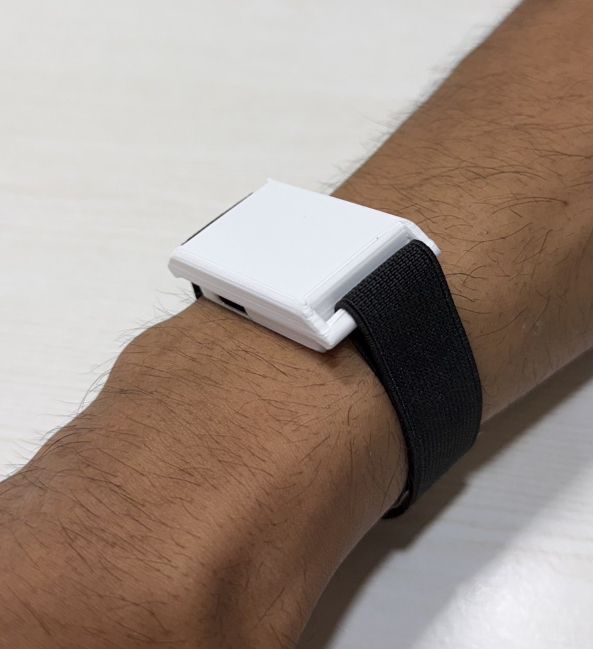
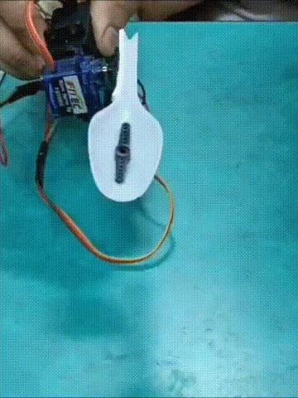

Engineering better movement intelligence.
Biomedical deep-tech for accessible wearable and assistive technology
ParkinSense
Measure and understand movement
TremoSense
Assist people with tremor
POSITIONING
For older adults, people living with movement disorders and the clinicians and families who support them in urban India, AVERRA is a biomedical technology company that turns precise movement sensing into everyday insight (ParkinSense) and practical assistance (TremoSense), at prices built for Indian households.
Pranshu Kumar · Pawan Shinde
Co-founders · B.Tech EXTC, VJTI Mumbai · SEC-ENT-301
Photos: real prototypes from the project repositories.
Notes:
[0:00–0:40 | 40 s] Title
Good morning. I'm Pranshu Kumar, and with my co-founder Pawan Shinde I'm building AVERRA. Our line is: engineering better movement intelligence.
AVERRA is a biomedical technology company. We turn precise movement sensing into products people can use every day, at prices built for India.
We start with two products. ParkinSense measures and helps people understand their movement. TremoSense assists people who already live with tremor.
Over the next eleven minutes I'll show you what we've built, what we've actually tested, what it costs, and exactly what we're asking for.

Slide 2
01 · PROBLEM & WHY NOW
Movement is measured for minutes — and lived with all day
≈4.6 lakh
≈12.8 lakh
4–12 Hz
WHY NOW
Jun 2018
Apple opens a Movement Disorder API in ResearchKit
Indians aged 60+ living with Parkinson's (derived)
with essential tremor (single-study estimate)
tremor band that turns a spoon into a spill
Jun 2022
Rune Labs' Apple Watch PD monitoring gets FDA clearance
CUSTOMER DISCOVERY · PLACEHOLDERS
“[Insert verbatim quote: how movement is tracked between visits]”
— Neurologist
Oct 2023
Licensing becomes mandatory for medical devices in India
“[Insert verbatim quote: eating and daily tasks]”
— Person living with tremor
Sep 2023
UNFPA: India's 60+ population 149M → 347M by 2050
“[Insert verbatim quote: what they use today and would pay]”
— Caregiver
Mar 2025
BMJ: 25.2M people with Parkinson's worldwide by 2050
No interviews supplied. Replace with verbatim quotes, role, date and consent.
Sources: UNFPA 2023; Khurana & Gourie-Devi, Cureus 2025; Chin et al. 2021; Engadget 2018; 9to5Mac 2022; Digital Health News; BMJ 2025. Full links in the companion guide.
AVERRA
Notes:
[0:40–1:35 | 55 s] Problem & why now
Start with the people. About 4.6 lakh Indians over sixty live with Parkinson's, and roughly 12.8 lakh more have essential tremor, though that second figure comes from a single study.
Two things fail them. Their movement is measured for a few minutes in a clinic, then not at all. And at home, a tremor of four to twelve hertz turns a spoon into a spill.
The customer-discovery quotes on the right are deliberately left as placeholders. We will only present verbatim quotes from real interviews.
Why now? Apple opened a movement API in 2018, and a Parkinson's monitoring app was FDA-cleared in 2022. India made device licensing mandatory in 2023. And our over-sixty population is set to more than double by 2050.

Slide 3
02 · ONE COMPANY, TWO PRODUCTS
Shared engineering, different customers
ParkinSense
MEASURE & UNDERSTAND
TremoSense
ASSIST
SHARED
Nordic nRF52840 MCU family
Who: wellness-minded adults and households living with movement disorders
Buys it: the user, online
Value: activity and vitals plus movement-specific insight
LSM6DS3 6-axis IMU
Who: older adults whose tremor disrupts eating
Buys it: family, via clinic or OT referral
Value: eat more independently, at an Indian price
Real-time signal processing
Embedded firmware
The same founding team
No shared revenue or cost savings claimed.
Hardware from the ParkinSense and TremoSense repositories.
AVERRA
Notes:
[1:35–2:20 | 45 s] One company, two products
So here is AVERRA: one company with two complementary products.
ParkinSense is a wellness wearable. Activity and vitals come first, and movement intelligence is its edge.
TremoSense is assistive. It physically stabilises a spoon for someone whose tremor gets in the way of eating.
They serve different people and different buying decisions. What they share is real: the same Nordic microcontroller family, the same six-axis IMU, the same signal-processing skills, and the same team. We are not claiming shared revenue or cost savings beyond that.

Slide 4
03 · PARKINSENSE
A wellness wearable with movement intelligence
ParkinSense
MEASURE
MOVEMENT SIGNAL
FEATURE STATUS (repository = source of truth)
BLE streaming at 104 Hz, 10-sample packets
BENCH-TESTED
Steps, cadence, distance, active minutes
BENCH-TESTED
Tremor score, frequency, burden, rest index
BENCH-TESTED
Heart rate, HRV (RMSSD, SDNN, pNN50), SpO₂
IMPLEMENTED
Wearable streams IMU + PPG over BLE (firmware does no analysis)
↓ FFT
Skin-contact deep sleep, ≈7 mA active
BENCH-TESTED
Host runtime (Python today; mobile app in development) decodes packets
Clinical evaluation with ICMR
IN PROGRESS
Three pipelines: motion · PPG · steps
Mobile companion app
IN DEVELOPMENT
Shared motion-context classifier gates steps and discounts HR confidence
Processing on the wearable itself
NEEDS HW/FW
voluntary <2 Hz tremor peak ≈5 Hz
Sleep, recovery, activity-type, calories, VO₂ max
PLANNED
Biomarkers logged to CSV/JSON; live dashboard
Synthetic signal, for illustration
Early identification of Parkinson's-related movement change
RESEARCH
Research path, not a claim: Broader wellness wearable → Reliable longitudinal movement data → Research collaborations (ICMR evaluation in progress) → Reference assessments → Prospective validation → Sensitivity, specificity, false positives → Regulatory assessment before any medical claim
ParkinSense does not diagnose, predict or clinically detect Parkinson's disease. Status from the ParkinSense repository (develop) and paper.
AVERRA
Notes:
[2:20–3:20 | 60 s] ParkinSense
ParkinSense today is a wrist wearable with an IMU and an optical sensor. It streams over BLE at 104 hertz into three pipelines: motion, heart and steps.
Its edge is the shared motion classifier. Tremor isn't counted as steps, and heart rate is trusted less while you move.
Here's the status, honestly. Streaming, steps, tremor scoring and motion context are bench-tested. Heart rate, HRV and SpO2 are implemented but research-grade. The mobile app is in development, and all analysis currently runs on a host, not on the wrist.
A clinical evaluation is in progress with ICMR. The results aren't back yet, so we make no clinical claim today. Longer term, ParkinSense could support research into early movement change in Parkinson's. That path runs through reference assessments, prospective validation and regulatory review. It is not a diagnostic claim.

Slide 5
04 · TREMOSENSE
TremoSense: bench-proven, not yet tested on people
TremoSense
ASSIST
77.3%
AUDIT · REPO vs PAPER
 | Public repository | Paper
Firmware | Zephyr RTOS, multi-threaded (repo) | Arduino framework (paper Table II)
Estimator | 2-state EKF (roll, pitch) + fixed calibration offsets | 4-state EKF with gyro-bias tracking
Spectral gate 4–12 Hz vs <2 Hz | Not found in firmware | Described as a pipeline stage
Sampling | IMU data-ready at 208 Hz | 100 Hz, 10 ms loop
Servos / power | MG995 + FS90MG, no battery (README) | 2 × MG92B, XL6009, 1250 mAh LiPo
Tuning constants | Q, R, K_lqr set to 0 in public constants.h | Q = 10⁻⁴, R = 1.0, solved K_lqr
Hardware results | None in repo; README lists benchmarking as future scope | 77.3% mean rejection, 4–8 Hz (Table IV)
mean tremor rejection on a motorised simulator, 4/6/8 Hz, ±5° (paper, bench)
>90% / >80%
Hand IMU (LSM6DS3) on the handle
roll / pitch suppression across 3–7 Hz in Simulink (repo)
EKF estimates roll and pitch
LQR gain matrix maps states to two servo commands
0
Two servos counter-rotate the spoon head
people with tremor tested so far
Boost converter + capacitor hold the rail through servo current spikes
Next: reproduce Table IV on the current build (M3), then the user study (M6).
Results: TremoSense paper Table IV (bench) and repository README (Simulink). Audit: tremosense-app/src (ekf.c, imu.c), include/constants.h.
AVERRA
Notes:
[3:20–4:15 | 55 s] TremoSense
TremoSense is for people who already have tremor. An IMU in the handle feeds a Kalman filter that estimates roll and pitch. An LQR controller then drives two servos to counter-rotate the spoon head.
On a motorised tremor simulator, our paper reports 77.3 percent average rejection at four, six and eight hertz. Simulation shows over 90 percent on roll and over 80 on pitch.
Our audit found that the public firmware differs from the paper. It uses a simpler two-state filter, different servos, no battery and zeroed tuning constants. So our first technical milestone is to reproduce the paper's result on the current build.
No person with tremor has used it yet.

Slide 6
05 · COMPETITION
Where we can compete — and what we still have to prove
ParkinSense vs wellness wearables
TremoSense vs tremor aids
 | WHOOP One | Amazfit Bip 6 | Fitbit Charge 6 | ParkinSense
Price (India) | ₹17,990/yr membership | ₹8,999 | ₹12,999 | ₹7,999 + ₹199/mo (hypothesis)
Wellness | Recovery, sleep, strain, VO₂ max | HR, sleep, GPS | HR, SpO₂, sleep, GPS | Steps, HR, HRV, SpO₂ (research-grade); sleep planned
Movement insight | Not documented | Not documented | Not documented | Tremor score, burden, motion context (bench-tested)
Battery | 14+ days | Up to 14 days | ≈7 days | ≈100 h (estimate)
Evidence | Commercial product | Commercial product | Commercial product | Bench tests only
 | GyroGlove | Liftware | Weighted spoon | TremoSense
Price | US$5,899 per glove (≈₹5.6 L) | US$195 (2015 price, dated) | ≈₹5,358 (US retail) | ₹9,999 launch hypothesis
What it does | Gyroscopic stabiliser for the whole hand | Motorised handle cancels tremor at the utensil | Added mass damps motion | Two-axis servo gimbal cancels tremor at the spoon
Mechanism | Gyroscope (passive-active) | Sensors + motors | Passive | IMU → EKF → LQR → 2 servos
Evidence | No study cited on listing | Maker cites study: 70% less shaking | Varies | 77.3% on a bench simulator; no users yet
They do well: Polished hardware, multi-day battery, sleep and recovery, large app ecosystems.
We are building: Movement-specific insight (tremor burden, motion context) on a wellness wearable.
Accessible value: A price hypothesis of ₹7,999 — below WHOOP, Fitbit Charge 6 and the Amazfit Bip 6 (₹8,999), with no mandatory subscription.
Still to prove: Accuracy against reference devices (ICMR evaluation results pending), battery life, sleep features, and that people value movement insight.
The problem: Active tremor aids are imported and priced for other markets: one GyroGlove ≈ ₹5.6 L.
Our opportunity: An Indian-built active spoon at a ₹9,999 hypothesis, serviced locally through clinics.
What it does today: Cancels simulated 4–8 Hz tremor on a bench rig; a spoon, not a whole-hand device.
Still to prove: User benefit in real eating, durability, comfort, and parity with Liftware-class products.
Prices checked 12 Oct 2026 (whoop.in, 91mobiles, smartprix, Parkinson's UK, MJFF 2015, WellBefore). Benchmarks only — links in the guide.
AVERRA
Notes:
[4:15–5:05 | 50 s] Competition
Competitors, with prices checked this month.
WHOOP costs ₹17,990 a year, a Fitbit Charge 6 about ₹12,999, and an Amazfit Bip 6 ₹8,999. They are excellent at sleep, recovery and battery life. None documents tremor or movement-disorder insight. That's our space, and we have to prove people value it.
For tremor assistance, one GyroGlove costs 5,899 US dollars, about 5.6 lakh rupees, for one hand. Liftware sold for 195 dollars in 2015, and a weighted spoon is cheap but passive.
TremoSense is a spoon, not a glove, and we don't claim it matches either product. The opportunity is an Indian-built active aid priced under 2 percent of one GyroGlove, while being honest that it does far less.

Slide 7
06 · MVP & VALIDATION
Bench-proven, clinical evaluation under way
EXPERIMENT RUN
RESULT SO FAR
PRE-REGISTERED NEXT METRIC
DECISION
Motorised tremor simulator, 4/6/8 Hz, ±5° (paper)
77.3% mean rejection — not reproduced in the public repo yet
Self-feeding task, n ≥ 10: median tremor reduction ≥50% and ≥60% would pay (M6)
PERSEVERE — validate on people before any claim
Bench: rest, 5 Hz fixture, walking, arm motion; BLE soak; PPK II power. Clinical evaluation with ICMR in progress
8/8 bench conditions correct; ≈7 mA. ICMR results pending (founder-reported)
Dominant-frequency error ≤5% vs reference; 0 false steps in tremor (M10); add ICMR results when published
PERSEVERE — wellness launch; no clinical claim until results
No metric was pre-registered before the bench tests. These are the first pre-registered tests.
TremoSense paper Table IV; ParkinSense paper Tables IV–VIII.
AVERRA
Notes:
[5:05–6:05 | 60 s] MVP & validation
What has the MVP proven? Both products work on the bench. TremoSense hasn't been tested with users. ParkinSense is now in a clinical evaluation with ICMR, with results pending. Our bench tests had no preregistered metric, and I want to be upfront about that.
So we've preregistered the next test now. Twelve TremoSense units go to at least ten people with tremor for a self-feeding task. We continue if the median tremor reduction is at least 50 percent and at least 60 percent would pay.
For ParkinSense, the test is dominant-frequency error within 5 percent of a reference, and zero false steps during tremor. The ICMR results will be added the moment they're available.
Our decision is to persevere, and to validate on people before we make any medical claim.

Slide 8
07 · MARKET (BOTTOM-UP, INDIA)
₹416.9 Cr TAM → ₹51.9 Cr SAM → ₹109.0 L Year-3 SOM
TAM
 | ParkinSense (PD households) | TremoSense
TAM customers | 4,60,261 | 8,68,418
₹ / customer / year | ₹3,069 | ₹3,174
TAM | ₹141.3 Cr | ₹275.7 Cr
SAM | ₹17.6 Cr | ₹34.3 Cr
SOM customers / yr | 1,440 | 2,040
SOM | ₹44.2 L | ₹64.8 L
₹416.9 Cr
Patients × annual revenue per customer
SAM
₹51.9 Cr
Urban × under neurologist follow-up
SOM · Yr 3
₹109.0 L
Not sized: the general Indian wellness-wearable market — no sourced figure found. Estimates (purple in the model): 40% under follow-up, 50% eating-disruptive tremor, all prices.
30 clinics (Mumbai + Pune) + online
UNFPA 2023 (149M aged 60+); PD 308.9/lakh aged 60+ (Je et al., via Cureus 2025); ET 89.96/lakh (Chin et al. 2021); Census 2011 (31.1% urban). Workings: model › Market.
AVERRA
Notes:
[6:05–6:50 | 45 s] Market
We sized the market bottom-up.
TremoSense: Parkinson's plus essential tremor patients, half with tremor that disrupts eating, about 8.7 lakh people. At the launch price spread over a three-year life, that's ₹275.7 Cr a year.
ParkinSense's beachhead is households living with Parkinson's: ₹141.3 Cr. We have not sized the general wellness market, because we couldn't find a sourced Indian figure.
Filtering to urban patients under neurologist care gives a SAM of ₹51.9 Cr. Our year-three SOM, built from 30 clinics plus online, is about ₹109 L.

Slide 9
08 · BUSINESS MODEL
Clinics bring patients; families buy; labs fund early data
KEY PARTNERS
KEY ACTIVITIES
VALUE PROPOSITIONS
RELATIONSHIPS
CUSTOMER SEGMENTS
Neurology clinics · OT centres · university labs · test lab · contract assembler
User studies · CDSCO + ISO 13485 · firmware & DSP · small-batch assembly
ParkinSense: movement insight on a wellness wearable
TremoSense: active tremor assistance at an Indian price
Clinic-assisted trial · caregiver onboarding
Households with PD / ET · wellness-minded adults · research labs
KEY RESOURCES
CHANNELS
Sensing + control IP · bench evidence · two papers · prototypes
Clinic / OT referral · direct online · institutional procurement
COST STRUCTURE
REVENUE STREAMS · IN LAUNCH ORDER
Phase 1: team, study units, user study, IP · Phase 2: QMS, EMC, inventory, outreach
Research-use kits for labs
₹74,999 per kit · from M10 · no medical claim
1
2
TremoSense sale or rental
₹9,999 (hypothesis) · rental ₹799/mo · from M12
No reimbursement assumed — out-of-pocket or institutional only.
3
ParkinSense device + optional subscription
₹7,999 + optional ₹199/mo · from M25
Prices are hypotheses to test with customers. Model › Unit Economics.
AVERRA
Notes:
[6:50–7:25 | 35 s] Business model
The business model in brief. Clinicians and occupational therapists bring us patients. Families buy the device.
Revenue comes in three steps. First, research kits for labs, which need no medical claim. Then TremoSense as a one-time sale, with a rental option for those who can't pay upfront. Then ParkinSense, as a device with an optional subscription.
We assume no reimbursement. All revenue is out-of-pocket or institutional.

Slide 10
09 · PRICING & UNIT ECONOMICS
₹9,999 keeps a 31% contribution margin at small-batch cost
Price | B contribution | C contribution
₹5,999 | -₹510 (-11%) | ₹1,601 (33%)
₹6,999 | ₹252 (4%) | ₹2,363 (42%)
₹7,999 | ₹1,014 (16%) | ₹3,124 (48%)
₹8,999 from M19 (C) | ₹1,776 (24%) | ₹3,886 (53%)
₹9,999 launch (B) | ₹2,538 (31%) | ₹4,648 (57%)
 | TremoSense | ParkinSense
CAC | ₹1,079 | ₹1,500
LTV | ₹3,553 | ₹3,011
LTV : CAC | 3.3× | 2.0×
Payback | first sale | first sale
All estimates — no customers yet. ParkinSense launches at M25, after the wellness beta.
Gross margin 40% · contribution 31% at B. Below ₹9,999 needs verified C cost.
Channels at launch price (none validated): Direct online ₹3,966 · Clinic partnership ₹2,538 · Occupational-therapy centres ₹2,538 · Institutional procurement ₹3,014 · No-cost EMI (direct) ₹3,566 · rental ₹576/mo, device recovered in 9.3 mo
A ₹4,862 · B ₹4,830 · C ₹2,720
Prototype parts today ≈ ₹4,062. ₹2,000 = volume electronics TARGET (C: ₹1,950), needs quotes.
GST 5% device / 18% wearable & software (verify HSN). Clinic margin 15%. Warranty 5% (8% in A). Model › TremoSense Costs, Price Matrix, Unit Economics.
AVERRA
Notes:
[7:25–8:25 | 60 s] Pricing & unit economics
Pricing. Today's prototype parts cost about ₹4,062. Two thousand rupees is a volume target for the electronics, not today's cost.
We modelled three cost levels. At a small batch of a hundred, the unit costs ₹4,830. At ₹9,999, after GST, a clinic margin, warranty and shipping, we keep ₹2,538. That's a 31% contribution margin and 40% gross margin, so every unit is profitable from the first sale.
Once supplier quotes and tooling bring cost down to ₹2,720, we cut the price to ₹8,999 and still keep ₹3,886, or 53%. ₹6,999 would still be viable at that cost; we hold it back until the company is profitable.
CAC is about ₹1,079, and LTV to CAC is 3.3. ParkinSense at ₹7,999 reaches 2.0, positive after acquisition cost, though thinner.

Slide 11
10 · FINANCIAL FORECAST
Profitable from Aug 2029 — break-even in month 26
Year 1: costs · burn
₹35.2 L · ₹2.93 L/mo
Year 2: cash in · result
₹53.1 L · -₹17.7 L
Sustained break-even
M26 · Aug-29
Year 3: cash in
₹2.12 Cr
Year 3: operating profit
₹11.7 L (5.5%)
Needed to reach profit
₹60.9 L
Cash basis. TremoSense 695 units (Y2), 1890 (Y3, SOM 2040/yr); ParkinSense 1380 (Y3). Requirement = peak gap × 1.2.
AVERRA
Notes:
[8:25–9:20 | 55 s] Financial forecast
The plan starts in July 2027 and runs three years.
Phase one, the first six months, is about proof: the TremoSense user study, the patent filing and a regulatory opinion. It costs ₹8.8 L.
Phase two launches TremoSense, with first sales in month twelve. In year three we scale the clinic network and launch ParkinSense as a wellness product.
Year-one costs are ₹35.2 L, a gross burn of about ₹2.93 L a month. Year two still loses 17.7 lakh rupees as volume builds.
We reach sustained operating break-even in month 26, August 2029. Year three makes an operating profit of ₹11.7 L on ₹2.1 Cr of cash in, and we exit at about ₹2.3 L profit a month.
Getting there needs ₹60.9 L in total. Phase one alone needs ₹10.5 L, and that number shapes our ask.

Slide 12
11 · TEAM & GROWTH
A builder team, growing through clinics
Pranshu Kumar
Co-founder · CEO
Wearables, DSP & firmware
Pawan Shinde
Co-founder · CTO
Control, gimbal & power
ACQUISITION 100%
1. In-clinic trial → purchase
10 clinics, 8 weeks
Pass: ≥30% buy at ₹9,999, CAC ≤ ₹1,079
1,000 caregivers via 10 clinics
ACTIVATION 25%
In-clinic TremoSense trial
ParkinSense lead author · TremoSense co-author · EXTC GPA 9.17 · minor in AI/ML
TremoSense co-author (EKF + LQR platform) · EXTC, VJTI
REVENUE 40% of trials
2. Support-group referrals
PD / ET caregiver groups
Pass: ≥15% refer; CAC ≤ ₹800
Buys at launch price
RETENTION ≥70%
Daily use at day 30
3. ParkinSense wellness beta
100 users, 8 weeks
Pass: ≥40% weekly active and ≥25% would subscribe
REFERRAL 15%
Hardware & test engineer
Hire at M7 (Phase 2)
Refers another family
Targets, not data
Contract: regulatory consultant, industrial designer. Advisors: none agreed. Collaborators (not founders): Prithvi Tambewagh; ParkinSense co-authors; VJTI supervisors.
Equity split: founders' agreement (not set) · ESOP 5% · inventor assignments before filing
Role evidence: paper author lists, repository history, academic record.
AVERRA
Notes:
[9:20–10:05 | 45 s] Team & growth
The team comes from the evidence. I built ParkinSense and co-authored TremoSense, and I lead the company, the wearables and signal processing. Pawan co-built TremoSense and leads control and hardware. In phase two we hire one test engineer. The equity split will be set in a founders' agreement.
Growth runs through clinics. From a thousand caregivers reached, we target a quarter trying the device and 40 percent of those buying. These are targets, not data.
Three experiments come first: an in-clinic trial-to-purchase test, support-group referrals, and a ParkinSense wellness beta.

Slide 13
12 · FUNDING ASK & VALUATION
Raise ₹10.51 L at ₹75 L pre-money — 12.3% to the investor
This round · Milestone 1 (M1–M6)
Year-1 cash costs
Total to reach profitability
CAP TABLE
₹10.5 L
₹35.2 L
₹60.9 L
Before
After (at ₹75 L)
Pre-money | Investor | Founders* | Basis
₹44.75 L | 19.0% | 76.0% | Floor: cost-to-duplicate
₹60.00 L | 14.9% | 80.1% | Conservative ≈ Berkus cross-check
₹75.00 L | 12.3% | 82.7% | PROPOSED working target
₹100.00 L | 9.5% | 85.5% | Ambitious — only if substantiated
Founders
100%
Founders 82.7%
* after 5% ESOP · equity fixed at ₹10.51 L · Berkus-style cross-check ₹60 L; ₹75 L is a negotiation target, not an established value
Pre-money P
₹75,00,000
proposed working target
Equity I
₹10,51,171
Milestone-1 requirement (gap × 1.2)
ESOP 5.0%
Post-money
₹85,51,171
= P + I
Investor 12.3%
Investor
12.29%
= I ÷ (P + I)
Founders
82.71%
= 100% − investor − 5% ESOP
Milestone-1 round ₹10.5 L · SISFS ₹20 L applied, NOT secured
Scenarios A–D in the model: grant + full raise 35%; no grant 45%; staged tranche 2 priced on evidence. Floor = cost-to-duplicate (34 PM × ₹1.25 L + ₹2.25 L).
AVERRA
Notes:
[10:05–11:05 | 60 s] Funding ask & valuation
Now the ask, kept separate from the full plan. Year one costs ₹35.2 L and reaching profitability needs ₹60.9 L. Today we raise only for milestone one: ₹10,51,171.
We propose a pre-money valuation of ₹75 L. That's a working target to negotiate, not an established value. Two methods frame it. Cost to duplicate gives a floor of ₹44.75 L: 34 person-months of engineering plus prototypes. A Berkus-style scorecard gives about ₹60 L, credited mainly for two working prototypes. The premium above that reflects two products and a clinical evaluation already under way.
At ₹75 L, post-money is P plus I: ₹85,51,171. The investor owns I over post-money, 12.3%. After a 5 percent ESOP pool, the founders keep 82.7%. Even at the floor, the investor would own 19.0%.
The Startup India grant is applied for, not awarded, and the next round is priced on the user-study result.

Slide 14
13 · USE OF FUNDS, MILESTONES & RISKS
Six months to a clear yes or no; month 26 to profit
Phase 1 (M1–M6) costs ₹8.8 L → funded by the ₹10.5 L round (incl. buffer)
Team
₹2.7 L · 31%
Regulatory & quality
₹0.3 L · 3%
Go-to-market & admin
₹0.8 L · 10%
Validation (both products)
₹1.6 L · 18%
Prototyping, tools, IP
₹2.5 L · 29%
Contingency
₹0.8 L · 9%
M2
M3
M4
M6
M7
M9–10
M11
M12
M19
M25
M26
IP
Provisional patent filed
TREMOSENSE
12 study units built
REGULATORY
CDSCO classification opinion; ethics approval
MILESTONE 1
User study n ≥ 10 → kill / continue
PHASE 2
Tranche 2 closes; engineer hired
REGULATORY
EMC pre-compliance; CDSCO filing
TREMOSENSE
100-unit pilot batch
COMMERCIAL
First TremoSense sales
SCALE
Verified lower cost; price to ₹8,999
PARKINSENSE
ParkinSense wellness launch
PROFITABILITY
Sustained operating break-even
KILL / CONTINUE at M6 (TremoSense user study, n ≥ 10)
Continue: median tremor reduction ≥50% and ≥60% would pay
Pivot: benefit holds but price fails → clinic rental model
Stop: reduction <30% → stop TremoSense, focus on ParkinSense
Engineering better movement intelligence.
Ask: ₹10.5 L for 12.3%. Other risks — technical, regulatory, IP, funding — with triggers in the companion guide.
AVERRA
Notes:
[11:05–11:55 | 50 s] Milestones, risks & close
Here's what the money buys. The patent is filed in month two, study units are built in month three, and in month six the user study decides kill or continue. If we continue, we move through EMC testing and the CDSCO filing to first sales in month twelve, and to break-even in month 26.
The biggest risk is clinical. If the median tremor reduction falls below 30 percent, we stop TremoSense and put everything into ParkinSense. If it works but people won't pay, we pivot to clinic rental.
AVERRA: engineering better movement intelligence. We're asking for ₹10.5 L at a ₹75 L pre-money, 12.3%, to reach a clear yes-or-no on a product that's profitable on every unit. Thank you.

