Slide 1
COLDINFER: A STATIC-MEMORY RUNTIME
FOR SMALL NEURAL-NETWORK
INFERENCE ON MICROCONTROLLERS
VigneshKumar (714023247109) | Siddharth T (714023247088)
Syedha Sulthani Beevi (714023247103) | Sridhanwanth (714023247095)
Date: 27-10-2026 Supervised by
Shanmathi S

Slide 2
Project Area
ColdInfer is a lightweight, static-memory C++ neural-network inference runtime for small MLP models on microcontrollers (e.g. ESP32), without heavy ML frameworks, malloc, or runtime model parsers.
It targets TinyML constraints—typically a few hundred kilobytes of SRAM and limited flash—where data movement and heap fragmentation dominate.
The project serves as a transparent teaching and research baseline: every parameter and activation buffer is visible in source, with host benchmarks and an ESP32 HTTP demonstration.

Slide 3
Base Paper
“ColdInfer: a static-memory runtime for small neural-network inference on microcontrollers.”
Literature places TinyML bottlenecks in memory access and heap use (Sze et al., 2017; David et al., 2021). Production stacks include TFLM’s arena planner, TVM/MicroTVM, CMSIS-NN, MCUNet and µNAS; MLPerf Tiny stresses explicit latency protocols.
Research gap: a small, fully auditable float32 teaching baseline with compile-time parameter binding—while production tools prioritise speed and graph coverage.

Slide 4
Problem Identification
Microcontrollers cannot host general-purpose ML frameworks; deployment must separate training from a lean on-device runtime with hard SRAM and flash limits.
Mature tools (TFLM interpreters, TVM/CMSIS-NN compilers) are effective but large and hard to audit byte-by-byte for student or research memory-policy experiments.
Host framework processes hide true model cost. Without a transparent static layout, activation lifetimes and weight placement remain opaque, and heap use risks SRAM fragmentation.

Slide 5
Objective of the Project
Provide full memory visibility: bind float32 weights at compile time and keep every parameter and activation buffer pointable in source.
Eliminate heap allocations during inference—parameters fixed in flash, activations in static ping-pong scratch—and decouple PyTorch training from a lean C++ runtime.
Benchmark host RSS, binary sections and latency against PyTorch, TensorFlow Lite and TFLM, and demonstrate the same kernels on ESP32 via HTTP POST /infer.

Slide 6
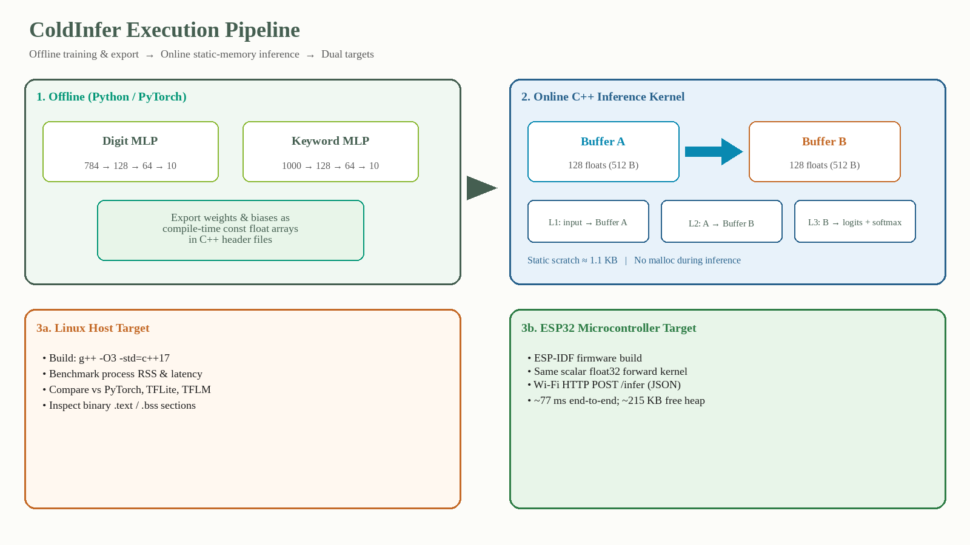
Methodology

Slide 7
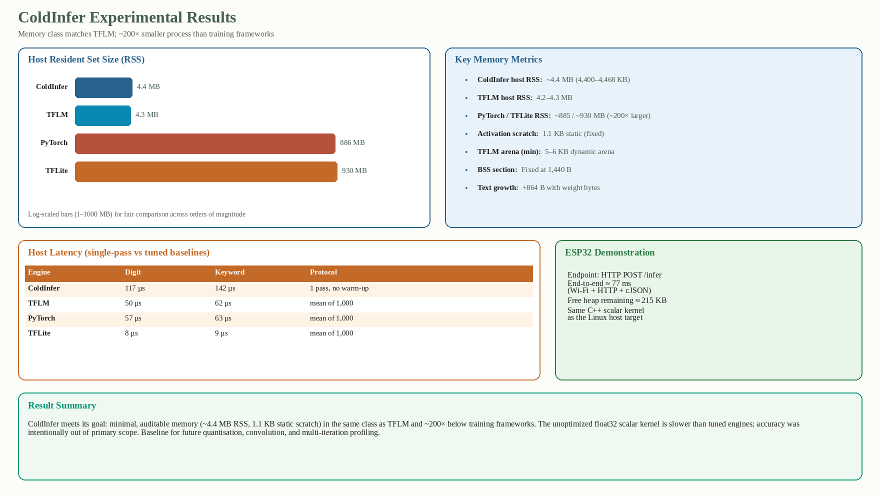
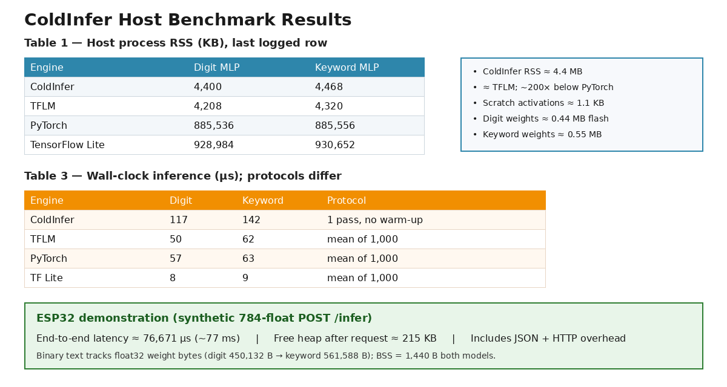
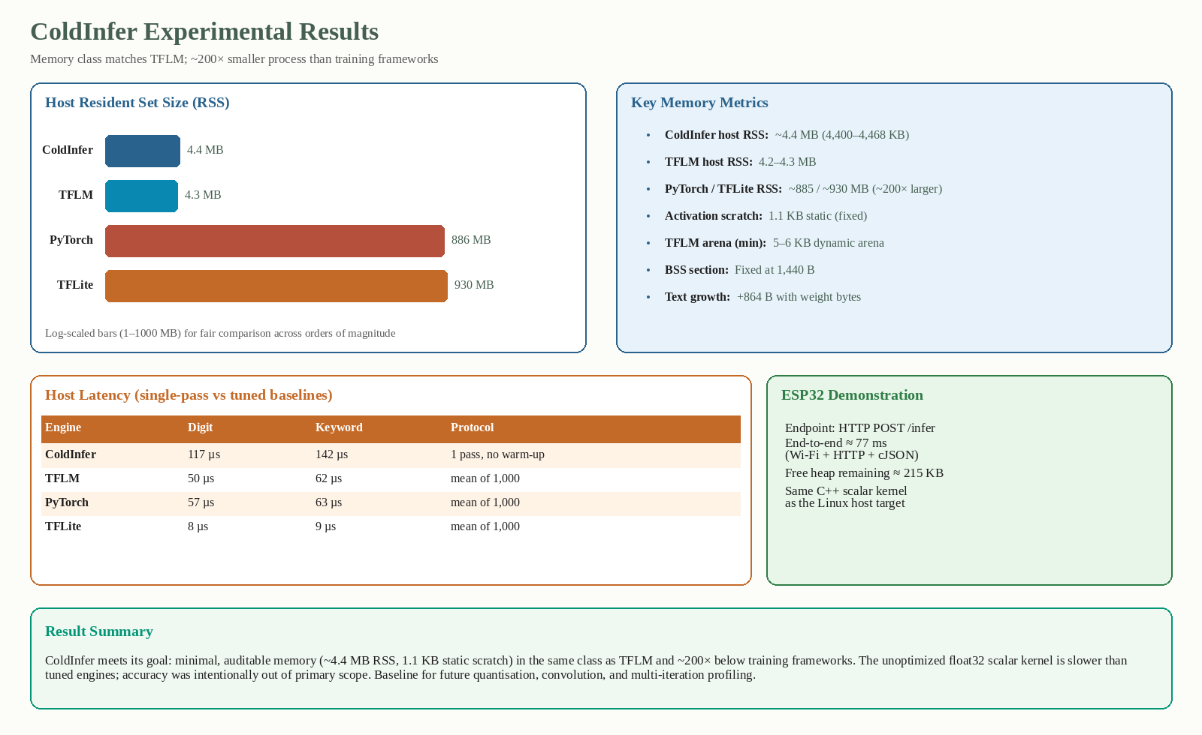
Results

Slide 8
Future Works
Add integer quantisation (e.g. int8) and convolutional / pooling operators so workloads align with MLPerf Tiny-style models.
Introduce a real memory planner and multi-iteration latency profiling with warm-up, matching baseline timing protocols (mean of 1,000 calls).
Report test-set accuracy with C++ probability checks; separate JSON parse from kernel time on ESP32; harden the HTTP path for non-bench use.

Slide 9
Conclusion
ColdInfer shows that compile-time float32 export plus static scratch yields ~4.4 MB host RSS near TFLM and ~200× below training frameworks, with 1.1 KB fixed activation scratch and BSS fixed at 1,440 B.
The scalar float32 kernel is slower than tuned engines under stated protocols; the ESP32 path answered /infer in ~77 ms with ~215 KB free heap.
The artefact is an auditable teaching and research baseline for quantisation, convolution and memory-management experiments—not a replacement for TFLM, CMSIS-NN or an optimising compiler.

