Slide 1
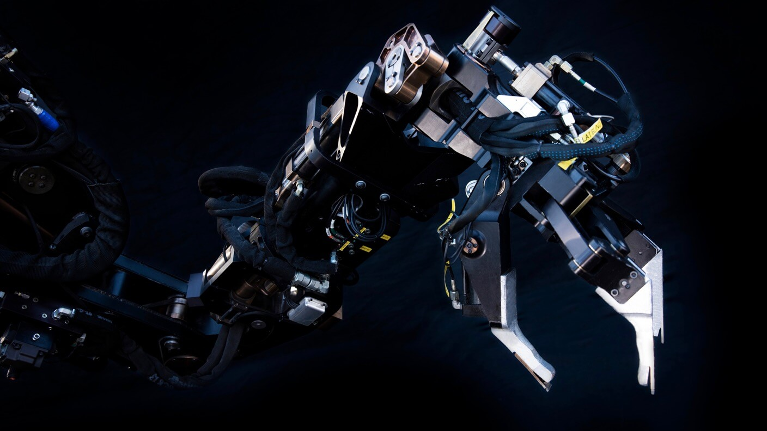
BETA: OTHELLO Implementing Othello Using Q-Learning & BNNs
Shubham Singh, Narendra Gangwani
This Photo by Unknown Author is licensed under CC BY-ND

Slide 2
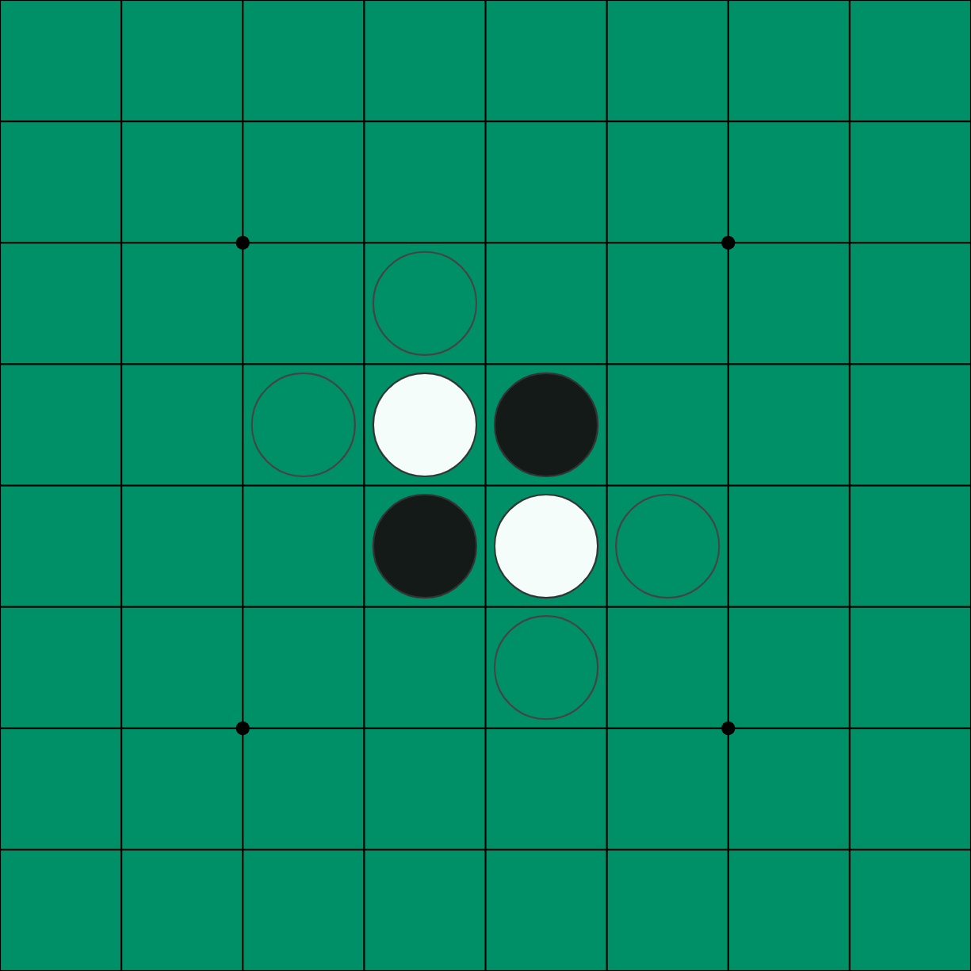
Problem Overview
Othello, is an 8x8 board game played by two players, typically using black and white stones.
The objective is to have more discs of your color on the board at the end of the game.
Challenges include the large state space and the need for an AI agent to adapt to various opponent strategies.

Slide 3
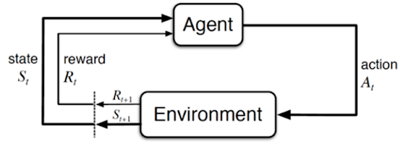
Approaches – Markov Decision Process(MDP)
MDPs model the decision-making process in environments with probabilistic state transitions and rewards.
In Othello, MDPs can represent game states, actions, and rewards based on board positions.

Slide 4
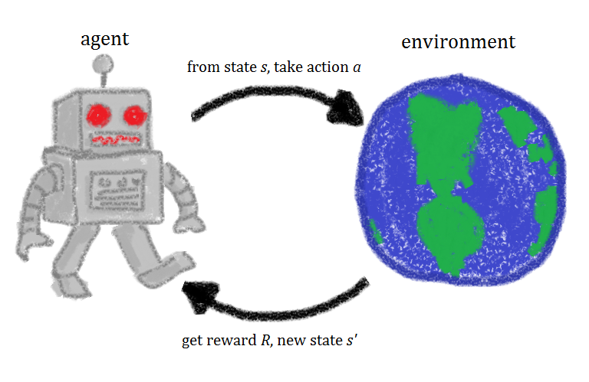
Approach – Q-Learning
Q-Learning is a reinforcement learning algorithm that learns optimal policies by updating action-value estimates iteratively.
Q-Learning algorithm tends to approximate action-value for each game state.
Applying Q-Learning to Othello can help AI agents learn winning strategies through trial and error.

Slide 5
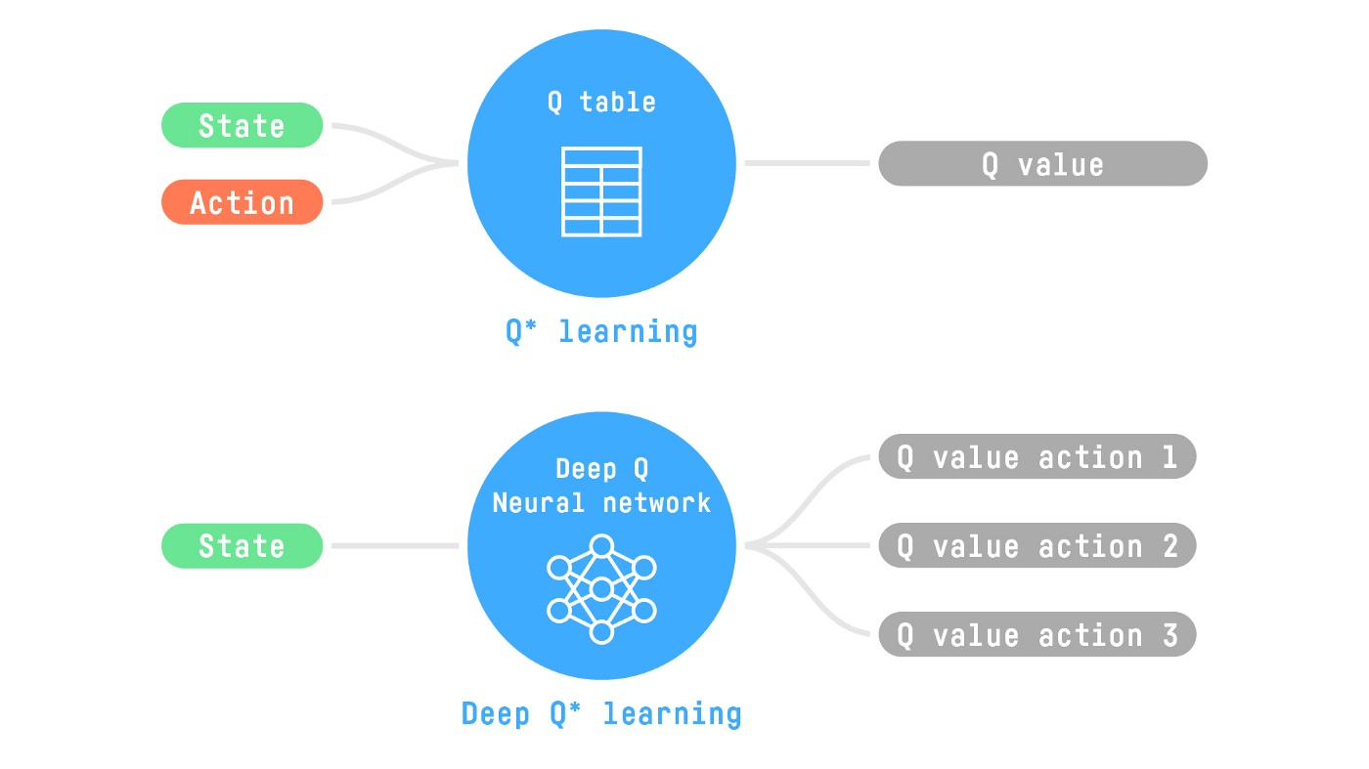
Deep Q-Learning
Deep Q-Learning combines Q-Learning with Deep Neural Networks to learn complex patterns and strategies in large state spaces.
The neural network acts as a function approximator, predicting action values given game states.

Slide 6
Bayesian NNs over Standard NNs
Standard Neural Networks are prone to overfit.
This mitigates overfitting, enables learning from small datasets, and tells us how uncertain our predictions are.
By capturing uncertainty, BNNs can help AI agents adapt their strategies more effectively, leading to improved performance.

Slide 7
BAYESIAN INFERENCE

Slide 8
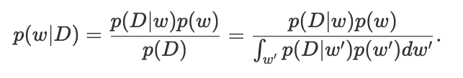
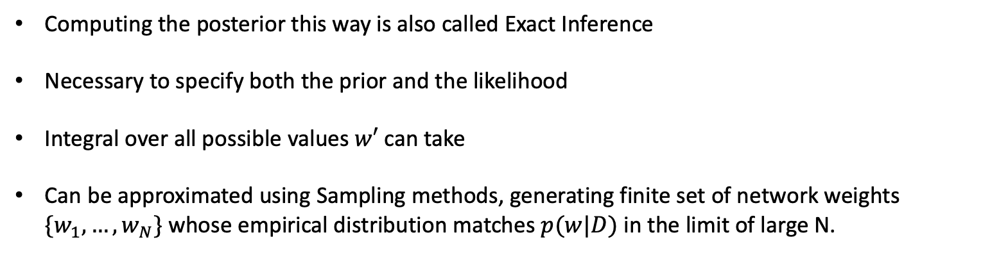
Posterior Distribution
Computing the posterior this way is also called Exact Inference
Necessary to specify both the prior and the likelihood
Integral over all possible values $w′$ can take
Can be approximated using Sampling methods, generating finite set of network weights $\{w_{1},…, w_{N}\}$ whose empirical distribution matches $p(w|D)$ in the limit of large N.

Slide 9
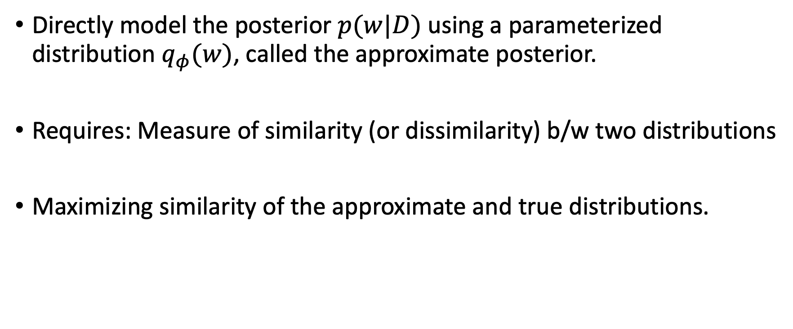
Variational Inference
Directly model the posterior $p(w|D)$ using a parameterized distribution $q_{φ}(w)$, called the approximate posterior.
Requires: Measure of similarity (or dissimilarity) b/w two distributions
Maximizing similarity of the approximate and true distributions.

Slide 10
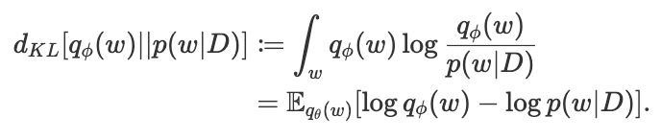
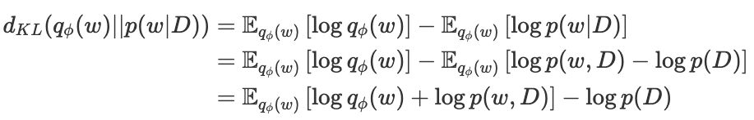
KL - Divergence
Conveys dissimilarity between 2 distributions.
Objective ”minimize KL divergence from the approx. posterior to the true posterior”

Slide 11
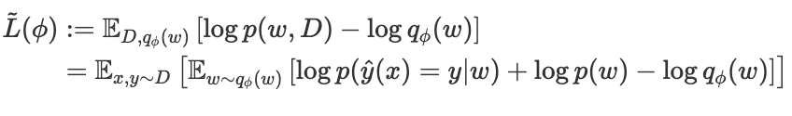

Evidence Lower Bound
Thus, Variational Inference corresponds to optimizing the ELBO with respect to variational parameters:

Slide 12
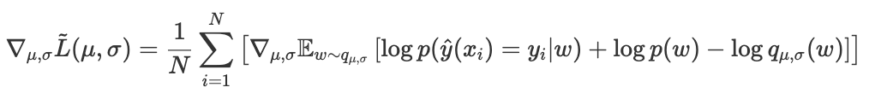

Stochastic Variational Inference
Specifying q as $q_{μ, σ}\left(w\right)= 𝒩(μ, σ^{2}I)$, a diagonal Gaussian
Therefore, the VI neural network training objective is:
The VI objective involves expectation over weight distribution

Slide 13
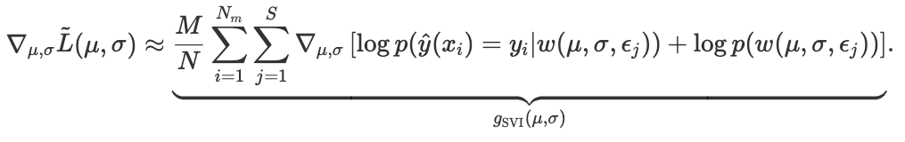

Reparameterization
As $w \sim 𝒩(μ, σI)$, it can be reparametrized as $w=μ+σε$ with $ε \sim 𝒩(0,I)$.
Putting this all together we get the SVI gradient estimator as:

Slide 14
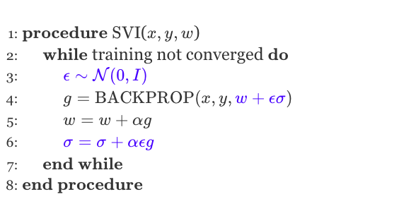
Stochastic Variational Inference

Slide 15
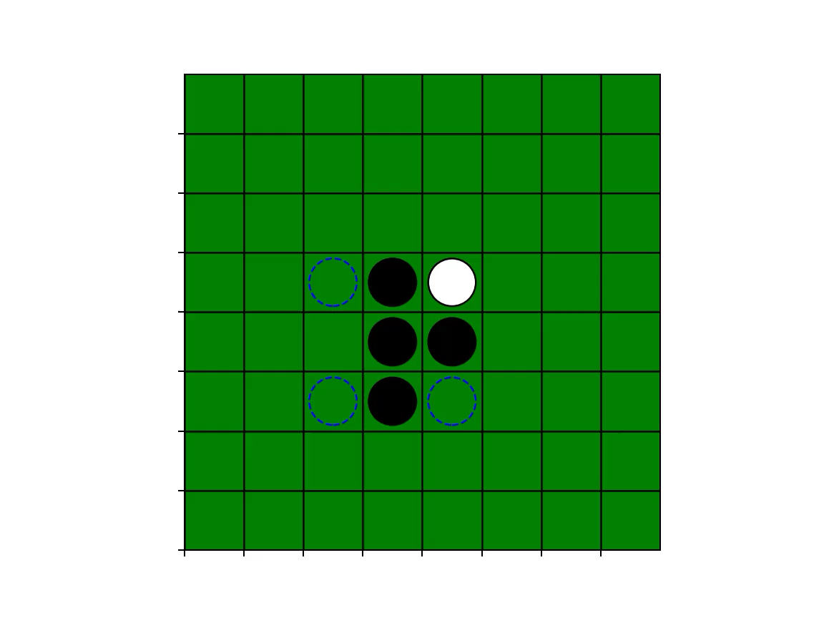
DEMO

