Slide 1

locality.org.uk

Slide 2

Community Engagement
Kathryn Roper
Membership Officer
Kathryn.roper@locality.org.uk

Slide 3
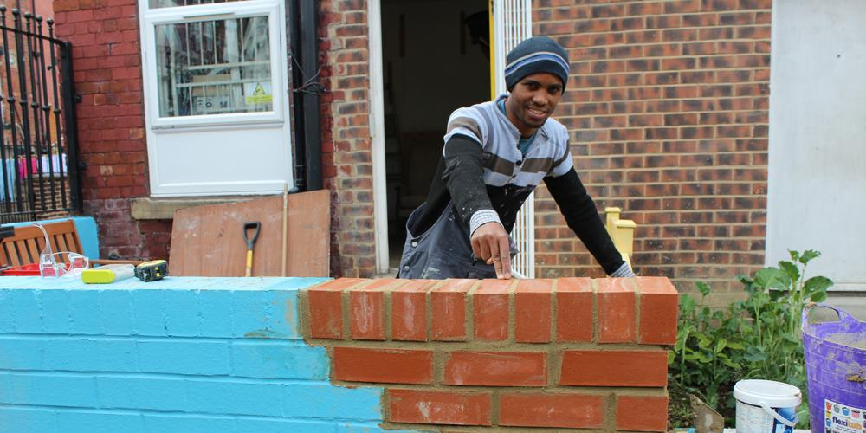
Locality supports local community organisations to unlock the power in their community to build a fairer society

Slide 4
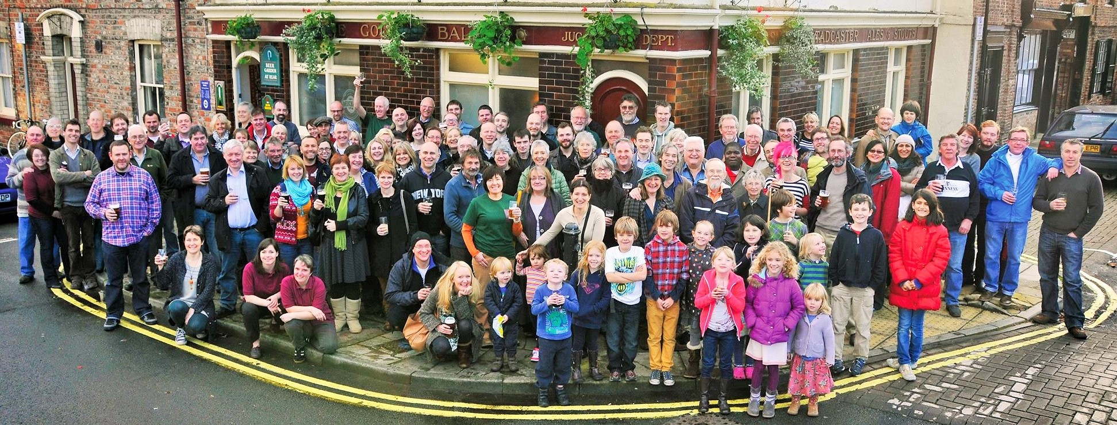
Our members are independent, locally focused and locally led. Together we create spaces where everyone belongs, and where lives are transformed.
.

Slide 5
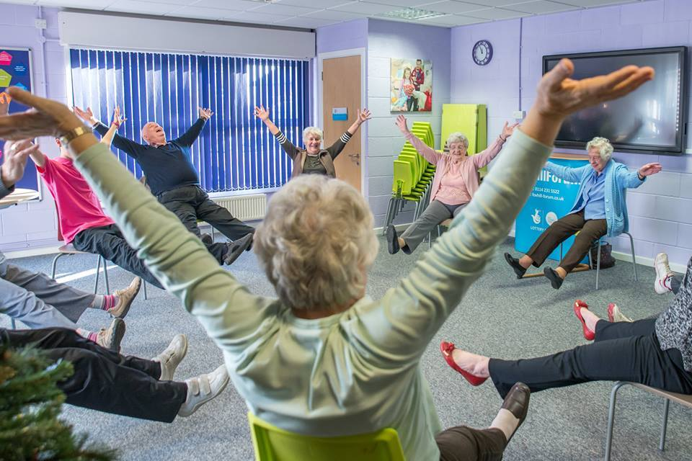
Like you, we believe in the power of community.
Join us – joinus@locality.org.uk
.

Slide 6
Community Engagement – today’s focus
Harnessing community support
Involving your community in decision making
Planning
Managing community challenges/issues
Social media/communication
Fundraising

Slide 7
“It is a general term covering a range of approaches”
“Consultation, co-operation and participation”. “ “Harnessing community support”
Engagement is another word for taking part.
What is community engagement?

Slide 8
Community Engagement
Informing
Researching
Consulting
Involving
Decision making
Community action

Slide 9
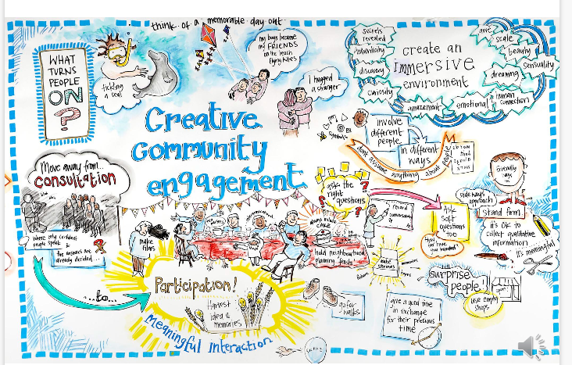

Slide 10
Why do it?
Decide on a direction - effectively meet diverse community needs
Help people develop a sense of ownership /pride in a service and their community as a whole
Challenge assumptions
To add to lifetime
Access funding
To make things happen

Slide 11


More than a helping hand….
Surveys
Meetings
Competitions
Market stalls
Trustees
Steering group
Petitions
Rallies
Fundraising

Slide 12
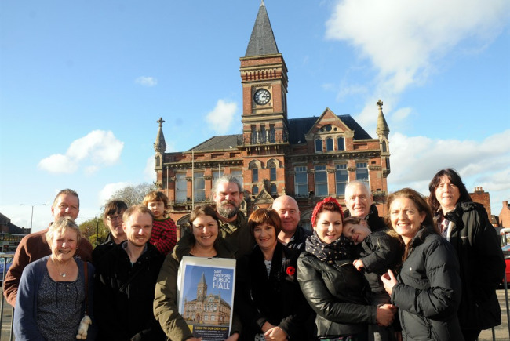
What gets people involved?
Personal motivation
Opportunity and capability
Information
A trigger (such as being asked!)

Slide 13
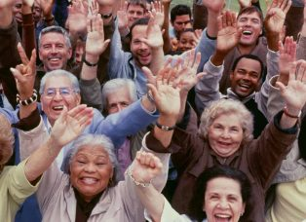
What keeps people involved?
A good experience:
Feeling involved and valued
Good relationships
Enjoyment
Training and development

Slide 14
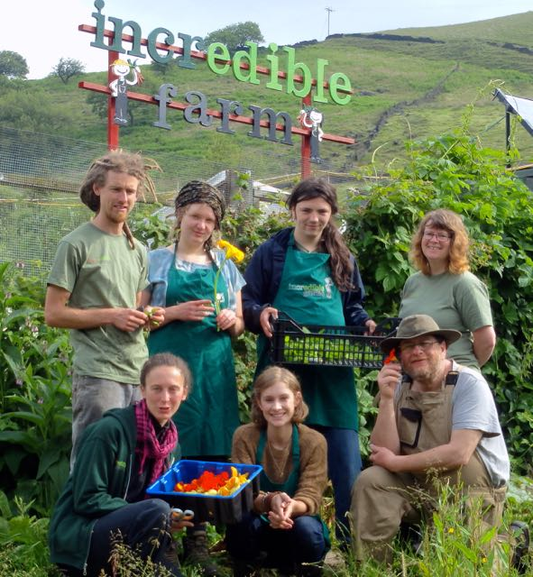
Why do people get involved?
Personal motivations
Helping others
Developing friendships
Exercising values and beliefs
Having influence
A sense of purpose
Being part of something

Slide 15

Why do people get involved?
The structure is right
Reaching out & listening
Communications & publicity
Open and inclusive
Direct requests and word of mouth
Easy ways in - tasters/open days
Feedback loops

Slide 16

What to avoid or minimise
Conflict and cliques
Lack of fun
Not feeling valued or making a difference
Wasting time
Changing priorities
Racism, sexism, ageism

Slide 17

Caution!
What may work in one area with one group of people may not work as well down the road with another set of people.
There are no absolutes. No answer to every situation.
It’s not quick if you want it to be meaningful.

Slide 18
Caution!
You won’t always hear what you want to hear.
People may not agree with you (or each other).
You can say no – just be polite!
Honesty is the best policy – but be respectful.
Safety first!

Slide 19
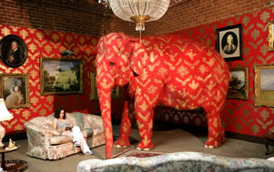
Managing community challenges
Acknowledge the issue
Empathise
Communicate –preferably face-to-face
Build your evidence
Be pragmatic

Slide 20
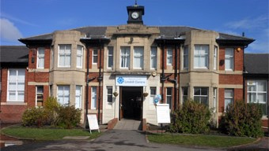
Case study

Slide 21


Success factors
Hidden’ engagement – then and now
Existing events
Varied opportunities
Newsletter
Membership scheme
Innovative governance
Outreach
Frequent asks!
Evidence

Slide 22

Four principles for
effective community engagement

Slide 23
1. Agree and communicate a clear purpose
and scope
What do you want to know/ what are you asking/what needs doing?
How do you want people to be involved?
Who are you asking? Why them?
What barriers might there be to people participating?

Slide 24
2. Choose appropriate engagement methods according to the purpose and scope
Engagement methods can include: Arts/creative projects, community mapping, Planning for Real, public meetings, workshops & focus groups, forums, web- based engagement/ social media, street stalls, community surveys, crowd funding, community organising.
Think about how you can use existing networks and events.
Use a variety of methodologies – be creative and make it fun!

Slide 25
3. Always feedback on what happened
Think about …
How and when feedback will be provided
How and when decisions will be taken
Further opportunities for engagement
Whether/how groups/individuals can be involved at the implementation stage

Slide 26
4. Build in community engagement on a continual basis, not just as a one-off exercise.
When was the last time you did a consultation or mapping exercise, to establish local needs?
How well do you engage with the diversity of your community (young and old, BME groups etc.)?

Slide 27
Planning
Use the principles to create a plan that includes:
Purpose – be clear what the engagement activity seeks to achieve
Context – pay attention to the needs and character of the local community
People – consider who should be involved, what there needs are what support or incentives may help them take part and how you’ll feedback
Method – design the process and choose a method that is appropriate to purpose, context people and
Outcome – set the goals and overall objectives (include monitoring and evaluation methods)

Slide 28


Social media/communication
Inform/broadcast
Consult
Inspire
Engage
Consider your platform
Update regularly

Slide 29
Locality toolkits
http://locality.org.uk/resources/social-media-toolkit-twitter-facebook/
http://locality.org.uk/resources/social-media-toolkit-youtube-linkedin/
http://locality.org.uk/resources/social-media-toolkit-blogging/

Slide 30
Fundraising
Driving donations
One-off purchasing
Crowdfunding
Community shares

Slide 31
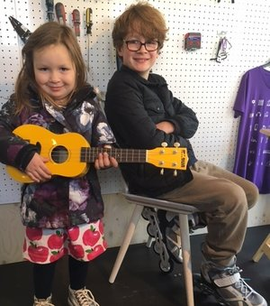
Success factors
Not working alone – pick the right partners
Networks
Social media but also stalls
Visuals (film)
People believed in our cause
Volunteer run
Open door
Updates and feedback
Quick response to questions
Inspiring model
Led by example
Used every opportunity

