Slide 1
High-Level Synthesis using Data Mining Algorithms
Venkatesh.R.Mahadevan
April 02,2015

Slide 2
Agenda
What is data mining?
Need for data mining
Types of data mining models
Examples of data mining algorithms
Comparison of software implementations
Need for hardware acceleration
Research (past and present)
Role of High-Level Synthesis
Impact on performance
Conclusion

Slide 3
What is data mining?
Interdisciplinary field of computer science.
Computation process of discovering patterns in large data sets.
Involves database and data management concepts, raw analysis, pre-processing, model and inference considerations.
Automatic/semi-automatic of large quantities of data to extract interesting patterns such as groups of records (clustering), unusual records (anomaly detection) , and dependencies (association rule mining).

Slide 4

Data mining in action

Slide 5
Need for data mining
Lots of questions can be answered via data mining
What goods should be promoted to this customer?
What medical diagnosis should be assigned to this patient?
How should load balancing be performed with regards to traffic on the Internet?

Slide 6
Types of data mining models
Two main types:
Predictive - data with known results used to develop a model for explicitly predicting values.
Descriptive – Used to describe patterns in existing data.
Abstract representations of reality.
Can be used as guides for understanding business and suggesting actions.

Slide 7
Examples of data mining algorithms
C4.5
K-means
Support Vector Machines
Apriori
Expectation-Maximization (EM)
PageRank
Adaboost
kNN
Naive Bayes
CART

Slide 8
C4.5
Given a set S of cases, C4.5 first grows an initial tree using the divide-and-conquer algorithm as follows:
If all the cases in S belong to the same class or S is small, the tree is a leaf labeled with the most frequent class in S.
Otherwise, choose a test based on a single attribute with two or more outcomes. Make this test the root of the tree with one branch for each outcome of the test, partition S into corresponding subsets S1, S2,... according to the outcome for each case, and apply the same procedure recursively to each subset.

Slide 9
C4.5 (Cont.)
Two heuristic criteria used to rank possible tests:
Information gain - minimizes the total entropy of the subsets {Si } (but is heavily biased towards tests with numerous outcomes)
Default gain ratio - divides information gain by the information provided by the test outcomes.
Limitations:
Complex rule-set classifiers.
Large amounts of CPU time and memory.
Accuracy greatly affected by omission of test cases.

Slide 10
K-means
Simple iterative algorithm to partition a dataset into user-specified number of clusters k.
Algorithm initialized by picking k points as the initial k cluster representatives or “centroids”. Techniques for selecting these initial seeds include sampling at random from the dataset, setting them as the solution of clustering a small subset of the data or perturbing the global mean of the data k times.
Iteration performed on the following 2 steps:

Slide 11
K-means (Cont.)
Data Assignment - Each data point assigned to its closest centroid, with ties broken arbitrarily. This results in a partitioning of the data.
Relocation of “means”. Each cluster representative is relocated to the center (mean) of all data points assigned to it. If the data points come with a probability measure (weights), then the relocation is to the expectations (weighted mean) of the data partitions.
Converges when assignments no longer change.

Slide 12
K-means (Cont.)
Weaknesses:
Ambiguity in quantification of “closeness” in assignment step.
Greedy descent to a local and not global optimum.
Sensitive to initial locations of centroids.
Data must not be in non-convex clusters.
Sensitive to presence of outliers.
Cost of optimal solution decreases with increasing k till it hits zero when the number of clusters equals the number of distinct data-points. This makes it more difficult to (a) directly compare solutions with different numbers of clusters and (b) to find the optimum value of k

Slide 13
Support Vector Machines
Tries to find the best classification function to distinguish between members of classes in the training data.
Involves finding linear hyper-planes that maximize the margin between classes by calculating the Lagrangian.
Geometrically, the margin corresponds to the shortest distance between the closest data points to a point on the hyper-plane.
Offers the best classification performance, and leaves room for correct classification of future data.

Slide 14
Support Vector Machines (Cont.)
Weaknesses:
Computational inefficiency.
Will need specialized kernel functions in case data is not linearly separable.
Allows for the existence of ‘noisy’ data.

Slide 15
Apriori
Used to find frequent item-sets using candidate generation.
First scans the database and searches for frequent item-sets of size 1 by accumulating the count for each item and collecting those that satisfy the minimum support requirement.
Iteration on the following three steps to extract all the frequent item-sets:
1. Generate Ck+1, candidates of frequent item-sets of size k + 1, from the frequent item-sets of size k.
2. Scan the database and calculate the support of each candidate of frequent item-sets.
3. Add those item-sets that satisfies the minimum support requirement to Fk+1.

Slide 16
Apriori (Cont.)
Cost of generating candidate sets expensive when item-sets very frequent, large, or support minimum.
Uses horizontal data format – frequent item-sets associated with each transaction.
Vertical format with transaction ID’s can improve performance.
FP (frequent pattern) growth can mitigate Apriori problems:
Compression of the database representing frequent items into a structure called FP-tree (frequent pattern tree) that retains all the essential information
Division of the compressed database into a set of conditional databases, each associated with one frequent item-set and mining each one separately

Slide 17
Expectation Maximization (EM)
Finite mixture distributions provide a flexible and mathematical-based approach to the modeling and clustering of data observed on random phenomena.
These can be fitted by maximum likelihood via the EM algorithm.
Estimate of vector of all unknown parameters allows for a probabilistic clustering into clusters in terms of posterior probabilities of component membership.
Weaknesses:
Appropriate choice of number of clusters needs to be made via Bayesian information criterion as native selection is inefficient.

Slide 18
PageRank
Search ranking algorithm used by Google that uses hyperlinks on the Web.
Value compiled offline and does not depend on queries.
Hyperlink from page x to page y regarded as a vote, by page x, for page y.
Votes casted by pages that are themselves “important” weigh more heavily and help to make other pages more “important”.
Similar to rank prestige in social networks.

Slide 19
PageRank (Cont.)
Main considerations:
1. A hyperlink from a page pointing to another page is an implicit conveyance of authority to the target page. Thus, the more in-links that a page i receives, the more prestige the page i has.
Pages that point to page i also have their own prestige scores. A page with a higher prestige score pointing to i is more important than a page with a lower prestige score pointing to i. In other words, a page is important if it is pointed to by other important pages.
Web represented as a graph with directed edges.
Damping factor used along with Markov chains to model the above.
Recursive algorithm, can be solved via power iteration method.

Slide 20
Adaboost
Uses the concept of “ensemble learning” (multiple learners) to solve problems.
Works as follows:
Assign equal weights to all the training examples.
Denote the distribution of the weights at the t-th learning round as Dt.
From the training set and Dt generate a weak or base learner ht : X → Y by calling the base learning algorithm.
Use the training examples to test ht, and increase the weights of incorrectly classified examples, obtaining an updated weight distribution Dt+1.
From the training set and Dt+1 generate another weak learner by calling the base learning algorithm again.

Slide 21
Adaboost (Cont.)
Possible improvements:
Can a weak learning algorithm that performs just slightly better than random guess could be “boosted” into an arbitrarily accurate strong learning algorithm?
Can a cascade process be used for speeding up the algorithm?
Gave rise to the concept of “boosting”.

Slide 22
kNN
Finds a group of k objects in the training set that are closest to the test object, and bases the assignment of a label on the predominance of a particular class in this neighborhood.
Driven by three key elements:
Set of stored records.
Distance or similarity metric to compute distance between objects.
Number of nearest neighbours k.

Slide 23
kNN (Cont.)
Weaknesses:
Choice of k –small k increases sensitivity to noise, large allow inclusion of points from other classes.
Combining class labels.
Choice of distance measure.
Attributes need to be scaled.
Lazy learners – cheap to build model, expensive to classify.
Can use condensing to speed up classification.
Other approaches include proximity graphs and fuzzy kNN’s.

Slide 24
Naive Bayes
Given a set of objects, each of which belongs to a known class, and each of which has a known vector of variables, to construct a rule which will allow assignment of future objects to a class, given only the vectors of variables describing the future objects.
Construct a score from known objects and compare with threshold for classification purposes.
p dimensional multivariate problem reduced to p univariate estimation problems.

Slide 25
Naive Bayes (Cont.)
Weaknesses:
Need to ease variable independence assumption.
Decision surface produced can have a highly non-linear shape.
Variable independence restriction is to introduce extra terms in the models of distribution for x in each class, to allow for interactions.
Can use multinomial logistic regression to improve predictability.

Slide 26
CART
Used in Artificial Intelligence, Machine Learning, non-parametric statistics and data mining.
Binary recursive partitioning procedure capable of processing continuous and nominal attributes both as targets and predictors.
Data are handled in their raw form; binning not required.
Trees grown to a maximal size without the use of a stopping rule and then pruned back (essentially split by split) to the root via cost-complexity pruning.

Slide 27
CART (Cont.)
The next split to be pruned is the one contributing least to the overall performance of the tree on training data.
Sequence of nested pruned trees, all of which are candidate optimal trees.
Tree performance is always measured on independent test data (or via cross validation) and tree selection proceeds only after test-data-based evaluation.
If no test data exist and cross validation has not been performed, CART will remain agnostic regarding which tree in the sequence is best.

Slide 28
CART (Cont.)
Other characteristics:
Splitting rules.
Prior probabilities and class balancing.
Missing value handling.
Attribute importance.
Dynamic feature construction.
Cost-sensitive learning
Stopping rules, pruning, tree sequences, and tree selection.
Probability trees.

Slide 29
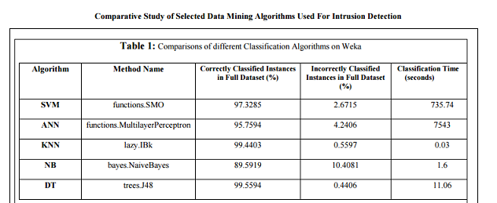
Comparison of software performance
http://www.ijsce.org/attachments/File/v3i3/C1662073313.pdf

Slide 30
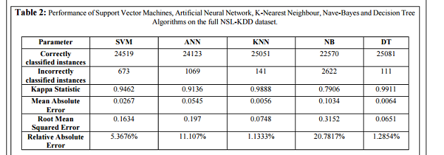
Comparison of software performance (Cont.)
http://www.ijsce.org/attachments/File/v3i3/C1662073313.pdf

Slide 31
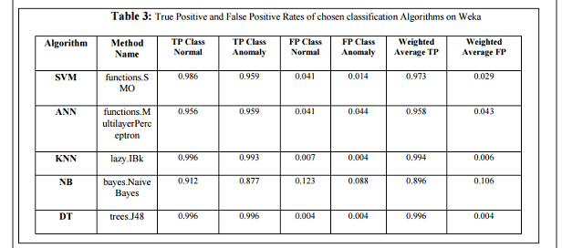
Comparison of software performance (Cont.)
http://www.ijsce.org/attachments/File/v3i3/C1662073313.pdf

Slide 32
Need for hardware acceleration
Rapid increase in amount of data creates interesting opportunities to speed data mining algorithms.
Data mining algorithms have high throughput but very long computation times even in the best case.
Can use hardware accelerators for stream processing.
Accelerators can be implemented on top of reconfigurable hardware (FPGA’s).
Highly parallel with low clock frequencies compared to CPU’s, but lots of resources which can be used when pipelining.

Slide 33
Research (past and present)
Digital technology fuelling data growth.
System performance improving slower than volume of data.
Data mining applications regularly oscillate between computation-intensive and data-intensive phases.
K-means clustering has been implemented with reconfigurable hardware.
Apriori implemented on FPGA’s using two approaches:
scalable systolic array architecture to efficiently carry out the set operations, and a ‘systolic injection’ method for efficiently reporting unpredicted results to a controller.
Bitmapped CAM architecture

Slide 34
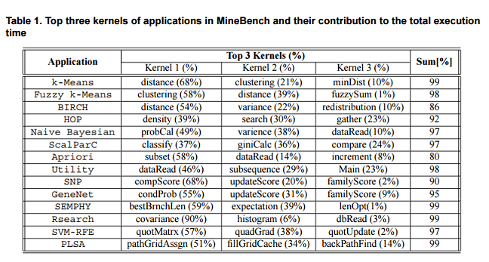
Research (past and present) (Cont.)
http://www.ece.iastate.edu/~zambreno/pdf/ChoNar07A.pdf

Slide 35
Role of High Level Synthesis
Can accelerate data mining algorithms using customized accelerators.
High Level Synthesis seeks to convert software to hardware using synthesis techniques learnt in this course.
Can help developers accelerate their applications without the need to know a HDL.
Will convert C/C++/System C into hardware.
System can be prototyped on FPGA before creation of the actual ASIC.
Savings in time/cost/fixing bugs.

Slide 36
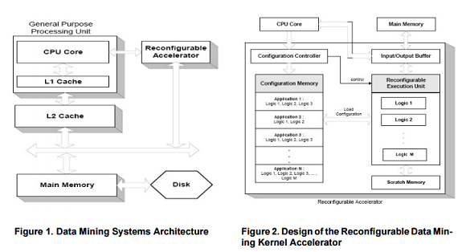
Role of High-Level Synthesis

Slide 37
Impact on performance
When applications are loaded, their specific kernels should be loaded into the reconfigurable logic.
Once the logics have been loaded, the execution unit hardly needs to be reprogrammed.
Only reprogrammed during application change.
Once the kernels are identified for each application, the hardware logic can be built and stored into the configuration memory by examining the underlying computations.
Two case studies described next:
K-Means and fuzzy K-Means
Decision Trees

Slide 38
K-Means and fuzzy K-Means
Clustering kernel is more time consuming than the distance calculation.
In fuzzy logic, the computations involved in performing the membership calculation (owing to multiple membership property) are more intense than the actual distance calculation.
Distance calculation –N subtractors and multipliers.
Markers attached to code to allow processor to offload code to accelerator.
Pipelined design becomes more effective when data set size increases.
For K-Means and fuzzy K-Means, speedups from 500x to 3600x and 400x to 1600x in the distance calculation kernel, respectively, and 600x to 1600x in minimum kernel in fuzzy K-Means.

Slide 39
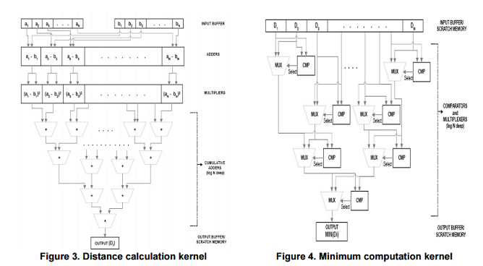
K-Means and fuzzy K-Means (Cont.)

Slide 40
Decision Trees
Poor scalability with increasingly large and complex data sets, as well as the existence of concise, well defined kernels make DTC a suitable candidate for hardware acceleration.
Determining the split attribute and the split index is a critical component of the decision tree induction process.
Splitting criteria used is to minimize the Gini index of the split.

Slide 41
Decision Trees (Cont.)
The Gini score is a mathematical measure of the inequality of a distribution. Computing the Gini value for a particular split index requires computing the frequency of each class in each of the partitions. Therefore a linear search is made for the optimum split value, by evaluating the Gini score for all possible splits. This process is repeated for each attribute, and the optimum split index over all attributes is chosen. The total complexity of this operation is O(|R|∗|A|), where |R| and |A| represent the number of records and the number of attributes, respectively.
Several parallel Gini units used for speedup.

Slide 42
Decision Trees (Cont.)
Bitmaps used for generating class ID’s required to compute Gini score sent to the DTC Controller.
Absolute value of the Gini score computed is irrelevant to the algorithm.
Simplification of the Gini computation to require minimal hardware resources, while generating the same value of split position and split attribute.
A speedup of 5.58x over the software implementation with usage of 16 Gini units.
Higher speedups possible using large-capacity FPGA’s.

Slide 43
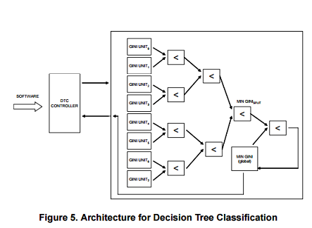
Decision Trees (Cont.)

Slide 44
Conclusion
As data set sizes exponentially increase, conventional data mining applications are unable to scale up to the computational demands of these inputs.
Hardware acceleration an attractive option.
Generic data mining system proposed for reconfigurable logic.
Appreciable speedups can be obtained.
Field is still in its infancy.
I ♥ HLS!

