Slide 1
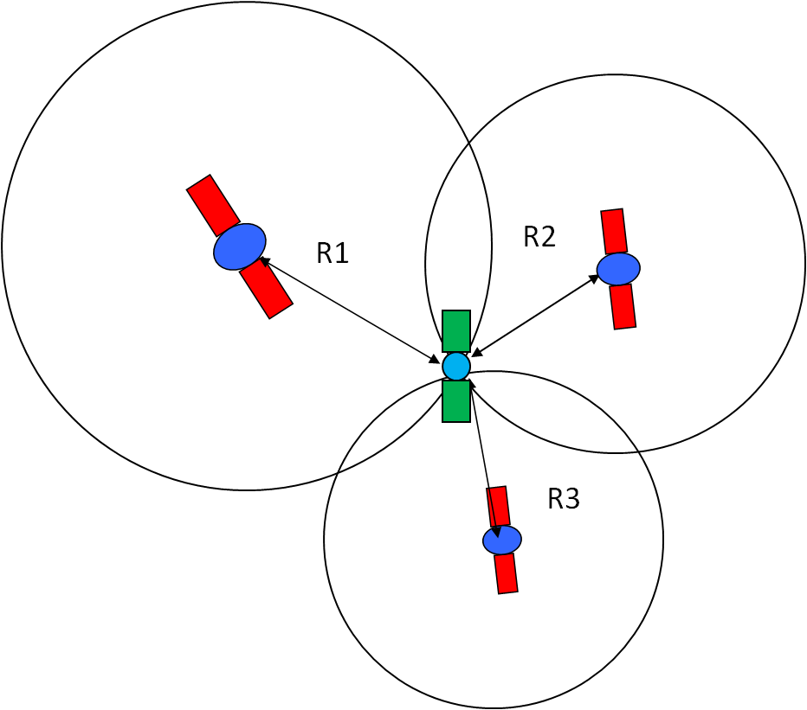
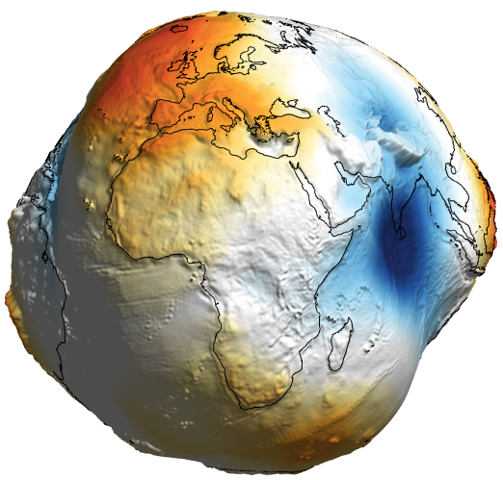
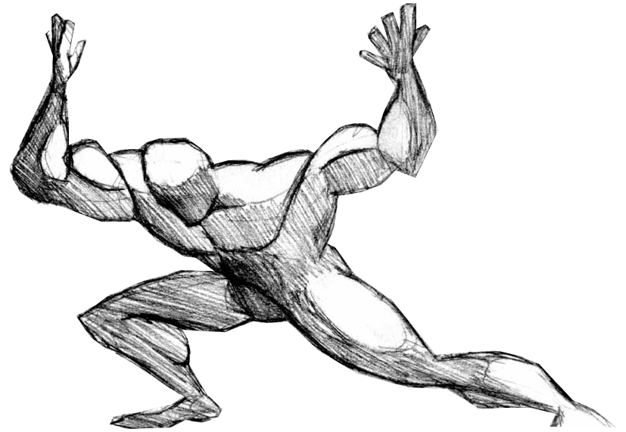
Time Keepers
A prolog to GIS Survey Standards & Specifications
Bhaskar Mangal
27th-Jul 2017

Slide 2
Overview
1. Time Keepers - Atomic clocks
2. Global Navigation Satellite Systems (GNSS)
3. Space based PNT services
4. Calculate positions on the earth
  Shape of the Earth - Ellipsoid, Geoid
  Reference for measurement - Datum (eg: WGS 1984)
  Transformation of a curved earth to a flat map - Projections (eg: UTM 1975)

Slide 3
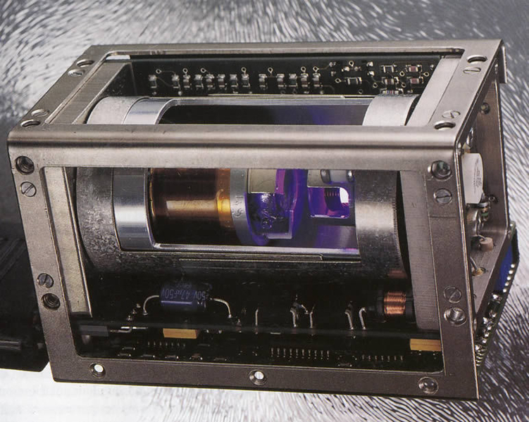
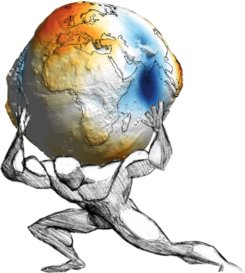
Time Keepers
Atomic Clocks
Distance is Measured in Time
In 1 nanosecond light travels ~30cm
Since 1983 , the standard meter has been redefined as the length of the path traveled in the vacuum by the light for a duration of 1/299 792 458 seconds.
Once synchronised, a cesium atomic clock—which harnesses the transition of electron energy levels in cesium atoms to measure time accurately—won't miss a second in 10,000 years
Poor the accuracy of these atomic clocks, less the accuracy of the distance calculated

Slide 4
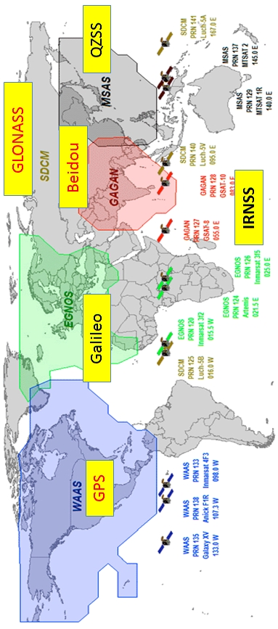
GNSS - Global Navigation Satellite System
Operational
GPS – USA
GLONASS – Russia
Galileo – European Union
In Development
BeiDou 2 – China (by 2020)
RNSS - Regional Navigation Satellite System
Japan – QZSS
China – BeiDou 1
India – NavIC (IRNSS)
GNSS Augmentation
US – WAAS, DGPS
RU - SDCM
EU – EHNOS
FR - DORIS
JP – MSAS
IN – GAGAN
PNT services for public and military (encrypted, 2x-10x higher accuracy)

Slide 5
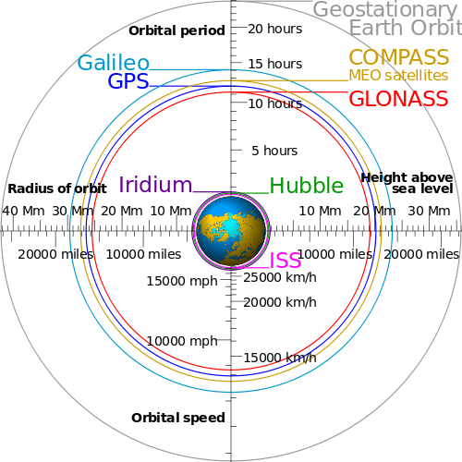

Slide 6
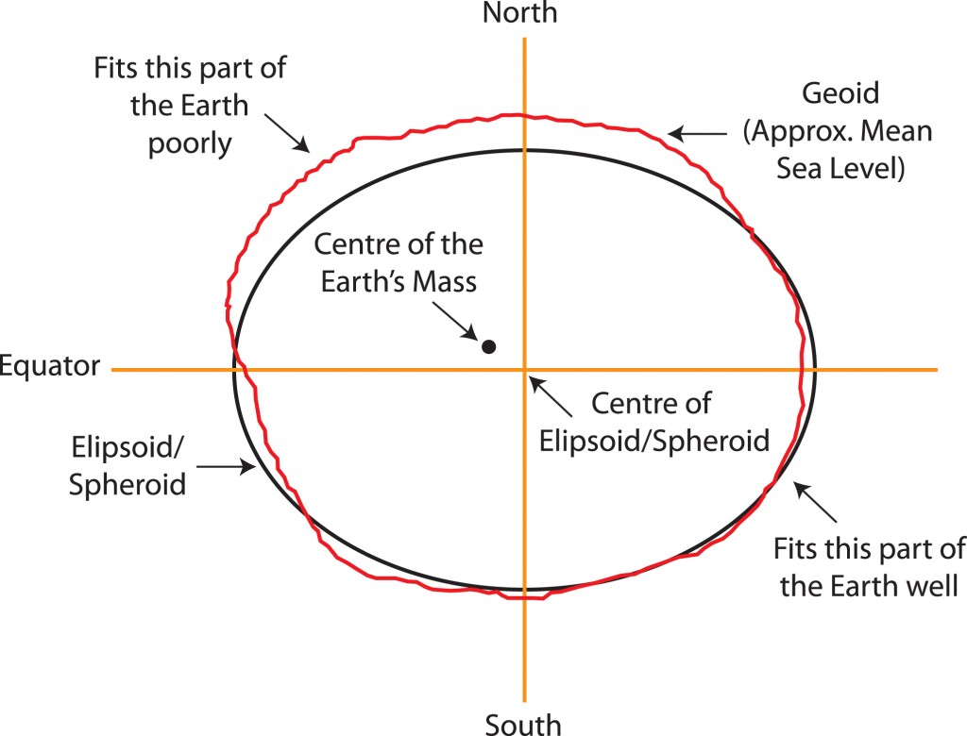
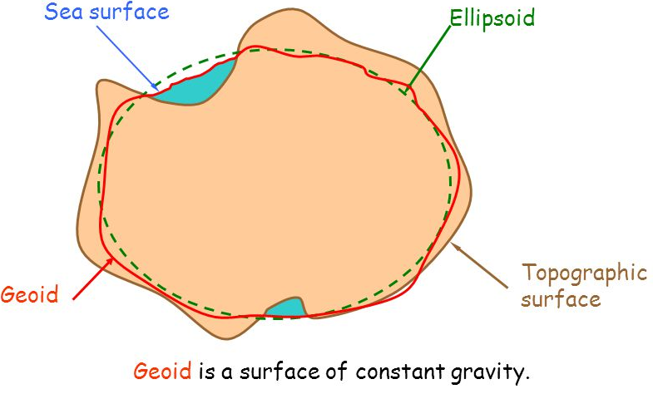
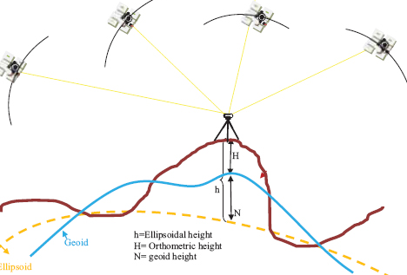
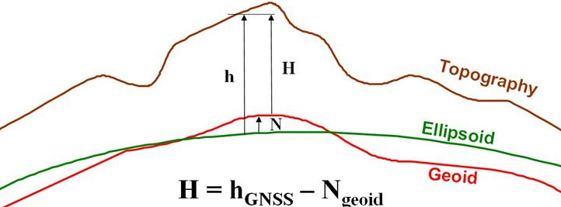

Slide 7
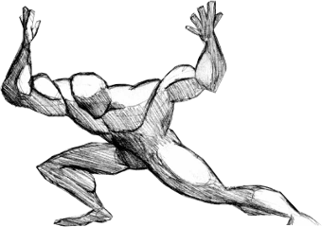
Appendix
IERS - International Earth Rotation and Reference Systems
BIPM - Bureau International des Poids et Mesures
UTC - Coordinated Universal Time
Thank You

