Slide 1
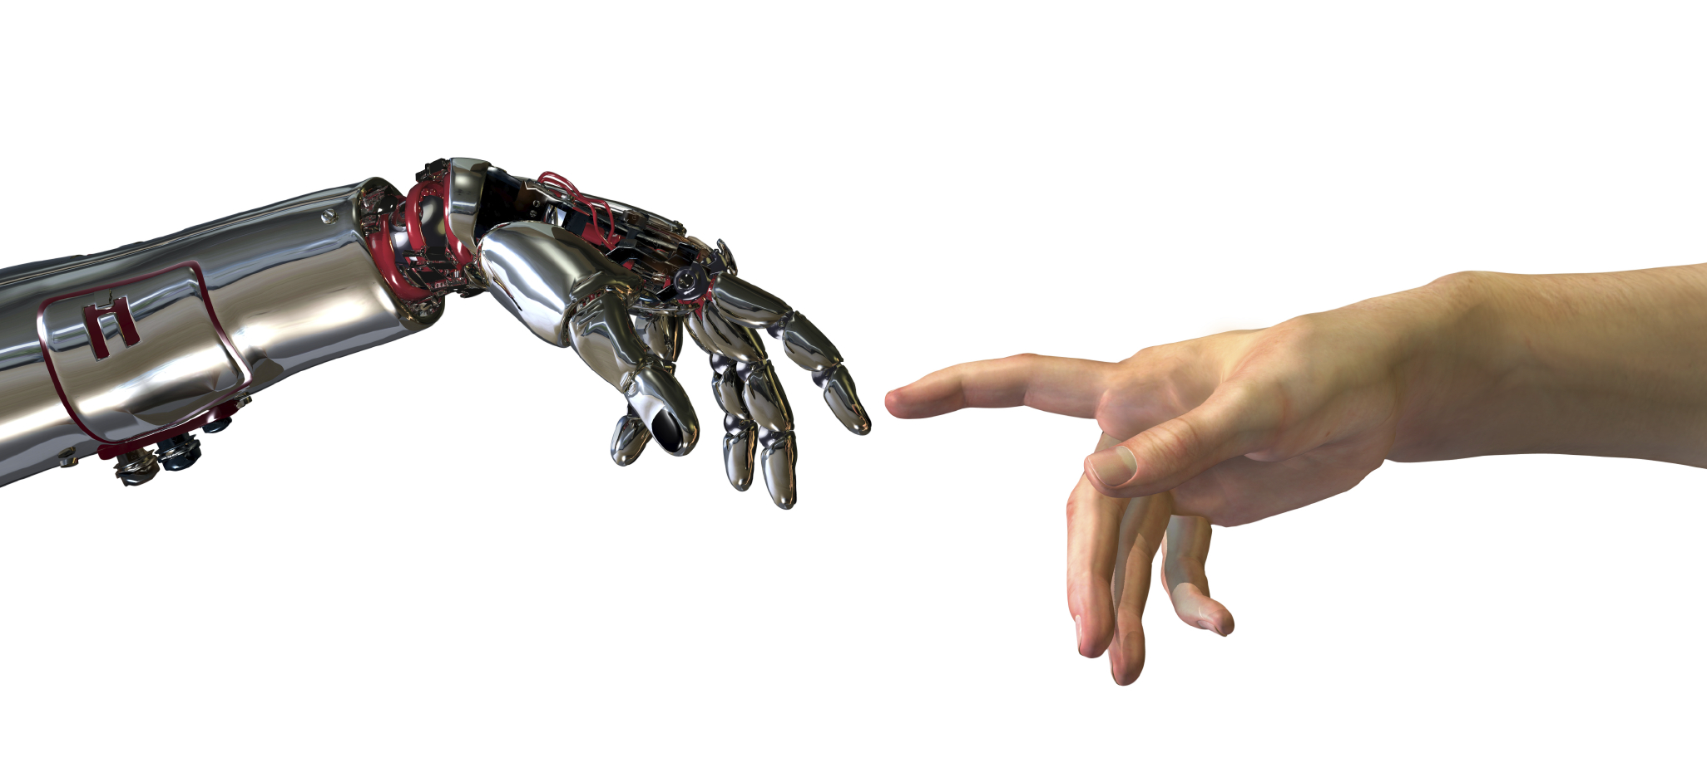
Applications of Machine Learning
in Advance Map Creation
July 2017
Bhaskar Mangal
Technical Architect
VidTeq (MMI)

Slide 2


Philosophy
Machine Learning
Artificial Neural Networks
Artificial Intelligence
Robots
Full Automation
Machines
With
Vs
Increase
Productivity
Facilitates
Empower
Augment
Efficiancy
Semi Automation
Human

Slide 3
Applications of ML
Categorization
Text from the photographs
Image Categorization/Classification
Structure Segmentation and Re-construction
CBIR (Content Based Image Retrival)
Specific Use Cases
Number Plate Masking (ALPR)
Face obfuscation
POI – auto-fill (OCR)
POI – categorization
Road Edges, Lane Re-construction
Traffic Sign Detection and Extraction
Image based search

Slide 4
Plan
ML, Deep Learning Readiness
– 15th Apr’17 till 15th Jul’17
– Hands on ML and CNN in computer vision, technology survey, feasibility, use cases identification, production workflow planning
– Refer Readme.html for updates
Use Case Implementations
– 15th Jul’17 till 15th Sep’17
  Number Plate Masking
  Number Plate based Image retrival
– Standalone and Integrated workflow with Internal Tools
– Architecture, Specifications, Workflow documentations

