Slide 1



Nvidia Driveworks
&
Deep Neural Networks
Blog, k-bank, forum
Setup scripts
Updates till 7th May 2017
by Bhaskar Mangal

Slide 2



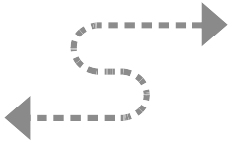
Bangalore Development Center
[BDC]
???
Product Line
Markets
Advance Mapping Technology
[AMT]
Digital Map Twin
[DMT]
(HD 3D Map)
PCD
Annotation
Modelling
Smart Cities
ADAS
Nvidia Driveworks
Photogrammetry
Deep Learning
Autonomous Cars
Diwali Challange
Training+Material
Internal Toolchain
??? Carve Products

Slide 3
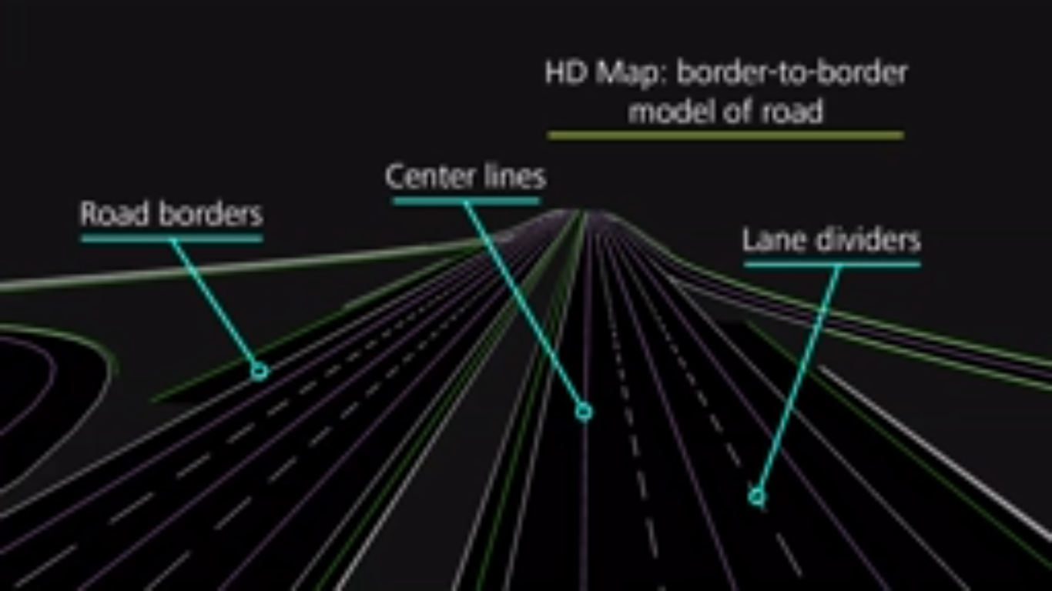
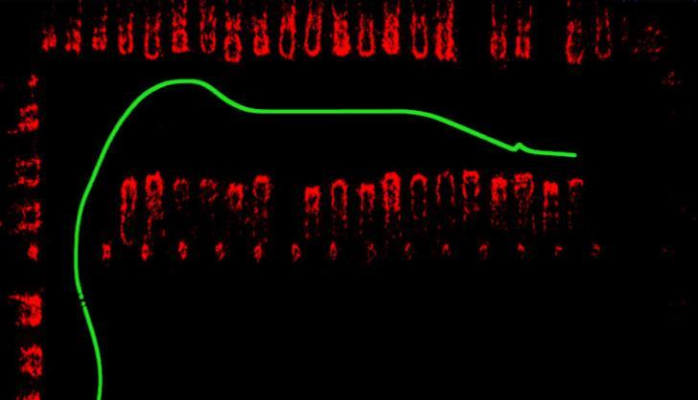
HD Map
???
Product Line
Markets
Digital Map Twin
[DMT]
(HD 3D Map)
Smart Cities
ADAS
Occupancy Map
Autonomous Cars
Diwali Challange
??? Carve Products

Slide 4
Desktop System:
Ubuntu 14.04 64-bit; GeForce GT 730 (CUDA Compute capability 3.5), 8GB RAM
Driveworks:
SDK v0.1.2 for PC
SDK v0.2 for DRIVE PX2
Nvidia graphics driver (nvidia 371)
CUDA 8.0 Toolkit
cuDNN
TensorRT
Deep Learning:
ConvNetJs
Tensorflow-gpu (desktop)
Tensortflow (laptop, no gpu)
Deep Learning:
Trainings & Tutorials
  Learned concepts of DNN,CNN,RNN, different frameworks, python basics
Shortlisted & setup done for:-
  TensorFlow (Python) - with & without GPU
  ConvNetJs (Javascript)
In next couple of weeks will have following:-
  Output runs from available neural networks for Hand-written digit identification dataset
  Identify problems, available neural networks and training datasets
Driveworks:
Most of the SDK dependencies installed
Some compiled samples are executed
Few compiled samples and demo failed – graphics card compatibility issue
Need discussion times like on hardware interface
Need workstation with CUDA CC>=5.0
Couple of options:-
Use SDK for PC, interface it with hardware
Use DRIVE PX2, supported sensors and Driveworks (refer manual for supported sensors)
Nvidia Driveworks
Deep Learning

Slide 5

Graphics Cards (GPUs)
Brand Name
GeForce, Quadro, NVS, Tesla
Desktop GPUs – GeForce
Entertainment, PC Gaming, general-purpose, cost-sensitive
Mobile GPUs
Workstation GPUs – Quadro
Professional use - CAD, CGI, DCC, DNN/CNN
Mobile Workstation GPUs - Quadro Go (GL) & Quadro FX Go series
GPUMicroarchitecture
Tesla
Fermi 2010
Kepler 2012
Maxwell 2014
Pascal 2016
Volta 2017-2018
AI Supercomputing
Nvidia
GPUs
Highly parallel
Multi-core systems
Process large blocks of data in parallel
SoC
DRIVE PX2, Xavier
GPU
PhysX - game physics engine
Bullet - soft & rigid body dynamics
CUDA
Parallel computing platform
API for GPU programming
Driveworks v0.1.2 requires CUDA CC >= 5.0
CUDA SDK 8.0, Compute Capability 5.0 – 6.x (Maxwell, Pascal)
SoC – System on a Chip (IC)
Jetson
Parker
Erista
DRIVE ( CX, PX, PX2 ) - 2015-16
Xavier – 2017
mobile devices
Self-driving cars
AI Supercomputer

