Slide 1


Design Patterns: An Introduction
CS6.401 Software Engineering
Dr. Karthik Vaidhyanthan
karthik.vaidhyanathan@iiit.ac.in
https://karthikvaidhyanathan.com

Slide 2
Acknowledgements
The materials used in this presentation have been gathered/adapted/generated from various sources as well as based on my own experiences and knowledge
-- Karthik Vaidhyanathan
Sources:
Applying UML and Patterns, Craig Larman
Design Patterns: Elements of Reusable Object-Oriented Software by Erich Gamma, Richard Helm, Ralph Johnson and John Vlissides

Slide 3
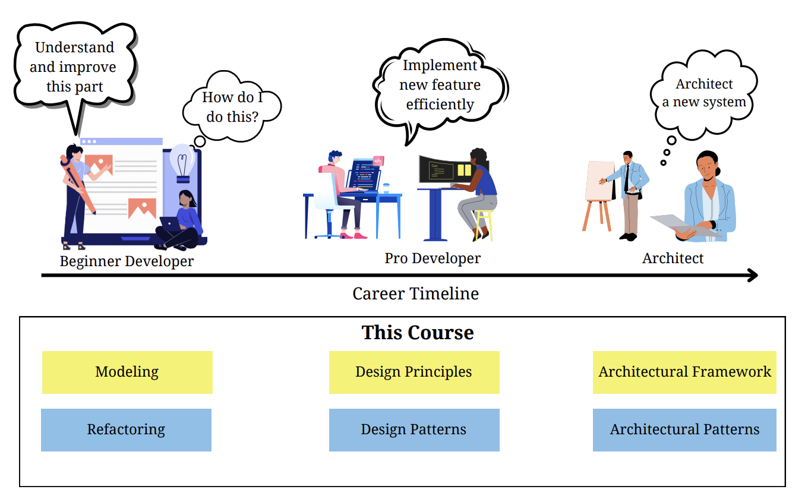
The Journey

Slide 4
What were some Lessons Learned form Unit 1?

Slide 5

Key Design Principles
Abstraction
Encapsulation
Modularization
Hierarchy
So all we need to follow them – Problem Solved!!
This Photo by Unknown Author is licensed under CC BY-NC

Slide 6
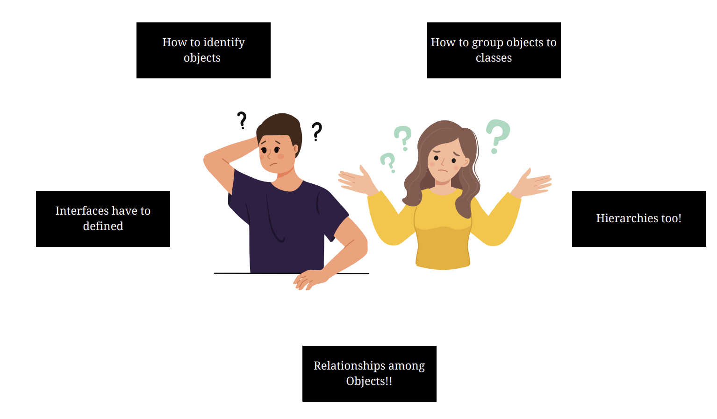
Designing that too OO Systems is not very straightforward

Slide 7
Things Improve with Practice
Designs should be reusable, flexible and understandable
Very difficult to get it right the first time – Not hard though!!
Experience people also take multiple iterations
Novice find it even more difficult to get their head around!
Experts are able to make good design….How?

Slide 8
Things Improve with Practice
Experts tend to reuse solution that have worked in the past!
The way objects are identified, relationships are established becomes recurring activity
When something has been tried and worked well, why not use it again!!
They start seeing recurring patterns over time
What if this experience could be recorded for reuse?

Slide 9
GRASP

Slide 10
General Responsibility Assignment Software Patterns or Principles
Information Expert: Who gets the responsibility?
Find which class has the data
The one who has data also should have the operations to perform the data
Creator: Who gets the role of the creator?
Defines guidelines for which class should be in charge of creating objects of other type
E.g. Class B should be in charge of creating objects of A if:
B contains or compositely aggregates A
B closely uses A
B has inputs to construct A
B records A

Slide 11
General Responsibility Assignment Software Patterns or Principles
Low Coupling: How to minimize impact of change?
Assign responsibilities such that to reduce coupling
Given two alternatives, chose the one that minimizes coupling
High Cohesion: How to keep everything together in one object to better manage and to minimize coupling?
Do one thing and do it very well
Give one end-to-end responsibility to one class
Reduce communication

Slide 12
General Responsibility Assignment Software Patterns or Principles
Polymorphism: How to decouple clients from different ways of accomplishing a single task?
Contributes to low coupling
Several ways to accomplish a task or a functionality
Achieved through interfaces, overloading methods of super classes
Pure Fabrication: Whom to assign the responsibility when it does not fit into either of the classes?
Promotes cohesion
Sometimes a responsibility needs to be assigned but need not fit well into a class
Create a new class (does not map to domain object for handling the responsibility

Slide 13
General Responsibility Assignment Software Patterns or Principles
Indirection: How to ensure that one can communicate with another without knowing each other well?
Another principle/pattern to reduce coupling
Introduce a new class between two classes A and B
Changes in A or B doesn’t affect each other. The intermediary absorbs the
impact
Introduces a class as opposed to protected variation
Protected Variation: How to protect part of a class from changes in part of another class?
Related to ensuring low coupling
Code of a part of class B is protected from changes in code of part A
Introduce interface around the unstable part of the codebase

Slide 14
General Responsibility Assignment Software Patterns or Principles
Controller: What if there is a need for someone to control the responsibility between classes?
Kind of a subtype of pure fabrication
Very common in UI applications -> between UI and the backend
Separate concerns clearly between two classes by having someone in middle
Does not map to any domain object

Slide 15
Design Patterns

Slide 16

Design Patterns
Each Pattern describes a problem which occurs over and over again in our environment and then describes the core of the solution to that problem, in such a way that you can use this solution a million times over, without ever doing it the same way twice -- Christopher Alexander
Patterns captures {Context, Problem, Solution}
What are some of the patterns you can think of?
Source: A Pattern Language, Christopher Alexander
This Photo by Unknown Author is licensed under CC BY-NC

Slide 17
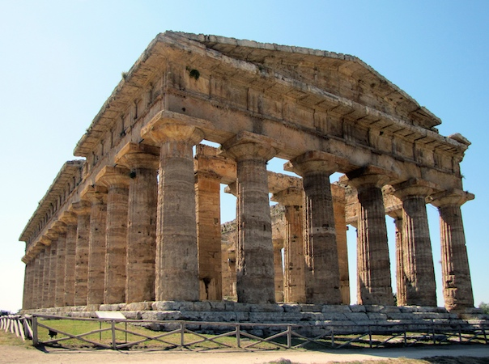


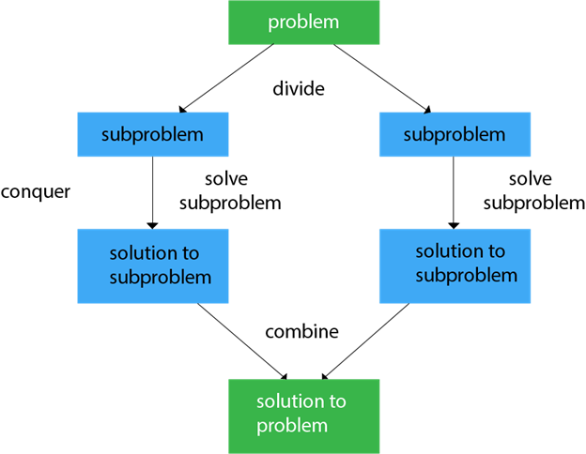
Patterns patterns everywhere!
We have a natural tendency to look for patterns in anything and everything
Pattern of grades for courses
Pattern of questions in question papers
Climate patterns (rainfall, summer, …)
…
Architectural Patterns
Color Patterns
Algorithmic Patterns
Data Patterns
Roman architecture
Island houses in Greece
Divide and conquer
Covid cases curve

Slide 18
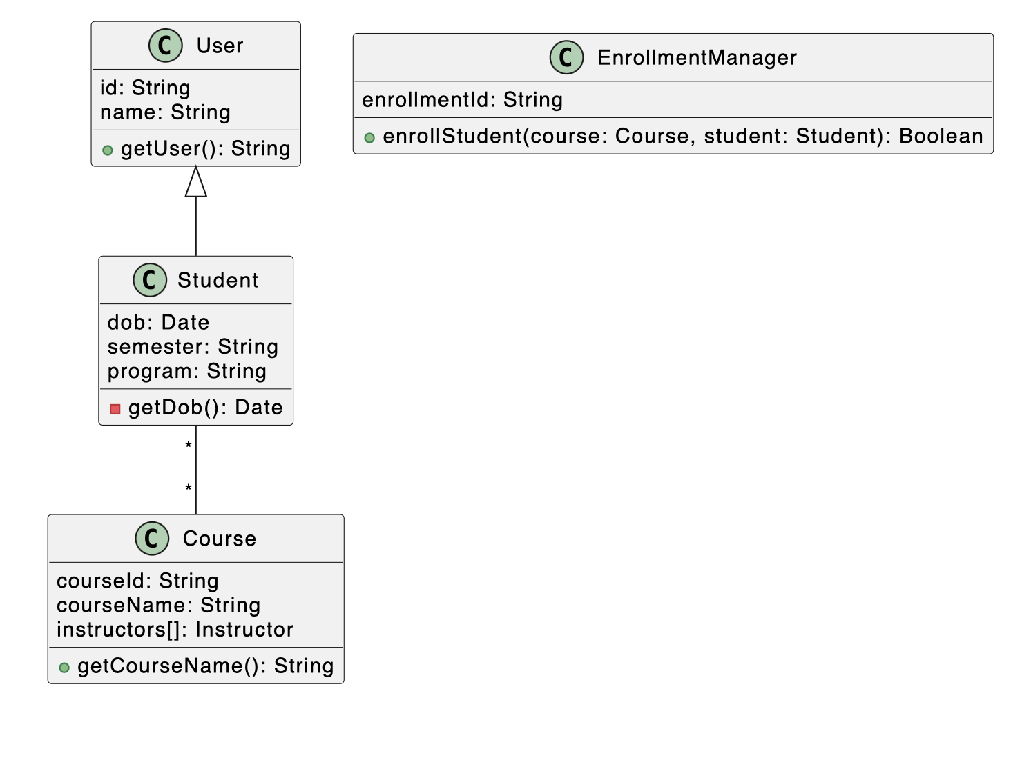
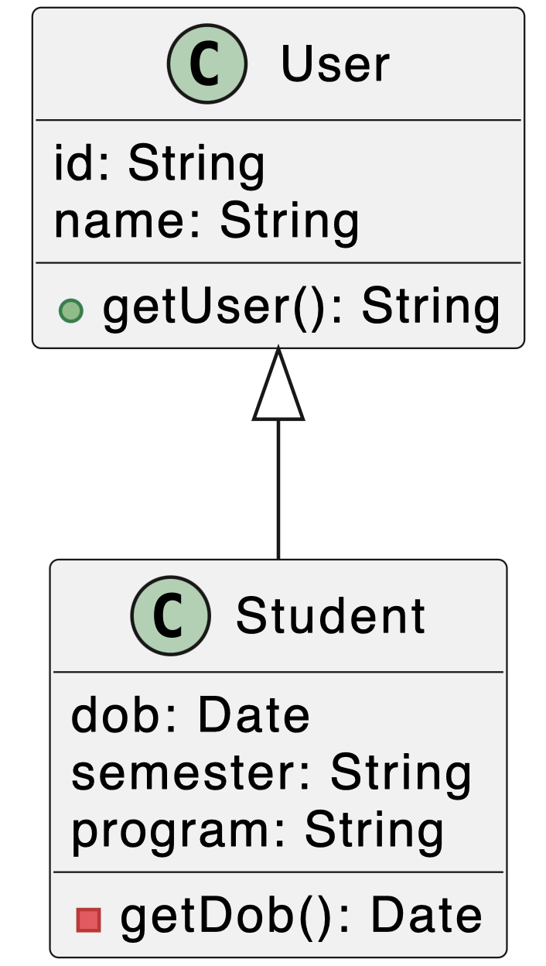
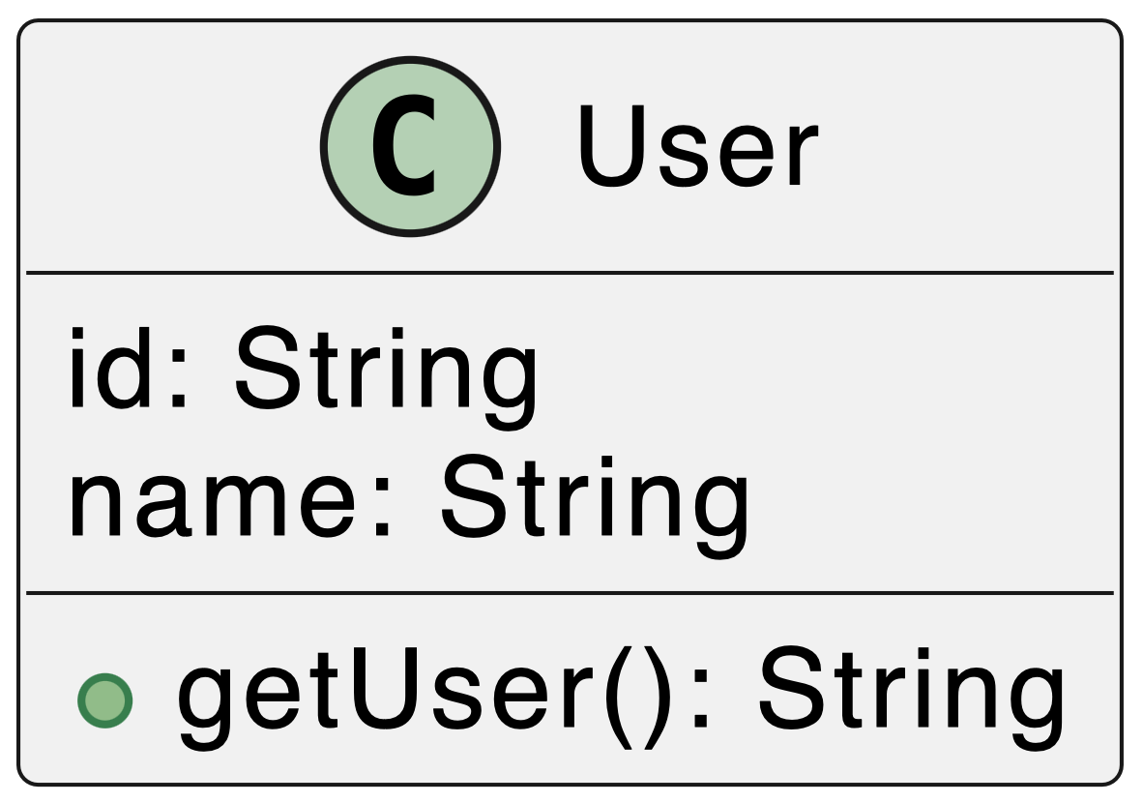
What about Software?
Many patterns to design and build software systems
Architectural Patterns [Higher Level]
Design Patterns [Lower level]
Patterns for extracting objects
And classes
(Look for nouns, verbs, etc.)
Patterns for structuring
everything
Patterns for distributing functionality

Slide 19
Four Elements of a Pattern
Pattern Name: Handle to describe a design problem
Problem: When to apply the pattern, preconditions, special relationships, etc.
Solution: Elements that make up the design, relationships and collaborations
Not a particular solution but abstract representation with potentials
Consequences: Results and trade-off of applying a given pattern
Perform cost-benefit analysis

Slide 20
Design Patterns
Principles, relationships and techniques for creating reusable OO design
Identifies participating objects, their roles, responsibilities and relationships
Not about Linked Lists, hash tables, etc.
The are low level structures inside classes
Not about complex domain specific design or design of subsystems
Domain specific design is more at high level – Architectural level

Slide 21
Classification of Design Patterns
Mainly divided into three based on the purpose they serve
Creational, Structural and Behavioral
Each category has a purpose, a set of patterns that work in different scope:
Class or object
There are a total of 23 classic patterns: Gang of Four (GOF) patterns
The famous book Design Patterns: Elements of Reusable Object-Oriented Software by Erich Gamma, Richard Helm, Ralph Johnson and John Vlissides

Slide 22
Classification of Design Patterns
Creational
Class - Defer creation to subclasses
Object – Defer creation to another object
Structural
Class – Structure via inheritance
Object – Structure via Composition
Behavioral
Class – algorithms/control via inheritance
Object – algorithms/control via object groups

Slide 23
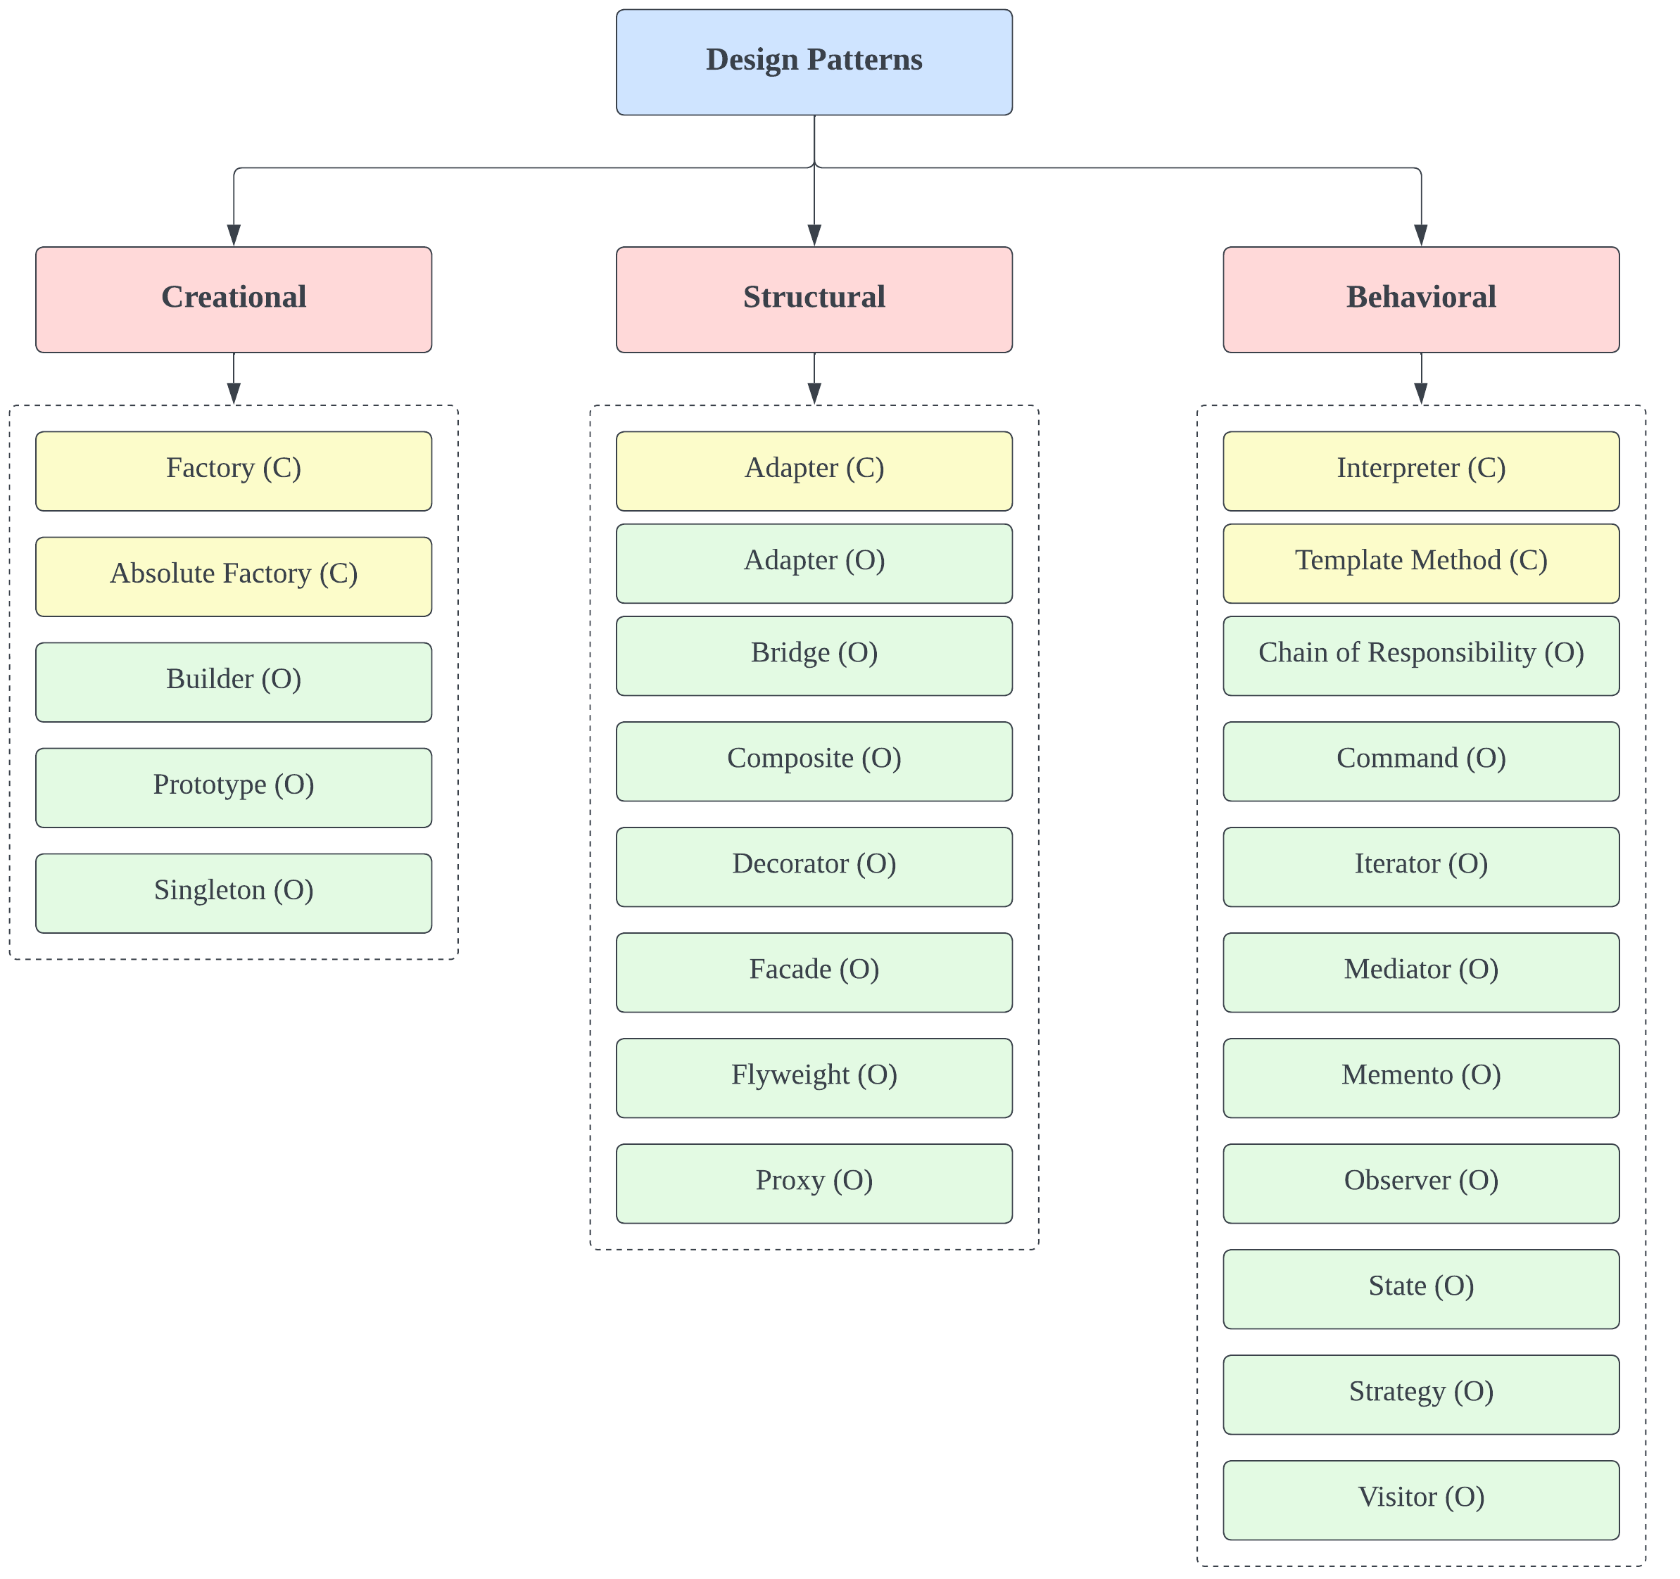
C – Scope is Class
O – Object Scope

Slide 24
Describing Patterns
Pattern Name and Classification
Name captures essence and classification the category it tackles
Intent
What does the design pattern do?
What is its rationale and intent – What problem does it address?
AKA (Also Known As): Other known names
Motivation
A scenario that illustrates the problem and how pattern can solve it
Applicability
What are the situation in which the pattern can be applied and how to recognize them?

Slide 25
Describing Patterns
Structure
Graphical representation of the pattern in UML or other modeling language
Participants
The classes/objects participating and their responsibilities
Collaborations
How the participants collaborate to carry out their responsibilities.
Consequences
How well does the pattern support its objectives?
What are the trade-offs and results of using the pattern?
What part can be varied independently?

Slide 26
Describing Patterns
Implementations and Sample Code
Code fragments to illustrate implementation in OOP language of choice
Known Uses
Examples of patterns in real systems
Related Patterns
What are the patterns closely related to this one?
What are the key differences?
What other patterns with which this can be used?

Slide 27
Some Principles

Slide 28
Program to Interface Not Implementation
One of the most important OO Design Principles
“Program to interface” refers to the idea of ensuring loose coupling
Does not only mean the “Interface”?
Very useful when lot of changes are expected
Create an interface, define methods -> create classes that implements them
Allows external objects to easily communicate
Maintainability and flexibility increases

Slide 29
Favor Object Composition over Class Inheritance
Two most common techniques: Inheritance and Composition
Class inheritance: White-box reuse
Internals of parent class are visible to child class
Defined statically at compile time
Sub class can override methods of parent class
Inheritance is not always the go to solution - ”breaks encapsulation”
Composition: Black-box reuse
Objects acquiring references to other objects
Defined dynamically at run time
Encapsulation is not broken – Objects are accessed through interfaces
Get what is needed by assembling and not by creating

Slide 30

Thank You
Course website: karthikv1392.github.io/cs6401_se
Email: karthik.vaidhyanathan@iiit.ac.in
Web: https://karthikvaidhyanathan.com
Twitter: @karthi_ishere

