Slide 1


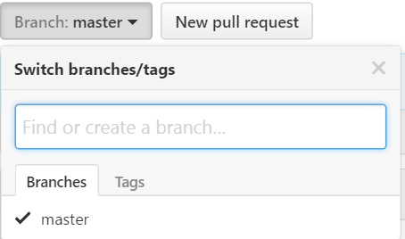
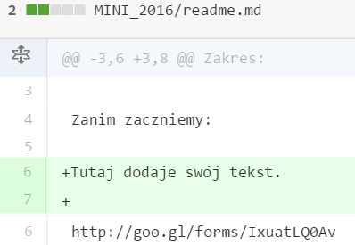

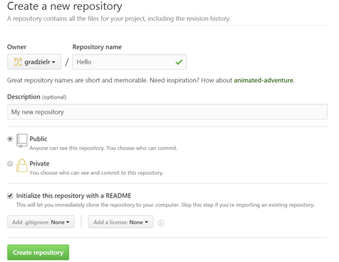
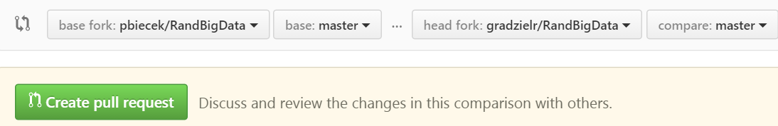

Code hosting
with GitHub
Cheat Sheet
Step 1’ – Fork a Repository
A fork is a copy of a repository. Forking a repository allows you to freely experiment with changes without affecting the original project. Especially useful during classes.
Find a repository in which you are intrested. In the upper right corner click Fork.
Now, this repository is available in your list of repositories.
Basics
Step 2 – Create a Branch
GitHub is a code hosting platform for version control and collaboration.
Pros of using GitHub:
- you and your coworker can each upload your revisions to the same page, and Git will save both copies,
- you can merge your changes together without losing any work along the way,
- you can revert to an earlier version at any time, Git keeps a “snapshot” of every change ever made,
- free of charge account.
A repository is usually used to organize a single project.
Repositories can contain folders and files, images, videos, spreadsheets, and data sets – anything your project needs.
1. In the upper right corner, next to your avatar or identicon, click and then select New repository.
2. Write name and short description, click create repository.
Branching is the way to work on different versions of a repository at one time.
By default your repository has one branch named master. We use branches to experiment and make edits before committing them to master.
1. Go to your repository.
2. Click the drop down at the top of the file list that says branch: master.
3. Type a branch name.
4. Select the blue Create branch box or hit “Enter” on your keyboard.
Step 1 – Create a Repository
Step 3 – Open a Pull Request
When you have made changes in a branch or a forked repository, you can open a pull request.
After opening a pull request, you are proposing your changes and requesting that someone review and pull in your contribution. Pull requests show differences of the content from both branches. The changes, additions, and subtractions are shown in green and red.
1. At the top of the file list click New pull request.
2. Select the branch to compare with. Look over your changes in the diffs on the Compare page.
3. Give your pull request a title and write short comment of your changes.
4. Click Create pull request.
author: Rafał Grądziel, prepared for: R and Big Data, MiNI PW

