Slide 1
Spam Filtering
Krishna.S.S

Slide 2
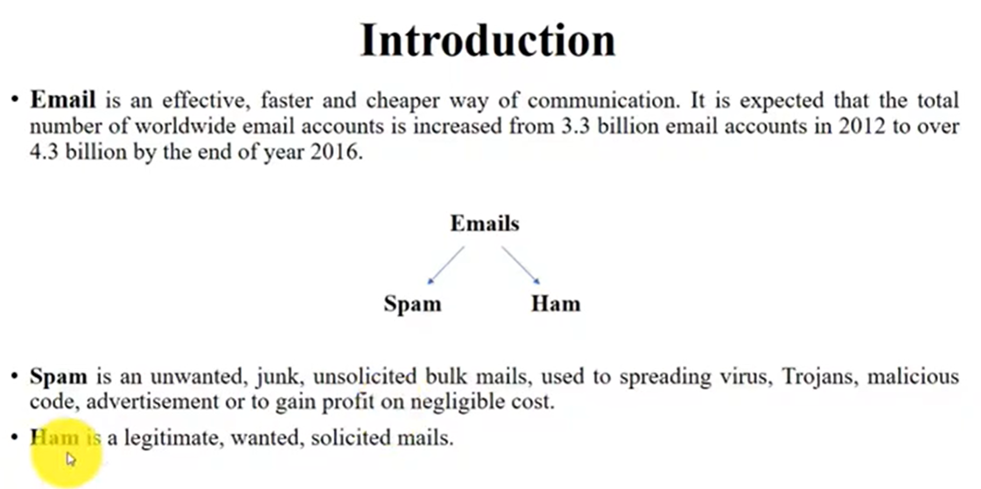

Introduction
E-mail is an effective , faster and cheaper way of communication, it is expected that the total number of world wide email accounts is increased every year
Spam is an unwanted junk , unsolicited bulk mails, used to spreading virus, Trojans, malicious codes, advertisements, or to gain profit on negligible cost
Ham is a legitimate , wanted , solicited mails

Slide 3

E-mail Spamming
E-mail spamming is increasing day by day because of effective , fast and cheap way of exchanging information with each other
According to investigation user receives spam mails> ham mails
About 120 billion of spam mails are sent per day and the cost of spending is approximately zero
Spam is a major problem that attacks the existence of electronic mail
So it is very important to distinguish ham e-mails from spam e-mails
Many methods have been proposed for classification of e-mail as spam or ham

Slide 4

Classification
Classification is a predictive modelling
Classification consists of assigning a class labels to a set of unclassified cases
Steps of Classification
1) Model Construction
2) Model Usage

Slide 5

Model Construction
Describing a set of predetermined classes
Each tuple /sample is assumed to belong to a predefined class , as determined by the class label attribute
The set of tuples used for model construction is training set
The model is represented as classification rules , decision trees ,or mathematical formulae

Slide 6

Model Usage
For classifying future or unknown objects
Estimate accuracy of the model
If the accuracy is acceptable, use the model to classify new data

Slide 7

Naïve Bayes Algorithm
The Naïve bayes classification algorithm is a probabilistic classifier
It is based on probability models that incorporate strong independence assumptions
The independence assumptions often do not have an impact on reality
Therefore they are considered as naïve
You can derive probability models by using Bayes theorem
Depending on the nature of the probability model, you can train the naïve Bayes algorithm in a supervised learning setting

Slide 8

Cntd
Below is the formula for calculating the conditional probability
P(H) is the probability of hypothesis H being true. This is known as the prior probability
P(E) is the probability of evidence (regardless of hypothesis)
P(E|H) is the probability of the evidence given that hypothesis is true
P(H|E) is the probability of the hypothesis given that the evidence is there
$$P\left(H | E\right)=\frac{P\left(E | H\right)∗P(H)}{P(E)}$$

Slide 9
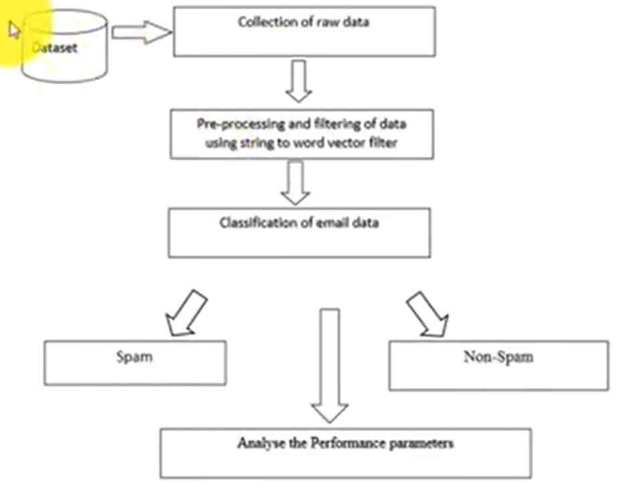

Slide 10
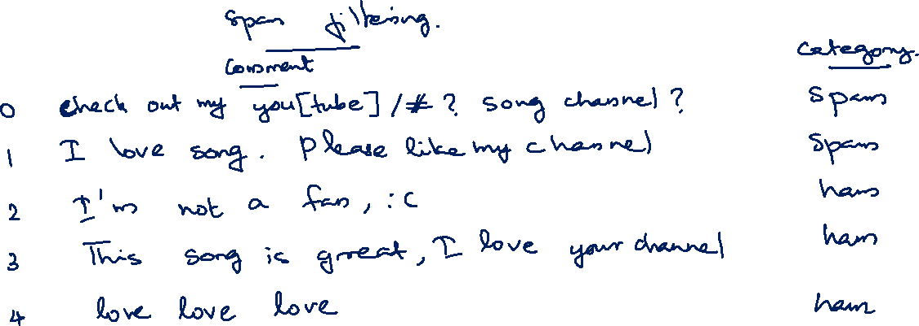

Slide 11
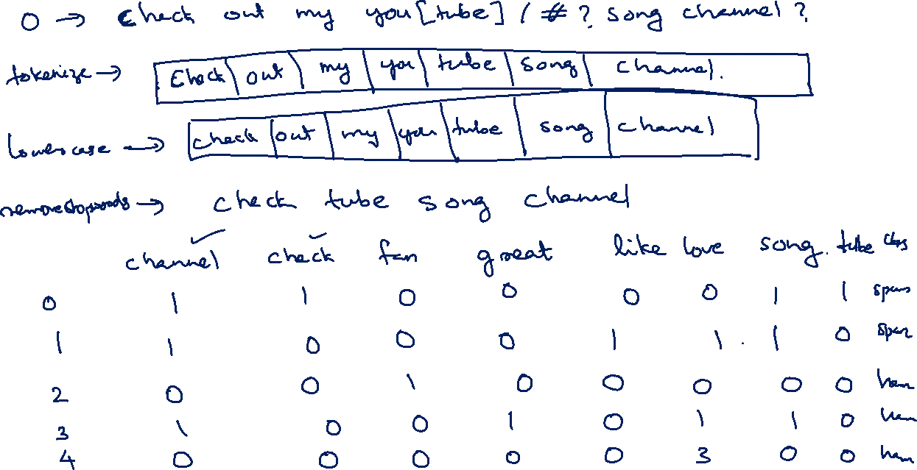

Slide 12
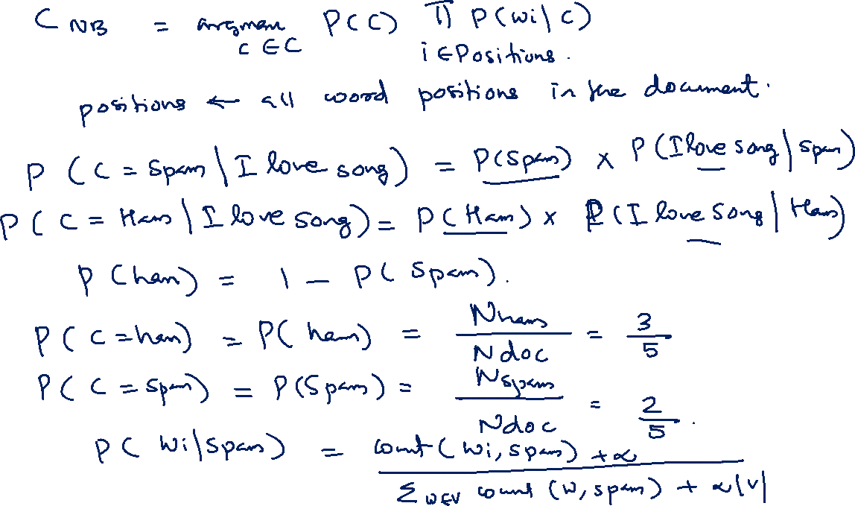

Slide 13
