Slide 1
Mining Association Rules

Slide 2
Association rule mining
Proposed by Agrawal et al in 1993.
It is an important data mining model studied extensively by the database and data mining community.
Assume all data are categorical.
No good algorithm for numeric data.
Initially used for Market Basket Analysis to find how items purchased by customers are related.
Bread → Milk [sup = 5%, conf = 100%]

Slide 3
Association rule mining
Association rule mining finds interesting associations and relationships among large sets of data items.
This rule shows how frequently a itemset occurs in a transaction.
A typical example is Market Based Analysis.

Slide 4
The model: data
I = {i₁, i₂, …, i_{m}}: a set of items.
Transaction t :
  t a set of items, and t ⊆ I.
Transaction Database T: a set of transactions T = {t₁, t₂, …, t_{n}}.

Slide 5
Transaction data: supermarket data
Market basket transactions:
  t1: {bread, cheese, milk}
  t2: {apple, eggs, salt, yogurt}
  … …
  tn: {biscuit, eggs, milk}
Concepts:
  An item: an item/article in a basket
  I: the set of all items sold in the store
  A transaction: items purchased in a basket; it may have TID (transaction ID)
  A transactional dataset: A set of transactions

Slide 6
Transaction data: a set of documents
A text document data set. Each document is treated as a “bag” of keywords
doc1: Student, Teach, School
doc2: Student, School
doc3: Teach, School, City, Game
doc4: Baseball, Basketball
doc5: Basketball, Player, Spectator
doc6: Baseball, Coach, Game, Team
doc7: Basketball, Team, City, Game

Slide 7
The model: rules
A transaction t contains X, a set of items (itemset) in I, if X ⊆ t.
An association rule is an implication of the form:
X → Y, where X, Y ⊂ I, and X ∩Y = ∅
An itemset is a set of items.
  E.g., X = {milk, bread, cereal} is an itemset.
A k-itemset is an itemset with k items.
  E.g., {milk, bread, cereal} is a 3-itemset

Slide 8
Rule strength measures
Support: The rule holds with support sup in T (the transaction data set) if sup% of transactions contain X ∪ Y.
  sup = Pr(X ∪ Y).
Confidence: The rule holds in T with confidence conf if conf% of tranactions that contain X also contain Y.
  conf = Pr(Y | X)
An association rule is a pattern that states when X occurs, Y occurs with certain probability.

Slide 9
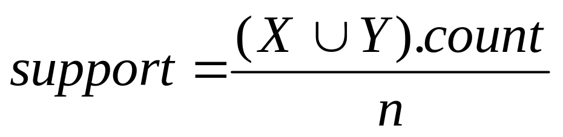
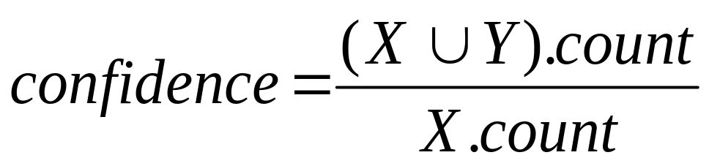
Support and Confidence
Support count: The support count of an itemset X, denoted by X.count, in a data set T is the number of transactions in T that contain X. Assume T has n transactions.
Then,

Slide 10
Goal and key features
Goal: Find all rules that satisfy the user-specified minimum support (minsup) and minimum confidence (minconf).
Key Features
  Completeness: find all rules.
  No target item(s) on the right-hand-side
  Mining with data on hard disk (not in memory)

Slide 11
An example
  t1: Beef, Chicken, Milk
  t2: Beef, Cheese
  t3: Cheese, Boots
  t4: Beef, Chicken, Cheese
  t5: Beef, Chicken, Clothes, Cheese, Milk
  t6: Chicken, Clothes, Milk
  t7: Chicken, Milk, Clothes
Transaction data
Assume:
minsup = 30%
minconf = 80%
An example frequent itemset:
{Chicken, Clothes, Milk} [sup = 3/7]
Association rules from the itemset:
Clothes → Milk, Chicken [sup = 3/7, conf = 3/3]
… …
Clothes, Chicken → Milk, [sup = 3/7, conf = 3/3]

Slide 12
Transaction data representation
A simplistic view of shopping baskets,
Some important information not considered. E.g,
  the quantity of each item purchased and
  the price paid.

Slide 13
Association rule mining Algorithm
In general, association rule mining can be viewed as a two-step process:
    Step 1. Find all frequent itemsets: By definition, each of these itemsets will occur at least as frequently as a predetermined minimum support count.
    Step 2. Generate strong association rules from the frequent itemsets: By definition, these rules must satisfy minimum support and minimum confidence.

Slide 14
The Apriori algorithm
Probably the best known algorithm
Two steps:
  Find all itemsets that have minimum support (frequent itemsets, also called large itemsets).
  Use frequent itemsets to generate rules.
E.g., a frequent itemset
{Chicken, Clothes, Milk} [sup = 3/7]
and one rule from the frequent itemset
  Clothes → Milk, Chicken [sup = 3/7, conf = 3/3]

Slide 15
Step 1: Mining all frequent itemsets
A frequent itemset is an itemset whose support is ≥ minsup.
Key idea: The apriori property (downward closure property): any subsets of a frequent itemset are also frequent itemsets
ABC ABD ACD BCD
AB AC AD BC BD CD
A B C D

Slide 16
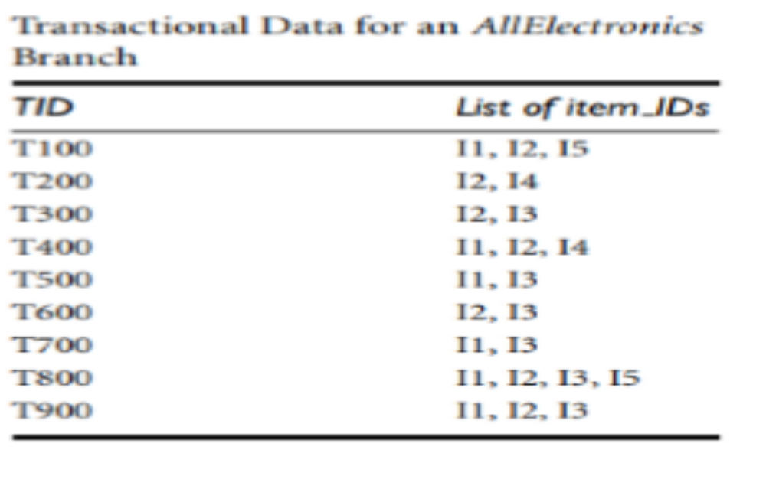
Example Problem 1:
Based on the AllElectronics transaction database, D, of Table below. Find association rule present in the database by considering Minimum support of 20% and confidence of 75%?.

Slide 17
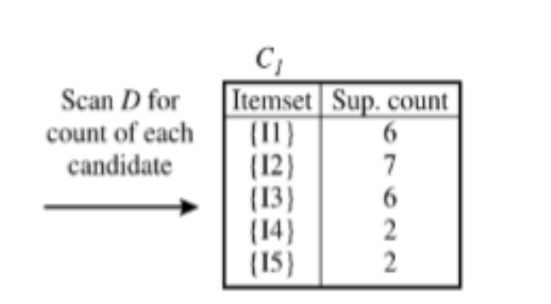
Part –I Frequent Item Set generation
There are nine transactions in this database, that is, n = 9.
Set of Items, I={I1,I2,I3,I4,I5}
Step 1- Each item is a member of the set of candidate 1-itemsets, C1.
The algorithm simply scans all of the transactions to count the number of occurrences of each item.

Slide 18
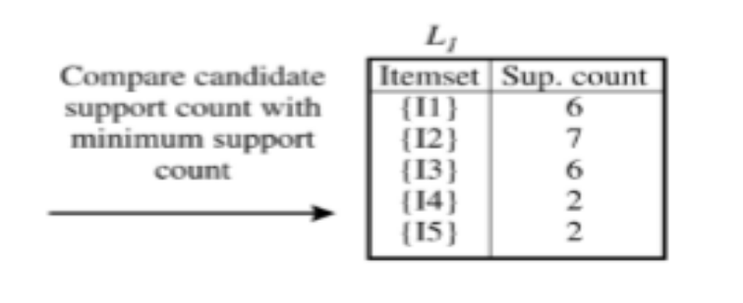
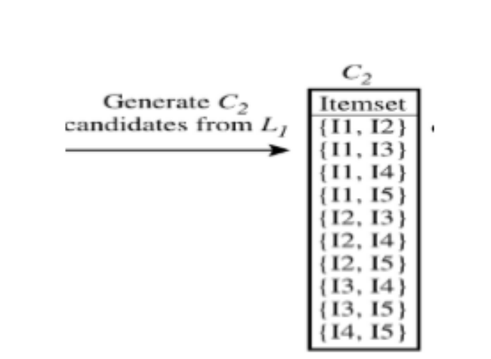
Step 2- The set of frequent 1-itemsets, L1, can then be determined Minimum support count required is 2, that is, min sup = 2. (Here, support is 2/9 = 22%.). All Items in C1 are qualified.

Slide 19
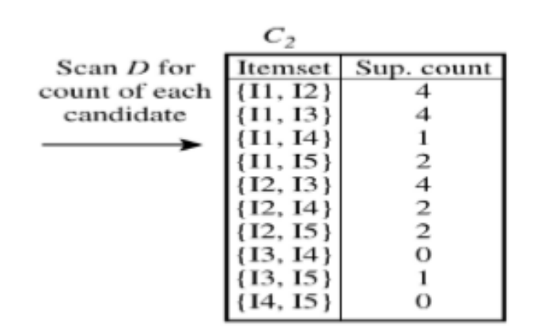
Step 4. Next, the transactions in D are scanned and the support count of each candidate itemset in C2 is calculated
Step 5: The set of frequent 2-itemsets, L2, is then determined, consisting of those candidate 2-itemsets in C2 having minimum support.

Slide 20
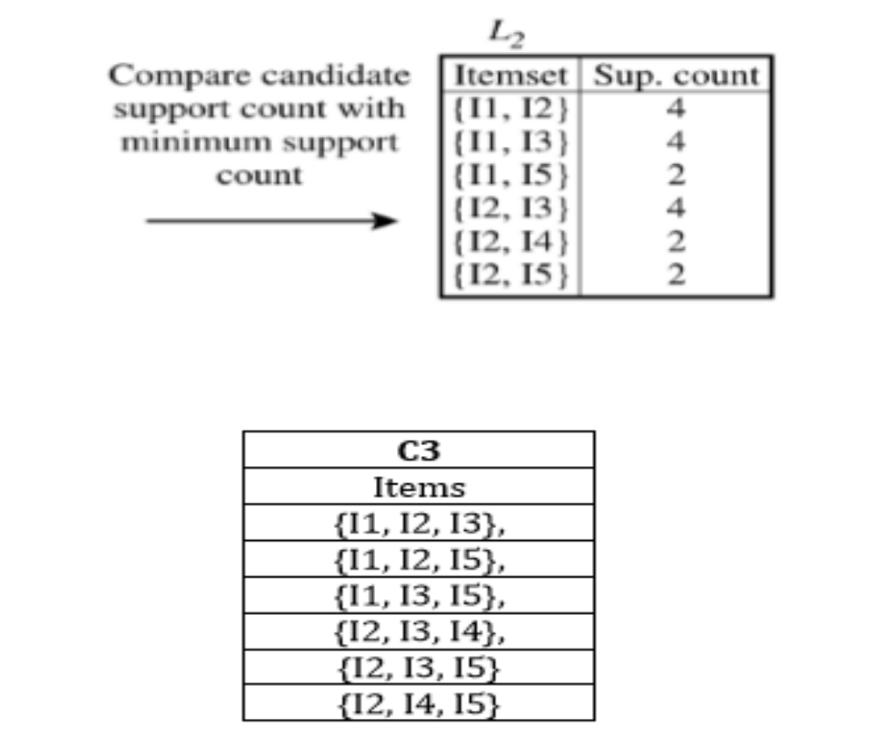

Slide 21
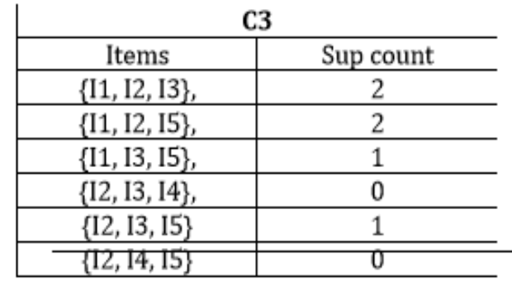
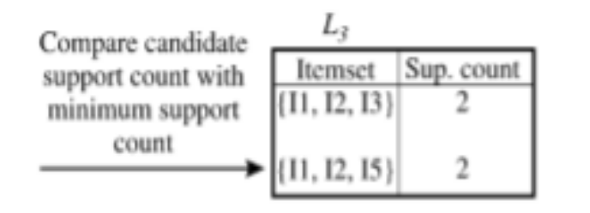
Step 7. The transactions in D are scanned to determine support count of C3
Step 8: Find 3 frequent item set, L3. ( candidate 3-itemsets in C3 having minimum support.)

Slide 22
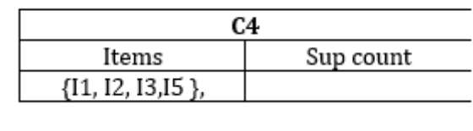
Step 9: Generation of the set of the candidate 4-itemsets, C4. From the join step, we first get C4 = L3 ⋈L3
Step 10: Find 4 frequent item set, L4. ( C3 having minimum support)
NULL list. Stop Frequent Item set generation.

Slide 23
Part –II
Minimum confidence required 75 %
Confidence ( X ⇒Y)= ( support of X and Y together)/( support of X)= P(X∩Y)/ P(X)= P(Y|X)
Consider L3={{I1, I2, I3},{I1, I2, I5}}
Association rules formed from frequent Item set {I1, I2, I3},
I1^I2⇒I3, conﬁdence = 2/4 = 50%
I2^I3⇒I1, conﬁdence = 2/4 = 50%
I1^I3⇒I2, conﬁdence = 2/4 = 50%
I3⇒I1^I2, conﬁdence = 2/6 = 33%
I1⇒I2^I3, conﬁdence = 2/6 = 33%
I2⇒I1^I3, conﬁdence = 2/7 = 29%
Association rules formed from frequent Item set {I1, I2, I5},

Slide 24
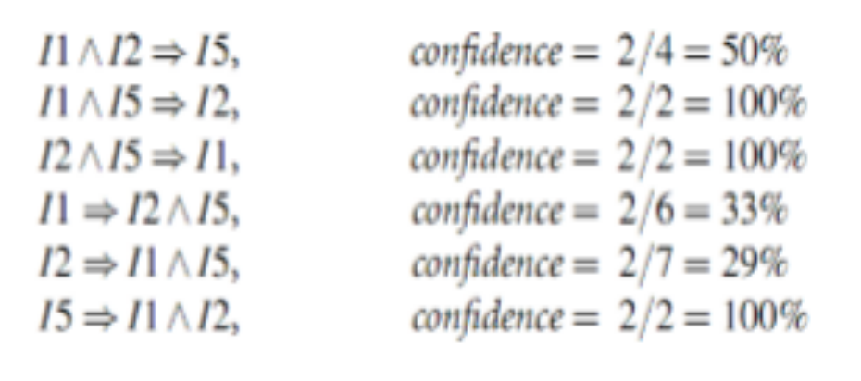
Association rules that satisfy minimum confidence are {I1^I5⇒I2 ,I2^I5⇒I1, I5⇒I1^I2

Slide 25
The Algorithm
Iterative algo. (also called level-wise search): Find all 1-item frequent itemsets; then all 2-item frequent itemsets, and so on.
  In each iteration k, only consider itemsets that contain some k-1 frequent itemset.
Find frequent itemsets of size 1: F₁
From k = 2
  C_{k} = candidates of size k: those itemsets of size k that could be frequent, given F_{k-1}
  F_{k} = those itemsets that are actually frequent, F_{k} ⊆ C_{k} (need to scan the database once).

Slide 26
Details: ordering of items
The items in I are sorted in lexicographic order (which is a total order).
The order is used throughout the algorithm in each itemset.
{w[1], w[2], …, w[k]} represents a k-itemset w consisting of items w[1], w[2], …, w[k], where w[1] < w[2] < … < w[k] according to the total order.

Slide 27
Details: the algorithm
Algorithm Apriori(T)
C₁ ← init-pass(T);
F₁ ← {f | f ∈ C₁, f.count/n ≥ minsup}; // n: no. of transactions in T
for (k = 2; F_{k-1} ≠ ∅; k++) do
C_{k} ← candidate-gen(F_{k-1});
for each transaction t ∈ T do
for each candidate c ∈ C_{k} do
if c is contained in t then
c.count++;
end
end
F_{k} ← {c ∈ C_{k} | c.count/n ≥ minsup}
end
return F ← _{k} F_{k};

Slide 28
Apriori candidate generation
The candidate-gen function takes F_{k-1} and returns a superset (called the candidates) of the set of all frequent k-itemsets. It has two steps
  join step: Generate all possible candidate itemsets C_{k} of length k
  prune step: Remove those candidates in C_{k} that cannot be frequent.

Slide 29
Step 1:-Candidate-gen function
Function candidate-gen(F_{k-1})
C_{k} ← ∅;
forall f₁, f₂ ∈ F_{k-1}
with f₁ = {i₁, … , i_{k-2}, i_{k-1}}
and f₂ = {i₁, … , i_{k-2}, i’_{k-1}}
and i_{k-1} < i’_{k-1} do
c ← {i₁, …, i_{k-1}, i’_{k-1}}; // join f₁ and f₂
C_{k} ← C_{k} ∪ {c};
for each (k-1)-subset s of c do
if (s ∉ F_{k-1}) then
delete c from C_{k}; // prune
end
end
return C_{k};

Slide 30
Step 2: Generating rules from frequent itemsets
Frequent itemsets ≠ association rules
One more step is needed to generate association rules
For each frequent itemset X,
For each proper nonempty subset A of X,
  Let B = X - A
  A → B is an association rule if
    Confidence(A → B) ≥ minconf,
    support(A → B) = support(A∪B) = support(X)
    confidence(A → B) = support(A ∪ B) / support(A)

