Slide 1
Clustering
Clustering or cluster analysis is the task of grouping a set of objects in such a way that objects in the same group (called a cluster) are more similar (in some sense) to each other than to those in other groups (clusters).
Useful for:
Automatically organizing data
Understanding hidden structure in data
Pre processing for further analysis

Slide 2
Applications include
Grouping of news online
Biology: Classification of plant and animal kingdom given their features
Marketing: Customer segmentation based on customer data and past records
Recognize communities in social network
Biology: taxonomy of living things: kingdom, phylum, class, order, family, genus and species
Information retrieval: document clustering
Land use: Identification of areas of similar land use in an earth observation database
City-planning: Identifying groups of houses according to their house type, value, and geographical location
Earth-quake studies: Observed earth quake epicenters should be clustered along continent faults
Climate: understanding earth climate, find patterns of atmospheric and ocean
Economic Science: market research

Slide 3
Aspects of clustering
A clustering algorithm
Partitional clustering
Hierarchical clustering
A distance (similarity, or dissimilarity) function
Clustering quality
Inter-clusters distance ⇒ maximized
Intra-clusters distance ⇒ minimized
The quality of a clustering result depends on the algorithm, the distance function, and the application

Slide 4
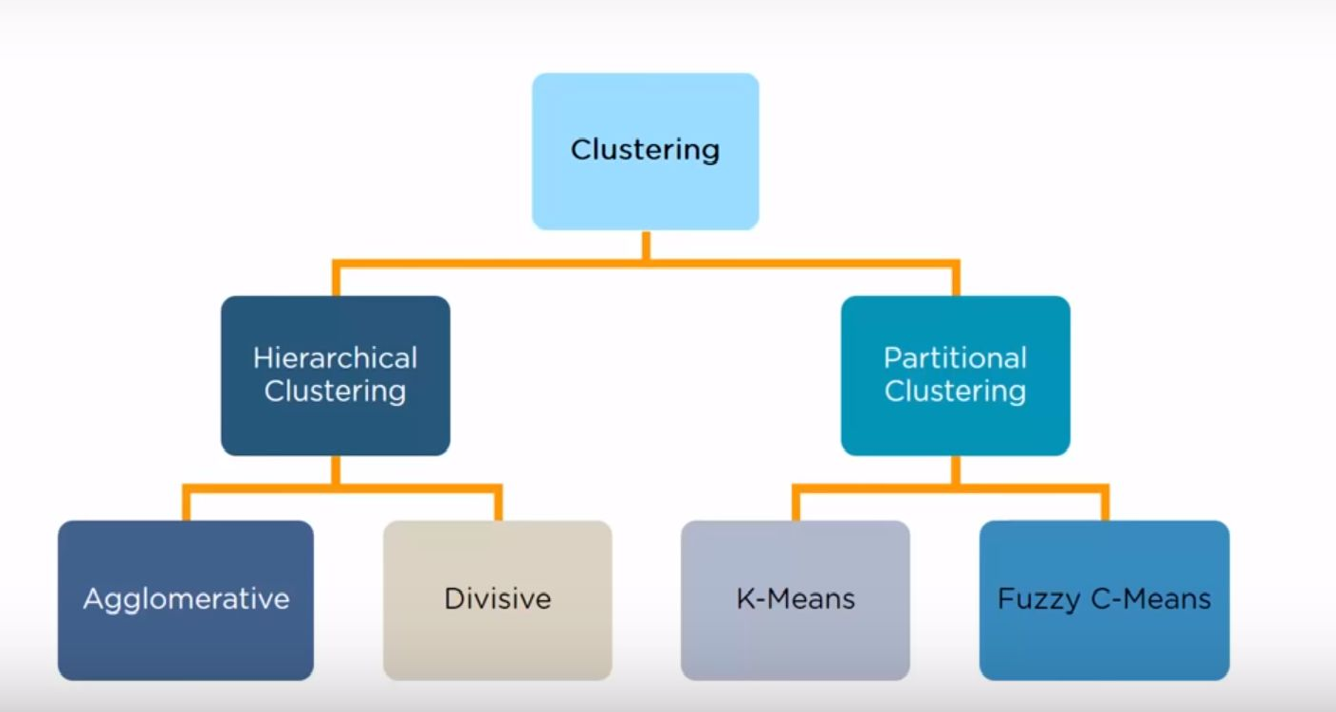
Types of Clustering

Slide 5
Major Clustering Approaches
11
Partitioning approach:
Construct various partitions and then evaluate them by some criterion, e.g., minimizing the sum of square errors
Typical methods: k-means, k-medoids
Hierarchical approach:
Create a hierarchical decomposition of the set of data (or objects) using some criterion
Typical methods: Diana(Divisive Analysis), Agnes(Agglomerative Nesting), BIRCH, CAMELEON
Density-based approach:
Based on connectivity and density functions
Typical methods: DBSACN, OPTICS, DenClue

Slide 6
Partitional
Simply a division of the set of data objects into non-overlapping subsets (clusters) such that each data object is in exactly one subset.
Eg K Means

Slide 7
k-means clustering
One of the simplest unsupervised learning algorithms for solving the clustering problem.
Start by choosing k points arbitrarily as the “centres” of the clusters, one for each cluster.
Then associate each of the given data points with the nearest centre.
Now take the averages of the data points associated with a centre and replace the centre with the average, and this is done for each of the centres.
Repeat the process until the centres converge to some fixed points.

Slide 8
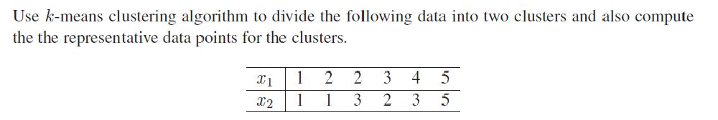

k-means clustering – Problem 1
𝖣 The distance between the points (x1, x2) and (y1, y2) will be calculated using the familiar distance formula of elementary analytical geometry:

Slide 9

Solution
In the problem, the required number of clusters is 2 and we take k = 2.
We choose two points arbitrarily as the initial cluster centres. Let us choose arbitrarily
3. We compute the distances of the given data points from the cluster centers.

Slide 10
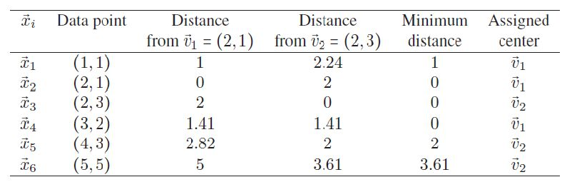
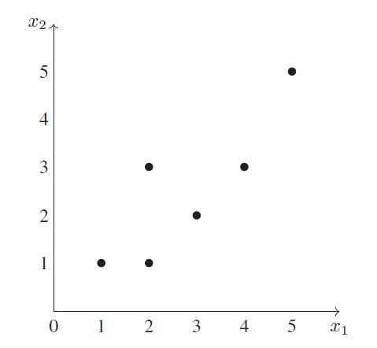
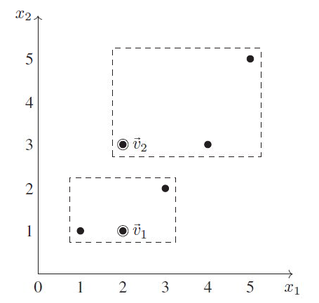

Slide 11
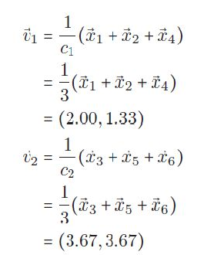
4. The cluster centres are recalculated as follows:
5. We compute the distances of the given data points from the new cluster centers.

Slide 12
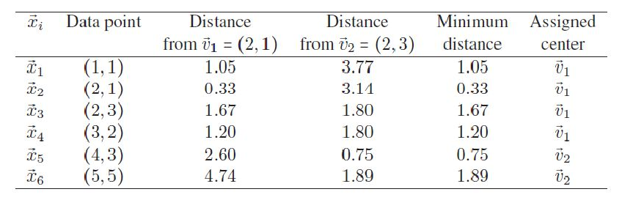
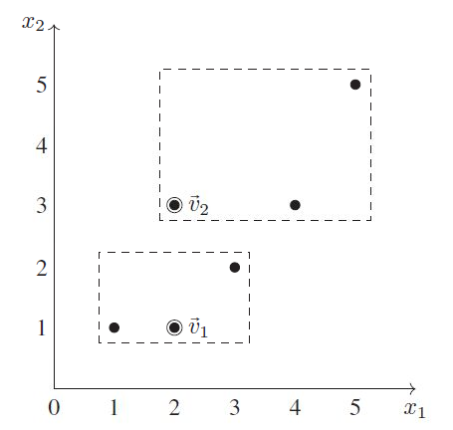
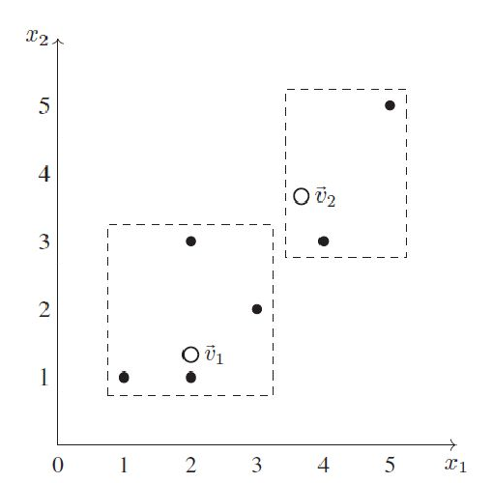

Slide 13
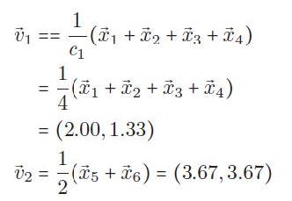
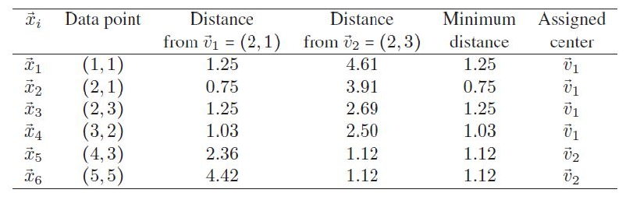
6. The cluster centres are recalculated as follows:
7. We compute the distances of the given data points from the new cluster centers.

Slide 14
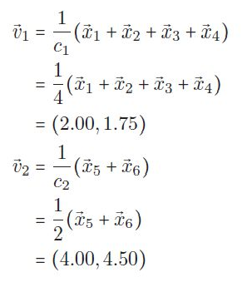
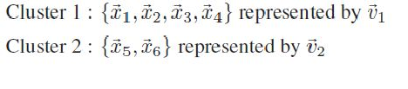
8. The cluster centres are recalculated as follows:
9. This divides the data into two clusters as follows

Slide 15
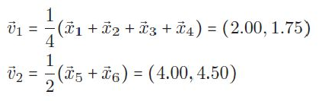

10.The cluster centres are recalculated as follows:
These are identical to the cluster centres calculated in Step 8. So there will be no reassignment of data points to different clusters and hence the computations are stopped here.
Conclusion: The k means clustering algorithm with k
= 2 applied to the dataset yields the following clusters and the associated cluster centres:

Slide 16
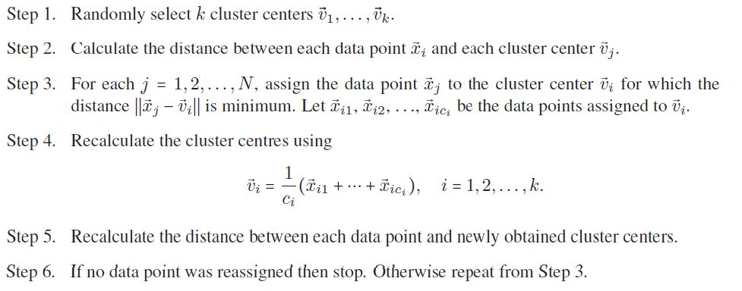
k-means clustering - Algorithm

Slide 17
Disadvantage of K means clustering
Learning algorithm requires apriori specification of number of clusters
Final cluster depends on the initial selection of centroids (seed points)
With different representation of data, we get different results (Cartesian and Polar coordinate representation)
Cannot be applied to categorical data
Random selection of initial cluster centre is not efficient
Euclidian distance can unequally weight underlying factors

Slide 18
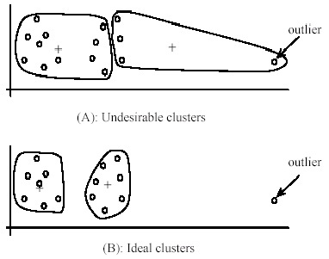
Weaknesses of k-means: Problems with
outliers

Slide 19
Hierarchical clustering
𝖣 is a method of cluster analysis which seeks to build a hierarchy of clusters (or groups) in a given dataset.
𝖣 The hierarchical clustering produces clusters in which the clusters at each level of the hierarchy are created by merging clusters at the next lower level.
𝖣 The decision regarding whether two clusters are to be merged or not is taken based on the measure of dissimilarity between the clusters.

