Slide 1
Digital Image Processing

Slide 2
Module 1
Fundamentals of Image Processing
Electromagnetic Spectrum
Image Acquisition - Sensors
Image sampling, Quantization.
Color Image Processing
Color image processing fundamentals
RGB, HSI Color Models,

Slide 3
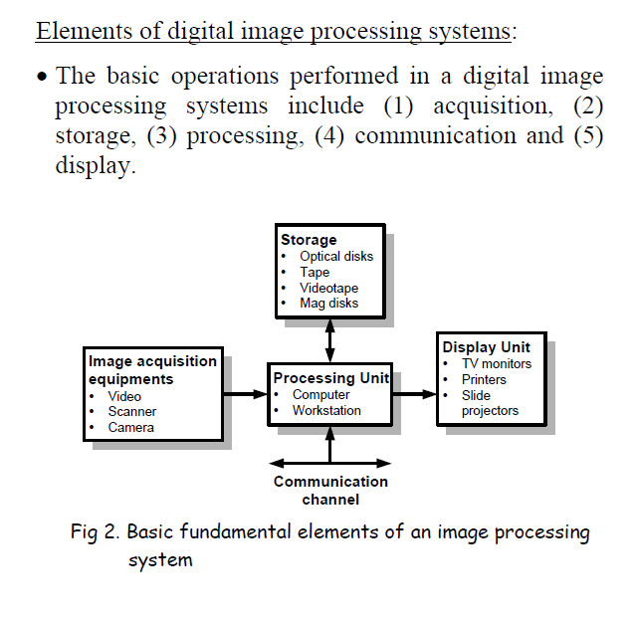

Slide 4

Digital Image
Digital image = a multidimensional
array of numbers (such as intensity image)
or vectors (such as color image)
Each component in the image
called pixel associates with
the pixel value (a single number in
the case of intensity images or a
vector in the case of color images).

Slide 5
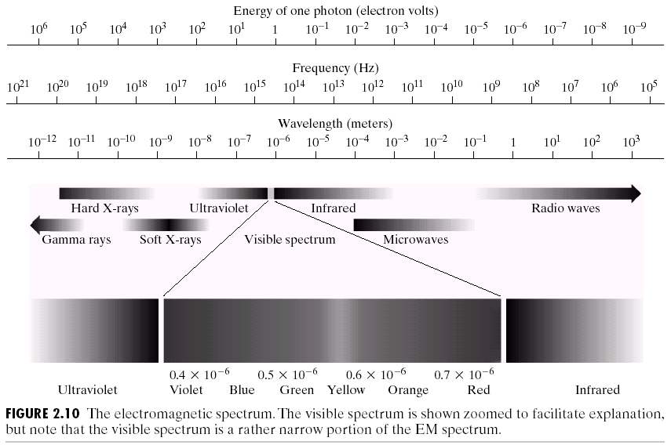
Electromagnetic Spectrum Visible Spectrum
(Images from Rafael C. Gonzalez and Richard E.
Wood, Digital Image Processing, 2nd Edition.

Slide 6
Electromagnetic Spectrum
Electromagnetic waves can be visualized as sine waves with wave length.
It can be a stream of massless articles , each travelling in a wave like pattern and moving at the speed of light.
Each massless particle contain certain amount of energy.
Each amount of energy is called a photon.
Energy is proportional to the frequency.

Slide 7
Higher frequency (shorter wave length) electromagnetic phenomena carry more energy per photon
Radio waves have photons with low energies.
Microwave has more energy than radio waves.
Then ultraviolet, Xrays and Gamma rays, the most energetic rays.
Gamma rays are so dangerous to human beings and living organisms.

Slide 8
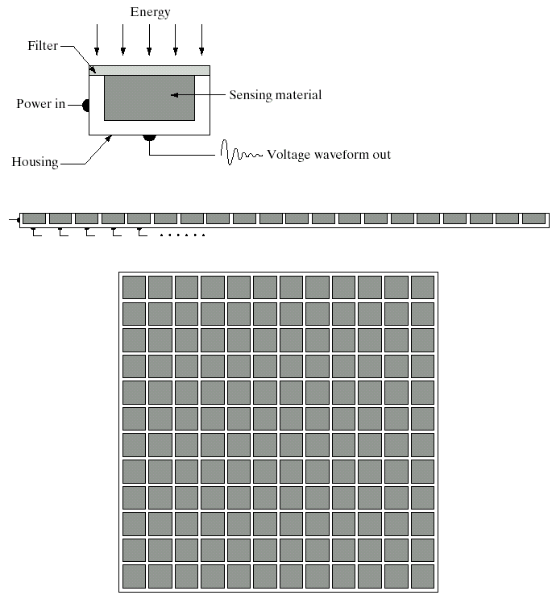
Image Sensors
Single sensor
Line sensor
Array sensor
(Images from Rafael C. Gonzalez and Richard E.
Wood, Digital Image Processing, 2nd Edition.

Slide 9
Images are generated by the combination of an illumination source and the reflection or absorption of energy from that source by the elements of the scene being imaged.
Illumination may originate from a source of electromagnetic energy such as radar, infra red or x-ray.

Slide 10
Basic Idea
Incoming energy is transformed into a voltage by the combination of input electrical power and sensor material that is responsive to the particular type of energy being detected.
The output voltage wave form is the response of the sensor and a digital quality image is obtained from each sensor by digitizing its response.

Slide 11
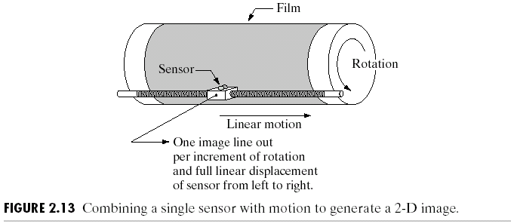
Image Sensors : Single Sensor
(Images from Rafael C. Gonzalez and Richard E.
Wood, Digital Image Processing, 2nd Edition.

Slide 12
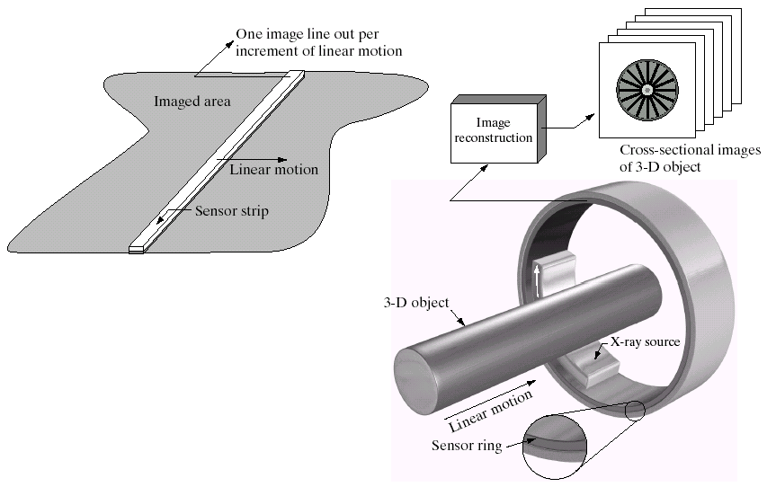
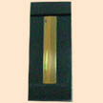
Image Sensors : Line Sensor
Fingerprint sweep sensor
Computerized Axial Tomography
(Images from Rafael C. Gonzalez and Richard E.
Wood, Digital Image Processing, 2nd Edition.

Slide 13
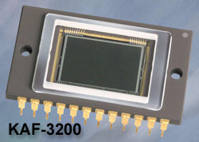
Image Sensors : Array Sensor
Charge-Coupled Device (CCD)
w Used for convert a continuous
image into a digital image
w Contains an array of light sensors
w Converts photon into electric charges
accumulated in each sensor unit
CCD KAF-3200E from Kodak.
(2184 x 1472 pixels,
Pixel size 6.8 microns²)

Slide 14
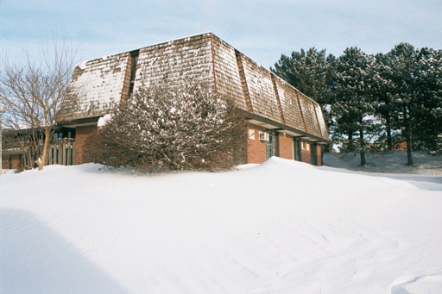
Fundamentals of Digital Images
x
Origin
y
Image “After snow storm”
f(x,y)
w An image: a multidimensional function of spatial coordinates.
w Spatial coordinate: (x,y) for 2D case such as photograph,
(x,y,z) for 3D case such as CT scan images
(x,y,t) for movies
w The function f may represent intensity (for monochrome images)
or color (for color images) or other associated values.

Slide 15
Digital Images
Digital image: an image that has been discretized both in
Spatial coordinates and associated value.
w Consist of 2 sets:(1) a point set and (2) a value set
w Can be represented in the form
I = {(x,a(x)): x ∈X, a(x) ∈ F}
where X and F are a point set and value set, respectively.
w An element of the image, (x,a(x)) is called a pixel where
- x is called the pixel location and
- a(x) is the pixel value at the location x

Slide 16
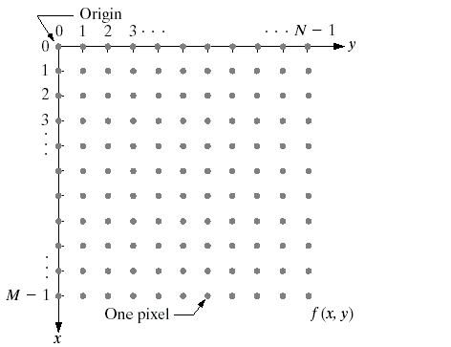
Conventional Coordinate for Image Representation
(Images from Rafael C. Gonzalez and Richard E.
Wood, Digital Image Processing, 2nd Edition.

Slide 17
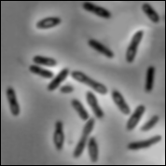
Digital Image Types : Intensity Image
Intensity image or monochrome image
each pixel corresponds to light intensity
normally represented in gray scale (gray
level).
Gray scale values

Slide 18
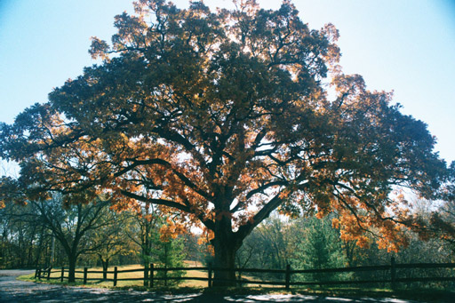
Digital Image Types : RGB Image
Color image or RGB image:
each pixel contains a vector
representing red, green and
blue components.
RGB components

Slide 19

Image Types : Binary Image
Binary image or black and white image
Each pixel contains one bit :
1 represent white
0 represents black
Binary data

Slide 20
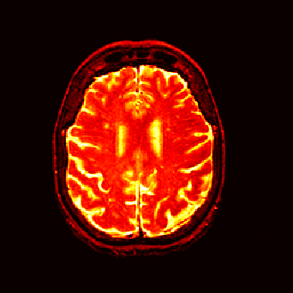
Image Types : Index Image
Index image
Each pixel contains index number
pointing to a color in a color table
Color Table
Index No. | Red component | Green component | Blue component
1 | 0.1 | 0.5 | 0.3
2 | 1.0 | 0.0 | 0.0
3 | 0.0 | 1.0 | 0.0
4 | 0.5 | 0.5 | 0.5
5 | 0.2 | 0.8 | 0.9
… | … | … | …
Index value

Slide 21
A Simple Image Model
Image: a 2-D light-intensity function f(x,y)
The value of f at (x,y) → the intensity (brightness) of the image at that point
0 < f(x,y) < ∞

Slide 22
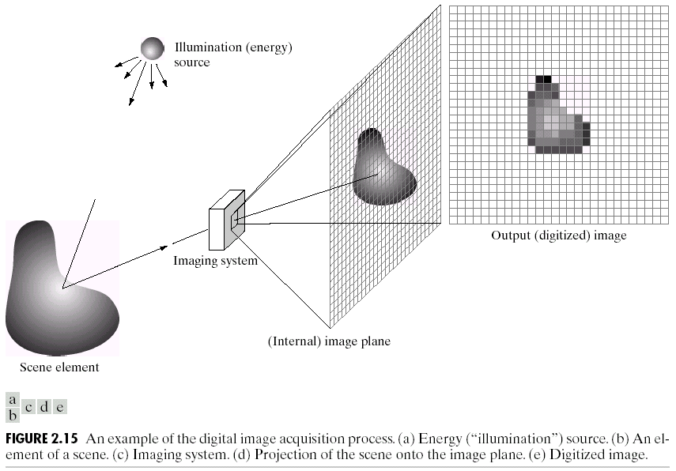
Digital Image Acquisition

Slide 23
Simple Image Formation Model
Nature of f(x,y):
f(x,y) is characterized by two components:
The amount of source light incident on the scene being viewed - Illumination
The amount of light reflected by the objects in the scene
- Reflectance
f(x,y) = i(x,y) * r(x,y)

Slide 24
Image Formation Model
Illumination & reflectance components:
Illumination: i(x,y)
Reflectance: r(x,y)
f(x,y) = i(x,y) ⋅ r(x,y)
0 < i(x,y) < ∞
and 0 < r(x,y) < 1
(from total absorption to total reflectance)

Slide 25
Sampling & Quantization
The spatial and amplitude digitization of f(x,y) is called:
image sampling when it refers to spatial coordinates (x,y) and
gray-level quantization when it refers to the amplitude.

Slide 26
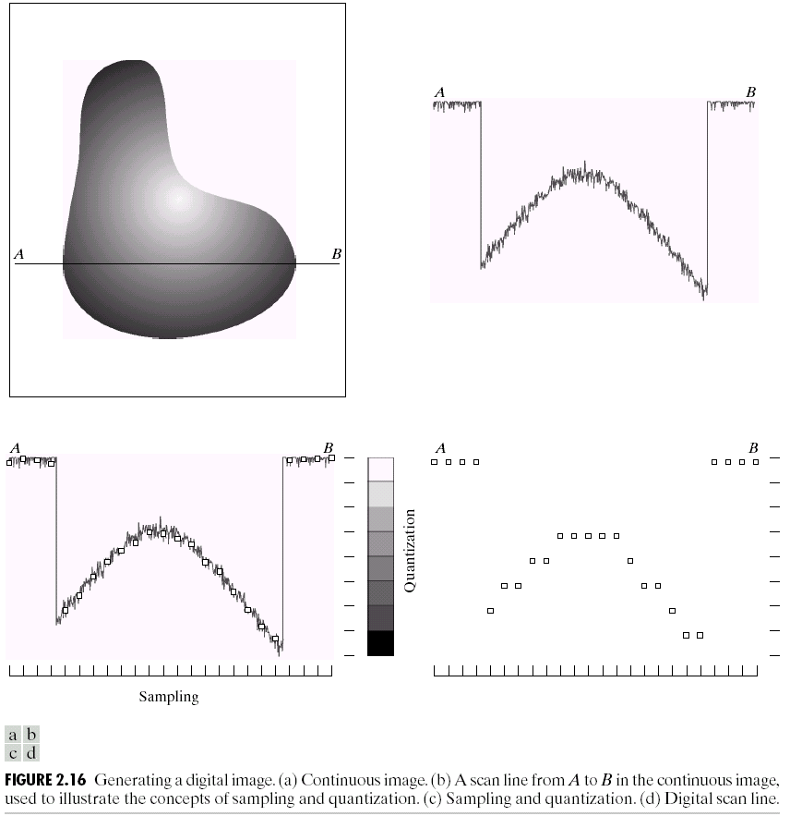
Digital Image

Slide 27
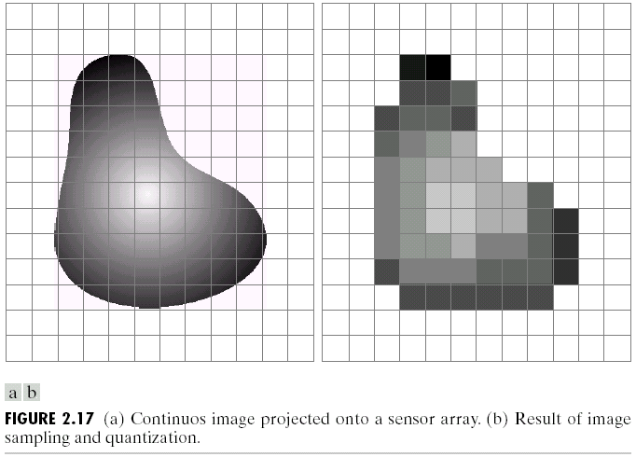
Image Sampling and Quantization
Image sampling: discretize an image in the spatial domain
Spatial resolution / image resolution: pixel size or number of pixels
(Images from Rafael C. Gonzalez and Richard E.
Wood, Digital Image Processing, 2nd Edition.

Slide 28
Sampling & Quantization
f(x,y) is a digital image if:
(x,y) are integers from Z² and
f is a function that assigns a gray-level value (from R) to each distinct pair of coordinates (x,y) [quantization]
Gray levels are usually integers
then Z replaces R

Slide 29
Sampling & Quantization
The digitization process requires decisions about:
values for N,M (where N x M: the image array)
and
the number of discrete gray levels allowed for each pixel.

Slide 30
Spatial and Intensity Resolution
Spatial Resolution
Smallest noticeable (visible) detail of an image.
Intensity Resolution
Smallest noticeable (visible) change in the intensity level of an image.

Slide 31
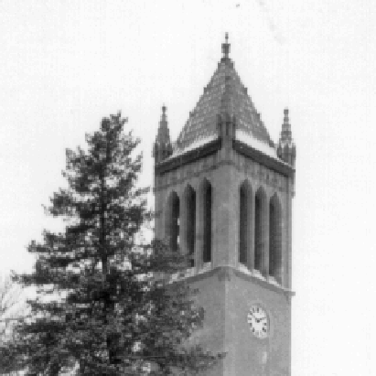
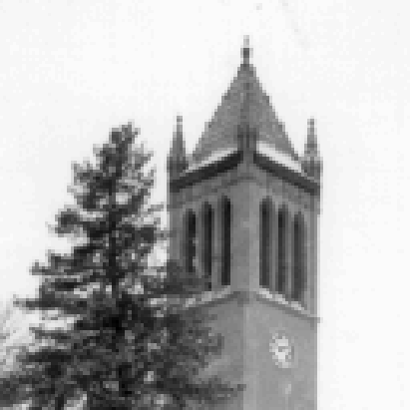

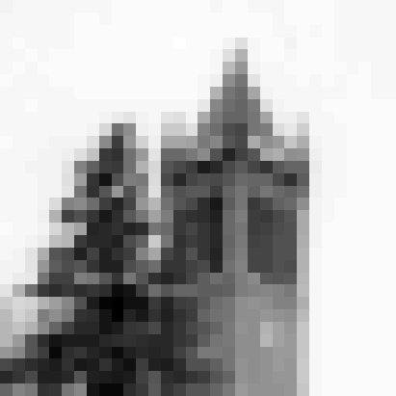
Effect of Spatial Resolution
256x256 pixels
128x128 pixels
64x64 pixels
32x32 pixels

Slide 32
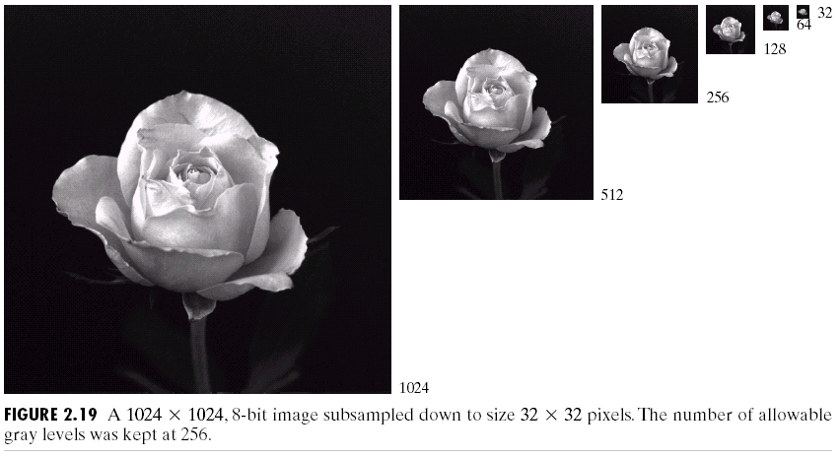
Effect of Spatial Resolution
(Images from Rafael C. Gonzalez and Richard E.
Wood, Digital Image Processing, 2nd Edition.

Slide 33
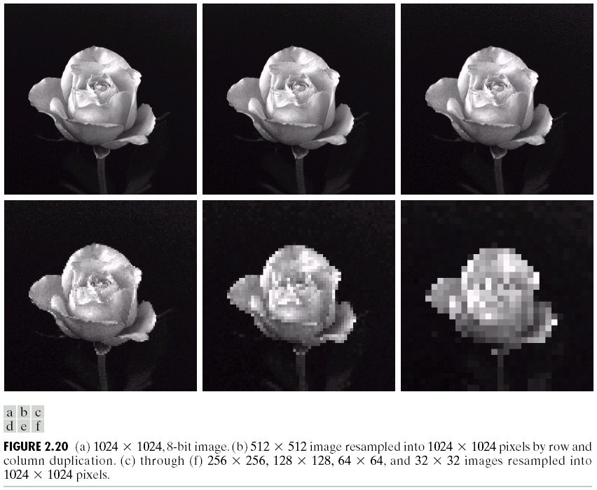
Effect of Spatial Resolution
(Images from Rafael C. Gonzalez and Richard E.
Wood, Digital Image Processing, 2nd Edition.

Slide 34
Image Interpolation
Nearest Neighbor interpolation
Bilinear Interpolation
Bicubic interpolation

Slide 35
Image Transformation Domains
Spatial Domain – Frequency Domain (apply transformation)
Inverse Transform – Spatial Transform

Slide 36
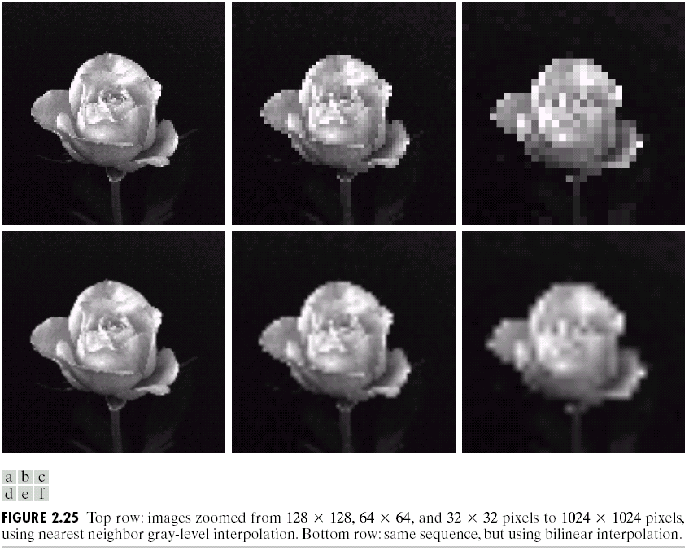
Can we increase spatial resolution by interpolation ?
Down sampling is an irreversible process.
(Images from Rafael C. Gonzalez and Richard E.
Wood, Digital Image Processing, 2nd Edition.

Slide 37
Image Quantization
Image quantization:
discretize continuous pixel values into discrete numbers
Color resolution/ color depth/ levels:
- No. of colors or gray levels or
- No. of bits representing each pixel value
- No. of colors or gray levels N_{c} is given by
where b = no. of bits

Slide 38



Effect of Quantization Levels
256 levels
128 levels
64 levels
32 levels

Slide 39




Effect of Quantization Levels (cont.)
16 levels
8 levels
In this image,
it is easy to see
false contour.
4 levels
2 levels

Slide 40
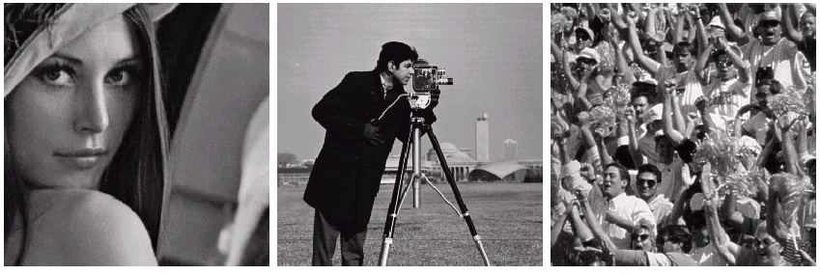
How to select the suitable size and pixel depth of images
The word “suitable” is subjective: depending on “subject”.
Low detail image
Medium detail image
High detail image
Lena image
Cameraman image
To satisfy human mind
1. For images of the same size, the low detail image may need more pixel depth.
2. As an image size increase, fewer gray levels may be needed.
(Images from Rafael C. Gonzalez and Richard E.
Wood, Digital Image Processing, 2nd Edition.

Slide 41
Basic Relationship of Pixels
(0,0)
x
(x-1,y-1)
(x,y-1)
(x+1,y-1)
(x-1,y)
(x,y)
(x+1,y)
y
(x-1,y+1)
(x,y+1)
(x+1,y+1)
Conventional indexing method

Slide 42
Neighbors of a Pixel
Neighborhood relation is used to tell adjacent pixels. It is
useful for analyzing regions.
4-neighbors of p:
(x,y-1)
(x−1,y)
(x+1,y)
(x,y−1)
(x,y+1)
(x-1,y)
p
(x+1,y)
N₄(p) =
(x,y+1)
4-neighborhood relation considers only vertical and
horizontal neighbors.
Note: q ∈ N₄(p) implies p ∈ N₄(q)

Slide 43
Neighbors of a Pixel (cont.)
8-neighbors of p:
(x-1,y-1)
(x,y-1)
(x+1,y-1)
(x−1,y−1)
(x,y−1)
(x+1,y−1)
(x−1,y)
(x+1,y)
(x−1,y+1)
(x,y+1)
(x+1,y+1)
(x-1,y)
p
(x+1,y)
(x-1,y+1)
(x,y+1)
(x+1,y+1)
N₈(p) =
8-neighborhood relation considers all neighbor pixels.

Slide 44
Neighbors of a Pixel (cont.)
Diagonal neighbors of p:
(x-1,y-1)
(x+1,y-1)
(x−1,y−1)
(x+1,y−1)
(x−1,y+1)
(x+1,y+1)
p
N_{D}(p) =
(x-1,y+1)
(x+1,y+1)
Diagonal -neighborhood relation considers only diagonal
neighbor pixels.

Slide 45
COLOUR IMAGE PROCESSING

Slide 46
Light and Electromagnetic Spectrum
Monochromatic(achromatic) light
Light that is without color.
Only attribute present is intensity
Gray level is used to denote monochromatic intensity.
Chromatic(color) Light
It is a light with color
In addition to frequency, there are 3 components that describe the quality of the light

Slide 47
Quality of the light - Parameters
Luminance
Measure of the amount of the energy an observer perceives from a light source. Measured in lumens
Radiance
Total amount of the energy that flows from the light source and it is measured in watts.
Brightness
Subjective descriptor of light perception
Cannot measure
Embodies the achromatic notion of intensity and one of key factors in describing the color sensation

Slide 48
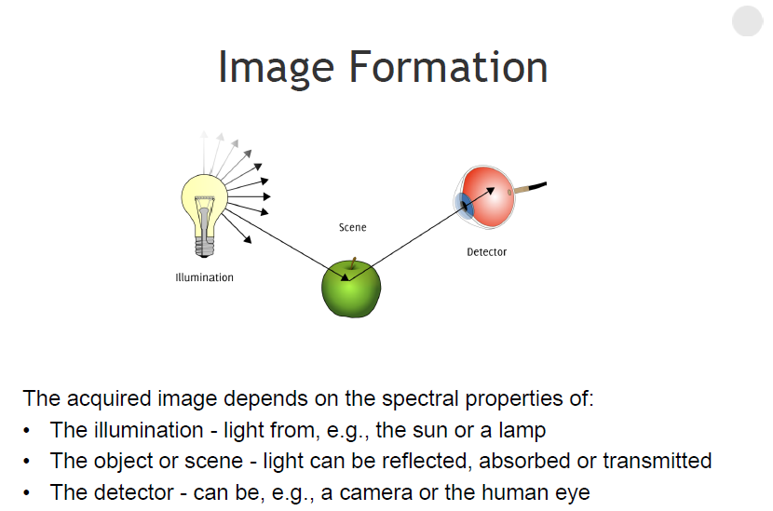

Slide 49
Color image processing
The use of color in image processing is primarily motivated by two major factors
Humans can perceive thousands of shades of color as opposed to only about two dozen shades of gray
Color is a powerful descriptor that greatly simplifies object segmentation and identification
Color image processing is divided into two major areas
• Full-color processing – images are acquired and processed in full color
• Pseudo-color processing – images are by nature grayscale and are converted to color images for visualization purposes

Slide 50
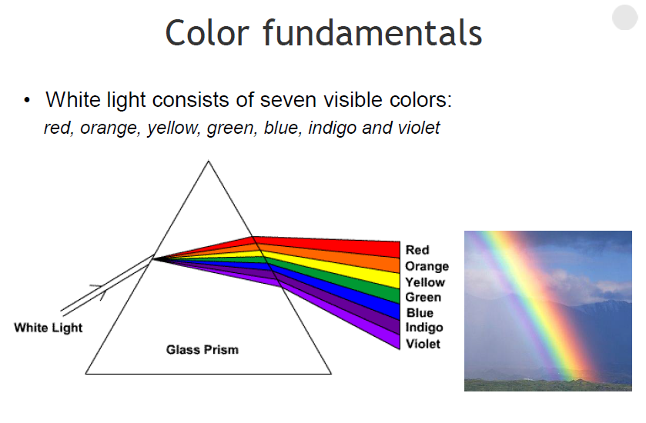

Slide 51
Color is Light
Objects that appear white reflect a balanced amount of wavelengths within the visible spectrum
Inbalances in the composition of light is perceived as color
Light without color is called achromatic (void of color) and its only attribute is its intensity (amount)

Slide 52
Color is Light
The colors that are perceived by a viewer or a sensor are made up by light of different wavelengths
As light propagates through medias and is reflected off objects these different
Wavelengths are affected in different ways

Slide 53
Chromatic light
Chromatic light is described by three basic quantities
• Radiance - The total amount of energy that flows from the light source. Measured in Watts
• Luminance - The amount of energy an observer perceives from the light source. Measured in lumens
• Brightness - The (chromatic) intensity of the light from the light source

Slide 54
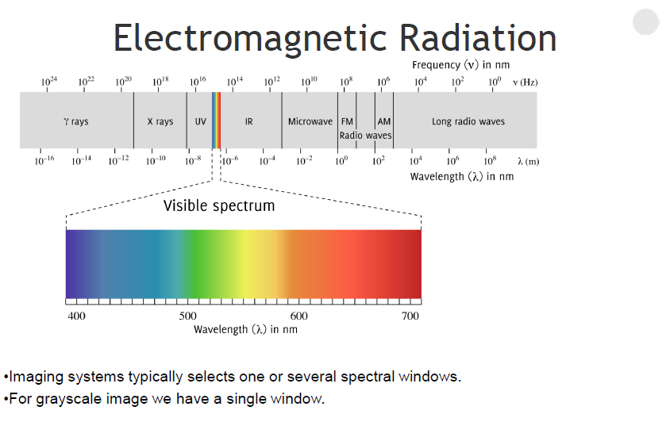

Slide 55
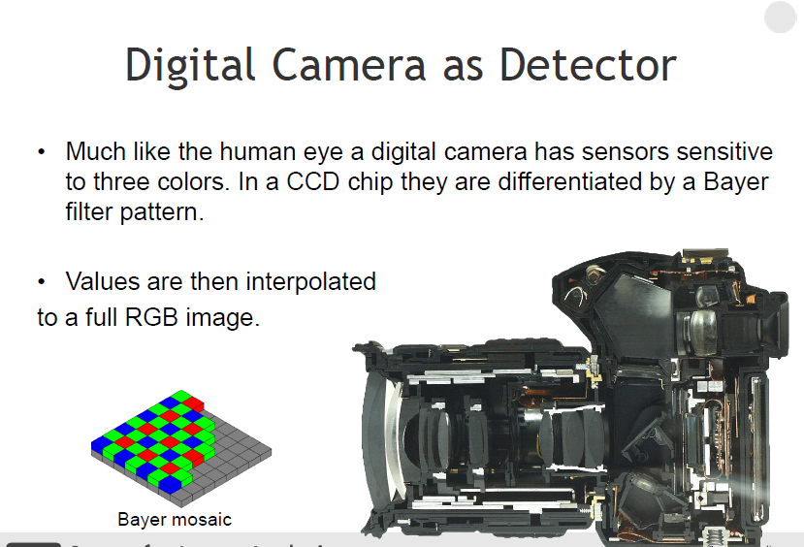

Slide 56
Primary & Secondary colors
A primary color of light is defined by the lights frequency
A primary color of pigment is defined as one that absorbs one primary color of light and reflects the other two
Primary colors of light constitute the secondary colors of pigment and vice versa
Primary colors can be added to produce the secondary colors
magenta = red + blue
cyan = green + blue
yellow = red + green
Combining a primary with a complementary secondary color produces white
magenta + green = white

Slide 57
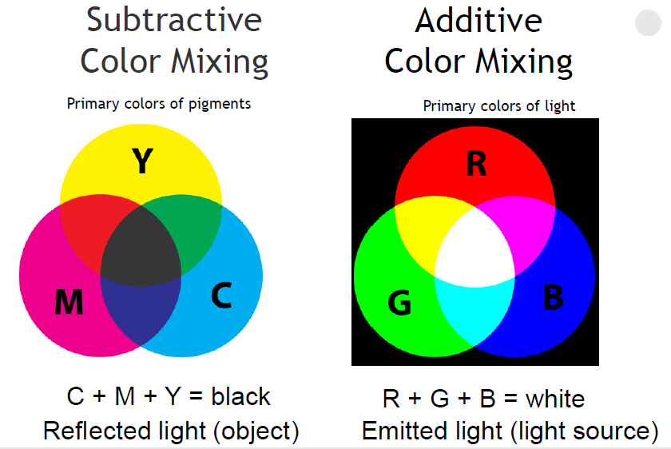

Slide 58
Three characteristics are used to distinguish one color from another
Hue
The dominant wavelength or color of light as perceived by the receiver . “This ball is red”
Saturation
The relative purity of the light (the amount of white vs pigment color)
The pure spectrum colors are fully saturated
Brightness
The (chromatic) intensity of the light from the light source
Hue and saturation together are called chromaticity

Slide 59
What are the perceived properties of color?
Intensity
– Sum of the spectrum
– Energy under the spectrum
Hue
– Mean wavelength of the spectrum
– What wavelength sensation is dominant?
Saturation
– Standard deviation of the spectrum
– How much achromatic/gray component?
Chrominance – Hue and saturation

Slide 60
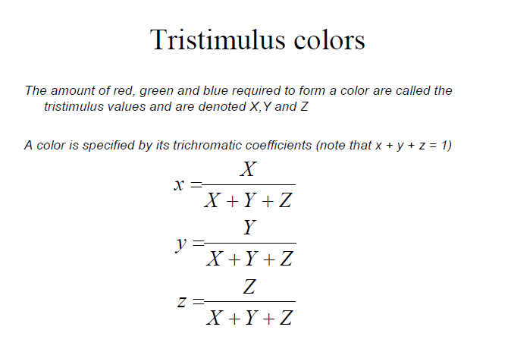

Slide 61
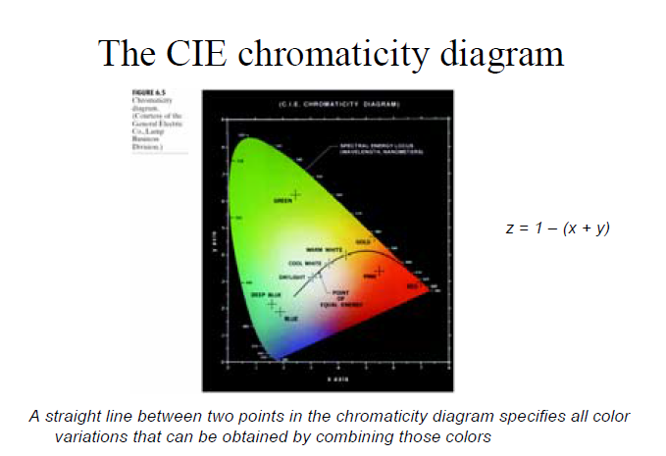

Slide 62
Color models
Color model, color space, color system
Specify colors in a standard way
A coordinate system that each color is represented by a single point
RGB model
CYM model
CYMK model
HSI model
Suitable for hardware or
applications
- match the human description

Slide 63
Color models
Purpose of a color model is to provide a standardized way to specify colors
Color models specify a coordinate system and a subspace within that system
where each color is represented by a single point
Most color models are either oriented towards hardware
RGB (color monitors) • CMY / CMYK (color printing)
or towards applications where color manipulation is a goal
HSI (models human color perception)
L*a*b* (uniform color specification)
YUV (color compression in video coding)
YCbCr (- “ -)

Slide 64
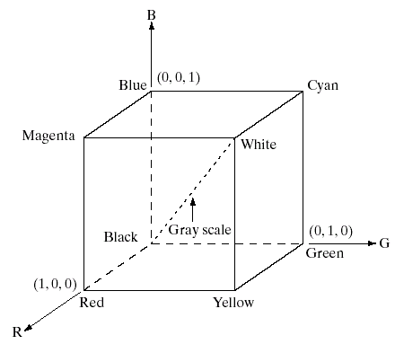
RGB color model

Slide 65
RGB Color Model
Colors are specified in terms of their primary spectral components
The model is a cartesian coordinate system, grayscale values lie along a diagonal line from black to white and the color range is defined by a cube
Colors are specified as vectors from origin to the color coordinates
All color values are assumed to be in the interval [0,1]

Slide 66
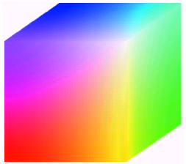
Pixel depth
Pixel depth: the number of bits used to represent each pixel in RGB space
Full-color image: 24-bit RGB color image
(R, G, B) = (8 bits, 8 bits, 8 bits)

Slide 67
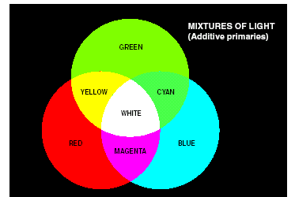
CMY model (+Black = CMYK)
CMY: secondary colors of light, or primary colors of pigments
Used to generate hardcopy output

Slide 68
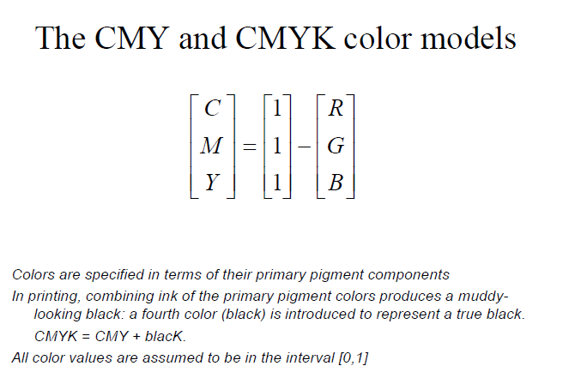

Slide 69
HSI color model
Will you describe a color using its R, G, B components?
Human describe a color by its hue, saturation, and brightness
Hue : color attribute
Saturation: purity of color (white->0, primary color->1)
Brightness: achromatic notion of intensity

Slide 70
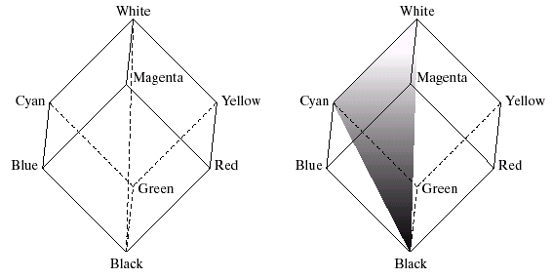
HSI color model (cont.)
RGB -> HSI model
Colors on this triangle
Have the same hue
Intensity
line
saturation

Slide 71
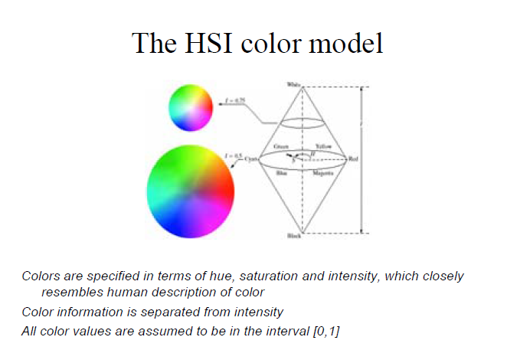

Slide 72
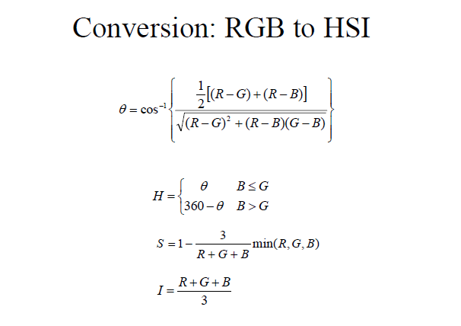

Slide 73
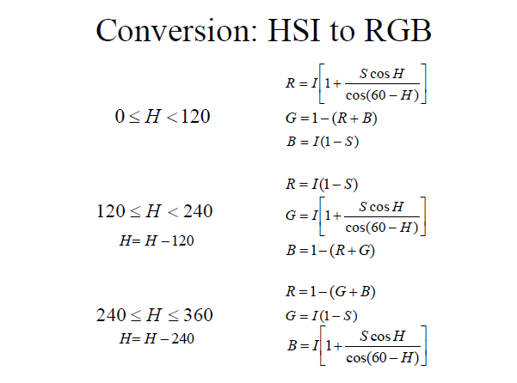

Slide 74
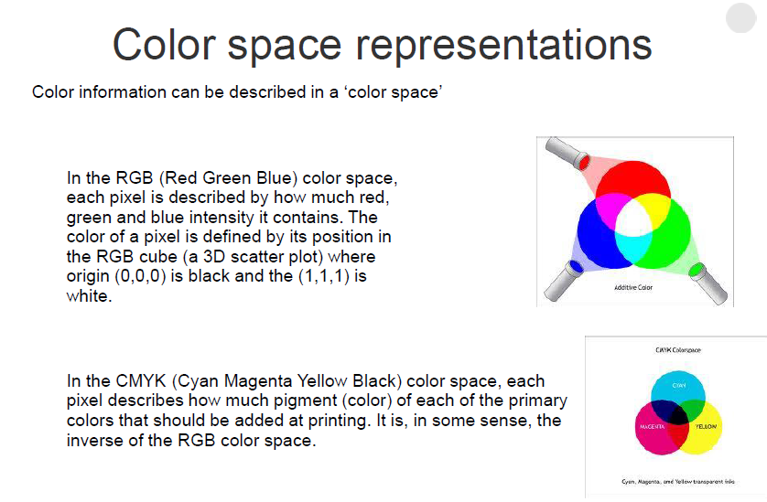

Slide 75
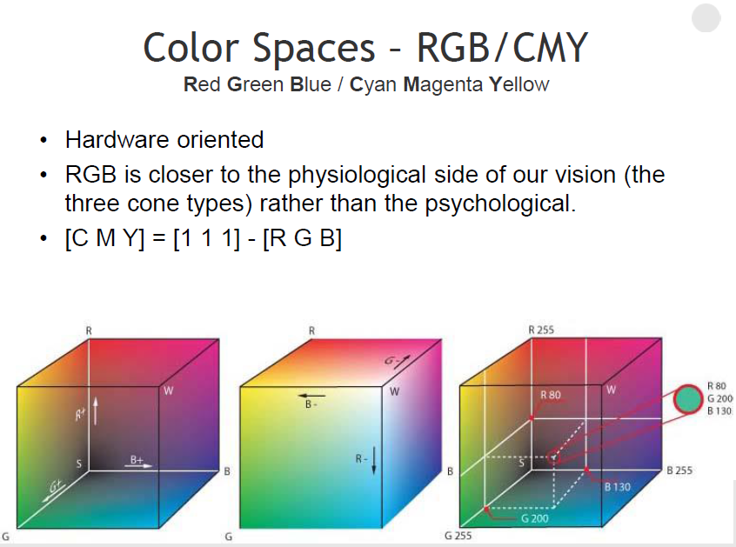

Slide 77
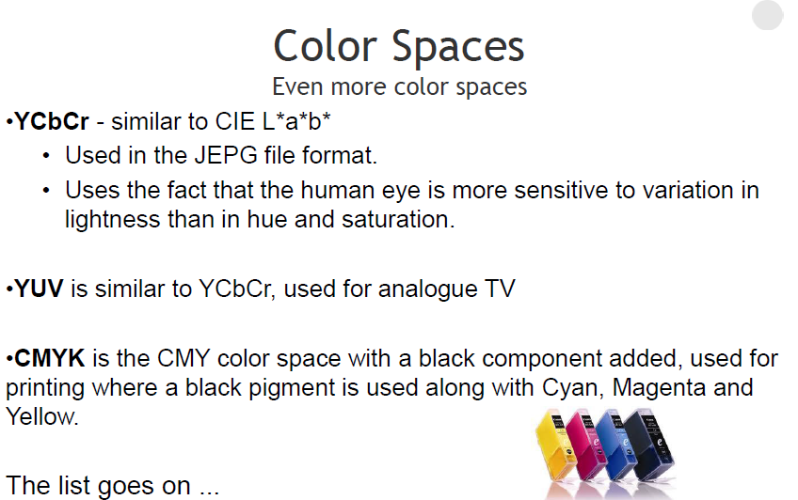

Slide 78
THANK YOU

