Slide 1
Histogram Processing

Slide 2
Histogram Processing
Histogram
where is the kth gray level and is the number of pixels in the image having gray level
Normalized histogram

Slide 3
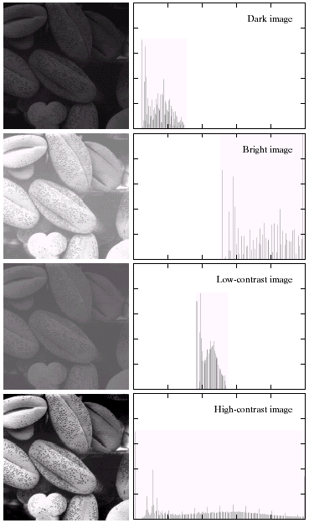

Slide 4
Histogram Equalization
Histogram equalization is used to enhance contrast.
It is not necessary that contrast will always be increase in this.
There may be some cases were histogram equalization can be worse.
In that cases the contrast is decreased.

Slide 5
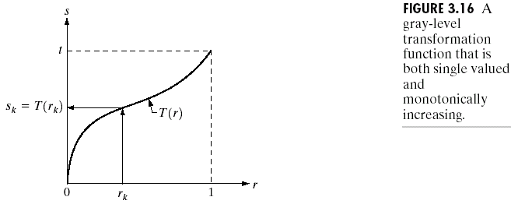
Histogram equalization

Slide 6
Histogram Equalization Problem
https://www.tutorialspoint.com/dip/histogram_equalization.htm

Slide 7
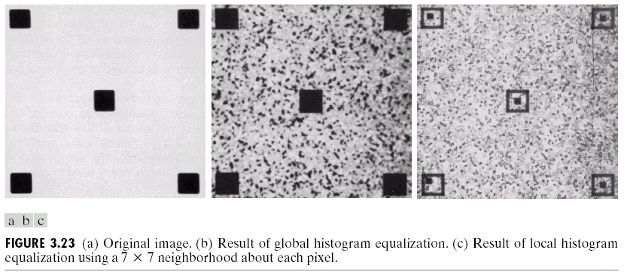
Local enhancement
Histogram using a local neighborhood, for example 7*7 neighborhood

Slide 8
Histogram using a local 3*3 neighborhood

Slide 9
Thank you

