Slide 1
CFG

Slide 2
Context Free Grammars
A widely used formal system for modeling constituent structure in natural language is the context-free grammar, or CFG
Context-free grammars are also called phrase-structure grammars
A context-free grammar consists of a set of rules or productions, each of which expresses the ways that symbols of the language can be grouped and ordered together, and a lexicon of words and symbols.
For example, the following productions express that an NP (or noun phrase) can be composed of either a ProperNoun or a determiner (Det) followed by a Nominal; a Nominal in turn can consist of one or more Nouns

Slide 3

cntd
The symbols that are used in a CFG are divided into two classes.
The symbols that correspond to words in the language (“the”, “nightclub”) are called terminal symbols; the lexicon is the set of rules that introduce these terminal symbols.
The symbols that express abstractions over these terminals are called non-terminals.
In each context-free rule, the item to the right of the arrow (->) is an ordered list of one or more terminals and non-terminals; to the left of the arrow is a single non-terminal symbol expressing some cluster or generalization.
The non-terminal associated with each word in the lexicon is its lexical category, or part of speech.
A CFG can be thought of in two ways: as a device for generating sentences and as a device for assigning a structure to a given sentence.
Viewing a CFG as a generator, we can read the -> arrow as “rewrite the symbol on the left with the string of symbols on the right”.

Slide 5
We say the string a flight can be derived from the non-terminal NP. Thus, a CFG can be used to generate a set of strings.
This sequence of rule expansions is called a derivation of the string of words.
It is common to represent a derivation by a parse tree (commonly shown inverted with the root at the top). Figure 17.1 shows the tree representation of this derivation.

Slide 6
In the parse tree shown in Fig. 17.1, we can say that the node NP dominates all the nodes in the tree (Det, Nom, Noun, a, flight).
We can say further that it immediately dominates the nodes Det and Nom.
The formal language defined by a CFG is the set of strings that are derivable from the designated start symbol.
Each grammar must have one designated start symbol, which is often called S.
Since context-free grammars are often used to define sentences, S is usually interpreted as the “sentence” node, and the set of strings that are derivable from S is the set of sentences in some simplified version of English.

Slide 7

Figure 17.2 gives a sample lexicon, and Fig. 17.3 summarizes the grammar rules we’ve seen so far, which we’ll call L0.
Note that we can use the or-symbol | to indicate that a non-terminal has alternate possible expansions.

Slide 8
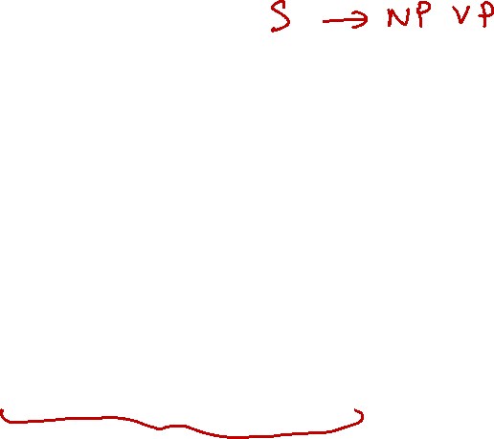
We can use this grammar to generate sentences of this “ATIS-language”.
We start with S, expand it to NP VP, then choose a random expansion of NP (let’s say, to I), and a random expansion of VP (let’s say, to Verb NP), and so on until we generate the string I prefer a morning flight.
Figure 17.4 shows a parse tree that represents a complete derivation of I prefer a morning flight.

Slide 10
Bracketed Notation
We can also represent a parse tree in a more compact format called bracketed notation; here is the bracketed representation of the parse tree of Fig. 17.4:
[S [NP [Pro I]] [VP [V prefer] [NP [Det a] [Nom [N morning] [Nom [N flight]]]]]]

Slide 11
Formal Definition of CFG
A context-free grammar G is defined by four parameters: N; 𝞢; R; S (technically it is a “4-tuple”).

Slide 12
Treebanks

Slide 13
Treebanks
A corpus in which every sentence is annotated with a parse tree is called a treebank
Treebanks play an important role in parsing as well as in linguistic investigations of syntactic phenomena
Treebanks are generally made by parsing each sentence with a parse that is then hand-corrected by human linguists.

Slide 14
Cntd
Figure shows sentences from the Penn Treebank project, which includes various treebanks in English, Arabic, and Chinese.

Slide 15
We show a standard node-and-line tree representation in following Figure

Slide 16
The sentences in a treebank implicitly constitute a grammar of the language.
For example, from the parsed sentences in Fig. 17.5 we can extract the CFG rules shown in Fig. 17.7 (with rule suffixes (-SBJ) stripped for simplicity).

Slide 17
CNTD
The grammar used to parse the Penn Treebank is very flat, resulting in very many rules
For example, among the approximately 4,500 different rules for expanding VPs are separate rules for PP sequences of any length and every possible arrangement of verb arguments:

