Slide 1
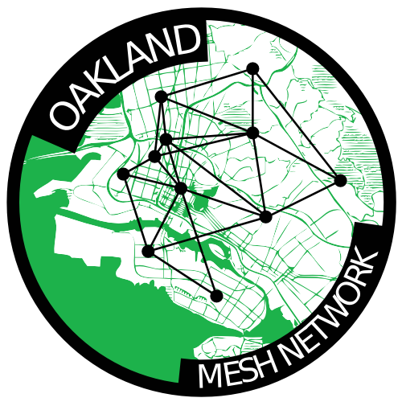


Slide 2
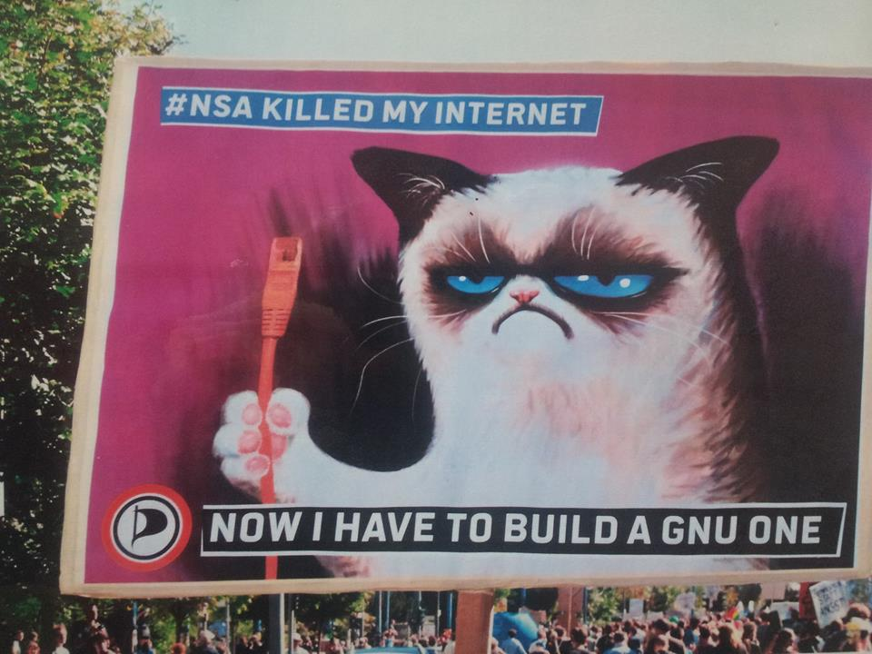

Slide 3

Why mesh networks are rad:
1. Decentralized.
2. Resilient.
3. Community-owned communications rooted in the commons.
Notes:
They don't depend on the existing centralized ISPs to function. Though they can be connected to the Internet as we know it now, a mesh provides a decentralized means of communication with our local community.
Creating a community telecommunications infrastructure is one avenue to reconnecting to our neighbors, supporting local businesses, and enabling grassroots community collaboration.
In the event of disaster or government censorship, an active mesh network is a resilient means of communication and sharing of information.

Slide 4
Use Cases!

Slide 5
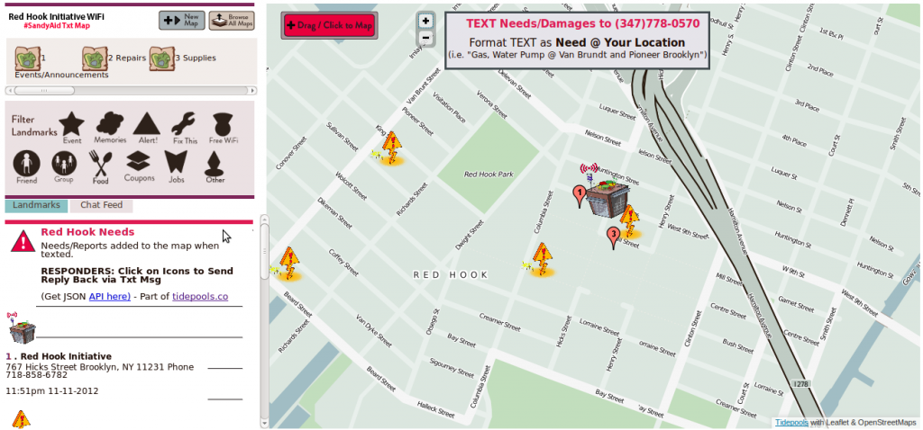
Disaster Relief

Slide 6
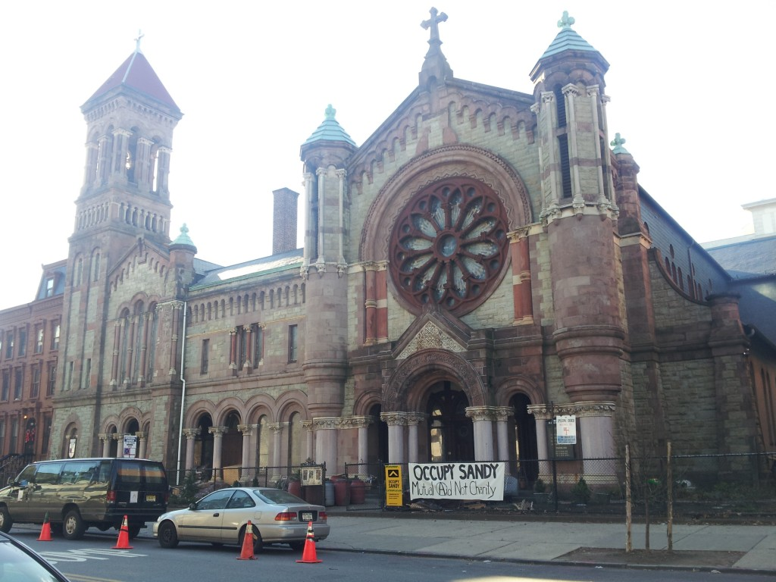
Grassroots Community Collaboration
Notes:
Churches, schools, parks, coffeeshops, local businesses – we are social creatures living in a society in which the public domains of civil society are continually impinged upon by the institutions of corporate and state power. Community networks do well when they connect to existing community spaces.
This is an image of the Church of St. Luke and St. Matthew in Brooklyn, which opened its doors less than 48 hours after superstorm Sandy to serve as an organizing hub for donations and volunteers in the wake of the storm.

Slide 7
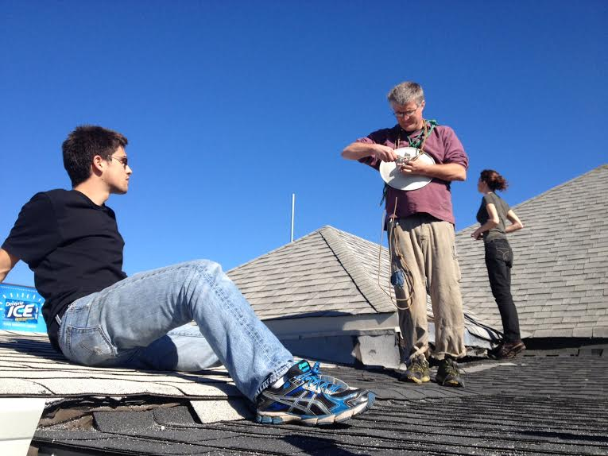

Slide 8
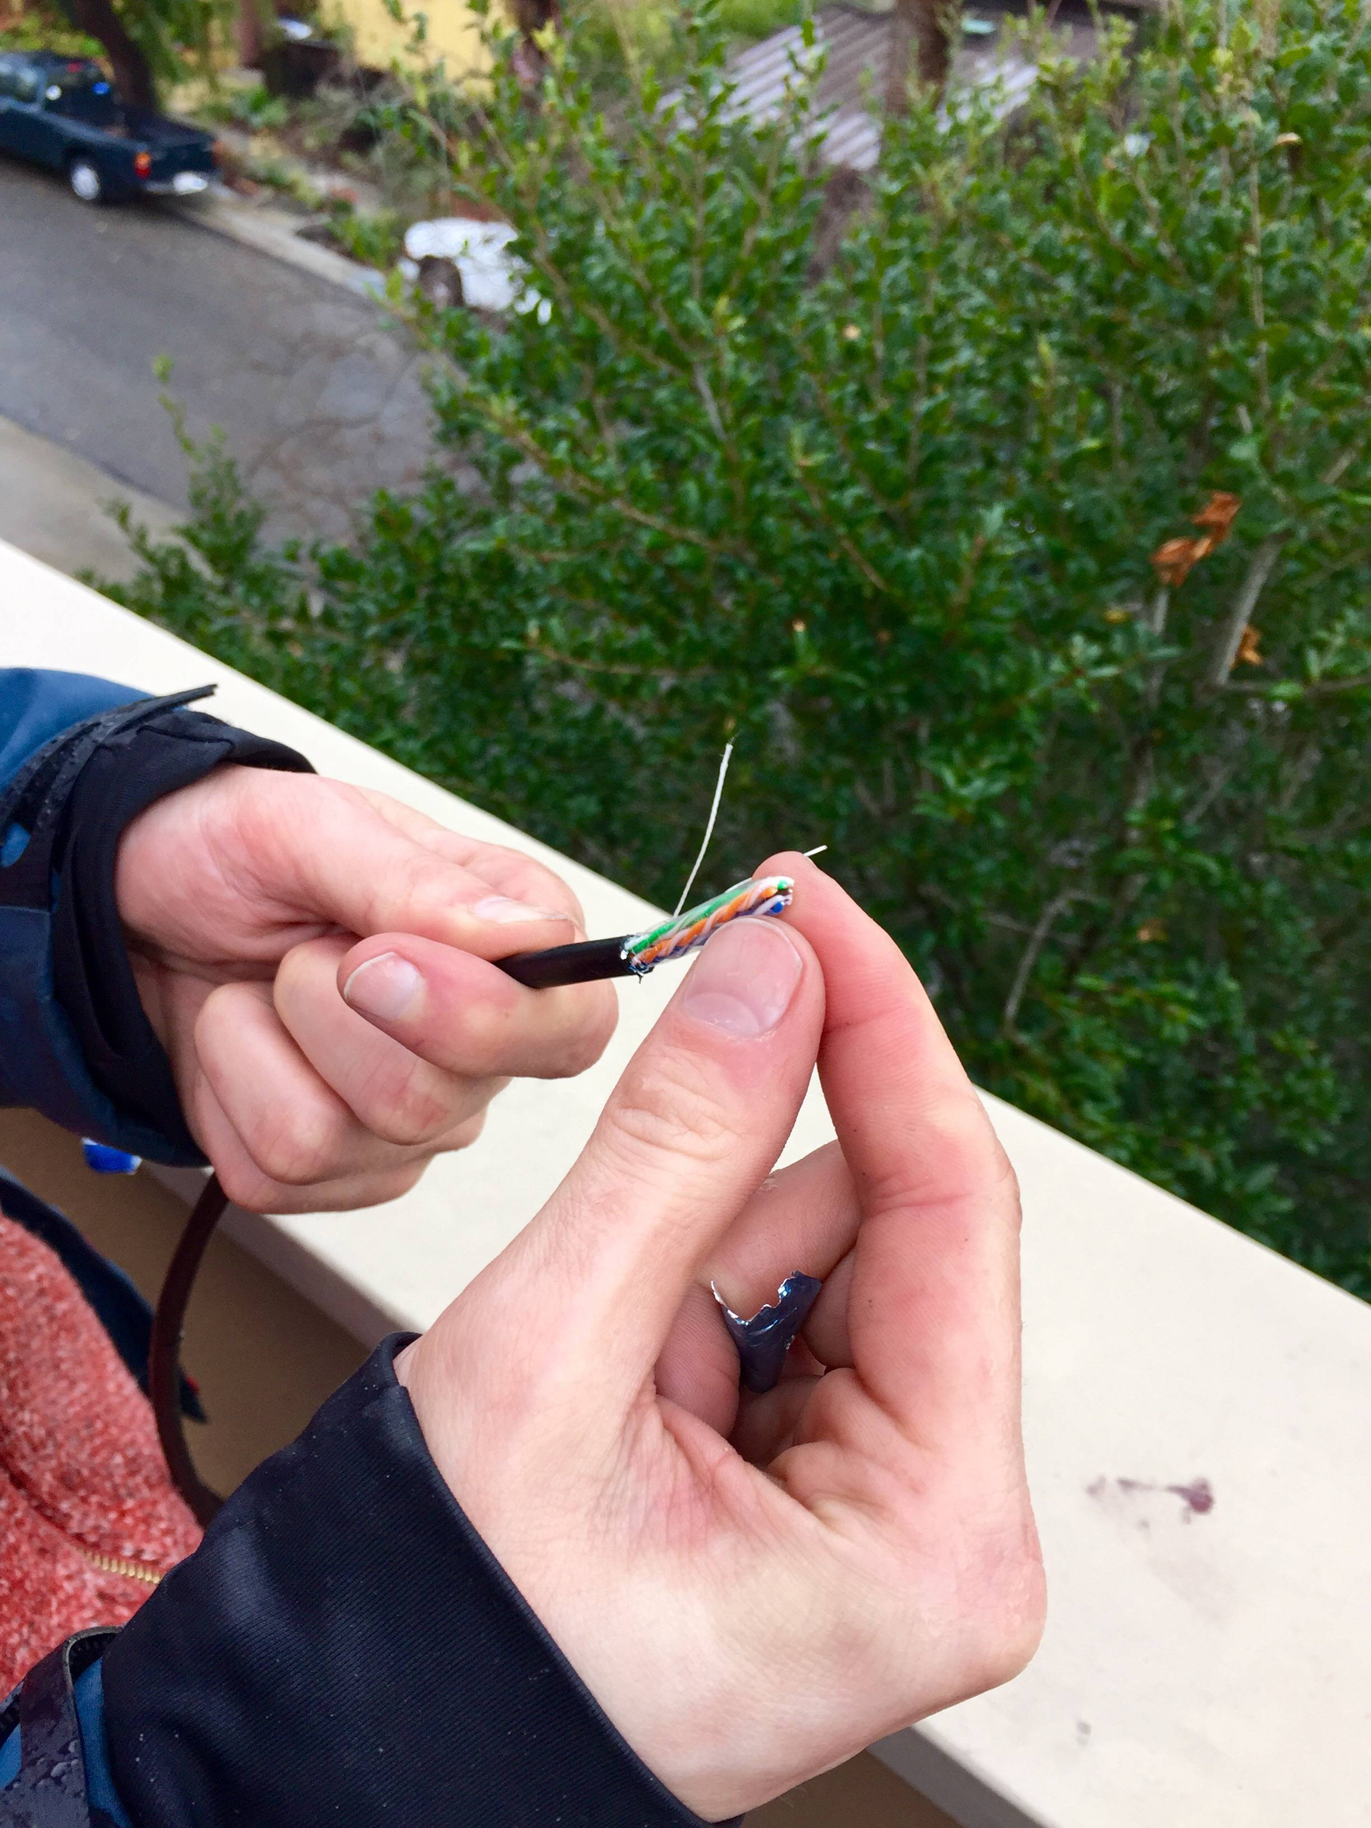

Slide 9
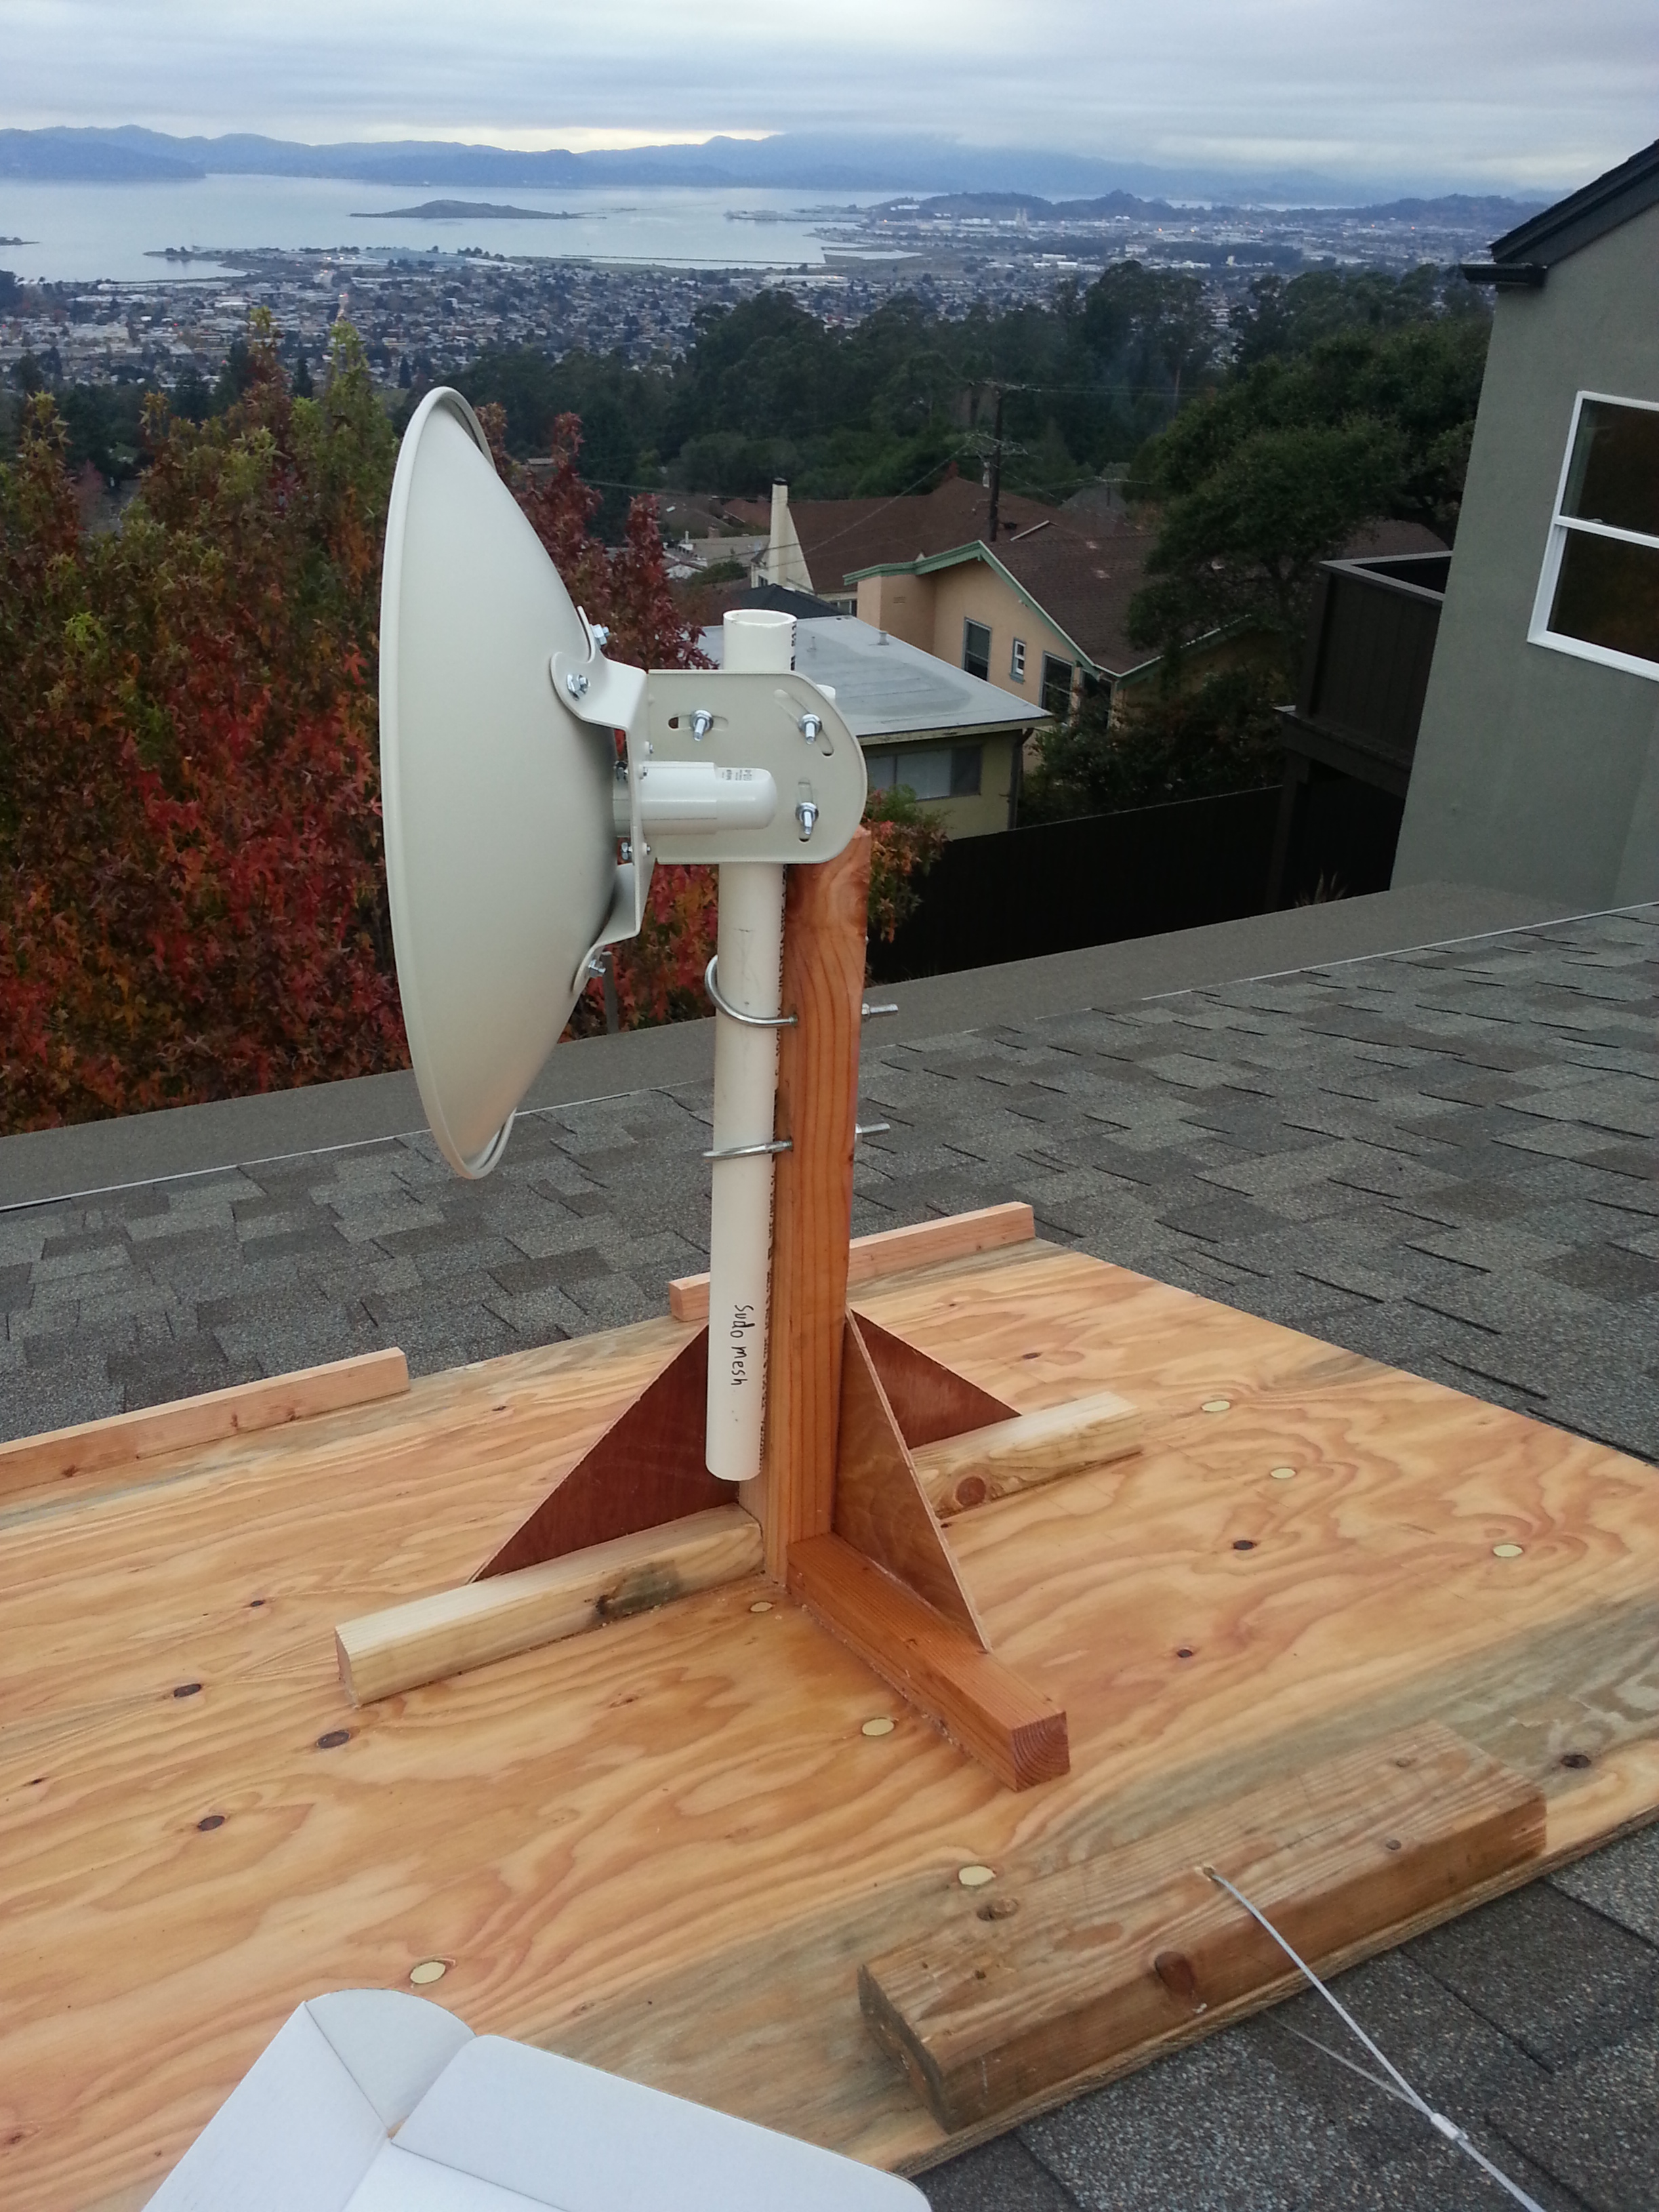

Slide 10
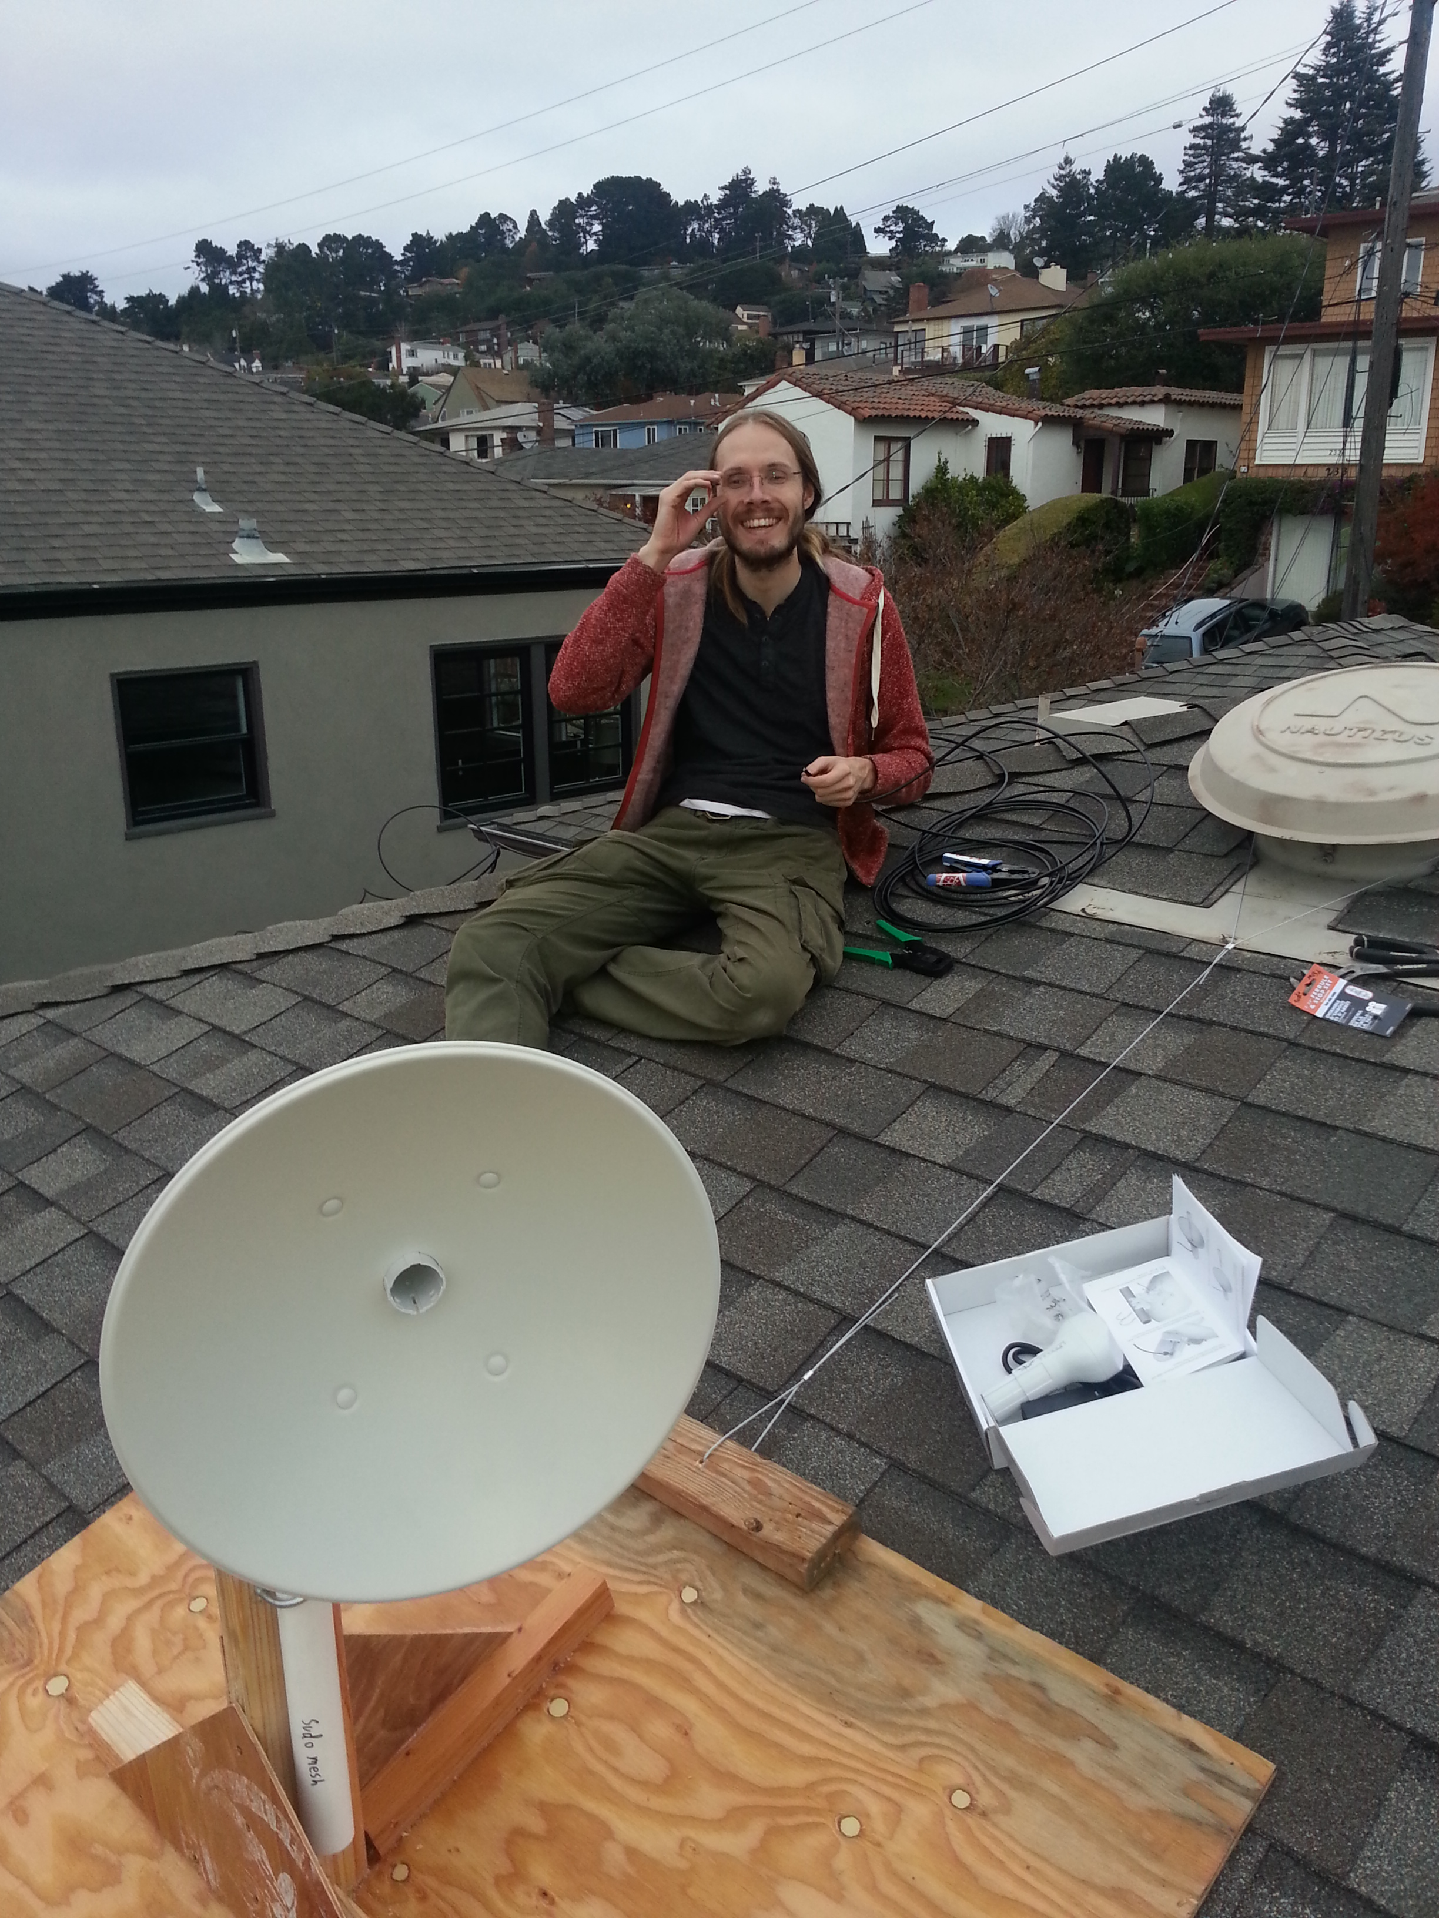

Slide 11
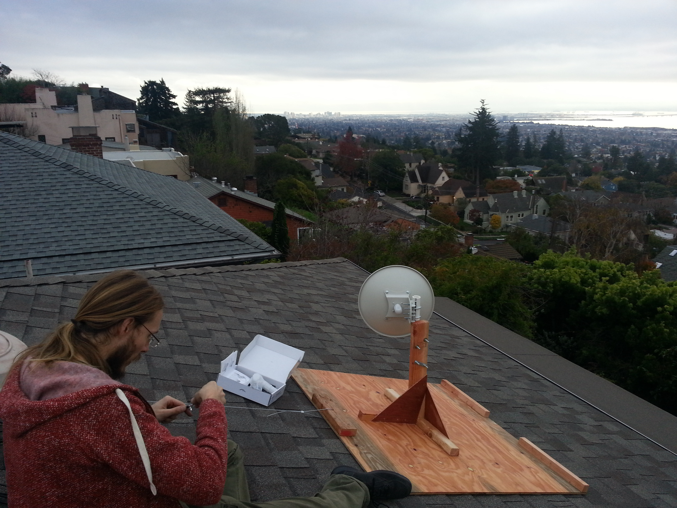

Slide 12
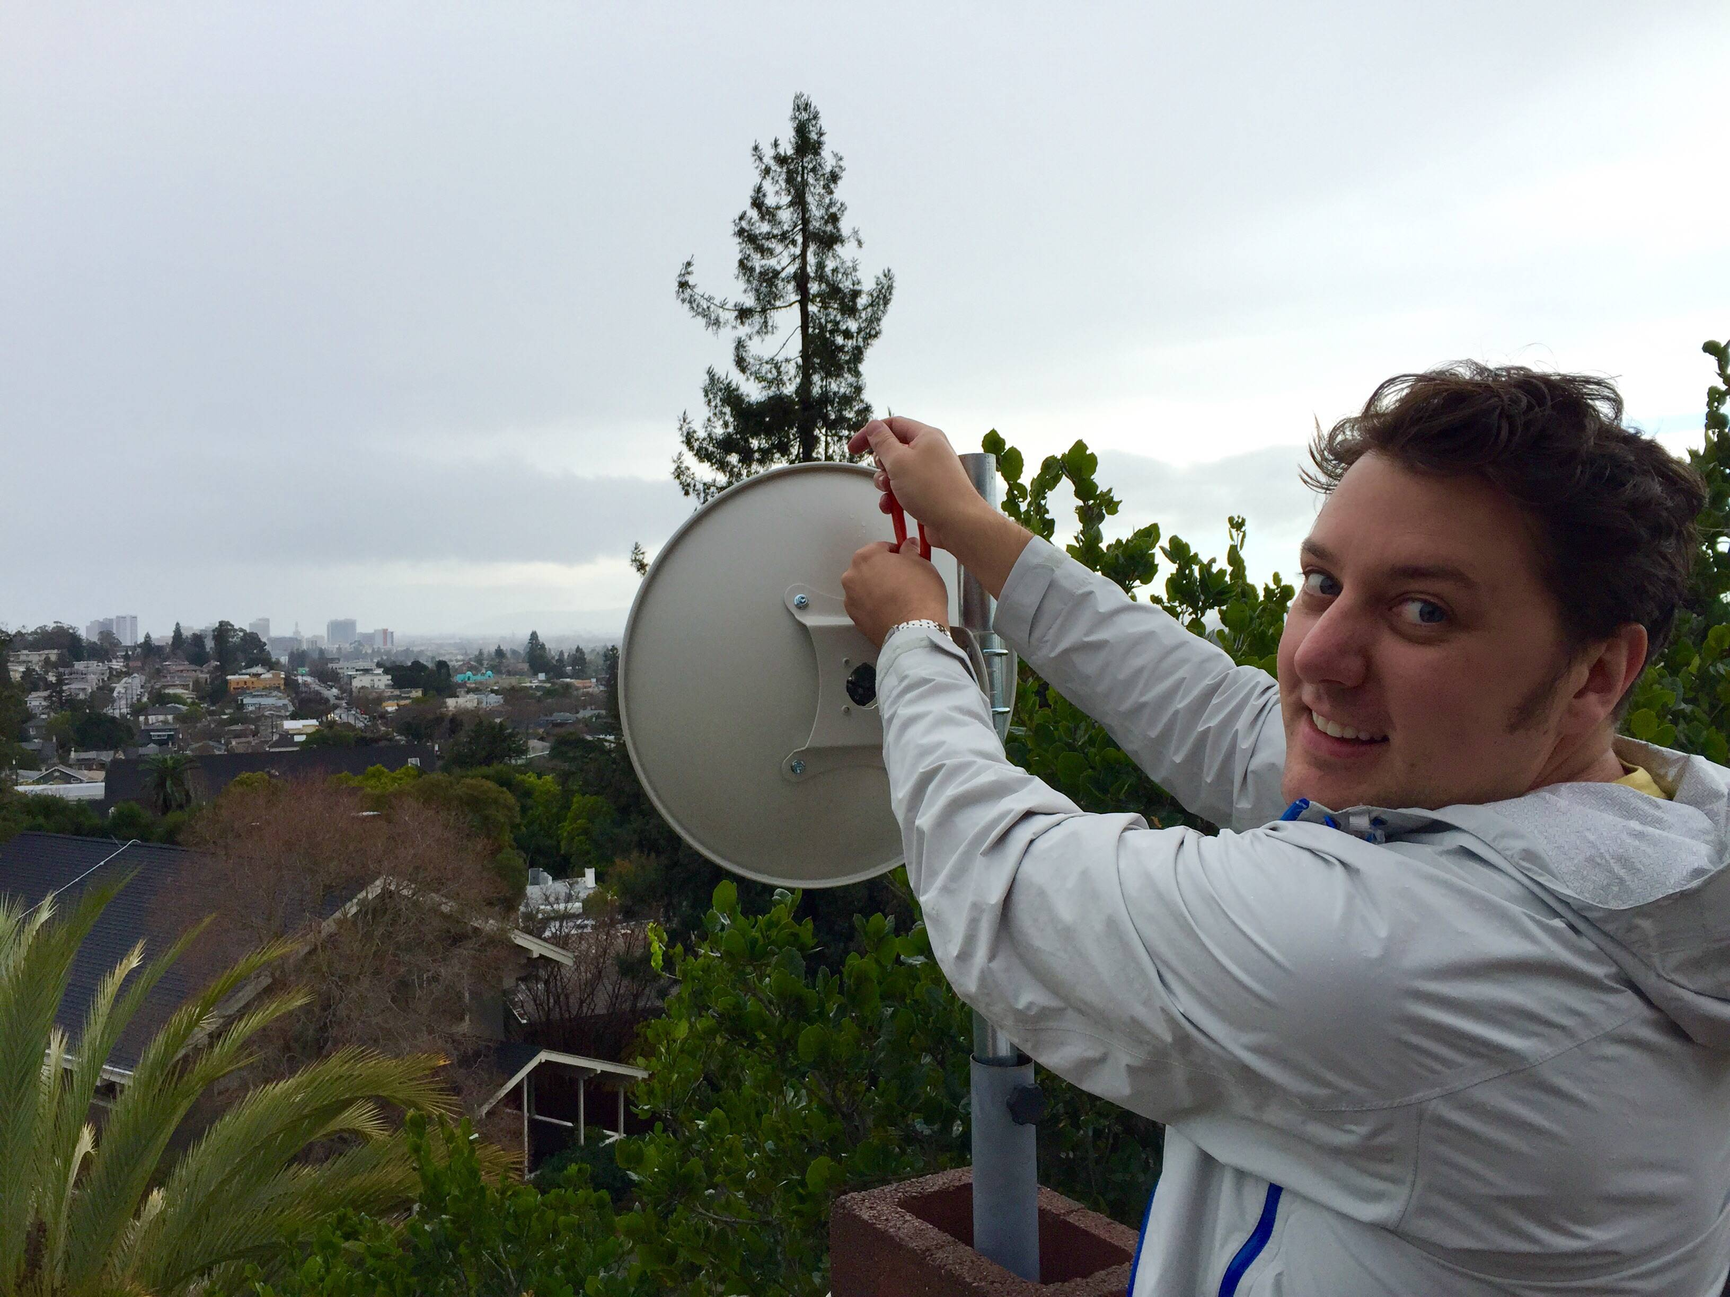

Slide 13
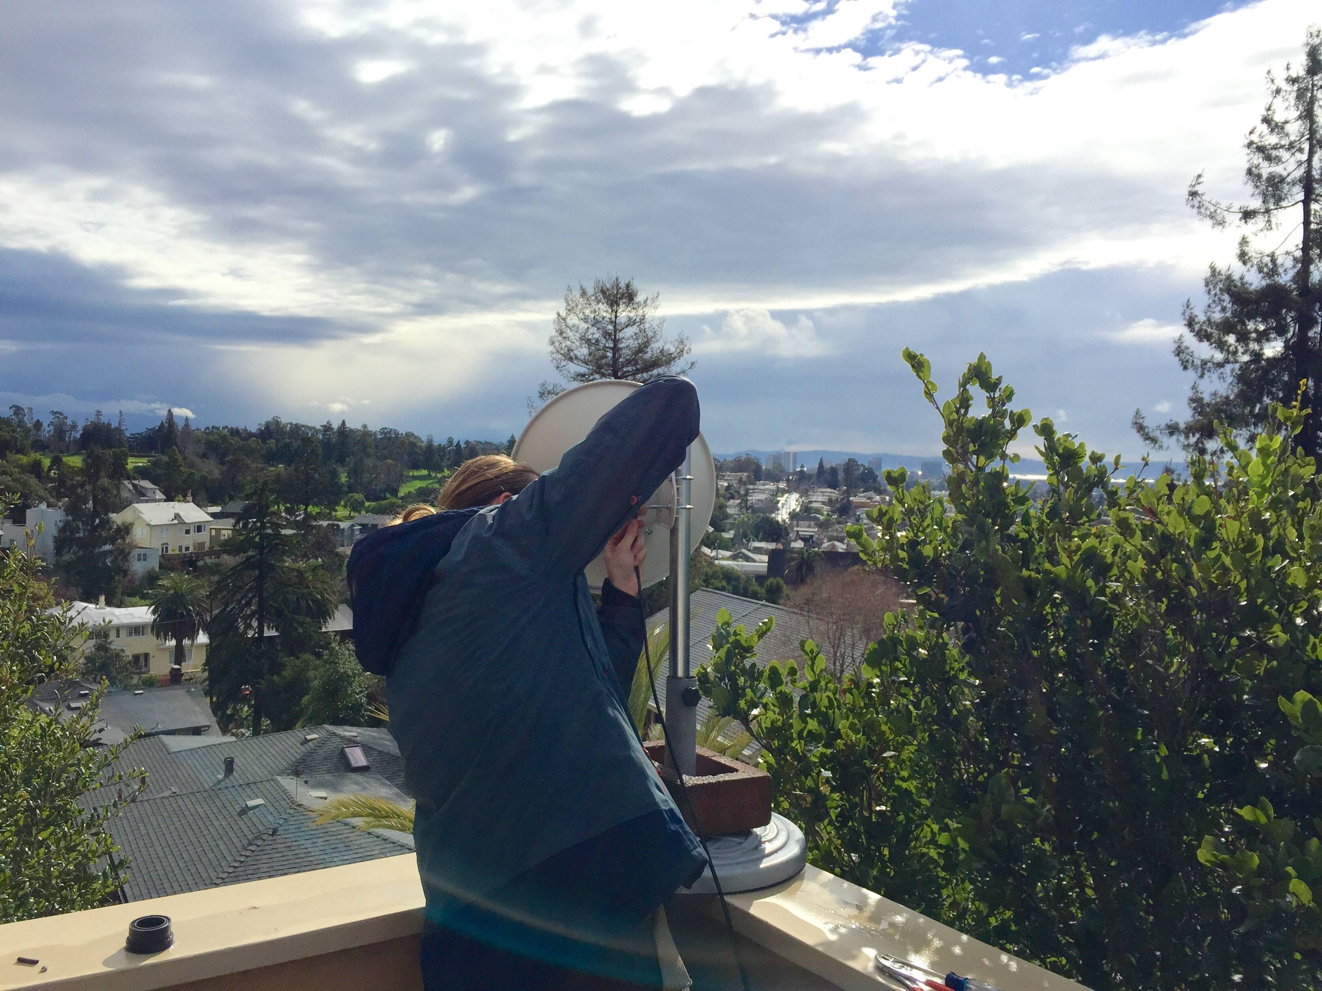

Slide 14
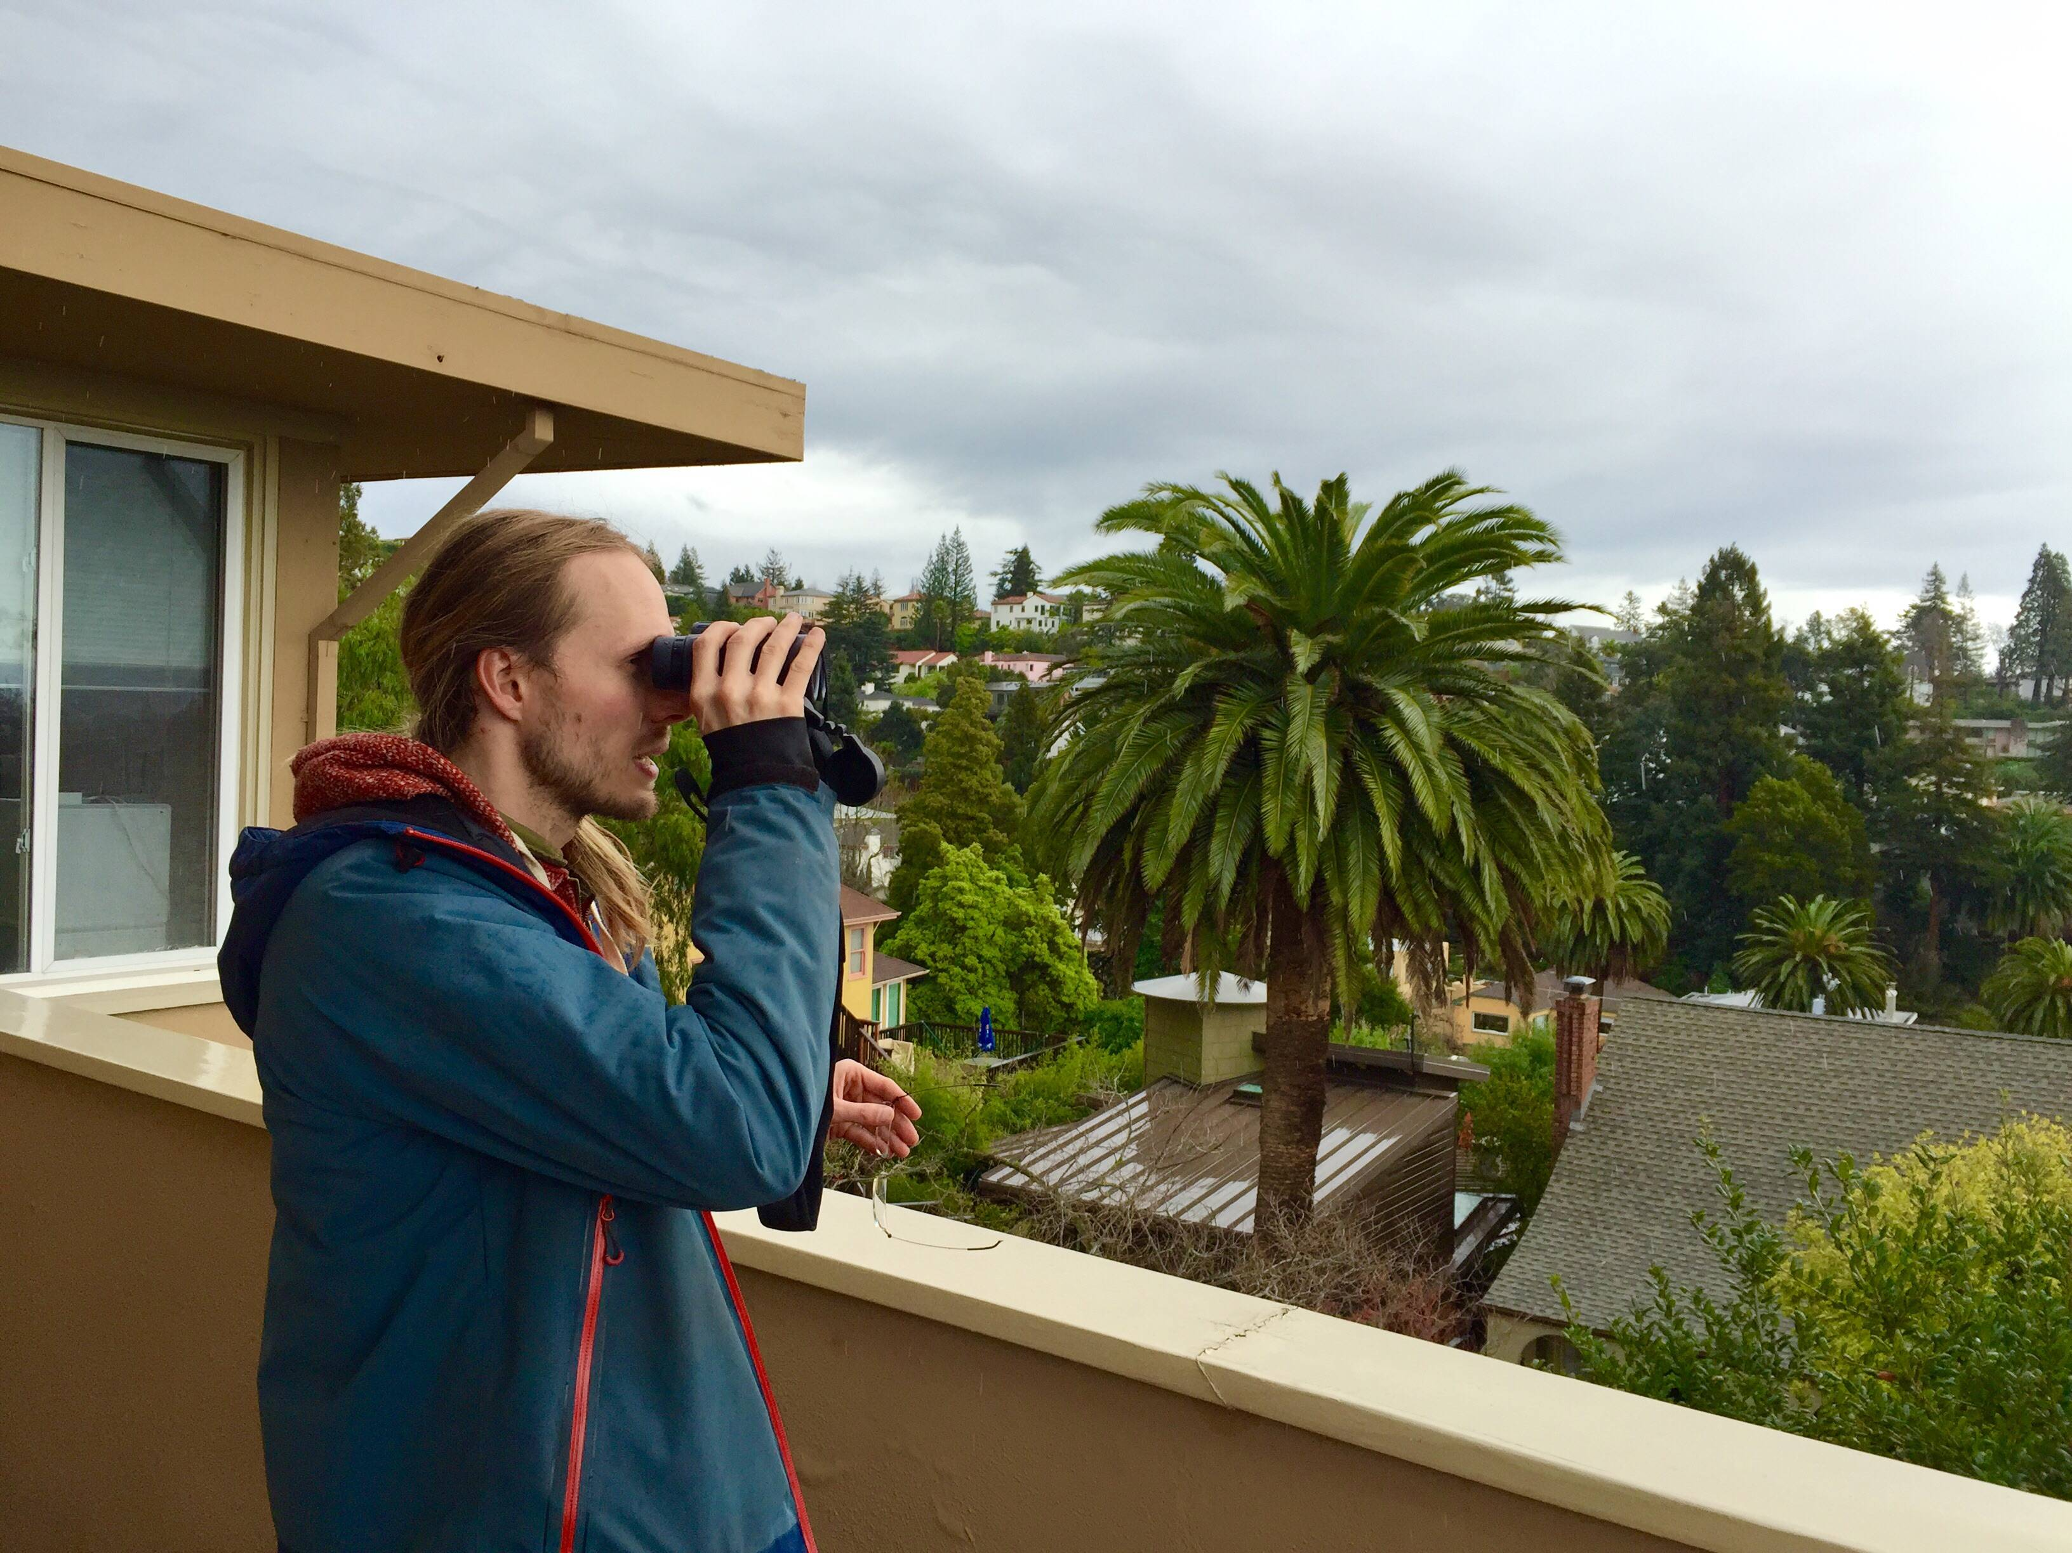

Slide 15
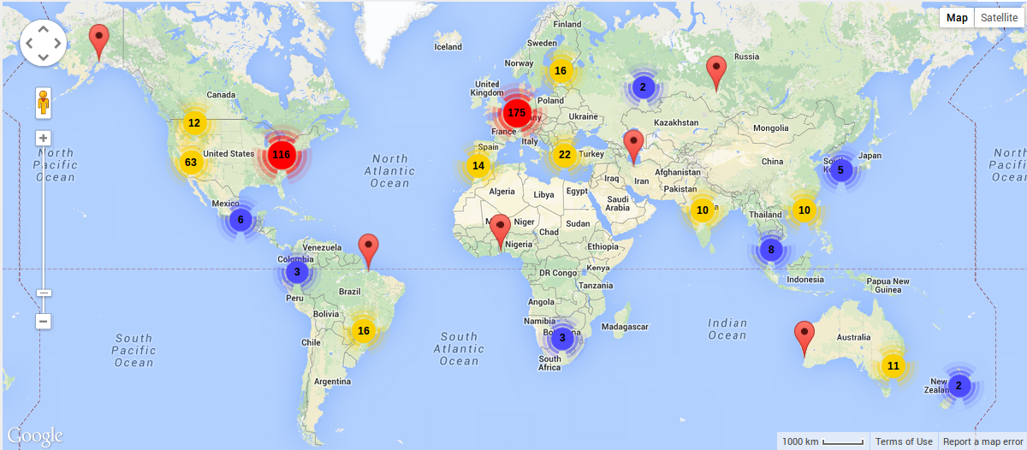
Hackerspaces Worldwide
Notes:
The hackerspace movement took off in 2007 following the last CCCamp, triggering a domino effect of community hack spaces across the globe. Hacknights for sudo mesh take place at sudo room, an Oakland hackerspace we co-founded and use as an all-purpose space for meetings, hacking, storing tools and equipment, running workshops and putting on larger-scale events!

Slide 16
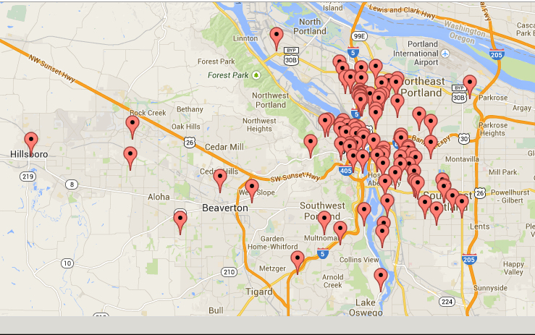
Personal Telco node map (Portland)

Slide 17
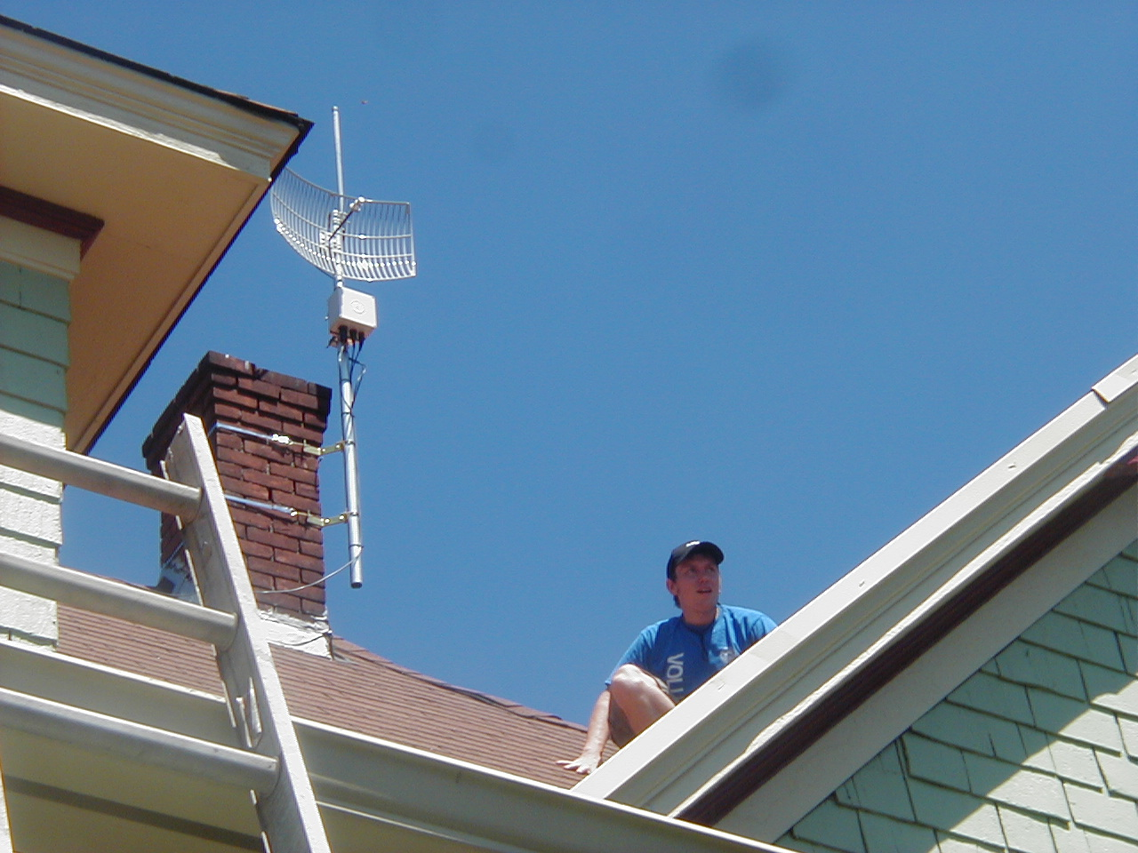
rooftop mount in Portland

Slide 18
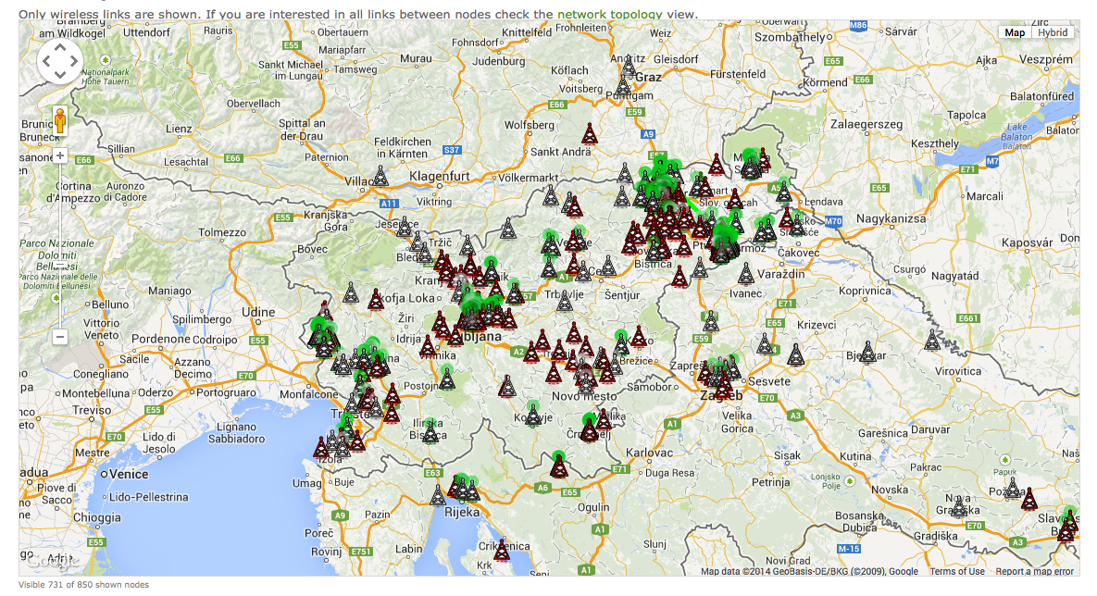
wlan slovenija node map

Slide 19
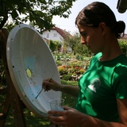

painting antennae in Slovenia

Slide 20
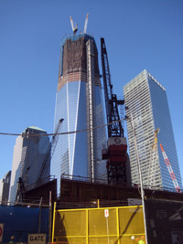
Freedom Tower in Zuccotti Park
image courtesy of Matt Cutugno
(http://staythirstymedia.com/201111-063/html/201111-cutugno-occupying-my-thoughts.html)

Slide 21
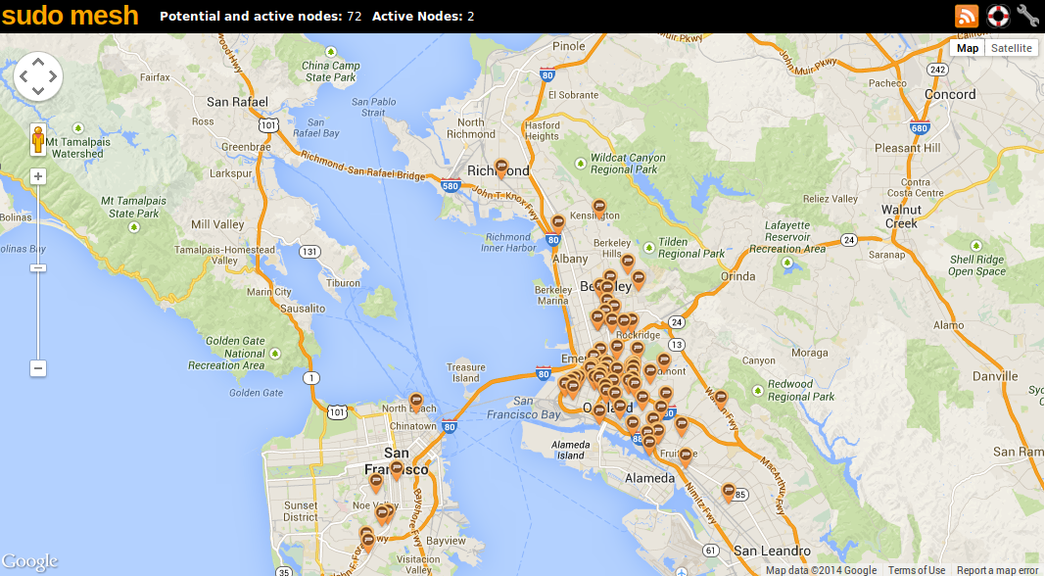

Slide 22
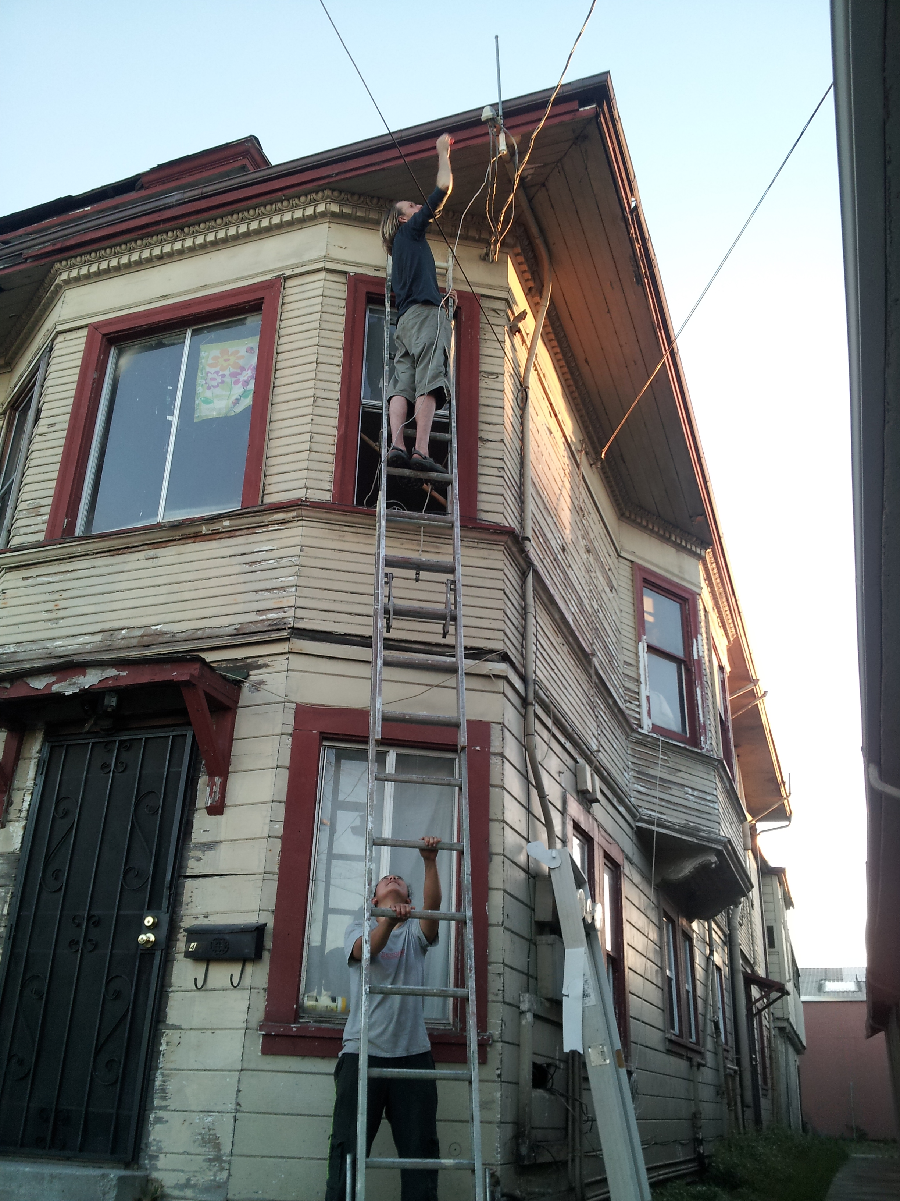
mounting a rooftop node in Oakland

Slide 23
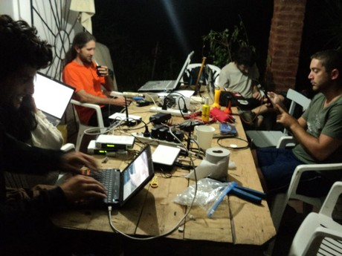
hackathon + mate in Argentina

Slide 24
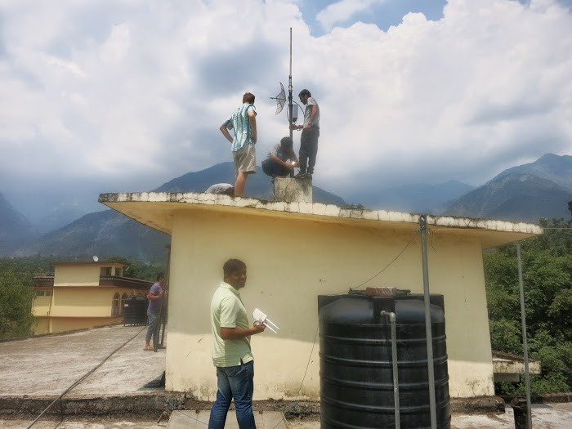
mounting Commotion routers in India

Slide 25
Three types of mesh nodes
Rooftop / mast nodes.
  These form the high-speed backbone of the mesh
  High power. High speed. 5 Ghz.
Outdoor routers
  Street-level connection points for phones / laptops
  Medium range. Medium speed. 2.4 Ghz.
Indoor routers
  Extending the mesh into buildings.
  Short range. High speed. 2.4 / 5 Ghz.

Slide 26
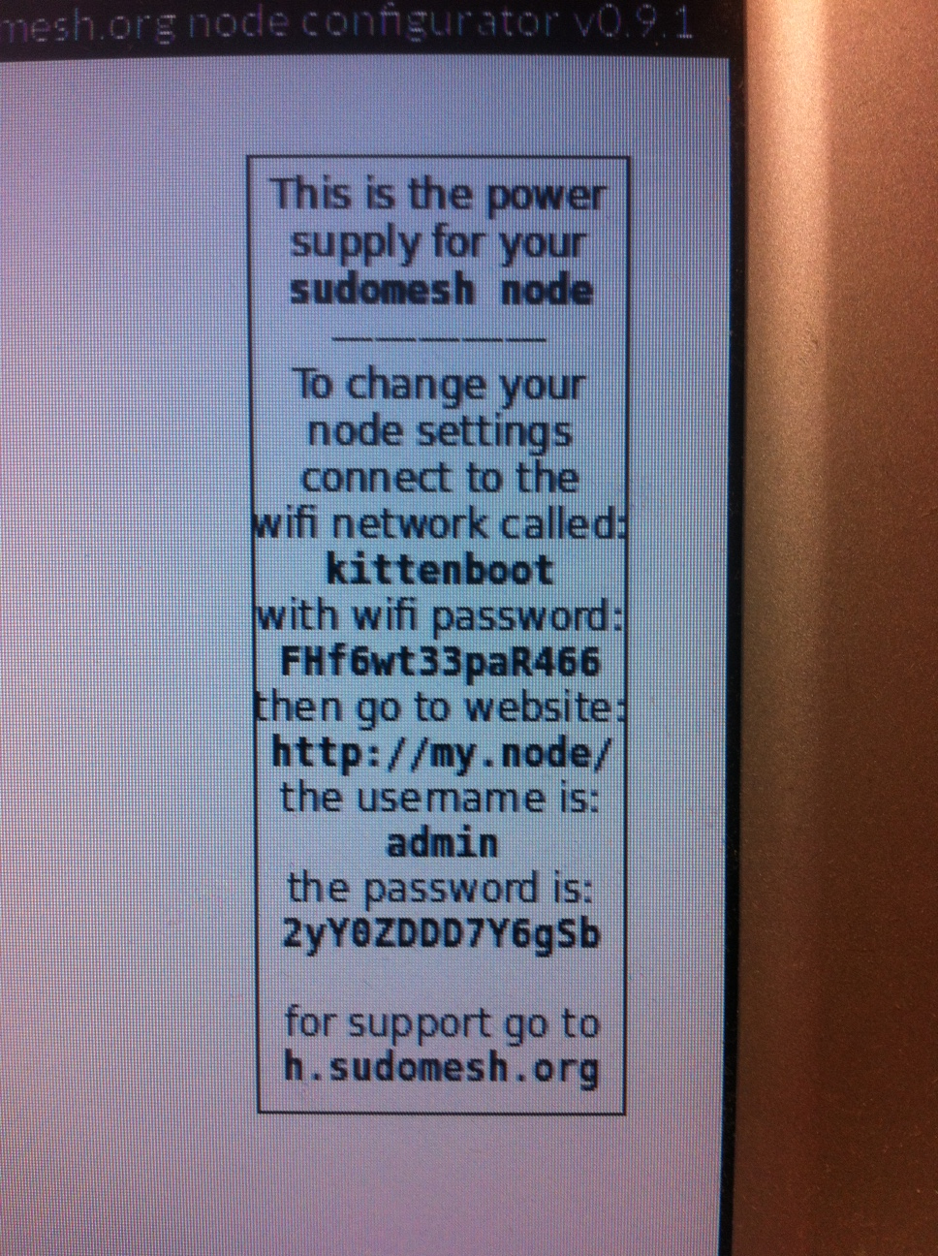
automated sticker labels!

Slide 27
Bootstrapping a mesh
Problems with bootstrapping
  Few nodes == no mesh
  No mesh == no incentive to join
  Roof / outdoor mounting is intimidating / expensive
Solutions
  Make nodes connect to mesh via internet (tunnel)
  Nodes provide safe internet sharing
  Provide cheap indoor routers to get people's feet wet
  Nodes provide extra private access point for owners

Slide 28
Safe internet sharing
User-selectable bandwidth limiting
  Incoming data limited before it reaches mesh
All traffic from mesh is VPN'ed
  VPN server owned by shell non-profit
  Abuse complaints received by non-profit

Slide 29
Making it easy to become a node-owner
Online shop for ordering nodes
  User provides initial bandwidth limits
Automated flashing / configuration of nodes
Automated printing of:
  “How to care for your node” guide
  Sticker with password and support info
Inventory / fulfillment infrastructure so vo

Slide 30
Limiting centralization
Network is separate from mesh organization
  Mesh Network: peoplesopen.net
  Mesh Organization: sudo mesh
Joining network requires only agreeing to the Nearly Free Network License
Make mesh organization fork()'able
  Document EVERYTHING!
  Open source everything.
    Website. Wiki. Legal documents. Software. Firmware.
  Provide script for forking / rebranding.
  Encourage forking for geographic expansion

Slide 31
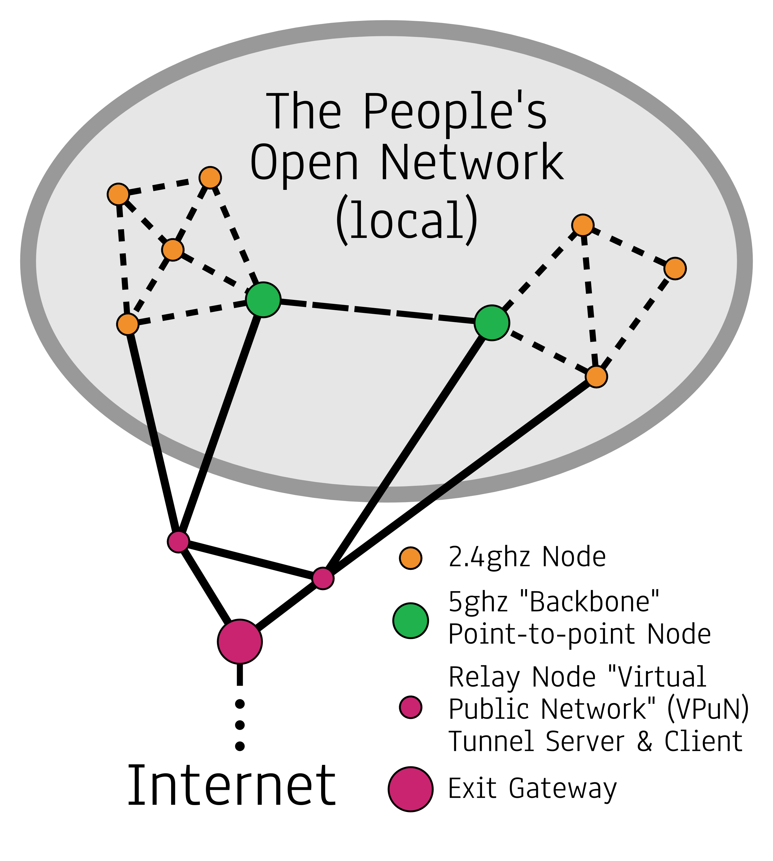

Slide 32
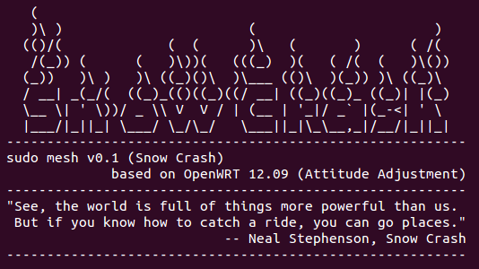
adapting OpenWRT

Slide 33
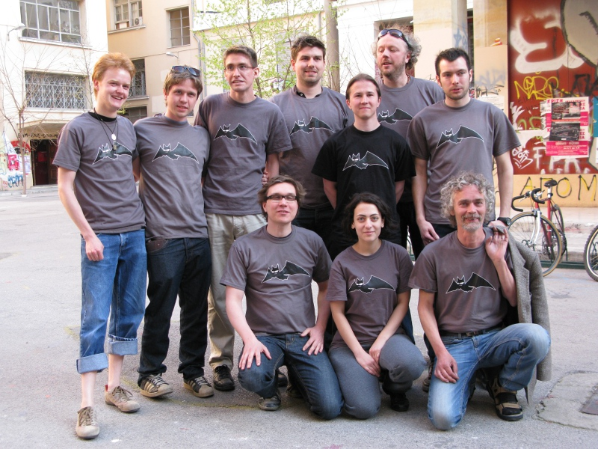
B.A.T.M.A.N. Advanced

Slide 34
Get involved!
Open source software projects:
* OpenWRT, Byzantium, Commotion
* batman-adv, OLSRd, BMX6, Babel
* tunneldigger, nodewatcher, nodeshot
Events:
* Battlemesh
* Int'l Summit for Community Wireless Networks
DIY:
* Join or start a local mesh network!

Slide 35


