Slide 1
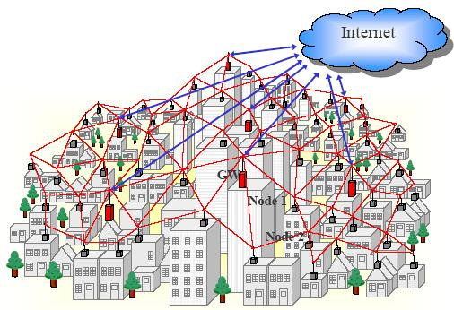

Slide 2
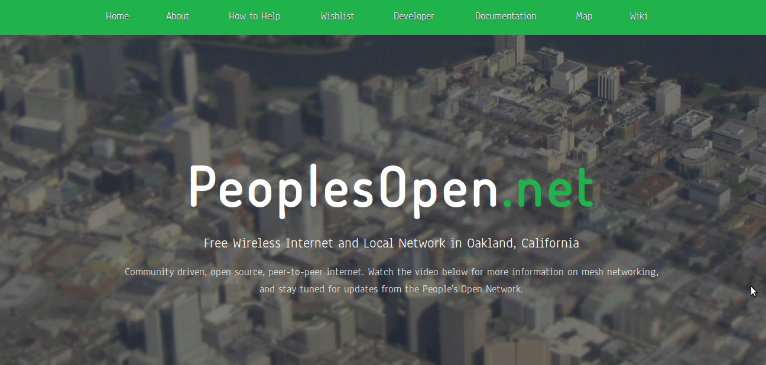

Slide 3

Why mesh networks are rad:
1. Decentralized.
2. Resilient.
3. Community-owned communications rooted in the commons.
Notes:
They don't depend on the existing centralized ISPs to function. Though they can be connected to the Internet as we know it now, a mesh provides a decentralized means of communication with our local community.
Creating a community telecommunications infrastructure is one avenue to reconnecting to our neighbors, supporting local businesses, and enabling grassroots community collaboration.
In the event of disaster or government censorship, an active mesh network is a resilient means of communication and sharing of information.

Slide 4
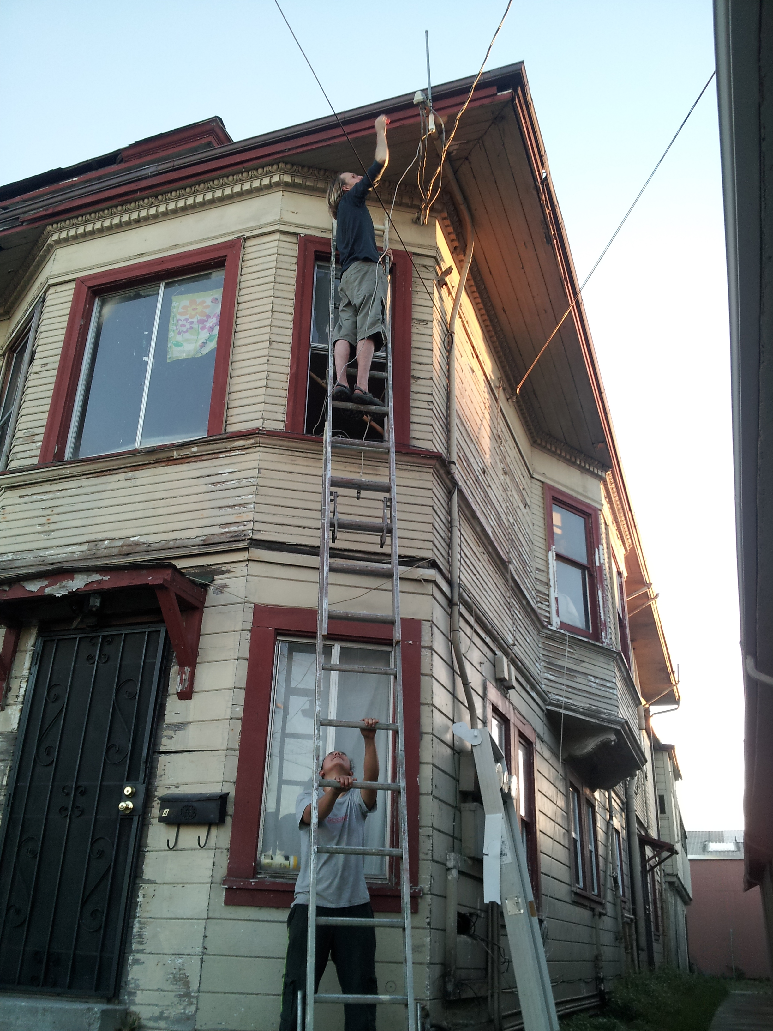
We are building a network of point-to-point connections between rooftops, dispersing the signal out to public spaces and community centers to build our own network commons infrastructure.
Our current challenge lies in developing the software for running the network, and in building a larger community of participants, supporters, and team members.

Slide 5
How does it work?
Get off-the-shelf wifi routers
Replace operating system with an open one
Install mesh protocol made by german hackers
Get people to buy/adopt routers and put them on their rooftops, outside walls and inside their homes.
Get people to donate internet bandwidth

Slide 6
Three types of mesh nodes
Rooftop / mast nodes.
  These form the high-speed backbone of the mesh
  High power. High speed. 5 Ghz.
Outdoor routers
  Street-level connection points for phones / laptops
  High power. Medium speed. 2.4 Ghz.
Indoor routers
  Extending the mesh into buildings.
  Low power. Medium or high speed. 2.4 Ghz.

Slide 7
Internet?

Slide 8
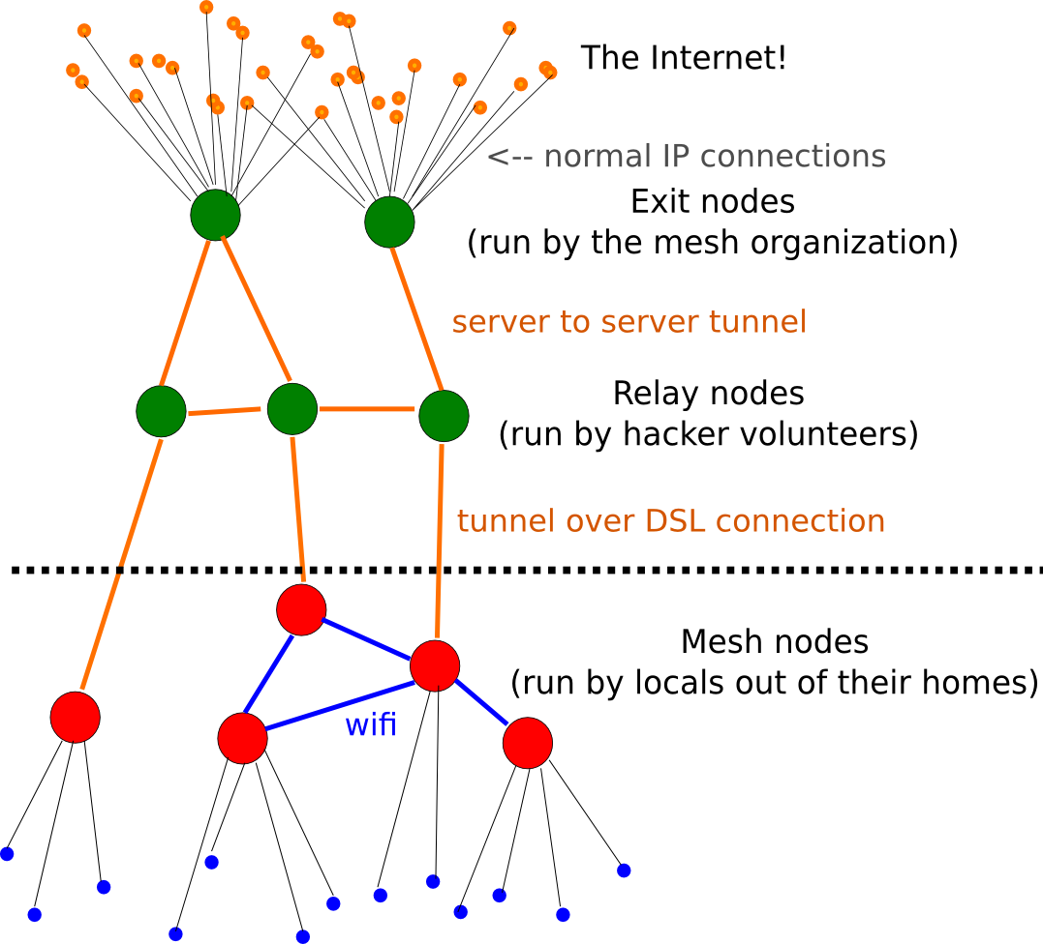
← Normal Wi-Fi connections
Laptops, Smartphones, etc;

Slide 9
Hardware!

Slide 10
Hardware
Ubiquiti gear
  Atheros chipsets
  Many models. Proprietary. Closed.
Cheap home routers (e.g. TP-Link)
  Atheros chipsets
  Cheaper than Ubiquiti. Less powerful. Closed.
Open-mesh.com routers:
  Atheros chipsets
  Same price as Ubiquiti. Few models. More open.

Slide 11
Software!

Slide 12
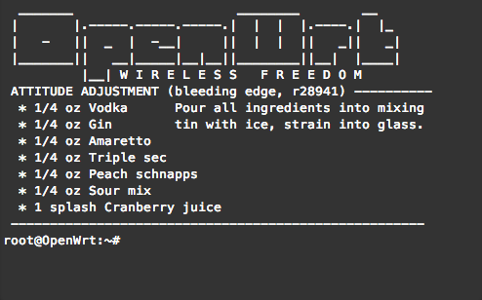
OpenWRT

Slide 13
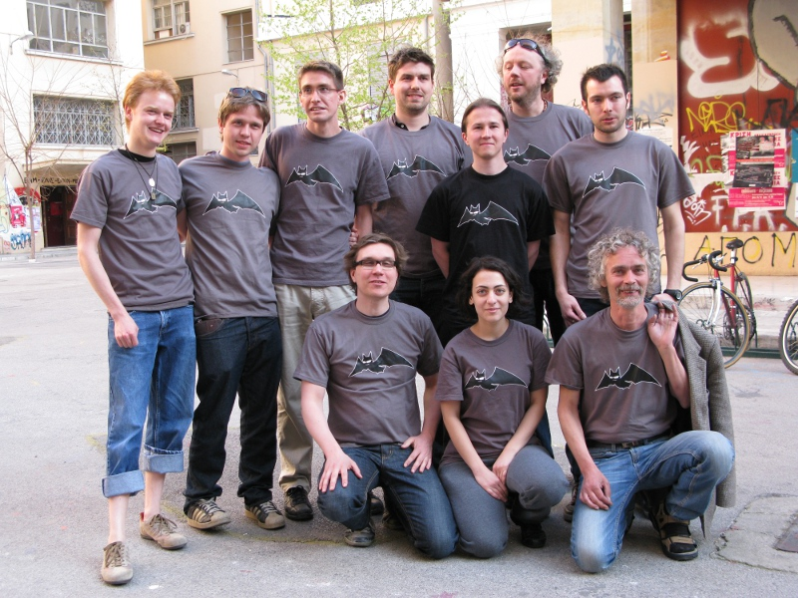
B.A.T.M.A.N. Advanced

Slide 14
Organization
Local 501(c)3 non-profit
  Volunteers maintaining local network
  Classes / Workshops
  We're working on sustainable business models
Network separate from non-profit
  Peering-agreements with other networks
  Anyone can join if they sign the peering agreement
  No need to be part of non-profit.

Slide 15
Plan
Launch the People's Open Network at https://peoplesopen.net
* Start test network (small) *
Launch in a single neighborhood
Advertise and grow spread with early adopters
Connect to other networks and build backbone

Slide 16
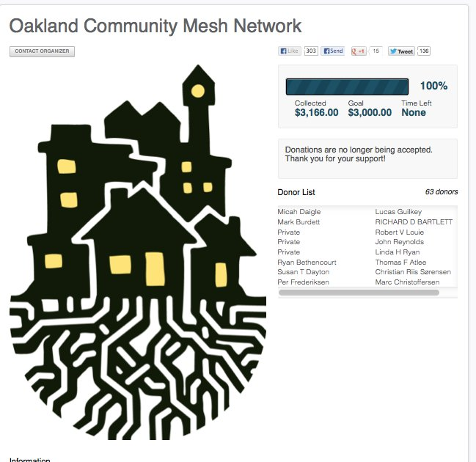

Slide 17
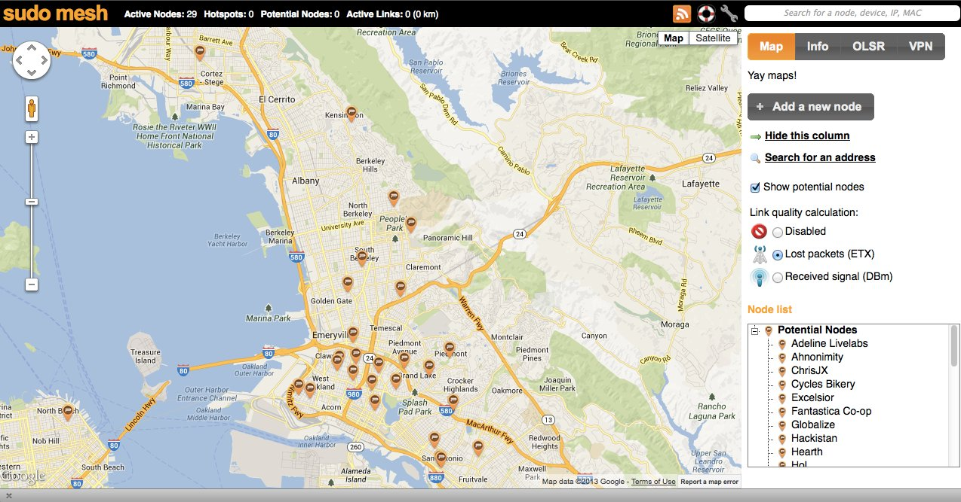
What’s a mesh?
Free as in freedom alternative internet.
So far we have deployed two experimental mesh nodes in West Oakland. Using this map you can add your home as a potential location for new mesh nodes! There are currently 55 potential nodes on our map: http://meshmap.sudoroom.org/

Slide 18
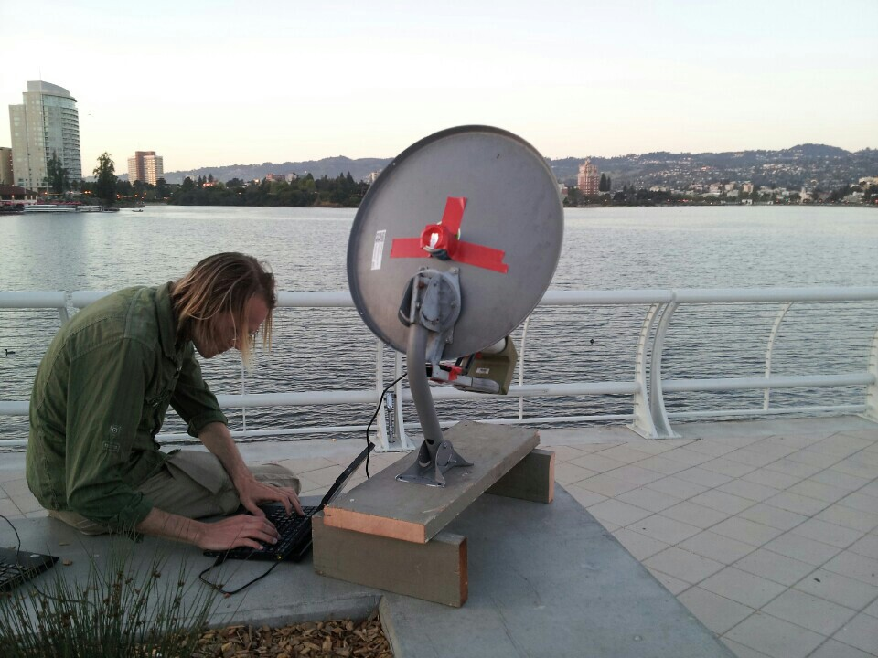
Experimenting → Learning → Doing
Notes:
The place that hosts our hacknights is here before you. Everything in that room has been donated, yet its literally a treasure trove of possibility. Technology evolves in unexpected ways, unintended uses often resulting in the most useful applications. Our objective is to implement a solution that is at once extremely modular and meticulously localized – contextually contingent while also being valuable at large. Our solution is to document our process – our research and ideas, communications and creativity. However, this process is nonetheless locally contextual – most pertinent to the geographic area we inhabit.

Slide 19
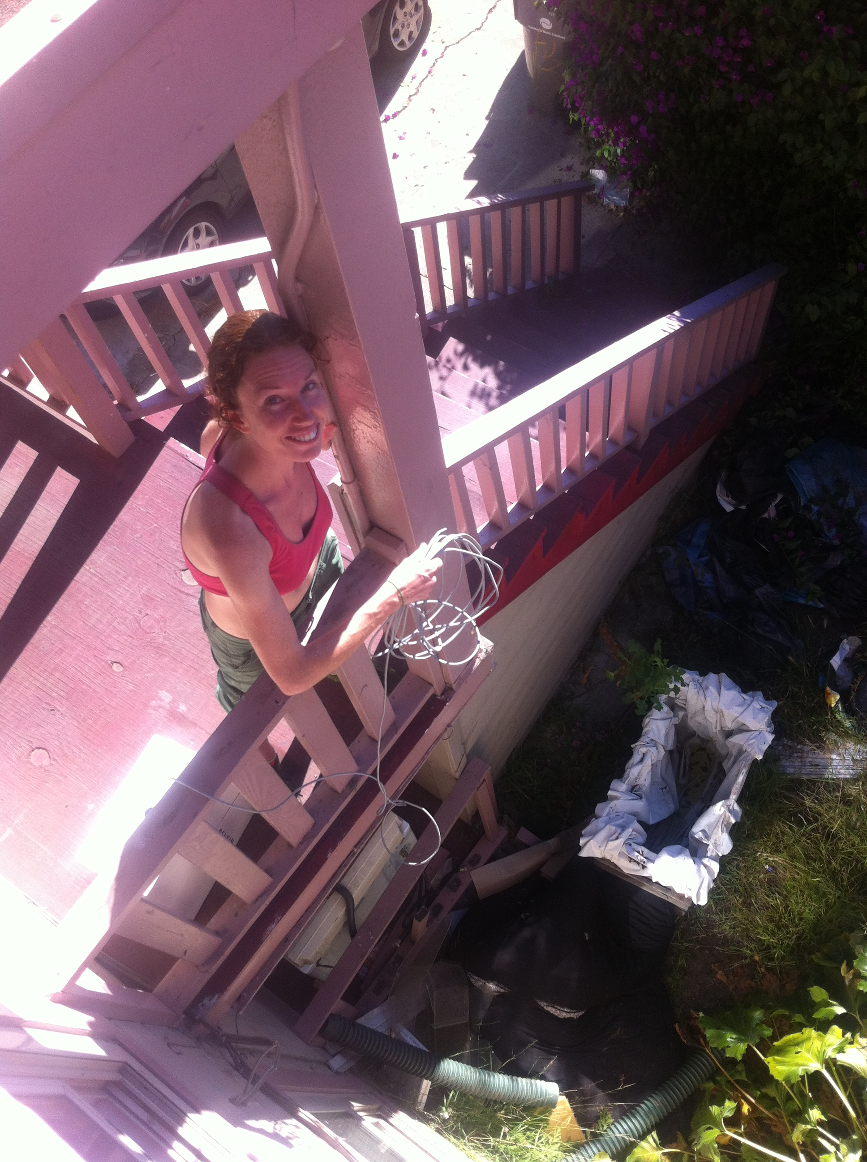

Slide 20


Slide 21
How to Help!
Come to our Thursday hacknights
  7:30 pm at sudo room!
Community outreach!: Make a flier, upload the design to our wiki, and post it up in your neighborhood.
Do research on other mesh projects and city policies.
Technical: Work on firmware, and learn more about networks!
User research: Designing use cases, and sketching UIs for local applications.
Organize finances, tweak our bylaws, research legal issues, and come up with business models.
Wiki: http://sudoroom.org/wiki/Mesh
Mailing List: http://lists.sudoroom.org/listinfo/mesh
Freenode IRC: #peoplesopennet

