Slide 1
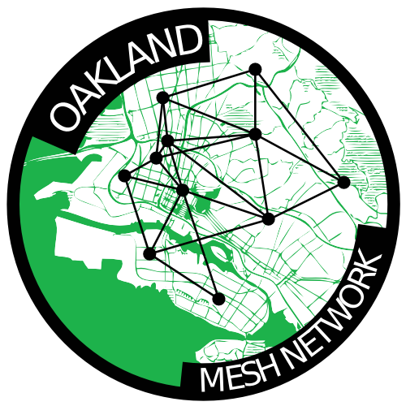
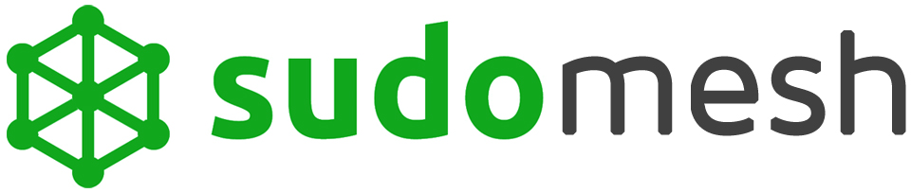

Slide 2
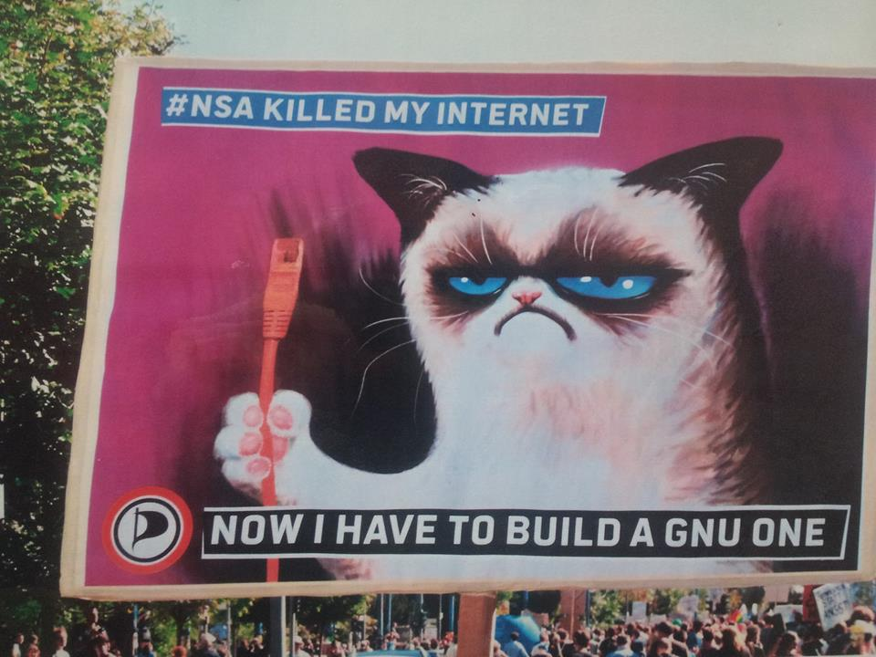

Slide 3
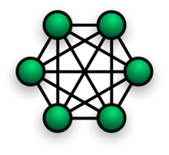
Why mesh networks are rad
1. Decentralized.
2. Resilient.
3. Community-owned communications rooted in the commons.
Notes:
They don't depend on the existing centralized ISPs to function. Though they can be connected to the Internet as we know it now, a mesh provides a decentralized means of communication with our local community.
Creating a community telecommunications infrastructure is one avenue to reconnecting to our neighbors, supporting local businesses, and enabling grassroots community collaboration.
In the event of disaster or government censorship, an active mesh network is a resilient means of communication and sharing of information.

Slide 4
Use Cases!

Slide 5
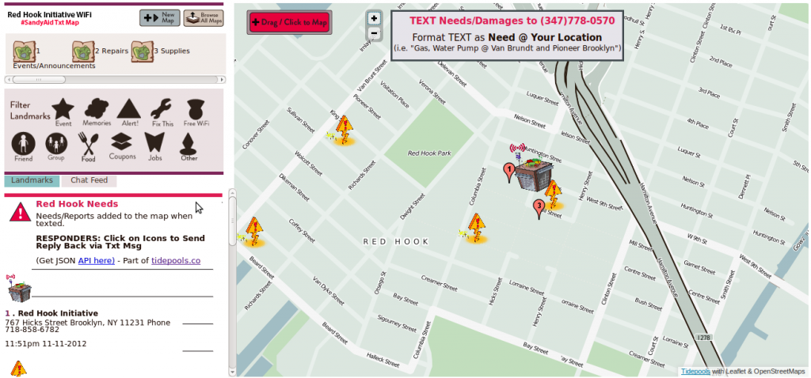
Disaster Relief

Slide 6
Off-grid connectivity
Build peer-to-peer communications networks in places where reception is poor or nonexistent:
  Crowded festivals, like Burning Man & Symbiosis
  Remote villages in unconnected or difficult-to-reach areas around the world
  Pooling funds and sharing a single satellite connection with many people

Slide 7
Be your own ISP!
Find a building already lit up with fiber connectivity.
Pool funds to buy a fast commercial connection
Use high-speed wifi to distribute bandwidth between the rooftop nodes (the backbone) and

Slide 8
Phone company alternative
If wifi coverage is good enough, you won't need to pay the cell phone company.
Airplane mode + wifi on = avoid stingrays
Wifi still allows MAC-based tracking
  Some phones can use MAC randomizers

Slide 9
Share your internets!
Share a portion of your existing bandwidth locally.
Encourage others to participate and share their connection as well
As others join the mesh, shared bandwidth expands to cover a whole city...

Slide 10
Sensor networks
Internet of Things is happening
Consumer products are aimed at the home
  Intelligent lightbulbs, Intelligent smoke alarm
Mesh expands IoT to the public sphere
  Community garden “water me now” sensors
  Which community spaces are open now?
  Air pollution / sound pollution monitoring
  Gunfire triangulation

Slide 11
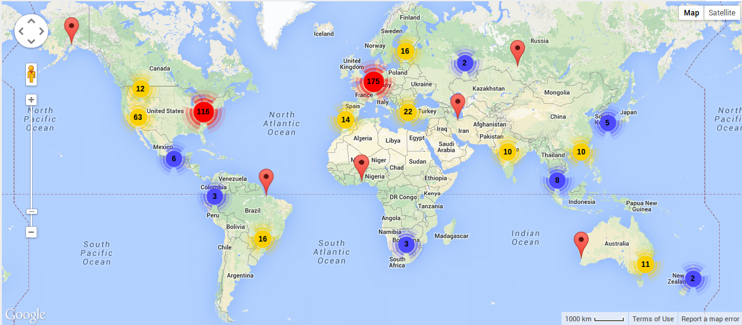
Hackerspaces Worldwide
Notes:
The hackerspace movement took off in 2007 following the last CCCamp, triggering a domino effect of community hack spaces across the globe. Hacknights for sudo mesh take place at sudo room, an Oakland hackerspace we co-founded and use as an all-purpose space for meetings, hacking, storing tools and equipment, running workshops and putting on larger-scale events!

Slide 12
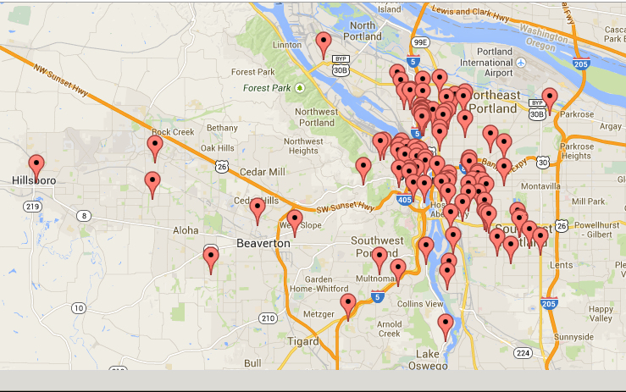
Personal Telco node map (Portland)

Slide 13
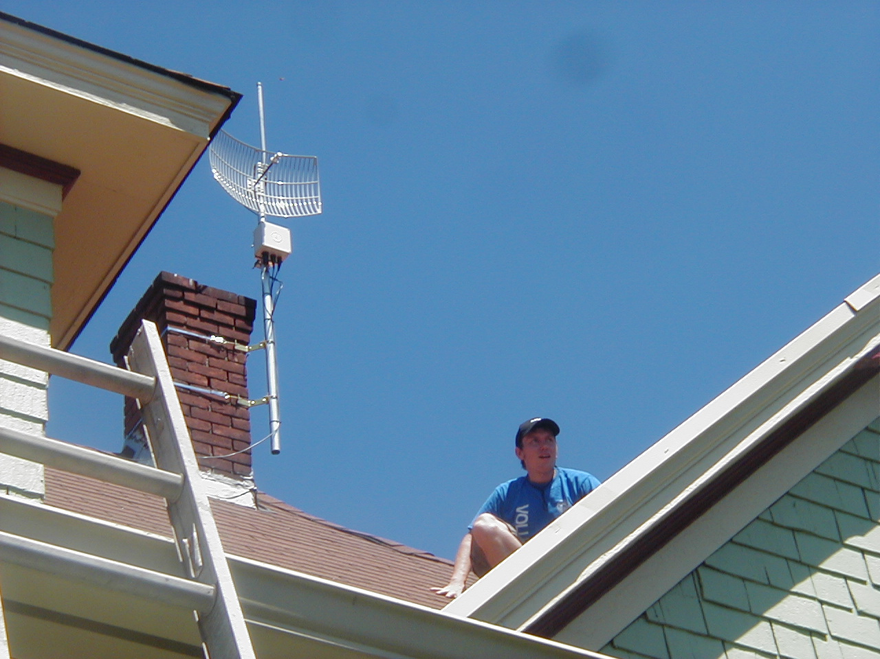
rooftop mount in Portland

Slide 14
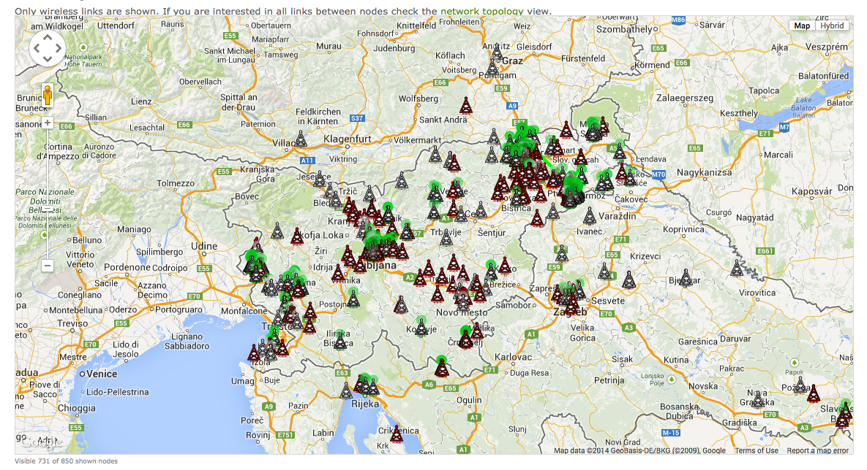
wlan slovenija node map

Slide 15
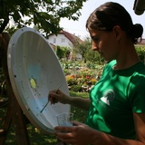

painting antennae in Slovenia

Slide 16
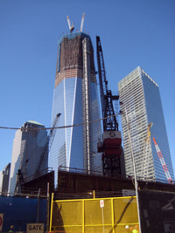
Freedom Tower in Zuccotti Park
image courtesy of Matt Cutugno
(http://staythirstymedia.com/201111-063/html/201111-cutugno-occupying-my-thoughts.html)

Slide 17
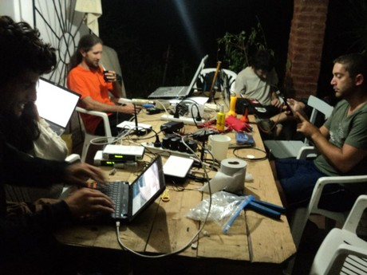
hackathon + mate in Argentina

Slide 18
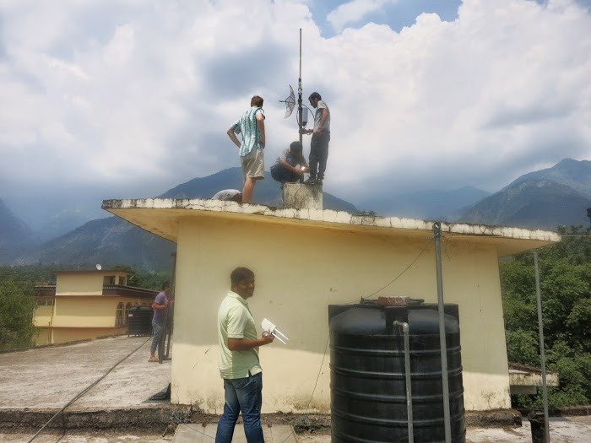
mounting Commotion routers in India

Slide 19
People's Open Network
Founded in 2013
Based out of Oakland, CA
All volunteer run community grass-roots project
All free and open source software + documentation
Spent the last two years developing firmware
Beta test network became active last month
Currently expanding beta network
  Join our monthly community meeting http://sudomesh.org/
Seeking more beta node operators in the east bay
  Sign up on http://map.sudomesh.org/

Slide 20
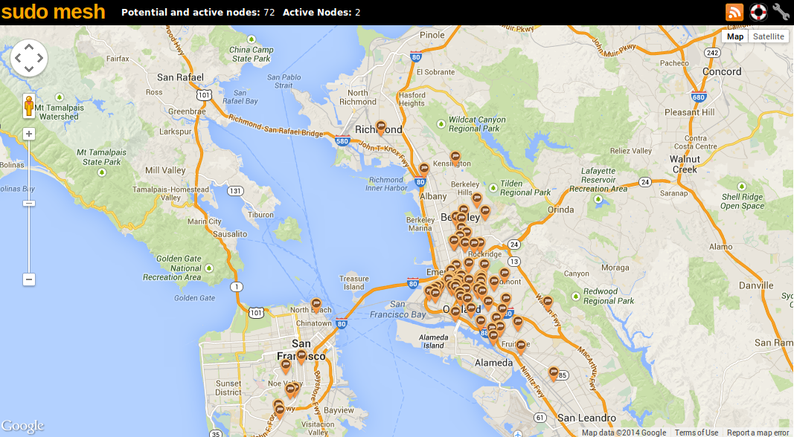

Slide 21
Always seeking more volunteers!
There are lots of ways to participate in building a community network. Any given network needs:
  Networking geeks and radio-heads
  Community organizers (human network relations)
  Designers and software developers
  People who like to climb buildings... ^_^

Slide 22
Three types of mesh nodes
Home nodes
  Cheap (~$50) indoor-only base unit
  Shares your Internet
  Short range (1-2 family home). Omni-directional. Both 2.4 + 5 Ghz.
Medium range extender nodes
  Street-level access points for phones / laptops
  Mount on outside of home or point it out a window
  Multi-block range. Semi-directional. Either 2.4 or 5 Ghz.
Long range backbone extender nodes
  These form the high-speed backbone of the mesh
  Mount on rooftops, flagpoles or antenna towers.
  20+ mile range. Highly directional. Either 5 Ghz or 900 MHz.

Slide 23
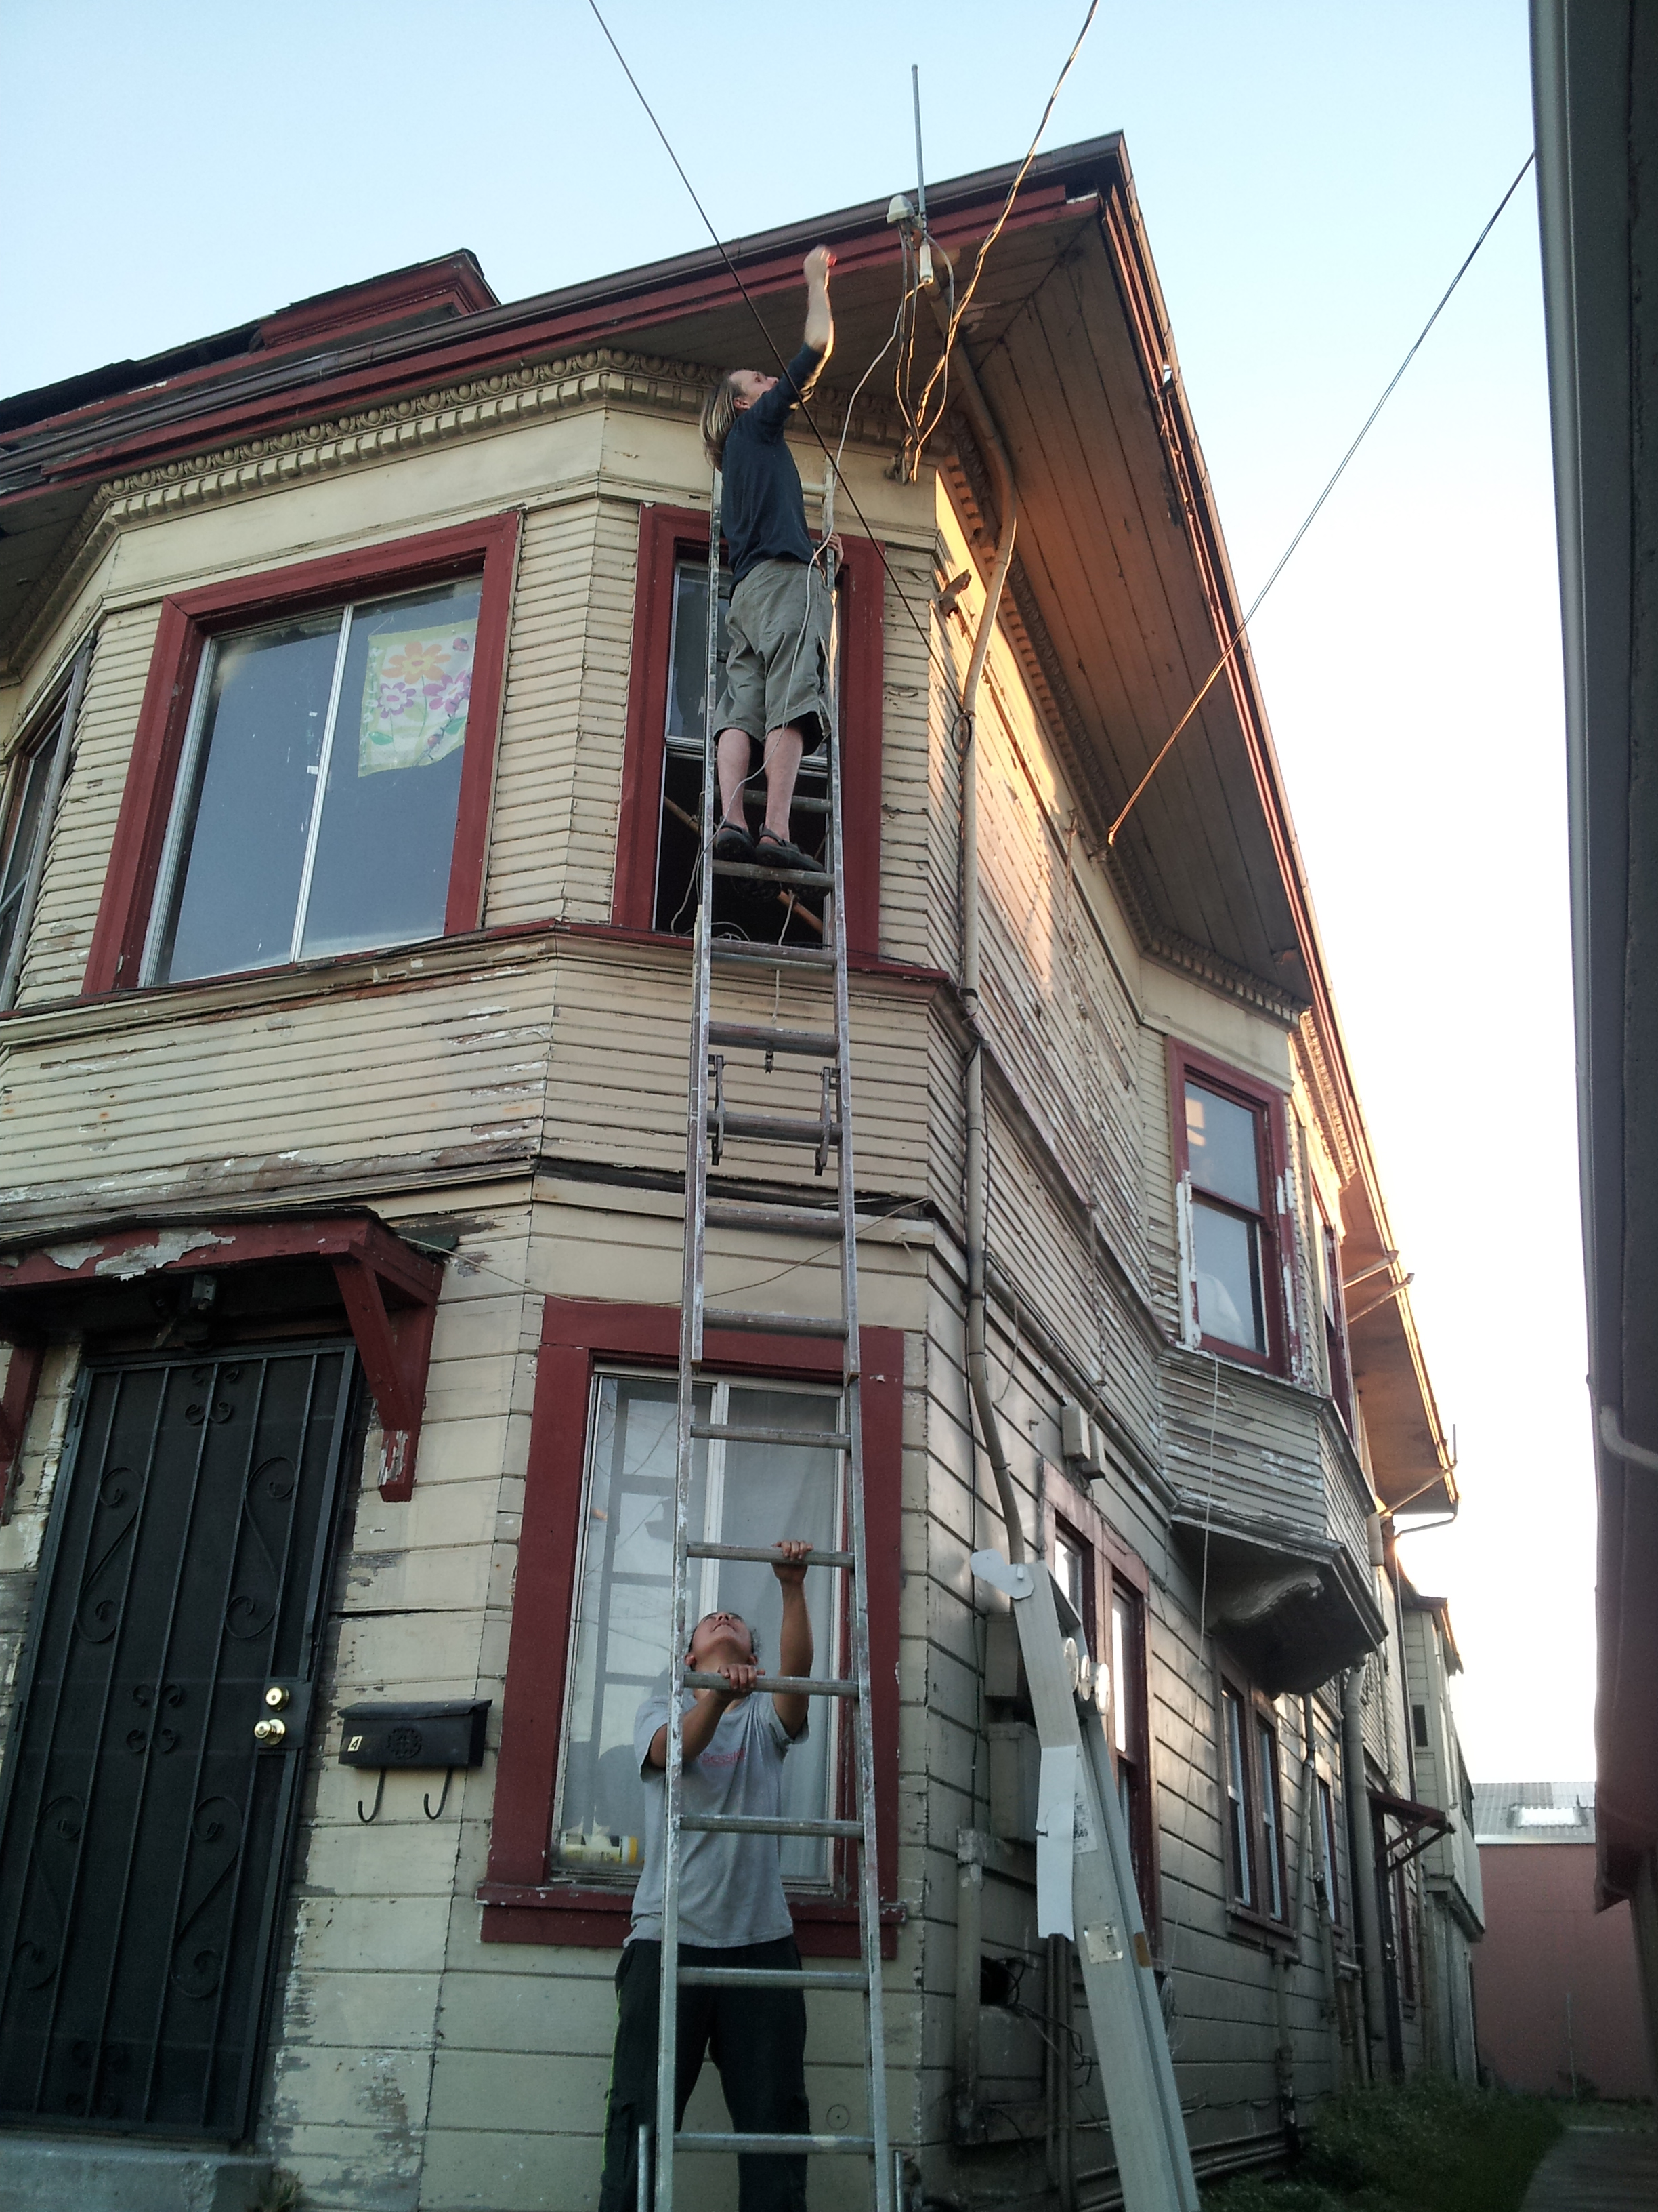
mounting a rooftop node in Oakland

Slide 24
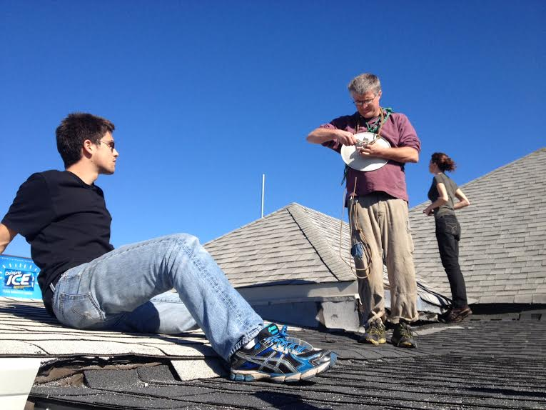

Slide 25
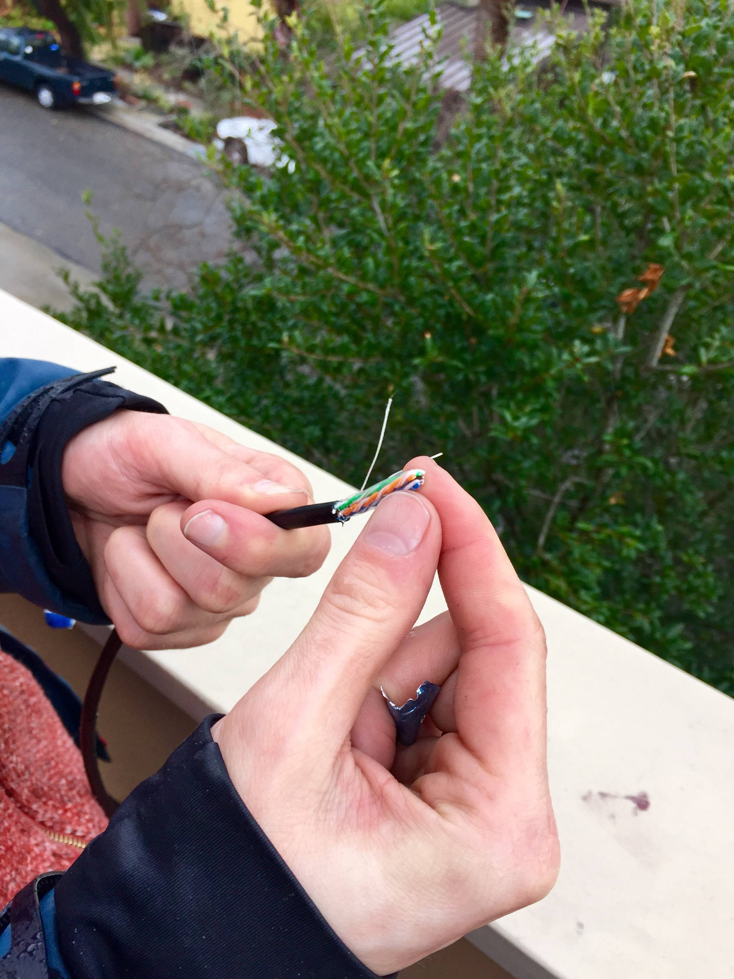

Slide 26
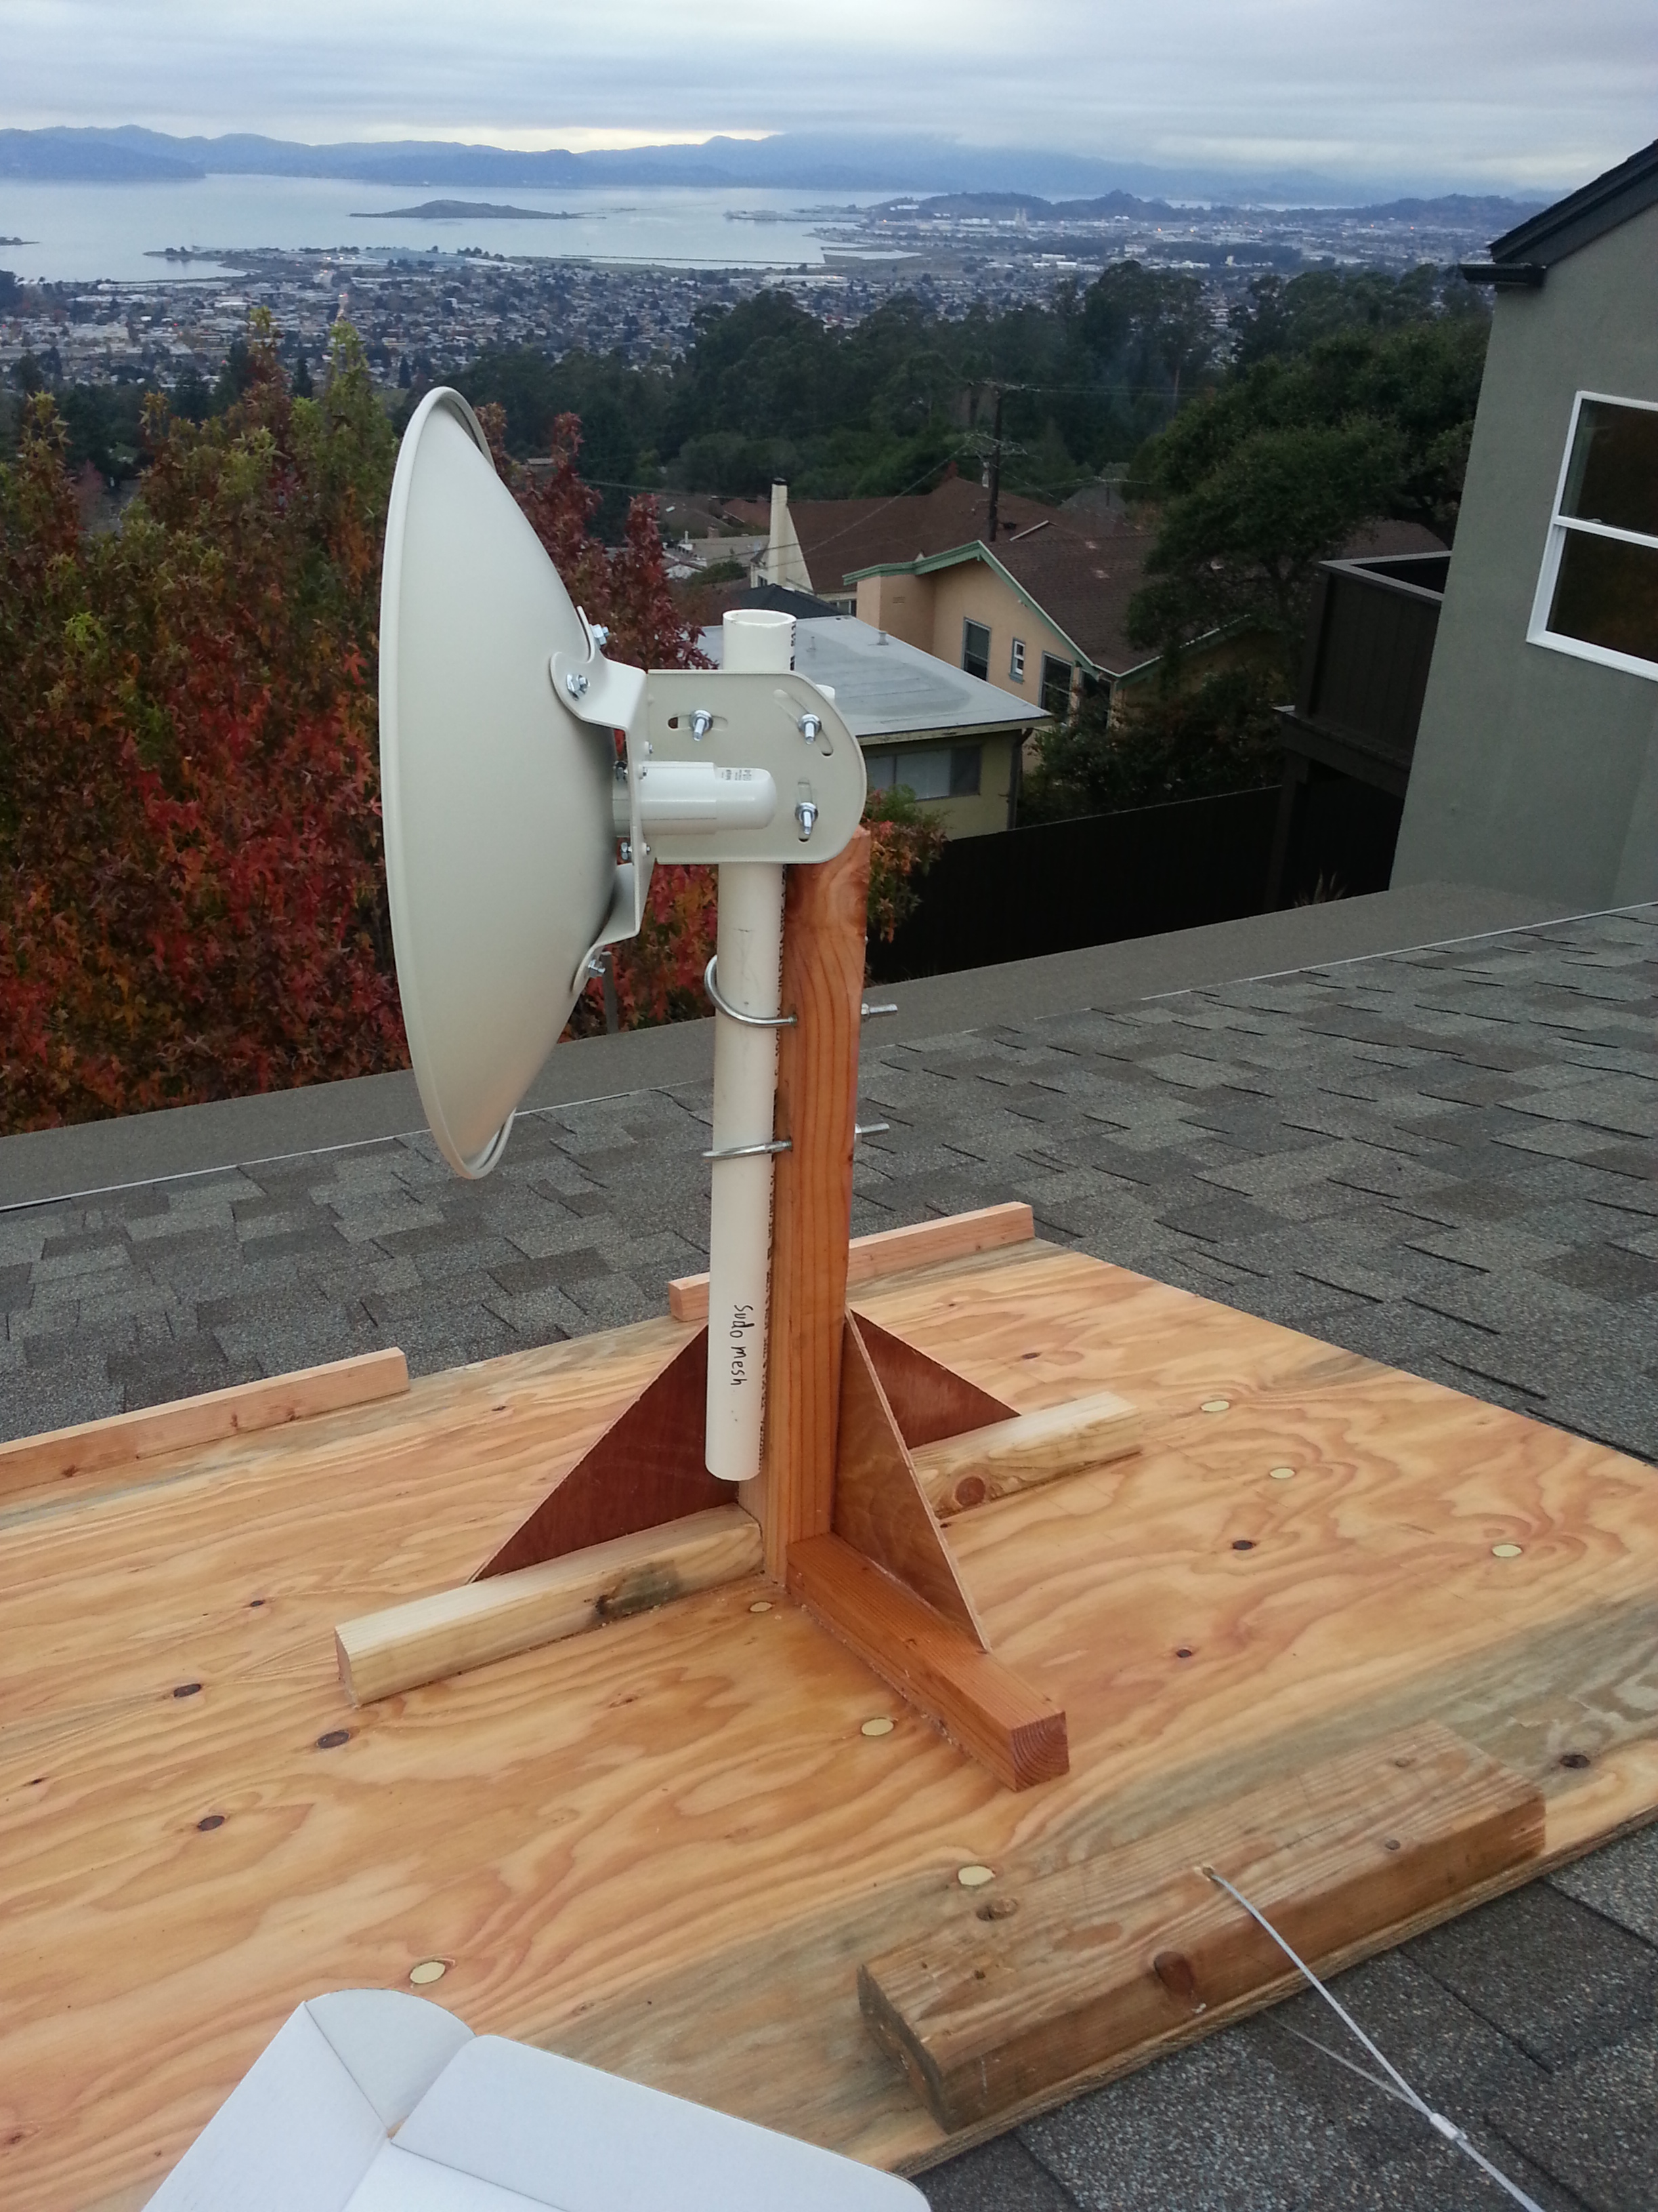

Slide 27
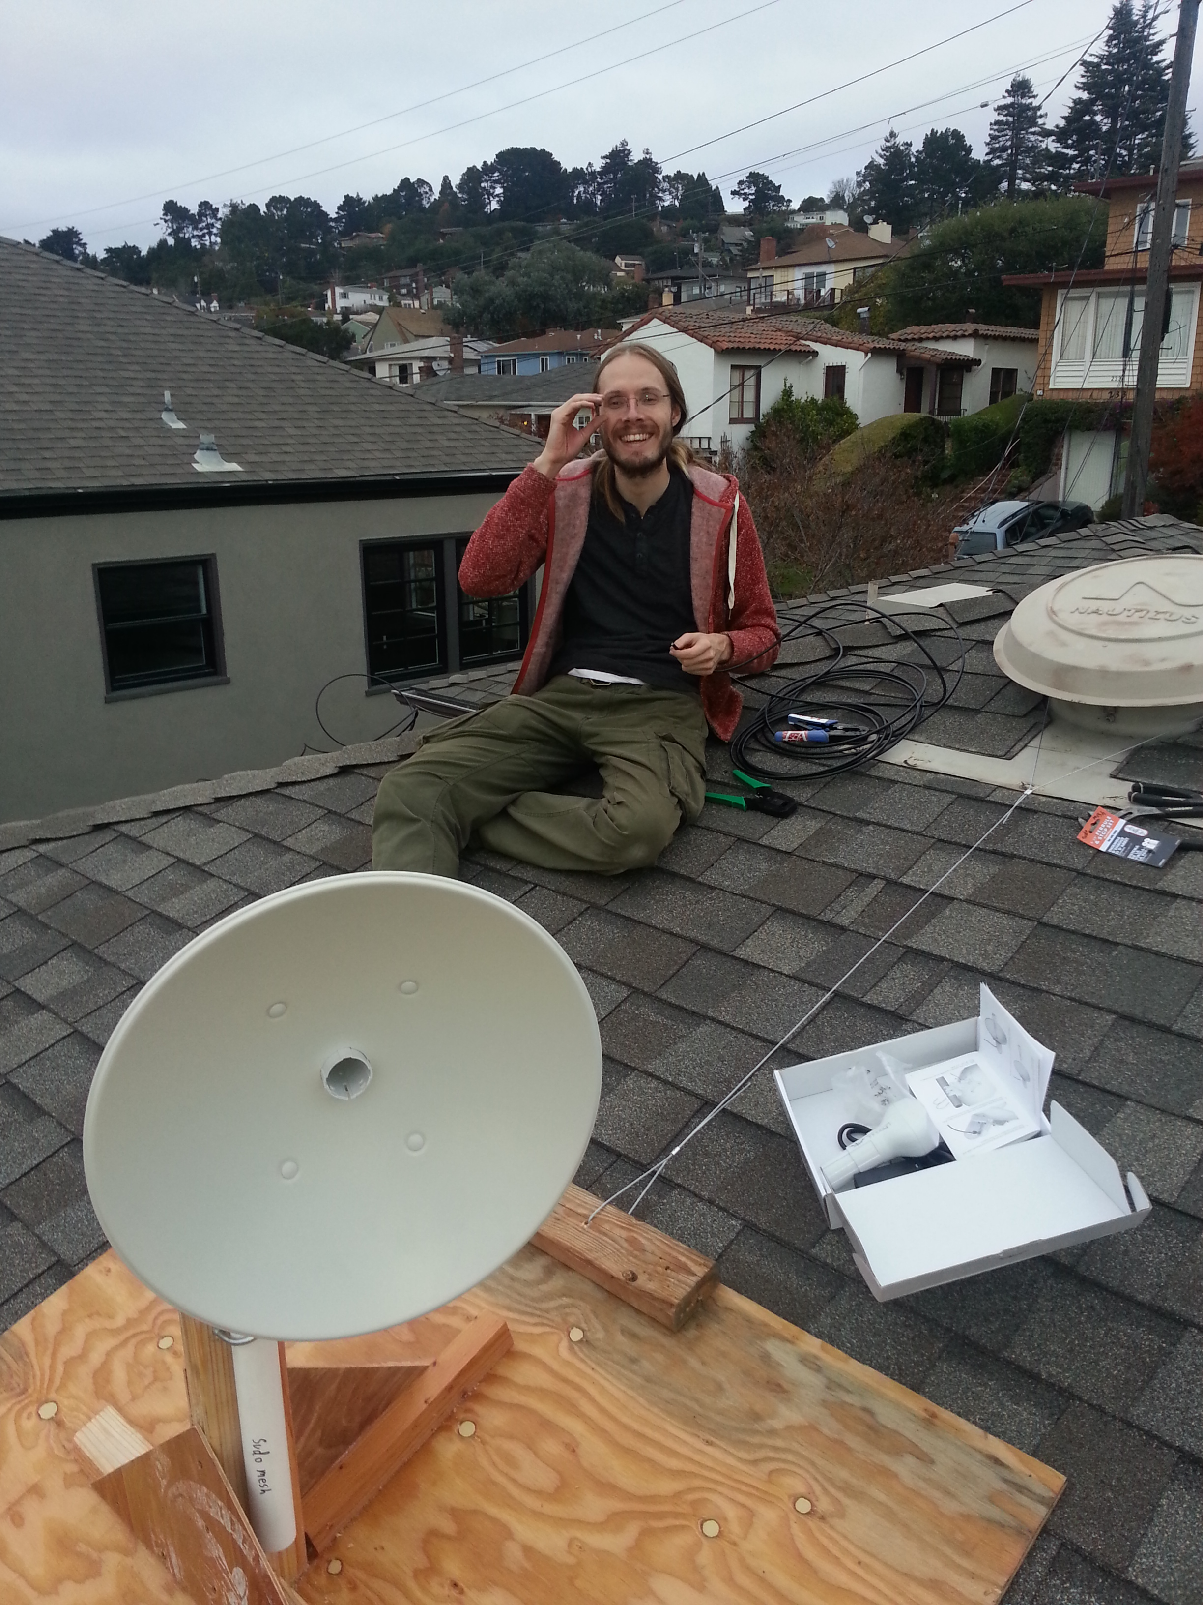

Slide 28
Bootstrapping a mesh
Problems with bootstrapping
  Few nodes == no mesh
  No mesh == no incentive to join
  Rooftop mounting is intimidating / more expensive
Solutions
  Make nodes connect to mesh via internet (tunnel)
  Nodes provide safe internet sharing
  Provide cheap indoor routers to get people's feet wet
  Nodes provide extra private access point for owners

Slide 29
Safer internet sharing
User-selectable automatic bandwidth limiting
  Share up to a limited portion
  Still use 100% when no-one else is using bandwidth
  Still share 100% when you aren't using using bandwidth
All traffic from mesh is VPN'ed
  VPN server owned by shell non-profit
  Abuse complaints received by shell non-profit
  No logs: “Sorry we can't tell you who pirated this movie”

Slide 30
Every node has three wifi networks
Mesh wifi network
  Node-to-node connectivity.
Public wifi network
  Connectivity for normal phone/laptop devices
Private wifi network
  Password protected. Node owner sets password
  Isolated from public/mesh networks
  Unlimited access to own Internet connection (if present)
  Buying a new wifi access point? Why not mesh?

Slide 31
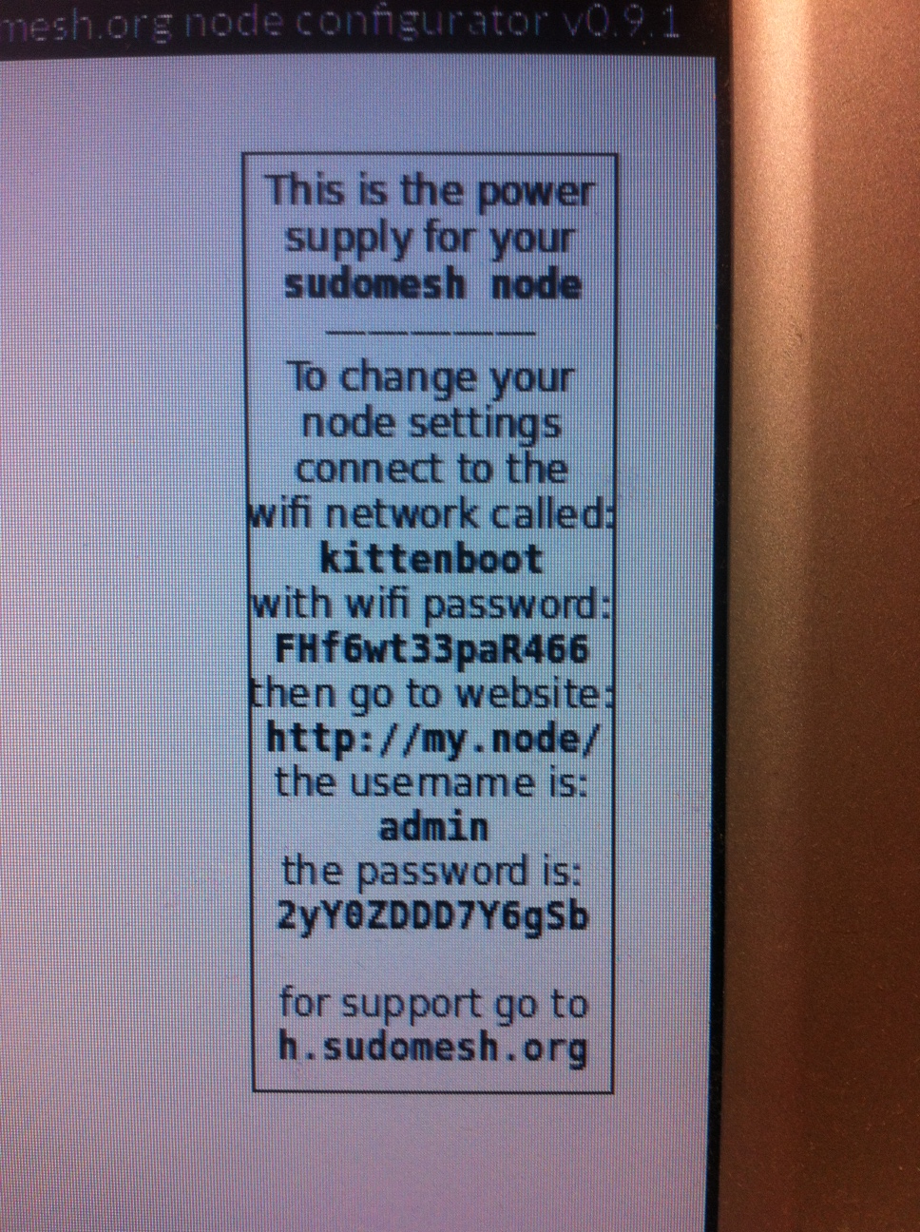
Logistics
Make it easy to buy pre-configured nodes
  User provides initial bandwidth limits, private wifi password, etc.
Automated flashing / configuration of nodes
Automated printing of:
  “How to care for your node” guide
  Sticker with password and support info
Inventory / fulfillment infrastructure

Slide 32
Limiting centralization
Network is separate from mesh organization
  Mesh Network: peoplesopen.net
  Mesh Organization: sudo mesh
Joining network only requires agreeing to the Nearly Free Network License
Make mesh organization fork()'able
  Document EVERYTHING!
  Open source everything.
    Website. Wiki. Legal documents. Software. Firmware.
  Make it easy to fork and rebrand.
  Encourage forking for geographic expansion

Slide 33
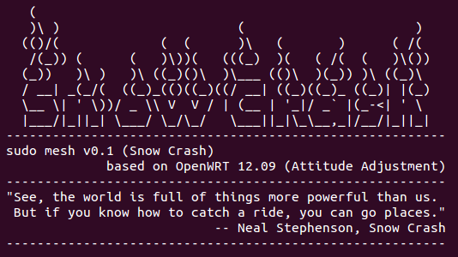
Free and Open Source

Slide 34
FCC Lockdown?!
There's a current FCC proposal to lock down wireless routers by requiring vendors to “ensure that only properly authenticated software is loaded and operating the device.” This has huge implications for community networks in the US, with similar rules being discussed for the EU and Canada.
While the proposal has been on the table since early 2014, it has only recently come to the attention of the hacker community - thanks in large part to a presentation and discussion that took place last month at BattleMesh v8 (an annual conference/competition testing open source wireless mesh networking protocols).
Submit public comments to the FCC by October 9th!

Slide 35
Get involved!
Join!
Join a local mesh network!
Ask your local hackerspace:
https://hackerspaces.org
Initiate!
Start a local mesh network!
Talk to us: info@sudomesh.org
Events
Battlemesh
(spring equinox, Oakland, ca)
Int'l Summit for Community Wireless Networks

Slide 36


