Slide 1
DisasterRadio
A low-bandwidth wireless mesh

Slide 2
WiFi mesh networks
Pros
  High bandwidth
  IP transport
Cons
  Short range or
  Require directional antennas, rooftop mounting, runnning cable
    Most nodes are short range

Slide 3
How do we solve rooftop mounting?

Slide 4
Solutions?
Running cables is problematic
  Run all nodes on solar + battery so they won't need power
  Relay to separete router inside of building
Mounting and aiming is problematic
  Remotely aimable antennas?
    Phased array? Many directional antennas + antenna switcher?
  Use drones to lift node onto roof?
    How do we prevent them from blowing away in strong winds?
      Weigh them down with water? Self-filling rain water container? Only deploy during strong rains?

Slide 5
Minimal useful implementation?

Slide 6
Minimal useful implementation
Entirely solar powered
No cables
No mounting
No aiming
Some amount of bandwidth
At least one useful application
  Chat? Microblogging?

Slide 7
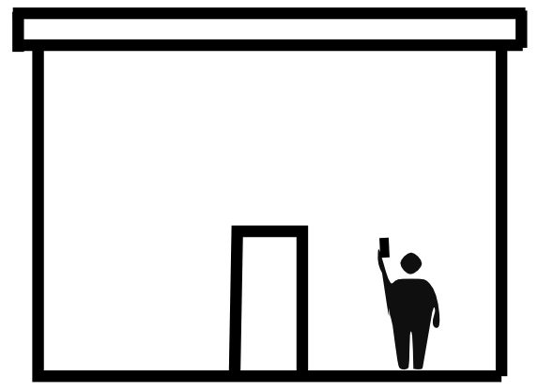
DisasterRadio node version 0

Slide 8
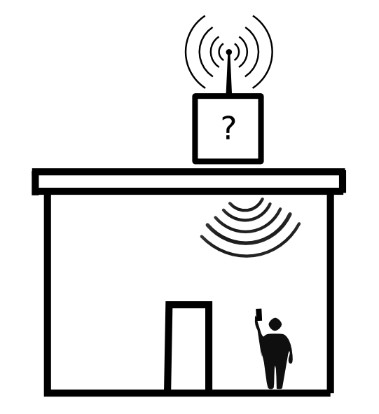
DisasterRadio node version 0

Slide 9
Low-bandwidth FSK/CSS radios
Pros
  Long range, even without directional antennas
  Very low power
  Cheap
Cons
  Very low bandwidth
  Very small packet size (usually smaller than min IPv6 packet)
  Not suitable as IP transport
  (usually) no built-in channel sharing mechanism (no TDMA, CSMA, etc)
    Low frequency utilization
Antenna: High gain „omni“-directional (flattened donut radiatation pattern)

Slide 10
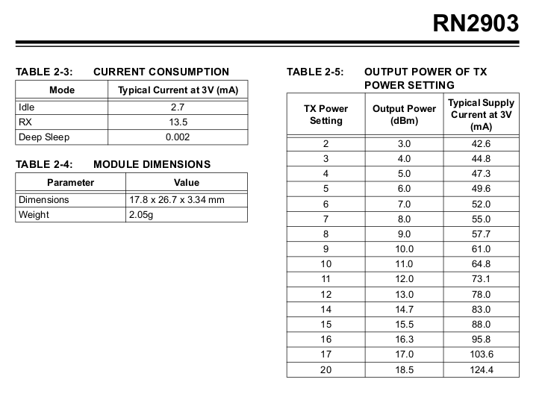
0.041 W
0.373 W
RN2903 is LoRaWAN but layer 2 can be disabled

Slide 11
Stated range (RN2903)
> 15 km in suburban settings
> 2 km in dense urban environements
  https://www.digikey.com/en/articles/techzone/2016/nov/lorawan-part-1-15-km-wireless-10-year-battery-life-iot
> 3 miles (4.8 km) in urban environments
  Microchip (manufacturer)
Easy to cover large areas!

Slide 12
Processor and WiFi
ESP8266 / ESP32
  Low cost
  Large community
  Integrated WiFi
Downward-pointing high gain panel
  Cheap (on-PCB design possible)
  Suitable directionality for covering inside of house/apartment

Slide 13
Solar + battery
Solar
  3-4 watt
  5-6 volt
Battery
  Single 18650 li-ion cell
Needs MPPT solar charge and battery controller
  10% to 90% charging to increase battery lifetime
  Temperature monitoring
  Elektra's design modified for low power?
  AdaFruit's design: https://www.adafruit.com/product/390

Slide 14
First prototype
100% off-the-shelf components
  Minimal soldering
  Inefficient
  Short life
  Possibly unsafe

Slide 15
What can it do?
Probably no IP
  Tiny packets can't do IPv6
  Small amount of total network bandwidth: Easy to saturate network
Small twitter-sized sized messages
  ~160 bytes (after header, checksum, signature)
Apps
  Chat and microbloggin
  Community mapping (like Tidepools) with local vector maps

Slide 16
Software
Using NodeMCU (lua) for rapid prototyping
  Issues with memory leaks
  Not yet ready for ESP32
Integrated
  DHCP server
  DNS server
  Web server
    Serving up chat app
  Telnet lua console for development

Slide 17
Meshing
v0
  Flooding only: Every node gets every message
  Off-the-shelf components
v1
  Nodes subscribe to feeds and publish messages to feeds
  Custom PCB with on-board WiFi panel antenna

Slide 18
ToDo
Hardware
  Evaluate radio transceivers
    RN2903
    RFM95W
    DRF1276G
  Evaluate solar battery charge systems
  Evaluate ESP32 as alternative
Software
  Fix memory leak issue
  Add WebSocket support

Slide 19
Thank you

