Slide 1
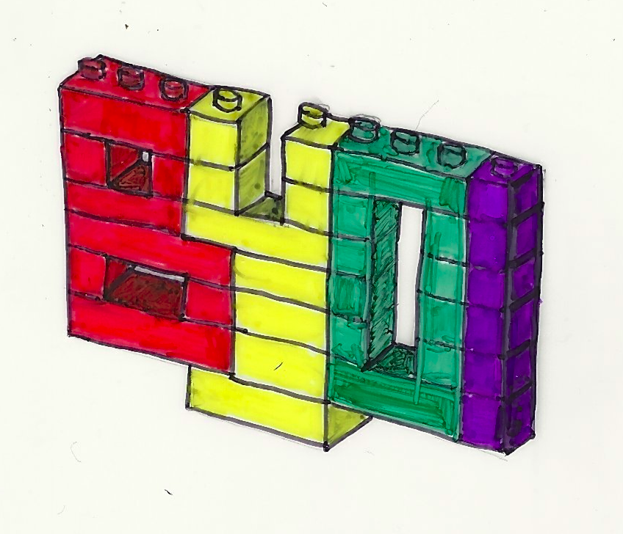
BYOI by Bullitt D. Bourbon licensed under CC BY-NC-SA 2.0
Build Your Own Internet Workshop
July 1st, 2017

Slide 2
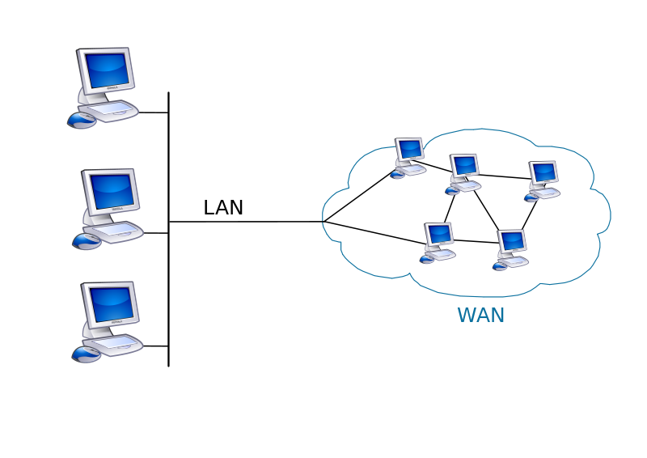

Current Network Infrastructure
the Internet
your
home
Corporate
Internet
Service
Provider
Notes:
This is the current old fashioned structure of the internet

Slide 3
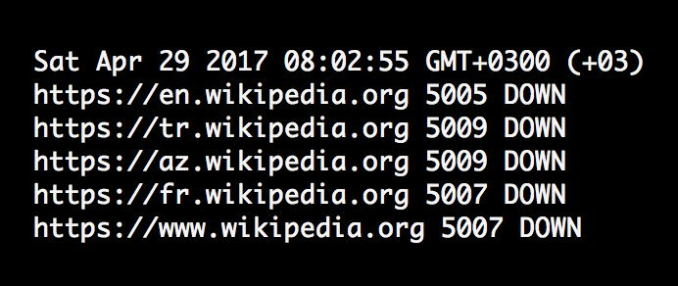
Notes:
Disaster scenarios Protest situations State censorship Privacy
Obvious disaster scenarios
people posting to social media had to travel 10 miles to the Prairie Knights Casino to get online
Microwave backhaul, distributed with ubiquiti equipment
Wikipedia shutdown in turkey due to articles discussing their questionable election results
Of course if you think it can’t happen here look at the recent roll back on net neutrality by the FCC
Less corporate/government oversight
But these are all reactionary

Slide 4



How to get involved!
Volunteer to host a node on https://peoplesopen.net/
Hack on some code with https://github.com/sudomesh
Visit our weekly meeting, Tuesday 7:30pm

Slide 5
Current Network Infrastructure
Notes:
This is the current old fashioned structure of the internet

Slide 6
Current Network Infrastructure
your
home
Notes:
This is the current old fashioned structure of the internet

Slide 7
Current Network Infrastructure
your
home
Notes:
This is the current old fashioned structure of the internet

Slide 8
Current Network Infrastructure
the Internet
your
home
Notes:
This is the current old fashioned structure of the internet

Slide 9
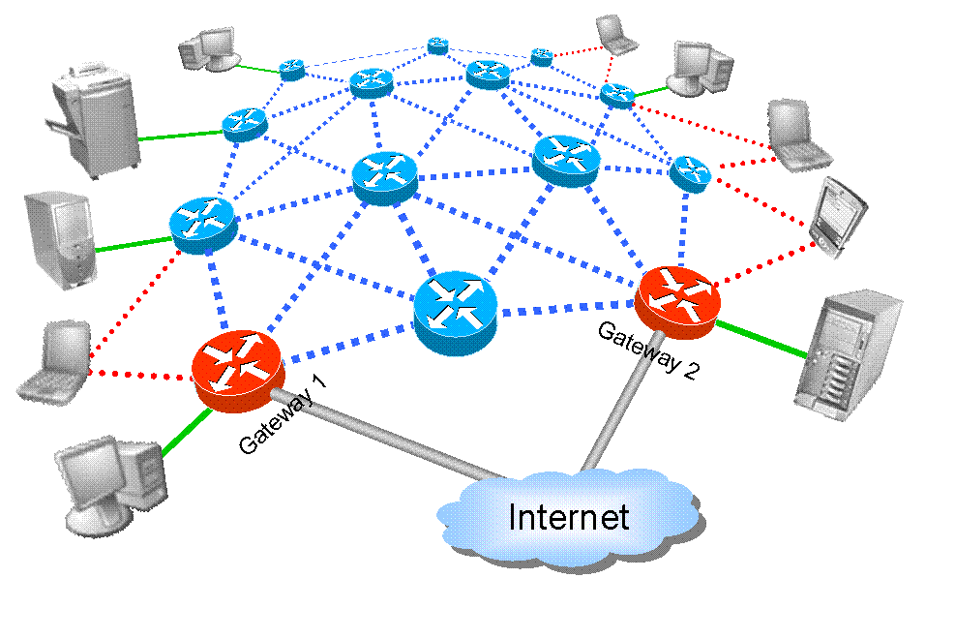
Future Network Infrastructure
MAN
LAN
WAN

Slide 10
Future Network Infrastructure
the MAN (mesh area network)
LAN
WAN

Slide 11
Future Network Infrastructure
the MAN (mesh area network)
LAN
WAN

Slide 12
Future Network Infrastructure
the MAN (mesh area network)
LAN
you
WAN

Slide 13
Future Network Infrastructure
the MAN (mesh area network)
your
neighbor
LAN
you
WAN

Slide 14
Future Network Infrastructure
the MAN (mesh area network)
Dave
Jane
Jim
Chris
Pat
Bob
your
neighbor
LAN
Alice
you
WAN

Slide 15
Future Network Infrastructure
the MAN (mesh area network)
Dave
Jane
Jim
Chris
Pat
Bob
your
neighbor
LAN
Alice
you
Less-evil
Still-corporate
ISP #2
Less-evil
Still-corporate
ISP #1
WAN

Slide 16
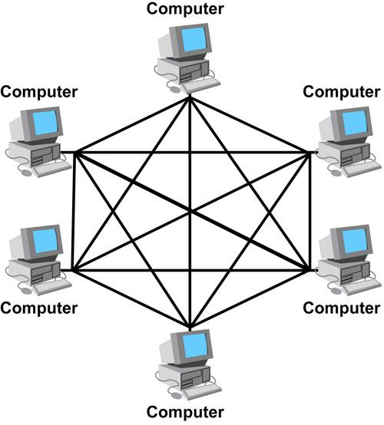
What does this do?
More resilient network
More control by users
Open access to information
Free as in freedom
(not sure about this slide either?)
Notes:
More points of failure
More controlled by users less by centralized authority
Comment on open vs. free

Slide 17
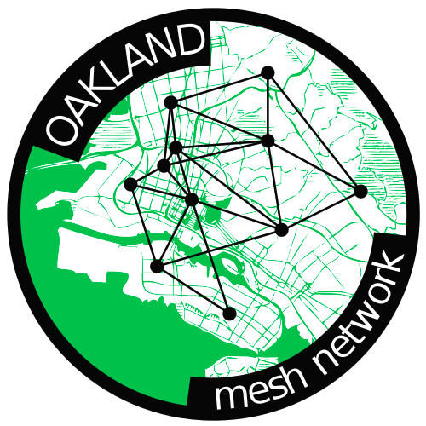
Why does this matter?
Revive, empower the local communities
Educational opportunity
Prevent corporations from extracting value from communities
Demonstrate the existence of an alternative
Notes:
(wealth, resources, jobs) More local copies More local services that can’t be throttled Direct connection to immediate resources.
Be careful here
Teach people about how the internet works, and how it could work for them. Rather than just black boxing it or clouding it

Slide 18
What does the PeoplesOpen Network do?
Current reality:
most nodes “meshing” over VPuN (Virtual Public Network)
one gateway to the internet
Future goals:
most nodes meshing over wireless
multiple gateways to the internet

Slide 19
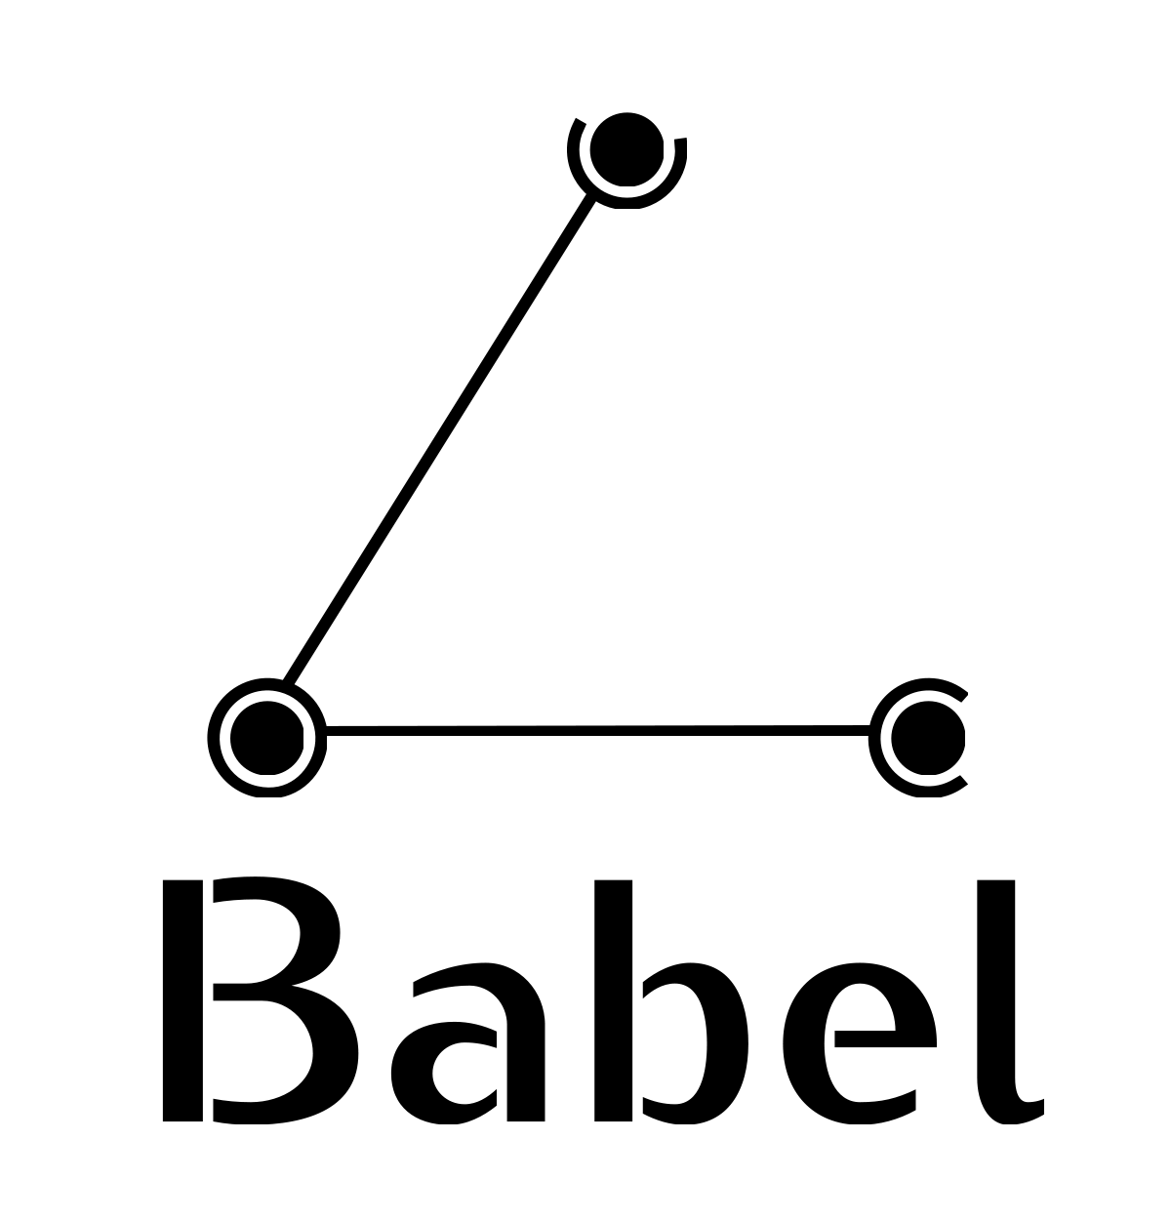
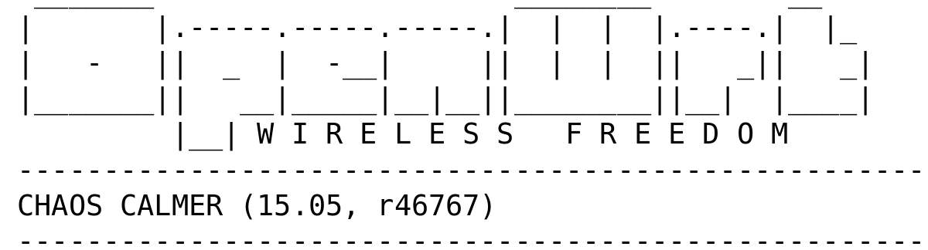
How do we do this?
Open source software:
Routing protocol (Babeld)
Custom firmware (OpenWrt)
Get on people’s roofs and mount antennas!

Slide 20
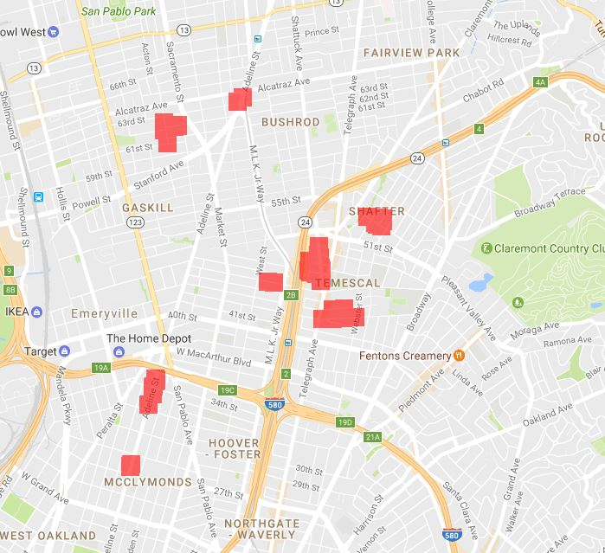

Slide 21
Ongoing projects
Mesh services needed!
Static webpage backups? Local commodity exchange? weather reporting?
Firmware improvements
Pushing patches/updates to nodes, automated setup of new nodes
Community outreach
Temescal, West Oakland, businesses and residents
Notes:
Do-cracy vs ideology
Even if internet connection is down, still able to access services hosted on the mesh
I’ve been working with the firmware, me and sierk, splash page
We also have hardware projects

