Slide 1
Build Your
Own
Internet

Slide 3
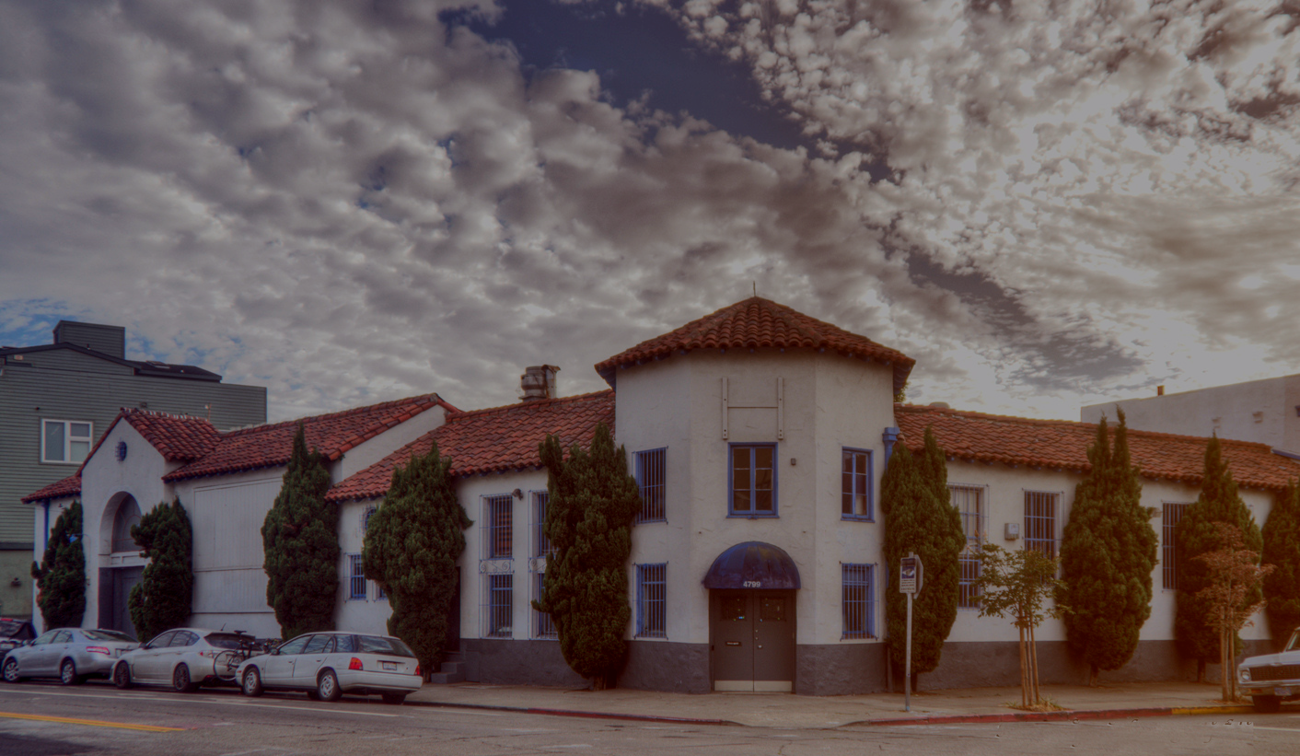

Slide 4
Omni Commons /
omnicommons.org
4799 Shattuck Ave
Oakland, CA

Slide 5
Omni Commons /
omnicommons.org
4799 Shattuck Ave
Oakland, CA
Sudo Room /
sudoroom.org

Slide 6
Omni Commons /
omnicommons.org
4799 Shattuck Ave
Oakland, CA
Sudo Room /
sudoroom.org
Sudo Mesh /
sudomesh.org

Slide 7
Omni Commons /
omnicommons.org
4799 Shattuck Ave
Oakland, CA
Sudo Room /
sudoroom.org
Sudo Mesh /
sudomesh.org
People’s Open Network
peoplesopen.net

Slide 8
Omni Commons /
omnicommons.org
4799 Shattuck Ave
Oakland, CA
Sudo Room /
sudoroom.org
Sudo Mesh /
sudomesh.org
Disaster Radio
disaster.radio

Slide 9
Omni Commons /
omnicommons.org
4799 Shattuck Ave
Oakland, CA
Sudo Room /
sudoroom.org
Sudo Mesh /
sudomesh.org
Build Your Own Internet
buildyourowninter.net

Slide 10
Omni Commons /
omnicommons.org
4799 Shattuck Ave
Oakland, CA
Sudo Room /
sudoroom.org
Sudo Mesh /
sudomesh.org
People’s Open Network
peoplesopen.net
Disaster Radio
disaster.radio
Build Your Own Internet
buildyourowninter.net

Slide 12
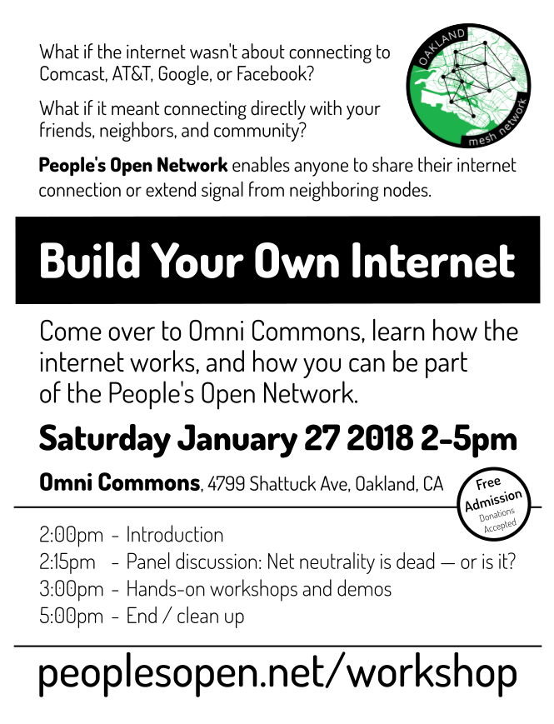
Interested to learn more and get involved?
Join for
Tues 7.30p meetings at Omni or upcoming workshop.

