Slide 1

ClipRefine
ClipRefine is a smart clipboard manager
that automatically refines copied text
based on your custom rules.

Slide 2
Key Features
Custom Text Replacement Rules
Create rules to automatically transform copied text.
Global Toggle
Enable or disable all rules with one click from the popup.
Toast Notifications
See visual confirmation when text is refined.

Slide 3

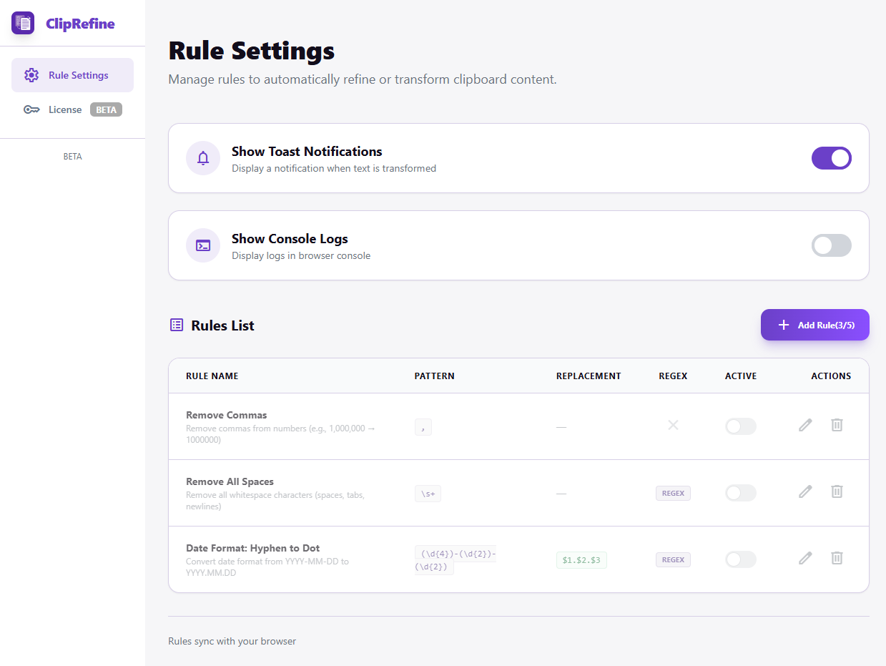
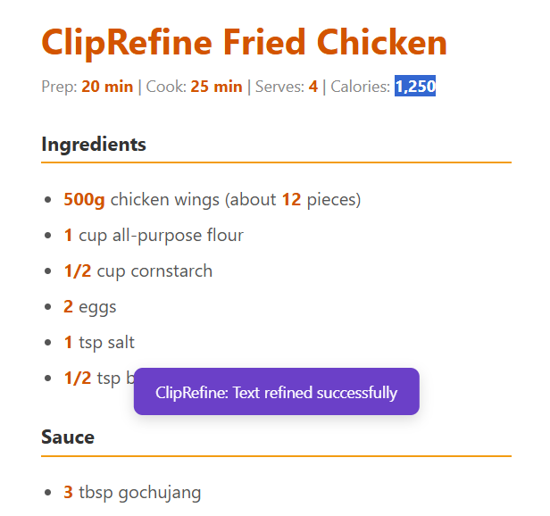
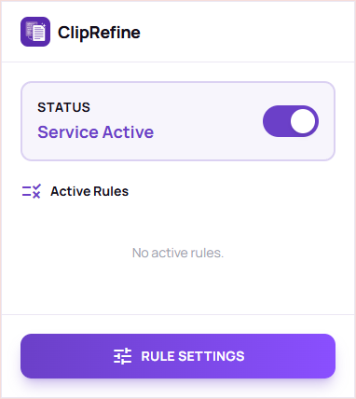
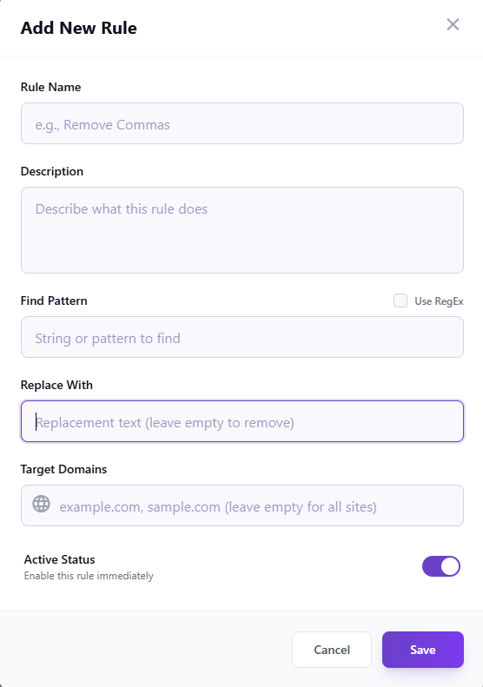
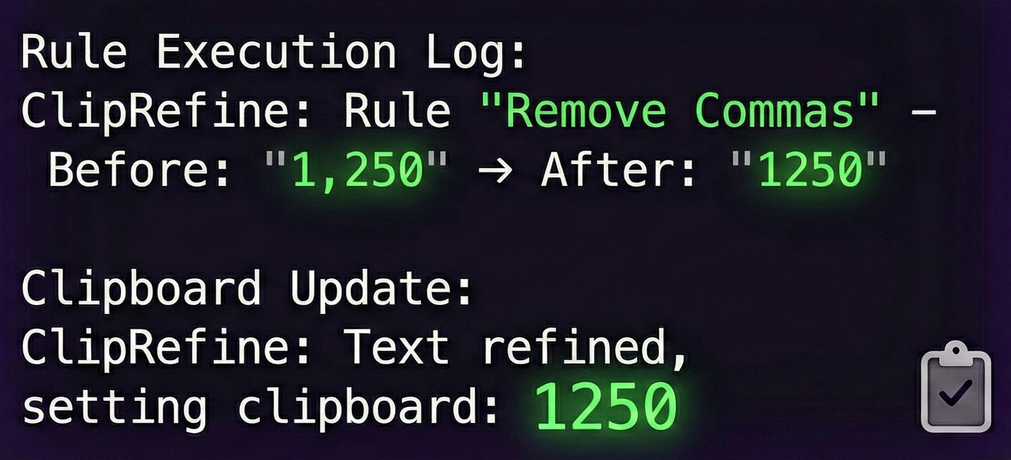
How to Use
Step 1: Open Settings
Click the ClipRefine icon in your browser toolbar, then click Rule Settings.
Step 2: Create a New Rule
Click Add Rule button to create your first rule.
Step 3: Copy Text
ClipRefine automatically applies your rules whenever you copy text

