Slide 1


SMART INDIA HACKATHON 2026
TITLE PAGE
• Problem Statement ID – 26106
• Problem Statement Title – AI-Powered Email Threat
Detection,
Geolocation and Forensic Intelligence
Platform
• Theme – Blockchain & Cybersecurity
• PS Category – Software
• Team ID – [enter portal ID]
• Team Name – Cyber Squad
CYBER SQUAD

Slide 2
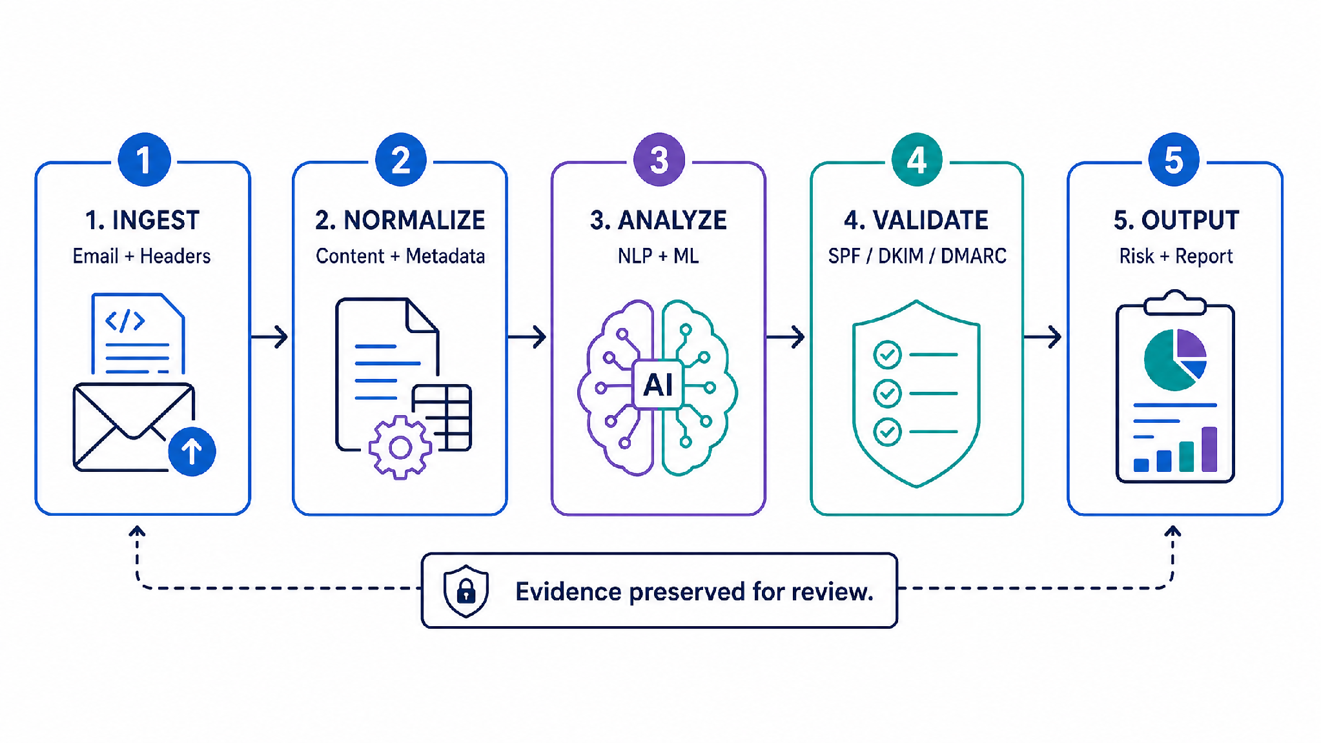
PROPOSED SOLUTION
CYBER SQUAD
Connect email evidence, AI detection and analyst action.
ONE PLATFORM • ONE WORKFLOW
Detection + traceability + response in one view.
The platform targets BEC patterns such as executive impersonation, invoice diversion, thread hijacking, credential phishing and sensitive-data requests. It combines email-content analysis, header forensics, SPF/DKIM/DMARC validation, IP/DNS/geolocation enrichment and graph correlation to produce an explainable risk score and structured forensic report.
OUTPUTS
Email evidence → AI analysis → risk + report
Explainable alerts • risk scores • origin-confidence estimates
Visual trace maps • structured forensic reports
CHAIN OF CUSTODY
SHA-256 hash generated at ingestion
Original email hash → Immutable Ledger
WHY IT IS DIFFERENT
BLOCKCHAIN-SECURED AUDIT TRAIL
Explainable BEC detection with tamper-proof, court-admissible forensic reporting.

Slide 3
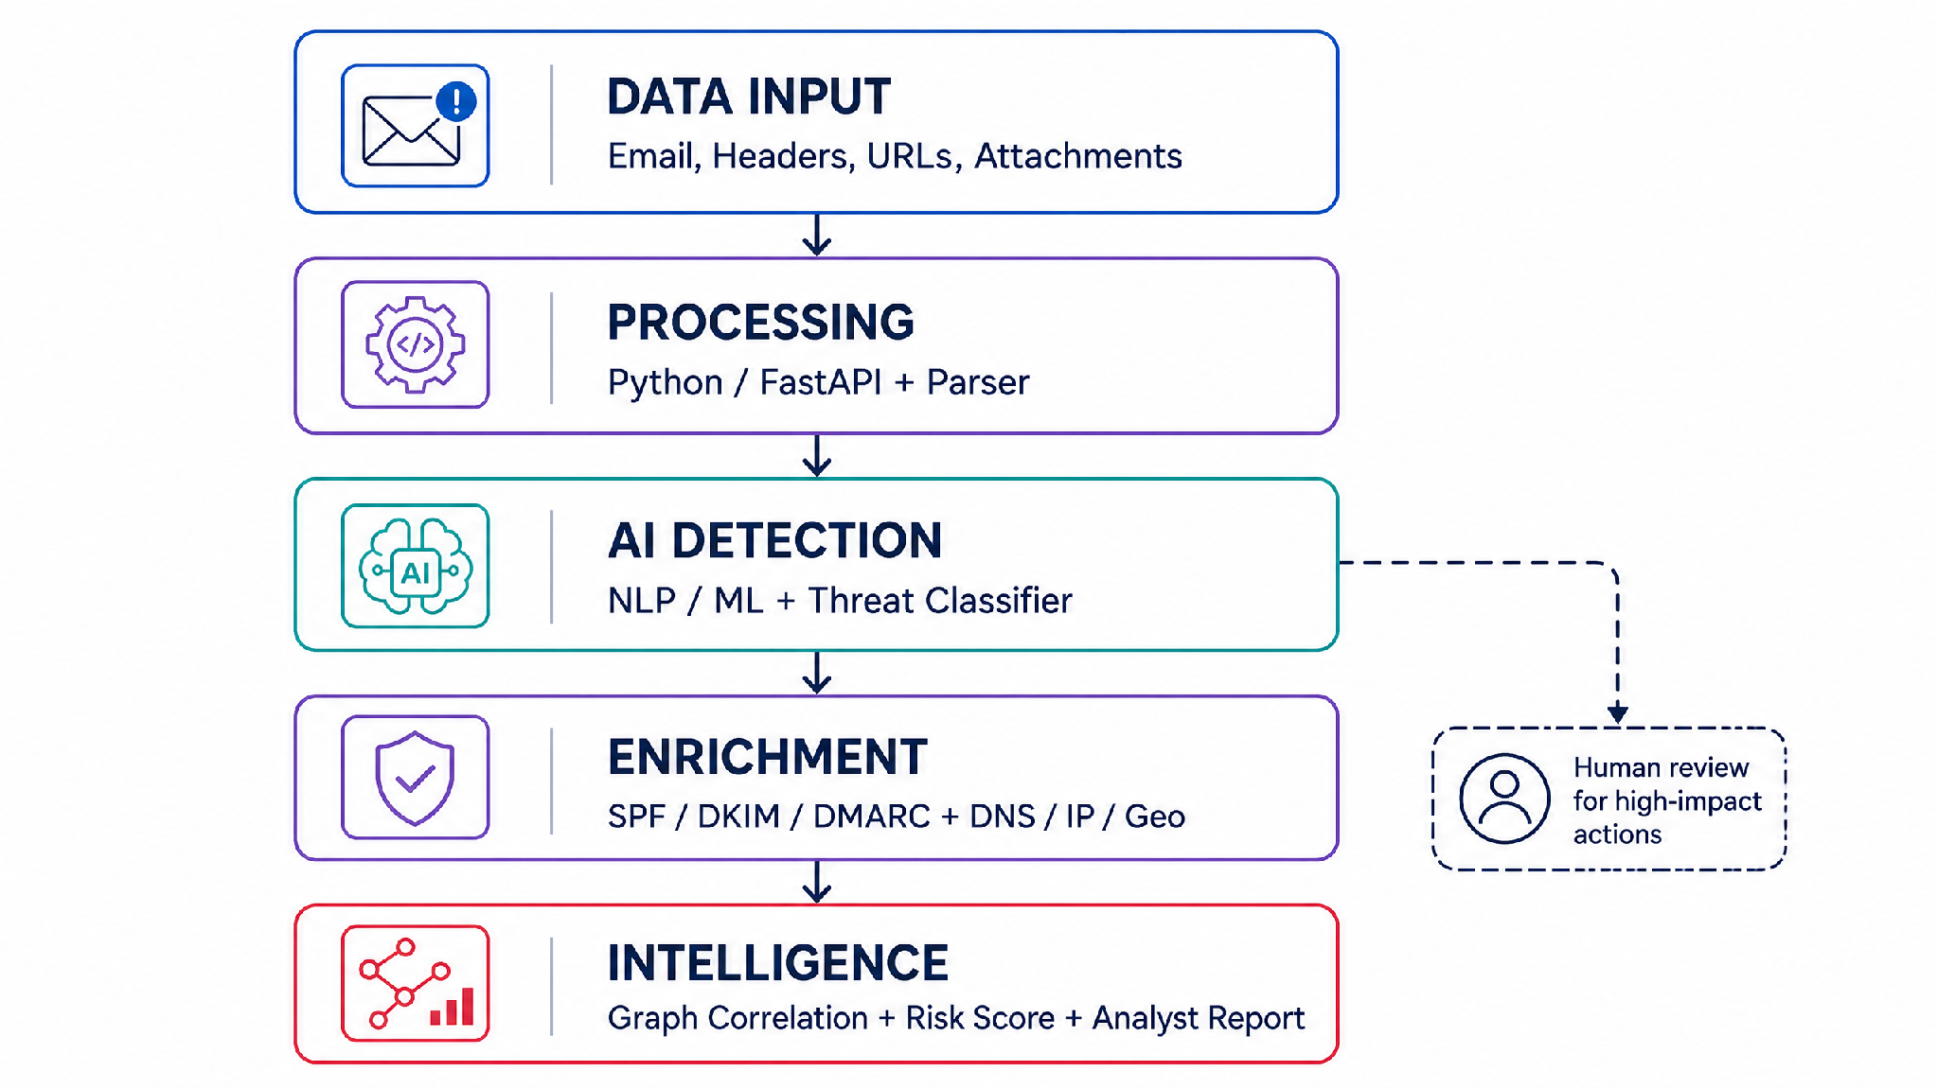









TECHNICAL APPROACH
CYBER SQUAD
A layered pipeline turns raw messages into a reviewable case.
Data Ingestion
Data Processing
Threat Detection
Data Enrichment
Threat
Intelligence
IMPLEMENTATION
Python/FastAPI services ingest and normalize email artifacts, including .eml and .msg files, headers, links, and attachments.
NLP/ML models classify intent regarding phishing, impersonation, urgency, payment diversion, thread hijacking, and data exfiltration.
Protocol validation (SPF, DKIM, DMARC) and infrastructure/campaign context enrichment via IP/DNS/geolocation and graph correlation.
AI DETECTION
NLP/ML (BERT-based) + MITRE ATT&CK T1566 mapping
Risk Score → Graph Correlation (Neo4j) → Forensic Report
TOOLS USED

Slide 4
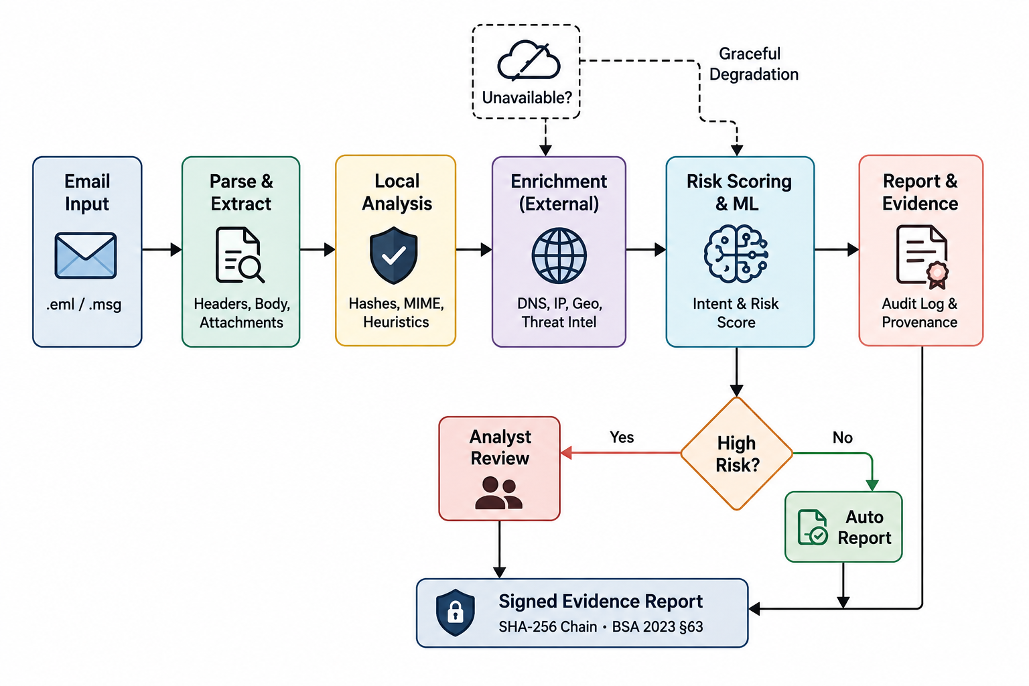
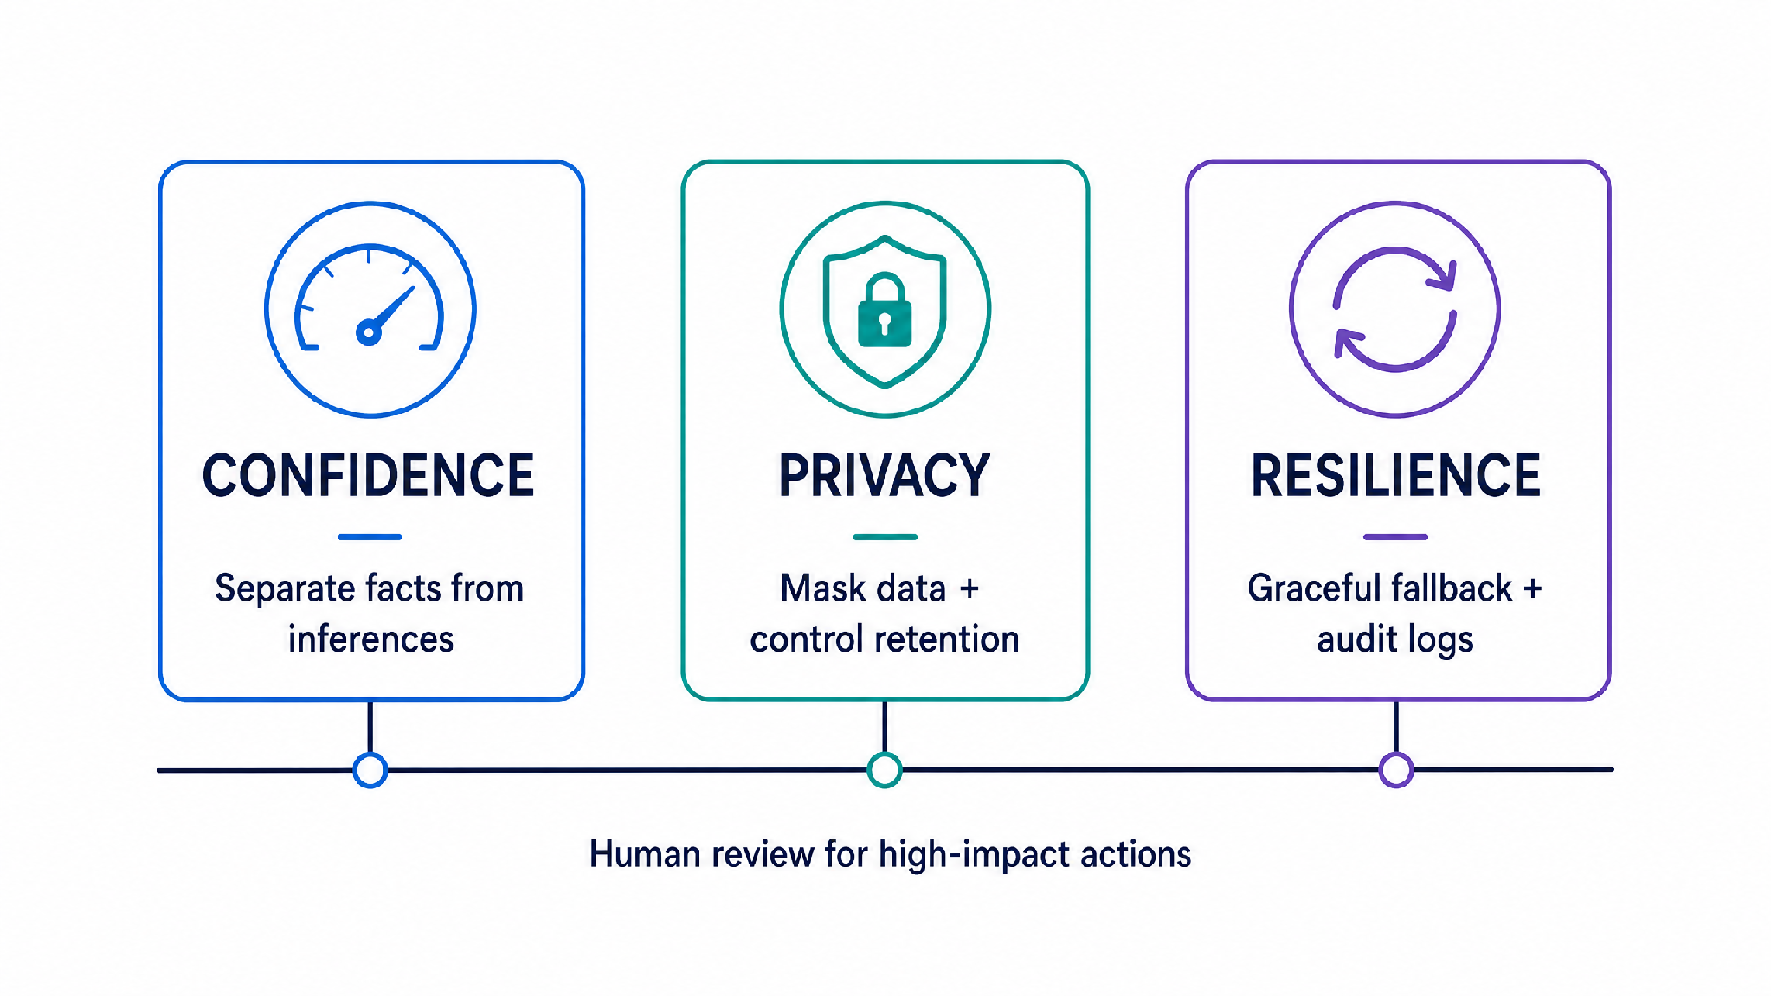
FEASIBILITY & VIABILITY
CYBER SQUAD
Feasibility depends on standard components, controls and human review.
WHY THE MVP IS FEASIBLE
RISKS & CONTROLS
Separate observed facts from inferences and show evidence provenance.
Mask sensitive data; enforce retention, access control and audit logs.
Degrade gracefully when headers are incomplete or enrichment is unavailable.
Keep high-impact actions reviewable by a security analyst.
Feasibility depends on standard components, controls and human review.
COMPLIANCE • NIST SP 800-61 + IT Act

Slide 5
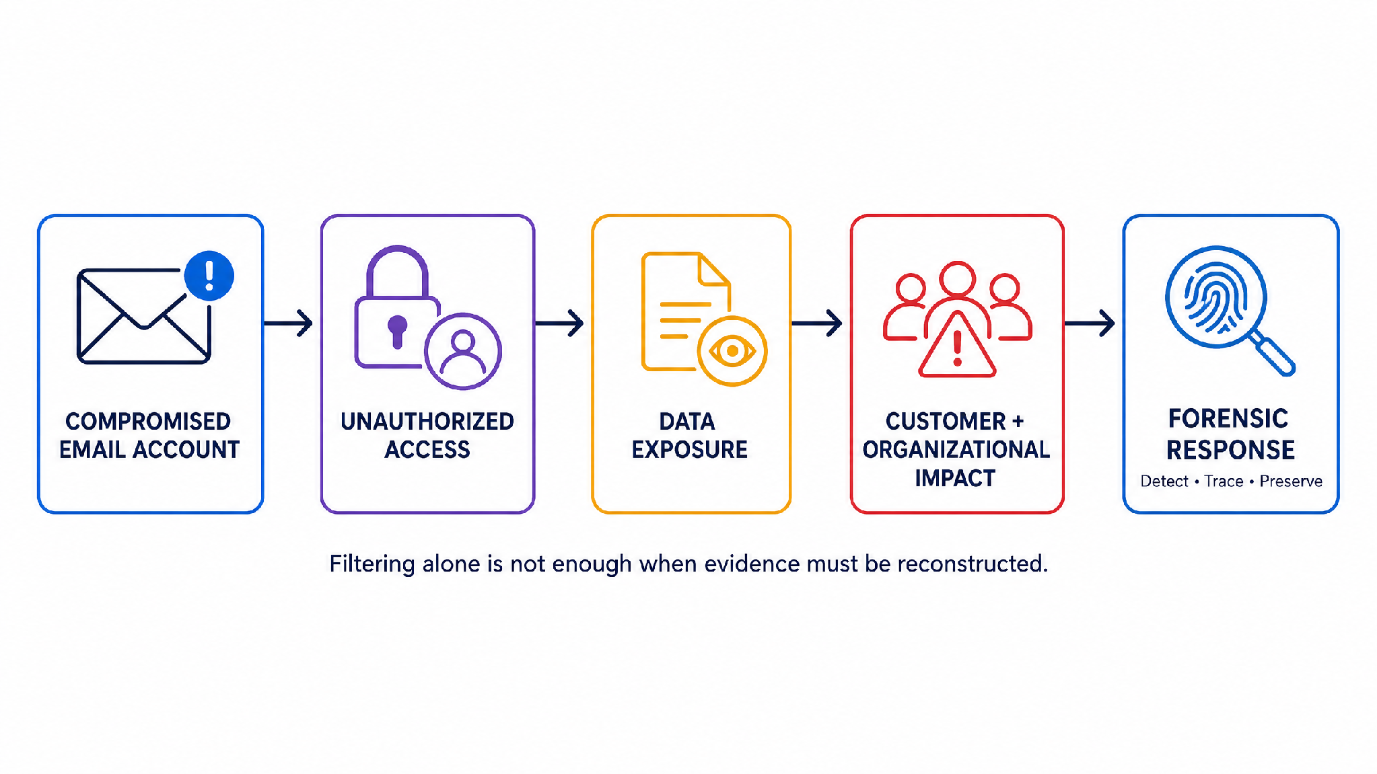
IMPACT & BENEFITS
CYBER SQUAD
Earlier signals reduce uncertainty and strengthen response.
WHO BENEFITS
CASE CONTEXT • JULY 2026
Earlier warning, clearer decisions, stronger evidence.
Security analysts gain explainable alerts, trace paths and campaign context.
Administrators can prioritize high-risk messages before user interaction.
Fraud-response and law-enforcement support teams receive preserved, structured evidence.
Organizations gain earlier warning against phishing, impersonation, BEC and financial fraud.
INCIDENT PATH → EVIDENCE PATH → RESPONSE PATH
Why this case matters
Unauthorized access occurred via a compromised employee email account.
Compromised information includes customer data, identification documents, loan records, and internal audits.
The bank's core systems remain secure.
A forensic review is currently underway to assess the full scope of the incident.
BENEFITS
Detection, validation, origin traceability, and forensic reporting are consolidated into a single, unified workflow.
✕ Traditional filter Blocks email, no trace
✓ Cyber Squad Blocks + traces + court-ready report
Investigation time: days → minutes | Compromised-account origin + IP path become traceable.
Public data-volume figures are claims,not verified scope.

Slide 6
RESEARCH & REFERENCES
CYBER SQUAD
Every conclusion is tied to evidence, confidence and source context.
PROJECT BASIS
Supplied SIH2026 problem statement #26106 and SIH IDEA Presentation Format. The platform scope follows the statement’s focus on NLP/ML, email-header forensics, authentication checks, IP/DNS intelligence, geolocation, graph correlation, alerting, reporting, privacy and chain of custody.
RESEARCH + FRAMEWORKS
[1] Altwaijry et al., Sensors (2024), “Advancing Phishing Email [2] NIST SP 800-61 Rev. 3 (2025) [3] MITRE ATT&CK Phishing Technique (T1566) [4] Cloudflare Learning Center, SPF, DKIM and DMARC aut.
NEWS + MEDIA
[5] Reuters — Customer data from India’s Bank of Baroda leaked online,
[6] The Times of India – Compromised email data leak, says Bank of bob
[7] 13Cubed — “Email Header Analysis and Forensic Investigation” [8] NIST SP 800-177 — Trustworthy Email guidance.
Evidence → Confidence → Source context | Chain-of-custody + MITRE mapping

