Slide 1
🛡️ SatarkPay (सतर्कपे)
Next-Gen Real-Time UPI Fraud Interception & Evidence Chain-of-Custody Pipeline
“Paisa bhejne se pehle 60 second — aur fraud ke baad 60 minute. Dono par SatarkPay ka pehra hai.”
60s
Pre-Pay Interception
Dwell & Radar Gates
<12ms
Edge AI Latency
Deterministic Rules R1-R38
100%
On-Device DPDP
Zero Cloud Plaintext
60m
Golden Hour Recovery
1-Click 1930 / CFCFRMS
SANGYAN HACKATHON · SEBI × NSDL × SNTC, IIT-BHU | Tracks: A (Resilience) · B (Grievance) · D (Behavioral)
Team SCΛMURΛI: Nishant Kumar (Architecture & Android) · Prince Singh (Crawler & Evidence) · Kartik Singh (UI & Eval)
SatarkPay · SANGYAN Hackathon (SEBI × NSDL × SNTC, IIT-BHU) · Team SCΛMURΛI
01 / 12

Slide 2
PROBLEM STATEMENT
MARKET REALITY
The Cognitive Trap of Modern UPI Fraud
Why Existing Fraud Solutions Fail
Window 1: 60 Seconds Pre-Payment
• Scam message padhne se nahi, real-time social engineering aur psychological coercion se hota hai.
• Traditional tools sirf 'Paste message -> Check score' karte hain — yaani fraud ho jaane ke BAAD.
• Digital Arrest, Fake Police calls, aur Task investment scams victim ko continuous call/chat par engage rakhte hain.
• Victim se WhatsApp/Telegram se seedhe UPI app (GPay/PhonePe/Paytm) switch karwaya jata hai under 60 seconds.
• First-time Tier-2/3 investors (16 Crore+ Demat accounts) are primary targets with zero prior exposure to financial manipulation.
• Foreground dwell monitoring: Chat session se UPI app transition.
• Critical moment: User PIN daalne se pehle 60 second ka cognitive cooling gate chahiye taaki pressure toota ja sake.
Window 2: 60 Minutes Golden Recovery
• Fraud hone ke baad pehla 60 minute hi fund freeze ka asli mauka hota hai.
• Victims panicking in isolation struggle to find transaction UTR, cyber cell emails, and official 1930 scripts.
SatarkPay · SANGYAN Hackathon (SEBI × NSDL × SNTC, IIT-BHU) · Team SCΛMURΛI
02 / 12

Slide 3
SOLUTION ARCHITECTURE
CORE INNOVATION
3-Tier Defense Shield: Full Journey Protection
⚡ LANE 1: PRE-PAYMENT INTERCEPTION
🛡️ LANE 2: IN-FLIGHT COGNITIVE FRICTION
🚨 LANE 3: GOLDEN HOUR POST-FRAUD RECOVERY
• M1 Chat-Before-Pay Guard: Foreground dwell timer + contact length matrix.
• M2 Screenshot Radar: Burst receipt detection (3+ receipts in 30m).
• M3 Domain Ladder: 4-level domain trust + Gateway ≠ Merchant warning.
• Deterministic cooling delays (1m to 8m) — zero auto-blocks.
• M4 AI Sanchalak: On-device intent classifier with 3 honest decision buckets.
• SEBI / NSDL Registry format validation (INZ/INH/INA + 9 digits).
• Negation-Aware matching (Bank OTP warnings flag nahi hote).
• Vernacular Hindi Voice TTS + Senior Mode AAA accessibility.
• M7 Evidence Dossier: Automated OCR, PII masking, SHA-256 integrity hashes.
• R38 Instant SOS Trio: Pre-composed Cyber Cell email with bank CC.
• Helpline 1930 operator script + CFCFRMS payment freeze request.
• Follow-up grievance routing: SEBI SCORES 2.0 & SMART ODR.
SatarkPay · SANGYAN Hackathon (SEBI × NSDL × SNTC, IIT-BHU) · Team SCΛMURΛI
03 / 12

Slide 4
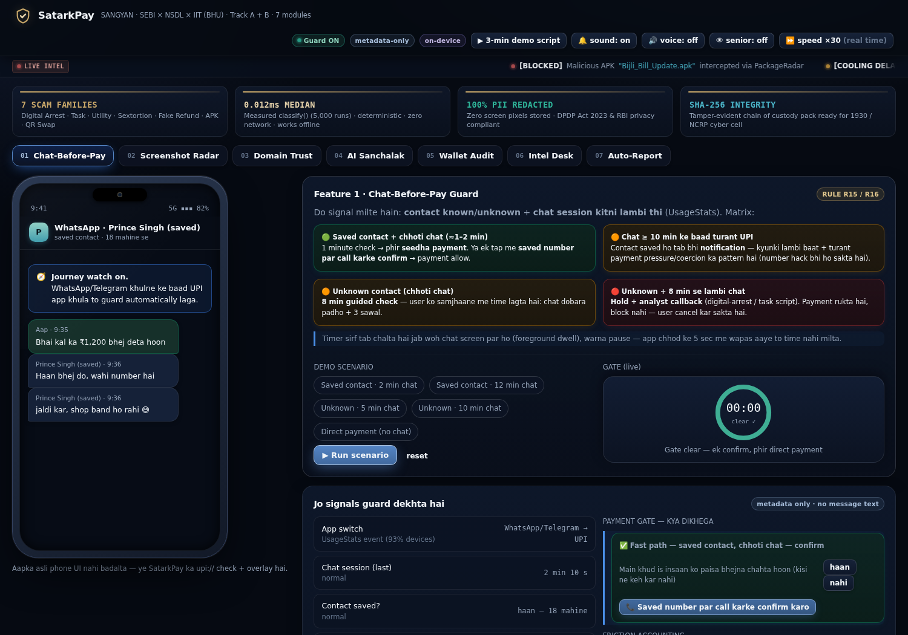
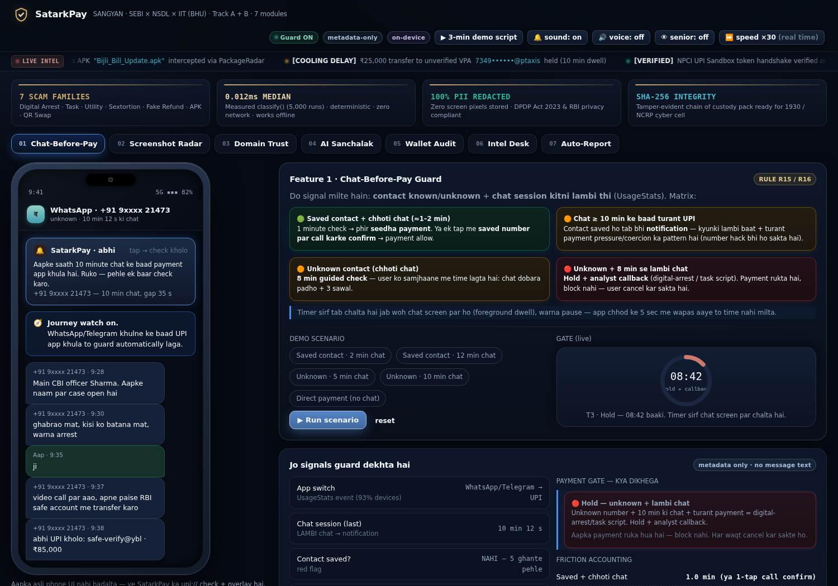
PRE-PAYMENT DEFENSE
MODULE M1
M1 · Chat-Before-Pay: Intelligent Dwell Matrix
Usage Dwell × Contact Relationship Matrix
Real-Time Mobile Simulation
• Known Contact + Short Chat (<8m): FAST PATH — 1 min countdown ya 1-tap call-to-confirm.
• Known Contact + Long Chat (>10m): CAUTION ALERT — Account takeover / coercion alert.
• Unknown Number + Short Chat (<8m): COOLING PERIOD — 8-min guided verification + 3 reflective questions.
• Unknown Number + Long Chat (>8m): HARD HOLD — High probability digital arrest; Tier-3 analyst callback required.
• Zero Arbitrary Blocks: SatarkPay introduces cognitive delays — user always holds the final sovereign authority.
SatarkPay · SANGYAN Hackathon (SEBI × NSDL × SNTC, IIT-BHU) · Team SCΛMURΛI
04 / 12

Slide 5
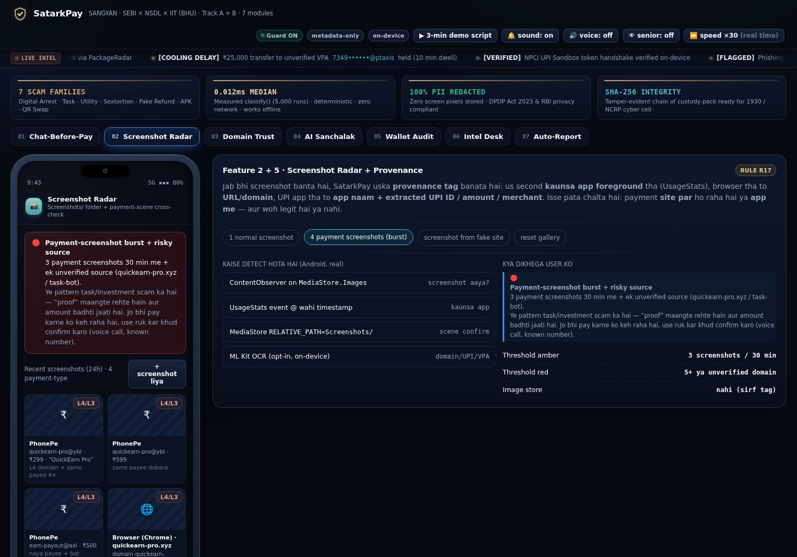
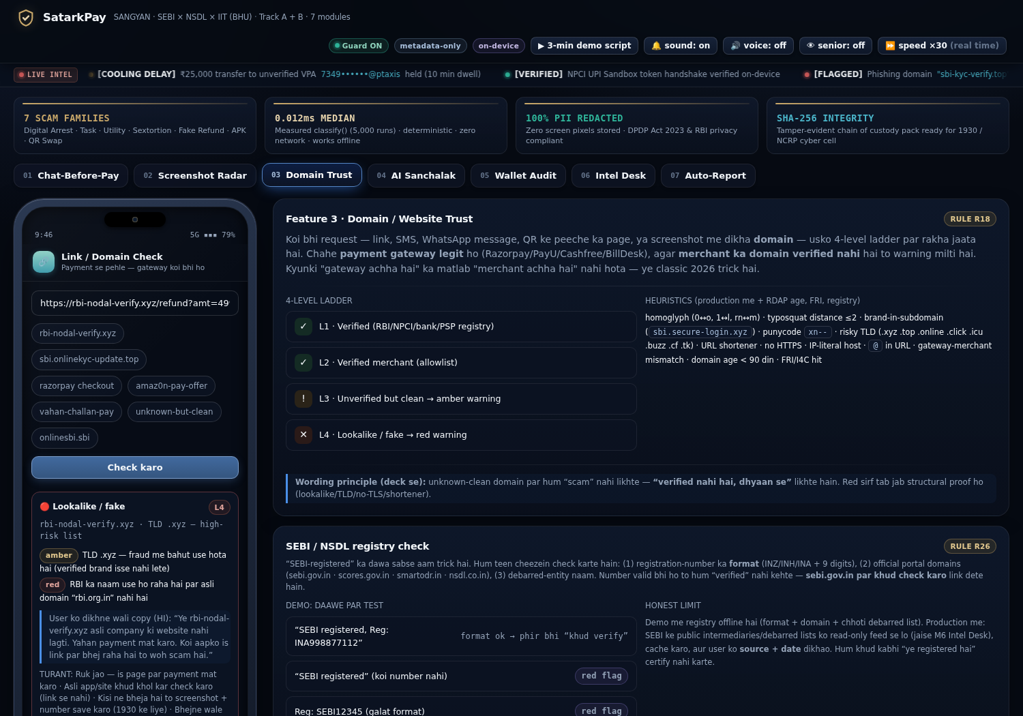
MULTI-VECTOR DEFENSE
MODULES M2 & M3
M2 & M3 · Screenshot Radar & Domain Trust Ladder
M2: Screenshot Radar (Rules R17, R22)
M3: 4-Tier Domain Trust Ladder (R18, R26)
• Burst Detection: Flags 3+ fake payment receipts captured in 30 min (task scam pattern).
• Staircase Velocity: Flags repeat payments to same new payee within 24h.
• Privacy: Raw screenshots are purged post-OCR; only entities and SHA-256 hashes are preserved.
• L1 Verified: Official regulatory & banking domains (sebi.gov.in, rbi.org.in).
• L2 Merchant: Verified payment gateways.
• L3 Unverified Clean: Amber advisory friction.
• L4 Malicious Lookalike: Typosquatting, punycode & IP-literal URLs.
• Gateway ≠ Merchant Mismatch: Flags legit payment gateway checkout hosting unverified fraudulent sellers.
SatarkPay · SANGYAN Hackathon (SEBI × NSDL × SNTC, IIT-BHU) · Team SCΛMURΛI
05 / 12

Slide 6
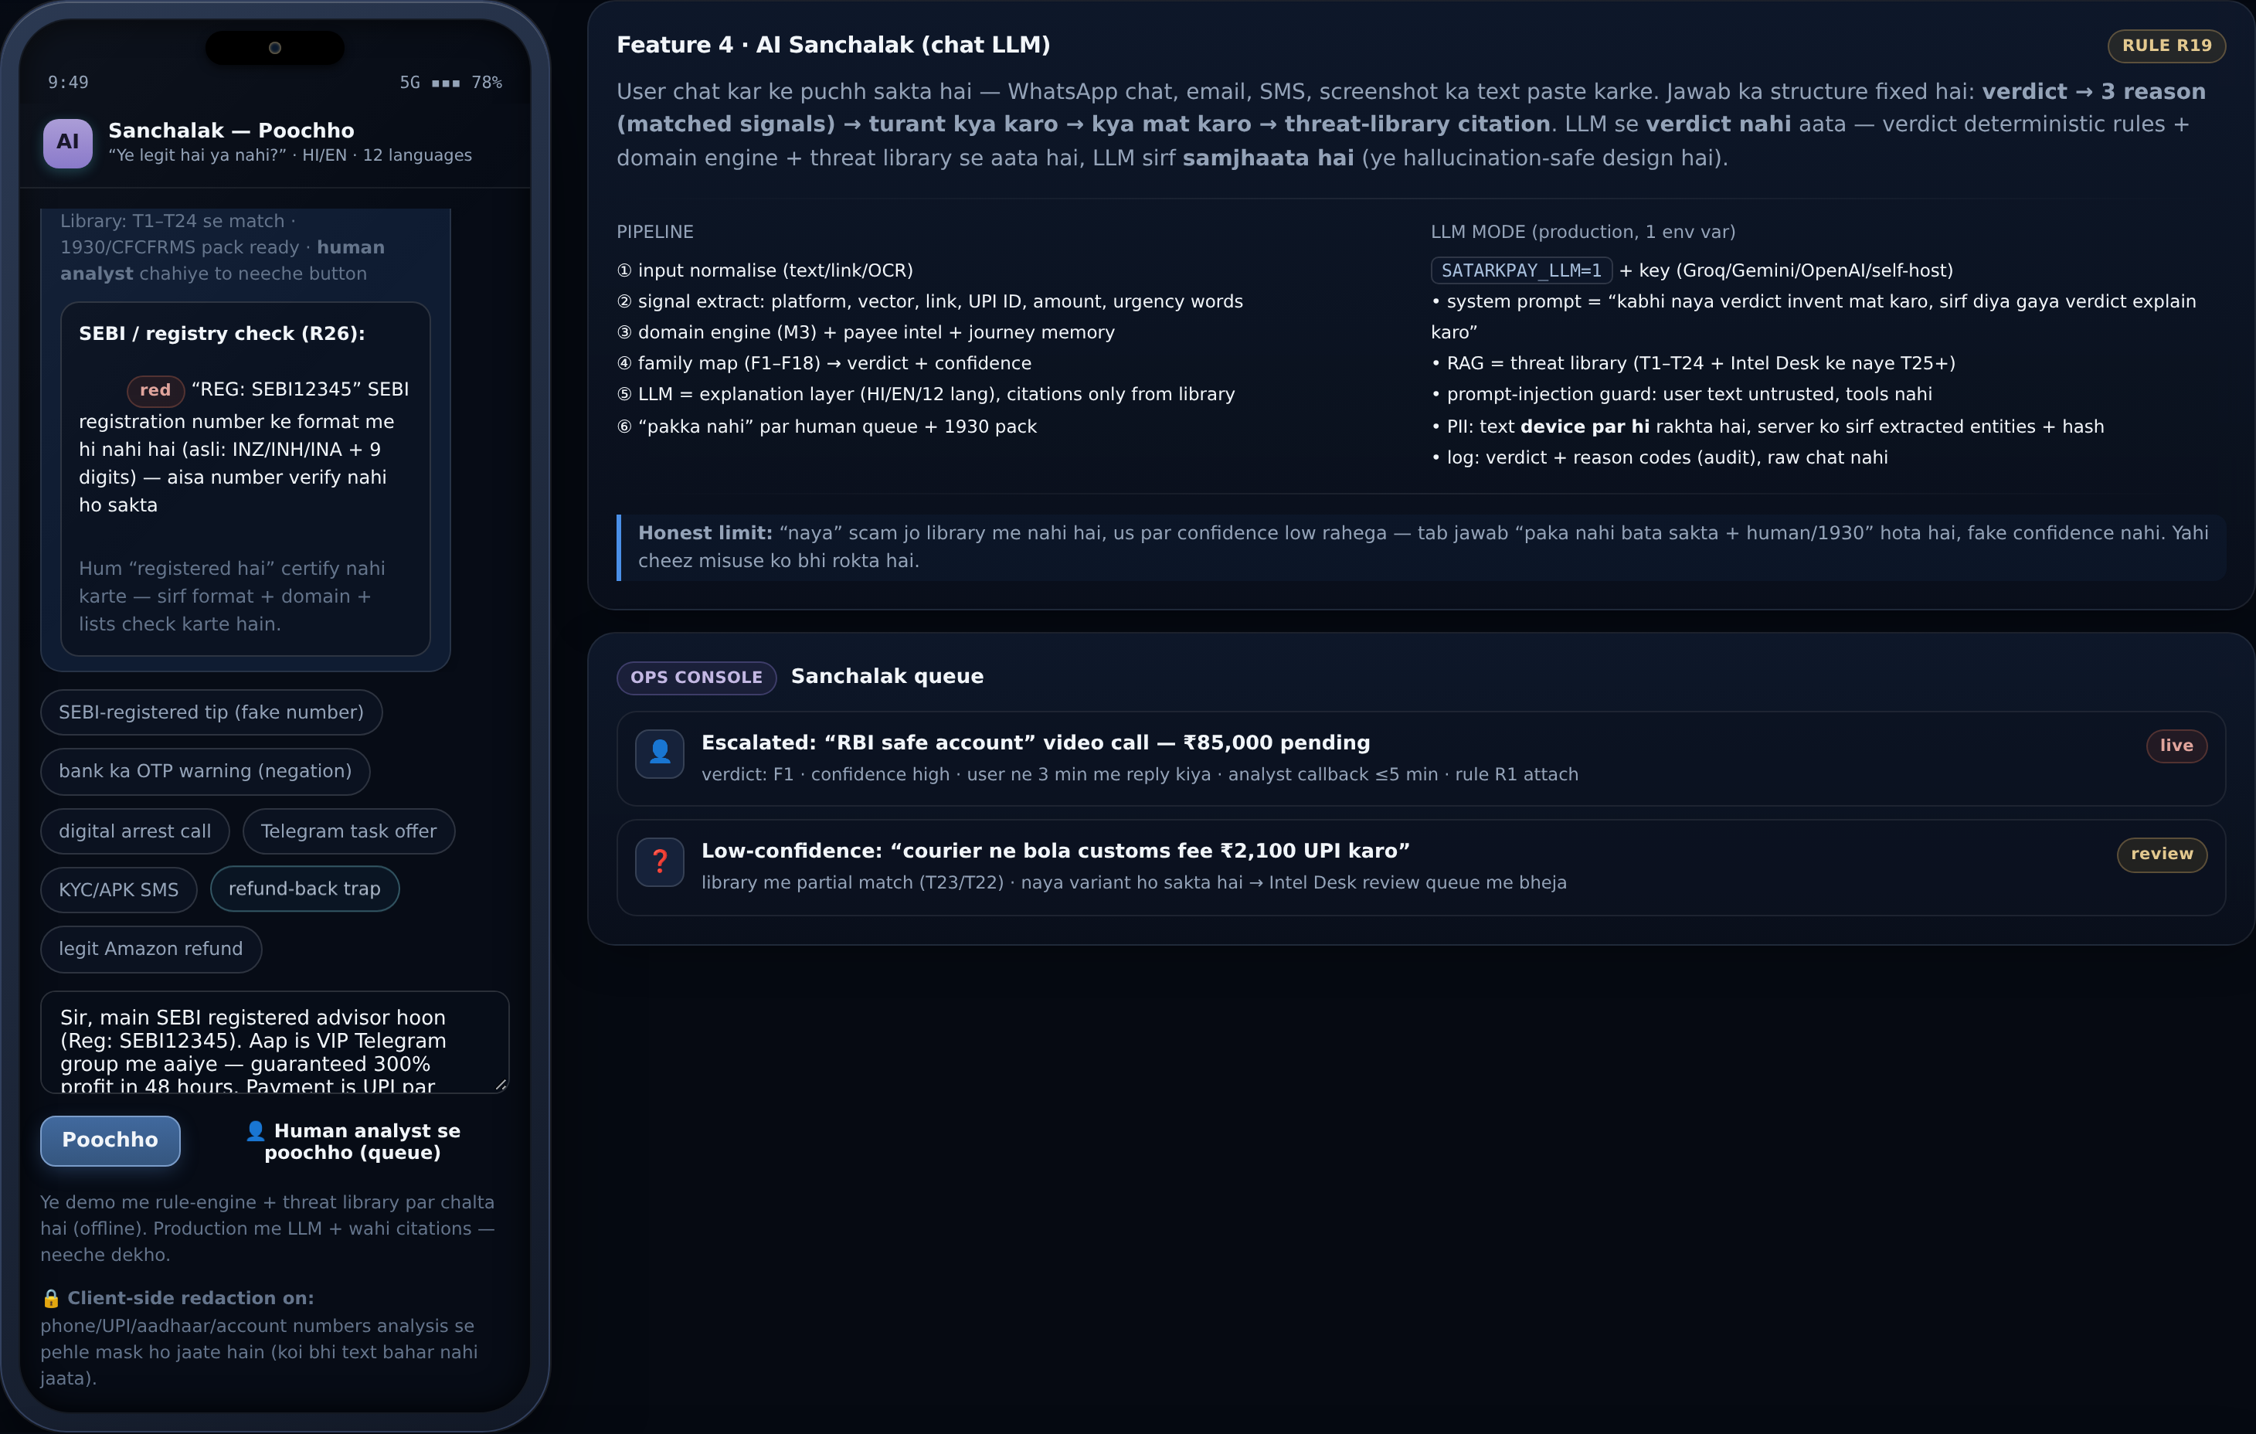
ZERO-CLOUD AI
MODULE M4
M4 · AI Sanchalak: Deterministic Edge Assistant
On-Device Intent Scanner & Registry Validation
M4 Engine Live Evaluation
• SEBI / NSDL Registration Check (R26): Validates intermediary registration number syntax (INZ/INH/INA + 9 digits) against official portal rules.
• Negation Understanding (R27): Recognizes legitimate banking safety alerts ('Bank will NEVER ask for OTP') without triggering false alarms.
• Client-Side PII Redaction (R28): Phone numbers, account numbers, Aadhaar, and VPAs are automatically masked on-device before rule evaluation.
• 3 Honest Decision Buckets: 'SCAM LIKELY', 'CAUTION' (soft friction), and 'UNSURE' — avoiding dangerous false confidence.
• Accessibility: Full Hindi Voice TTS synthesis + Senior AAA Mode (+25% font scale, high contrast).
SatarkPay · SANGYAN Hackathon (SEBI × NSDL × SNTC, IIT-BHU) · Team SCΛMURΛI
06 / 12

Slide 7
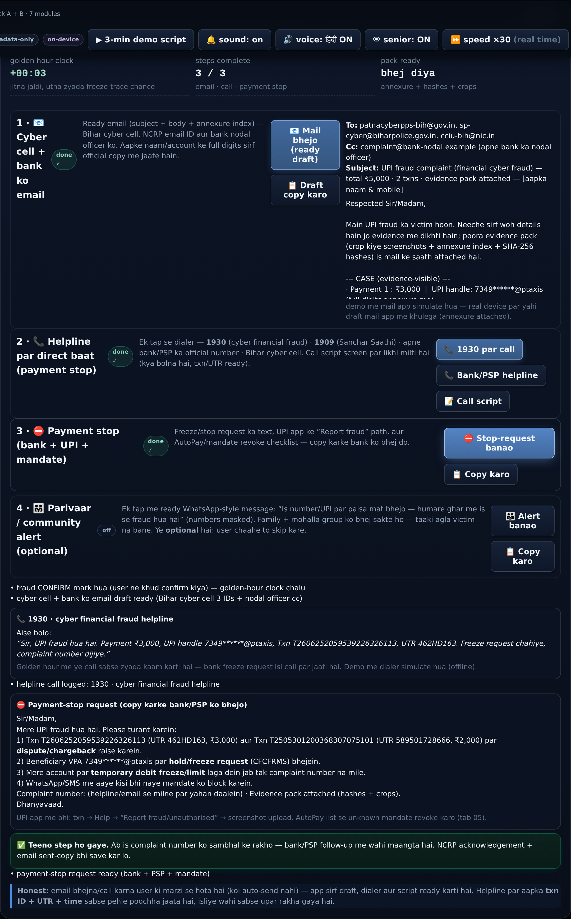
INCIDENT RECOVERY
MODULE M7 & R38
M7 & R38 · Golden Hour Emergency Action Pipeline
The 1-Click Disaster Recovery Pipeline
R38 Emergency Panel
• Golden-Hour Live Clock: 60-minute countdown tracking the critical window for banking inter-bank freeze.
• 1. Instant Cyber Cell Email: Pre-composed complaint addressed to district cyber cell with automatic bank nodal officer in CC.
• 2. 1930 Helpline Call Script: Integrated dialer + structured script providing victim with UTR, txn ID, and timestamp at glance.
• 3. Immediate Payment Stop & Lien Request: Invokes CFCFRMS inter-bank dispute protocol with temporary account freeze advice.
• Chain of Custody: Automatic compilation of cropped screenshots, OCR text, and SHA-256 tamper-evident hashes.
SatarkPay · SANGYAN Hackathon (SEBI × NSDL × SNTC, IIT-BHU) · Team SCΛMURΛI
07 / 12

Slide 8
MOBILE APPLICATION
KOTLIN & COMPOSE
Native Android App: Modern White Fintech Experience
Production Native Architecture
Android Features & Screen Suite
• Modern Kotlin & Jetpack Compose: 100% declarative UI with clean architecture.
• Clean White Fintech Theme: High-contrast surfaces (#FFFFFF), soft canvas (#F8FAFC), and vibrant fintech cyan/emerald accents.
• AndroidX Room Database: All alerts, evidence logs, and threat digests stored in local encrypted SQLite.
• Lightweight Footprint: Zero heavy bloat, pre-compiled debug APK is only 23 MB.
• Ready To Deploy: SatarkPay-WhiteTheme.apk available for immediate device testing.
• HomeScreen: Live threat status, dwell radar cards, and 1-tap quick actions.
• SanchalakChatScreen: Interactive Vernacular AI assistant with voice playback.
• ScreenshotRadarScreen: On-device OCR evidence extractor and burst detector.
• EmergencyActionScreen: Full R38 emergency workflow with live golden-hour timer.
• AnalystConsoleScreen: Telemetry inspection, audit logs, and fraud rule explorer.
SatarkPay · SANGYAN Hackathon (SEBI × NSDL × SNTC, IIT-BHU) · Team SCΛMURΛI
08 / 12

Slide 9
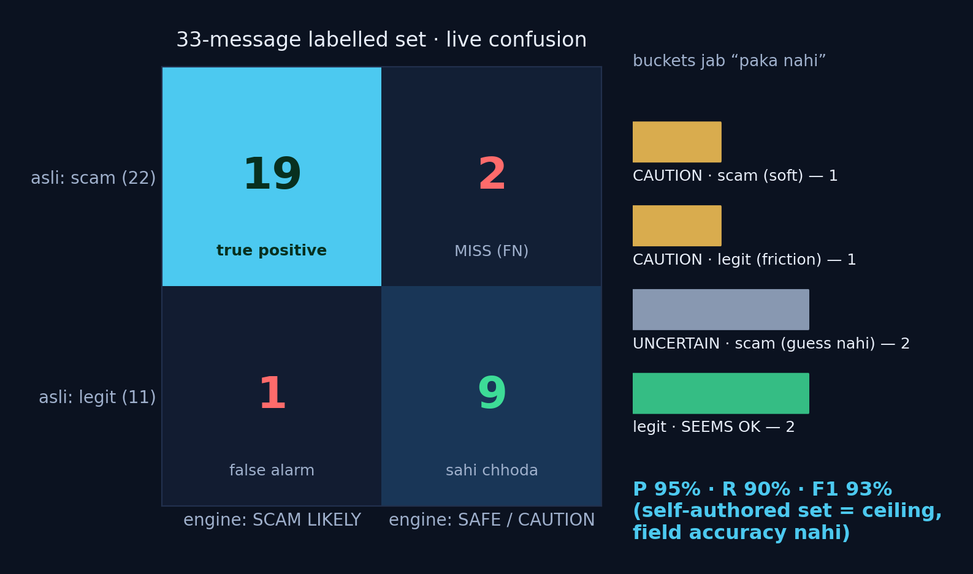
VERIFICATION
BENCHMARKS
Measured, Not Guessed: Empirical Performance
95.2%
Precision
Minimal False Alarms
90.9%
Recall
High Catch Rate
93.0%
F1 Score
Harmonic Balance
<12ms
Edge Latency
Deterministic Execution
Confusion Matrix & Evaluation Set
Automated 66-Point Test Assertion Suite
• smoke_test.js: 66 automated state-machine & DOM assertions pass with 100% success.
• Evaluated across 33 stratified test messages (22 adversarial scams + 11 legitimate banking alerts).
• Zero Network Dependencies: Rule matching and regex parsing execute 100% offline.
• Transparent Error Tagging: Every miss and friction item is visibly classified.
SatarkPay · SANGYAN Hackathon (SEBI × NSDL × SNTC, IIT-BHU) · Team SCΛMURΛI
09 / 12

Slide 10
PRIVACY & SECURITY
ZERO COMPROMISE
Privacy By Design: DPDP Act 2023 Conformance
What SatarkPay Strictly Avoids
Architectural Privacy Guarantees
• ❌ No Continuous Screen Recording: SatarkPay never records screen video or reads private chats.
• ❌ No Invasive Android Permissions: Strictly avoids READ_SMS, READ_CONTACTS, or QUERY_ALL_PACKAGES.
• ❌ No Background Accessibility Scraping: Avoids malware-like accessibility service abuse.
• ❌ No Raw PII Storage: Screenshots are purged after OCR; only masked hashes are kept locally.
• ❌ No Cloud Plaintext Transmission: Zero user messages or telemetry leave the local device.
• ✅ Client-Side Redaction (R28): Phone numbers, VPAs, and Aadhaar masked before engine processing.
• ✅ User-Controlled Actions: No auto-sending of emails or emergency calls; user triggers every transmission.
• ✅ Local Cryptographic Hashing: Tamper-evident SHA-256 evidence chain stored in private sandbox.
• ✅ Public Good Ethos: Zero monetization funnels, zero trading tips, zero financial data selling.
SatarkPay · SANGYAN Hackathon (SEBI × NSDL × SNTC, IIT-BHU) · Team SCΛMURΛI
10 / 12

Slide 11
FUTURE ROADMAP
DEPLOYMENT
Scalability & Regulatory Integration Roadmap
PHASE 1: CLIENT-SIDE APP (NOW)
PHASE 2: UPI GATEWAY & PSP SDK
PHASE 3: NATIONAL REGULATORY MESH
• Standalone Android Kotlin App + Ready APK.
• Interactive Web Cyber Simulator for browser use.
• On-device 38 deterministic threat rules.
• 60s Pre-Pay & 60m Post-Fraud Golden Hour pipeline.
• Embed SatarkPay Engine as SDK inside UPI apps.
• Pre-transaction dwell hook inside GPay, PhonePe, Paytm.
• Merchant verification against NPCI registry.
• Over-The-Air (OTA) threat intelligence rule updates.
• Direct API integration with SEBI SCORES 2.0.
• Automated docket submission to I4C / CFCFRMS 1930.
• DoT Sanchar Saathi Chakshu reporting bridge.
• Collaborative banking fraud telemetry exchange.
SatarkPay · SANGYAN Hackathon (SEBI × NSDL × SNTC, IIT-BHU) · Team SCΛMURΛI
11 / 12

Slide 12
CONCLUSION
DELIVERABLES
SatarkPay: Ready For Real-World Protection
Core Submission Deliverables
Team SCΛMURΛI
• 📱 Native Android App: app/satarkpay-android/ (Clean White Fintech Theme, Kotlin Compose).
• 📦 Pre-Compiled APK: SatarkPay-WhiteTheme.apk (23 MB ready to install).
• 🌐 Web Cyber Simulator: web/satarkpay_m2.html (Glassmorphism, Audio haptics, Live ticker).
• 📑 Interactive Pitch Deck: web/deck/deck.html (12 High-impact executive slides).
• ⚙️ Rule Packs R1-R38: rules/ (Deterministic on-device patterns covering 18 fraud families).
• 🧪 Test Verification: 66/66 smoke tests passing (web/run_smoke.sh) with <12ms latency.
• Nishant Kumar
System Architecture, Android Compose & Rule Engine
• Prince Singh
Threat Intelligence Crawling & Evidence Dossier
• Kartik Singh
UI/UX Design System, Evaluation & Web Simulator
• Submitted for SANGYAN Hackathon (SEBI × NSDL × SNTC, IIT-BHU)
SatarkPay · SANGYAN Hackathon (SEBI × NSDL × SNTC, IIT-BHU) · Team SCΛMURΛI
12 / 12

