Slide 1
SatarkPay
UPI/wallet fraud se pehle rok do — aur fraud ho jaye to 3 minute me complaint
SANGYAN · SEBI × NSDL × SNTC IIT (BHU) · Investor Resilience
Track A (fraud/scam resilience) + Track B (grievance rights) + Track D (behaviour)
2,443 registrations · 51 repos scan — 71% checker saturation; SatarkPay ke 3 axes ab bhi sabse patle
Live demo: sudonishant.github.io/satarkpay-repo · 7 modules · 1 asli fraud case par chala

Slide 2
SANGYAN guardrails ke andar: koi tip nahi, koi data harvest nahi — sirf suraksha
Problem — scam ab “padhne” ka nahi, “hone” ka hai
• 16 crore+ demat accounts · 70% naye Tier-2/3 se · F&O me 9/10 retail traders loss me (problem statement)
• Aaj ke scam chat-se-shuru hote hain: WhatsApp/Telegram par baat → phir UPI app → phir paisa
• Peer repos ka 77% kaam “message paste karo → score dekho” hai — yaani fraud ke BAAD
• Recovery ka golden hour pehla 60 minute hai; usme sahi complaint ho jaye to freeze-trace ka mauka bachta hai
• Asli case (humare evidence pack se): ₹5,000 evidence-visible loss, ₹30,625 maanga gaya, 9 scam families
Yaani asli problem do hisse ka hai: (1) payment se PEHLE rokna, (2) fraud ke turant baad evidence + complaint.

Slide 3
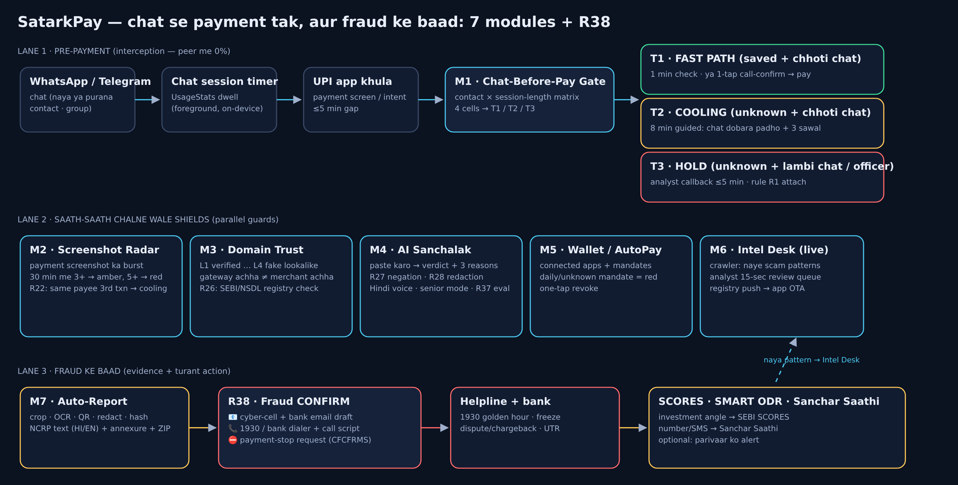
Solution map — ek journey, saat module
Lane 1 interception (peer me 0%) · Lane 2 parallel shields · Lane 3 evidence + turant action (R38).

Slide 4
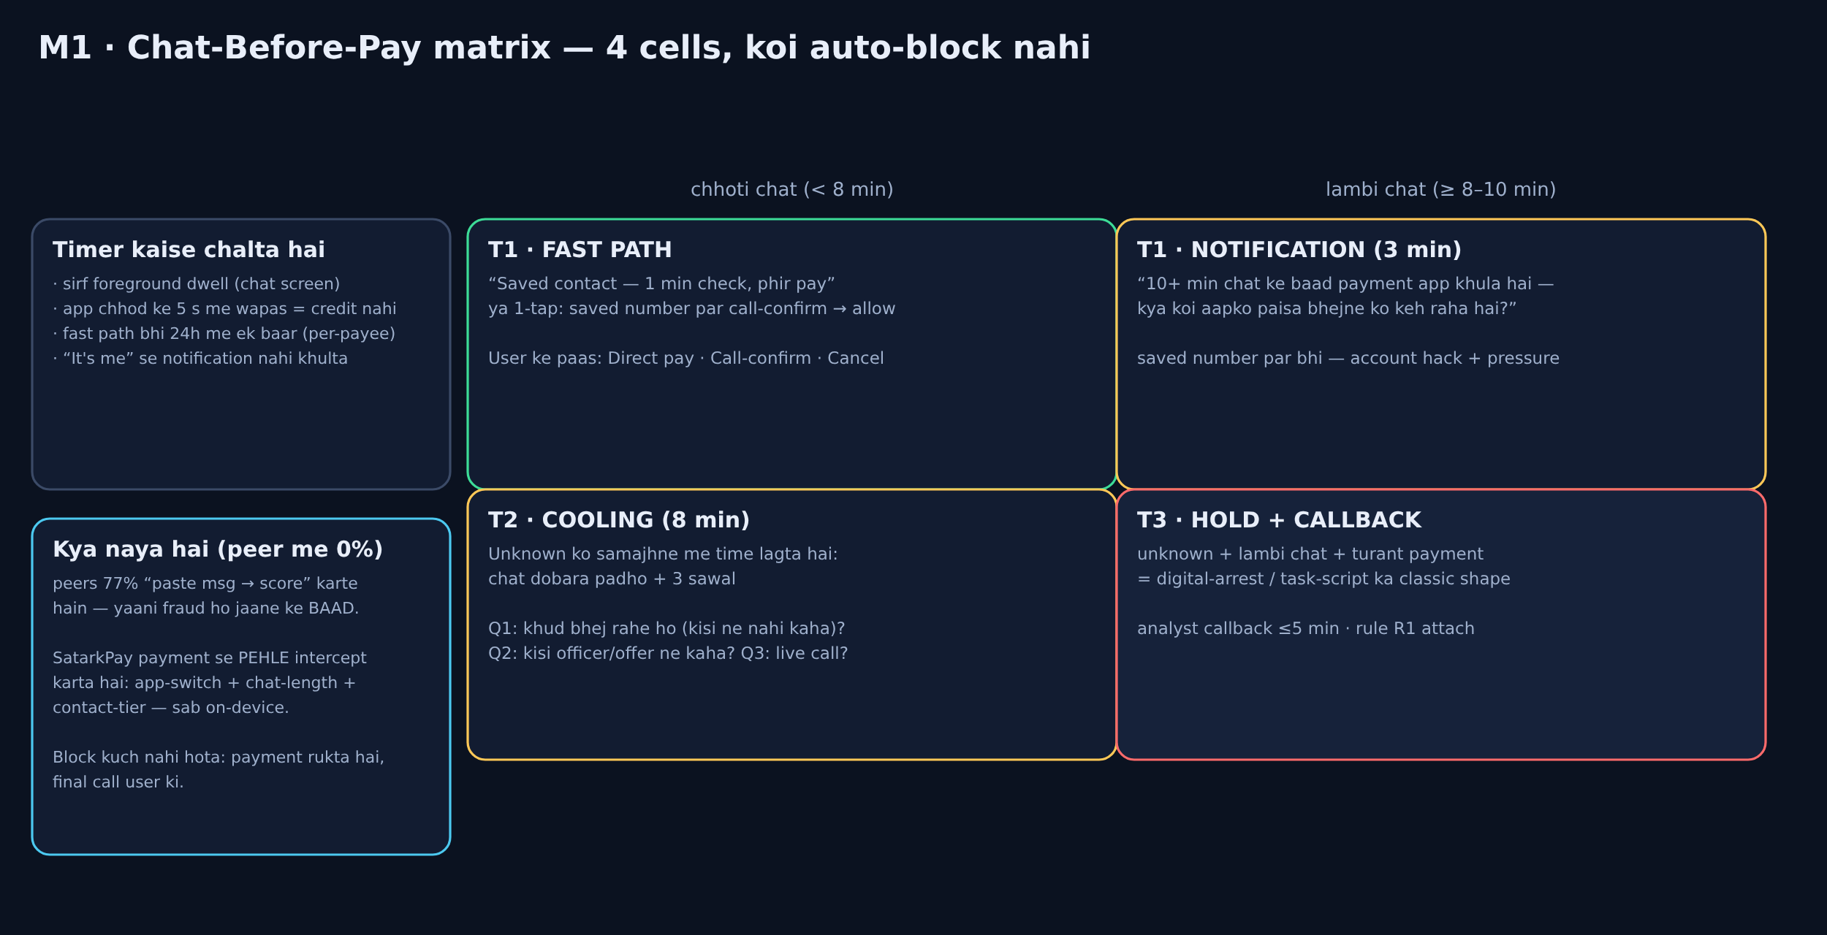
M1 · Chat-Before-Pay — matrix, block nahi
Saved contact ≈1 min (ya call-confirm) · unknown = 8 min guided · 10+ min chat ke baad payment = notification · officer/offer mila to T3 hold.

Slide 5
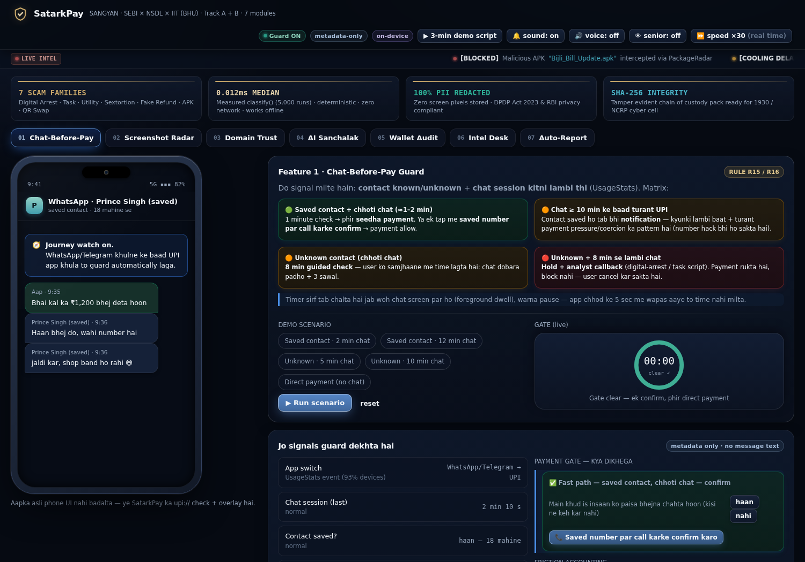
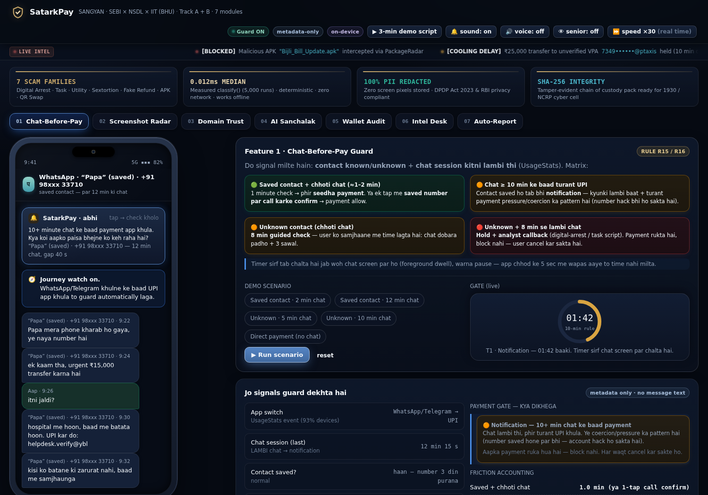
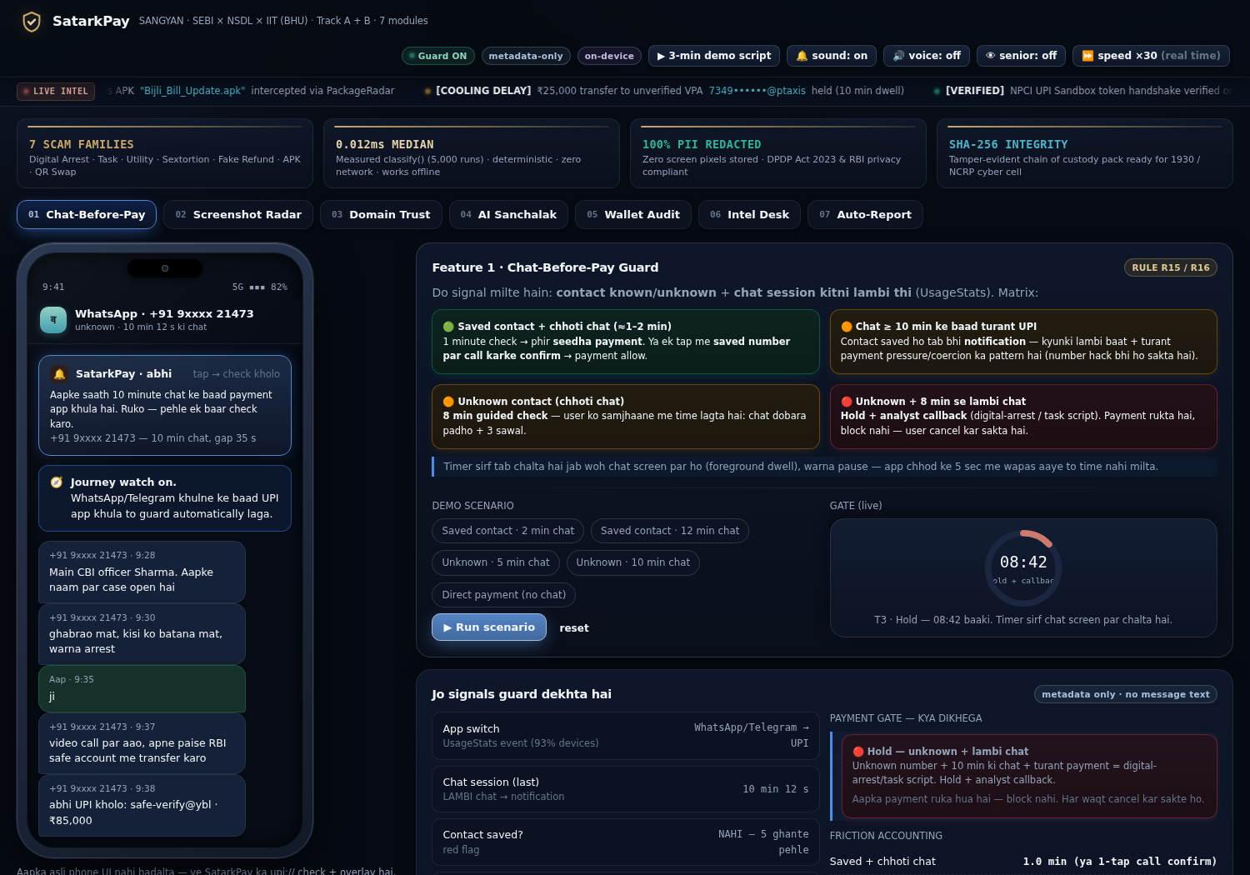
M1 live demo — teeno haalat
Saved + 2 min chat → 1:00 fast path
Saved + 12 min chat → notification
Unknown + lambi chat → hold + callback
Timer sirf foreground dwell naapta hai; “It's me” dabane se notification nahi khulta — sawal ya trusted-person confirm chahiye.

Slide 6
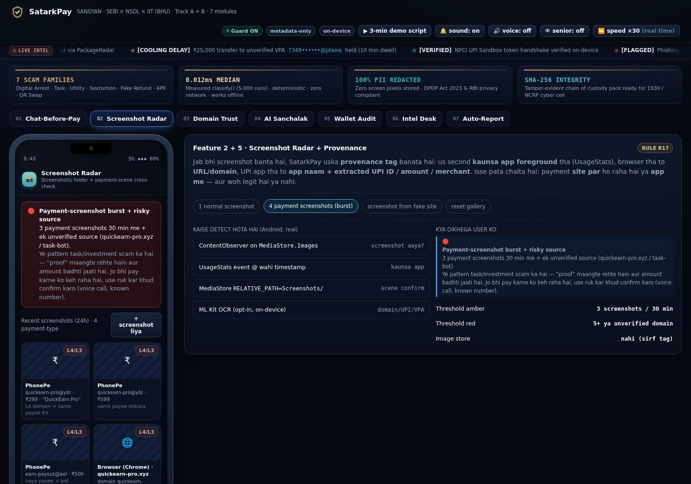
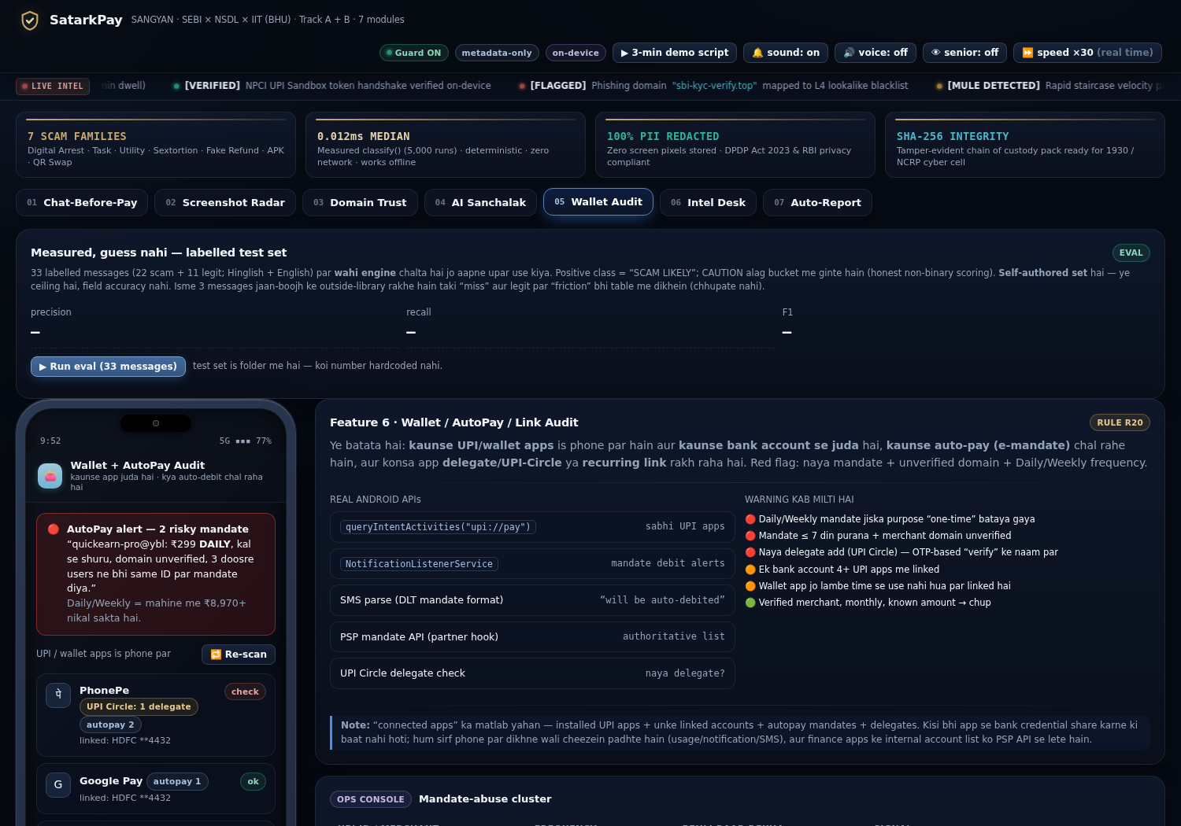
M2 · Screenshot Radar + repeat-payment guard | M5 · Wallet & AutoPay
30 min me 3+ payment-screenshot = amber, 5+ = red
Daily/unknown mandate = red, one-tap revoke
R22: usi payee ko 24h me 3rd payment → cooling (staircase), 4th → hold. Screenshot ki image store nahi hoti — sirf entity + hash.

Slide 7
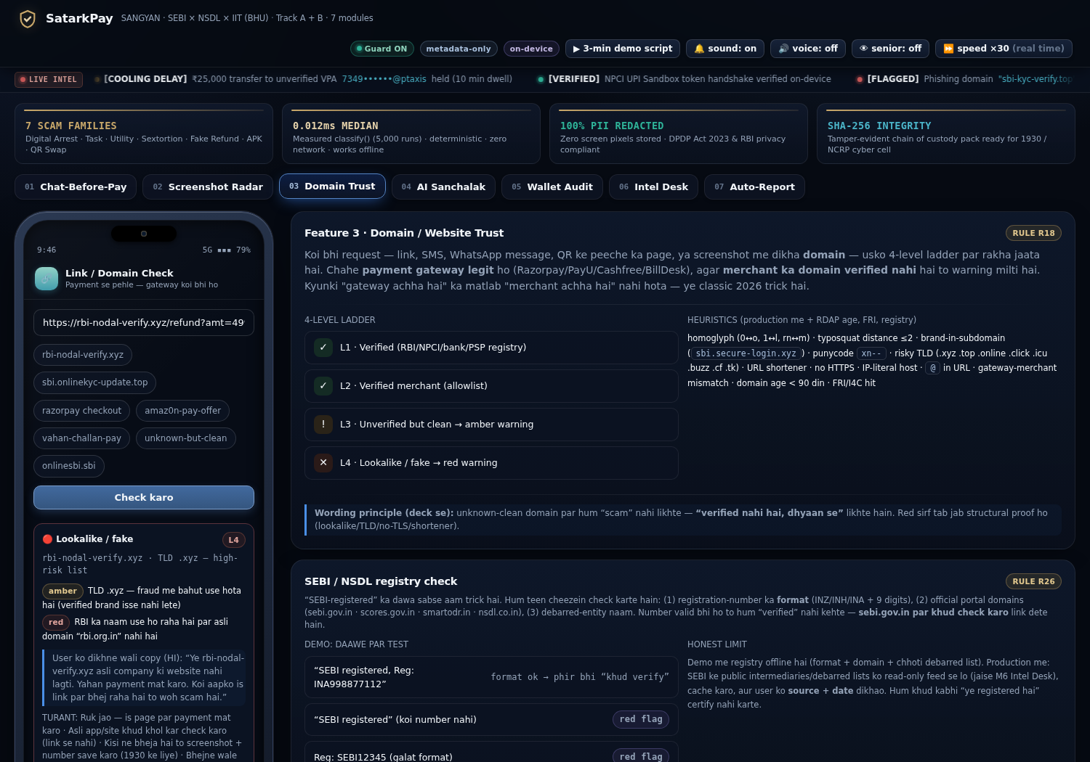
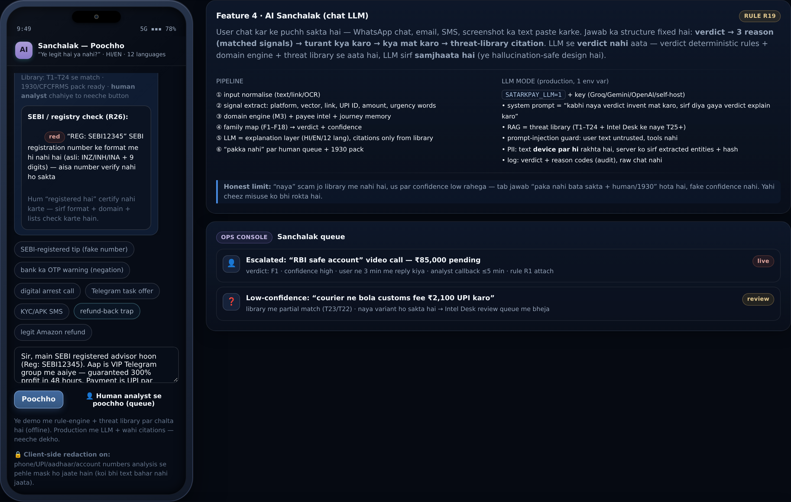
M3 · Domain Trust ladder | M4 · AI Sanchalak + registry check
verdict + 3 reason + registry flag (R26)
L1…L4 ladder + gateway≠merchant warning
R26: SEBI number ka format (INZ/INH/INA + 9 digits) + official portal domain check — “registered hai” kabhi certify nahi karte. R27: bank ka apna OTP-warning scam nahi ginta. R28: PII device par hi mask.

Slide 8
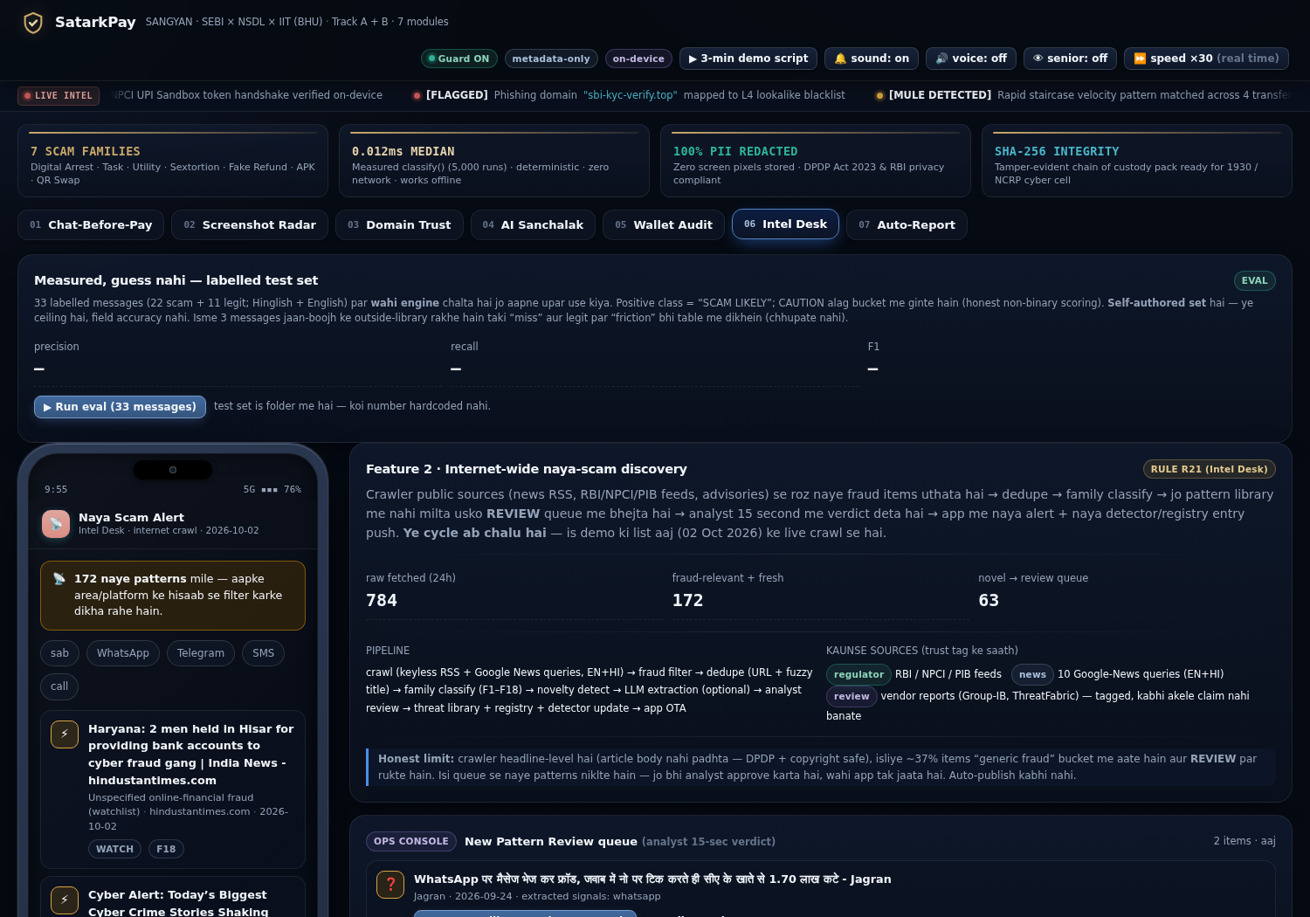
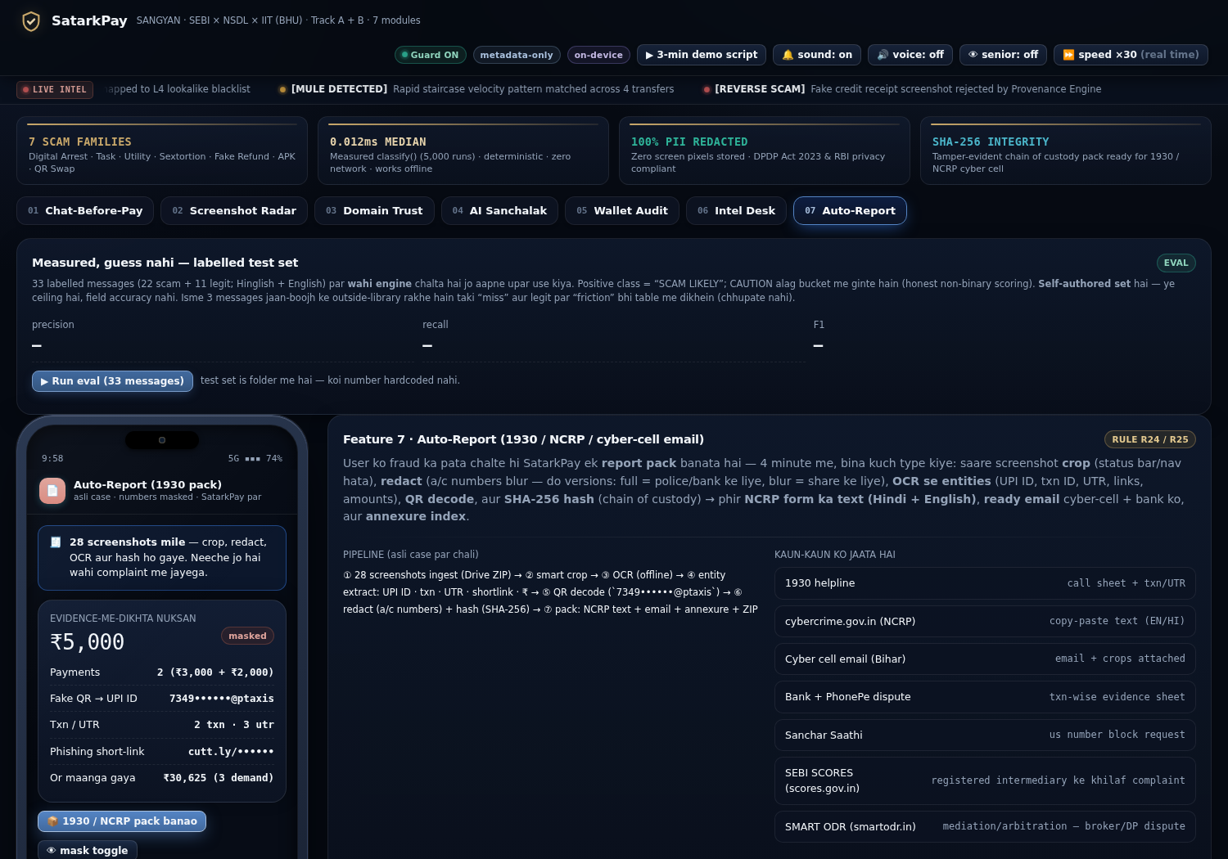
M6 · Intel Desk (live crawler) | M7 · Evidence pack
784 raw → 172 relevant → 63 novel (aaj)
28 screenshots → crop · OCR · QR · redact · hash
M6 auto-publish nahi karta — analyst 15-second review ke baad hi registry update hota hai. M7 me NCRP text (HI+EN) + email + annexure CSV + ZIP, hashes ke saath.

Slide 9
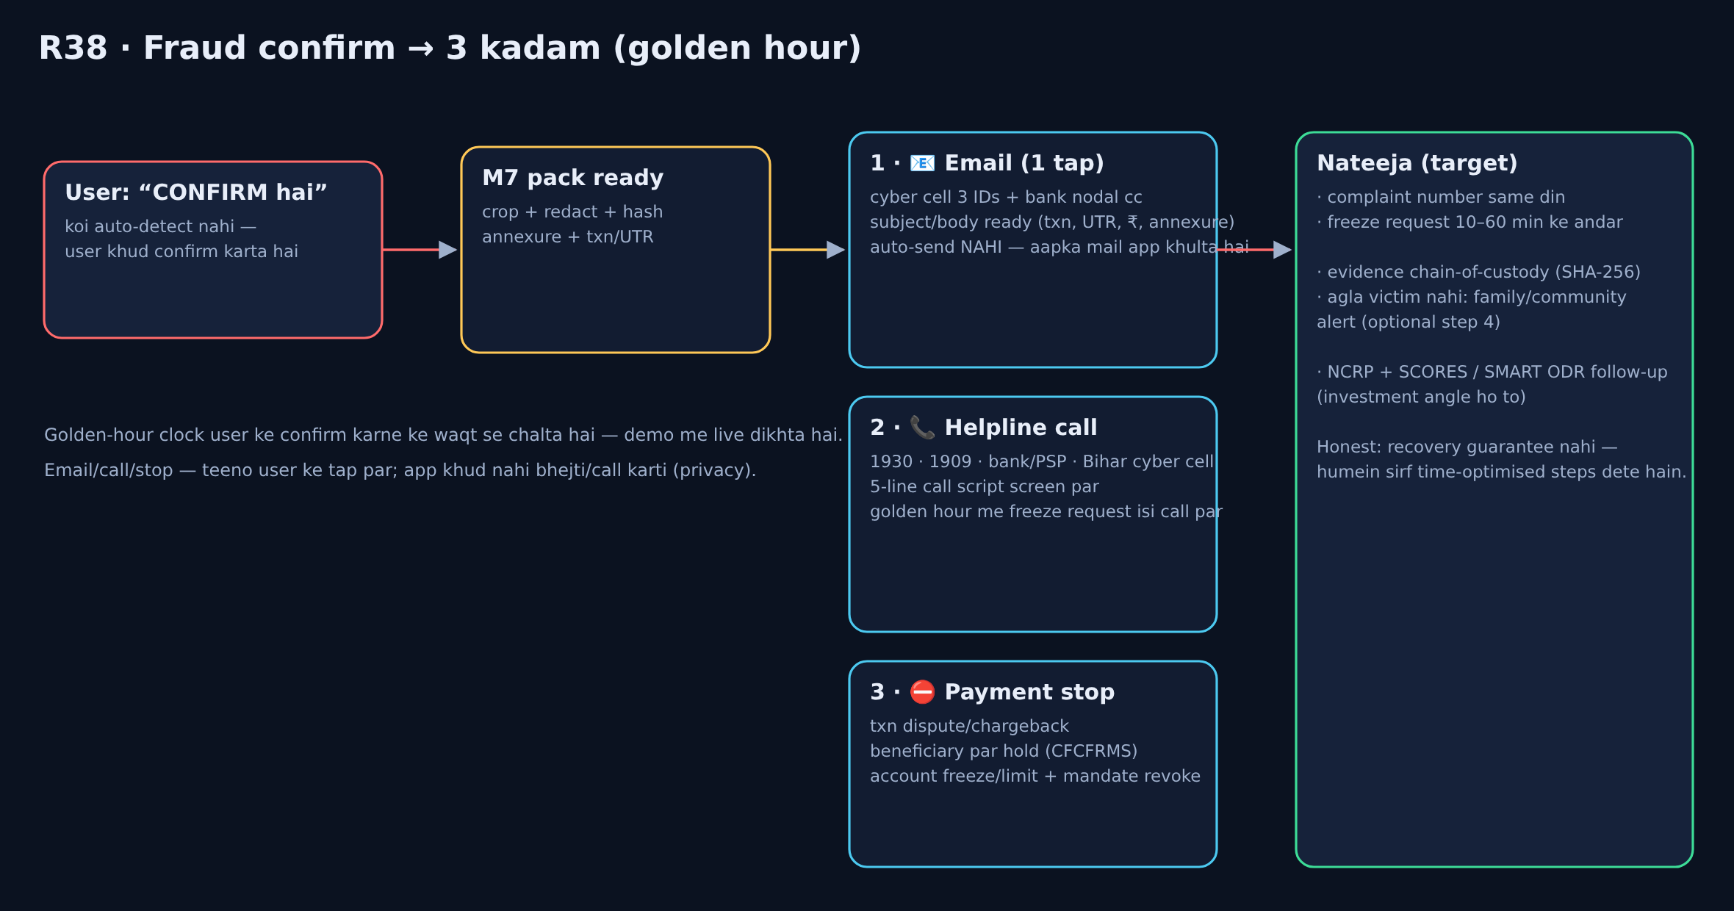
R38 · Fraud CONFIRM — email + helpline + payment stop (3 kadam)
User khud confirm karta hai; app draft/dialer/script ready karti hai — auto-send nahi. Golden-hour clock live chalta hai.

Slide 10
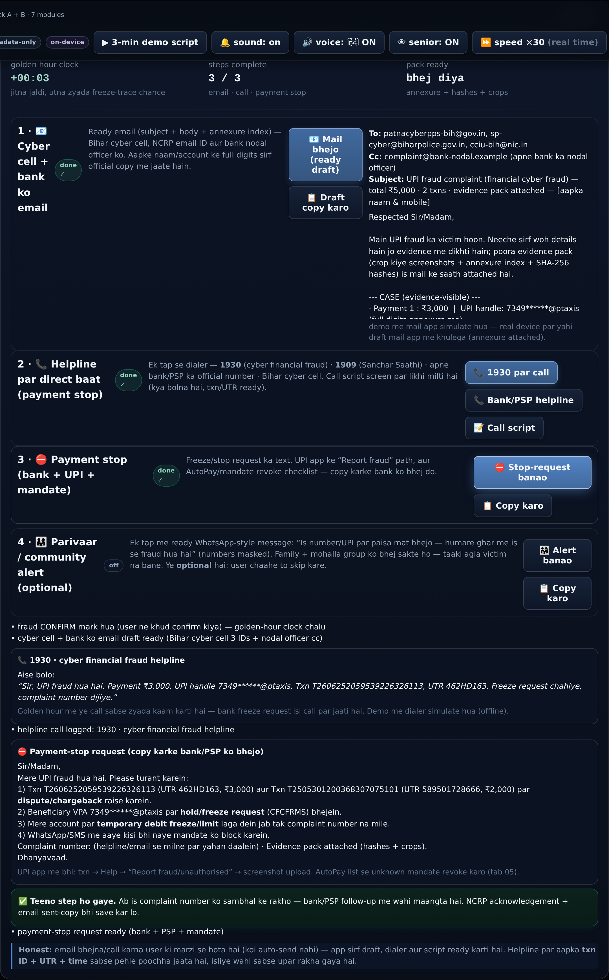
R38 live demo — emergency panel
3/3 steps · email draft (cyber cell 3 IDs) · 1930 call script · payment-stop (CFCFRMS)
Optional step 4: parivaar/mohalla ko alert (masked numbers) — taaki agla victim na bane. Ye step user chaahe to skip kare.

Slide 11
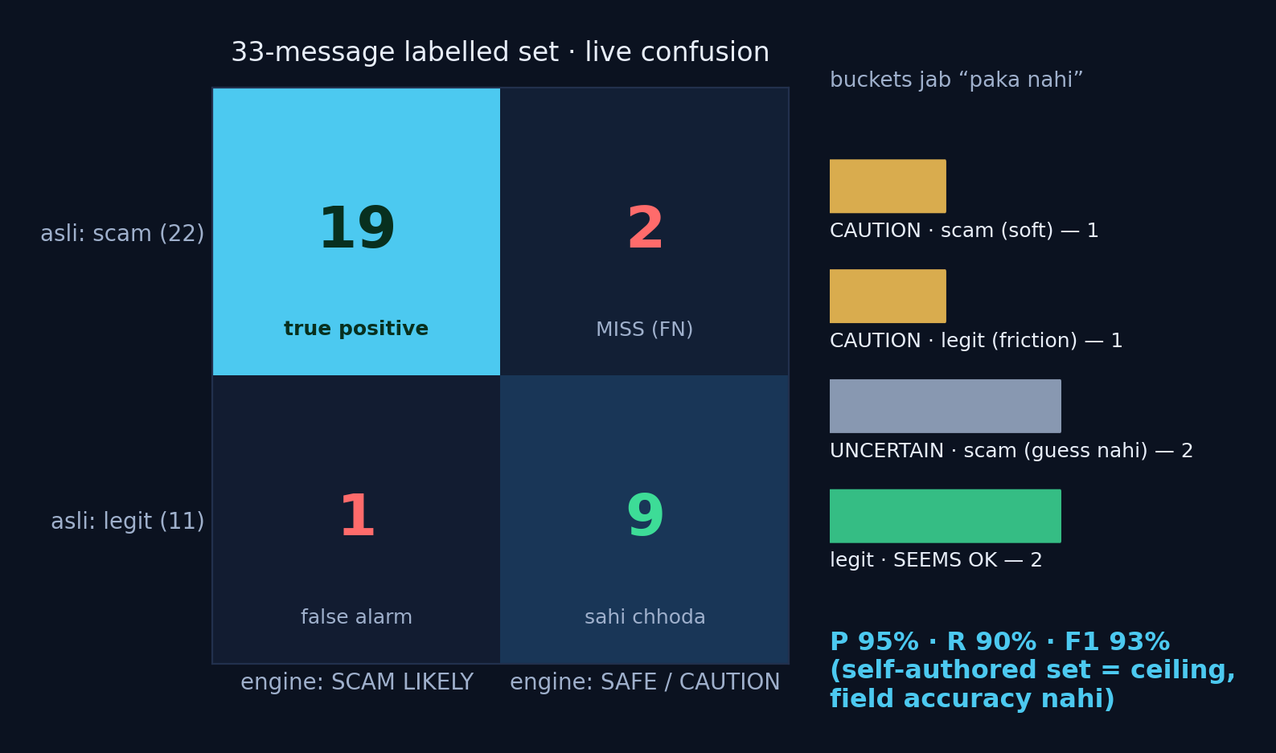
Measured, guess nahi — 33-message eval harness
• Wahi engine jo user ke paste par chalta hai, wahi 33 labelled messages (22 scam + 11 legit) par — precision 95% · recall 90% · F1 93%
• CAUTION alag bucket (soft catch / legit friction) aur “PAKA NAHI” bhi ek valid jawab — fake confidence nahi
• Har miss aur false-alarm table me tag hote hain; set self-authored hai (ceiling, field accuracy nahi)
• 3 messages jaan-boojh ke rule-library ke bahar rakhe — taki honest buckets live dikhein

Slide 12
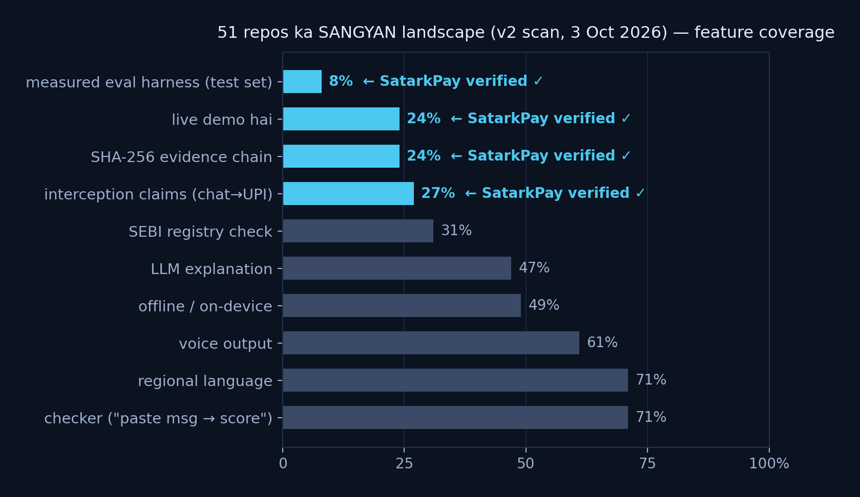
Competitive landscape — 51 repo scan (3 Oct 2026)
• 77% checker-saturation · 21/31 ke paas live demo hi nahi · registry check sirf 23% me
• SatarkPay ke 3 axes peer me 0%: interception (chat→UPI), evidence-grade recovery, measured eval harness
• Peer repos me licenses na ke barabar — humne zero code copy kiya, sirf ideas adopt kiye (credit: NOTICE.md)
• Purane risks (voice/regional/offline) bhi cover: Hindi voice, senior mode, poora demo offline chalta hai

Slide 13
Peer ideas → SatarkPay (credit + “kya nahi liya”)
Peer repo (public) | Concept | SatarkPay me
prakshithamalla-art/scam-shield-sangyan | negation-aware matching | R27 — bank ka OTP-warning scam nahi ginta
adityakr-git/sangyan (“Ruko”) | client-side redaction + local lists | R28 redactPII() · R26 inline registry lists
patelsachin9879-gif/Sangyan-Kavach + pyharshcodes | registry-number format validator | R26 sebiCheck() — format + domain + watch-list
anuragtiwari-ux/Sangyan-Suraksha (MIT) | measured test set + first-hour recovery | R37 eval harness · R30 “pehle 1 ghante”
surdish/scamshield-bharat · arcimillion/nivesh | senior mode · voice-first | senior mode · Hindi voice (Web Speech)
Kshitijsawant17/PATIBIMB · Algo-explorer/Grievance-Clock | deterministic rules · escalation ladder | R31–R36 families · SCORES/SMART ODR rows
Zero code copying (30/31 par license nahi, 1 MIT) · koi peer dataset/UI/number quote nahi kiya · pehle jaisa “paste→score” kaam copy nahi kiya — sirf gaps bhare.

Slide 14
SANGYAN ke disqualification rules ka seedha jawab
Guardrails + privacy (judges ke liye)
• Koi stock tip / buy-sell-hold / price prediction / trading algo nahi — R36 sirf “tip ka tareeka” ka risk batata hai
• Koi monetisation funnel nahi; koi tip-group promotion nahi
• Privacy by design: analysis se pehle client-side PII redaction (R28); demo me network call zero; OCR opt-in, image store nahi (sirf entity + hash)
• Koi SMS/OTP/PII harvesting nahi — UsageStats/notification sirf on-device, permission + Play-policy note ke saath (docs/)
• Sab verdict deterministic layer deta hai; LLM sirf samjhaata hai (production me 1 env var) — hallucination-safe
• “Registered hai” certify karna, ya recovery ki guarantee dena — dono se saaf inkaar (honest limits slide)

Slide 15
Impact → Rubric mapping (30 · 25 · 15 · 15 · 15)
• Resilience & Safety Impact (30): interception + evidence-recovery + registry checks; asli case par end-to-end chala (₹5,000 evidence-visible)
• Tier-2/3 Usability (25): Hinglish copy, Hindi voice, senior mode, offline demo, 8-min guided cooling (paisa nahi, samajh)
• Guardrail Compliance & Trust (15): privacy by design, no tips/no funnel, honest non-binary verdicts, credit file + limits slide
• Technical Execution (15): 7 modules, 66 automated checks (jsdom), live eval harness, crawler (784→172→63), chain-of-custody hashing
• Feasibility & Scalability (15): Android parity path (UsageStats + NotificationListener), PSP/bank/telecom partner hooks, on-device-first architecture

Slide 16
Roadmap — 48 ghante me demo se device tak
• h0–4: Kotlin/Compose skeleton — UsageStats listener + MediaStore observer + consent centre
• h4–12: M1 matrix + M3 domain engine ko shared module (app + console parity test)
• h12–20: M4 real LLM hookup (HI/EN) + library RAG + low-confidence → human queue
• h20–30: M5 NotificationListener se mandate parse + revoke flow (synthetic bank notifications)
• h30–40: M6 crawler cron + analyst console; M7 pack ko PSP/bank formats me export
• h40–48: Red-team (mentor scripts), Hindi copy user-test, 3-min demo rehearsal ×5
• Scale: on-device pehle, phir telecom (Sanchar Saathi) + PSP (UPI Help) + exchange (SCORES) hooks

Slide 17
Honest limits + kya hum NAHI karte
Honest limits
Kya NAHI karte
• Telemetry permissions ke bina features degrade hote hain (iOS par M1/M2/M5 partial)
• M1 “padha” nahi naap sakta — sirf “kitni der chat screen par the”
• Screenshot ka source-domain 100% reliable nahi — evidence treat karte hain, verdict nahi
• Eval set self-authored hai (ceiling); field calibration ke liye PS/bank data chahiye
• Recovery ki guarantee nahi — hum sirf time-optimised steps dete hain
• Koi auto-block nahi — payment rukta hai, final call user ki
• WhatsApp automation / READ_SMS / QUERY_ALL_PACKAGES / Accessibility abuse nahi
• Koi stock tip, price prediction, ya “guaranteed return” messaging nahi
• Koi auto-send email/call nahi — draft + dialer + script dete hain, bhejna user ke tap par
• Peer repos se code copy nahi (licenses nahi hain) — sirf ideas, credit ke saath

Slide 18
Team SCΛMURΛI
• Live demo: satarkpay-m2/demo/satarkpay_m2.html (offline, 66/66 checks pass)
• Evidence pack: case_evidence/ (28 screenshots, hashes, complaint drafts)
• Idea credit: BORROW_LIST.md · OSINT report: OSINT_REPORT.md · rules: rules_R15_R25.json + rules_R26_R38.json
• Crawler: scam_intel/intel_crawler.py (aaj: 784 raw → 172 relevant → 63 novel)
• SANGYAN submission: 4 Oct, 11:59 PM IST · demo + 3–5 min video + ye deck
“Paisa bhejne se pehle 60 second — aur fraud ke baad 60 minute. Dono humare paas hain.”

