Slide 1

SANGYAN 2026 · IIT-BHU · SEBI × NSDL
SatarkPay
सतर्कपे
Fraud detection that runs in the sixty seconds BEFORE the PIN —
not after the money has gone.
Nine attack-chain signals · Four honest tiers · Zero bytes uploaded
Team SCΛMURΛI — Nishant Kumar · Prince Singh · Kartik Singh
Track A: Fraud Resilience · Track B: Awareness & Grievance · Track D: Behavioral Security
SatarkPay · सतर्कपे · SANGYAN 2026
01

Slide 2
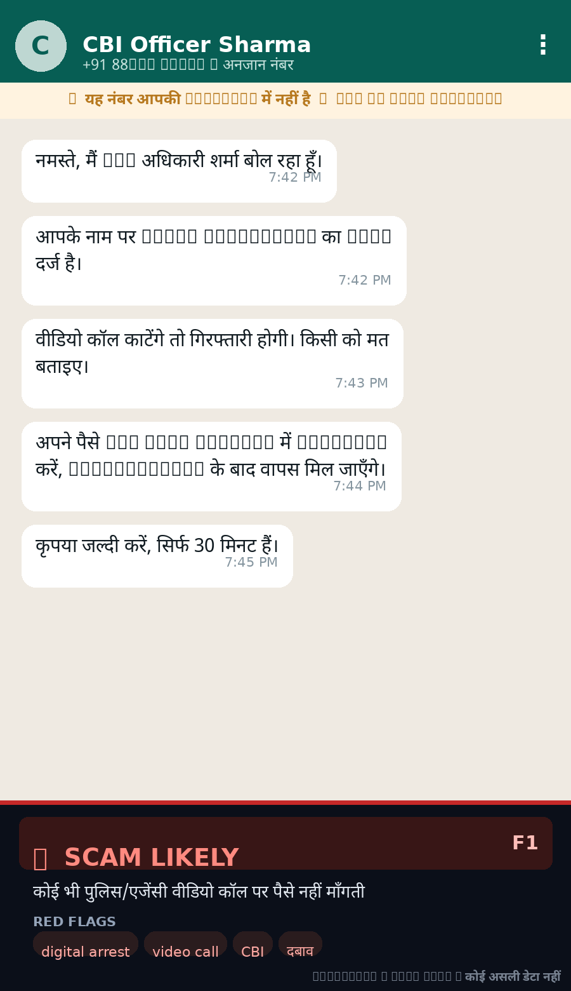
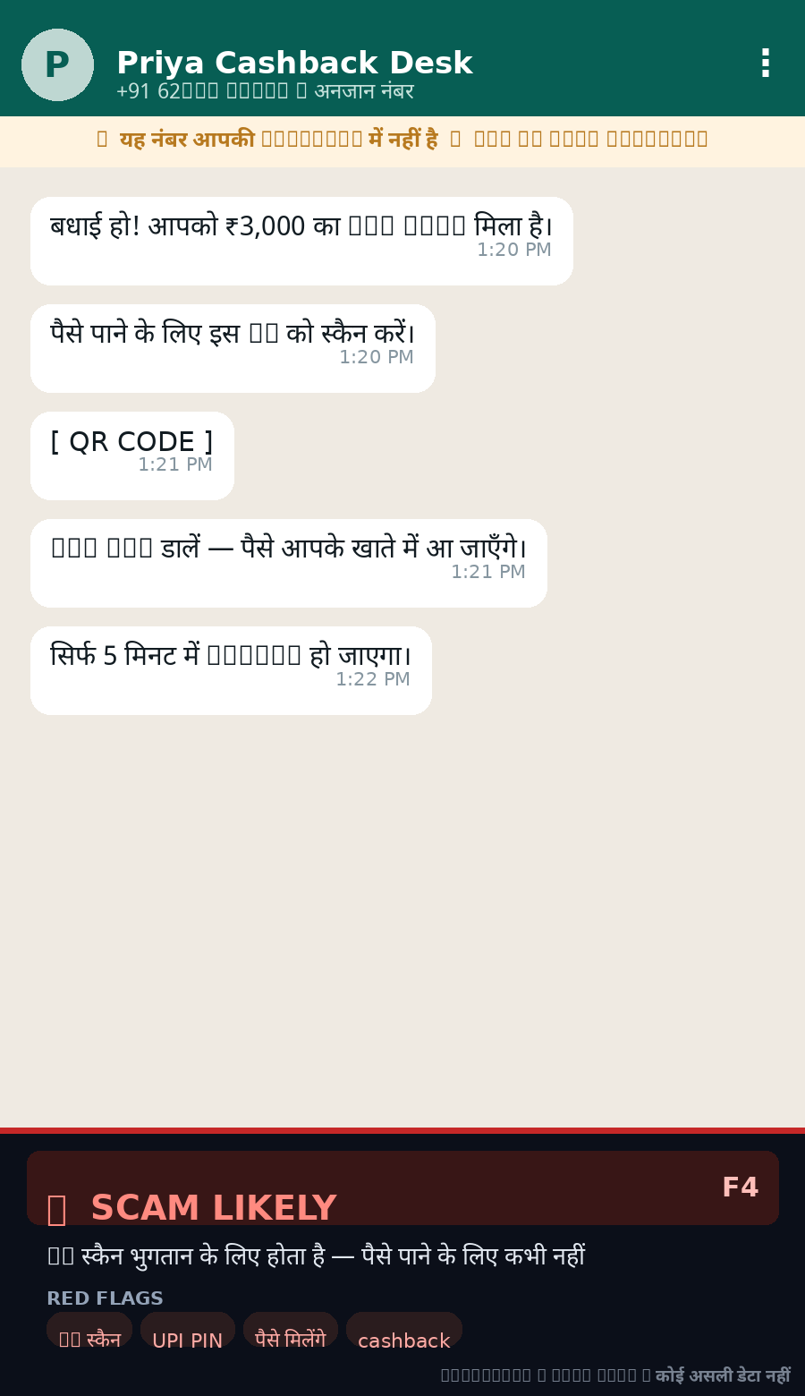
THE PROBLEM
01 · PROBLEM
UPI fraud is not a hack. It is a conversation.
Nobody breaks UPI encryption. They talk to you — a call, a deadline, a fake officer — and the money moves in one rushed moment, with one six-digit PIN.
60 seconds
before the PIN is where every real defence must live
1930 / NCRP
react after the loss — refunds are never guaranteed
Blacklists
are stale the day a new scam domain is registered
WHAT THE ATTACK LOOKS LIKE• Urgency + isolation — “stay on the call, do not tell anyone”
• Authority costume — fake CBI / bank / courier / SEBI officer
• Wrong direction of money — scan a QR to “receive”, pay a “fee” to get a loan/job
• Converging signals — any one is survivable; two or three together is an attack
Fake “digital arrest”
“Scan to receive refund”
SatarkPay · सतर्कपे · SANGYAN 2026
02

Slide 3
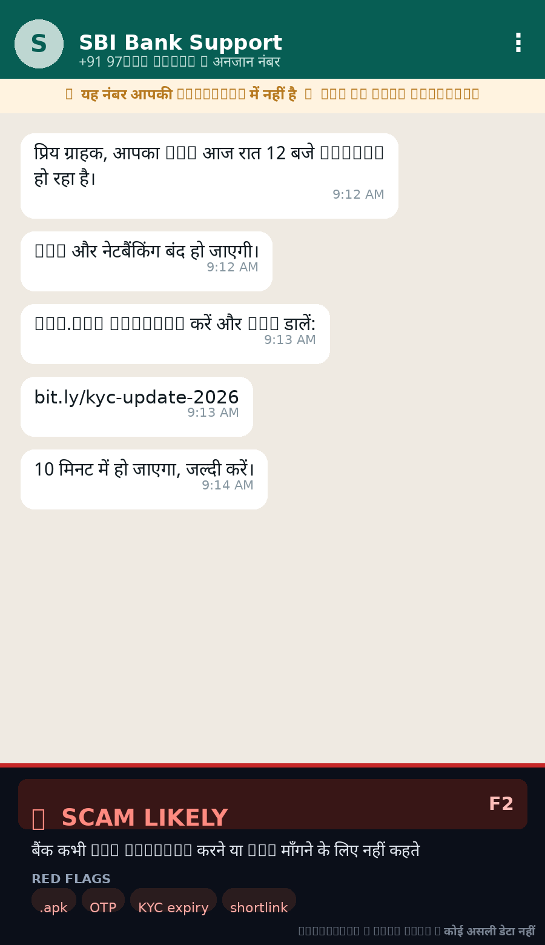
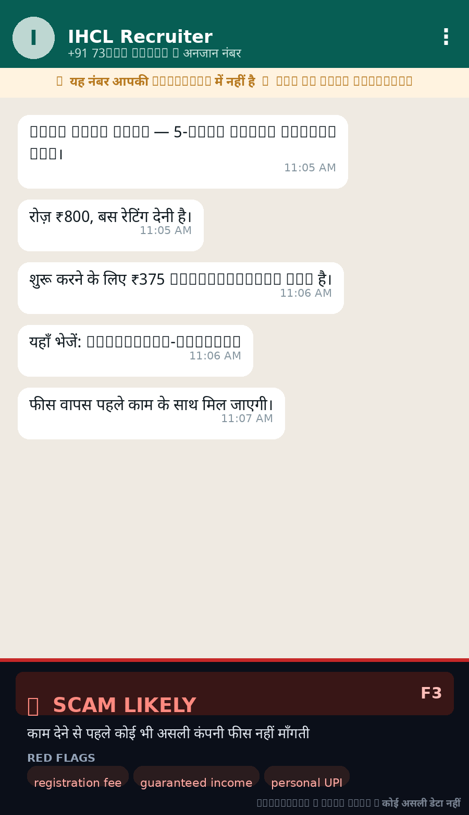
DOCUMENTED PATTERNS
02 · LIBRARY
Ten scams, four seen in the wild
Each pattern in the library names the physical fact that makes the ask impossible — that fact is what the engine encodes.
• Fake bank / KYC call
• UPI collect-request scam
• OTP / PIN / CVV theft
• Fake customer-care numbers
• Remote-access apps (AnyDesk)
• SIM-swap & “wrong refund”
All ten ship in Hindi too —
data/scam_library_hi.json
Digital arrest
No agency arrests over video call or collects a “security deposit”.
KYC / fake APK
The installed APK reads the OTP — the message is only bait.
Refund QR
A QR scan can only debit money. Never credit.
Fake job / loan
Salary and loans are never unlocked by a registration fee.
SatarkPay · सतर्कपे · SANGYAN 2026
03

Slide 4
THE SOLUTION
03 · HOW IT WORKS
Nine signals, one honest arithmetic
Every weight is a whole number, added in the open. The arithmetic IS the explanation — which is the only way a warning is ever believed.
THE ATTACK CHAIN (EXAMPLE)
On a call while paying ···· +4
“Scan to receive money” ···· +4
Screen sharing active ···· +3
First time paying this payee ···· +3
Amount ≫ your usual ···· +3
Instructions over chat ···· +2
Long build-up before the ask ···· +2
Handle is not a real PSP code ···· +2
Message matches known script ···· +5
score 23 → CRITICAL → pay action withheld
LOW · 0–2
Pay when ready — still match the payee name yourself.
CAUTION · 3–5
30-second cooling-off. Long enough to think, not to feel punished.
HIGH · 6–9
60-second cooling + a written alternative route per signal.
CRITICAL · 10+
Pay withheld. No countdown — it never “becomes available”.
SatarkPay · सतर्कपे · SANGYAN 2026
04

Slide 5
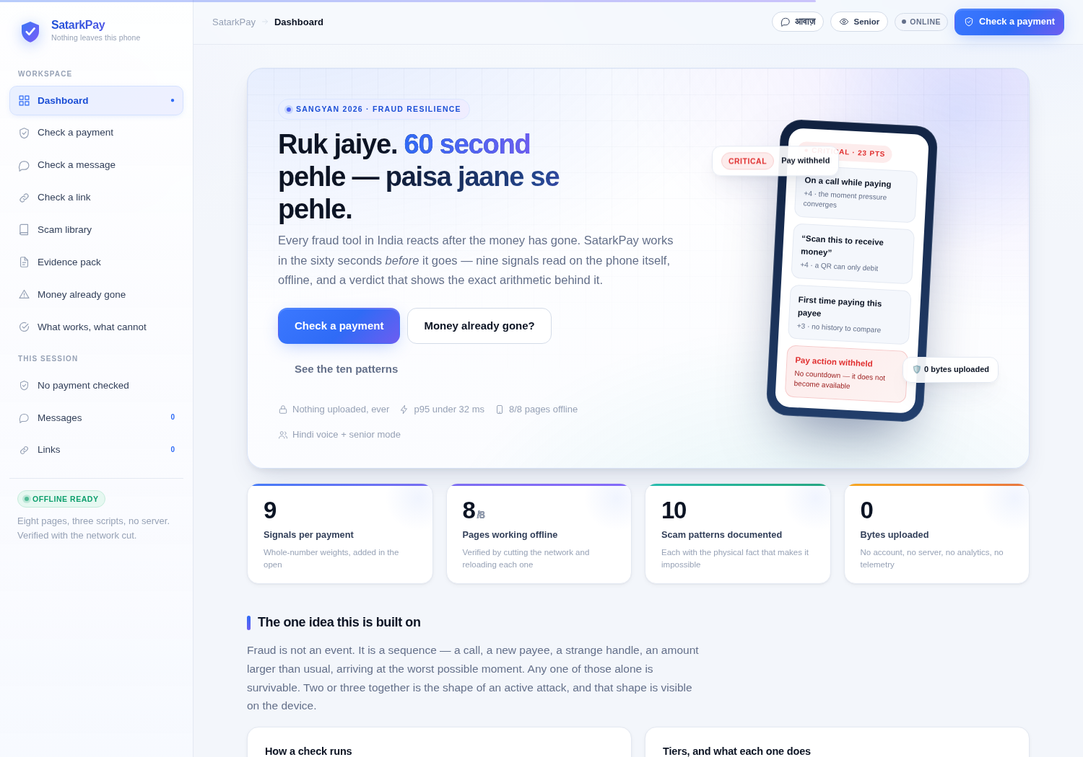
LIVE PRODUCT · WEB
04 · DEMO
SatarkPay web app — offline, no install
WHAT IT RUNS• Payment gate — nine questions → score → tier → gate
• Message checker — 13 fraud patterns + 4 legitimacy markers
• Link ladder — decomposition instead of blacklists
• Redaction first — UPI IDs, cards, OTPs masked on-device
• Evidence pack — structured, redacted, 1930-ready
• Emergency mode — seven steps in the order that matters
• Hindi voice + senior mode — for elders, in their language
8/8 pages work with the network cut.
No account, no server, no analytics. Verified by switching the browser offline and reloading every page.
Dashboard · attack-chain · tiers · 8 offline pages
SatarkPay · सतर्कपे · SANGYAN 2026
05

Slide 6
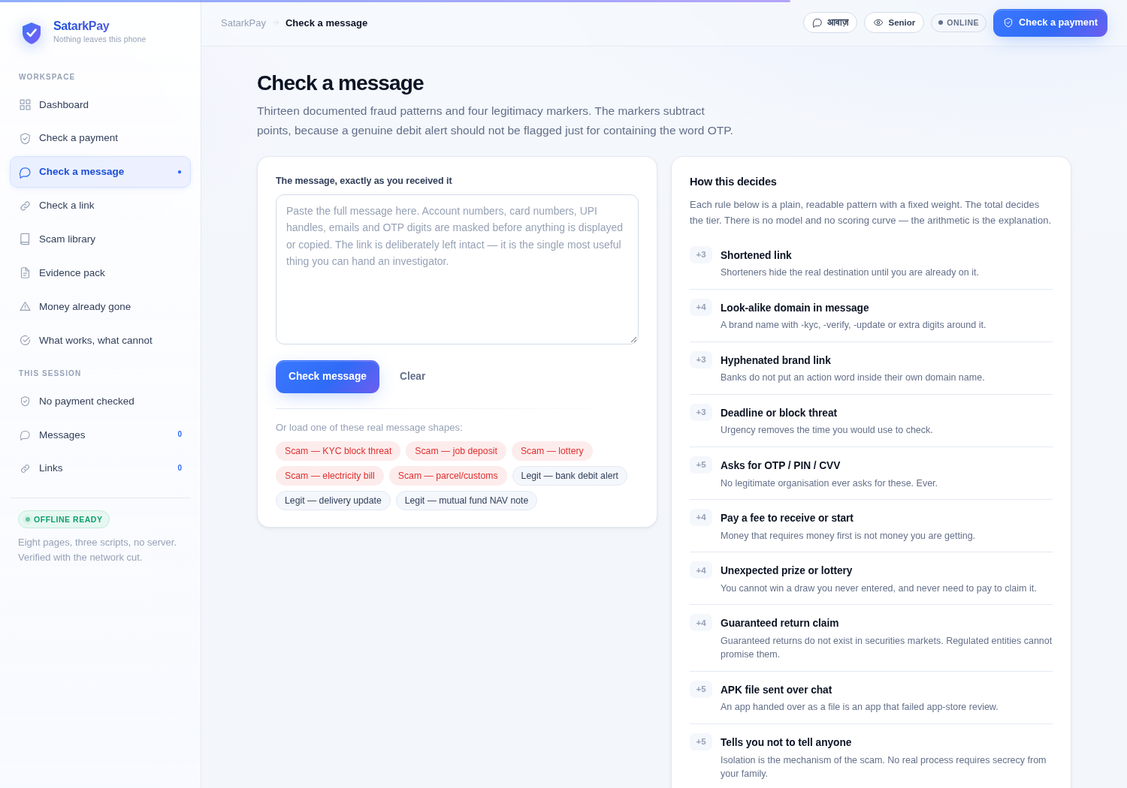
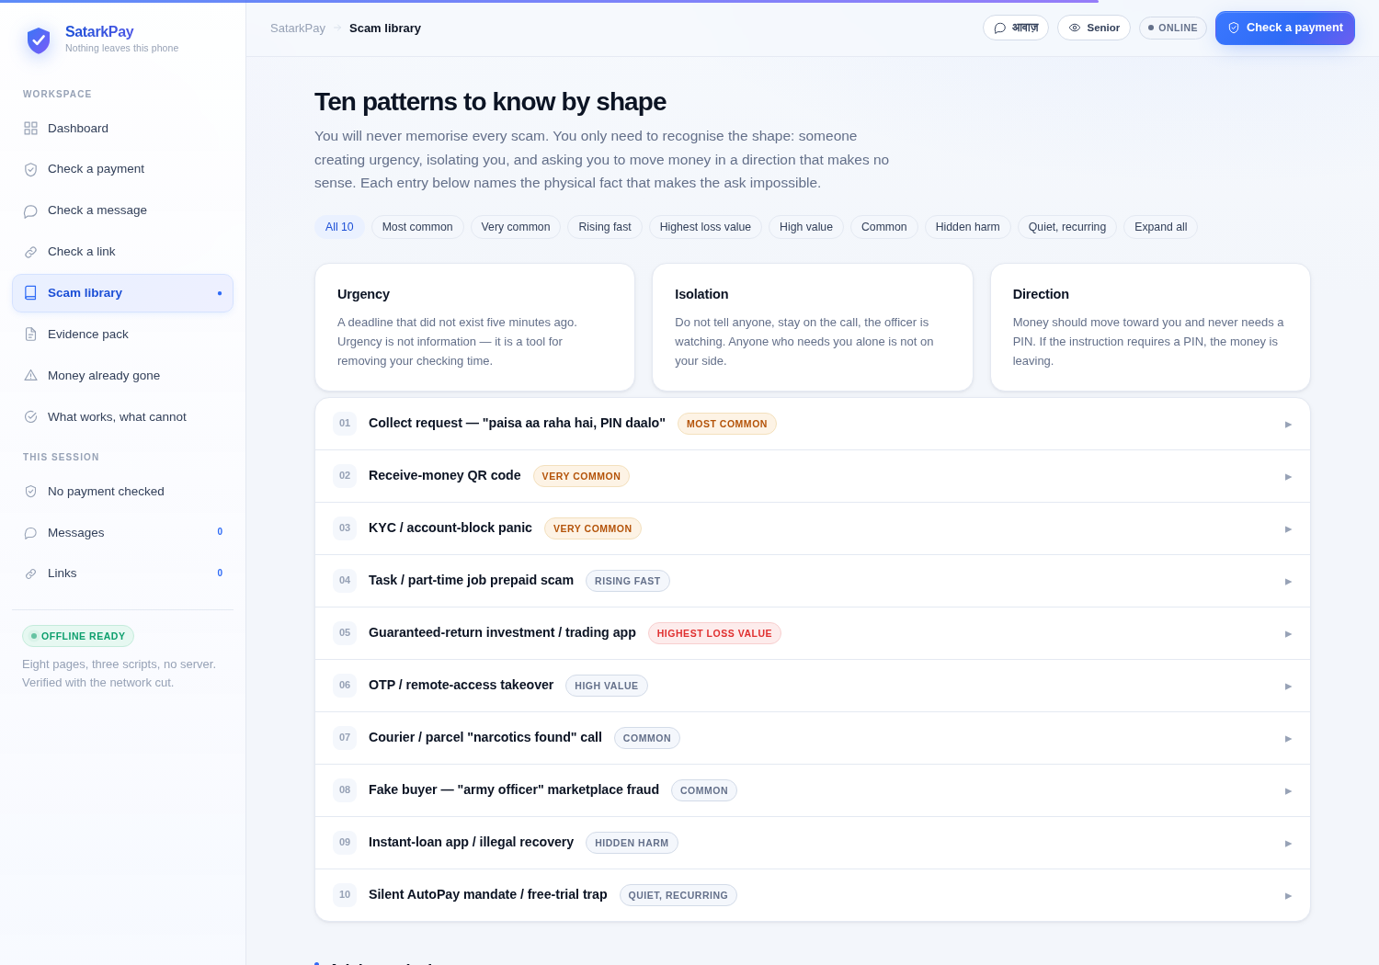
LIVE PRODUCT · WEB
04 · DEMO
Check a message · library · evidence
WhatsApp Scam Checker: paste any suspicious SMS / WhatsApp / job or loan offer → pattern match + legitimacy markers + “what not to do” + official complaint routes.
SatarkPay · सतर्कपे · SANGYAN 2026
06

Slide 7
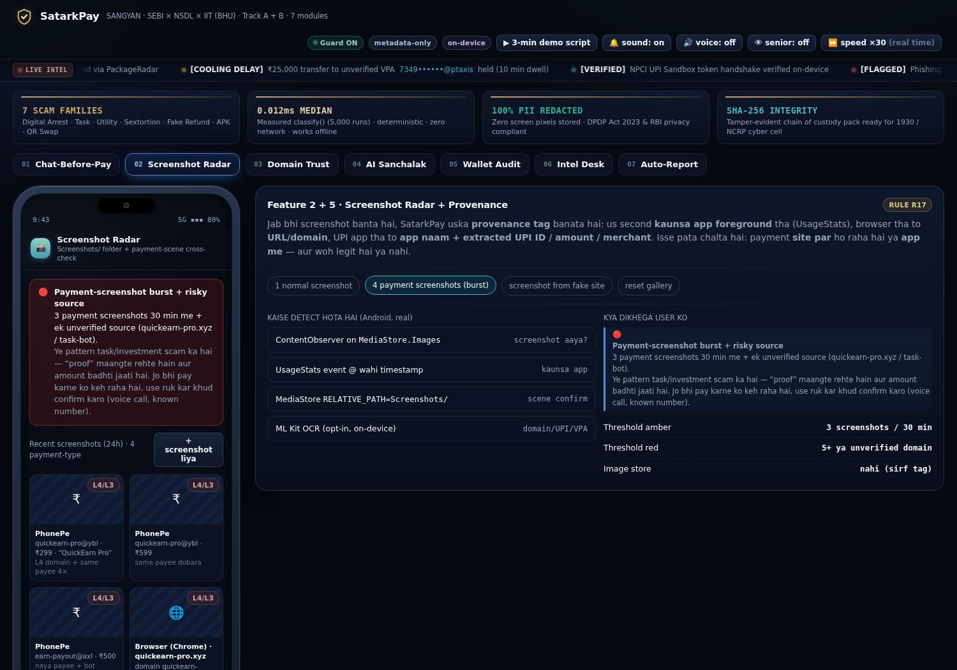
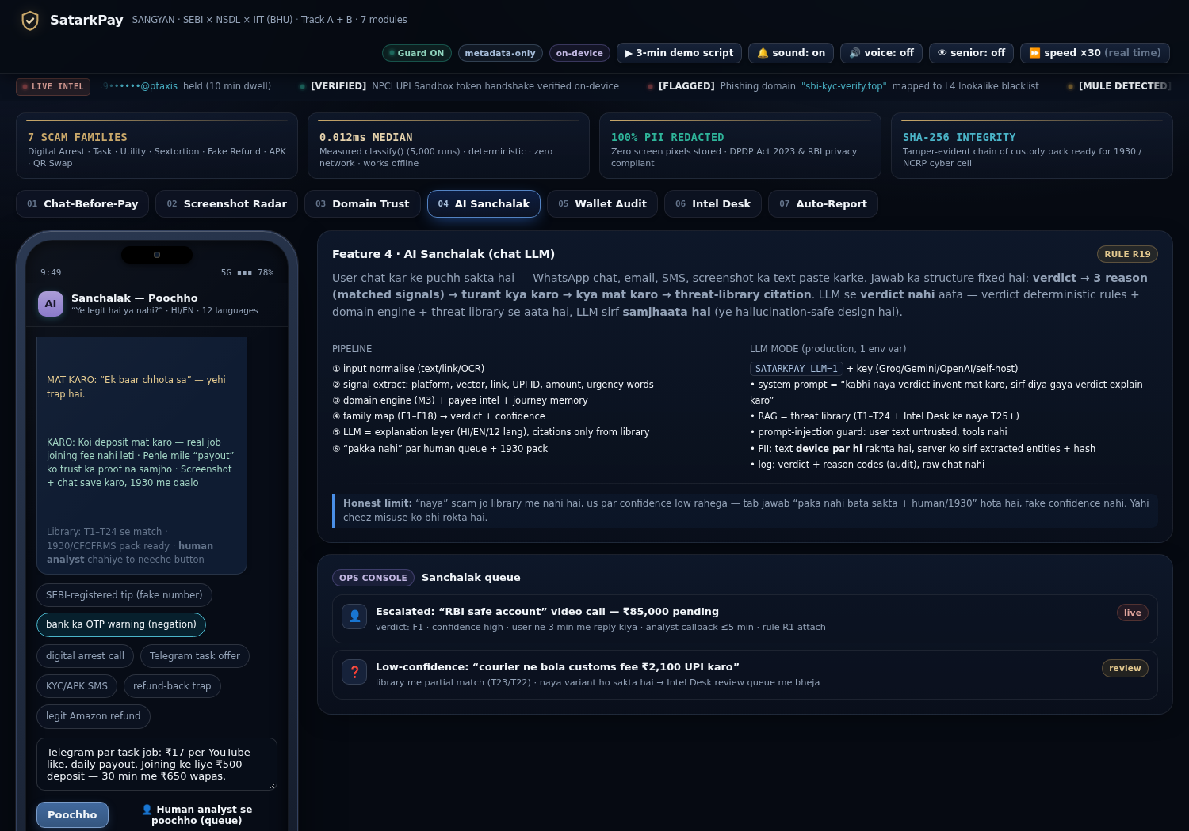
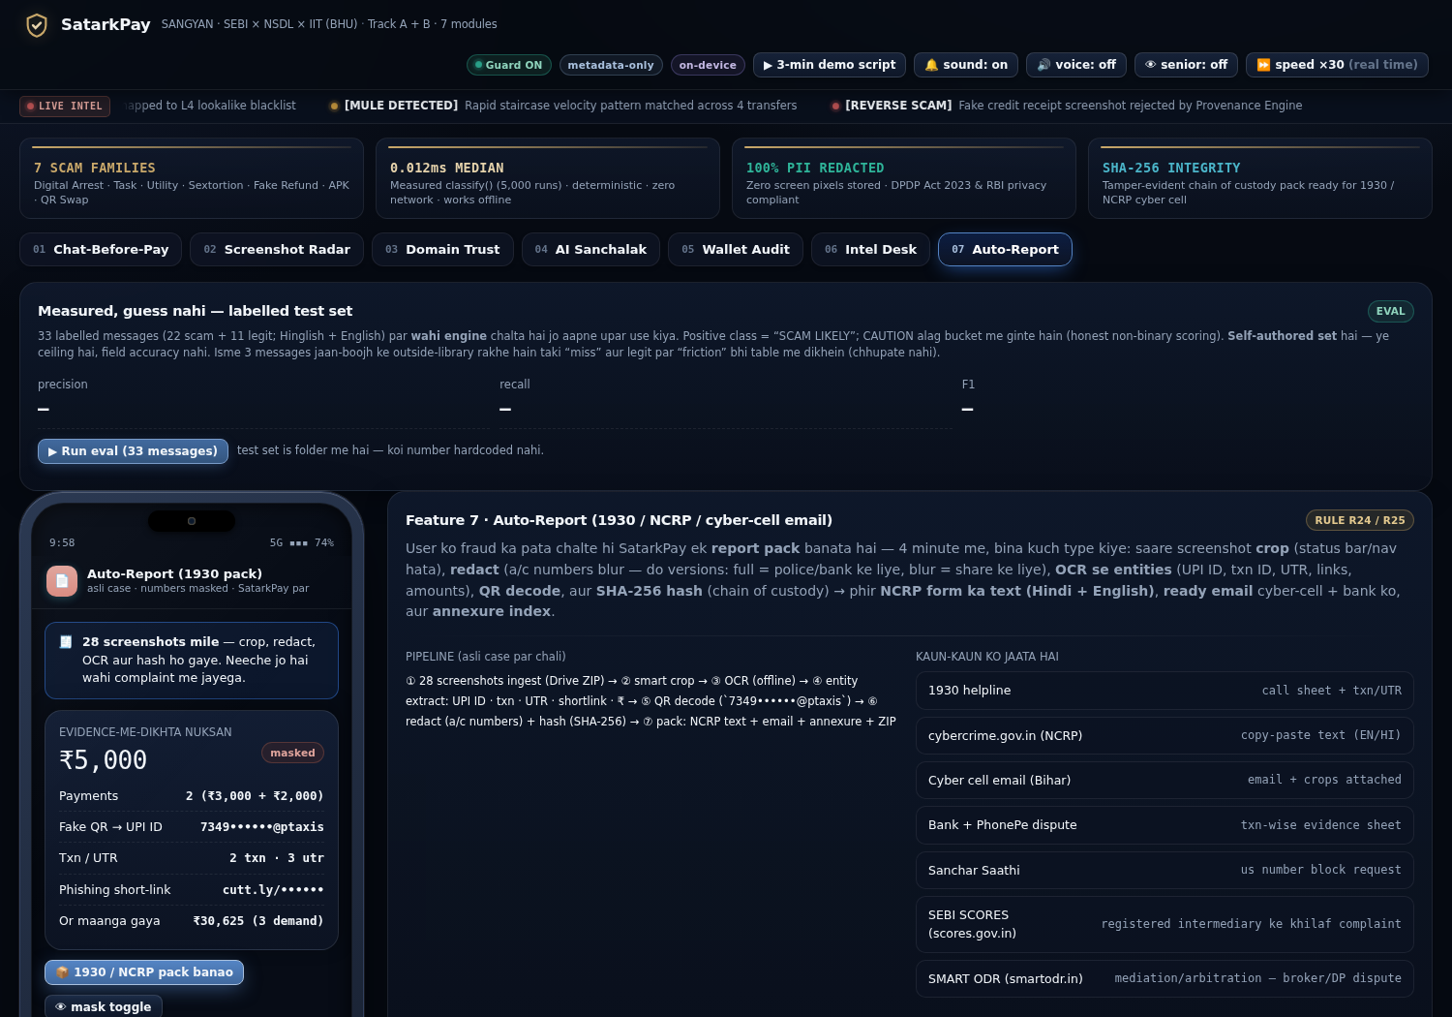
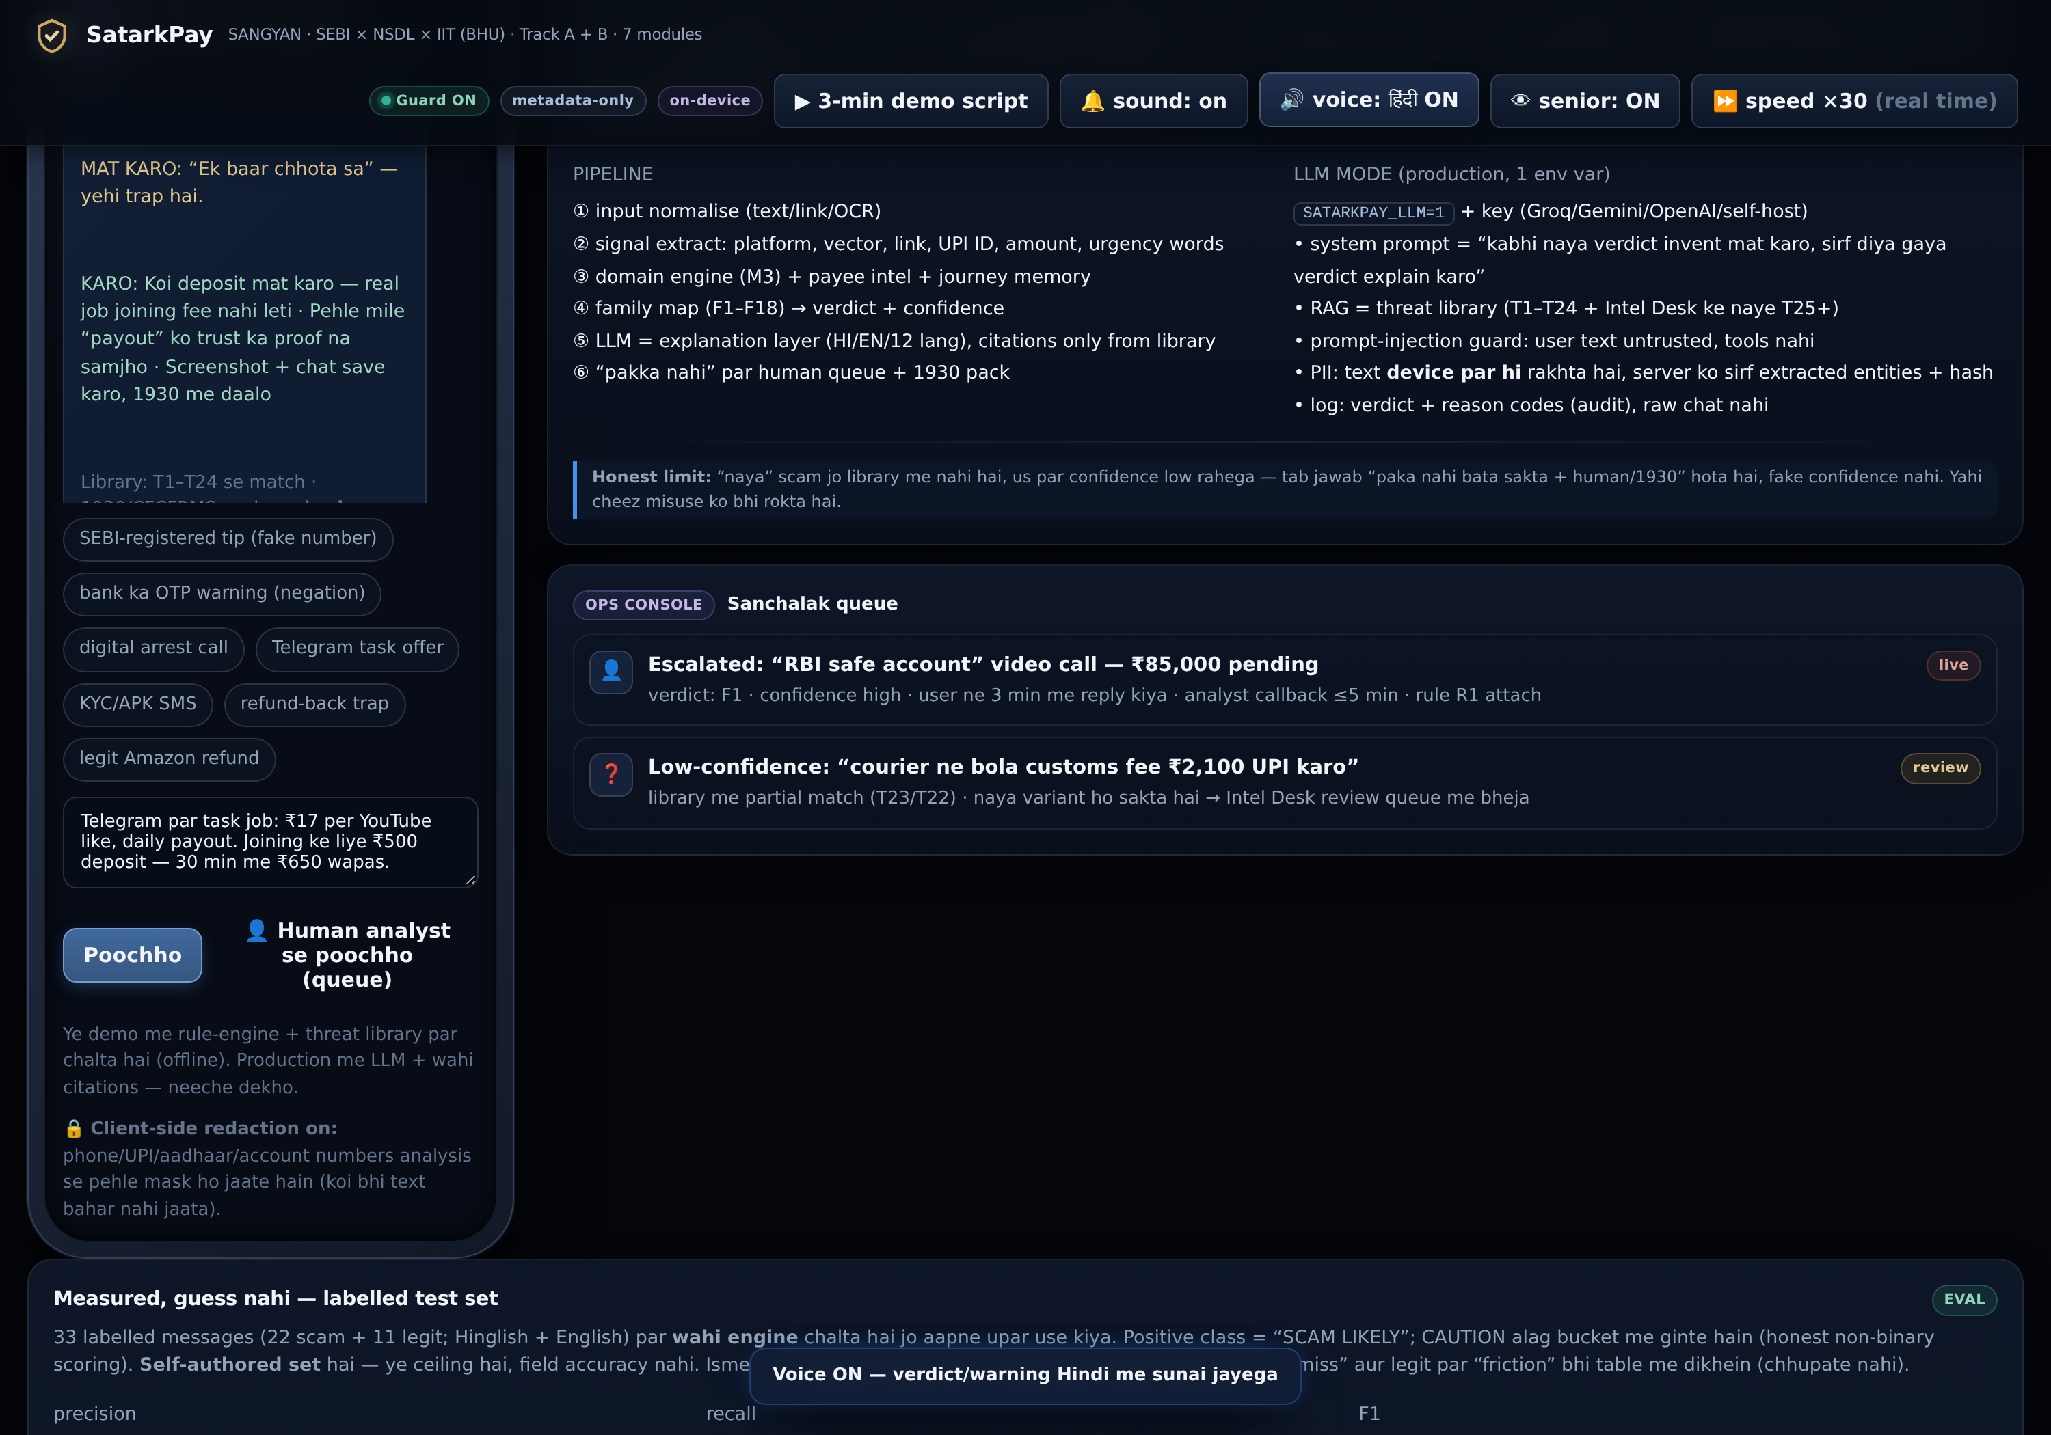
LIVE PRODUCT · ANDROID
05 · DEMO
Native app — Kotlin + Jetpack Compose
14 SCREENS · FULL STACK• Chat-before-Pay gate — the same engine, native
• Screenshot Radar — WhatsApp burst detection + triage
• Sanchalak AI chat — Hindi voice, audio notes (Gemini)
• Wallet AutoPay audit — silent mandates, exposed
• Emergency + Grievance — 1930 pack, SCORES/ODR ladder
• App-security scanner — remote-access app detector
• Room DB + offline rules — core protects with zero network
Premium light fintech theme —
same design system as the web app. Senior mode, Hindi TTS, PII masking built in.
SatarkPay · सतर्कपे · SANGYAN 2026
07

Slide 8
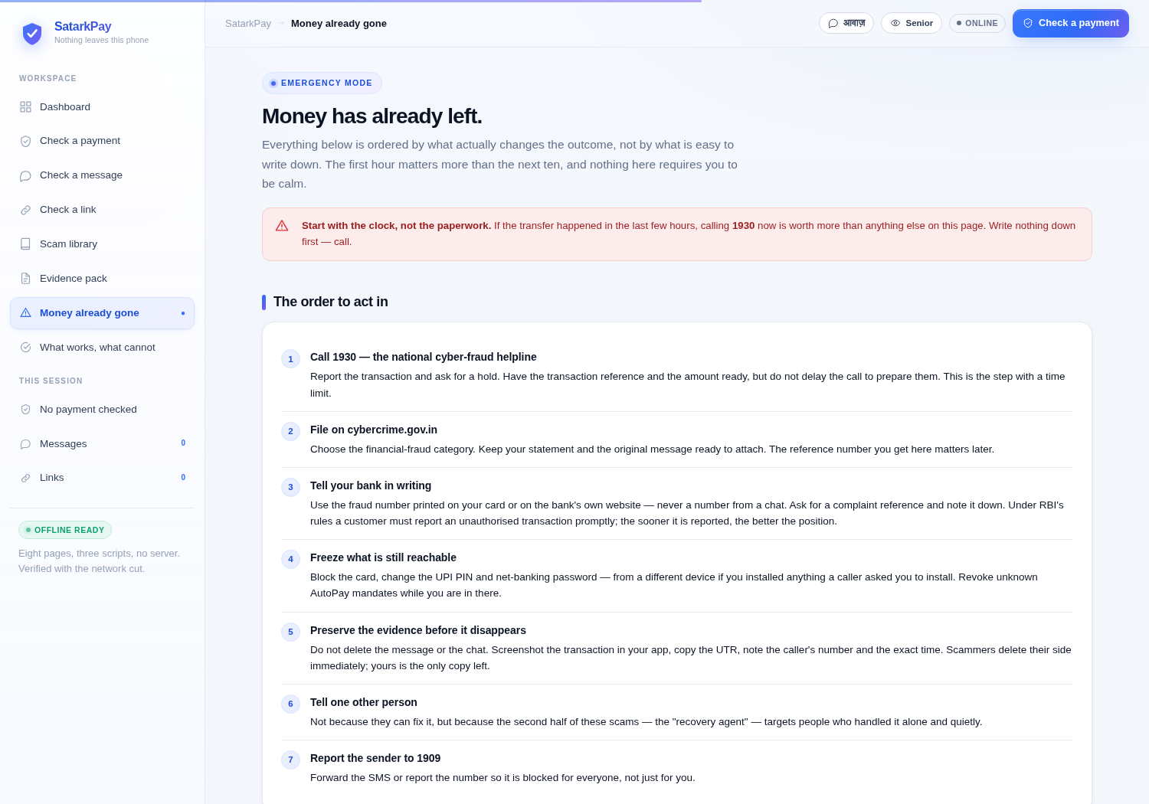
WHEN MONEY IS ALREADY GONE
06 · SUPPORT
10-minute emergency mode + complaint packet
IN THE ORDER THAT CHANGES THE OUTCOME
1. Call 1930 immediately — golden hour for freezing funds
2. Report on cybercrime.gov.in (Financial Fraud)
3. Bank + UPI app: block / freeze cards, UPI, net-banking
4. Preserve evidence: UTR, txn IDs, chats, screenshots
5. Get a written complaint number from the bank
6. Alert family — the “recovery agent” call is coming
7. Never pay anyone promising recovery
Complaint Packet Generator + Hindi voice
One structured redacted record for cybercrime.gov.in / the bank — plus voice guidance for seniors.
SatarkPay · सतर्कपे · SANGYAN 2026
08

Slide 9
VERIFIED IN THIS REPOSITORY
07 · RESULTS
Small numbers, honestly labelled
Self-authored, small-sample, reproducible — the commands are in docs/VERIFICATION.md.
92.7 %
Message classifier F1
P 95.0 · R 90.5 on 33 labelled messages
11.7 ms
Engine latency p50
p95 31.5 ms over 5,000 runs
139 / 139
Assertions passing
logic + UI + offline in a real browser
8 / 8
Pages offline
service-worker precache, verified cut-off
• A missing default in a weight map made score NaN for unknown sources — silently pushing every verdict to LOW.
• A countdown was displayed at CRITICAL, implying the payment would unlock. It never does.
THE HONEST BOUNDARY
Two misses in the classifier are frauds carried by a phone number and a context text rules cannot see — exactly the gap the on-device signal chain closes.
Payee-name verification against the bank record needs a PSP API. Until then, the app keeps saying: verify the name yourself.
SatarkPay · सतर्कपे · SANGYAN 2026
09

Slide 10
WHERE THIS GOES
08 · NEXT
Roadmap · team · thank you
• Web + Android demo complete
• Rules R1–R38 + eval harness
• Evidence pack → 1930 workflow
• Signed, versioned pattern updates
• PSP payee-name verification hook
• District-level awareness pilot
• Android accessibility service gate
• Bank / PSP grievance integrations
• Vernacular voice in 8 languages
Team SCΛMURΛI
Nishant Kumar · Prince Singh · Kartik Singh — SANGYAN 2026, SEBI × NSDL × SNTC, IIT-BHU
“Paisa bhejne se pehle 60 second, fraud ke baad 60 minute.”
Thank you — questions welcome. · Live: sudonishant.github.io/satarkpay-repo/webapp/
SatarkPay · सतर्कपे · SANGYAN 2026
10

