Slide 1

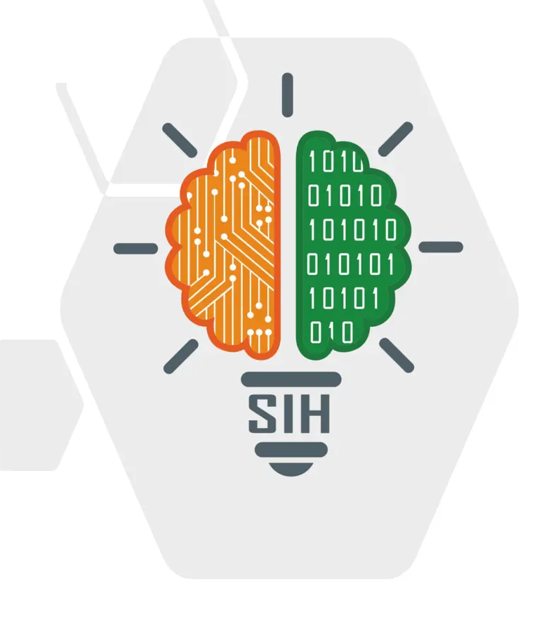
SMART INDIA HACKATHON 2026
IPSEC X-RAY — PROPOSED SOLUTION
Problem Statement ID – SIH26160
Problem Statement Title – AI-Powered IPsec VPN Protocol Analyzer and Security Assessment Framework
Theme – Blockchain & Cybersecurity
PS Category – Software
Team ID – 151087
Team Name – Sudo Spandr (Registered on portal)
Live URL – https://sudo-vpn.vercel.app/
Idea: IPsec X-Ray — check how safe an IPsec VPN is, just from its traffic (Live on Vercel)

Slide 2
Sudo Spandr
IPsec X-Ray — AI-Powered IPsec VPN Protocol Analyzer
PROPOSED SOLUTION • the idea • how it solves the problem • what is new
INPUT
IPsec X-RAY ENGINE
OUTPUTS
Encrypted IPsec tunnel (IKE / ESP / AH)
1 IDENTIFY
which protocol, IKE version, mode, ciphers, key exchange, SA settings, and what traffic is inside ESP
Security score
Office A
VPN gateway
copy of traffic
Office B
VPN gateway
traffic file (PCAP) or live traffic
Risk score
IPsec X-Ray
only listens — never touches the tunnel
IKE v1 / v2
2 ASSESS
checks: 25 live today, 66 by Dec · cipher strength · lifetimes · replay · PFS · metadata leaks
Threat matrix
Security score
0–100, grade A+ → F
Risk score + threat matrix
what can go wrong
Report + dashboard
for managers & engineers
ESP
%
AI confidence
AH
NAT-T
3 SCORE
0–100 with grade A+ → F · risk score · threat matrix · confidence for every finding
Report (2 levels)
WHAT
A tool that listens to VPN traffic (IKE / ESP / AH) and tells how safe the tunnel is — no keys, no software on the routers.
IPv4 / IPv6
Dashboard
HOW
It reads the open parts of the traffic, and uses AI on packet sizes and timing to find the hidden parts: cipher framing, mode, and traffic type inside (call, chat, mail, web, video); PFS observed on rekey or marked Unknown.
from the PS testbed
PASSIVE • NO KEYS • NO AGENTS • NO ROUTER ACCESS
WHY NOW
Old, breakable settings (IKEv1, 1024-bit DH, no PFS) are still common — and today nobody can see what a tunnel really uses without logging into every device.
WHAT IS NEW
Sees inside ESP without decrypting it — packet sizes + AI reveal the cipher, mode, PFS and traffic type.
Never guesses — every result is marked Observed / Inferred / Unknown with a confidence %, and names the standard it checks.
SUDO SPANDR • TEAM ID 151087 • PS SIH26160
@SIH Idea submission- Template
2

Slide 3
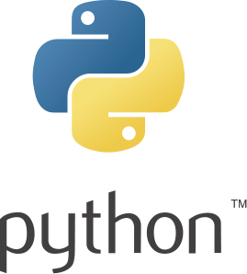





Sudo Spandr
TECHNICAL APPROACH
Technologies used • Step-by-step process • Working prototype
1 TESTBED
2 CAPTURE
3 PARSE
4 AI IDENTIFY
5 ASSESS & REPORT
Real VPN tunnels built in our lab (strongSwan / Libreswan)
all PS settings: both modes · AES-128/256 GCM & CBC · DH 14/19/20 (+ML-KEM) · PFS on/off · IPv4/IPv6
8 traffic types; lab saves keys only as ground-truth answer key to score our models
Record the traffic (tshark / Scapy): IKE, ESP, AH, NAT-T
from a file (PCAP) or live interface
Tool is 100% passive: uses NO keys, NO router access, NO decryption
Read the open fields: IKE messages, proposals, SPIs, lifetimes, sequence numbers
→ exact table of what the tunnel negotiated (Observed)
ESP length physics + Calibrated Random Forests
→ cipher framing (86.1%) · mode (95.7%) · traffic type
honest metric: 0 real flows in v1, fully transparent in meta.json
25 live checks (66 by Dec) → score, risk, threat matrix
web dashboard (FastAPI + React)
PDF report: 1 page for managers + details for engineers
OBSERVED — read directly from the open IKE / ESP headers
INFERRED — AI + confidence %
SCORED — against the standards
HOW THE AI SEES INSIDE AN ESP PACKET
TECH STACK
ESP header (SPI · Seq)
IV
encrypted data + padding + pad-len + next-header
ICV
Observed: SPI & sequence numbers → replay window, re-keys, lifetimes
Inferred: packet-length pattern → cipher family · ICV size → integrity algorithm · re-key size → DH group / PFS
Inferred: size & timing pattern → what traffic is inside
Python
Scapy
PyTorch
FastAPI
React
Docker
strongSwan
Libreswan
tshark
LightGBM
Streamlit → React
WHAT WORKS TODAY
✔
Testbed generator
lab with 200+ tunnel setups · recordings + keys
✔
ESP size analyzer
finds the cipher without keys (measured — slide 6)
IKE parser + 25 core checks
first security score (command line)
Dashboard + PDF report
Streamlit first, React later
✔
working
in progress (Oct)
SUDO SPANDR • TEAM ID 151087 • PS SIH26160
@SIH Idea submission- Template
3

Slide 4
Sudo Spandr
FEASIBILITY AND VIABILITY
Why it can be built • Challenges & risks • How we handle them
WHY IT CAN BE BUILT
CHALLENGES → HOW WE HANDLE THEM
OPEN TOOLS & STANDARDS
OUR OWN LAB = ANSWER KEY
AI ONLY WHERE NEEDED
Challenge / risk | Our answer
AES-128 and AES-256 look the same on the wire | Say 'AES-GCM, key size unknown' unless IKE shows it — never guess
PFS can be seen only when the tunnel re-keys | Mark 'PFS: Unknown' and tell the user how long to capture
Different vendors pad packets differently | Calibrate per vendor in our lab; lower the confidence if patterns disagree
AI may be over-confident | Calibrated probabilities; below the threshold → 'Unknown'
TLS / QUIC inside the tunnel hides the app | Report 'encrypted web' with lower confidence — no over-claiming
Lab has only strongSwan / Libreswan | Add Cisco / Fortinet / Windows captures in Nov; unknown vendor → 'Unknown'
Every PS setting can be built with free tools (strongSwan / Libreswan). Checks follow RFC 8221 / 8247 / 9395, NIST SP 800-77r1 and CNSA 2.0.
For 200+ tunnel setups we keep the traffic, the keys and the decrypted copy — so the AI is trained and tested on known answers.
Open fields are read directly. AI is used only for hidden fields, with a confidence %. Low confidence → 'Unknown'.
OUR LAB (Linux namespaces / VMs)
HOW EACH FIELD IS DECIDED
PC A
GW A
GW B
PC B
Is the field open in IKE?
yes
OBSERVED
capture point → traffic + keys + decrypted copy (answer key)
no
200+ tunnel setups × 8 traffic types (VoIP, WhatsApp, e-mail, web, ICMP, video…)
AI on packet sizes & timing
OCT
parser · 25 checks · first score
confidence high enough?
yes
STANDARDS
RFC 8221
RFC 8247
RFC 9395
NIST 800-77
CNSA 2.0
INFERRED
NOV
traffic-type AI · dashboard · dataset
+ confidence %
Low cost, easy to scale: runs on a normal laptop or a SOC server, 100 % open-source, works offline, no vendor lock-in. New ciphers or vendors are added as simple YAML rules, not code. The checks list and the dataset will be published.
DEC
polish · demo video · finale
no
₹
UNKNOWN + tip: capture longer
SUDO SPANDR • TEAM ID 151087 • PS SIH26160
@SIH Idea submission- Template
4

Slide 5
Sudo Spandr
IMPACT AND BENEFITS
Who gains from it • Benefits — security, cost, strategy
SAMPLE RESULT • lab tunnel #37
WHO BENEFITS
BENEFITS
45 / 100
NTRO / CERT-In & auditors — check any VPN from a traffic recording; no vendor login needed.
SECURITY
₹
COST & TIME
Weak tunnels (IKEv1, DES / 3DES, 1024-bit DH, no PFS) are found — with a score and a fix list.
Hours of manual checking → minutes per tunnel. Nothing to install, no downtime, free tools.
Grade D — weak
Power, banking, telecom, defence SOCs — watch the crypto health of every tunnel, all the time.
IKEv1 aggressive mode — deprecated
DH group 2 (1024-bit) — breakable
Compliance teams — a clear list of gaps vs RFC / NIST / CNSA, with what to fix first.
FUTURE-READY
IN
MADE IN INDIA
PFS — not seen yet (Unknown)
AES-CBC + HMAC-SHA2-256 — OK
Shows if a tunnel is ready for post-quantum crypto (ML-KEM) — against 'store now, break later'.
An Indian, vendor-neutral tool for national and critical networks.
Investigators & researchers — learn what kind of traffic a tunnel carries + an open dataset.
AI confidence 0.91 • 3 fixes suggested
days → minutes
time to audit one tunnel
0 keys · 0 agents
nothing to install
66 checks · 12 threats
score 0–100 · grade A+ → F
WHY IT MATTERS
Logjam (2015): pre-computing a single 1024-bit prime decrypts 18% of HTTPS; a second prime breaks ~66% of IPsec VPNs.
IKEv1 deprecated (RFC 9395, Apr 2023) — old tunnels still run; non-PQC captures recorded today can be broken in future.
✕ Manual check today: config files and vendor logins — trusts what is written, not what really runs.
✓ IPsec X-Ray: looks at the real traffic — what was really negotiated, what is weak, and how sure we are.
SUDO SPANDR • TEAM ID 151087 • PS SIH26160
@SIH Idea submission- Template
5

Slide 6
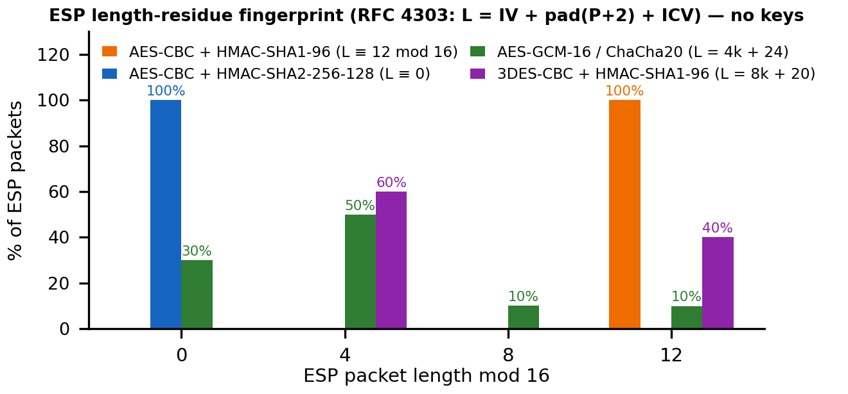
Sudo Spandr
RESEARCH AND REFERENCES
Sources and links behind this idea
STANDARDS WE CHECK AGAINST
WHAT WE WILL DELIVER • ALL 7 PS DELIVERABLES
[1] RFC 4303 — IP Encapsulating Security Payload (ESP) rfc-editor.org/rfc/rfc4303
[2] RFC 7296 — Internet Key Exchange Protocol v2 (IKEv2) rfc-editor.org/rfc/rfc7296
[3] RFC 8221 — Cryptographic algorithm requirements for ESP & AH rfc-editor.org/rfc/rfc8221
[4] RFC 8247 — Algorithm implementation requirements for IKEv2 rfc-editor.org/rfc/rfc8247
[5] RFC 9395 — Deprecation of IKEv1 and obsoleted algorithms rfc-editor.org/rfc/rfc9395
[6] NIST SP 800-77 Rev. 1 — Guide to IPsec VPNs csrc.nist.gov/pubs/sp/800/77/r1/final
[7] NSA CNSA 2.0 — DH 16/20, AES-256, SHA-384, ML-KEM (post-quantum) nsa.gov/Press-Room/Cybersecurity-Advisories-Guidance/
✔
1. AI-powered Protocol Analyzer
✔
2. Standards Security Assessor
✔
3. Testbed Suite (strongSwan)
✔
4. Real-time Live Dashboard
✔
5. Executive & Technical Reports
✔
6. Ground-Truth PCAP Corpus
✔
7. Threat Matrix & Replay Engine
OUR FIRST RESULT • LAB MEASUREMENT
RESEARCH, DATA & TOOLS
[8] Adrian et al., “Imperfect Forward Secrecy” (Logjam), ACM CCS 2015 weakdh.org
[9] Felsch et al., “The Dangers of Key Reuse: Practical Attacks on IPsec IKE”, USENIX Security 2018 usenix.org/conference/usenixsecurity18/presentation/felsch
[10] Bhargavan & Leurent, Sweet32 — 64-bit block-cipher (3DES) collision attacks sweet32.info
[11] ISCX VPN-nonVPN 2016 dataset (UNB CIC) — encrypted-traffic classification baseline unb.ca/cic/datasets/vpn.html
[12] ET-BERT — transformer for encrypted-traffic classification (arXiv 2202.06335) arxiv.org/abs/2202.06335
[13] IETF draft-ietf-ipsecme-ikev2-mlkem + strongSwan 6.0 (ML-KEM in IKEv2) — PQC testbed tunnels datatracker.ietf.org/doc/draft-ietf-ipsecme-ikev2-mlkem/
ESP length residues separate mode and tag size — basis of the AI inference step (Live: https://sudo-vpn.vercel.app/).
SUDO SPANDR • TEAM ID 151087 • PS SIH26160
@SIH Idea submission- Template
6

