Slide 1

Advanced Database Management System
Dwipen Laskar
Assistant Professor
Department of Computer Science
Gauhati University,

Slide 2
Introduction
Databases and database systems are an essential component of life in modern society.
Most of us encounter several activities every day that involve some interaction with a database
In the traditional database applications, in which most of the information that is stored and accessed is either textual or numeric.
In the past few years, advances in technology have led to exciting new applications of database systems
Multimedia databases, Geographic information systems (GIS) can store and analyze maps, weather data, and satellite images.
Data warehouses and online analytical processing (OLAP) systems are used in many companies to extract and analyze useful business information from very large databases to support decision making.
2

Slide 3
Introduction
A database is a collection of related data. By data, we mean known facts that can be recorded and that have implicit meaning.
For example, consider the names, telephone numbers, and addresses of the people we know can be recorded in an indexed address book or we may have stored it on a hard drive, using a personal computer and software such as Microsoft Access or Excel. This collection of related data with an implicit meaning is a database.
A database has the following implicit properties:
A database represents some aspect of the real world, sometimes called the mini-world or the universe of discourse (UoD). Changes to the mini-world are reflected in the database.
A database is a logically coherent collection of data with some inherent meaning. A random assortment of data cannot correctly be referred to as a database.
A database is designed, built, and populated with data for a specific purpose. It has an intended group of users and some preconceived applications in which these users are interested.
A database can be of any size and complexity .
3

Slide 4
Introduction
A database management system (DBMS) is a collection of programs that enables users to create and maintain a database.
The DBMS is a general-purpose software system that facilitates the processes of defining, constructing, manipulating, and sharing databases among various users and applications.
Defining a database involves specifying the data types, structures, and constraints of the data to be stored in the database. The database definition or descriptive information is also stored by the DBMS in the form of a database catalog or dictionary; it is called meta-data.
Constructing the database is the process of storing the data on some storage medium that is controlled by the DBMS.
Manipulating a database includes functions such as querying the database to retrieve specific data, updating the database to reflect changes in the mini-world, and generating reports from the data.
Sharing a database allows multiple users and programs to access the database simultaneously
4

Slide 5
Introduction
An application program accesses the database by sending queries or requests for data to the DBMS.
A query typically causes some data to be retrieved; a transaction may cause some data to be read and some data to be written into the database.
Other important functions provided by the DBMS include protecting the database and maintaining it over a long period of time.
Protection includes system protection against hardware or software malfunction (or crashes) and security protection against unauthorized or malicious access.
An Example:
A UNIVERSITY database for maintaining information concerning students, courses, and grades in a university environment. Figure 1.2.
The database is organized as five files, each of which stores data records of the same type, viz., STUDENT, COURSE, SECTION, GRADE_REPORT and PREREQUISITE.
5

Slide 6

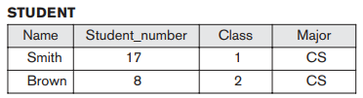
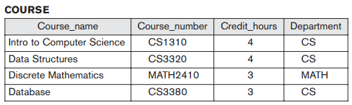
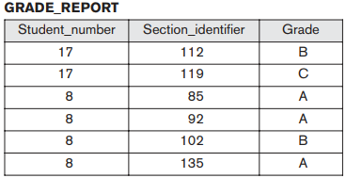
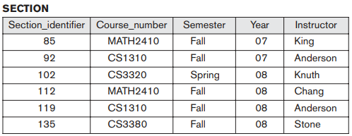
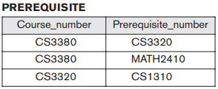
Introduction
6

Slide 7
Characteristics of the Database Approach
In traditional file processing, each user defines and implements the files needed for a specific software application as part of programming the application.
For example, one user, the grade reporting office, may keep files on students and their grades. Programs to print a student’s transcript and to enter new grades are implemented as part of the application.
A second user, the accounting office, may keep track of students’ fees and their payments. Although both users are interested in data about students, each user maintains separate files— and programs to manipulate these files—because each requires some data not available from the other user’s files. This redundancy results in wasted storage space and in redundant efforts to maintain common up-to-date data.
In the database approach, a single repository maintains data that is defined once and then accessed by various users.
In file systems, each application is free to name data elements independently. In contrast, in a database, the names or labels of data are defined once, and used repeatedly by queries, transactions, and applications
7

Slide 8
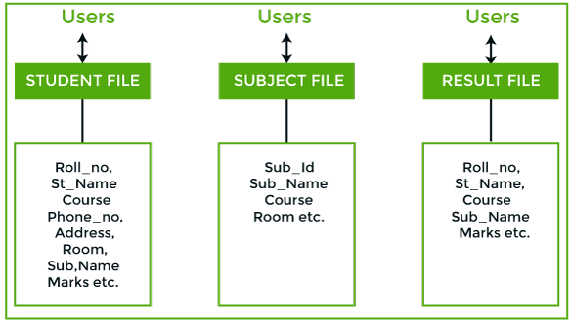
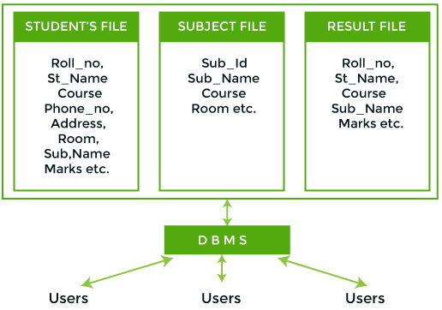
Characteristics of the Database Approach
Fig: File Processing System
Fig: DBMS
8

Slide 9
Characteristics of the Database Approach
The main characteristics of the database approach versus the file-processing approach are the following:
Self-describing nature of a database system
Insulation between programs and data, and data abstraction
Support of multiple views of the data
Sharing of data and multiuser transaction processing
Self-Describing Nature of a Database System
The database system contains the complete definition or description of the database structure and constraints along with the database.
This definition is stored in the DBMS catalog, which contains information such as the structure of each file, the type and storage format of each data item, and various constraints on the data.
The information stored in the catalog is called meta-data, and it describes the structure of the primary database
9

Slide 10
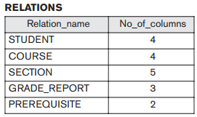
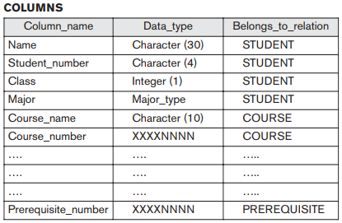
Characteristics of the Database Approach
Insulation between Programs and Data and Data Abstraction
In traditional file processing, the structure of data files is embedded in the application programs, so any changes to the structure of a file may require changing all programs that access that file.
By contrast, DBMS access programs do not require such changes in most cases.
The structure of data files is stored in the DBMS catalog separately from the access programs. This property is called as program-data independence
10

Slide 11
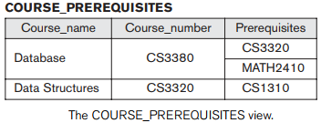
Characteristics of the Database Approach
Support of Multiple Views of the Data
A database typically has many users, each of whom may require a different perspective or view of the database.
A view may be a subset of the database or it may contain virtual data that is derived from the database files but is not explicitly stored.
Some users may not need to be aware of whether the data they refer to is stored or derived.
A multiuser DBMS whose users have a variety of distinct applications must provide facilities for defining multiple views.
11

Slide 12
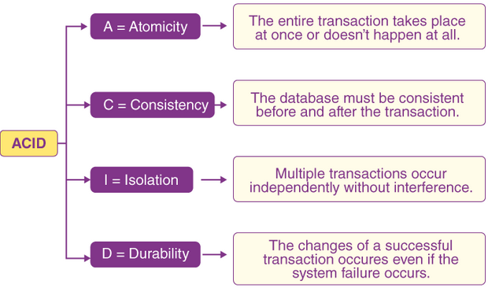
Characteristics of the Database Approach
Sharing of Data and Multiuser Transaction Processing
A multiuser DBMS, as its name implies, must allow multiple users to access the database at the same time.
This is essential if data for multiple applications is to be integrated and maintained in a single database.
The DBMS must include concurrency control software to ensure that several users trying to update the same data do so in a controlled manner so that the result of the updates is correct.
A fundamental role of multiuser DBMS software is to ensure that concurrent transactions operate correctly and efficiently.
12

Slide 13
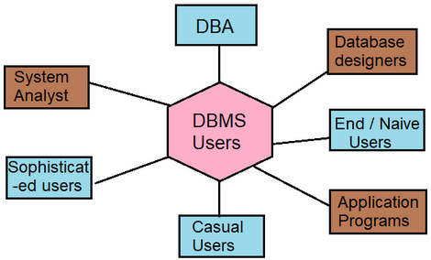
Types of users in DBMS
Database Administrator (DBA)
In a database environment, the primary resource is the database itself, and the secondary resource is the DBMS and related software.
Administering these resources is the responsibility of the database administrator (DBA). The
DBA is responsible for authorizing access to the database, coordinating and monitoring its use, and acquiring software and hardware resources as needed.
The DBA is accountable for problems such as security breaches and poor system response time. In large organizations, the DBA is assisted by a staff that carries out these functions.
13

Slide 14
Types of users in DBMS
Database designers
Database designers are responsible for identifying the data to be stored in the database and for choosing appropriate structures to represent and store this data.
Database designers are a part of a DBA team of an organization.
They are responsible for understanding the database needs of the end users.
On the basis of this knowledge they design various tables, their relationships, constraints and procedures to access the data in database.
End Users
End users are the people whose jobs require access to the database for querying, updating, and generating reports; the database primarily exists for their use. There are several categories of end users. They are Casual End Users, Naïve or Parametric end users, Sophisticated end users and Stand alone users
Casual End users
Casual end users occasionally access the database, but they may need different information each time. They use a sophisticated database query language to specify their requests and are typically middle- or high-level managers or other occasional browsers
14

Slide 15
Types of users in DBMS
End Users
Naïve or Parametric end users
Parametric End Users are the unsophisticated who don't have any DBMS knowledge but they frequently use the data base applications in their daily life to get the desired results. For examples, Railway's ticket booking users are naive users.
Sophisticated end users
These users basically include engineers, scientists, business analytics, and others who thoroughly familiarize themselves with the facilities of the DBMS in order to implement their application to meet their complex requirements
Stand alone users
These are those users whose job is basically to maintain personal databases by using a ready-made program package that provides easy-to-use menu-based or graphics-based interfaces, An example is the user of a tax package that basically stores a variety of personal financial data for tax purposes.
15

Slide 16
Types of users in DBMS
System Analyst
System analysts determine the requirements of end users, especially naive and parametric end users, and develop specifications for standard canned transactions that meet these requirements.
Application Programmers
Application programmers implement the specifications prepared by system analyst as programs;
then they test, debug, document, and maintain these transactions.
Such analysts and programmers—commonly referred to as software developers or software engineers—should be familiar with the full range of capabilities provided by the DBMS to accomplish their tasks.
16

Slide 17
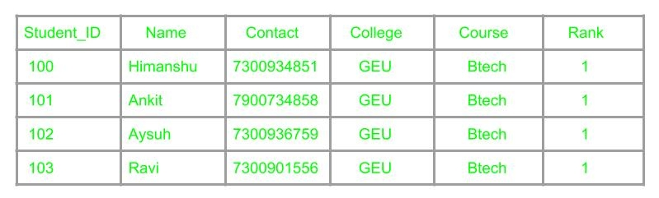
Advantages of using DBMS
Controlling redundancy
Redundancy means having multiple copies of same data in the database. This problem arises when a database is not normalized.
Suppose a table of student details attributes are: student Id, student name, college name, college rank, course opted.
As it can be observed that values of attribute college name, college rank, course is being repeated which can lead to problems.
Problems caused due to redundancy are: Insertion anomaly, Deletion anomaly, and Updation anomaly.
17

Slide 18

Advantages of using DBMS
Controlling redundancy
An insertion anomaly is the inability to add data to the database due to the absence of other data.
If a student detail has to be inserted whose course is not being decided yet then insertion will not be possible till the time course is decided for student.
18

Slide 19
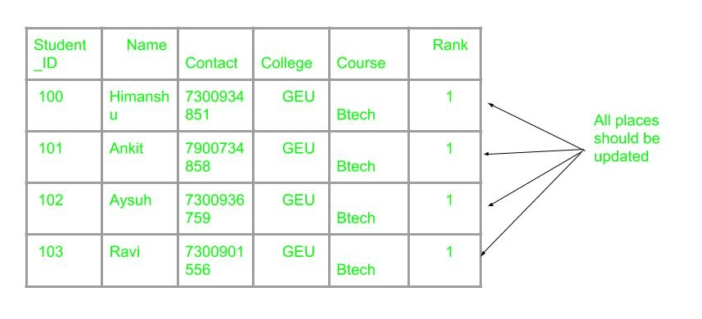
Advantages of using DBMS
Controlling redundancy
A deletion anomaly occurs when you delete a record that may contain attributes that shouldn't be deleted
E.g. If the details of students in this table are deleted then the details of college will also get deleted which should not occur by common sense.
Suppose if the rank of the college changes then changes will have to be all over the database which will be time-consuming and computationally costly.
If updation do not occur at all places then database will be in inconsistent state.
19

Slide 20
Advantages of using DBMS
Restricting Unauthorized Access
When multiple users share a large database, it is likely that most users will not be authorized to access all information in the database.
For example, financial data is often considered confidential, and only authorized persons are allowed to access such data.
A DBMS should provide a security and authorization subsystem, which the DBA uses to create accounts and to specify account restrictions.
Then, the DBMS should enforce these restrictions automatically.
Providing Persistent Storage for Program Objects
Databases can be used to provide persistent storage for program objects and data structures.
This is one of the main reasons for object-oriented database systems.
20

Slide 21
Advantages of using DBMS
Providing Storage Structures for Efficient Query Processing:
The DBMS maintains indexes (typically in the form of trees and/or hash tables) that are utilized to improve the execution time of queries and updates.
The choice of which indexes to create and maintain is part of physical database design and tuning and is the responsibility of the DBA.
The query processing and optimization module is responsible for choosing an efficient query execution plan for each query submitted to the system.
21

Slide 22
Advantages of using DBMS
Providing Backup and Recovery
A DBMS must provide facilities for recovering from hardware or software failures.
The backup and recovery subsystem of the DBMS is responsible for recovery.
For example, if the computer system fails in the middle of a complex update transaction, the recovery subsystem is responsible for making sure that the database is restored to the state it was in before the transaction started executing.
Alternatively, the recovery subsystem could ensure that the transaction is resumed from the point at which it was interrupted so that its full effect is recorded in the database.
22

Slide 23
Advantages of using DBMS
Providing Multiple User Interfaces
Because many types of users with varying levels of technical knowledge use a database, a DBMS should provide a variety of user interfaces.
These include query languages for casual users, programming language interfaces for application programmers, forms and command codes for parametric users, and menu-driven interfaces and natural language interfaces for stand-alone users.
Both forms-style interfaces and menu-driven interfaces are commonly known as graphical user interfaces (GUIs).
Many specialized languages and environments exist for specifying GUls.
Capabilities for providing Web GUl interfaces to a database- or Web-enabling a database-are also quite common.
23

Slide 24
Advantages of using DBMS
Providing Multiple User Interfaces
Because many types of users with varying levels of technical knowledge use a database, a DBMS should provide a variety of user interfaces.
These include query languages for casual users, programming language interfaces for application programmers, forms and command codes for parametric users, and menu-driven interfaces and natural language interfaces for stand-alone users.
Both forms-style interfaces and menu-driven interfaces are commonly known as graphical user interfaces (GUIs).
Many specialized languages and environments exist for specifying GUls.
Capabilities for providing Web GUl interfaces to a database- or Web-enabling a database-are also quite common.
24

Slide 25
Advantages of using DBMS
Representing Complex Relationships among Data
A database may include numerous varieties of data that are interrelated in many ways.
Consider the example shown in Figure 1.2. The record for ‘Brown’ in the STUDENT file is related to four records in the GRADE_REPORT file.
Similarly, each section record is related to one course record and to a number of GRADE_REPORT records—one for each student who completed that section.
A DBMS must have the capability to represent a variety of complex relationships among the data, to define new relationships as they arise, and to retrieve and update related data easily and efficiently
25

Slide 26
Advantages of using DBMS
Enforcing Integrity ~Constraints
Most database applications have certain integrity constraints that must hold for the data.
A DBMS should provide capabilities for defining and enforcing these constraints.
For example, in Figure 1.2, we can specify that every section record must be related to a course record. This is known as a referential integrity constraint.
Flexibility
It may be necessary to change the structure of a database as requirements change.
For example, a new user group may emerge that needs information not currently in the database.
In response, it may be necessary to add a file to the database or to extend the data elements in an existing file.
Modern DBMSs allow certain types of evolutionary changes to the structure of the database without affecting the stored data and the existing application programs.
26

Slide 27
Advantages of using DBMS
Availability of Up-to-Date Information
A DBMS makes the database available to all users.
As soon as one user's update is applied to the database, all other users can immediately see this update.
This availability of up-to-date information is essential for many transaction-processing applications, such as reservation systems or banking databases,
27

Slide 28


28

