Slide 1

The Relational Data Model and Relational Database Constraints
Dwipen Laskar
Assistant Professor
Department of Computer Science
Gauhati University,

Slide 2
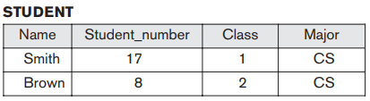
Introduction
The first commercial implementations of the relational model became available in the early 1980s, such as the SQL/DS system on the MVS (Multiple Virtual Storage) operating system by IBM and the Oracle DBMS.
Popular relational DBMSs (RDBMSs) are: DB2(IBM), Oracle, SQLServer and Access (from Microsoft), MySQL and PostgreSQL and many more.
Data models that preceded the relational model include the hierarchical and network models.
The relational model represents the database as a collection of relations. Informally, each relation resembles a table of values or, to some extent, a flat file of records.
It is called a flat file because each record has a simple linear or flat structure.
2

Slide 3
Domain, tuple, relation, degree
In a table of values, each row in the table represents a collection of related data values.
In the formal relational model terminology, a row is called a tuple, a column header is called an attribute, and the table is called a relation
A domain D is a unique set of values permitted for an attribute in a table as far as the formal relational model is concerned.
Name: The set of character strings that represent names of students.
A relation schema R, denoted by R(A₁, A₂, ..., A_{n}), is made up of a relation name R and a list of attributes, A₁, A₂, ..., A_{n}.
Each attribute A_{i} is the name of a role played by some domain D called as the domain of A_{i} and is denoted by dom(A_{i}).
The degree of a relation is the number of attributes in of its relation schema.
3

Slide 4
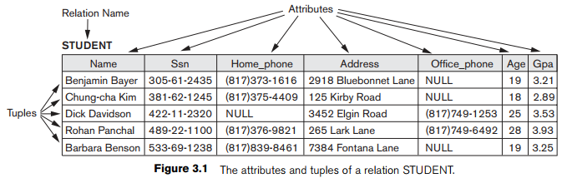
Domain, tuple, relation, degree
Properties of a Relation
Tuples in a relation are not ordered
Duplicate tuples are not allowed in a relation
Tuples may have values and NULLs
4

Slide 5
Relational Model Notation
A relation schema R of degree n is denoted by R(A₁, A₂, ..., A_{n}).
The uppercase letters Q, R, S denote relation names.
The lowercase letters q, r, s denote relation states.
The letters t, u, v denote tuples.
The name of a relation schema such as STUDENT indicates the current set of tuples in that relation—the current relation state—whereas STUDENT(Name, Ssn, ...) refers only to the relation schema.
An attribute A can be qualified with the relation name R to which it belongs by using the dot notation R.A—for example, STUDENT.Name.
An n-tuple t in a relation r(R) is denoted by t = <v₁, v₂, ..., v_{n}>, where v_{i} is the value corresponding to attribute A_{i}.
Both t[A_{i}] and t.A_{i} refer to the value v_{i} in t for attribute A_{i}.
As an example, the tuple t = <‘Barbara Benson’, ‘533-69-1238’, ‘(817)839-8461’, ‘7384 Fontana Lane’, NULL, 19, 3.25> in STUDENT t[Name] = <‘Barbara Benson’>
5

Slide 6
Relational Model Constraints
There are generally many restrictions or constraints on the actual values in a database state.
Constraints on databases can generally be divided into three main categories:
Constraints that are inherent in the data model. We call these inherent model-based constraints or implicit constraints. E.g., a relation can not have duplicate tuples.
Constraints that can be directly expressed in schemas of the data model, typically by specifying them in the DDL We call these schema-based constraints or explicit constraints.
Constraints that cannot be directly expressed in the schemas of the data model, and hence must be expressed and enforced by the application programs. We call these application-based or semantic constraints or business rules.
Another important category of constraints is data dependencies, which include functional dependencies and multi-valued dependencies.
They are used mainly for testing the “goodness” of the design of a relational database and are utilized in a process called normalization.
The schema-based constraints include domain constraints, key constraints, entity integrity constraints, and referential integrity constraints
6

Slide 7
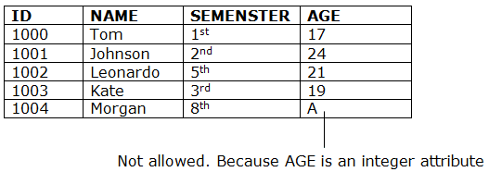
Domain Constraints
Domain constraints specify that within each tuple, the value of each attribute A must be an atomic value from the domain dom(A).
Every domain must contain atomic values(smallest indivisible units) it means composite and multi-valued attributes are not allowed.
Domain constraints also define of a valid set of values for an attribute.
7

Slide 8
Key Constraints
By definition all tuples in a relation must also be distinct.
Uniqueness constraint is specified by superkey which means that two different tuples in a relation can not have the same value for superkey.
Formal Definition of Super key: For any two distinct tuples t₁ and t₂ in a relation state r of R for a set of attribute SK, we have the constraint that: t₁[SK] ≠ t₂[SK], SK is called a superkey.
Every relation, we’ll have at least one superkey, i.e. a set of all the attributes.
Key is the minimal superkey.
Keys are the entity set that is used to identify an entity within its entity set uniquely.
Formal Definition of Key: A key K of a relation schema R is a superkey of R with the additional property that removing any attribute A from K leaves a set of attributes K^{t} that is not a superkey of R any more.
An entity set can have multiple keys, but out of which one key will be the primary key.
8

Slide 9
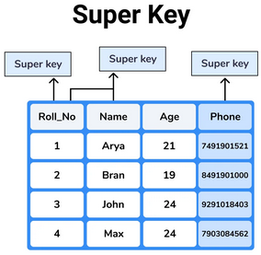
Key Constraints
Types of Keys in the relational model
Superkey
Primary Key
Candidate Key
Foreign Key
Alternate Key
Composite Key
Superkey:
A super key is a group of single or multiple keys which uniquely identifies rows in a table.
A Super key may have additional attributes that are not needed for unique identification.
9

Slide 10
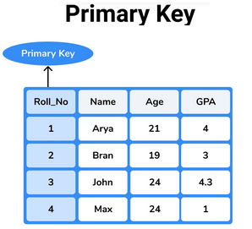
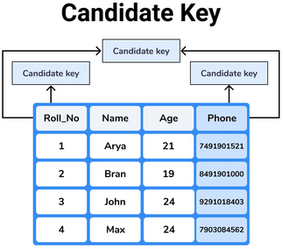
Key Constraints
Primary key:
A primary key is a constraint in a table which uniquely identifies each row record in a database table
It is a column or group of columns in a table that uniquely identify every row in that table
Candidate key:
It is a set of attributes that uniquely identify tuples in a table.
Candidate Key is a super key with no repeated attributes.
10

Slide 11
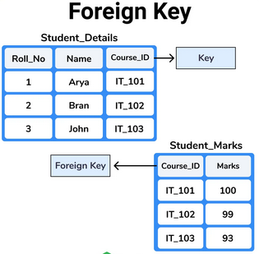
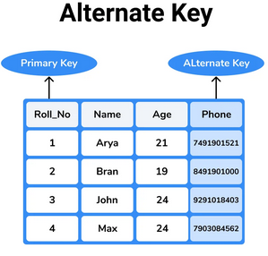
Key Constraints
Foreign key:
The foreign key constraint is a column or list of columns which points to the primary key column of another table
The main purpose of the foreign key is only those values are allowed in the present table that will match to the primary key column of another table.
Alternate key:
Alternate keys are columns present in the table which are not selected as primary keys but still, they have all the capabilities to be used as a primary key is called alternate key.
11

Slide 12
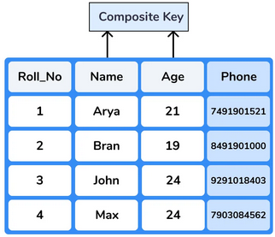
Key Constraints
Composite key:
A composite key is a combination of one or more attributes
Any key such as super key, primary key, candidate key, etc. can be called composite key if it has more than one attributes..
12

Slide 13
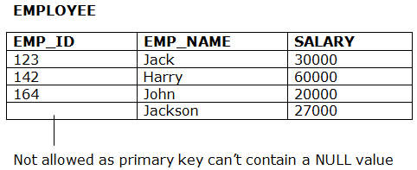
Entity integrity constraints
The entity integrity constraint states that primary key value can't be null.
This is because the primary key value is used to identify individual rows in relation and if the primary key has a null value, then we can't identify those rows.
A table can contain a null value other than the primary key field.
13

Slide 14
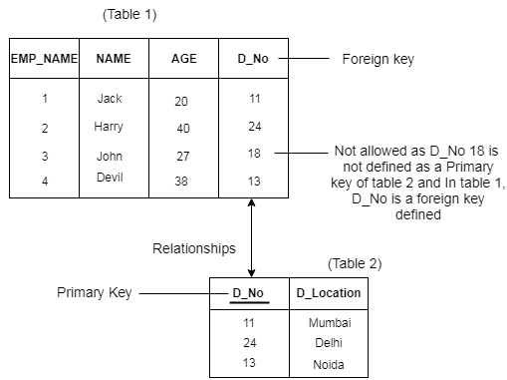
Referential integrity constraints
A referential integrity constraint is specified between two tables.
In the Referential integrity constraints, if a foreign key in Table 1 refers to the Primary Key of Table 2, then every value of the Foreign Key in Table 1 must be available in Table 2.
14

Slide 15
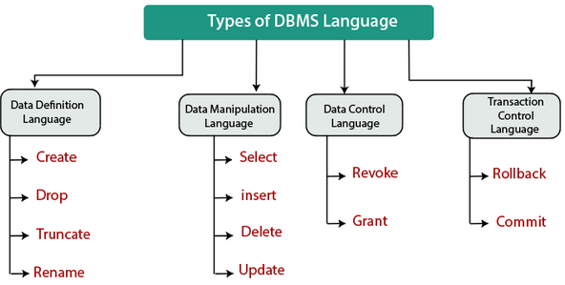
Basics of SQL
The name SQL is presently expanded as Structured Query Language. There are four types of SQL languages as given below:
Data Definition Language (DDL)
Data Definition Language is used for defining the structure or schema of the database.
It is also used for creating tables, indexes, applying constraints, etc. in the database.
The main purpose of DDL is to store the information of metadata like the number of schemas and tables
15

Slide 16
Basics of SQL
Data Manipulation Language (DML)
Data Manipulation Language is a language used to access or manipulate the data in the database.
In simple words, this language is used to retrieve the data from the database, insert new data into the database, and delete the existing data from the database.
Data Control Language (DCL)
DCL is used to access the stored or saved data.
It is mainly used for revoking and granting user access on a database.
Transactional Control Language (TCL)
Transaction Control language is a language which manages transactions within the database.
It is used to execute the changes made by the data manipulation language (DML) statements.
16

Slide 17
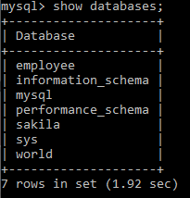
CREATE Command in SQL
CREATE is a DDL SQL command used to create a table or a database in relational database management system.
CREATE a Databases
The CREATE DATABASE statement is used to create a new SQL database
Syntax: CREATE DATABASE database_name;
SHOW DATABASES Command in SQL
Once a database is created, you can check it in the list of databases.
Syntax: SHOW DATABASES;
USE DATABASES Command in SQL
The use statement selects a specific database and then performs operations on it using the inbuilt commands of SQL.
Syntax: USE database_name;
17

Slide 18
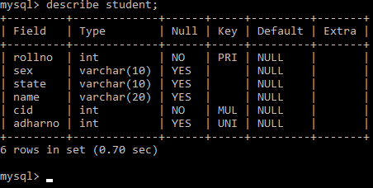
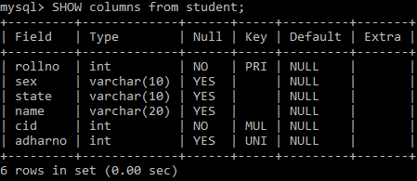
Viewing Schema in MySQL
The MySQL’s DESCRIBE or DESC both are equivalent.
The DESC is the short form of DESCRIBE command and used to display the information about a table like column names and constraints on column name.
It can be done by using SHOW command also.
18

Slide 19
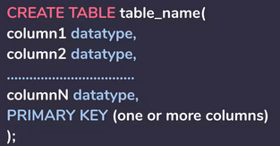
CREATE Command in SQL
CREATE a Table
The CREATE TABLE statement is used to create a new SQL table
Syntax:
SHOW TABLES Command in SQL
Once a database is created, you can check it in the list of tables.
Syntax: SHOW TABLES;
19

Slide 20
CREATE Command in SQL
CREATE a Table
The CREATE TABLE statement is used to create a new SQL table
Syntax:
SHOW TABLES Command in SQL
Once a database is created, you can check it in the list of tables.
Syntax: SHOW TABLES;
20

Slide 21
DROP Command in SQL
DROP a database
Syntax: DROP TABLE table_name;
DROP a TABLE
Syntax: DROP TABLE table_name;
21

Slide 22
ALTER Command in SQL
The ALTER TABLE statement is also used to add and drop various constraints on an existing table.
Adding a new column
ALTER TABLE table_name ADD column_name datatype ;
Adding multiple column
ALTER TABLE table_name ADD (
column_name1 datatype1,
column-name2 datatype2,
column-name3 datatype3 );
Add Column with default value
ALTER TABLE table_name ADD (column-name datatype DEFAULT some_value);
Modify the datatype of an existing Column
ALTER TABLE table_name modify (column_name datatype);
22

Slide 23
ALTER Command in SQL
The ALTER TABLE statement is also used to add and drop various constraints on an existing table.
Rename a column
ALTER TABLE table_name CHANGE Old_Col_name New_Col_name data_type;
ALTER TABLE table_name RENAME COLUMN Old_Col_name TO New_Col_name;
Rename a Table
ALTER TABLE table_name_old RENAME table_name_new;
Delete a Column
ALTER TABLE table_name DROP (column_name);
23

Slide 24
INSERT Command in SQL
Insert command is used to insert data into a table. Following is its general syntax,
INSERT INTO table_name (column1, column2, ...) VALUES (value1, value2, ...);
Insert into specific columns
INSERT INTO persons (col-1, col-4, col-6) VALUES (value1, value4, value6);
24

Slide 25
SELECT Command in SQL
The SELECT statement is used to select data from a database. The data returned is stored in a result table, called the result-set.
SELECT column1, column2, ... FROM table_name;
SELECT DISTINCT Statement
SELECT DISTINCT column1, column2, ...FROM table_name;
SELECT with WHERE
SELECT DISTINCT column1, column2, ...FROM table_name WHERE condition;
SELECT with WHERE with AND operator
SELECT column1, column2, ... FROM table_name WHERE condition1 AND condition2 ...;
SELECT with WHERE with OR operator
SELECT column1, column2, ... FROM table_name WHERE condition1 OR condition2 ...;
25

Slide 26
SELECT Command in SQL
SELECT with WHERE with NOT operator
SELECT column1, column2, ...FROM table_name WHERE NOT condition;
SELECT with WHERE with ORDER BY
SELECT column1, column2, ... FROM table_name ORDER BY column1, column2, ... ASC|DESC
SELECT with WHERE with LIKE operator
There are two wildcards often used in conjunction with the LIKE operator:
The percent sign (%) represents zero, one, or multiple characters
The underscore sign (_) represents one, single character
SELECT * FROM persons WHERE Firstname LIKE 'B%_h';
SELECT with WHERE with IN Operator
SELECT column_name(s) FROM table_name WHERE column_name IN (value1, value2, ...);
26

Slide 27
SELECT Command in SQL
SELECT with WHERE with NOT operator
SELECT column1, column2, ...FROM table_name WHERE NOT condition;
SELECT with WHERE with ORDER BY
SELECT column1, column2, ... FROM table_name ORDER BY column1, column2, ... ASC|DESC
SELECT with WHERE with LIKE operator
There are two wildcards often used in conjunction with the LIKE operator:
The percent sign (%) represents zero, one, or multiple characters
The underscore sign (_) represents one, single character
SELECT * FROM persons WHERE Firstname LIKE 'B%_h';
27

Slide 28
SELECT Command in SQL
SELECT with WHERE with IN Operator
SELECT column_name(s) FROM table_name WHERE column_name IN (value1, value2, ...);
SELECT column_name(s) FROM table_name WHERE column_name IN (SELECT STATEMENT);
SELECT with MAX(), MIN(), SUM(), AVG, COUNT()
SELECT MAX (column_name) FROM table_name WHERE condition;
SELECT MIN (column_name) FROM table_name WHERE condition;
SELECT AVG (column_name) FROM table_name WHERE condition;
SELECT COUNT (column_name) FROM table_name WHERE condition;
28

Slide 29
SELECT Command in SQL
SELECT with LIMIT operation: Access first n number of tuples
SELECT column_name(s) FROM table_name LIMIT number_of_records
SELECT column_name(s) FROM table_name WHERE column_name LIMIT number_of_records
SELECT with LIMIT operation: Access last n number of tuples
SELECT column_name(s) FROM table_name ORDER BY COLUMN(S) DESC LIMIT number_of_records
29

Slide 30
UPDATE/DELTE/TRUNCATE Command
The UPDATE statement is used to modify the existing records in a table.
UPDATE table_name SET column1 = value1, column2 = value2, ... WHERE condition;
The DELETE statement is used to delete existing records in a table.
DELETE FROM table_name WHERE condition;
TRUNCATE command removes all the records from a table.
TRUNCATE TABLE table_name;
30

Slide 31
SQL Constraints
SQL constraints are used to specify rules for data in a table.
NOT NULL - Ensures that a column cannot have a NULL value
UNIQUE - Ensures that all values in a column are different
PRIMARY KEY - A combination of a NOT NULL and UNIQUE. Uniquely identifies each row in a table
FOREIGN KEY - Prevents actions that would destroy links between tables
CHECK - Ensures that the values in a column satisfies a specific condition.
DEFAULT - Sets a default value for a column if no value is specified.
31

Slide 32


32

