Slide 1
VIRTUAL CLOUD COMPUTING | FINAL PROJECT
RL-Based Auto-Scaling
for Hospital Cloud
95.2%
SLA Violation
Reduction
Reducing SLA violations by 95.2% using
Proximal Policy Optimization on AWS
18.1%
Cost Reduction
M.Tech AI • IIT Jodhpur • Team of 6

Slide 2
THE PROBLEM
OPD Rush
Idle Waste
9am-12pm: CPU hits 80-90%. AWS reacts AFTER the spike — patients experience crashes.
3am-6am: CPU at 10-20%. VMs keep running unnecessarily — money wasted every night.
Spin-up Delay
No Learning
New VM takes 3+ hours to activate. SLA violated during this window every single day.
AWS threshold rule never learns. Makes the same mistakes on Monday as it did last Monday.
In healthcare, SLA violations = delayed treatment = risk to life

Slide 3
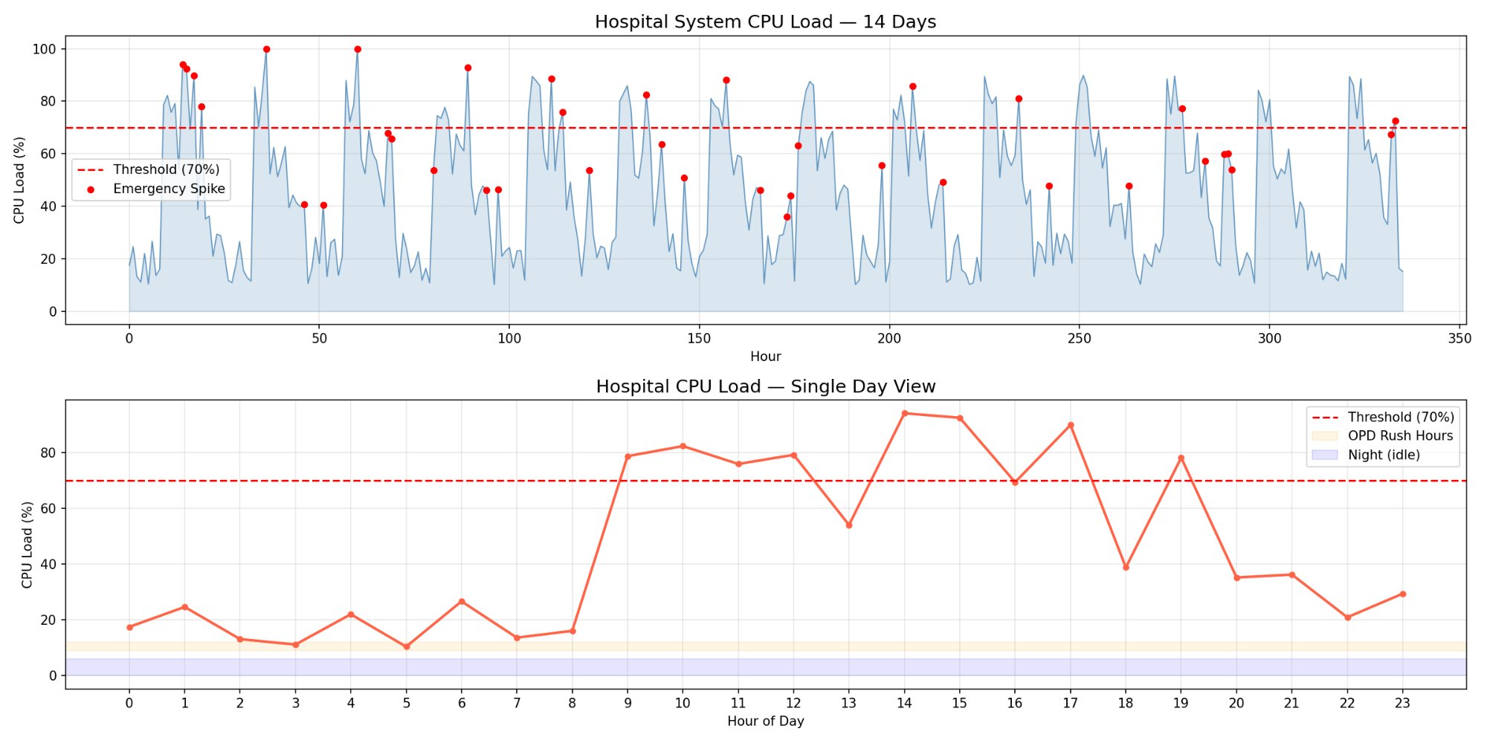
HOSPITAL WORKLOAD — 14 DAYS OF REAL PATTERNS
336 hours simulated • 38 emergency spikes • 69 hours above SLA threshold • Peak CPU: 100%

Slide 4
OUR SOLUTION
Replace AWS threshold rule with a PPO Reinforcement Learning agent that LEARNS and PREDICTS
AWS Default
RL Agent (PPO)
✗ Waits for CPU > 70%
✓ Predicts BEFORE spike hits
✗ Reacts AFTER damage done
✓ Proactive — scales early
→
✗ 3-hour spin-up delay
✓ Pre-warms VMs in advance
✗ No memory of patterns
✓ Learns OPD rush patterns
✗ Same mistakes daily
✓ Gets smarter every episode

Slide 5
VCC CONCEPTS DEMONSTRATED
Virtualization
Elasticity
EC2 VMs created & destroyed dynamically on AWS
System grows during OPD rush, shrinks at night
Auto-Scaling
SLA Management
RL agent controls horizontal VM scaling
Response time enforced under 70% CPU threshold
IaaS Model
Cloud Monitoring
Raw VM infrastructure managed on AWS EC2
AWS CloudWatch feeds live metrics to RL agent
Containerization
Serverless / FaaS
Hospital services isolated in Docker containers
AWS Lambda triggers scaling decisions
Cost Optimization
Multi-tenancy
18.1% cost reduction through intelligent scaling
Each hospital department = isolated Docker tenant

Slide 6
SYSTEM ARCHITECTURE ON AWS
AWS CLOUD — Mumbai Region
EC2
t3.micro
PPO RL
Agent
Docker
Containers
CloudWatch
Monitoring
AWS S3
Storage
Lambda
Trigger
🐳 OPD Portal
🐳 Lab System
🐳 Emergency
🐳 Records DB
EDGE NODES — Hospital Docker Containers

Slide 7
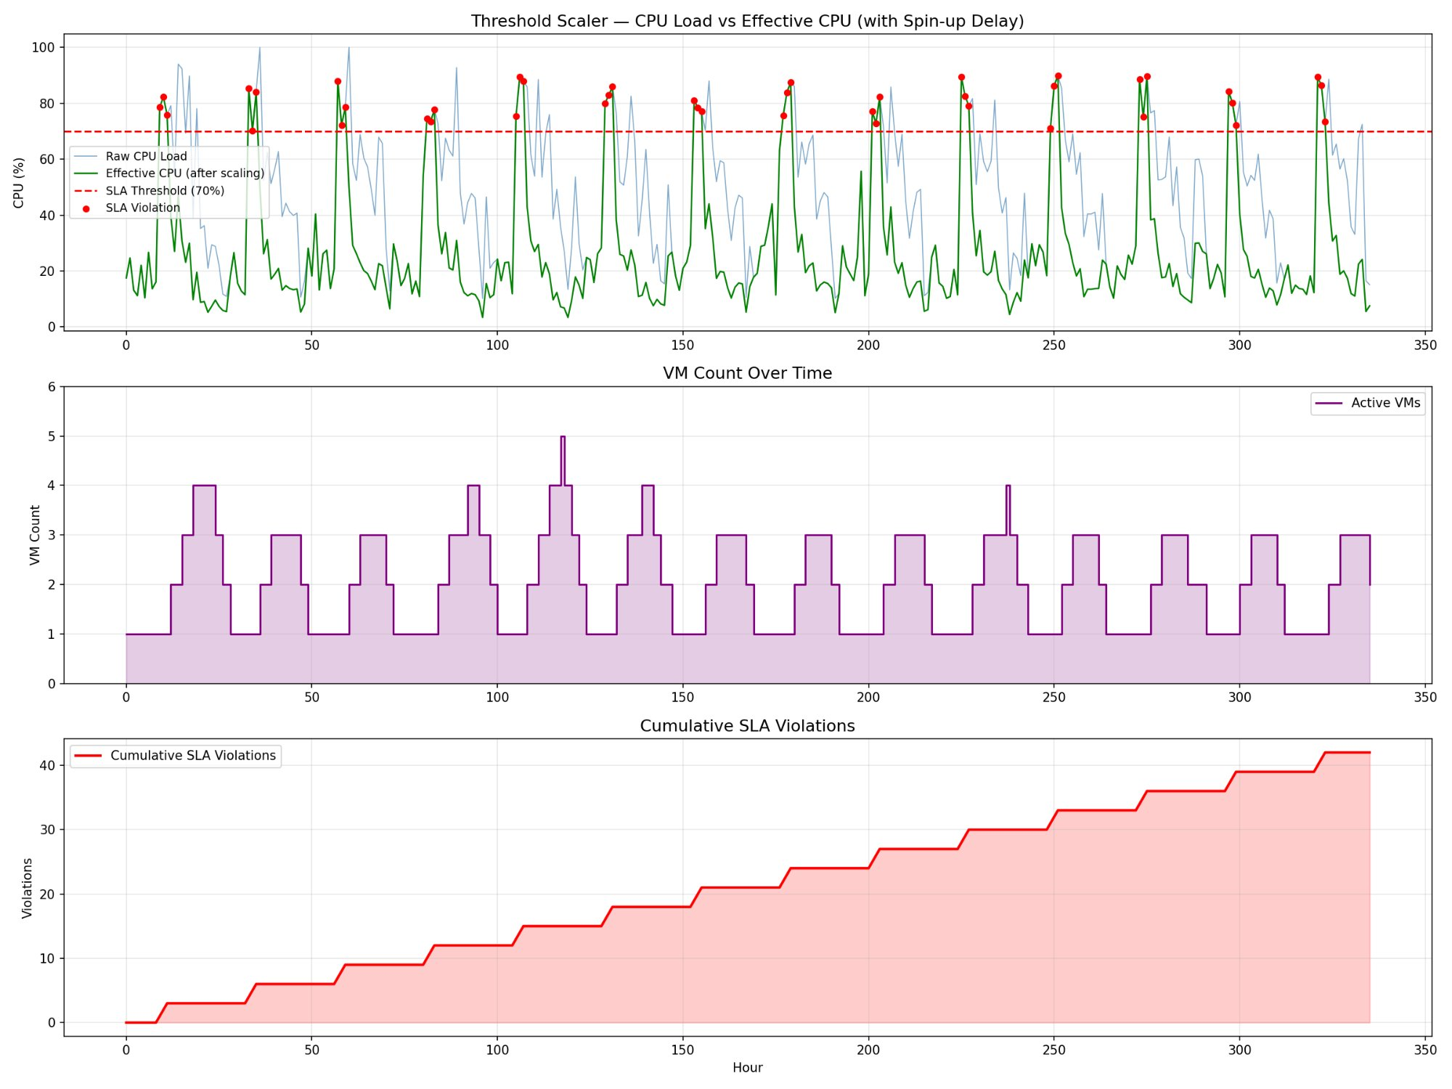
BASELINE — AWS THRESHOLD SCALER (The Problem)
42
SLA Violations
666
VM Hours Used
$6.93
14-Day Cost
1.98
Avg VMs
Reactive scaling causes 42 SLA violations in just 14 days — predictable, preventable, unacceptable

Slide 8
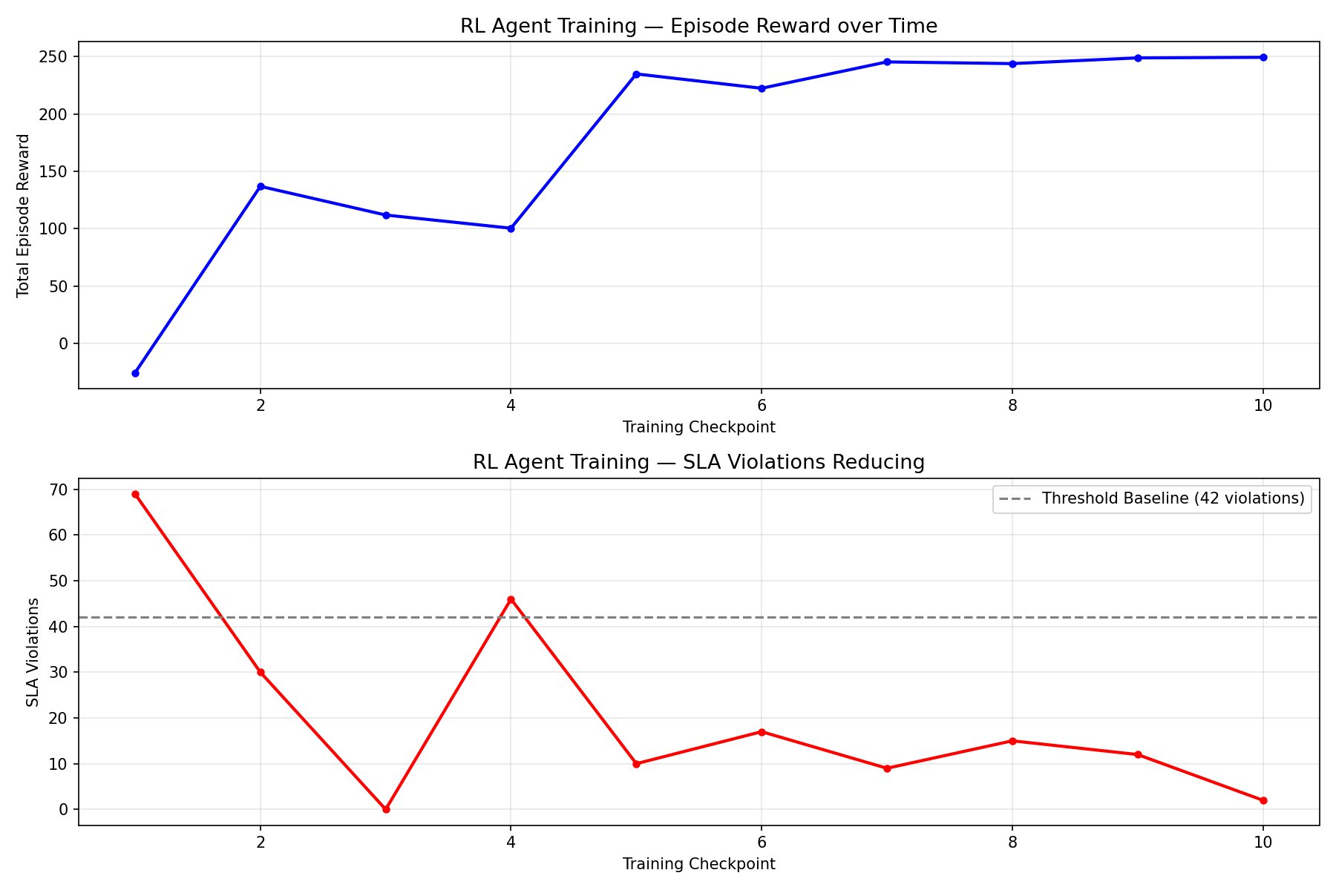
RL AGENT TRAINING — 50,000 Steps of Learning
10%
Random — 69 violations
30%
Learning patterns
50%
Converging fast
100%
Only 2 violations!
Reward rises from -25 to +249 as agent masters hospital workload patterns

Slide 9
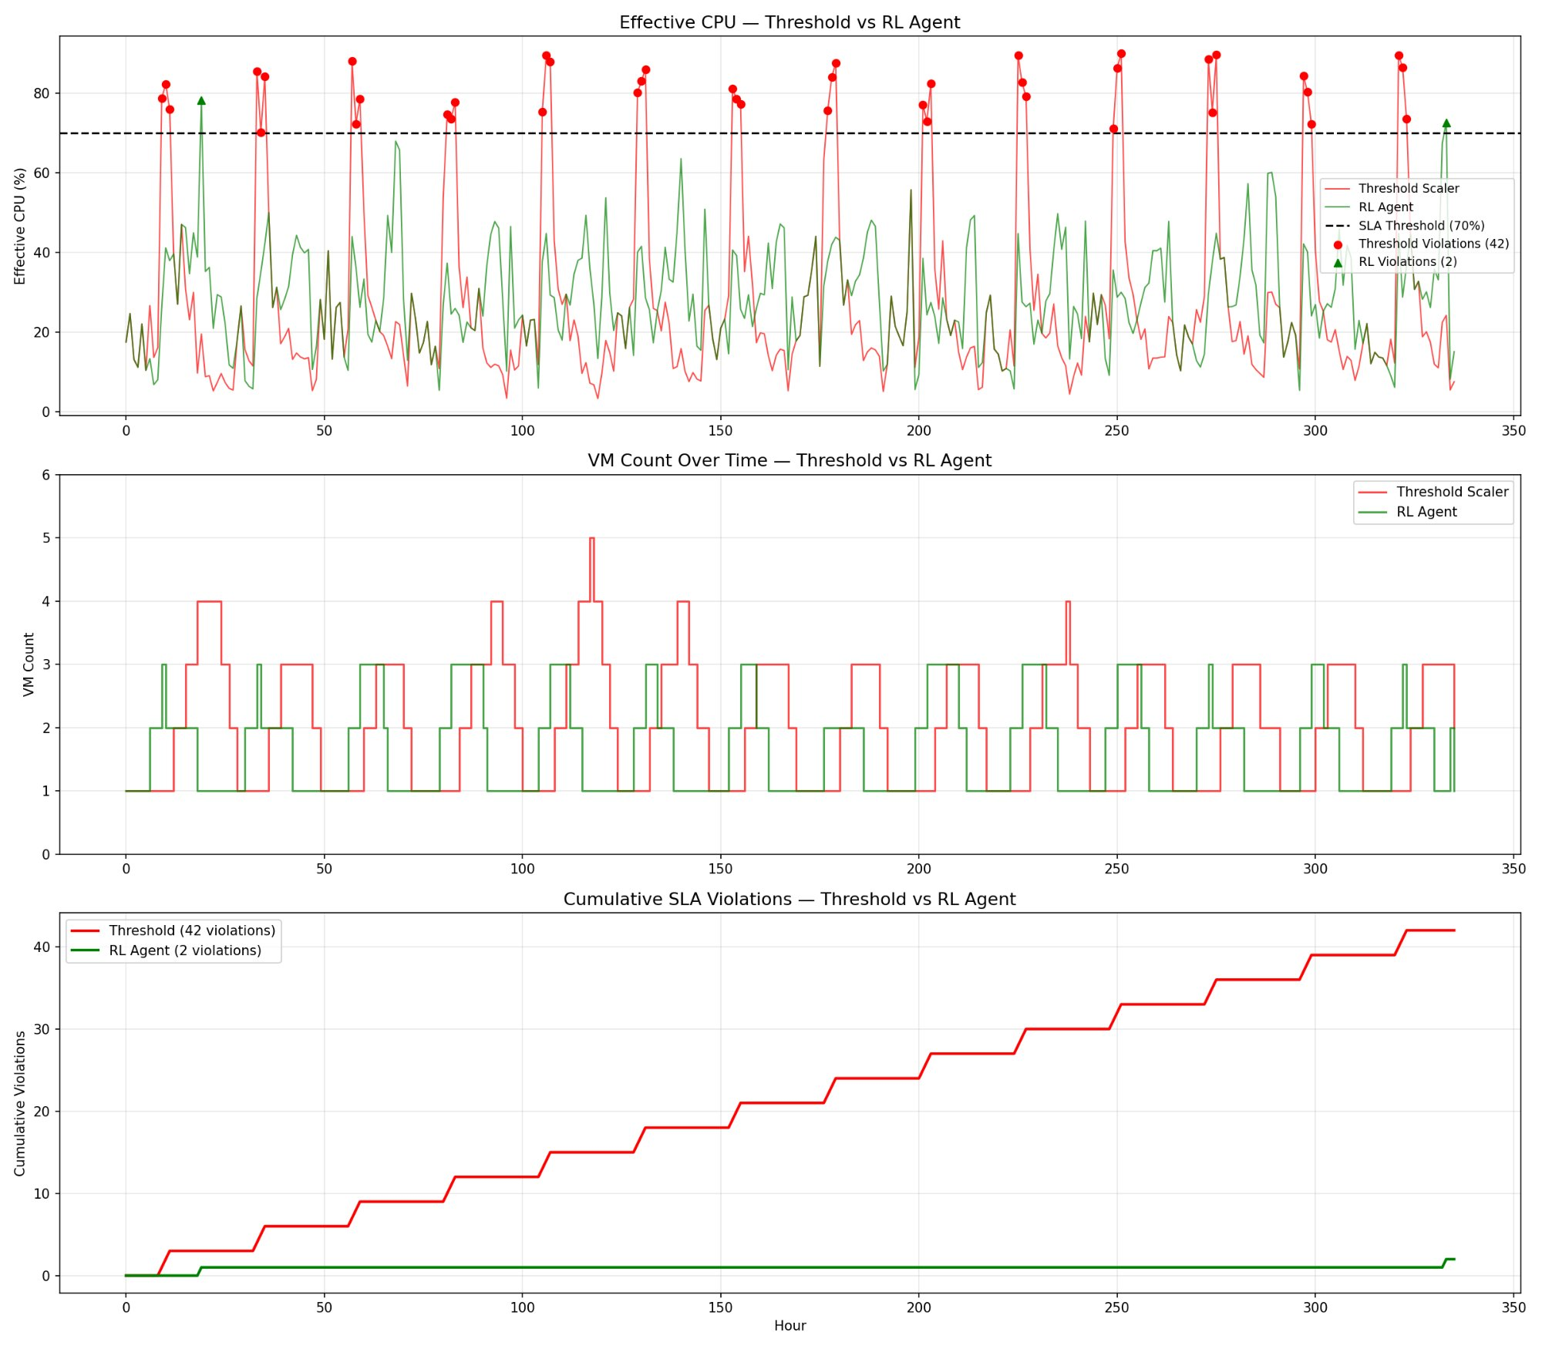
RESULTS — RL Agent vs Threshold Scaler
RL Agent: 2 violations vs Threshold: 42 violations — Cumulative SLA curve (bottom) tells the complete story

Slide 10
QUANTITATIVE RESULTS
Metric | Threshold (AWS) | RL Agent (PPO) | Improvement
SLA Violations (14 days) | 42 | 2 | 95.2% ↓
Total VM Hours | 666 | 546 | 18.0% ↓
Avg VMs Running | 1.98 | 1.62 | 18.2% ↓
Estimated Cost (14 days) | $6.93 | $5.68 | 18.1% ↓
RL Agent outperforms AWS default threshold scaling on ALL 4 metrics simultaneously

Slide 11
FUTURE SCOPE
Multi-Cloud Deployment
Kubernetes Orchestration
Federated RL
Extend RL agent to span AWS + Azure + GCP for cross-cloud cost optimization
Replace Docker Compose with K8s for production-grade container management
Multiple hospitals collaboratively train a shared RL policy without sharing data
Real MIMIC-III Data
Explainable RL
Predictive CloudWatch
Validate results on authentic ICU patient admission timestamps from PhysioNet
Apply SHAP to understand which state features drive the agent's scaling decisions
Use AWS Anomaly Detection to feed predictive signals into the RL state space

Slide 12
CONCLUSION
A PPO-based Reinforcement Learning agent reduces SLA violations by 95.2% and cloud infrastructure cost by 18.1% compared to AWS default threshold-based auto-scaling — demonstrating that intelligent, proactive cloud resource management is both technically feasible and clinically significant for hospital systems.
95.2%
18.1%
10
SLA Violations Reduced
Cloud Cost Saved
VCC Concepts Proven
M.Tech AI • IIT Jodhpur • Virtual Cloud Computing

